Slide 1
83rd Shock and Vibration Symposium 2012
Shock Response Spectra
& Time History Synthesis
By Tom Irvine

Slide 2


This presentation is sponsored by
NASA Engineering & Safety Center (NESC)
Dynamic Concepts, Inc. Huntsville, Alabama

Slide 3
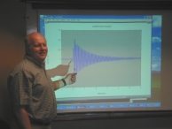
Contact Information
Tom Irvine
Email: tirvine@dynamic-concepts.com
Phone: (256) 922-9888
The software programs for this tutorial session are available at:
http://www.vibrationdata.com
Username: lunar
Password: module

Slide 4
Response to Classical Pulse Excitation

Slide 5
Outline
Response to Classical Pulse Excitation
Response to Seismic Excitation
Pyrotechnic Shock Response
Wavelet Synthesis
Damped Sine Synthesis
MDOF Modal Transient Analysis

Slide 6

Classical Pulse Introduction
Vehicles, packages, avionics components and other systems may be subjected to base input shock pulses in the field
The components must be designed and tested accordingly
This units covers classical pulses which include:
Half-sine
Sawtooth
Rectangular
etc

Slide 7
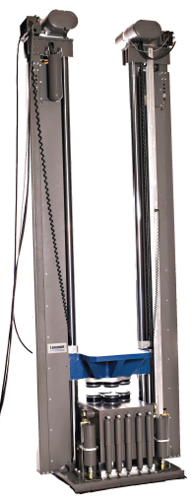
Shock Test Machine
Classical pulse shock testing has traditionally been performed on a drop tower
The component is mounted on a platform which is raised to a certain height
The platform is then released and travels downward to the base
The base has pneumatic pistons to control the impact of the platform against the base
In addition, the platform and base both have cushions for the model shown
The pulse type, amplitude, and duration are determined by the initial height, cushions, and the pressure in the pistons
platform
base

Slide 8
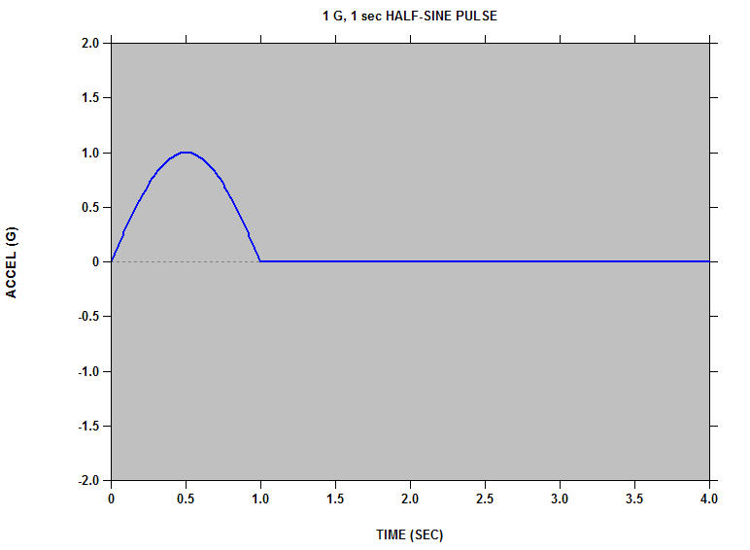
Half-sine Base Input
1 G, 1 sec HALF-SINE PULSE
Accel (G)
Time (sec)

Slide 9
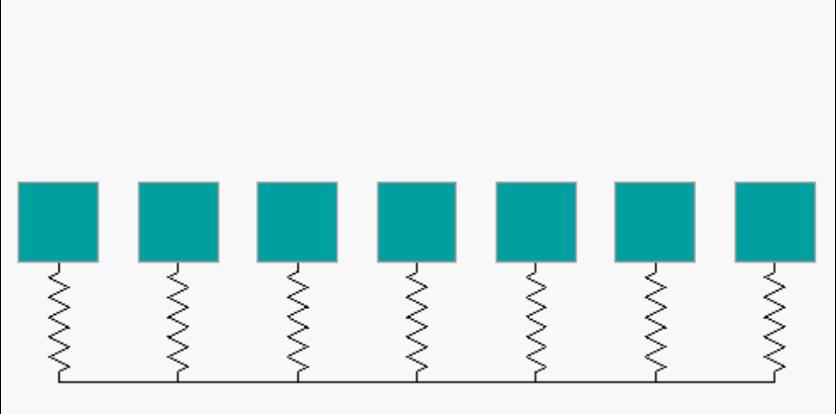
Systems at Rest
Soft
Hard
Natural Frequencies (Hz):
0.063 0.125 0.25 0.50 1.0 2.0 4.0
Each system has an amplification factor of Q=10

Slide 10
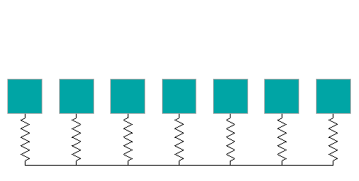
Click to begin animation. Then wait.

Slide 11
Systems at Rest
Soft
Hard
Natural Frequencies (Hz):
0.063 0.125 0.25 0.50 1.0 2.0 4.0

Slide 12
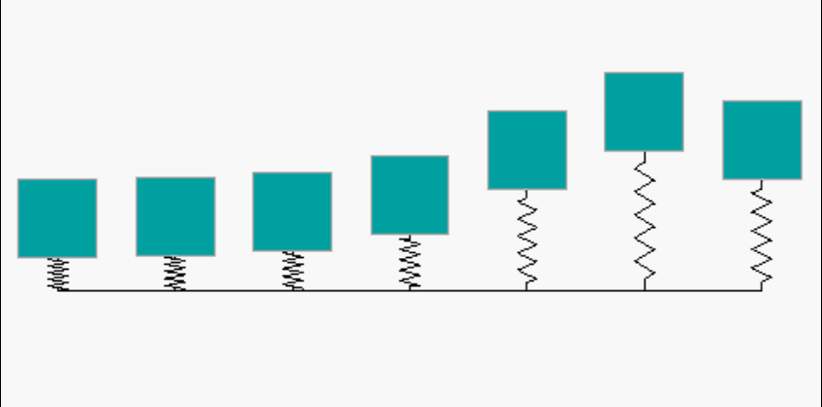
Responses at Peak Base Input
Soft
Hard
Soft system has high spring relative deflection, but its mass remains nearly stationary
Hard system has low spring relative deflection, and its mass tracks the input with near unity gain

Slide 13
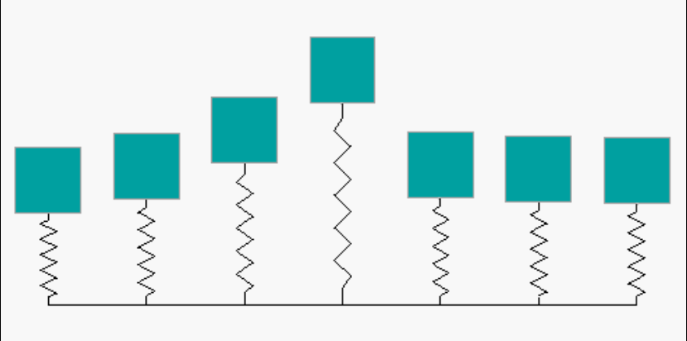
Responses Near End of Base Input
Soft
Hard
Middle system has high deflection for both mass and spring

Slide 14
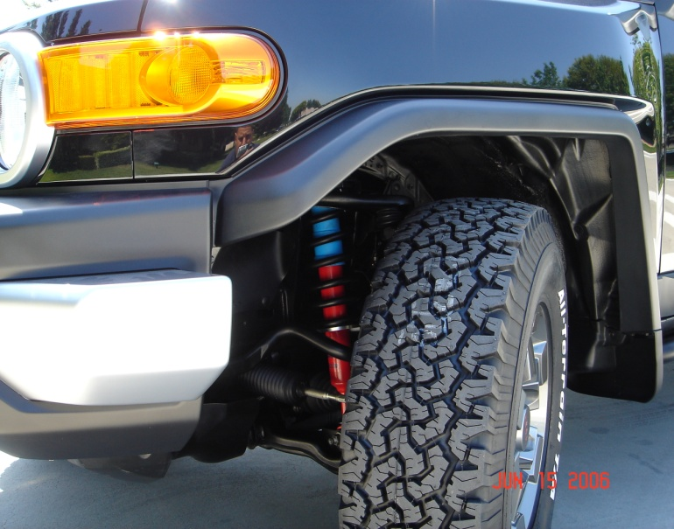
Soft Mounted Systems
Soft System Examples:
Automobiles isolated via shock absorbers
Avionics components mounted via isolators
It is usually a good idea to mount systems via soft springs.
But the springs must be able to withstand the relative displacement without bottoming-out.

Slide 15
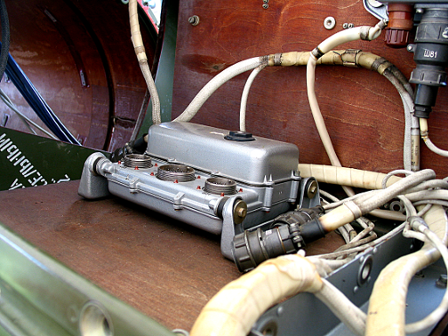
Isolated avionics component, SCUD-B missile.
Public display in Huntsville, Alabama, May 15, 2010
Isolator Bushing

Slide 16
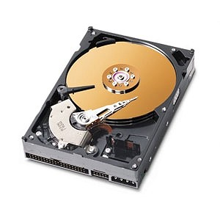
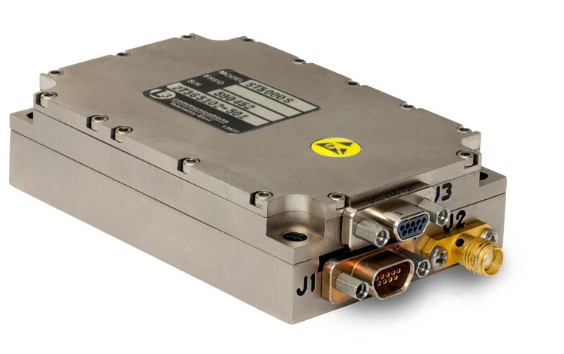
But some systems must be hardmounted.
Consider a C-band transponder or telemetry transmitter that generates heat. It may be hardmounted to a metallic bulkhead which acts as a heat sink.
Other components must be hardmounted in order to maintain optical or mechanical alignment.
Some components like hard drives have servo-control systems. Hardmounting may be necessary for proper operation.

Slide 17
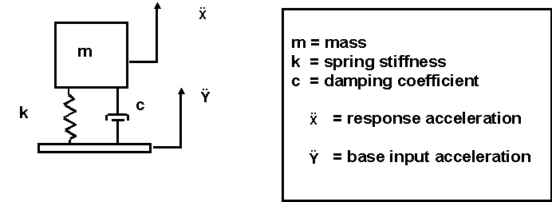
SDOF System

Slide 18
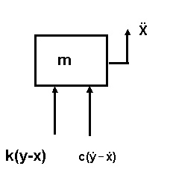

Free Body Diagram
Summation of forces

Slide 19

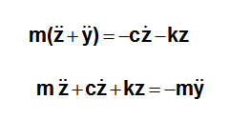

Derivation
Equation of motion
Let z = x - y. The variable z is thus the relative displacement.
Substituting the relative displacement yields
Dividing through by mass yields
19

Slide 20
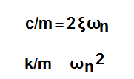

Derivation (cont.)
By convention
is the natural frequency (rad/sec)
is the damping ratio

Slide 21
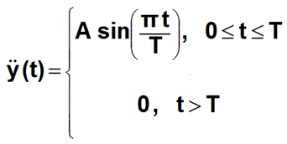
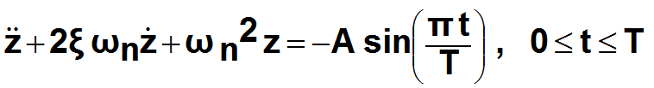
Base Excitation
Half-sine Pulse
Equation of Motion
Solve using Laplace transforms.

Slide 22
SDOF Example
A spring-mass system is subjected to:
10 G, 0.010 sec, half-sine base input
The natural frequency is an independent variable
The amplification factor is Q=10
Will the peak response be
> 10 G, = 10 G, or < 10 G ?
Will the peak response occur during the input pulse or afterward?
Calculate the time history response for natural frequencies = 10, 80, 500 Hz

Slide 23
SDOF Response to Half-Sine Base Input
>> halfsine
halfsine.m version 1.4 December 20, 2008
By Tom Irvine Email: tomirvine@aol.com
This program calculates the response of a single-degree-of-freedom system subjected to a half-sine base input shock.
Select analysis
1=time history response 2=SRS 1
Enter the amplitude (G) 10
Enter the duration (seconds) 0.010
Enter the natural frequency (Hz) 10
Enter amplification factor Q 10
maximum acceleration = 3.69 G
minimum acceleration = -3.154 G
Plot the acceleration response time history ?
1=yes 2= no 1

Slide 24
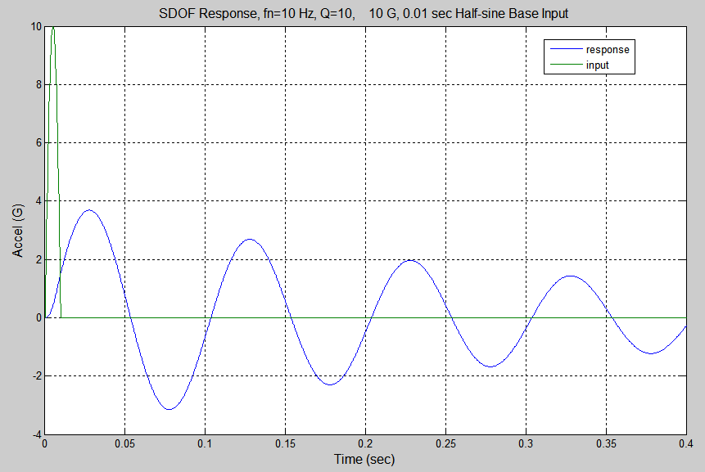
maximum acceleration = 3.69 G
minimum acceleration = -3.15 G

Slide 25
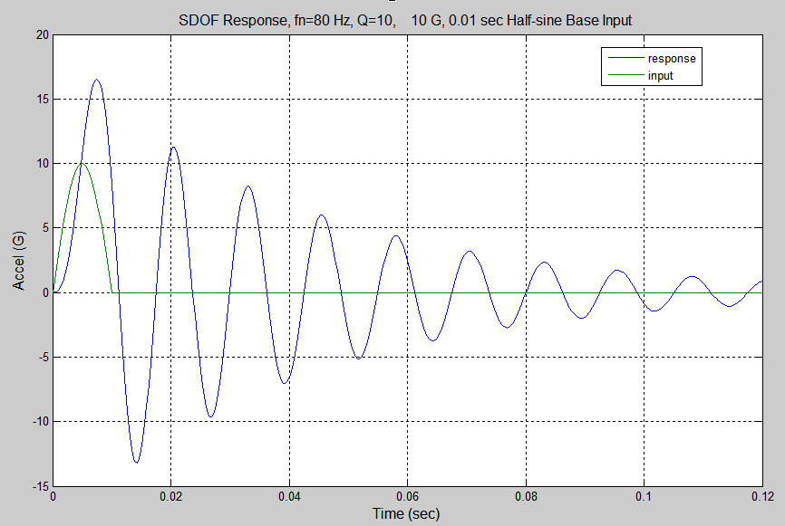
maximum acceleration = 16.51 G
minimum acceleration = -13.18 G

Slide 26
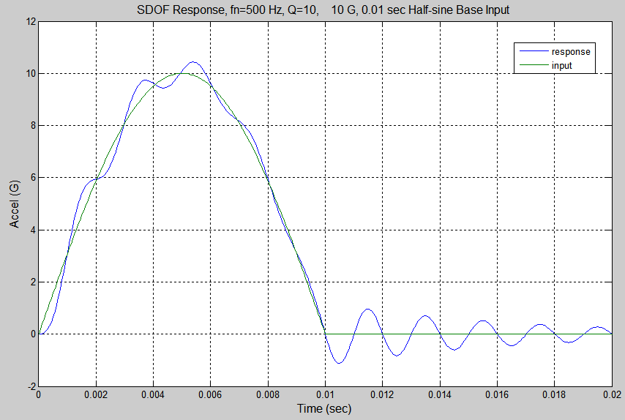
maximum acceleration = 10.43 G
minimum acceleration = -1.129 G

Slide 27
Summary of Three Cases
A spring-mass system is subjected to:
10 G, 0.010 sec, half-sine base input
Shock Response Spectrum Q=10
Natural Frequency (Hz) | Peak Positive Accel (G) | Peak Negative Accel (G)
10 | 3.69 | 3.15
80 | 16.5 | 13.2
500 | 10.4 | 1.1
Note that the Peak Negative is in terms of absolute value.

Slide 28
Half-Sine Pulse SRS
>> halfsine
halfsine.m version 1.5 March 2, 2011
By Tom Irvine Email: tomirvine@aol.com
This program calculates the response of
a single-degree-of-freedom system subjected
to a half-sine base input shock.
Assume zero initial displacement and zero initial velocity.
Select analysis
1=time history response 2=SRS 2
Enter the amplitude (G) 10
Enter the duration (seconds) 0.010
Enter the starting frequency (Hz) 10
Enter amplification factor Q 10
Plot SRS ?
1=yes 2= no 1

Slide 29
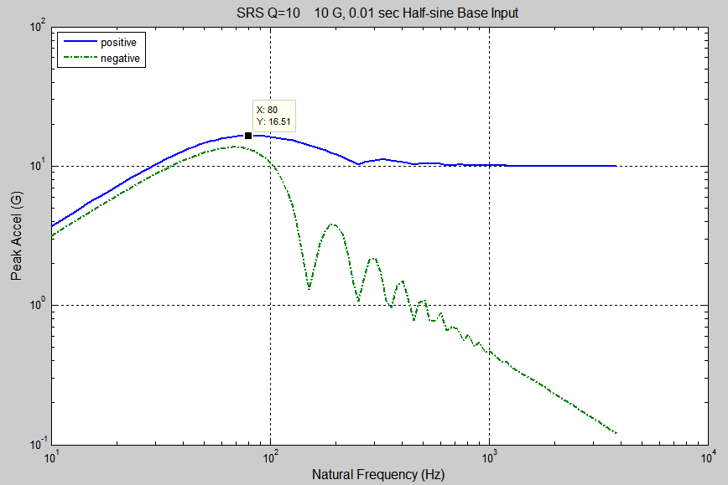
SRS Q=10 10 G, 0.01 sec Half-sine Base Input
X: 80 Hz
Y: 16.51 G
Natural Frequency (Hz)

Slide 30
Program Summary
Matlab Scripts
halfsine.m
terminal_sawtooth.m
Video
HS_SRS.avi
Papers sbase.pdf terminal_sawtooth.pdf
unit_step.pdf

Slide 31
Response to Seismic Excitation

Slide 32
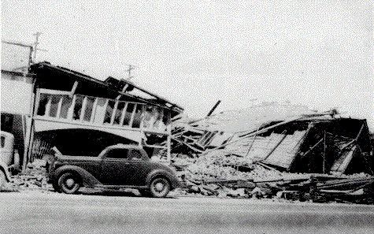
El Centro, Imperial Valley, Earthquake
Nine people were killed by the May 1940 Imperial Valley earthquake. At Imperial, 80 percent of the buildings were damaged to some degree. In the business district of Brawley, all structures were damaged, and about 50 percent had to be condemned. The shock caused 40 miles of surface faulting on the Imperial Fault, part of the San Andreas system in southern California. Total damage has been estimated at about $6 million. The magnitude was 7.1.

Slide 33
El Centro Time History

Slide 34
Algorithm
Problems with arbitrary base excitation are solved using a convolution integral.
The convolution integral is represented by a digital recursive filtering relationship for numerical efficiency.

Slide 35
Smallwood Digital Recursive Filtering Relationship

Slide 36
El Centro Earthquake Exercise I
Run Matlab script: arbit.m
Acceleration unit : G
ASCII text file: elcentro_NS.dat
Natural Frequency (Hz): 1.8
Q=10
Include Residual? No
Plot: maximax

Slide 37
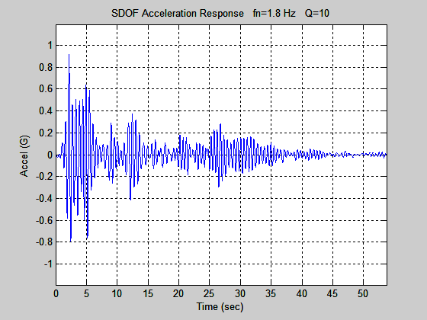
El Centro Earthquake Exercise I
Peak Accel = 0.92 G

Slide 38
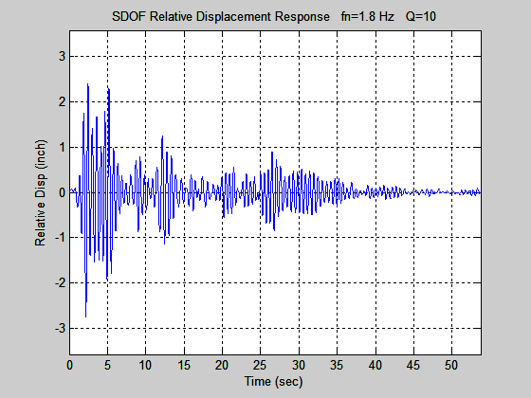
El Centro Earthquake Exercise I
Peak Rel Disp = 2.8 in

Slide 39
El Centro Earthquake Exercise II
Run Matlab script: srs_tripartite
Acceleration unit : G
ASCII text file: elcentro_NS.dat
Starting frequency (Hz): 0.1
Q=10
Include Residual? No
Plot: maximax

Slide 40
SRS Q=10 El Centro NS
fn = 1.8 Hz
Accel = 0.92 G
Vel = 31 in/sec
Rel Disp = 2.8 in

Slide 41
Peak Level Conversion
omegan = 2 π fn
Peak Acceleration ≅ ( Peak Rel Disp )( omegan^2)
Pseudo Velocity ≅ ( Peak Rel Disp )( omegan)
Run Matlab script: srs_rel_disp
Input : 0.92 G at 1.8 Hz

Slide 42

Golden Gate Bridge
Note that current Caltrans standards require bridges to withstand an equivalent static earthquake force (EQ) of 2.0 G.
May be based on El Centro SRS peak Accel + 6 dB.

Slide 43
Program Summary
Matlab Scripts
arbit.m
srs.m
srs_tripartite.m

Slide 44
Pyrotechnic Shock Response

Slide 45
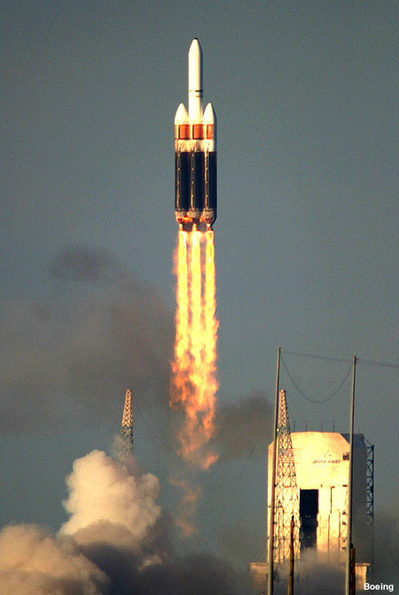
Delta IV Heavy Launch
The following video shows a Delta IV Heavy launch, with attention given to pyrotechnic events.
Click on the box on the next slide.

Slide 46

Delta IV Heavy Launch (click on box)

Slide 47
Pyrotechnic Events
Avionics components must be designed and tested to withstand pyrotechnic shock from:
Separation Events
Strap-on Boosters
Stage separation
Fairing Separation
Payload Separation
Ignition Events
Solid Motor
Liquid Engine

Slide 48
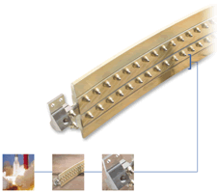
Frangible Joint
The key components of a Frangible Joint:
Mild Detonating Fuse (MDF)
Explosive confinement tub
Separable structural element
Initiation manifolds
Attachment hardware

Slide 49
Sample SRS Specification
Frangible Joint, 26.25 grain/ft, Source Shock
SRS Q=10
fn (Hz) | Peak (G)
100 | 100
4200 | 16,000
10,000 | 16,000

Slide 50
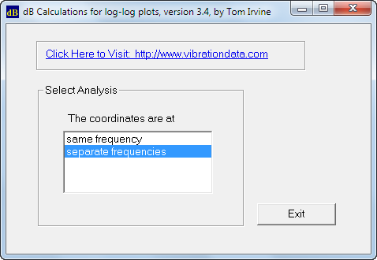
dboct.exe
Interpolate the specification at 600 Hz. The acceleration result will be used in a later exercise.

Slide 51
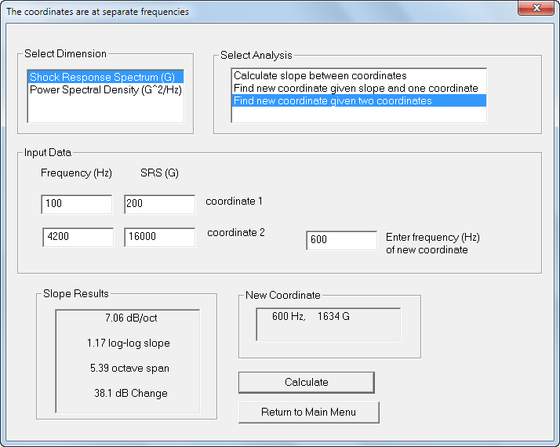

Slide 52
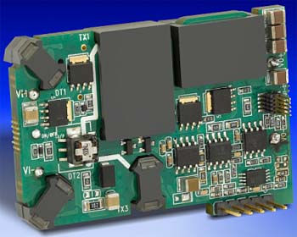
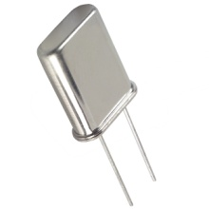
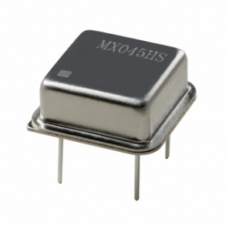
Pyrotechnic Shock Failures
Crystal oscillators can shatter.
Large components such as DC-DC converters can detached from circuit boards.

Slide 53
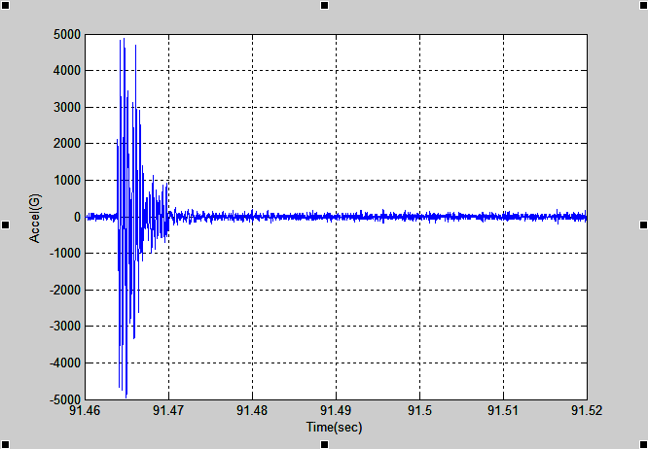
Flight Accelerometer Data, Re-entry Vehicle Separation Event
Source: Linear Shaped Charge.
Measurement location was near-field.

Slide 54
Pyrotechnic Shock Exercise
Run script: srs.m
External ASCII file: rv_separation.dat
Starting Frequency: 10 Hz
Q=10

Slide 55
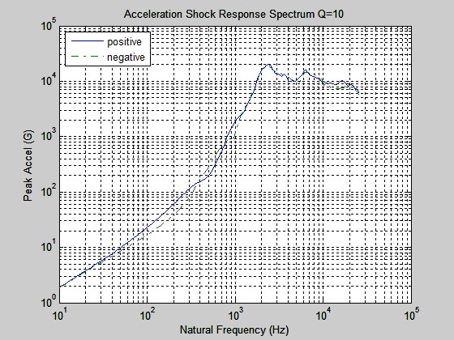
Flight Accelerometer Data SRS
Absolute Peak is 20385 G at 2420 Hz

Slide 56
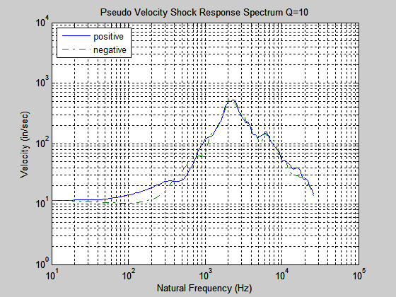
Flight Accelerometer Data SRS (cont)
Absolute Peak is 526 in/sec at 2420 Hz

Slide 57
Historical Velocity Severity Threshold
For electronic equipment . . .
An empirical rule-of-thumb in MIL-STD-810E states that a shock response spectrum is considered severe only if one of its components exceeds the level
Threshold = [ 0.8 (G/Hz) * Natural Frequency (Hz) ]
For example, the severity threshold at 100 Hz would be 80 G.
This rule is effectively a velocity criterion.
MIL-STD-810E states that it is based on unpublished observations that military-quality equipment does not tend to exhibit shock failures below a shock response spectrum velocity of 100 inches/sec (254 cm/sec).
The above equation actually corresponds to 50 inches/sec.
It thus has a built-in 6 dB margin of conservatism.
Note that this rule was not included in MIL-STD-810F or G, however.

Slide 58
Wavelet Synthesis

Slide 59
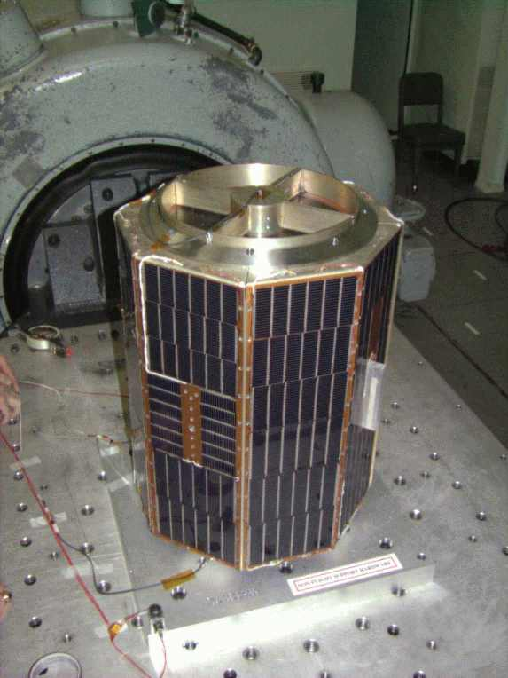
Shaker Shock
A shock test may be performed on a shaker if the shaker’s frequency and amplitude capabilities are sufficient.
A time history must be synthesized to meet the SRS specification.
Typically damped sines or wavelets.
The net velocity and net displacement must be zero.

Slide 60
Wavelets & Damped Sines
A series of wavelets can be synthesized to satisfy an SRS specification for shaker shock
Wavelets have zero net displacement and zero net velocity
Damped sines require compensation pulse
Assume control computer accepts ASCII text time history file for shock test in following examples

Slide 61
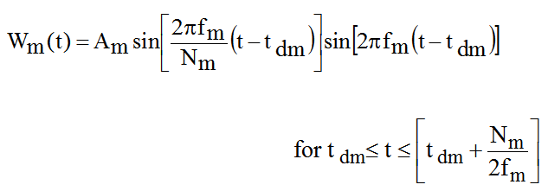
Wavelet Equation
W_{m} (t) = acceleration at time t for wavelet m
A_{m} = acceleration amplitude f _{m} = frequency t _{dm} = delay
N_{m} = number of half-sines, odd integer > 3

Slide 62
Typical Wavelet

Slide 63
SRS Specification
MIL-STD-810E, Method 516.4, Crash Hazard for Ground Equipment.
SRS Q=10
Synthesize a series of wavelets as a base input time history.
Goals:
Satisfy the SRS specification.
Minimize the displacement, velocity and acceleration of the base input.
Natural Frequency (Hz) | Peak Accel (G)
10 | 9.4
80 | 75
2000 | 75

Slide 64
Synthesis Steps
Step | Description
1 | Generate a random amplitude, delay, and half-sine number for each wavelet. Constrain the half-sine number to be odd. These parameters form a wavelet table.
2 | Synthesize an acceleration time history from the wavelet table.
3 | Calculate the shock response spectrum of the synthesis.
4 | Compare the shock response spectrum of the synthesis to the specification. Form a scale factor for each frequency.
5 | Scale the wavelet amplitudes.

Slide 65
Synthesis Steps (cont.)
Step | Description
6 | Generate a revised acceleration time history.
7 | Repeat steps 3 through 6 until the SRS error is minimized or an iteration limit is reached.
8 | Calculate the final shock response spectrum error. Also calculate the peak acceleration values. Integrate the signal to obtain velocity, and then again to obtain displacement. Calculate the peak velocity and displacement values.
9 | Repeat steps 1 through 8 many times.
10 | Choose the waveform which gives the lowest combination of SRS error, acceleration, velocity and displacement.

Slide 66
Matlab SRS Spec
>> srs_spec=[ 10 9.4 ; 80 75 ; 2000 75 ]
srs_spec =
1.0e+003 *
0.0100 0.0094
0.0800 0.0750
2.0000 0.0750

Slide 67
Wavelet Synthesis Example
>> wavelet_synth
wavelet_synth.m, ver 1.2, December 31, 2010
by Tom Irvine
Email: tomirvine@aol.com
This program synthesizes a time history using wavelets to satisfy
a shock response spectrum (SRS) specification.
The program also optimizes the time history to yield the lowest overall error, acceleration, velocity, and displacement.
The optimization is performed via trial-and-error.
Select data input method.
1=keyboard
2=internal Matlab array
3=external ASCII file
2

Slide 68
Wavelet Synthesis Example (cont)
The array must have two columns: Natural Freq(Hz) SRS(G)
Enter the array name: srs_spec
Enter octave spacing.
1= 1/3 2= 1/6 3= 1/12
3
Enter damping format for SRS.
1= damping ratio 2= Q
2
Enter SRS amplification factor Q (typically 10)
10
Enter the number of trials.
200
Enter units
1=English: G, in/sec, in
2=metric: G, m/sec, mm
3=metric: m/sec^2, m/sec, mm
1

Slide 69
Wavelet Synthesis Example (cont)
The following weight numbers will be used to select the optimum waveform.
Suggest using integers from 0 to 10
Enter individual error weight 2
Enter total error weight 2
Enter displacement weight 1
Enter velocity weight 1
Enter acceleration weight 1

Slide 70
Wavelet Synthesis Example (cont)
Peak Accel = 25.274 G
Peak Velox = 39.119 in/sec
Peak Disp = 0.450 inch
Max Error = 2.013 dB
Output Time Histories:
displacement
velocity
acceleration
shock_response_spectrum
wavelet_table [index accel(G) freq(Hz) half-sines delay(sec)]
Elapsed time is 804.485450 seconds (about 13 min)

Slide 71
Synthesized Acceleration

Slide 72
Synthesized Velocity

Slide 73
Synthesized Displacement

Slide 74
Synthesized SRS

Slide 75
data_convert.m
>> data_convert
data_convert.m ver 2.0 March 12, 2010
by Tom Irvine Email: tomirvine@aol.com
This program converts Matlab data to ASCII text data.
Enter the output filename:
wavelet_table.txt
Enter the Matlab data format:
1=Data is in a single array
2=Data is in multiple vectors
1
Enter the Matlab vector or array name: wavelet_table
Select precision:
1=single 2=double
1
Data save complete.

Slide 76
SDOF Modal Transient
Assume a circuit board with fn = 400 Hz, Q=10
Apply the reconstructed acceleration time history as a base input.
Use arbit.m

Slide 77
SDOF Response to Wavelet Series
>> arbit
arbit.m ver 2.6 January 3, 2011
by Tom Irvine Email: tomirvine@aol.com
This program calculates the response of a single-degree-of-freedom system to an arbitrary base input time history.
The input time history must have two columns: time(sec) & accel(G)
Select file input method
1=external ASCII file
2=file preloaded into Matlab
3=Excel file
2
Enter the matrix name: acceleration
Enter the natural frequency (Hz) 400
Enter damping format: 1= damping ratio 2= Q 2
Enter the amplification factor (typically Q=10) 10

Slide 78
SDOF Response to Wavelet Series (cont)
Include residual?
1=yes 2=no
1
Add trailing zeros for residual response
Calculating acceleration
Calculating relative displacement
Acceleration Response
absolute peak = 78.22 G
maximum = 72.26 G
minimum = -78.22 G
overall = 15.22 GRMS

Slide 79
SDOF Acceleration

Slide 80
Program Summary
NESC Academy
Programs
wavelet_synth.m
data_convert.m
th_from_wavelet_table.m
arbit.m
Homework
If you have access to a vibration control computer . . . Determine whether the wavelet_synth.m script will outperform the control computer in terms of minimizing displacement, velocity and acceleration.

Slide 81
Damped Sine Synthesis

Slide 82
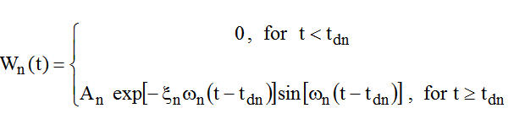

Damped Sinusoids
Synthesize a series of damped sinusoids to satisfy the SRS.
Individual damped-sinusoid
Series of damped-sinusoids
Additional information about the equations is given in Reference documents which are included with the zip file.

Slide 83
Typical Damped Sinusoid

Slide 84
Synthesis Steps
Step | Description
1 | Generate random values for the following for each damped sinusoid: amplitude, damping ratio and delay. The natural frequencies are taken in one-twelfth octave steps.
2 | Synthesize an acceleration time history from the randomly generated parameters.
3 | Calculate the shock response spectrum of the synthesis
4 | Compare the shock response spectrum of the synthesis to the specification. Form a scale factor for each frequency.
5 | Scale the amplitudes of the damped sine components

Slide 85
Synthesis Steps (cont.)
Step | Description
6 | Generate a revised acceleration time history
7 | Repeat steps 3 through 6 as the inner loop until the SRS error diverges
8 | Repeat steps 1 through 7 as the outer loop until an iteration limit is reached
9 | Choose the waveform which meets the specified SRS with the least error
10 | Perform wavelet reconstruction of the acceleration time history so that velocity and displacement will each have net values of zero

Slide 86
Specification Matrix
>> srs_spec=[100 100; 2000 2000; 10000 2000]
srs_spec =
100 100
2000 2000
10000 2000

Slide 87
damped_sine_syn.m
>> damped_sine_syn damped_sine_syn.m ver 3.9 October 9, 2012 by Tom Irvine Email: tomirvine@aol.com This program synthesizes a time history to satisfy a shock response spectrum specification. Damped sinusoids are used for the synthesis. Select data input method. 1=keyboard 2=internal Matlab array 3=external ASCII file 2 The array must have two columns: Natural Freq(Hz) SRS(G) Enter the array name: srs_spec

Slide 88
damped_sine_syn.m (cont.)
Enter duration (sec): (recommend >= 0.04) 0.04 Recommend sample rate = 100000 samples/sec Accept recommended rate? 1=yes 2=no 1 sample rate = 1e+05 samples/sec Enter damping format: 1=damping ratio 2=Q 2
Enter amplification factor Q (typically 10) 10
Number of Iterations for outer loop: 200

Slide 89
damped_sine_syn.m (cont.)
Perform waveform reconstruction? 1=yes 2=no 1 Enter the number of trials per frequency. (suggest 5000) 5000 Enter the number of frequencies. (suggest 500) 500
After script complete, copy array as follows:
accel_base = acceleration;

Slide 90
Acceleration

Slide 91
Velocity

Slide 92
Displacement

Slide 93
Shock Response Spectrum

Slide 94
SDOF Modal Transient
Assume a circuit board with fn = 600 Hz, Q=10
Apply the reconstructed acceleration time history as a base input.
Use arbit.m

Slide 95
SDOF Response to Synthesis
>> arbit
arbit.m ver 2.5 November 11, 2010
by Tom Irvine Email: tomirvine@aol.com
This program calculates the response of a single-degree-of-freedom system to an arbitrary base input time history.
The input time history must have two columns: time(sec) & accel(G)
Select file input method
1=external ASCII file
2=file preloaded into Matlab
3=Excel file
2
Enter the matrix name: accel_base
Enter the natural frequency (Hz) 600
Enter damping format: 1= damping ratio 2= Q 2
Enter the amplification factor (typically Q=10) 10

Slide 96
SDOF Response Acceleration
Absolute peak is 626 G. Specification is 600 G at 600 Hz.

Slide 97
SDOF Response Relative Displacement
Peak is 0.17 inch.

Slide 98
Peak Amplitudes
Absolute peak acceleration is 626 G.
Absolute peak relative displacement is 0.17 inch.
For SRS calculations for an SDOF system . . . .
Acceleration / ω_{n}² ≈ Relative Displacement
[ 626G ][ 386 in/sec^2/G] / [ 2 π (600 Hz) ]^2 = 0.17 inch

Slide 99
Program Summary
Programs
dboct.exe
damped_sine_syn.m
arbit.m
Additional Program
Convert acceleration time history to Nastran format as preprocessing step. The file can then be imported into a Femap model as function:
ne_table2.exe

Slide 100
Apply Shock Pulses to Analytical Models for MDOF & Continuous Systems
Modal Transient Analysis

Slide 101
Continuous Plate Exercise
ss_plate_base.m ver 1.6 October 10, 2012
by Tom Irvine Email: tom@vibrationdata.com
Normal Modes & Optional Base Excitation for a simply-supported plate.
Select material
1=aluminum 2=steel 3=G10 4=other
1
Enter the length (inch) 8
Enter the width (inch) 6
Enter the thickness (inch) 0.063
Structural mass = 0.3024 lbm
Add non-structural mass ? 1=yes 2=no
2
Total mass = 0.3024 lbm
Total mass density = 0.1 lbm/in^3
Plate Stiffness Factor D = 233.8 (lbf in)

Slide 102
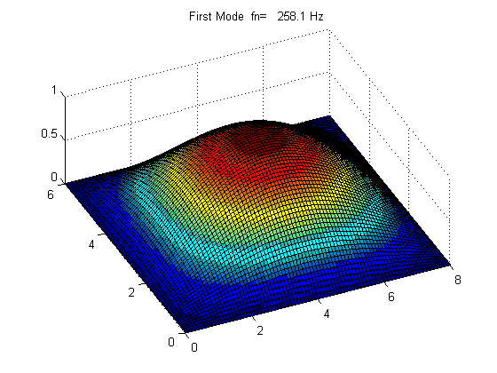
Continuous Plate (cont)
First Mode 258 Hz

Slide 103
Continuous Plate (cont)
Calculate Frequency Response Function 1=yes 2=no
1
Enter uniform modal damping ratio
0.05
Enter distance x
4
Enter distance y
3
Enter maximum base excitation frequency Hz
10000
max Rel Disp FRF = 2.368e-03 (in/G) at 256 Hz
max Accel FRF = 16.09 (G/G) at 259.7 Hz
max Power Trans = 258.8 (G^2/G^2) at 259.7 Hz

Slide 104
Continuous Plate (cont)
Perform modal transient analysis for base excitation?
1=yes 2=no
1
Apply half-sine base input? 1=yes 2=no
2
Apply arbitrary base input? 1=yes 2=no
1
Select file input method
1=external ASCII file
2=file preloaded into Matlab
3=Excel file
2
Enter the matrix name: accel_base

Slide 105
Continuous Plate (cont)
maximum frequency limit for modal transient analysis: fmax= 10000 Hz
Peak Response Values
Acceleration = 1774 G
Velocity = 147.2 in/sec
Relative Displacement = 0.06335 in
Output arrays:
rel_disp_H
accel_H
accel_H2
acc_arb
vel_arb
rd_arb

Slide 106
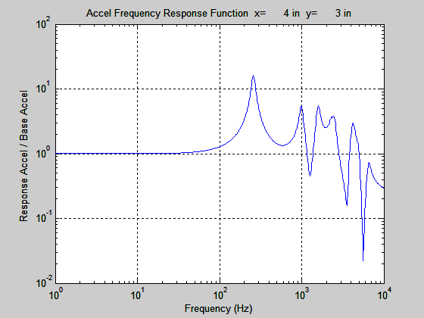
Continuous Plate (cont)

Slide 107
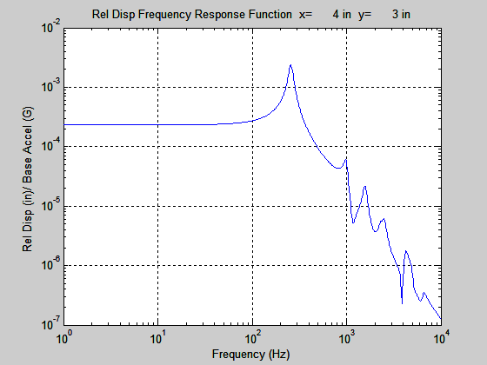
Continuous Plate (cont)

Slide 108
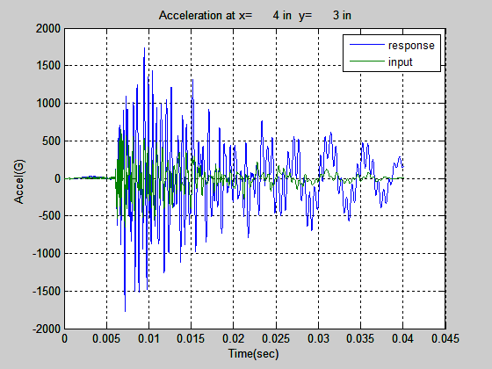
Continuous Plate (cont)
Peak Acceleration = 1774 G

Slide 109
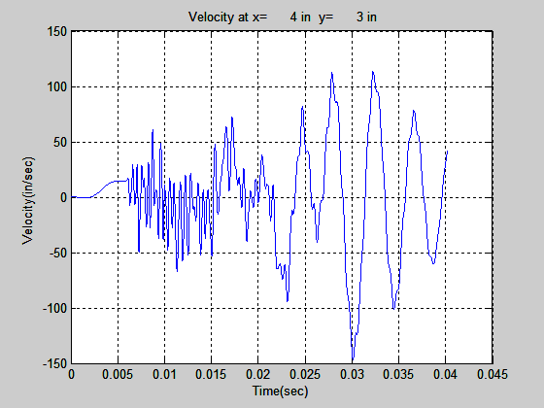
Continuous Plate (cont)
Velocity = 147.2 in/sec

Slide 110
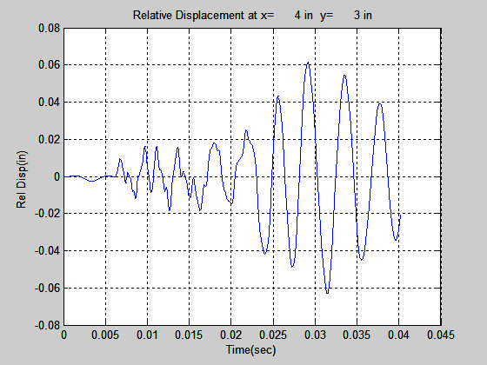
Continuous Plate (cont)
Relative Displacement = 0.063 in. Relative displacement is same as plate thickness, so there is a need to address large deflection theory, nonlinearity, etc.

Slide 111
Isolated Avionics Component Example
y
x
m, J
z
kz1
kz2
kx1
0
kx2
ky2
ky1
kz3
kz4
kx3
ky3
kx4
ky4

Slide 112
Isolated Avionics Component Example (cont)
a1
a2
y
x
z
C. G.
b
0
c1
c2

Slide 113
Isolated Avionics Component Example (cont)
y
α
0
θ
v
ky
ky
m_{b}
ky
ky

Slide 114
Isolated Avionics Component Example (cont)
M | = | 4.28 lbm
Jx | = | 44.9 lbm in^2
Jy | = | 39.9 lbm in^2
Jz | = | 18.8 lbm in^2
Kx | = | 80 lbf/in
Ky | = | 80 lbf/in
Kz | = | 80 lbf/in
a1 | = | 6.18 in
a2 | = | -2.68 in
b | = | 3.85 in
c1 | = | 3. in
c2 | = | 3. in
Run Matlab script: six_dof_iso.m
with these parameters
Assume uniform 8% damping

Slide 115
Isolated Avionics Component Example (cont)
Natural Frequencies =
1. 7.338 Hz
2. 12.02 Hz
3. 27.04 Hz
4. 27.47 Hz
5. 63.06 Hz
6. 83.19 Hz
Calculate base excitation frequency response functions?
1=yes 2=no
1
Select modal damping input method
1=uniform damping for all modes
2=damping vector
1
Enter damping ratio
0.08
number of dofs =6

Slide 116
Isolated Avionics Component Example (cont)
Apply arbitrary base input pulse?
1=yes 2=no
1
The base input should have a constant time step
Select file input method
1=external ASCII file
2=file preloaded into Matlab
3=Excel file
2
Enter the matrix name: accel_base

Slide 117
Isolated Avionics Component Example (cont)
Apply arbitrary base input pulse?
1=yes 2=no
1
The base input should have a constant time step
Select file input method
1=external ASCII file
2=file preloaded into Matlab
3=Excel file
2
Enter the matrix name: accel_base
Enter input axis
1=X 2=Y 3=Z
2

Slide 118
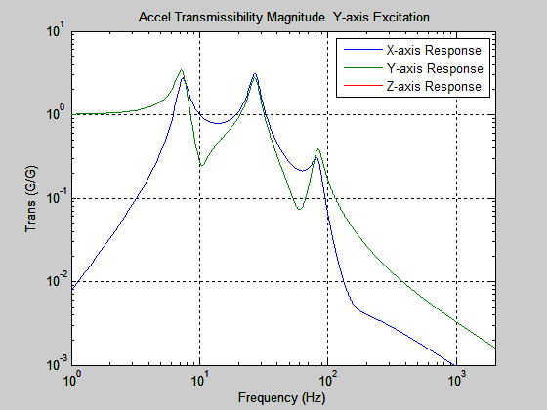
Isolated Avionics Component Example (cont)

Slide 119
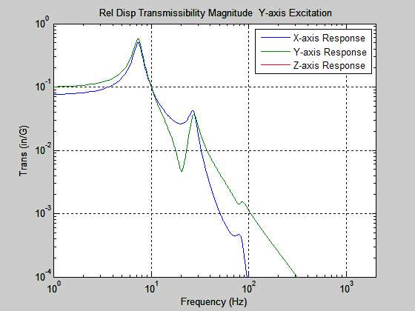
Isolated Avionics Component Example (cont)

Slide 120
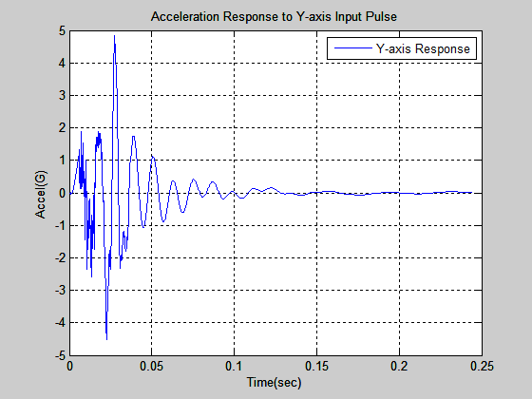
Isolated Avionics Component Example (cont)
Peak Accel = 4.8 G

Slide 121
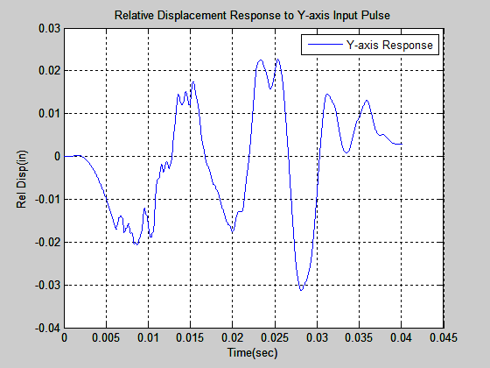
Isolated Avionics Component Example (cont)
Peak Response = 0.031 inch

Slide 122
Isolated Avionics Component Example (cont)
But . . .
All six natural frequencies < 100 Hz.
Starting SRS specification frequency was 100 Hz.
So the energy < 100 Hz in the previous damped sine synthesis is ambiguous.
So may need to perform another synthesis with assumed first coordinate point at a natural frequency < isolated component fundamental frequency. (Extrapolate slope)
OK to do this as long as clearly state assumptions.
Then repeat isolated component analysis . . . left as student exercise!

Slide 123
Program Summary
Programs
ss_plate_base.m
six_dof_iso.m
Additional programs are given at:
http://www.vibrationdata.com/StructuralDC.htm
http://www.vibrationdata.com/beams.htm
http://www.vibrationdata.com/rectangular_plates.htm
http://www.vibrationdata.com/circular_annular.htm
Papers
plate_base_excitation.pdf
avionics_iso.pdf
six_dof_isolated.pdf

