Slide 1
Unit 200
FEA Modal Transient for Base Excitation
using Femap, Nastran & Matlab, Part I
Revision J
Students should already have some familiarity with Femap & Nastran
They should also be able to perform SRS time history synthesis as shown in previous Vibrationdata units
NX Nastran is used as the solver, but the methods should work with other versions

Slide 2
Introduction
Shock and vibration analysis can be performed either in the frequency or time domain
The time domain method requires more computation time but is much better suited for transient and nonstationary excitation
Modal transient analysis for base acceleration excitation is considered in this report
There are two methods for applying the acceleration as shown on the next page
The indirect seismic mass method is the subject for this presentation
The direct enforced acceleration method will be covered in a future presentation
Transient excitation using direct integration will also be covered in future units
The following software steps must be followed carefully, otherwise errors will result

Slide 3






Acceleration Excitation Methods
Assume a rectangular plate mounted via posts at each corner
F
Rigid links
Directly enforce acceleration at corners
For uniform base excitation:
Mount plate to heavy seismic mass via rigid links
Apply force to yield desired acceleration at plate corners
3

Slide 4
Procedure, part I
Femap, NX Nastran and the Vibrationdata Matlab GUI package are all used in this analysis
The GUI package can be downloaded from: https://vibrationdata.wordpress.com/
The first step is to load a library time history into Matlab using the GUI as shown in the following slides
The synthesized time history array name is: srs2000G_Accel
The time history is shown to satisfy an SRS specification
Its corresponding velocity and displacement time histories are stable and each has a net value of zero
The time history is then converted into a Nastran file using the GUI
The Nastran file is exported in ASCII text format as: srs2000G_accel.nas

Slide 5
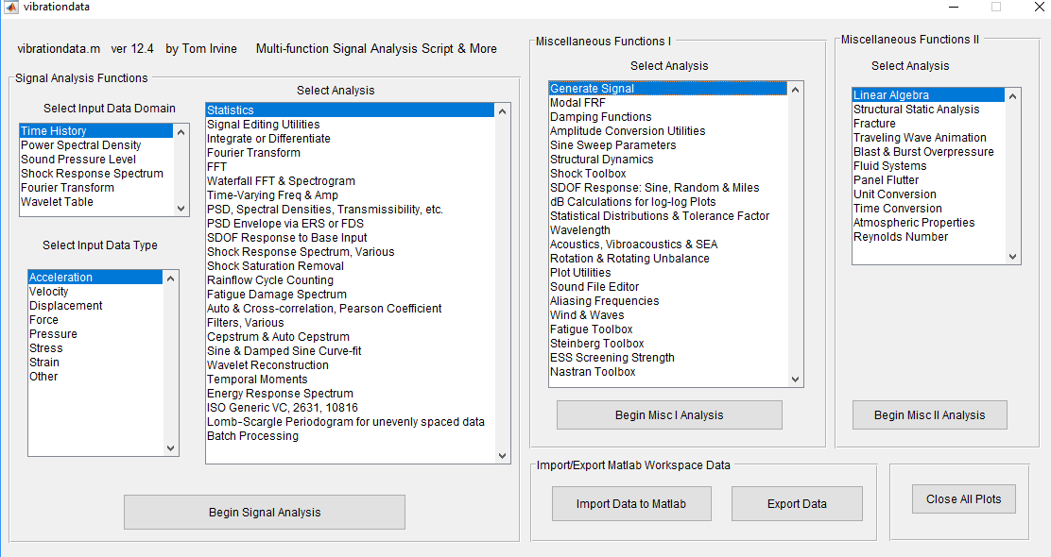
Matlab: Vibrationdata GUI
Type in Matlab Command Window: >> vibrationdata

Slide 6
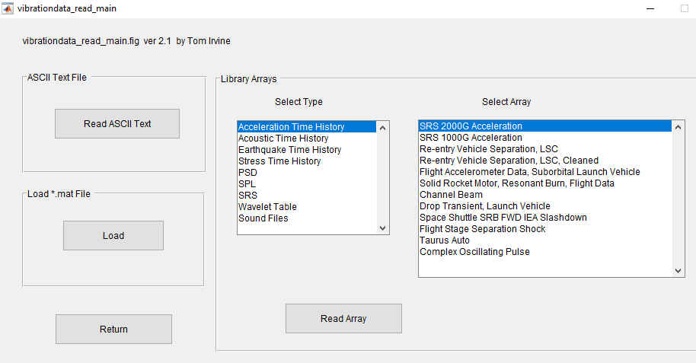
Matlab: Vibrationdata GUI, Read Menu

Slide 7
Synthesized array name: srs2000G_accel
Units: time(sec) & accel(G)
The sample rate is 100K samples/sec which is 10 x the highest SRS natural frequency
The time histories is composed of a series of damped sinusoids which have been reconstructed in terms of wavelet

Slide 8
fn(Hz) | Peak (G)
10 | 10
2000 | 2000
10,000 | 2000
The synthesized time history satisfies the SRS specification within tolerance bands
Most pyrotechnic SRS specifications begin at 100 Hz
A good practice is to extrapolate the specification down to 10 Hz because the structure may have some lower modal frequencies

Slide 9
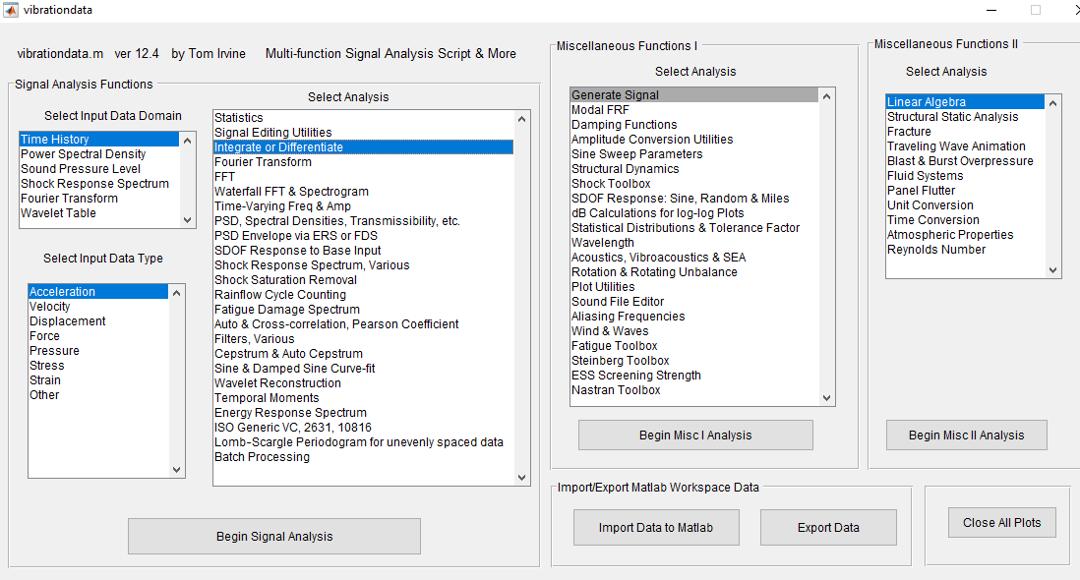
Matlab: Vibrationdata GUI

Slide 10
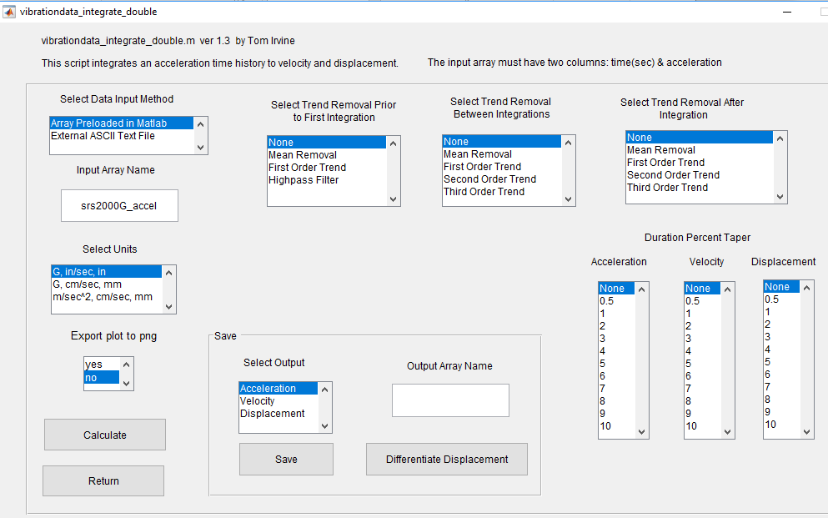
Matlab: Vibrationdata GUI, Integration

Slide 11
Matlab: Time History Set
Maintaining stable velocity & displacement are good engineering practice
Otherwise relative displacement error may occur due to significant digit effects if the displacement has a “ski slope” effect

Slide 12
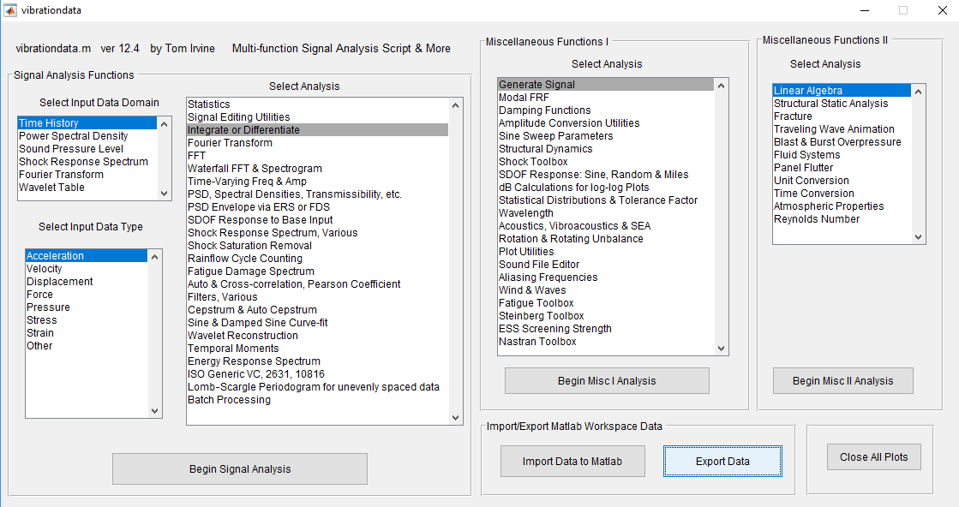
Matlab: Vibrationdata GUI

Slide 13
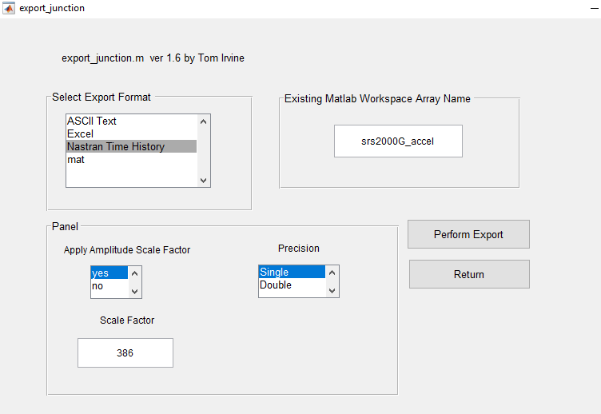
Matlab: Vibrationdata GUI, Export
The 386 scale factor is used to convert the unit from G to in/sec^2
Scale by 9.81 for conversion from G to m/sec^2
The time history is exported as: srs2000G_accel.nas

Slide 14
Procedure, part II
Students should already have some experience constructing finite element models in Femap
Flat square plate 12 x 12 x 0.25 inch (0.305 x 0.305 x 0.00635 meters)
Define plate on XY plane so that Z-axis is perpendicular to the plate
Material: aluminum 6061-T651
Use plate elements (quad4)
Each element is square with 0.25 x 0.25 inch (0.00635 x 0.00635 meters )
48 elements & 49 nodes per edge
Check for coincident nodes & merge accordingly
Renumber nodes beginning with 1
Constrain all corner nodes for no TX, TY or TZ translation

Slide 15
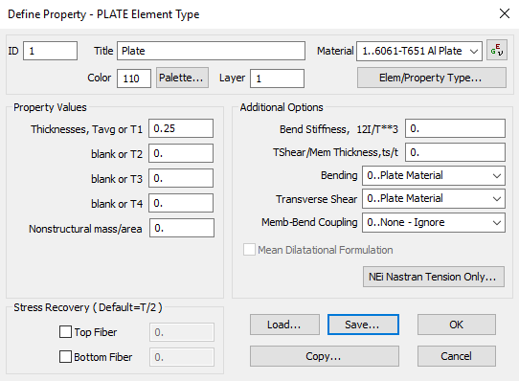
Femap: Plate Element Property

Slide 16

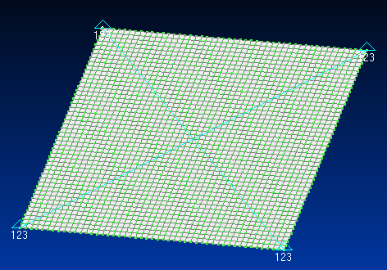
Femap: Plate Nodes, Elements & Corner Constraints
The diagonal lines are drawn to identify the center point
Node 1201 is at the center in this model

Slide 17
Procedure, part III
Set up normal modes analysis in Femap
Solve for first 150 eigenvalues
Select Print & PostProcess
Save model as: square_plate_normal_modes.modfem (or pick your own name)
Students who have Femap with Nastran bundled together can do the analysis directly
Otherwise export analysis file as: square_plate_normal_modes.bdf (or whatever)
Run Nastran solver for: square_plate_normal_modes.bdf
Import square_plate_normal_modes.f06 into Femap to view mode shapes
View > Select > Deform
Optional: view the f06 file in Notepad++ application https://notepad-plus-plus.org/

Slide 18
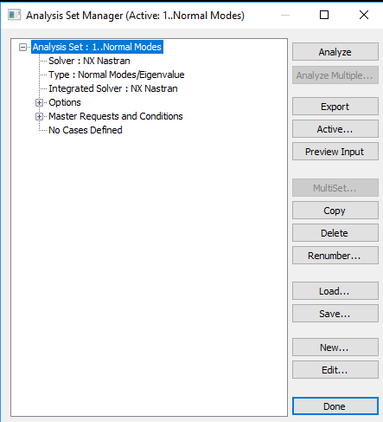
Femap: Set Up Analysis

Slide 19
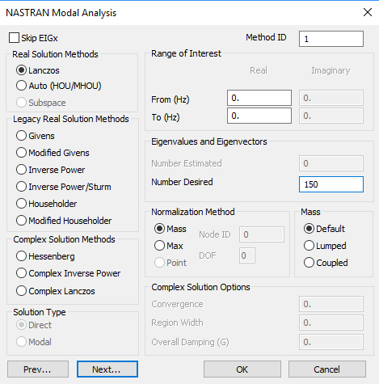
Femap: 150 Eigenvalues

Slide 20
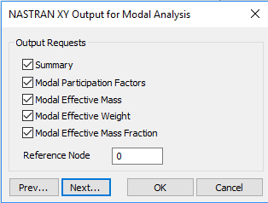
Femap: Select All Outputs

Slide 21
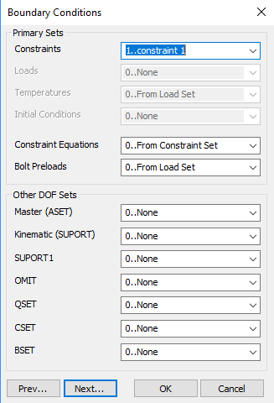
Femap: Add Constraint Set

Slide 22
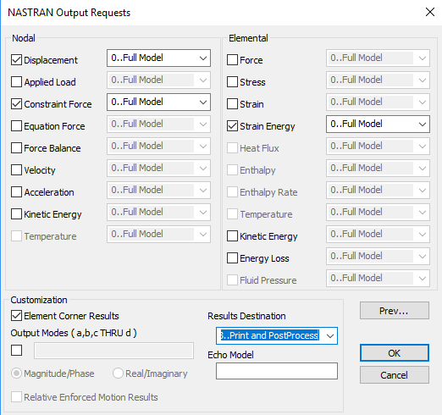
Femap: Print & PostProcess

Slide 23
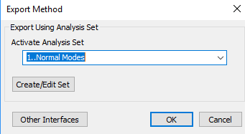
Femap: Export Normal Modes Analysis

Slide 24
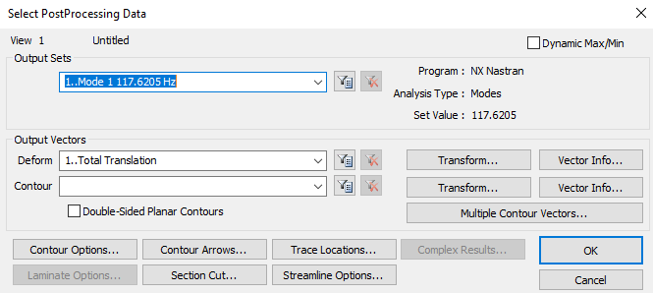
Femap: PostProcess Mode 1

Slide 25
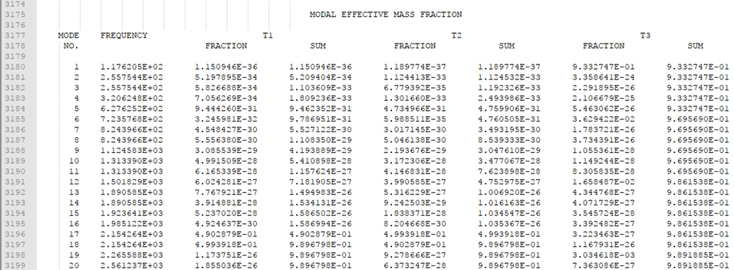
Nodepad++: View f06 File
T3 is motion in the Z-axis
The set composed of modes 1, 6, 12 & 19 accounts for 98.9% of the T3 total mass

Slide 26
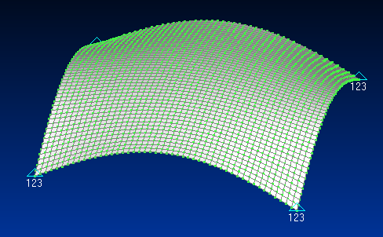
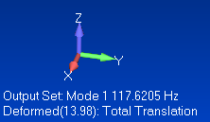
Femap: Mode Shape 1
The fundamental mode at 117.6 Hz has 93.3% of the total modal mass in the T3 axis
The plate appears to behave almost as a single-degree-of-freedom system
But higher modes make a very significant contribution to the overall shock response

Slide 27
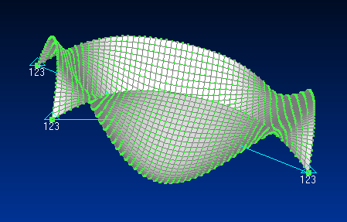
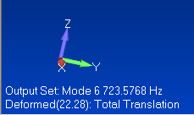
Femap: Mode Shape 6
The sixth mode at 723 Hz has 3.6% of the total modal mass in the T3 axis

Slide 28
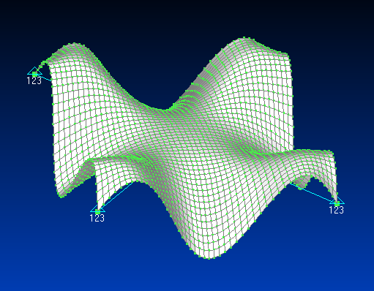
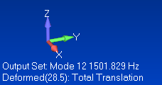
Femap: Mode Shape 12
The twelfth mode at 1502 Hz has 1.6% of the total modal mass in the T3 axis

Slide 29
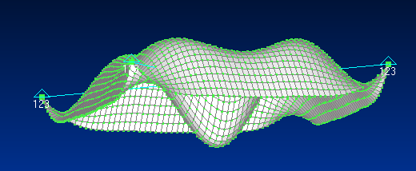
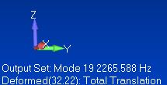
Femap: Mode Shape 19
The 19th mode at 2266 Hz has only 0.3% of the total modal mass in the T3 axis
But it has the highest contribution to the T3 peak acceleration response at the center node to the input shock

Slide 30
Hand Calculation Check
Reference: Steinberg, Vibration Analysis for Electronic Equipment
The fundamental frequency f _{n} for a flat square plate is
a | Plate length
D | Plate stiffness factor
ρ | Mass/area
E | Elastic modulus
h | Plate thickness
μ | Possion ratio

Slide 31
Hand Calculation Check (cont)
Aluminum mass per volume = 0.1 lbm/in^3 = 0.00025904 lbf sec^2/in^4
Plate mass per area: ρ = (0.00025904 lbf sec^2/in^4)(0.25 in)= 6.476e-05 lbf sec^2/in^3
Plate stiffness factor: D = (1.0e+07 lbf/in^2)(0.25 in)^3/(12(1-0.3^2)) = 1.431e+04 lbf in
Fundamental frequency:
f_{n} = (1.13/ (12 in )^2)sqrt(1.431e+04 lbf in / 6.476e-05 lbf sec^2/in^3 )
f_{n} = 116.6 Hz
Hand calculation has very good agreement with FEA result 117.6 Hz
Next post-process f06 file in Matlab GUI

Slide 32
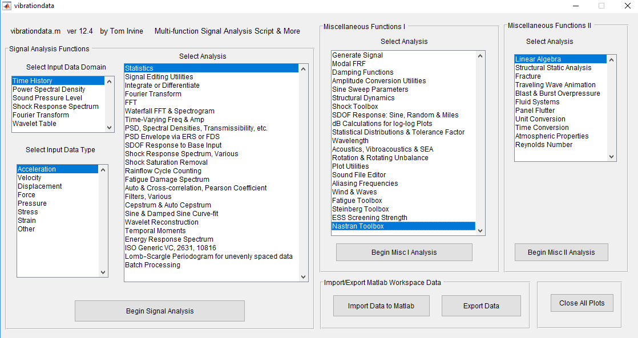
Matlab: Vibrationdata GUI

Slide 33
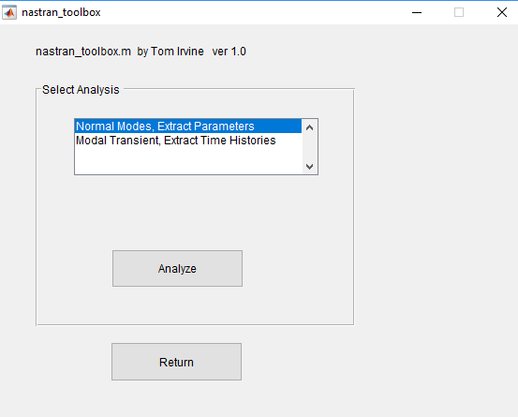
Matlab: Vibrationdata GUI, Nastran Toolbox

Slide 34
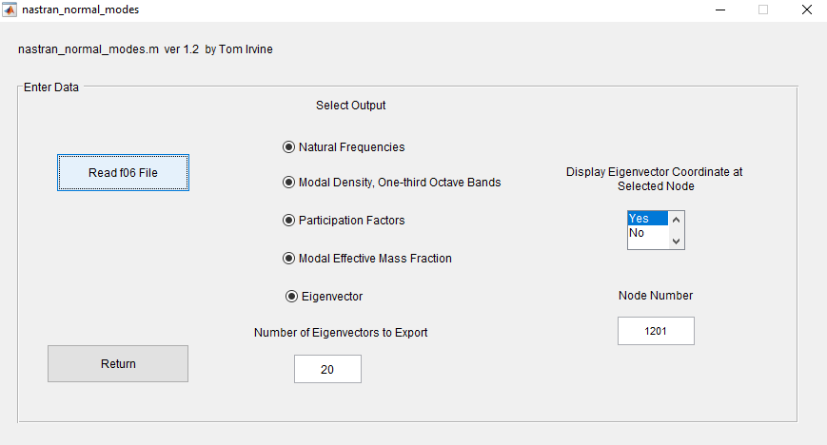
Matlab: Vibrationdata GUI, Read f06 File

Slide 35
Matlab: Modal Density, One-third Octave Format
This plot could be useful for Statistical Energy Analysis (SEA)

Slide 36
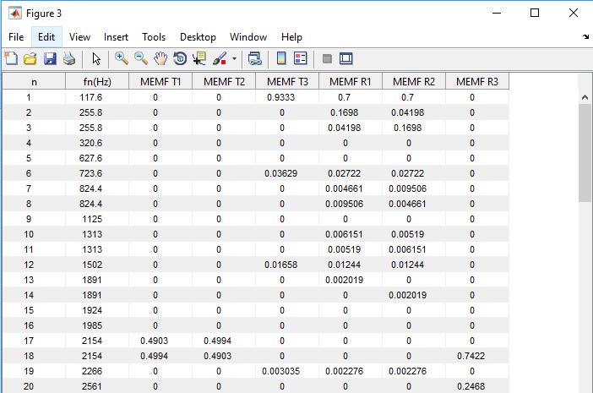
Matlab: Modal Effective Mass Fractions
T3 is the out-of-plane bending axis
The dynamic analysis will be performed for the first twenty modes based on this table
Some consideration is also given to the maximum SRS frequency and the sample rate

Slide 37
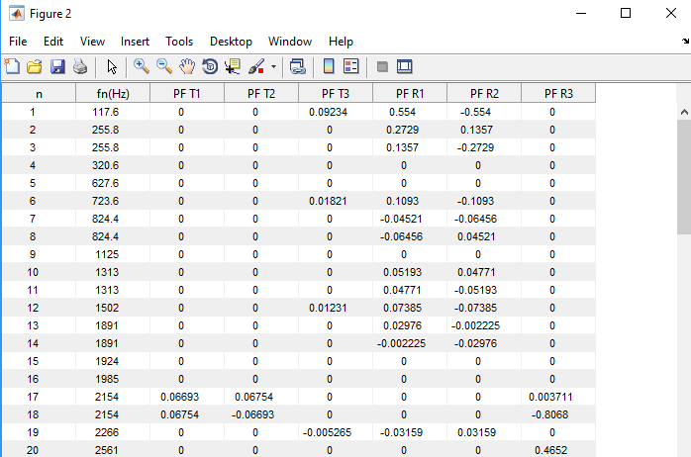
Matlab: Modal Participation Factors

Slide 38
Matlab: Node 1201 Eigenvectors
Extract Eigenvector 1
node T1 T2 T3 R1 R2 R3
1201 7.394e-18 -1.256e-19 13.98 7.813e-12 4.043e-12 0
Extract Eigenvector 6
node T1 T2 T3 R1 R2 R3
1201 5.028e-15 -1.428e-16 -22.28 -2.212e-12 1.172e-12 0
Extract Eigenvector 12
node T1 T2 T3 R1 R2 R3
1201 -8.278e-13 -7.012e-13 2.499 6.68e-13 2.427e-12 0
Extract Eigenvector 19
node T1 T2 T3 R1 R2 R3
1201 -1.219e-12 -1.024e-12 -32.22 1.791e-12 -4.14e-13 0

Slide 39
Matlab: Node 1201 Parameters for T3
n | fn (Hz) | Modal Mass Fraction | Participation Factor | Eigenvector
1 | 117.6 | 0.933 | 0.0923 | 13.98
6 | 723.6 | 0.036 | 0.0182 | 22.28
12 | 1502 | 0.017 | 0.0123 | 2.499
19 | 2266 | 0.003 | 0.0053 | 32.22
The Participation Factors & Eigenvectors are shown as absolute values
The Eigenvectors are mass-normalized
The Eigenvectors are the only parameter in the table which depends on location
Modes 1, 6, 12 & 19 account for 98.9% of the total mass

Slide 40
Matlab: Node 49 Parameters for T3
n | fn (Hz) | Modal Mass Fraction | Participation Factor | Eigenvector
1 | 117.6 | 0.933 | 0.0923 | 9.81
6 | 723.6 | 0.036 | 0.0182 | 17.92
12 | 1502 | 0.017 | 0.0123 | -28.5
19 | 2266 | 0.003 | 0.0053 | -16.6

Slide 41
Procedure, part IV
Prepare Femap model for modal transient analysis
Delete output set from normal modes analysis
Also: delete > model > functions
Set up damping function
Import time history: srs2000G_accel.nas
Edit corner node constraints
Add seismic mass to model
Set up dynamic analysis to apply acceleration time history to model
Femap will convert the acceleration time history to a force time history
Add some constraints

Slide 42
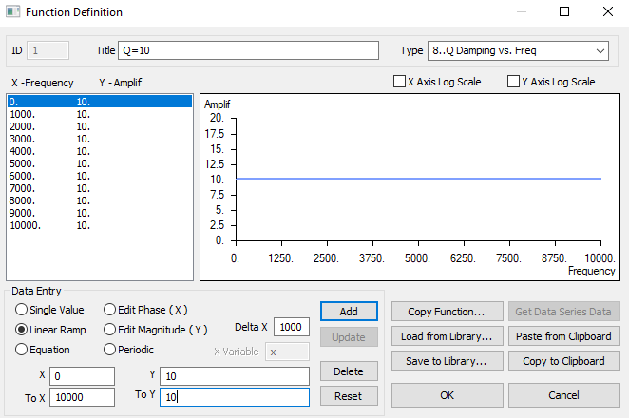
Femap: Q Damping
Customize the damping table according to your analysis problem need
Damping can vary with frequency
Q=10 is equivalent to 5% viscous modal damping

Slide 43
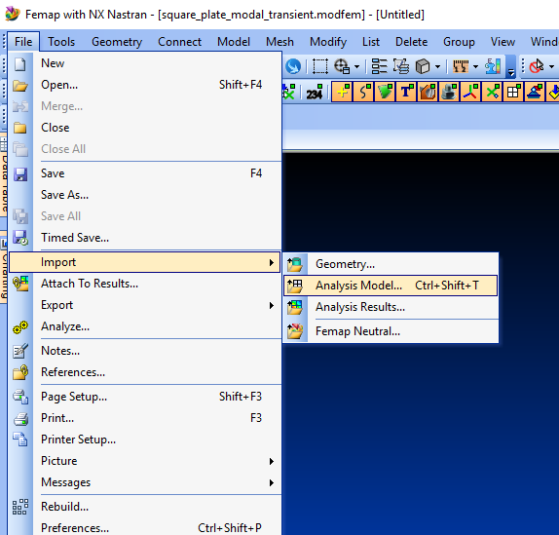
Femap: Import Nastran Acceleration Time History
srs2000G_accel.nas

Slide 44
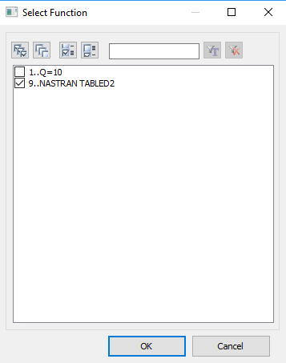
Femap: View Acceleration Time History
Modify > edit > function
NASTRAN TABLED2 is the function for srs2000G_accel.nas

Slide 45
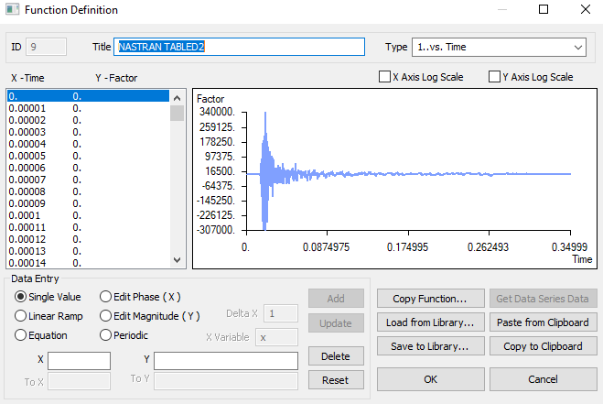
Femap: Acceleration Time History
The X-axis is Time (sec)
The Y-axis is Acceleration (in/sec^2)

Slide 46
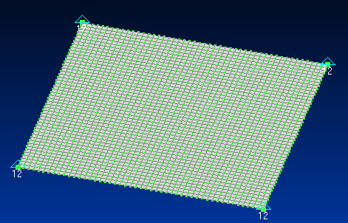
Femap: Constraints
Edit corner node constraints so that only TX & TY are fixed

Slide 47
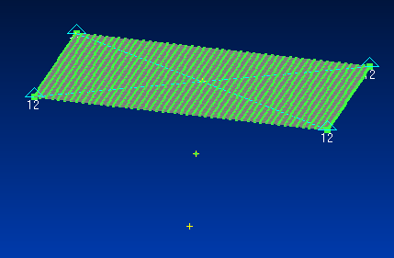
Femap: Added Points and Node
Node 2402
Copy center point twice at -3 inch increments in the Z-axis
Place node on point at middle point

Slide 48
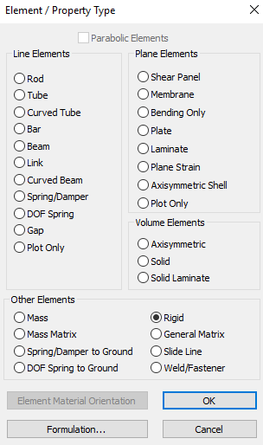
Femap: Select Rigid Element

Slide 49
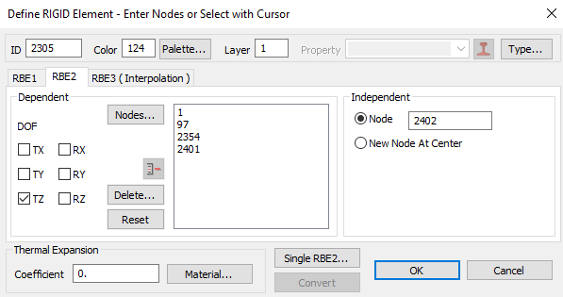
Femap: Configure Rigid Element, RBE2
Dependent DOF is TZ
Dependent Nodes are the corner nodes
Node 2402 is the independent Node, -3 inch from plate’s center node in Z-axis

Slide 50
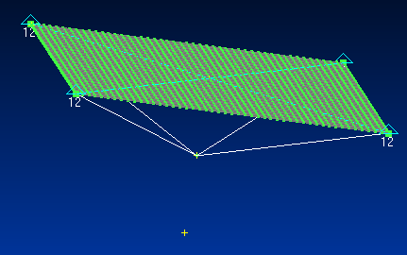
Femap: Plate with Rigid Element
Rigid Link
Node 2402

Slide 51
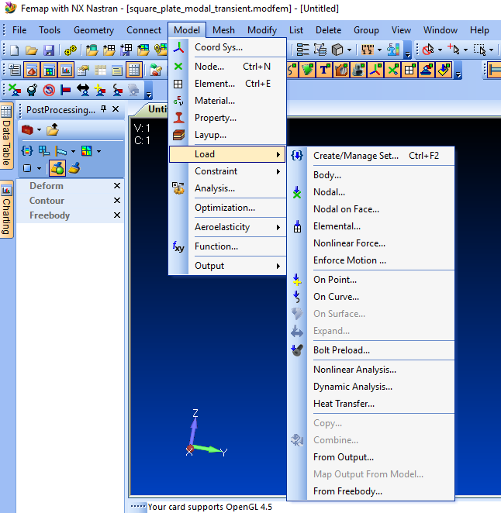
Femap: Load Set
Step 1:
Create Load Set
Step 2:
Dynamic Analysis

Slide 52
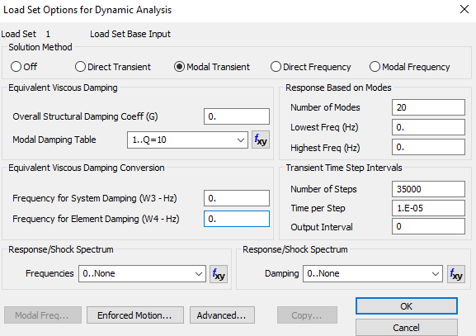
Femap: Dynamic Analysis Set
Damping Function
Modal Transient
Limit to 20 modes
Same time per step as input acceleration time history
Click on Enforced Motion

Slide 53
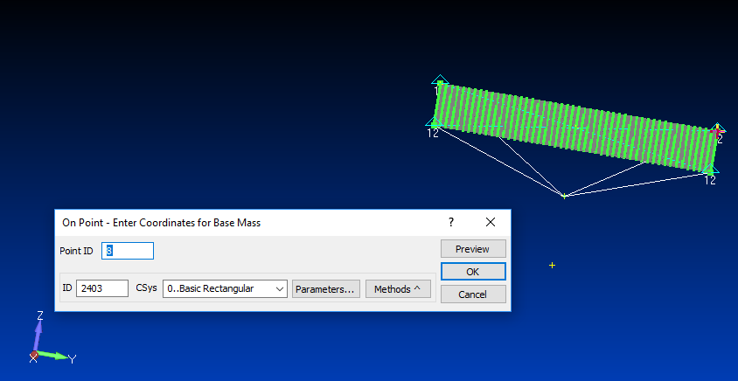
Femap: Base Mass for Enforced Motion
Point 8

Slide 54
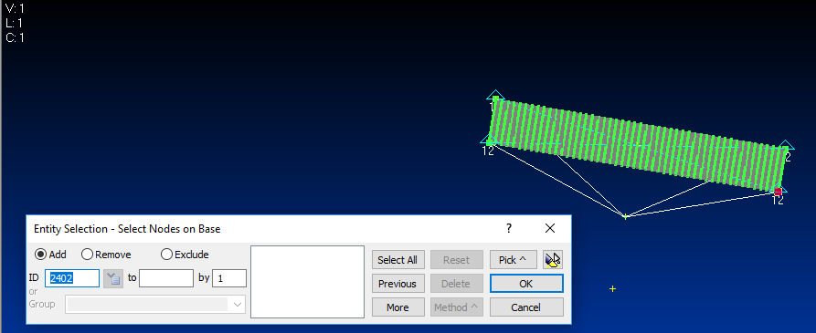
Femap: Node on Base
Node 2402

Slide 55
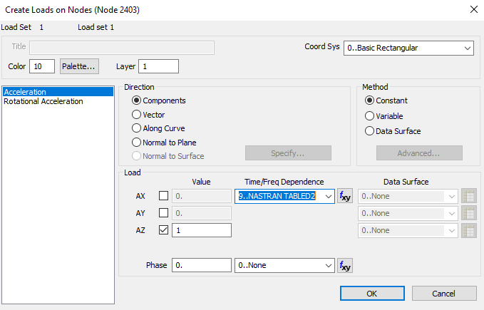
Femap: Create Load
Acceleration Time History

Slide 56
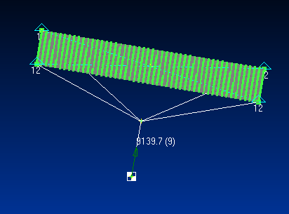
Femap: Plate with Seismic Mass
Node 2402
Node 2403
Seismic mass is located at Node 2403

Slide 57
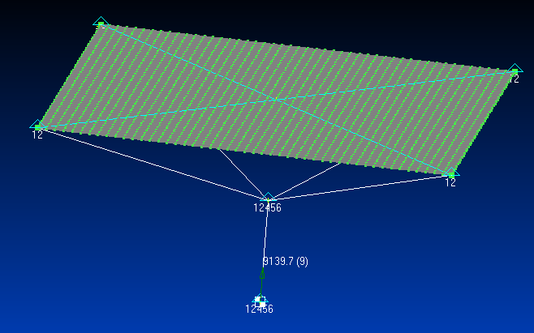
Femap: Additional Constraints
Nodes 2402 & 2403, all DOF constrained except TZ is free

Slide 58
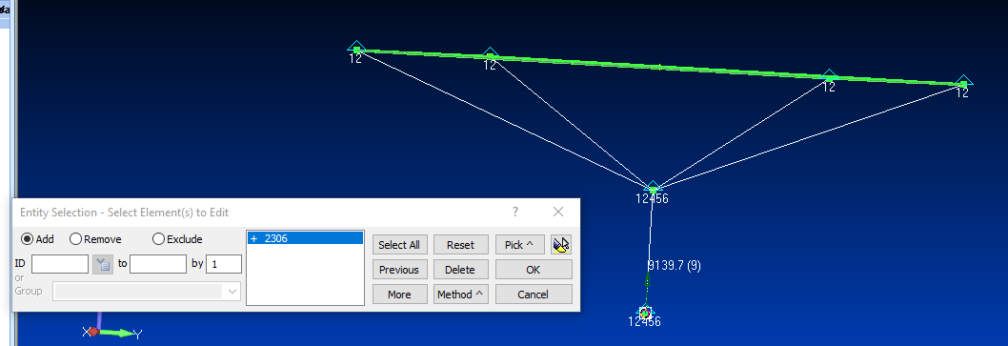
Femap: Edit Rigid Link from Seismic Mass to Base Node
This Element

Slide 59
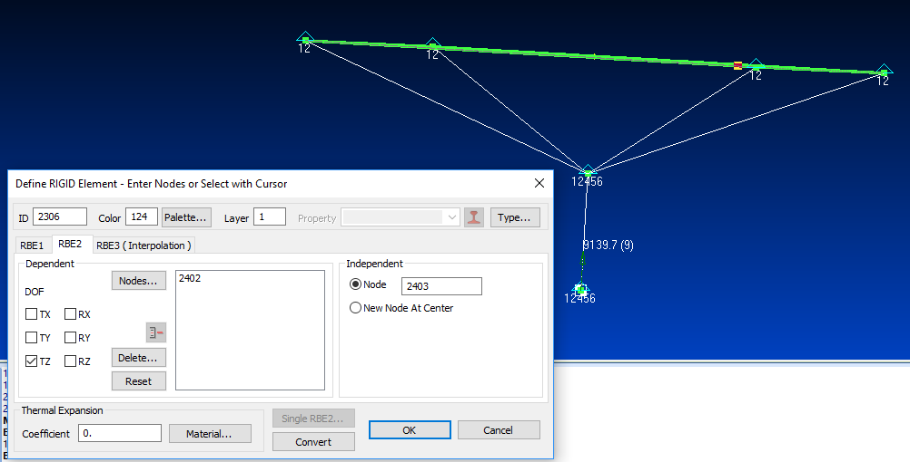
Femap: Edit Rigid Link from Seismic Mass to Base Node (cont)
Only allow TZ connection between Seismic Mass & Base Node

Slide 60
Procedure, part V
Perform normal modes analysis on plate with rigid links and seismic mass, using same steps as before
Verify that the first elastic modal frequency is 117.6 Hz

Slide 61
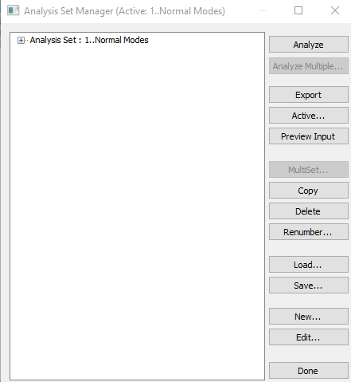
Femap: Normal Modes
Export analysis as: square_plate_normal_modes_seismic_mass.bdf (or your choice)
Run model in Nastran to generate f06 file

Slide 62
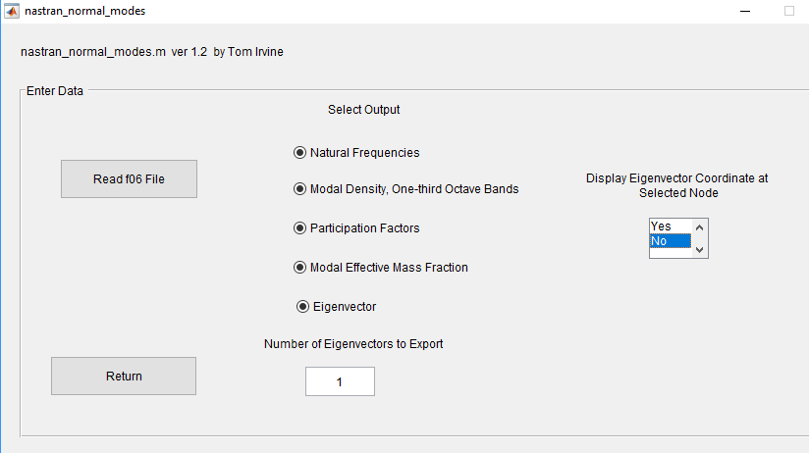
Vibrationdata GUI for f06 File

Slide 63
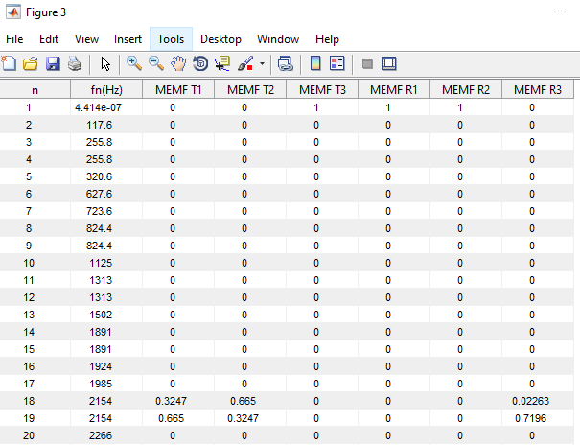
Nastran Results, f06 File Imported to Matlab via Vibrationdata GUI
The first modal frequency is essentially zero, representing a rigid-body mode
The second modal frequency corresponds to the first elastic mode
The first elastic modal frequency is 117.6 Hz as expected

Slide 64
Procedure, part VI
Model is too big to output:
response displacement time histories at each node
stress time histories at each element
Form groups for a few selected node and elements
Prepare modal transient analysis with great care
Save as: square_plate_modal_transient.modfem (or whatever)
Run model in Femap/Nastran bundle or export analysis file for running solver outside of Femap
Call f06 file into Matlab Vibrationdata GUI

Slide 65


Femap: Create Groups for Nodes & Elements
Node Group: Select node at center of plate. one at a middle edge & the base drive node & any others of interest
Element Group: Select at least one of the four elements which has a corner node at the center & any others

Slide 66

Femap: Node Group
Node 1
Node 49
Node 1201
Node 2402
Node 2403

Slide 67

Femap: Element Group
Element 50
Node 1201
Element 1129

Slide 68

Femap: Create Analysis

Slide 69

Femap: Modal Solution with 20 Eigenvalues
The 20 eigenvector number is chosen with consideration given to the modal mass fraction, maximum SRS frequency and sample rate
The sample rate should be at least 10x greater than the maximum eigenvalue frequency of interest and also the maximum SRS frequency
The 20th modal frequency is 2266 Hz
The highest SRS frequency is 10,000 Hz
The sample rate is 100,000 samples/sec

Slide 70

Femap: Damping, Time Parameters & 20 Eigenvalues

Slide 71

Femap: Output for Modal Analysis
Only Summary selected

Slide 72

Femap: Verify Constraints & Load Set

Slide 73

Femap: Output Requests, Displacement, Acceleration & Stress
Element Corner Results is off
Print & Post-process to generate f06 file

Slide 74

Femap: Nastran File Export
Export analysis file to: square_plate_modal_transient_seismic_mass.bdf (or some name)
Then run in Nastran

Slide 75

Matlab: Vibrationdata GUI Nastran f06 File Post-processing

Slide 76

Matlab: Vibrationdata GUI, Modal Transient Extraction
Input File: square_plate_modal_transient_seismic_mass.f06
Node 2402 is base drive node

Slide 77

Femap: Response Element & Node
Element 1129
Node 1201

Slide 78
Matlab: Relative Displacement, Edge Center, Node 49
The absolute peak is 0.073 inch for T3

Slide 79
Matlab: Relative Displacement, Plate Center, Node 1201
The absolute peak is 0.105 inch for T3

Slide 80
Matlab: Relative Velocity, Edge Center, Node 49
The absolute peak is 68.9 in/sec for T3

Slide 81
Matlab: Relative Velocity, Plate Middle, Node 1201
The absolute peak is 79.7 in/sec for T3

Slide 82
Matlab: Absolute Acceleration, Edge Center, Node 49
The absolute peak is 586 G for T3

Slide 83
Matlab: Absolute Acceleration, Plate Middle, Node 1201
The absolute peak is 461 G for T3

Slide 84
Matlab: Stress Response, Near Corner, Element 50

Slide 85
Matlab: Signed Von Mises Stress, Near Corner, Element 50
The signed Von Mises stress is useful for fatigue analysis
The absolute peak is 7662 psi

Slide 86
Matlab: Stress Response, Plate Middle, Element 1129

Slide 87
Matlab: Signed Von Mises, Plate Middle, Element 1129
The signed Von Mises stress is useful for fatigue analysis
The absolute peak is 4741 psi
(The analysis was repeated for a model with four times as many elements resulting in peak stress of 4733 psi at the plate center)
Convention: Signed Von Mises Stress= (Von Mises Stress)*sign(Major Principal Stress)

Slide 88
Matlab: Response Peaks
Nodal Response Comparison for T3
Peak Absolute Response | Edge Center Node 49 | Plate Middle Node 1201
Relative Displacement (in) | 0.073 | 0.105
Relative Velocity (in/sec) | 68.9 | 79.7
Absolute Acceleration (G) | 586 | 461
The Plate Middle Node has the highest relative displacement & velocity
The Edge Center Node has the highest acceleration
Von Mises Stress Response Comparison, unit: psi
Near Corner Element 50 | Plate Middle Element 1129
7662 | 4741

Slide 89
Modal Combination Methods
Response spectrum analysis is actually an extension of normal modes analysis
ABSSUM – absolute sum method
SRSS – square-root-of-the-sum-of-the-squares
NRL – Naval Research Laboratory method
The SRSS method is probably the best choice for response spectrum analysis because the modal oscillators tend to reach their respective peaks at different times according to frequency
The lower natural frequency oscillators take longer to peak

Slide 90
ABSSUM Method
Conservative assumption that all modal peaks occur simultaneously
Pick D values directly off of Relative Displacement SRS curve
where is the mass-normalized eigenvector coefficient for coordinate i and mode j
These equations are valid for both relative displacement and absolute acceleration.

Slide 91
SRSS Method
Pick D values directly off of Relative Displacement SRS curve
These equations are valid for both relative displacement and absolute acceleration.

Slide 92
Acceleration Response Check for Node 49 T3
n | fn (Hz) | MMF | PF | Eigen vector | Specification SRS (G) | | PF x Eig x Spec | (G) | | PF x Eig x Spec |² (G²)
1 | 117.6 | 0.933 | 0.0923 | 9.81 | 117.6 | 106.5 | 11339
6 | 723.6 | 0.036 | 0.0182 | 17.92 | 723.6 | 236.0 | 55695
12 | 1502 | 0.017 | 0.0123 | -28.5 | 1502 | 526.5 | 277230
19 | 2266 | 0.003 | 0.0053 | -16.6 | 2000 | 176.0 | 30962
 |  |  |  |  |  | sum = 1045 G | sum = 375,225 G²
 |  |  |  |  |  |  | sqrt of sum = 613 G
This checking method is an approximation for the response of a multi-degree-of-freedom system to an SRS input
The table is taken from the plate model modal analysis results prior to the addition of the seismic mass, with three added columns
The set composed of modes 1, 6, 12 & 19 accounts for almost 99% of the total mass
The seventh column is the participation factor times the eigenvector times the SRS specification
The sum of the absolute responses is 1045 G, which conservatively assumes that each mode reaches its peak at the same time as the others
The “square root of the sum of the squares” is 613 G
The FEA modal transient peak response was 586 G which passes the “sanity check”

Slide 93
Acceleration Response Check for Node 1201 T3
n | fn (Hz) | MMF | PF | Eigen vector | Specification SRS (G) | | PF x Eig x Spec | (G) | | PF x Eig x Spec |² (G²)
1 | 117.6 | 0.933 | 0.0923 | 13.98 | 117.6 | 152 | 23104
6 | 723.6 | 0.036 | 0.0182 | -22.28 | 723.6 | 293 | 85849
12 | 1502 | 0.017 | 0.0123 | 2.499 | 1502 | 46 | 2116
19 | 2266 | 0.003 | 0.0053 | 32.22 | 2000 | 342 | 116964
 |  |  |  |  |  | sum = 833 G | sum = 228033 G²
 |  |  |  |  |  |  | sqrt of sum = 478 G
The table is taken from the plate model modal analysis results prior to the addition of the seismic mass, with three added columns
The sum of the absolute responses is 833 G, which conservatively assumes that each mode reaches its peak at the same time as the others
The “square root of the sum of the squares” is 478 G
The FEA modal transient peak response was 461 G which passes the “sanity check”

Slide 94

Vibrationdata GUI

Slide 95

Vibrationdata Shock Toolbox
Repeat previous calculation using Matlab

Slide 96

Vibrationdata SRS Modal Combination
Matlab Command Window >> spec=[10 10; 2000 2000; 10000 2000]

Slide 97
Vibrationdata SRS Modal Combination Results, Node 1201 T3
SRS Q=10
fn(Hz) Accel(G)
10.0 10.0
2000.0 2000.0
10000.0 2000.0
fn Q=10
(Hz) SRS(G)
117.6 117.6
723.6 723.6
1502 1502
2266 2000
fn Part Eigen SRS Modal Response
(Hz) Factor vector Accel(G) Accel(G)
117.6 0.0923 13.98 117.6 151.7
723.6 0.0182 -22.28 723.6 293.4
1502 0.0123 2.499 1502 46.17
2266 0.0053 32.2 2000 341.3
ABSSUM= 832.7 G SRSS= 477.2 G

Slide 98
Stress-Velocity Equation
The stress [σ_{n}]_{max} for mode n is:
E | Elastic modulus
ρ | Mass per volume
[V_{n}]_{max} | Modal velocity
Ĉ is a constant of proportionality dependent upon the geometry of the structure, often assumed for complex equipment to be 4 < Ĉ < 8
Ĉ ≈ 2 for all normal modes of homogeneous plates and beams

Slide 99

Matlab: Vibrationdata Shock Toolbox

Slide 100

Matlab: MDOF SRS Stress Analysis for Node 1201
Matlab Command Window >> spec=[10 10; 2000 2000; 10000 2000]
The peak velocity response occurs at center Node 1201
The peak stress occurs near each of the four corners
The stress-velocity calculation accounts for this difference

Slide 101
Matlab: Peak MDOF SRS Stress from Node 1201 velocity
SRS Q=10
fn(Hz) Accel(G)
10.0 10.0
2000.0 2000.0
10000.0 2000.0
fn Q=10
(Hz) SRS(G)
117.6 117.6
723.6 723.6
1502 1502
2266 2000
fn Q Part Eigen Accel PV SRS Modal Response
(Hz) Factor vector SRS(G) (in/sec) Stress(psi)
117.6 10 0.0923 13.98 117.6 61.43 8070
723.6 10 0.0182 -22.28 723.6 61.43 2536
1502 10 0.0123 2.499 1502 61.43 192.2
2266 10 0.0053 32.2 2000 54.22 942
ABSSUM= 11740 psi SRSS= 8513.1 psi
The peak FEA response spectrum stress for the whole plate was 7662 psi
FEA stress passes sanity check, but a lower Ĉ value may be justified so that the SRSS agrees more closely with the FEA results

Slide 102
Future Work
Expand Nastran stress post-processing options in Vibrationdata GUI
Include strain
Please contact Tom Irvine Email: tom@irvinemail.org if you have suggestions or find bugs in the Vibrationdata GUI
Homework
1. Repeat analysis with triangular plate elements
2. Experiment with different mesh densities
3. Repeat analysis with an alternate base input time history

