Slide 1
Unit 202
Nastran FEA Base Excitation with Multiple Response Spectrum Inputs
Revision A
Prerequisite: review Unit 201
The Vibrationdata Matlab GUI package for this Unit can be downloaded from: https://vibrationdata.wordpress.com/

Slide 2
Introduction
Aerospace pyrotechnic shock response spectrum (SRS) specifications are almost always given with an amplification factor Q=10
Corresponding time history waveforms for the base input acceleration are almost never given with the specifications
Users are allowed to synthesize their own waveforms for analysis & test purposes
Some shock analysis methods use the SRS directly without time history synthesis, such as modal combination methods
Consider the following specification with Q=10
What should be the new SRS level for Q=20 or 50?
SRS | Q=10
fn (Hz) | Peak Accel (G)
10 | 10
2000 | 2000
10000 | 2000
Pyrotechnic SRS specifications typically begin at 100 Hz, but extrapolation down to 10 Hz may be needed if the structure has any modal frequencies below 100 Hz

Slide 3
Introduction
There is no exact way to convert an SRS to a new Q value unless a corresponding time history is included with the SRS
The following is a reasonable approach for engineering purposes
Synthesize a time history to satisfy the SRS using a series of damped sinusoids
The resulting time history should “resemble” a pyrotechnic pulse or whatever pulse the SRS is suppose to represent
Verify the synthesis with respect to the SRS with its original Q value
Calculate the SRS of the synthesize signal with the new Q value
The new SRS will be somewhat jagged
Take the average or a maximum envelope of the jagged SRS to obtain a new smooth SRS specification, using trial-and-error curve-fitting to minimize the difference
An example using Matlab is shown on the following slides

Slide 4
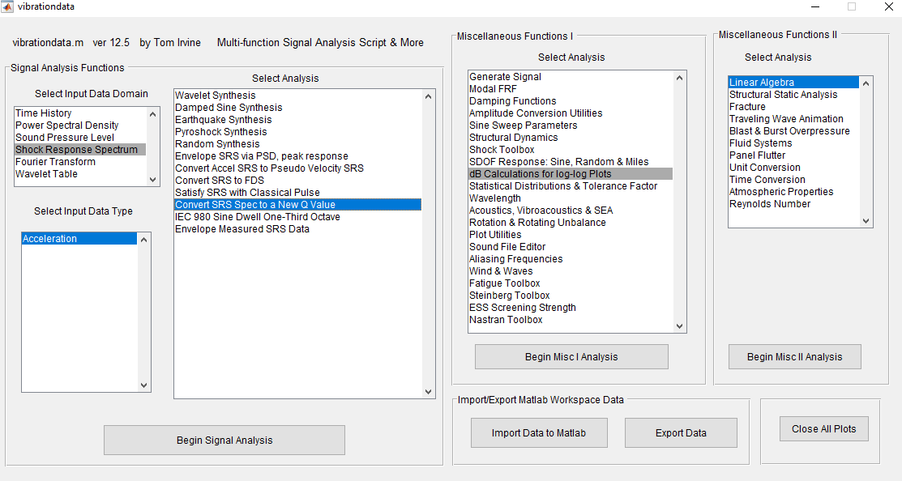
Vibrationdata Matlab GUI

Slide 5
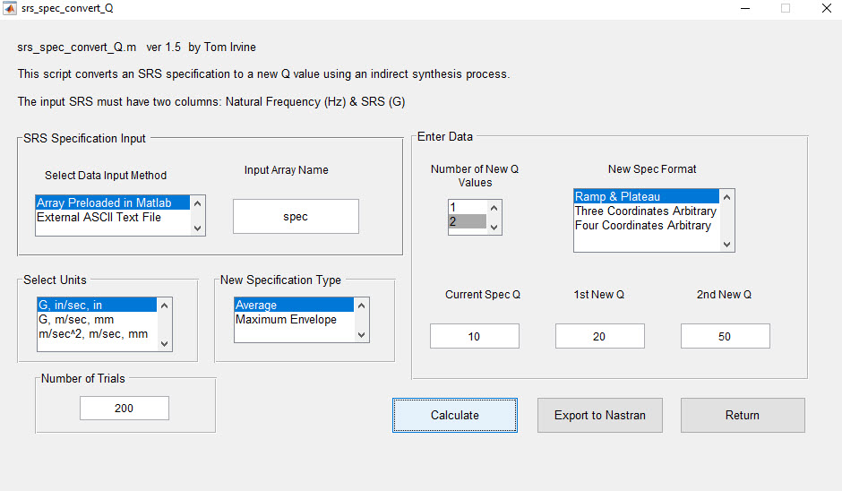
SRS Conversion Function
>> spec = [10 10; 2000 2000; 10000 2000]

Slide 6
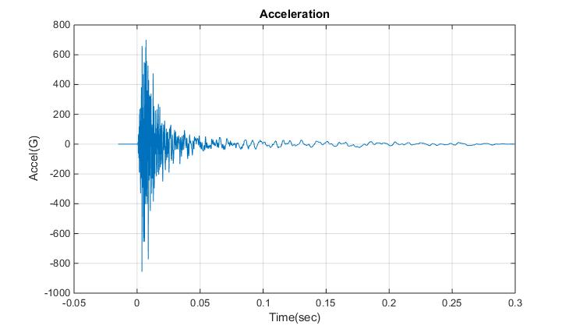
Synthesized Time History
The time history is a series of damped sinusoids
It is a plausible representation of a pyrotechnic shock pulse

Slide 7
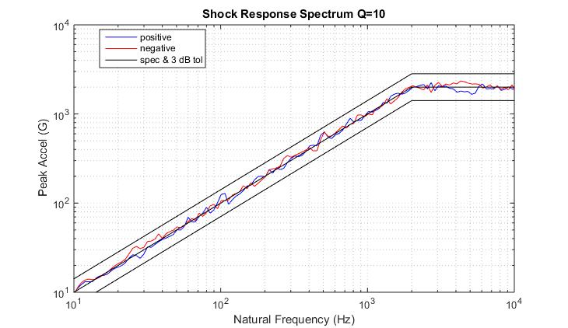
Synthesized Time History Verification
The positive & negative curves are from the synthesized time history
The time history satisfies the specification within reasonable tolerance bands

Slide 8
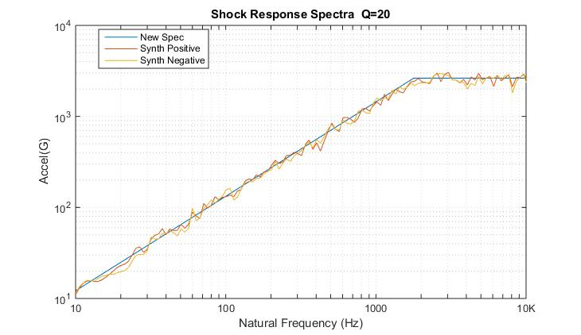
New Specification Q=20
The jagged lines are the SRS of the synthesized time history
The new spec is a ramp-plateau average which seeks to minimize the difference with respect to the absolute value SRS of the synthesis

Slide 9
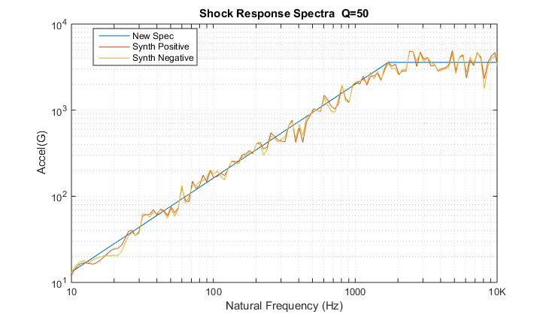
New Specification Q=50
The jagged lines are the SRS of the synthesized time history
The new spec is a ramp-plateau average which seeks to minimize the difference with respect to the absolute value SRS of the synthesis

Slide 10
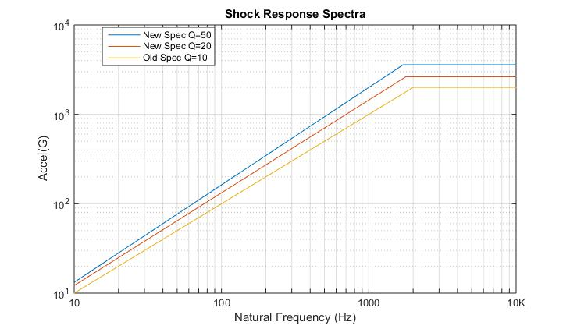
SRS Specifications for Two Q Values
The new spec can be used for analyzing the response of a single-degree-of-freedom system with Q=20 or 50
Interpolation can be used for other Q values between Q=10 and Q=50
The curves can also be used for multi-degree-of-freedom systems via modal combination methods

Slide 11
SRS Specification Comparison
Old Spec
New Spec 1
New Spec 2
SRS | Q=10
fn (Hz) | Peak Accel (G)
10 | 10
2000 | 2000
10000 | 2000
SRS | Q=20
fn (Hz) | Peak Accel (G)
10 | 12.2
1784 | 2633
10000 | 2633
SRS | Q=50
fn (Hz) | Peak Accel (G)
10 | 13.52
1709 | 3587
10000 | 3587
Output arrays:
synthesized_acceleration
synthesized_srs_old_Q
srs_spec_new_Q20
srs_spec_new_Q50

Slide 12
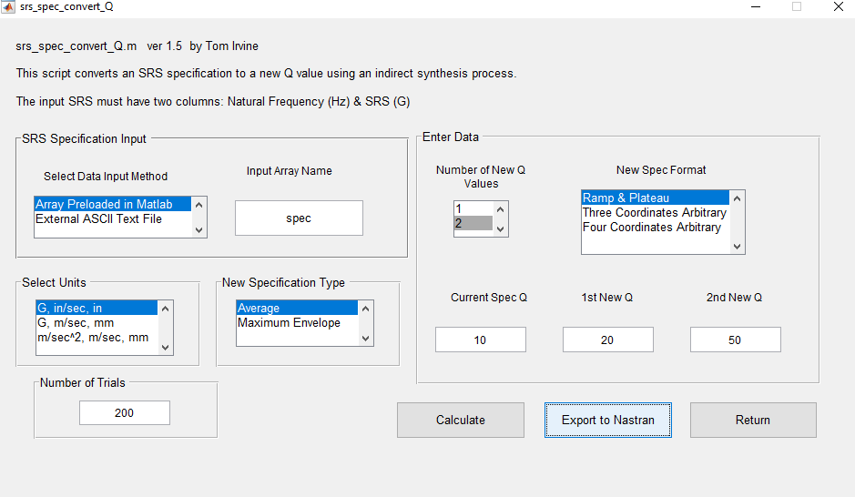
Matlab: Export to Nastran

Slide 13
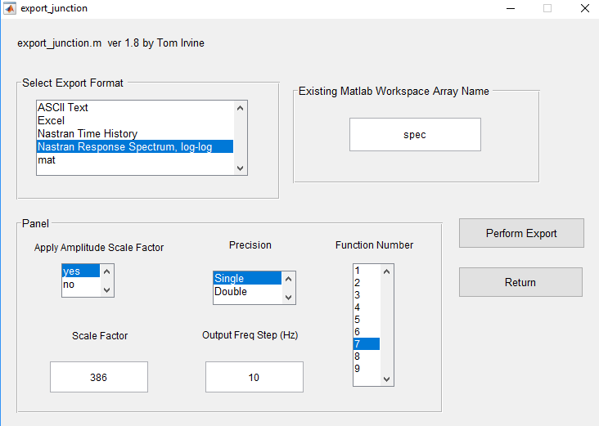
Spec is the SRS with Q=10
Choose Function Number 7
Export as: SRS_Q10.bdf

Slide 14
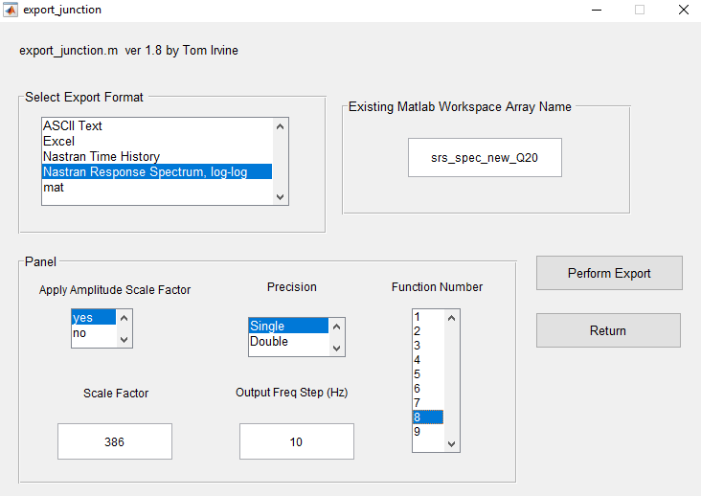
Choose Function Number 8
Export as: SRS_Q20.bdf

Slide 15
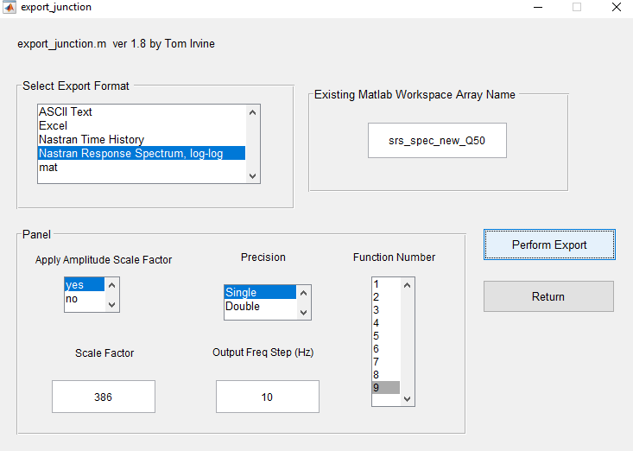
Choose Function Number 9
Export as: SRS_Q50.bdf

Slide 16

Introduction
Shock and vibration analysis can be performed either in the frequency or time domain
Continue with plate from Units 200 & 201
Aluminum, 12 x 12 x 0.25 inch
Translation constrained at corner nodes
Mount plate to heavy seismic mass via rigid links
Use response spectrum analysis
SRS is “shock response spectrum”
Delete all output and all functions if you are reusing Unit 201 model
The following software steps must be followed carefully, otherwise errors will result
Rigid links

Slide 17
Procedure, part I
Femap, NX Nastran and the Vibrationdata Matlab GUI package are all used in this analysis
The GUI package can be downloaded from: https://vibrationdata.wordpress.com/
Recall the plate center node 1201 Parameters for T3
The Participation Factors & Eigenvectors are shown as absolute values
The Eigenvectors are mass-normalized
Modes 1, 6, 12 & 19 account for 98.9% of the total mass
n | fn (Hz) | Modal Mass Fraction | Participation Factor | Eigenvector
1 | 117.6 | 0.933 | 0.0923 | 13.98
6 | 723.6 | 0.036 | 0.0182 | 22.28
12 | 1502 | 0.017 | 0.0123 | 2.499
19 | 2266 | 0.003 | 0.0053 | 32.22

Slide 18
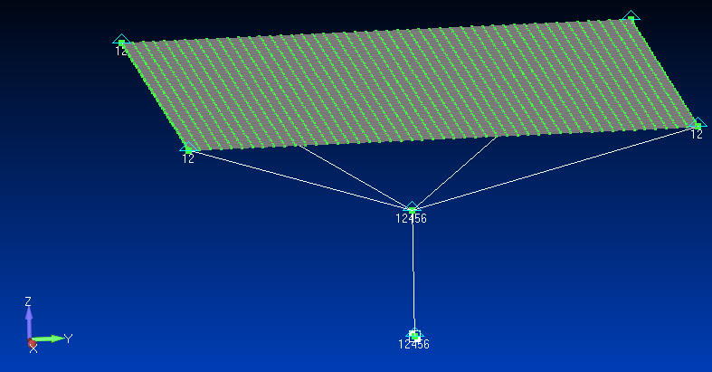
Femap: Seismic Constraints
The four plate corner nodes are constrained in T1 & T2
The lower nodes are constrained in all but T3

Slide 19
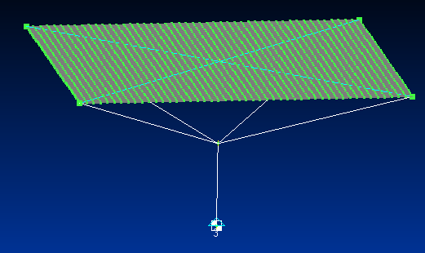

Femap: Kinematic Constraint
Constrain TZ
The seismic mass is constrained in TZ which is the response spectrum base drive axis

Slide 20
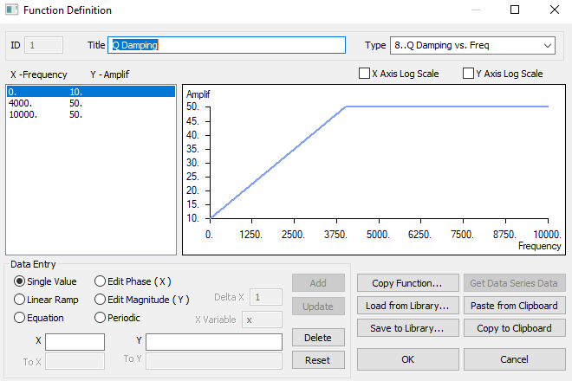
Femap: Define Q Damping Function
Q Damping varies between 0 and 4000 Hz

Slide 21
Femap: Q Values by Mode Number
n | fn (Hz) | Q
1 | 117.6 | 11.2
6 | 723.6 | 17.2
12 | 1502 | 25.0
19 | 2266 | 32.7
Nastran will perform interpolation for each mode using the three SRS curves in the following slides

Slide 22
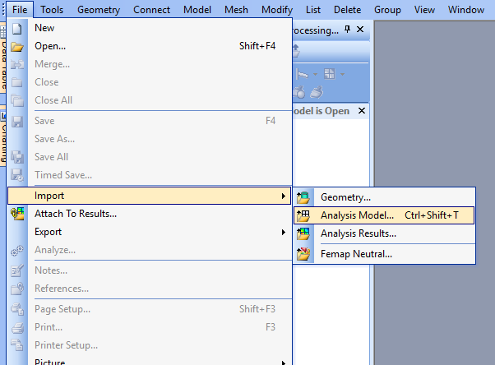
Femap: Import SRS Q=10 Function

Slide 23
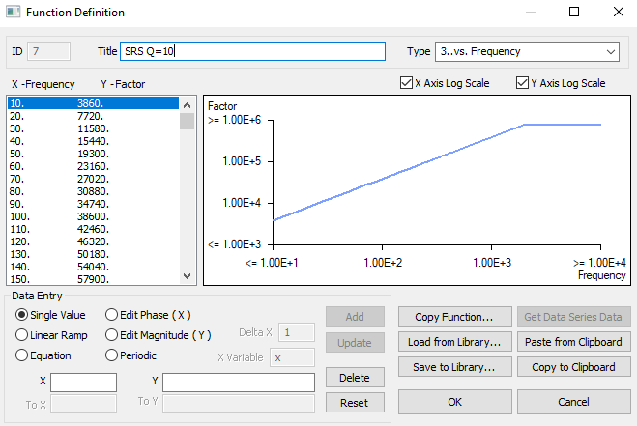
Femap: Import SRS Q=10 Function (cont)
Change title to SRS Q=10

Slide 24
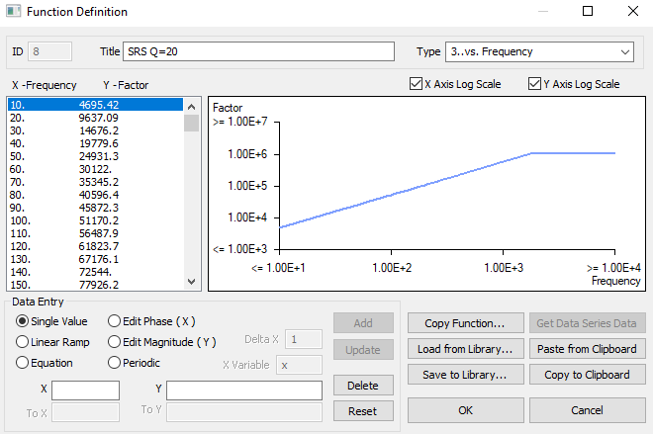
Femap: Import SRS Q=20 Function
Change title to SRS Q=20

Slide 25
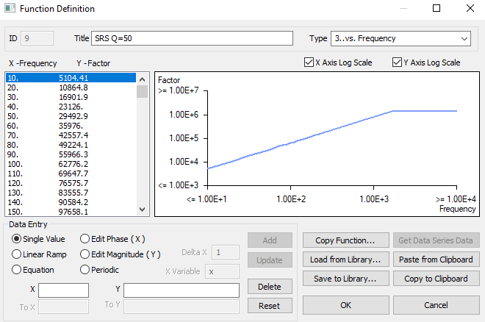
Femap: Import SRS Q=50 Function
Change title to SRS Q=50

Slide 26
Femap: Analysis
Each imported SRS function will add an Analysis function
Delete all of these extra Analysis cases

Slide 27
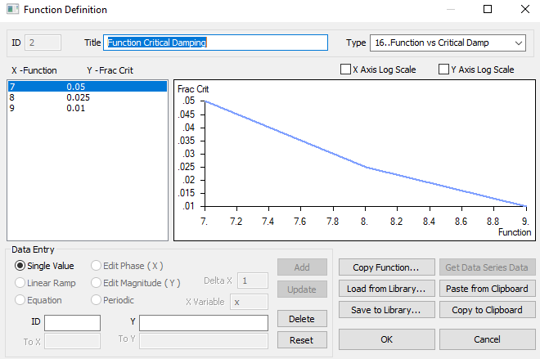
Femap: Define Function vs. Critical Damping for Cross-reference
Function | Q | Damping Ratio
7 | 10 | 0.05
8 | 20 | 0.025
19 | 50 | 0.01
Nastran will perform interpolation for each mode using the three SRS functions

Slide 28
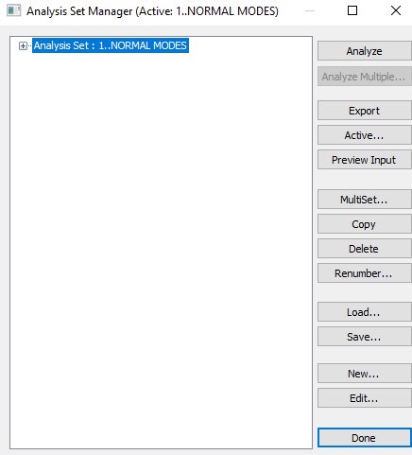
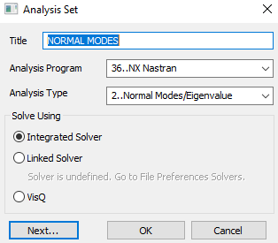
Femap: Define Normal Modes Analysis with Response Spectrum

Slide 29
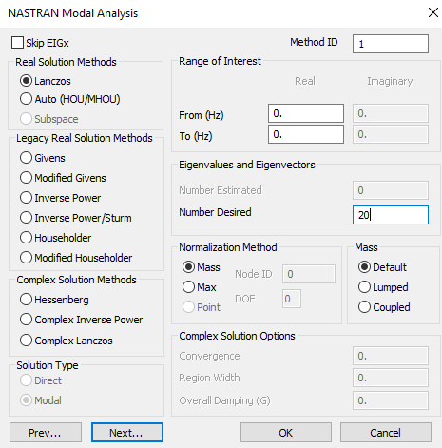
Femap: Define Normal Modes Analysis Parameters
Solve for 20 modes

Slide 30
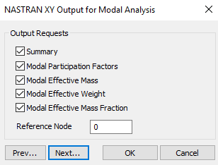
Femap: Define Nastran Output for Modal Analysis

Slide 31
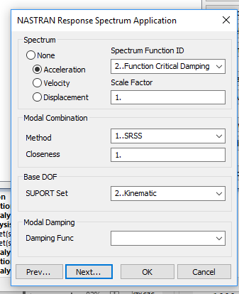
Femap: SRS Cross-Reference Function
This is the function that relates the SRS specifications to their respective damping cases
“Square root of the sum of the squares”
The responses from modes with closely-spaced frequencies will be lumped together

Slide 32
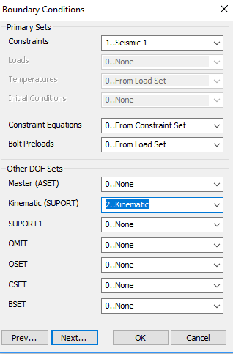
Femap: Define Boundary Conditions
Main Constraint function
Base input constraint, TZ for this example

Slide 33
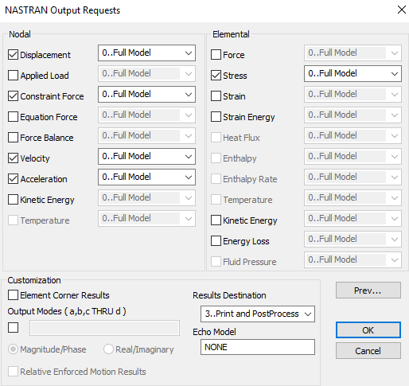
Femap: Define Outputs
Quick and easy to output results at all nodes & elements for response spectrum analysis
Only subset of nodes & elements was output for modal transient analysis due to file size and processing time considerations
Get output f06 file

Slide 34
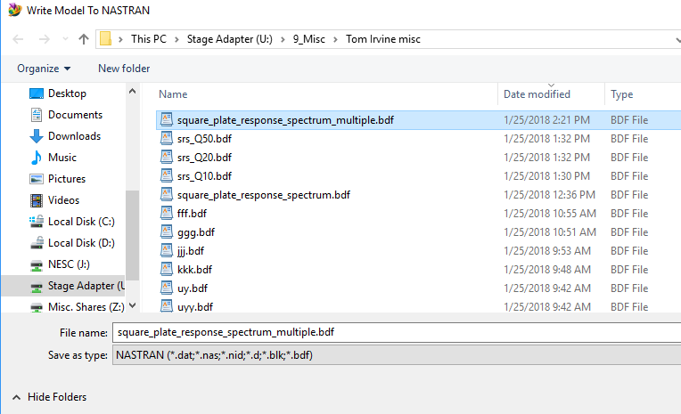
Femap: Export Nastran Analysis File
Export analysis file
Run in Nastran

Slide 35
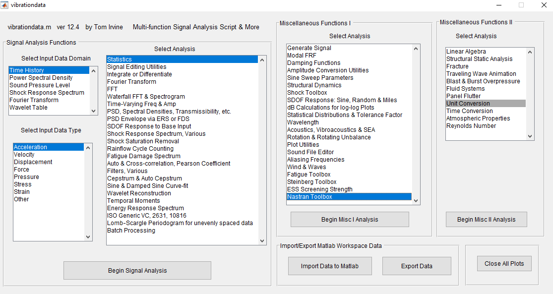
Matlab: Vibrationdata GUI

Slide 36
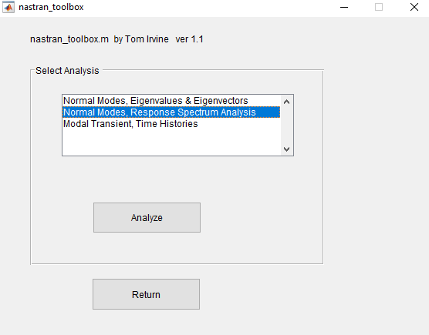
Matlab: Nastran Toolbox

Slide 37
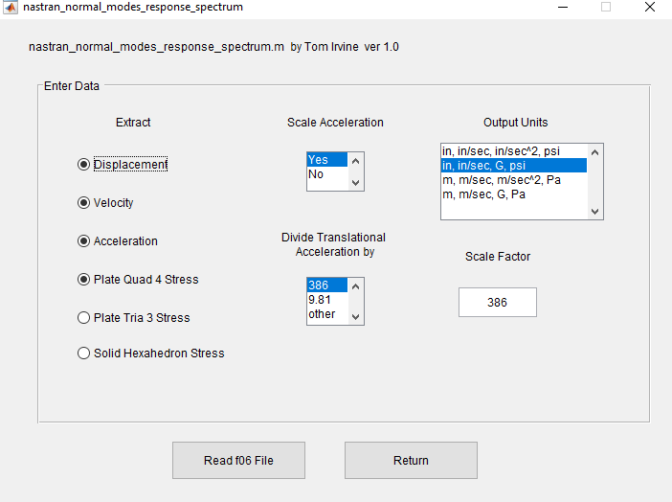
Matlab: Response Spectrum Results from f06 File

Slide 38
Matlab: Response Spectrum Results
Maximum Displacements:
node value
T1: 2376 0.00000 in
T2: 931 0.00000 in
T3: 1201 0.17744 in
R1: 1 0.03397 rad/sec
R2: 1 0.03397 rad/sec
R3: 1 0.00000 rad/sec
Maximum accelerations:
node value
T1: 2376 0.000 G
T2: 931 0.000 G
T3: 49 1237.766 G
R1: 1 236412.400 rad/sec^2
R2: 1 236412.400 rad/sec^2
R3: 1 0.000 rad/sec^2
Maximum velocities:
node value
T1: 2376 0.000 in/sec
T2: 931 0.000 in/sec
T3: 1201 140.588 in/sec
R1: 2354 36.947 rad/sec
R2: 1 36.947 rad/sec
R3: 1 0.000 rad/sec
Maximum Quad4 Stress:
element value
NORMAL-X : 1105 10082.950 psi
NORMAL-Y : 24 10082.950 psi
SHEAR-XY : 50 8072.997 psi
MAJOR PRNCPL: 50 10172.070 psi
MINOR PRNCPL: 1128 8426.593 psi
VON MISES : 50 14139.520 psi

Slide 39
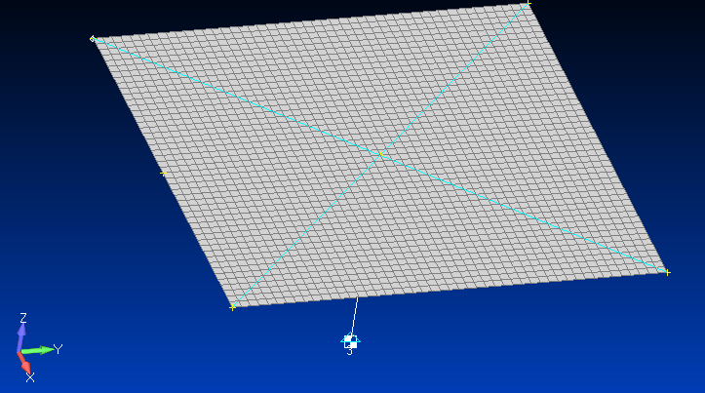
Matlab: Response Spectrum Acceleration Results (cont)
Node 49
Node 1201
Center node 1201 had T3 peak acceleration = 874.9 G
Edge node 49 had highest T3 peak acceleration = 1238 G
By symmetry, three other edge nodes should have this same acceleration
But node 1201 had highest displacement and velocity responses

Slide 40
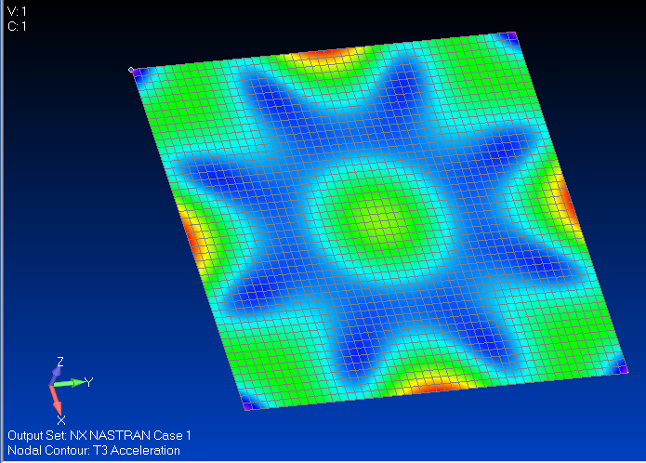
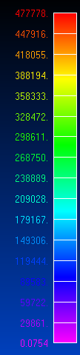
Femap: T3 Acceleration Contour Plot, unit = in/sec^2
Import the f06 file into Femap and then View > Select

Slide 41
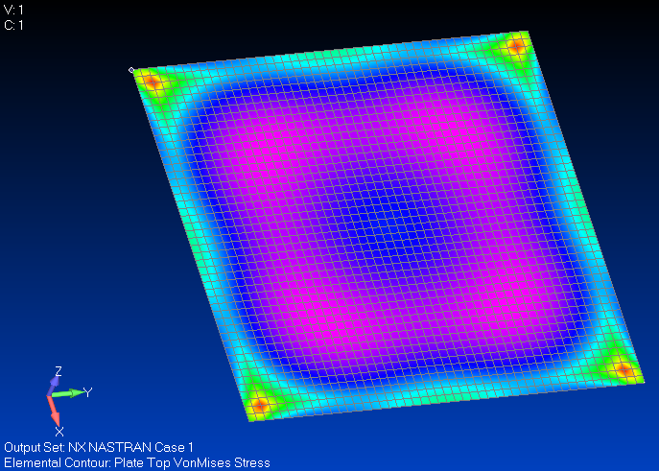
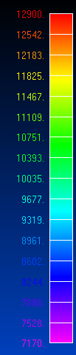
Femap: Von Mises Stress Contour Plot

Slide 42
Procedure, part II
Response spectrum analysis is actually an extension of normal modes analysis
ABSSUM – absolute sum method
SRSS – square-root-of-the-sum-of-the-squares
NRL – Naval Research Laboratory method
The SRSS method is probably the best choice for response spectrum analysis because the modal oscillators tend to reach their respective peaks at different times according to frequency
The lower natural frequency oscillators take longer to peak

Slide 43
ABSSUM Method
Conservative assumption that all modal peaks occur simultaneously
Pick D values directly off of Relative Displacement SRS curve
where is the mass-normalized eigenvector coefficient for coordinate i and mode j
These equations are valid for both relative displacement and absolute acceleration.

Slide 44
SRSS Method
Pick D values directly off of Relative Displacement SRS curve
These equations are valid for both relative displacement and absolute acceleration.

Slide 45
SRS Curve Interpolation
n | fn (Hz) | Q | Q=10 SRS (G) | Q=20 SRS (G) | Q=50 SRS (G) | Interpolated SRS (G)
1 | 117.6 | 11.2 | 117.6 | 157.1 | 196.2 | 122.3
6 | 723.6 | 17.2 | 723.6 | 1033 | 1411 | 946.4
12 | 1502 | 25.0 | 1502 | 2203 | 3118 | 2356
19 | 2266 | 32.7 | 2000 | 2633 | 3587 | 3037
The last column is the interpolated SRS for the given fn and Q values.

Slide 46
Acceleration Response Check for Node 1201 T3
n | fn (Hz) | PF | Eigen vector | Q | Interpolated SRS (G) | | PF x Eig x Spec | (G) | | PF x Eig x Spec |² (G²)
1 | 117.6 | 0.0923 | 13.98 | 11.2 | 122.3 | 157.8 | 24904
6 | 723.6 | 0.0182 | -22.28 | 17.2 | 946.4 | 383.8 | 147273
12 | 1502 | 0.0123 | 2.499 | 25.0 | 2356 | 72.4 | 5244
19 | 2266 | 0.0053 | 32.22 | 32.7 | 3037 | 518.6 | 268963
 |  |  |  |  |  | sum = 1133 G | sum = 446,384 G²
 |  |  |  |  |  |  | sqrt of sum = 668 G
The table is taken from the plate model modal analysis results prior to the addition of the seismic mass, with three added columns
The set composed of modes 1, 6, 12 & 19 accounts for almost 99% of the total mass
The seventh column is the participation factor times the eigenvector times the SRS specification
The sum of the absolute responses is 1133 G, which conservatively assumes that each mode reaches its peak at the same time as the others
The “square root of the sum of the squares” is 668 G
The FEA modal peak response was 874.9 G which passes the “sanity check”

Slide 47
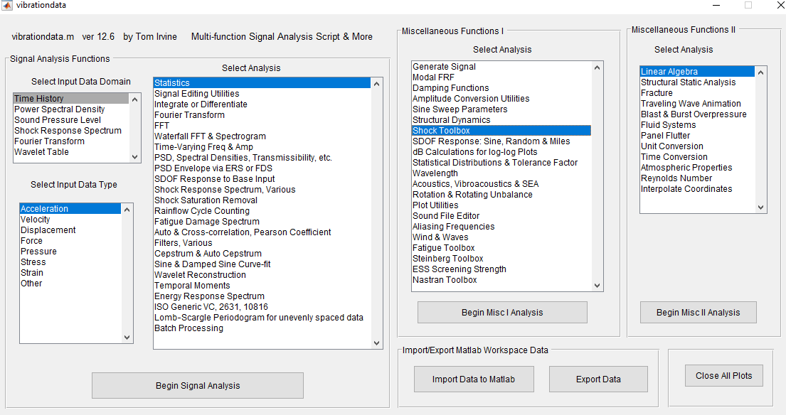
Vibrationdata GUI

Slide 48
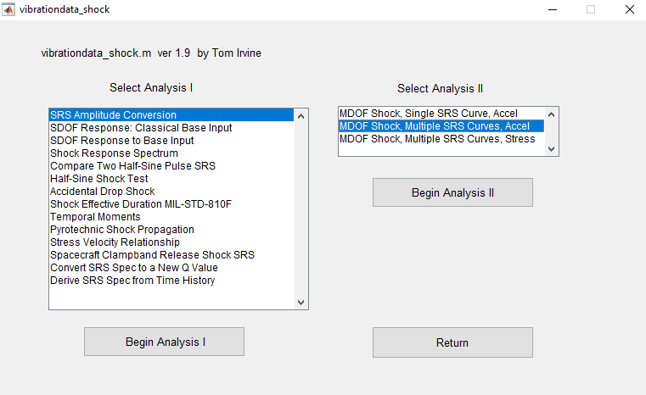
Vibrationdata Shock Toolbox

Slide 49
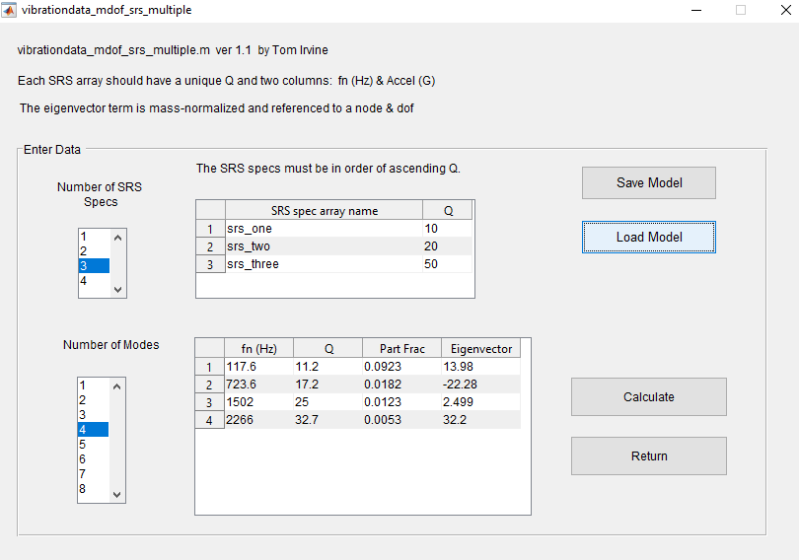
Vibrationdata MDOF SRS with Variable Q

Slide 50
Vibrationdata MDOF SRS with Variable Q Results
fn Q=10 Q=20 Q=50
(Hz) SRS(G) SRS(G) SRS(G)
117.6 117.6 157.1 196.3
723.6 723.6 1033 1411
1502 1502 2203 3118
2266 2000 2633 3587
fn Part Eigen SRS Modal Response
(Hz) Factor vector Accel(G) Accel(G)
117.6 0.0923 13.98 122.3 157.9
723.6 0.0182 -22.28 946.5 383.8
1502 0.0123 2.499 2355 72.4
2266 0.0053 32.2 3037 518.3
ABSSUM= 1132 G SRSS= 667.9 G
Again, The FEA modal peak response was 874.9 G which passes the “sanity check”

Slide 51
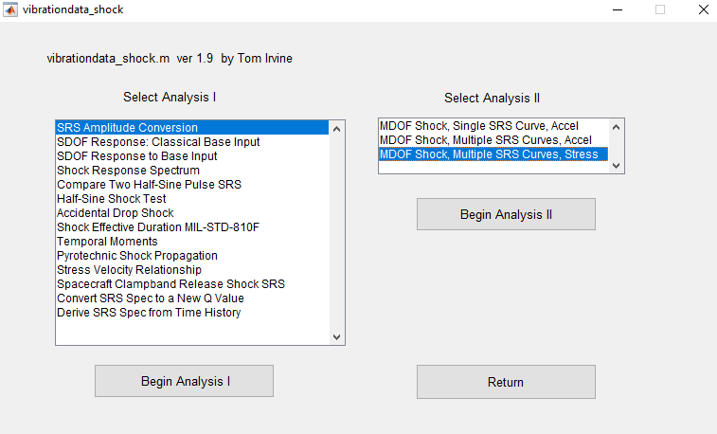
Vibrationdata Shock Toolbox

Slide 52
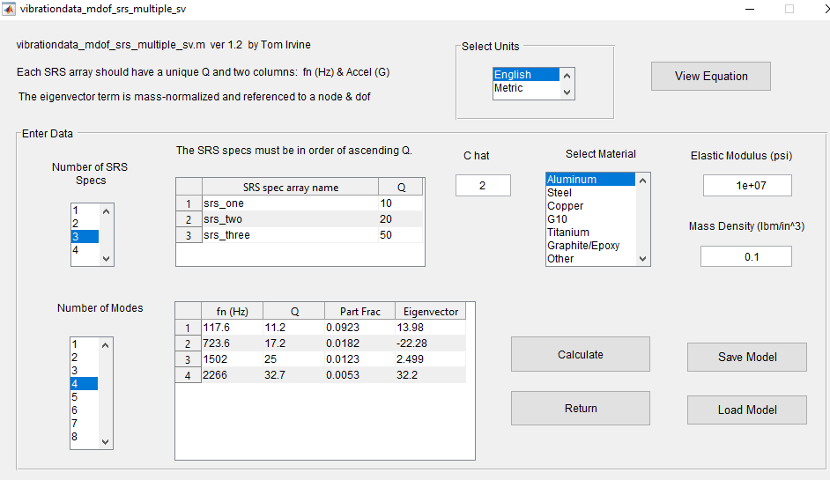
Vibrationdata Shock Toolbox Ĉ = 2

Slide 53
Matlab: Peak MDOF SRS Stress from Node 1201 Velocity, Ĉ = 2
fn Q=10 Q=20 Q=50
(Hz) SRS(G) SRS(G) SRS(G)
117.6 117.6 157.1 196.3
723.6 723.6 1033 1411
1502 1502 2203 3118
2266 2000 2633 3587
fn Q Part Eigen Accel PV SRS Modal Response
(Hz) Factor vector SRS(G) (in/sec) stress(psi)
117.6 11.2 0.0923 13.98 122.3 63.91 8395
723.6 17.2 0.0182 -22.28 946.5 80.36 3317
1502 25 0.0123 2.499 2355 96.34 301.4
2266 32.7 0.0053 32.2 3037 82.33 1430
ABSSUM= 13443 psi SRSS= 9143.7 psi
The peak FEA response spectrum stress for the whole plate was 14140 psi
FEA stress passes sanity check, but a higher Ĉ value may be justified so that the SRSS agrees more closely with the FEA results
Ĉ = 3 brings the SRSS to 13716 psi

