Slide 1
Unit 203
Nastran FEA Frequency Response Function for Base Input Revision B
Students should already have some familiarity with Femap & Nastran
NX Nastran is used as the solver, but the methods should work with other versions

Slide 2

Acceleration Excitation Method
The object is to apply a unit acceleration load in the frequency domain at the base input
Transmissibility functions are then derived to give the plate responses relative to the base input
Responses include displacement, velocity, acceleration and stress
The transmissibility function can then be used for a variety of sine and PSD base inputs
F
Rigid links
Assume a rectangular plate mounted via posts at each corner
Mount plate to heavy seismic mass via rigid links
Apply force to yield desired acceleration at plate corners

Slide 3
Procedure, part I
Femap, NX Nastran and the Vibrationdata Matlab GUI package are all used in this analysis
The GUI package can be downloaded from: https://vibrationdata.wordpress.com/
Use the previous finite element model from Unit 200

Slide 4
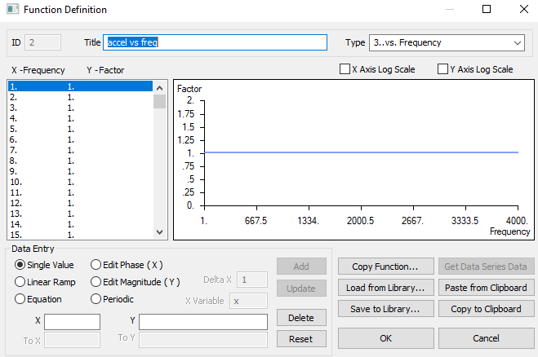
FEMAP: Function Definition, Acceleration
The amplitude is 1 from 1 to 4000 Hz in 1 Hz steps

Slide 5
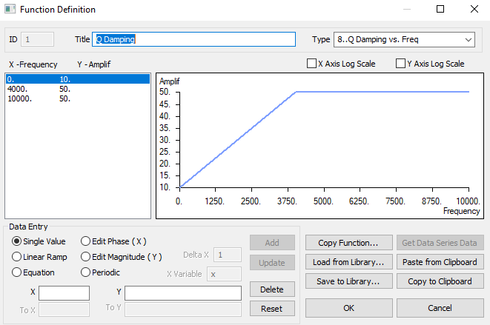
FEMAP: Function Definition, Damping

Slide 6
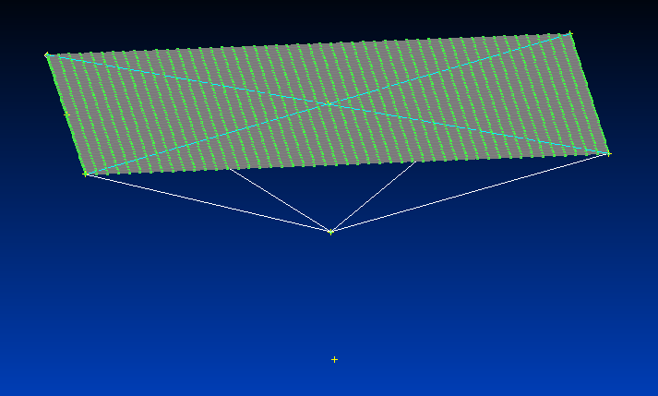
FEMAP: Reuse the Model from Unit 200
Delete the base mass, its rigid connecting link, its constraint & node

Slide 7
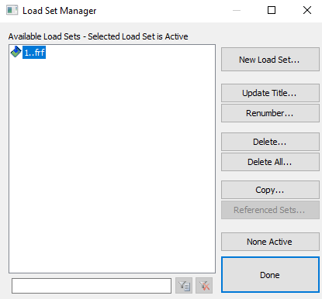
FEMAP: Create a New Load Set

Slide 8
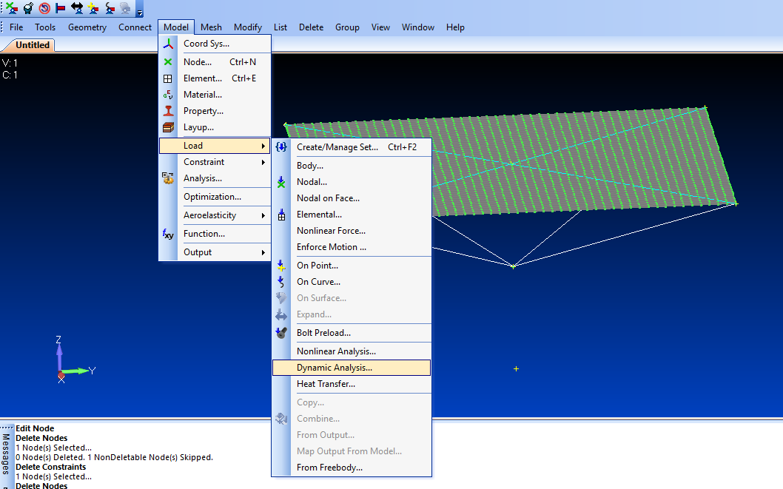
FEMAP: Dynamic Analysis

Slide 9
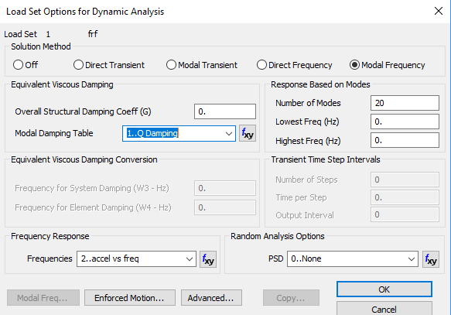
FEMAP: Load Set Parameters

Slide 10
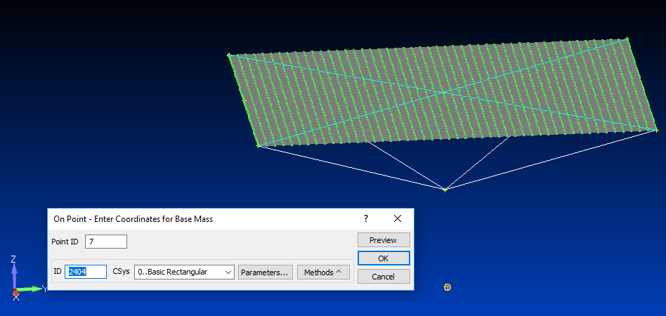
FEMAP: Base Mass Point

Slide 11
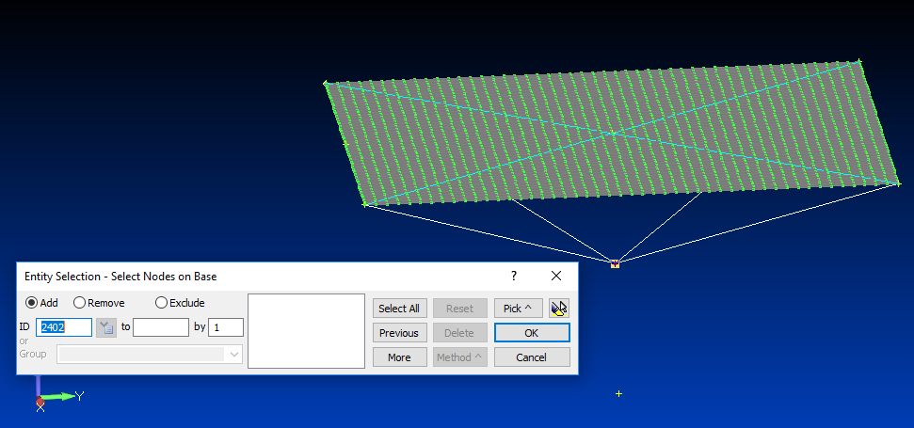
FEMAP: Base Mass Node

Slide 12
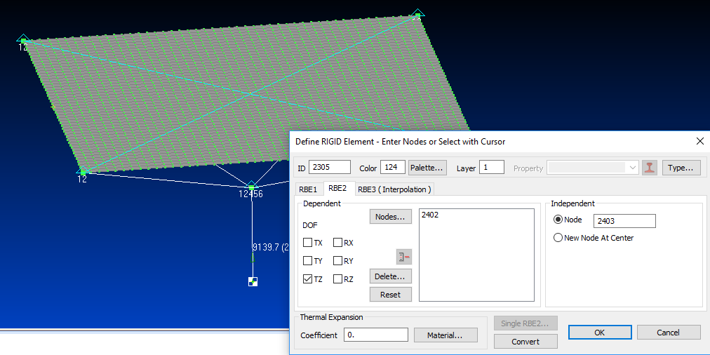
FEMAP: Rigid Connecting Link

Slide 13
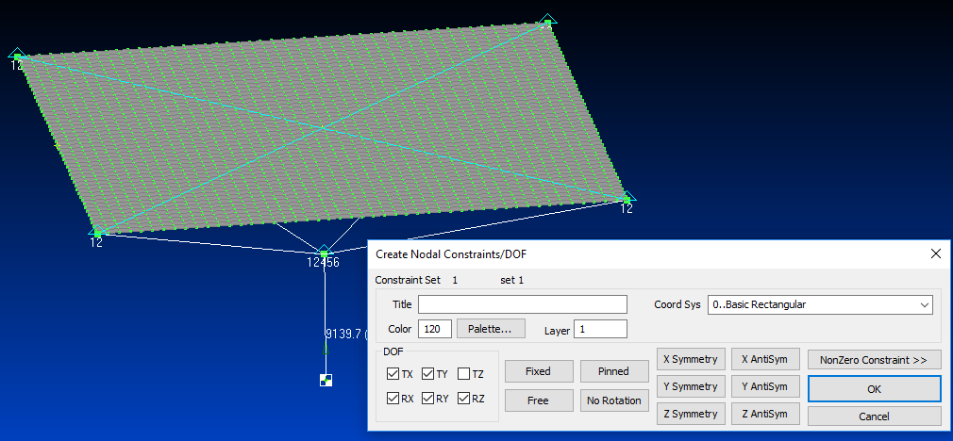
FEMAP: Constrain Base Mass Node
Note that the Z-axis is perpendicular to the plate

Slide 14
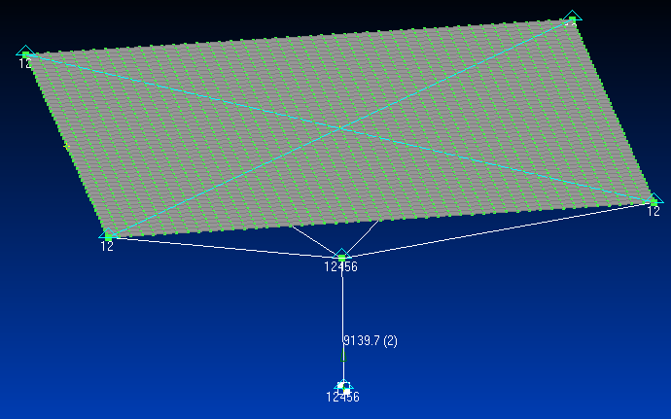
FEMAP: Model with Constraints

Slide 15
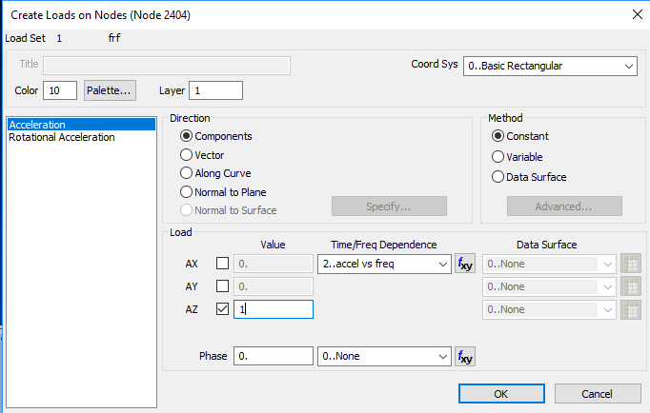
FEMAP: Create Acceleration Load on Base Mass

Slide 16
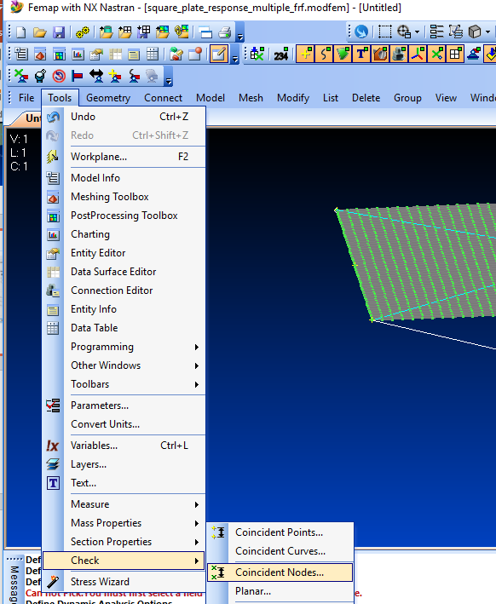
Femap: Node Check
This step may be unnecessary but it is a “good engineering” practice

Slide 17
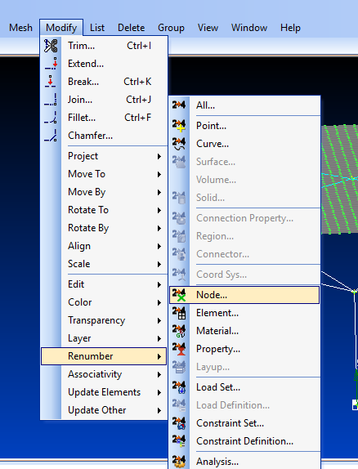
Femap: Renumber Nodes

Slide 18
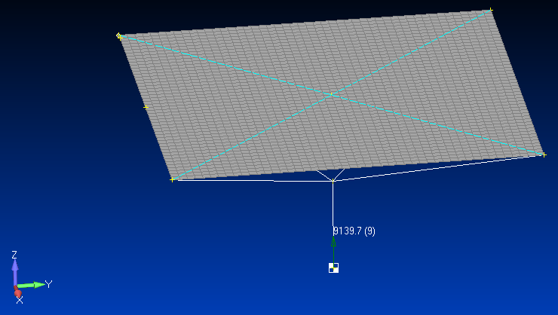
Femap: Node Group
Node 1
Node 49
Node 1201
Node 2402
Node 2403

Slide 19
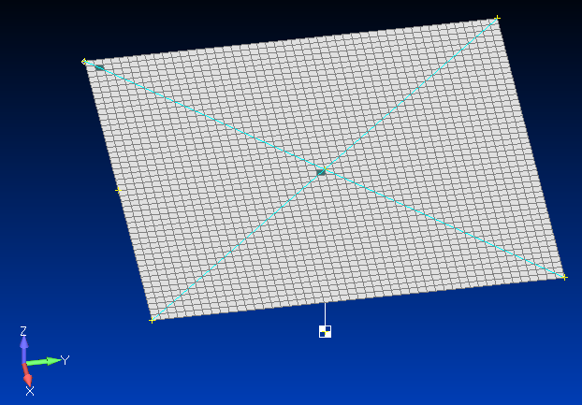
Femap: Element Group
Element 50
Node 1201
Element 1129

Slide 20
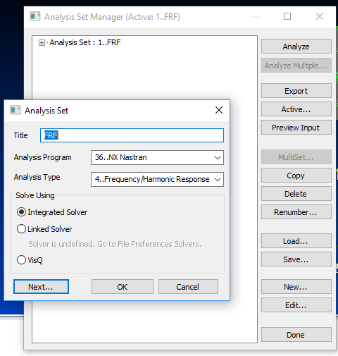
Femap: Analysis Set

Slide 21
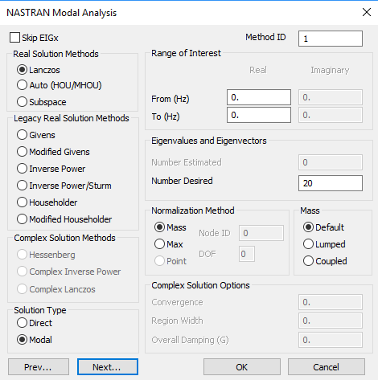
Femap: Modal Analysis

Slide 22
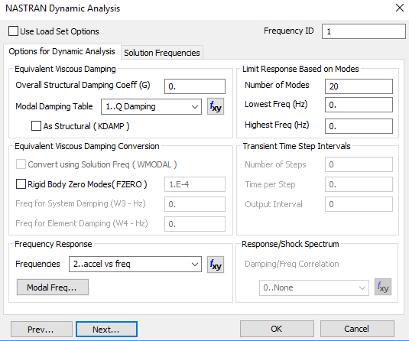
Femap: Dynamics Analysis

Slide 23
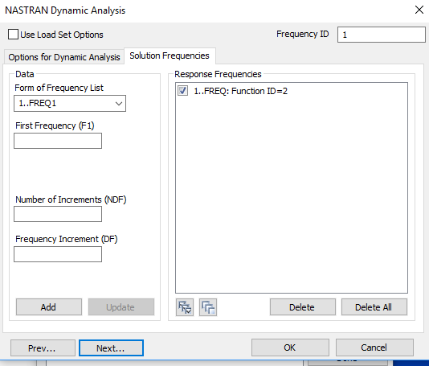
Femap: Dynamics Analysis, solution Frequencies

Slide 24
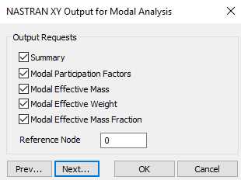
Femap: Modal Output

Slide 25
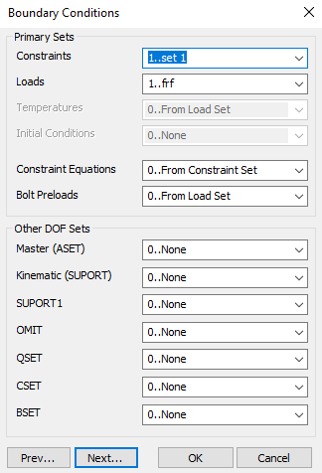
Femap: Boundary Conditions

Slide 26
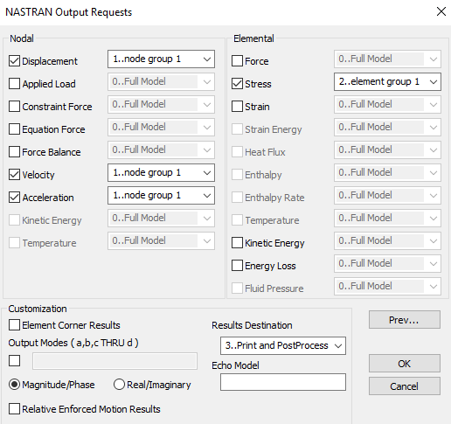
Femap: Output Request

Slide 27
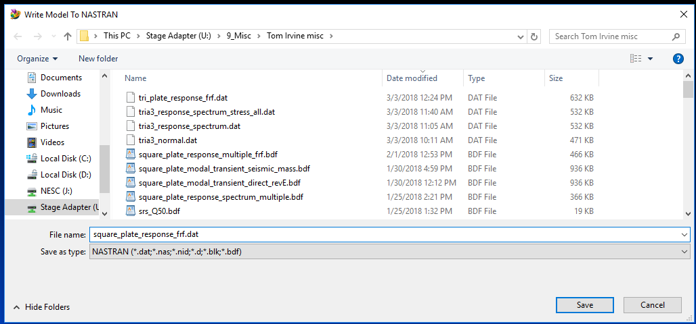
Femap: Export Analysis
Then run model in Nastran

Slide 28
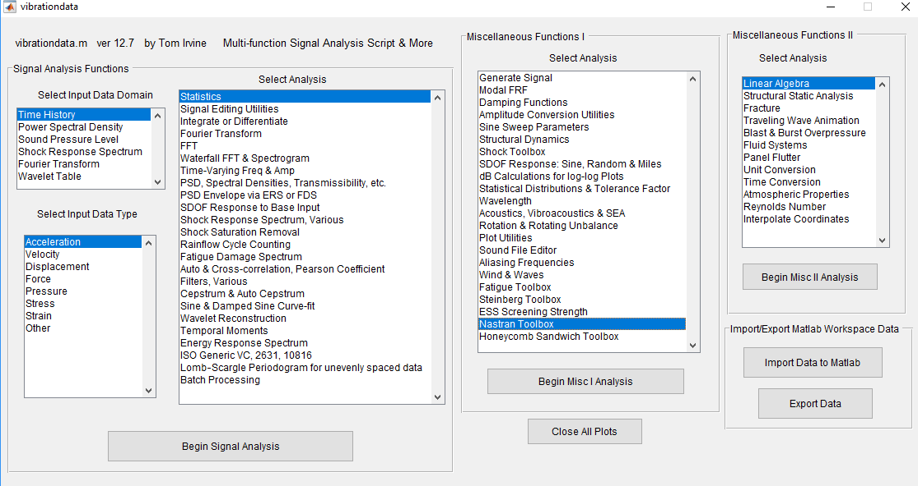
Vibrationdata Matlab GUI

Slide 29
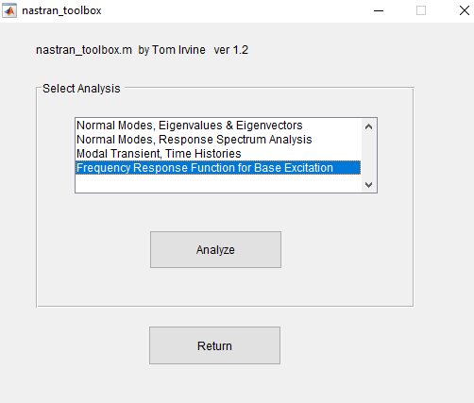
Vibrationdata: Nastran Toolbox

Slide 30
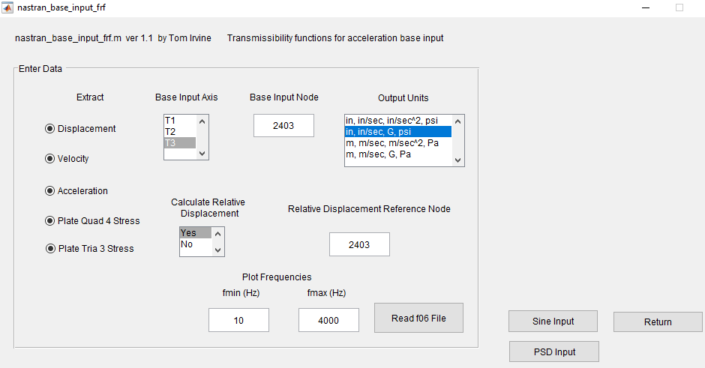
Vibrationdata: Base Input FRF

Slide 31
Edge Node Acceleration Response

Slide 32
Middle Node Acceleration Response

Slide 33
Element Near Corner

Slide 34
Element Near Center

Slide 35
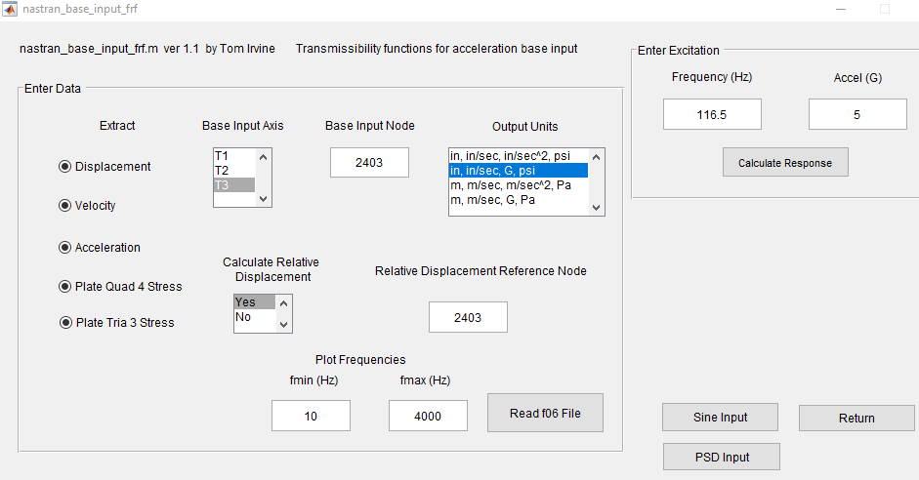
Response to Sinusoidal Base Acceleration

Slide 36
Response to Sinusoidal Base Acceleration, Results
Acceleration (G)
Node T1 T2 T3
1 0 0 5
49 0 0 46.16
1201 0 0 65.17
2403 0 0 5
Velocity (in/sec)
Node T1 T2 T3
1 0 0 2.637
49 0 0 24.34
1201 0 0 34.36
2403 0 0 2.637
Relative Velocity (in/sec)
Node T1 T2 T3
1 0 0 0
49 0 0 23.7
1201 0 0 33.76
Displacement (in)
Node T1 T2 T3
1 0 0 0.003602
49 0 0 0.03325
1201 0 0 0.04694
2403 0 0 0.003602
Relative Displacement (in)
Node T1 T2 T3
1 0 0 0
49 0 0 0.03237
1201 0 0 0.04612
Quad4 Von Mises
Element Stress (psi)
50 3449
1129 2015

Slide 37
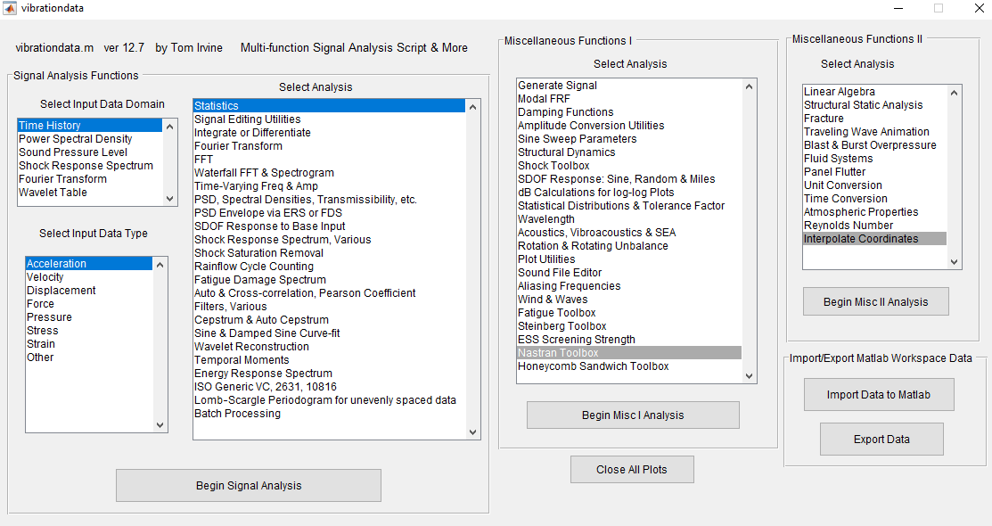
Import Library PSD to Matlab

Slide 38
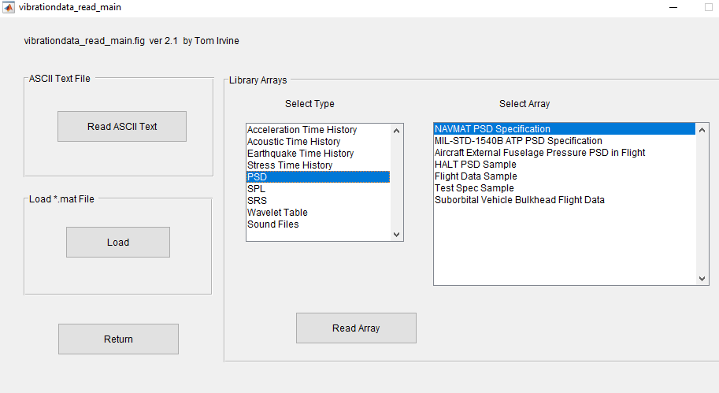
Import NAVMAT PSD Specification

Slide 39
NAVMAT PSD Base Input

Slide 40
Response to PSD Base Acceleration, Results
Overall Acceleration (GRMS)
Node T1 T2 T3
1 0 0 6.06
49 0 0 11.2
1201 0 0 13
2403 0 0 6.06
Overall Velocity (in/sec RMS)
Node T1 T2 T3
1 0 0 2.07
49 0 0 4.56
1201 0 0 6.15
2403 0 0 2.07
Overall Relative Velocity (in/sec RMS)
Node T1 T2 T3
1 0 0 2.07
49 0 0 2.07
1201 0 0 2.07
Overall Displacement (in RMS)
Node T1 T2 T3
1 0 0 0.00775
49 0 0 0.0101
1201 0 0 0.0118
2403 0 0 0.00775
Overall Relative Displacement (in RMS)
Node T1 T2 T3
1 0 0 0.00775
49 0 0 0.00775
1201 0 0 0.00775
Overall Von Mises
Elem Stress (psi RMS)
50 586
1129 344

Slide 41
Edge Node Acceleration PSD Response

Slide 42
Center Node Acceleration PSD Response

Slide 43
Stress in Element near Corner

Slide 44
Stress in Element near Center

Slide 45
Future Work
Expand Nastran stress post-processing options in Vibrationdata GUI
Include strain
Please contact Tom Irvine Email: tom@irvinemail.org if you have suggestions or find bugs in the Vibrationdata GUI

