Slide 1
Unit 204
FEA PSD Response for Base Excitation
using Femap, Nastran & Matlab
Students should already have some familiarity with Femap & Nastran
NX Nastran is used as the solver, but the methods should work with other versions

Slide 2

Introduction
Shock and vibration analysis can be performed either in the frequency or time domain
Continue with plate from Unit 200
Aluminum, 12 x 12 x 0.25 inch
Translation constrained at corner nodes
Mount plate to heavy seismic mass via rigid links
Use “Random Response” analysis
PSD is “power spectral density”
Compare results with modal transient analysis from Unit 203
The following software steps must be followed carefully, otherwise errors will result
Rigid links

Slide 3
Procedure, part I
Femap, NX Nastran and the Vibrationdata Matlab GUI package are all used in this analysis
The GUI package can be downloaded from: https://vibrationdata.wordpress.com/
The mode shapes are shown on the next several slides for review

Slide 4
NAVMAT PSD Base Input

Slide 5
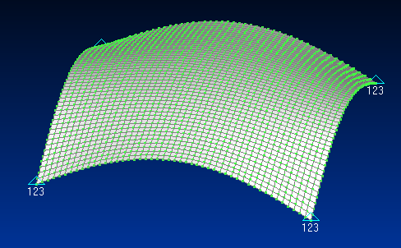
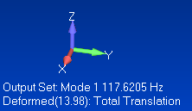
Femap: Mode Shape 1
The fundamental mode at 117.6 Hz has 93.3% of the total modal mass in the T3 axis
The acceleration response also depends on higher modes

Slide 6
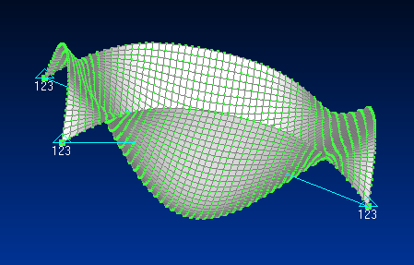
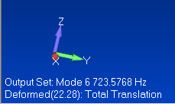
Femap: Mode Shape 6
The sixth mode at 723 Hz has 3.6% of the total modal mass in the T3 axis

Slide 7
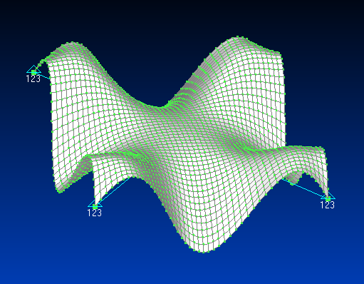
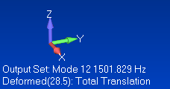
Femap: Mode Shape 12
The twelfth mode at 1502 Hz has 1.6% of the total modal mass in the T3 axis

Slide 8
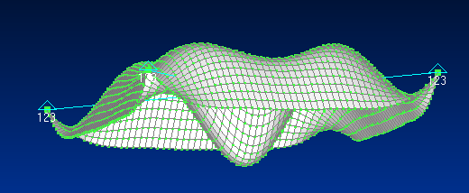
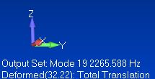
Femap: Mode Shape 19
The 19th mode at 2266 Hz has only 0.3% of the total modal mass in the T3 axis
But it still makes a significant contribution to the acceleration response

Slide 9
Matlab: Node 1201 Parameters for T3
n | fn (Hz) | Modal Mass Fraction | Participation Factor | Eigenvector
1 | 117.6 | 0.933 | 0.0923 | 13.98
6 | 723.6 | 0.036 | 0.0182 | 22.28
12 | 1502 | 0.017 | 0.0123 | 2.499
19 | 2266 | 0.003 | 0.0053 | 32.22
The Participation Factors & Eigenvectors are shown as absolute values
The Eigenvectors are mass-normalized
Modes 1, 6, 12 & 19 account for 98.9% of the total mass

Slide 10
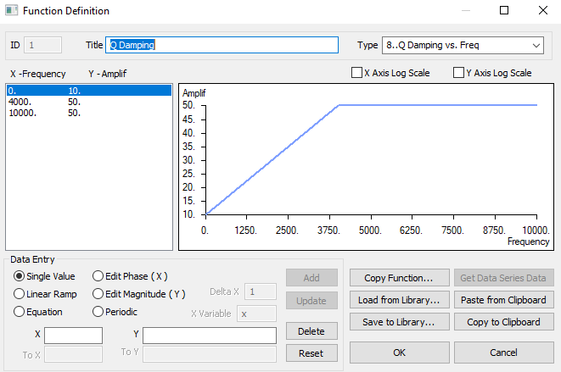
Femap: Define Damping Function

Slide 11
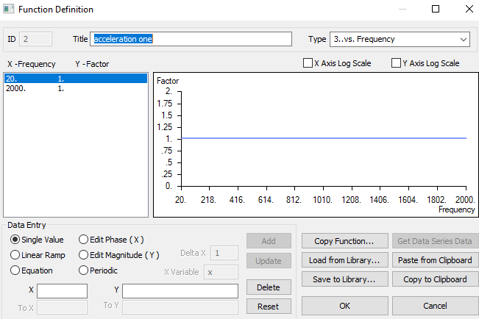
FEMAP: Function Definition

Slide 12
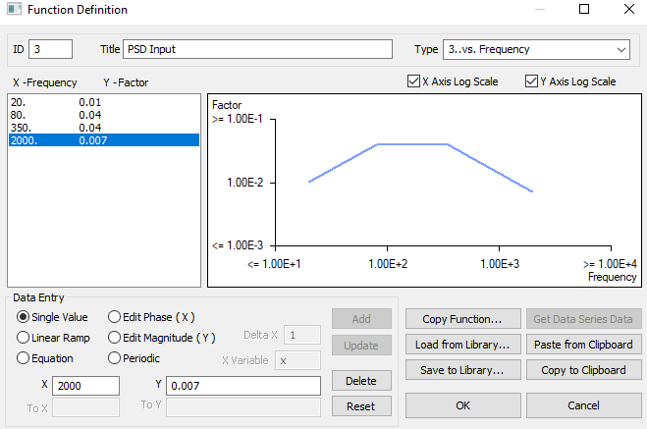
Femap: Define Accel PSD Function
The X-axis unit is Frequency (Hz)
The Y-axis unit is Accel (G^2/Hz)

Slide 13
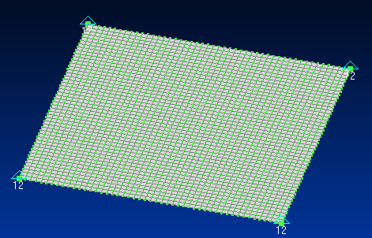
Femap: Constraints
Edit corner node constraints so that only TX & TY are fixed

Slide 14
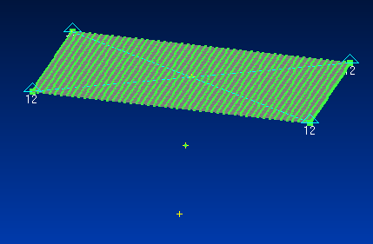
Femap: Added Points and Node
Node 2402
Copy center point twice at -3 inch increments in the Z-axis
Place node on point at middle point

Slide 15
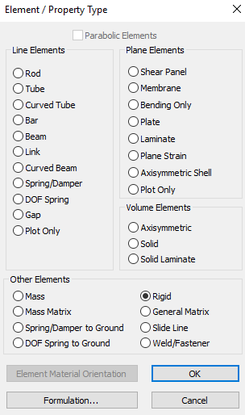
Femap: Select Rigid Element

Slide 16
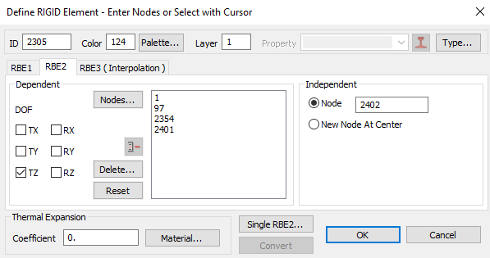
Femap: Configure Rigid Element, RBE2
Dependent DOF is TZ
Dependent Nodes are the corner nodes
Node 2402 is the independent Node, -3 inch from plate’s center node in Z-axis

Slide 17
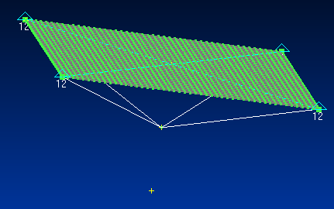
Femap: Plate with Rigid Element
Rigid Link
Node 2402

Slide 18
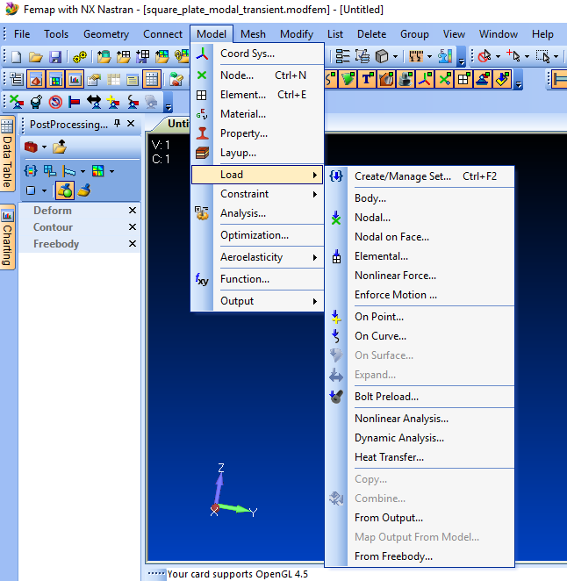
Femap: Load Set
Step 1:
Create Load Set
Step 2:
Dynamic Analysis

Slide 19
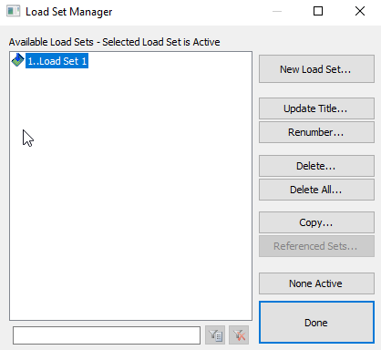
Femap: Load Set

Slide 20
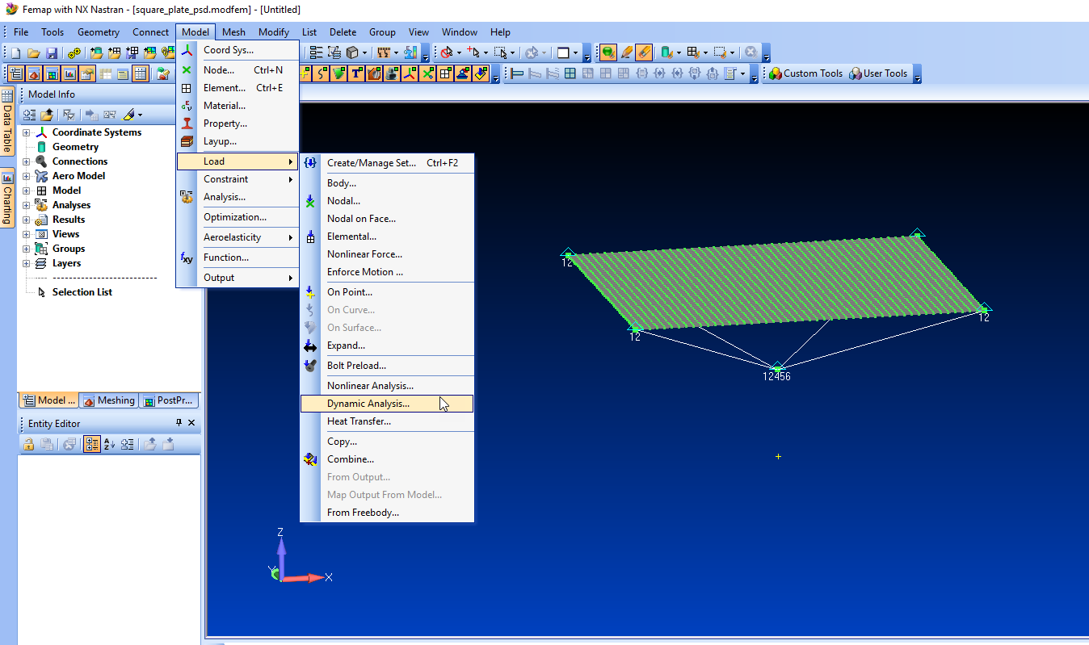

Slide 21
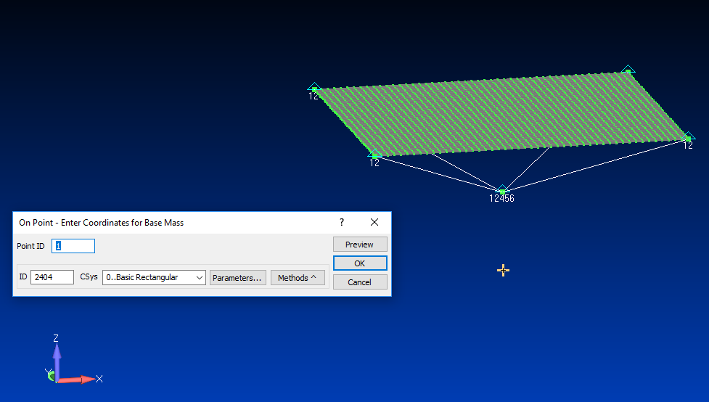

Slide 22
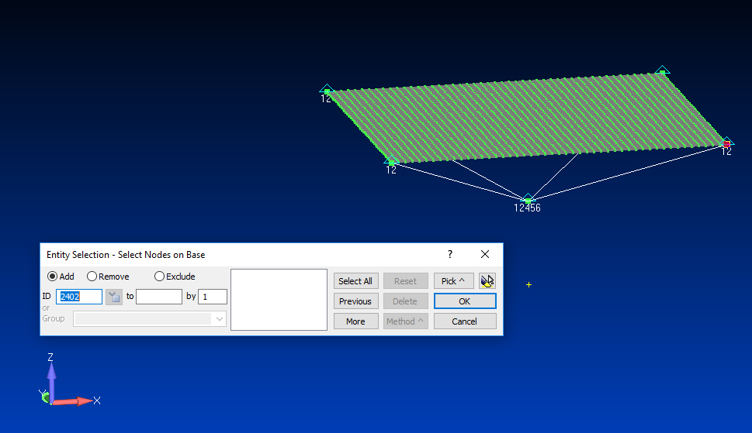

Slide 23
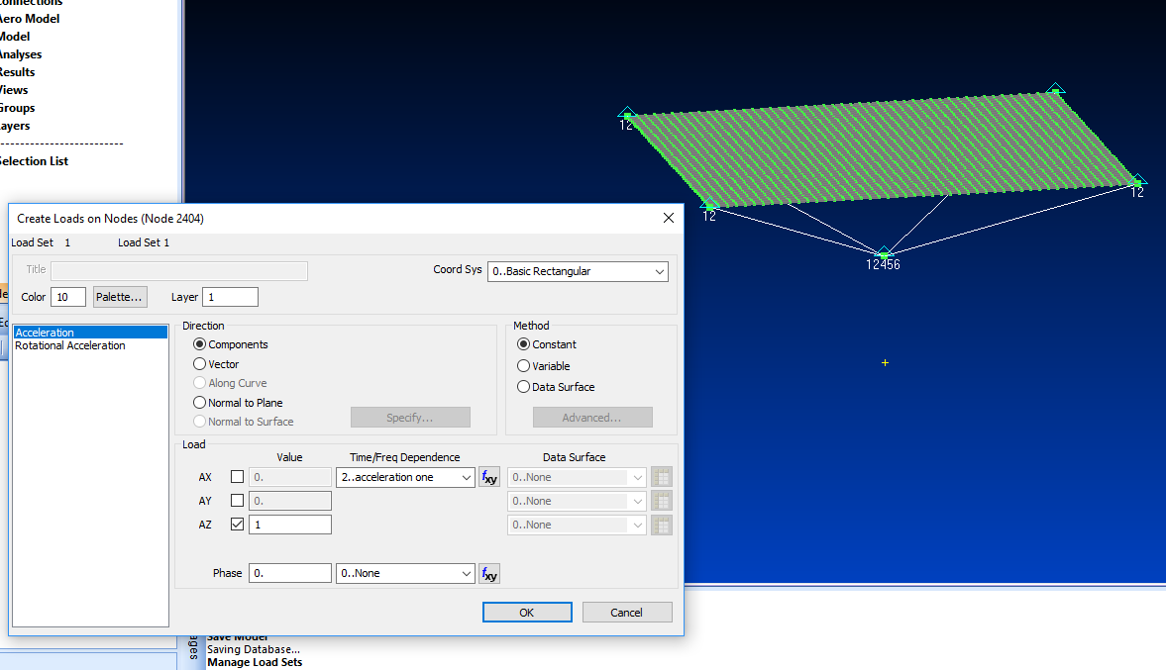

Slide 24
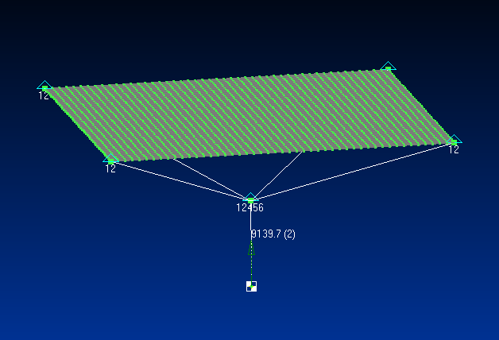

Slide 25
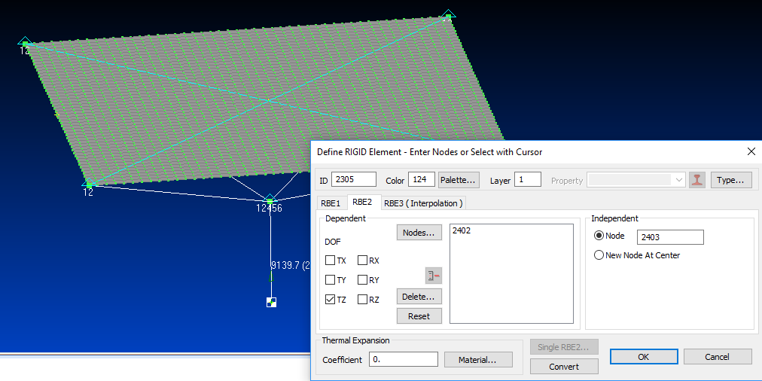
FEMAP: Rigid Connecting Link

Slide 26
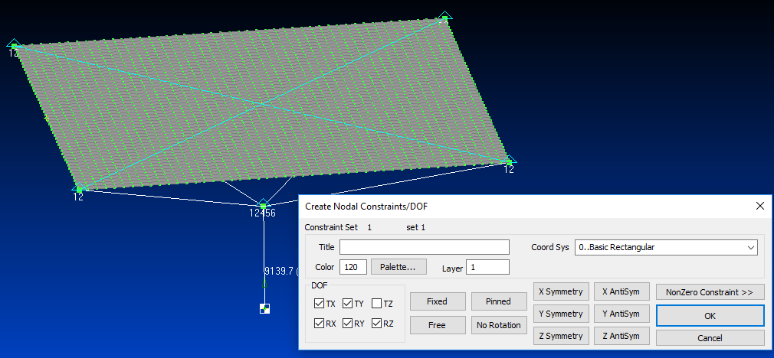
FEMAP: Constrain Base Mass Node
Note that the Z-axis is perpendicular to the plate

Slide 27
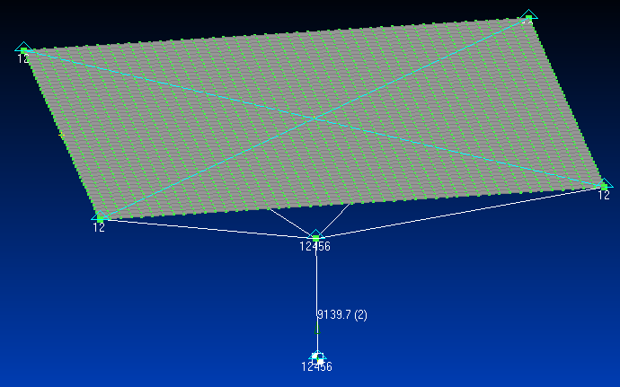
FEMAP: Model with Constraints

Slide 28
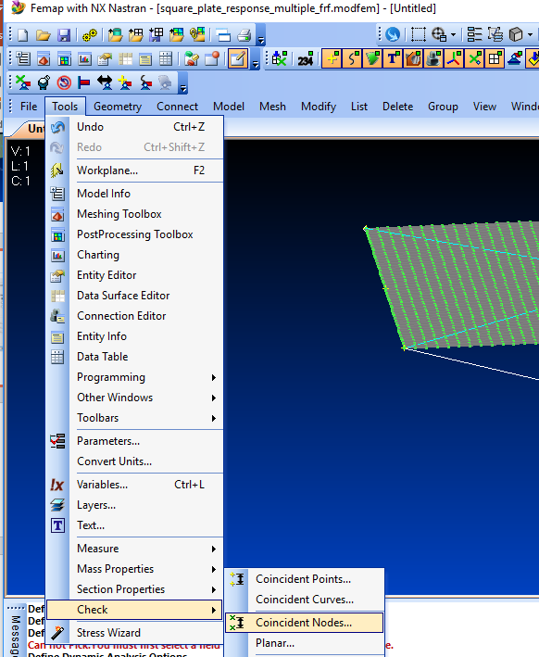
Femap: Node Check
This step may be unnecessary but it is a “good engineering” practice

Slide 29
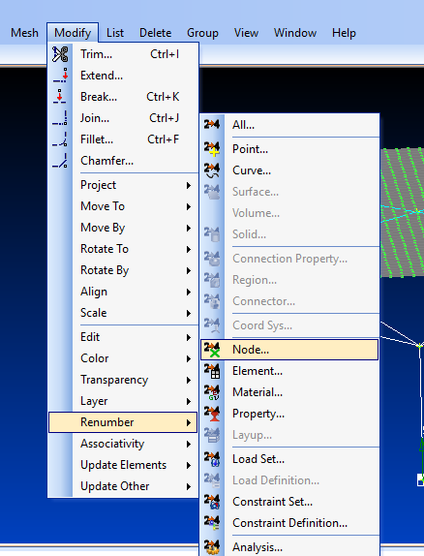
Femap: Renumber Nodes

Slide 30
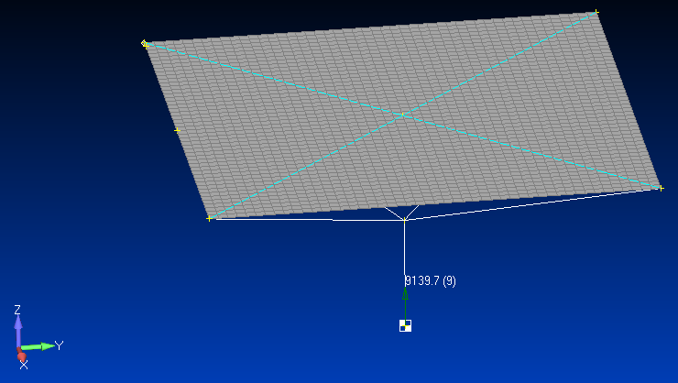
Femap: Node Group
Node 1
Node 49
Node 1201
Node 2402
Node 2403

Slide 31
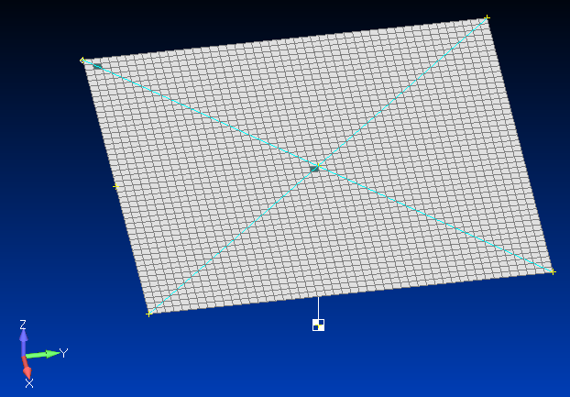
Femap: Element Group
Element 50
Node 1201
Element 1129

Slide 32
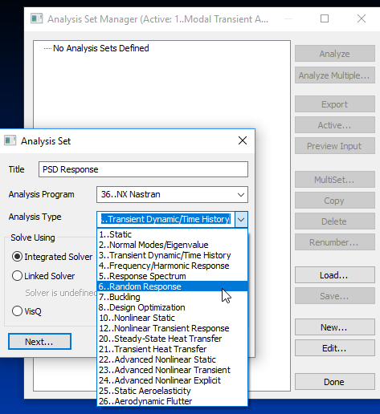
Femap: Random Response

Slide 33
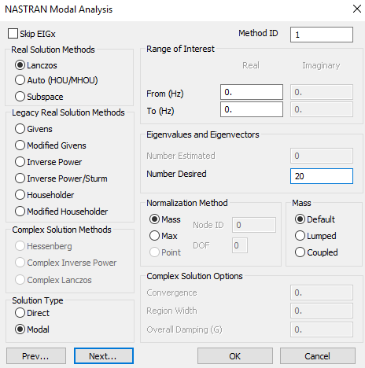
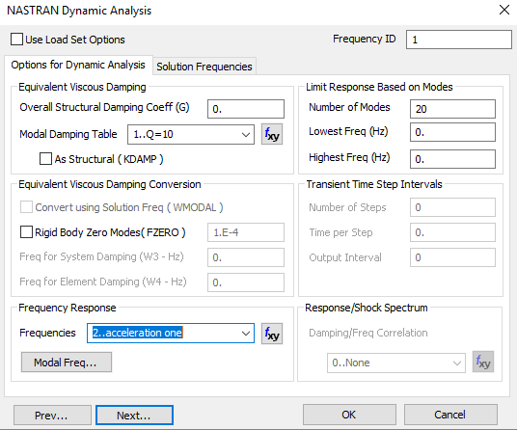
Femap: Analysis Steps

Slide 34
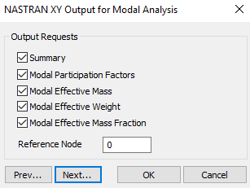
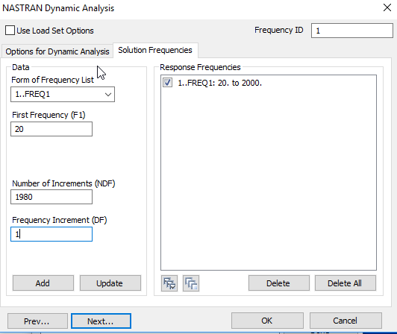
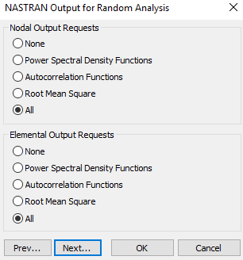
Femap: Analysis, Solution Frequencies, etc.

Slide 35
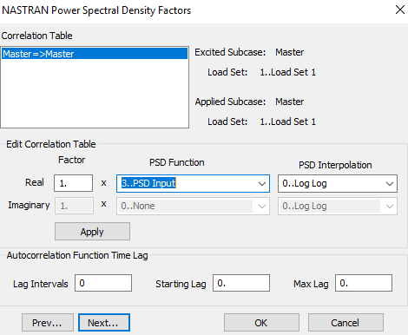
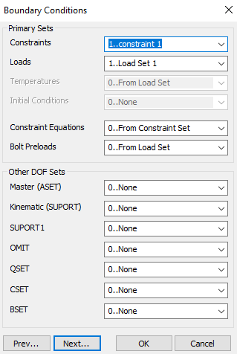
Femap: Analysis Steps, PSD & Boundary Conditions
PSD Function, previously defined

Slide 36
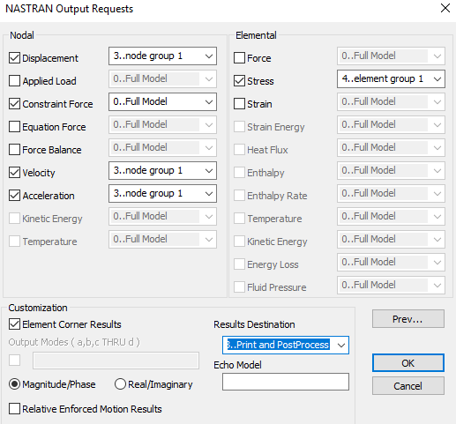
Femap: Analysis Final Step
Export the analysis model
Run in Nastran
Post-process the f06 file using the Matlab script as shown in the following slides

Slide 37
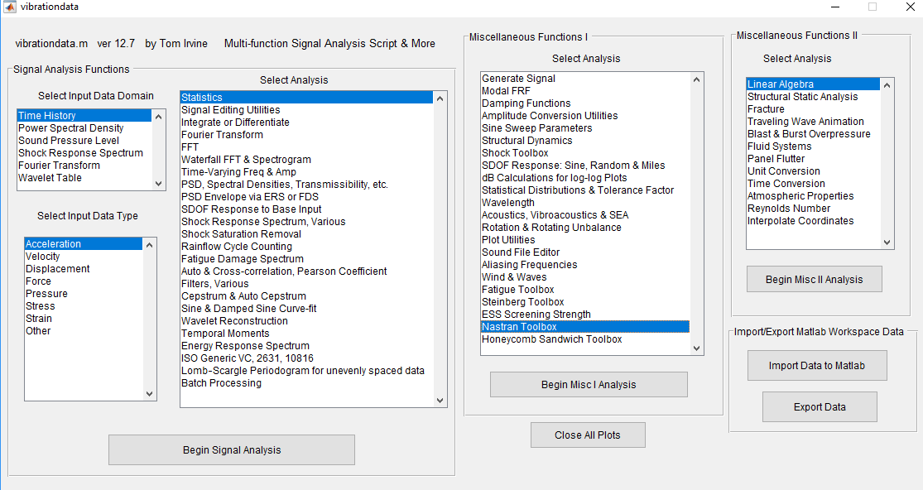
Vibrationdata Matlab GUI

Slide 38
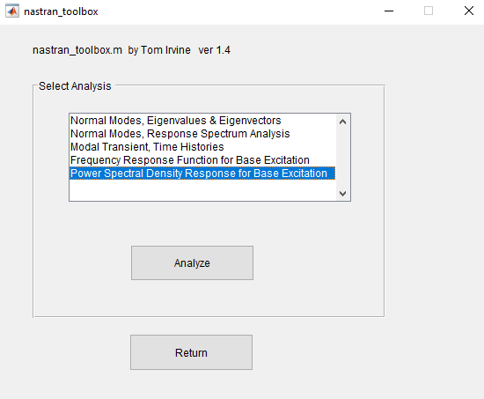
Vibrationdata: Nastran Toolbox

Slide 39
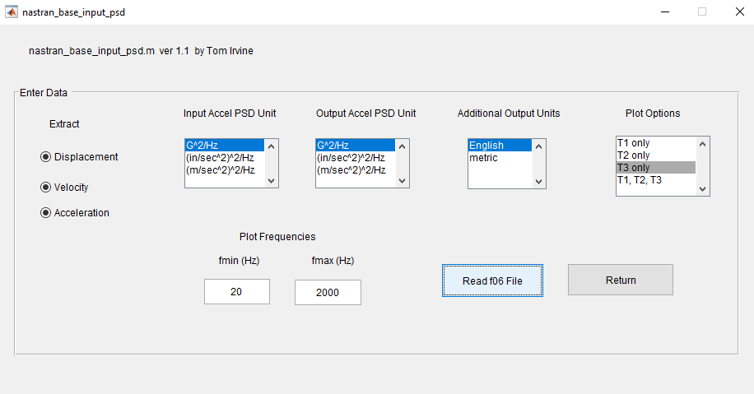
Vibrationdata: Nastran PSD Post-processing

Slide 40
NAVMAT PSD Base Input

Slide 41
PSD Response at Plate Center Node
This plot agrees with the result obtained in Unit 203

Slide 42
PSD Response at Plate Mid Edge Node
This plot agrees with the result obtained in Unit 203

