Slide 1



Shock Analysis of Launch Vehicle Equipment using Historical Accelerometer Records to Satisfy Shock Response Spectra Specifications
By Tom Irvine Email: tirvine@dynamic-concepts.com
Dynamic Concepts, Inc. Huntsville, Alabama
Vibrationdata
2nd Workshop on Spacecraft Shock Environment and Verification, 19-20 November 2015, ESA-ESTEC, Noordwijk, The Netherlands

Slide 2
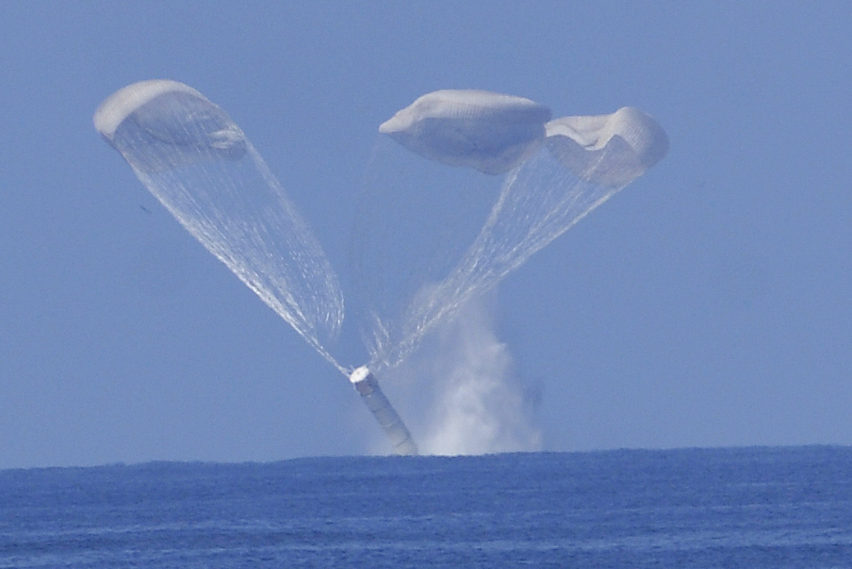
Introduction - Nonstationary Flight Data
Background
This presentation is extension of an SRB Splashdown shock project with my colleagues Robin Ferebee & Joe Clayton
NASA/TM—2008–215253, An Alternative Method of Specifying Shock Test Criteria
Recent work was prompted by a question from Siamak Ghofranian

Slide 3
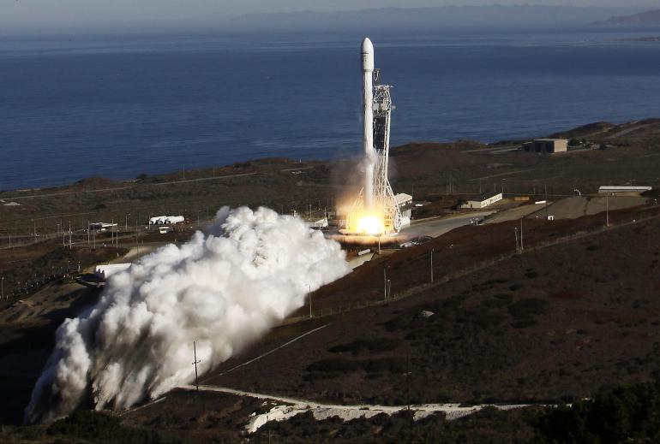
Introduction - Nonstationary Flight Data
Falcon 9 Launch, Vandenberg AFB
The vehicle as mounted on the pad is a tall cantilever beam
Its ability to withstand seismic events must be verified via analysis (NASA-HDBK-7005)

Slide 4
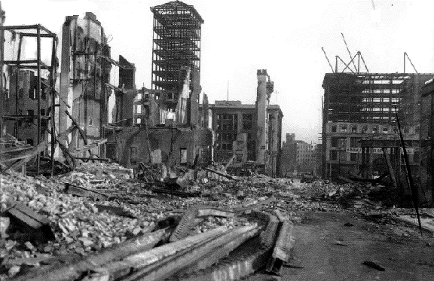
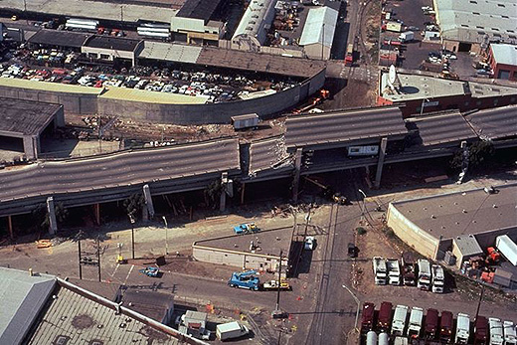
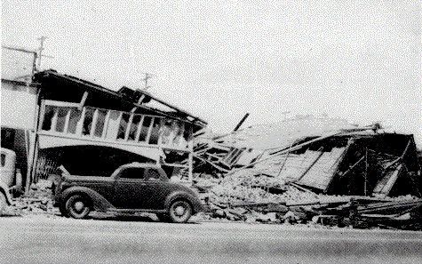
Introduction - Nonstationary Flight Data
California Earthquakes
http://a.scpr.org/i/22ebbc723746b0deb523a3e5cf1d687c/75480-full.jpg
San Francisco 1906
Loma Prieta 1989
El Centro 1940

Slide 5
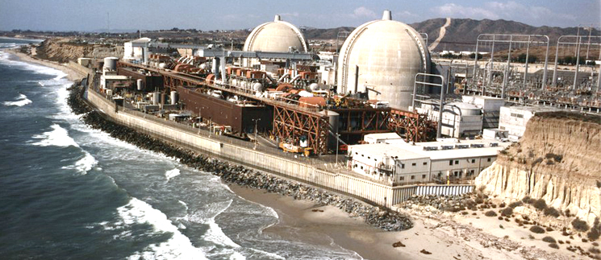
Conclusions
San Onofre Nuclear Power Plant
.
Nuclear plant equipment must be tested to seismic shock specifications.

Slide 6
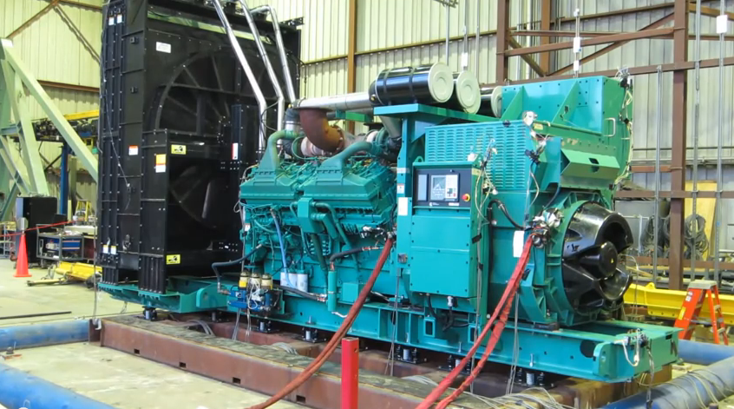
Conclusions
Generator Subjected to
Seismic Test
.
This could be an emergency power generator for a hospital in an active seismic zone
Video clip available on YouTube

Slide 7
Conclusions
Design & Testing
Consider the following type of systems & equipment:
Launch Vehicle & Ground Support Equipment
Telecommunication
Medical life-support
Network servers
Nuclear power plant control consoles
Now consider that this equipment is to be installed in an active seismic zone
The equipment must be designed to withstand the dynamic loads and tested if possible
A typical specification format for the loading is the shock response spectrum (SRS)
The testing is performed on a shaker table
.

Slide 8
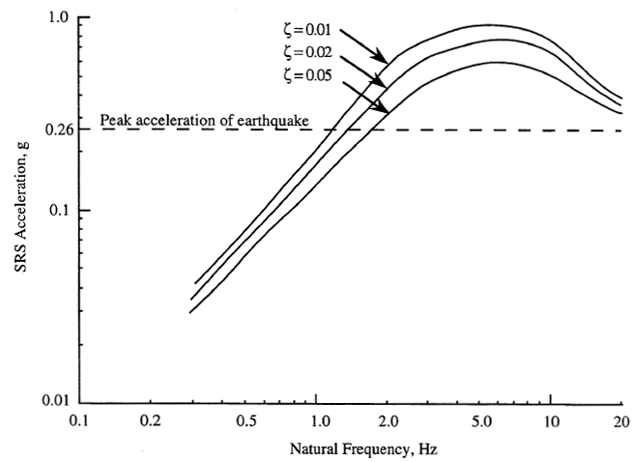
Conclusions
NASA HDBK-7005, Vandenberg AFB
Use the 1% damping (Q=50) curve in the following example

Slide 9
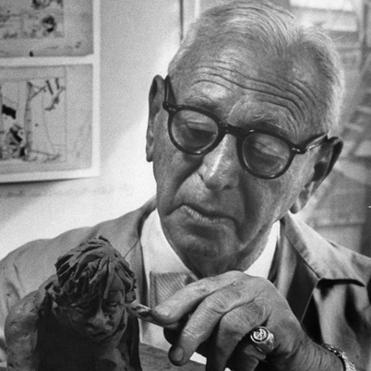
Conclusions
Time History Synthesis
A time history must be synthesized to satisfy the SRS for testing or transient finite element analysis
A wide variety of time histories could hypothetically be used including a sine sweep
But there are concerns about the test article’s linearity, multi-modal response, etc.
Also concerns about input time history’s skewness, kurtosis, energy, temporal moments, etc.
Goal is to use a time history which “resembles” a measured strong motion event
Use a Rube Goldberg method

Slide 10
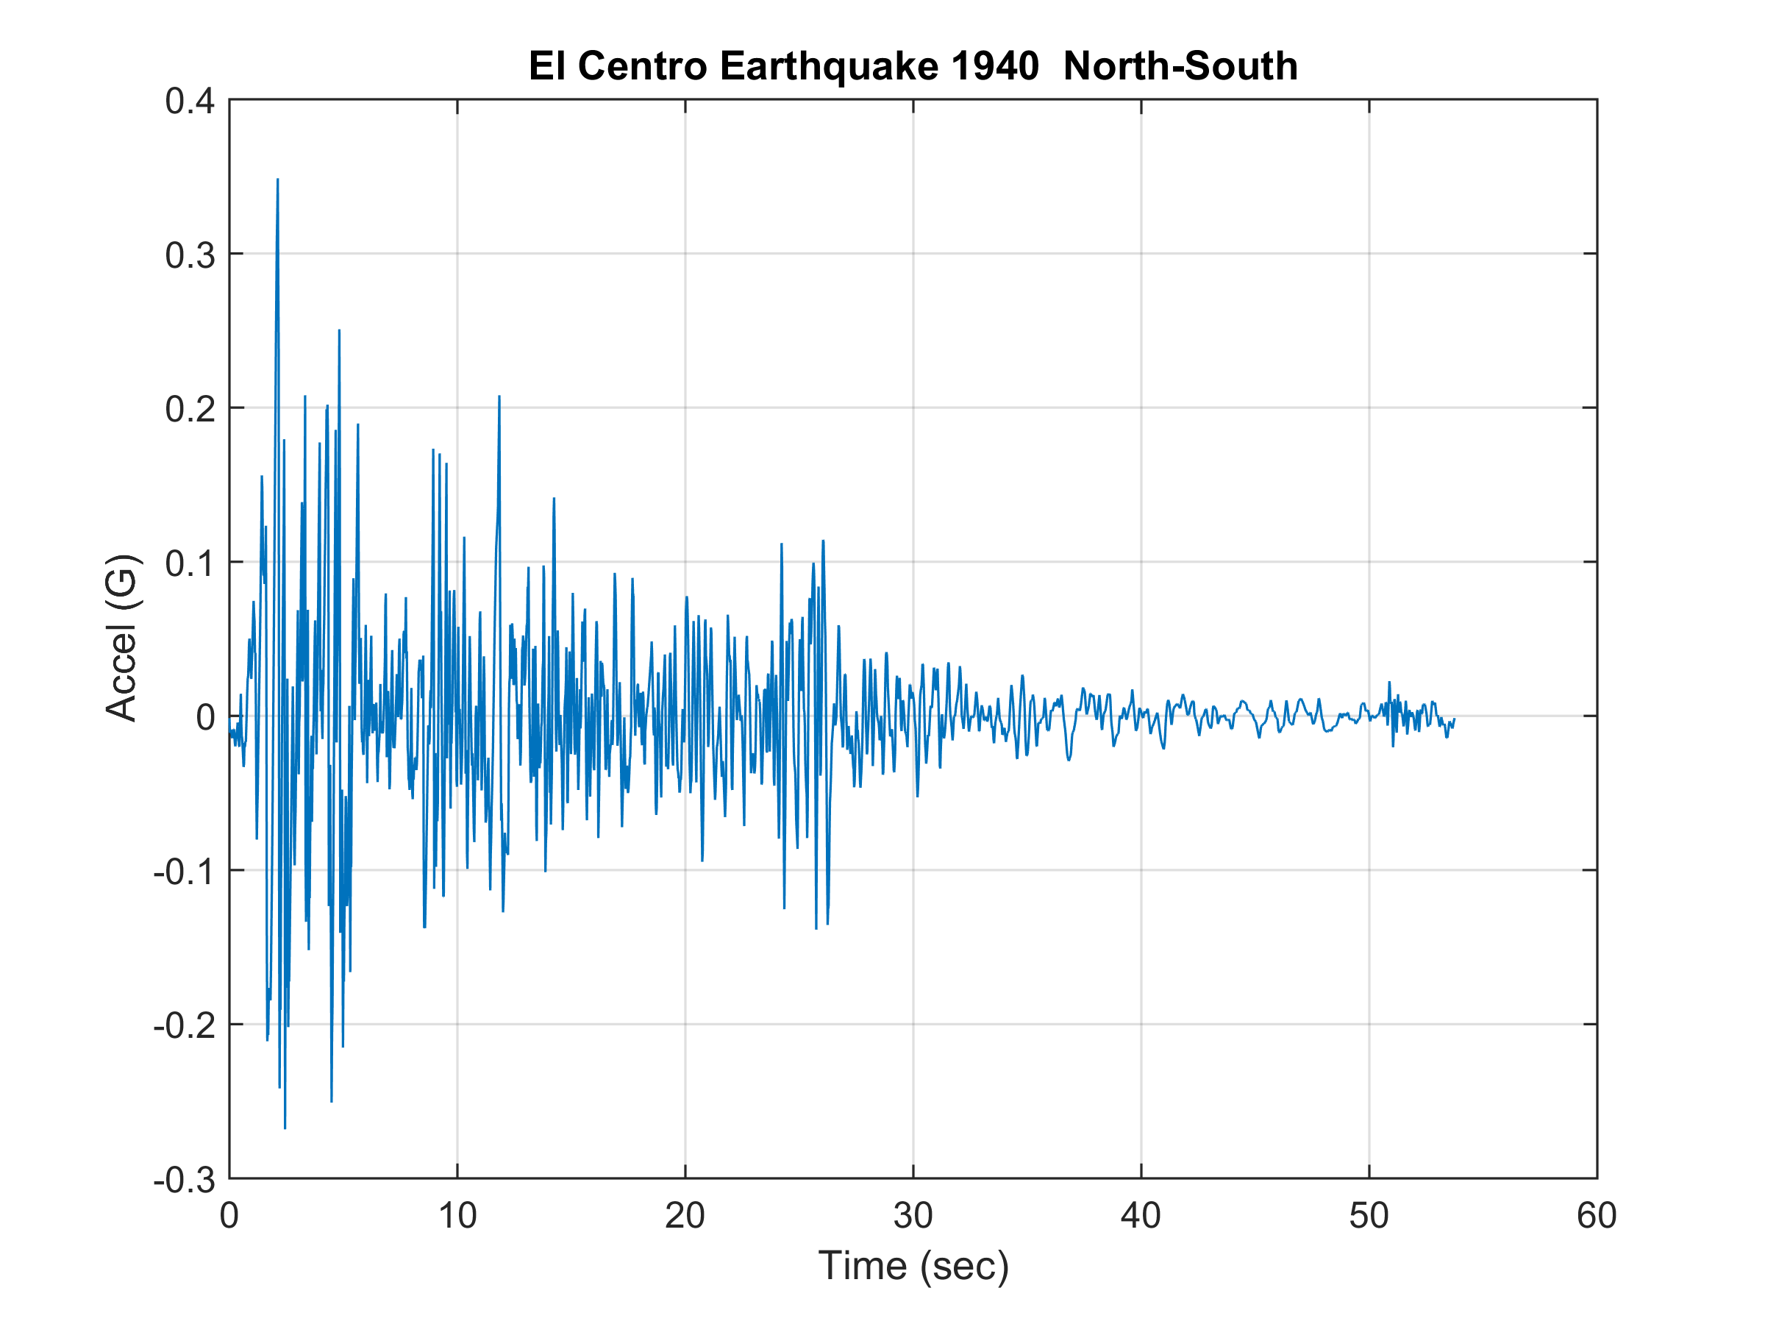
Conclusions
El Centro Strong Motion Data

Slide 11
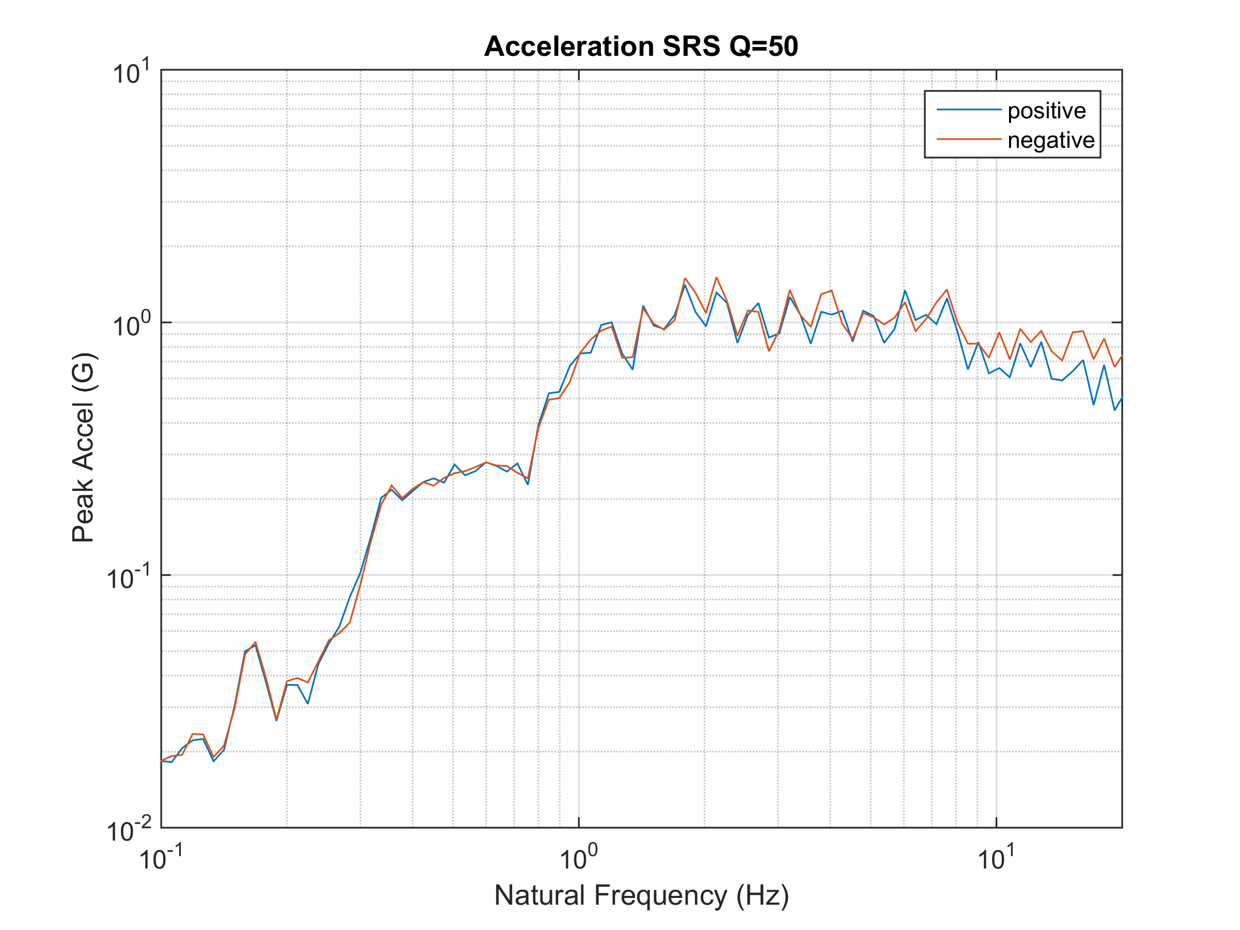
Conclusions
El Centro NS SRS
20

Slide 12
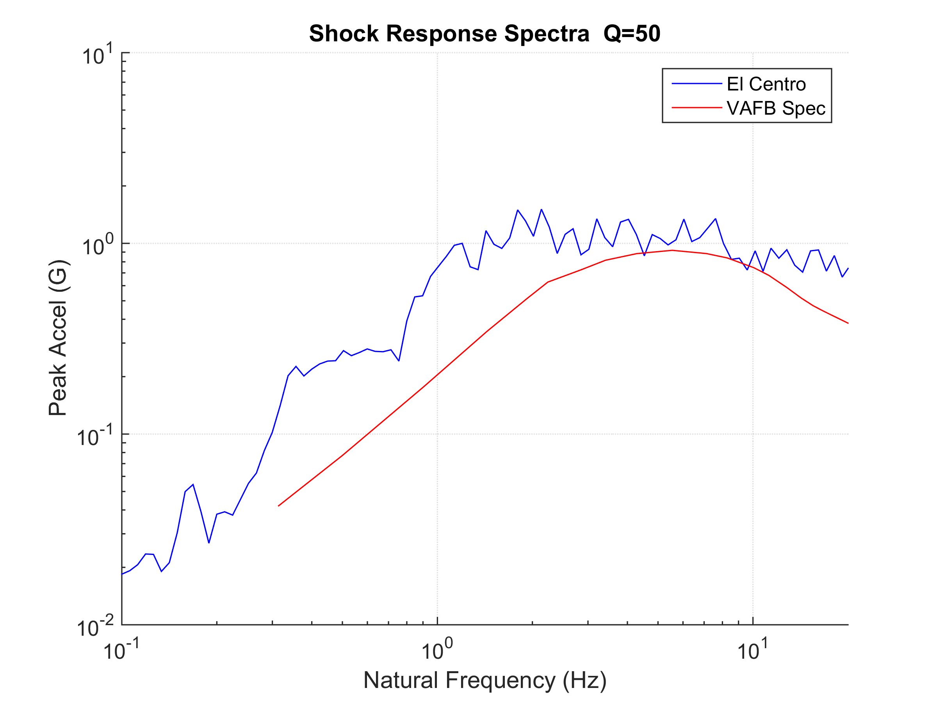
Conclusions
SRS Comparison
Initial slope of the Spec is about
8 dB/octave
20
El Centro SRS does not comply with VAFB specification “straight out of the box”
But the El Centro time history can be modified for compliance

Slide 13
Conclusions
Method Description, part 1
The following steps use trial-and-error-random number generation with some built-in convergence
The method is implemented as a function in the Vibrationdata Matlab GUI package (freely available)
The first step is to decompose the reference time history into a series of wavelets (non-orthogonal shaker shock wavelets)
An acceleration wavelet has zero net velocity and zero net displacement
A series of wavelets likewise has these properties
Wavelets are very amenable to shaker table shock testing and are also convenient for analysis
The examples in this presentation use a series of 200 wavelets to model a reference time history

Slide 14
Conclusions
Method Description, part 2
The second step is to randomly vary the wavelet amplitudes so that the modified wavelet series will have an SRS that matches the specification as closely as possible
The number of iterations may be 16000 or so
The modified time history will thus have some distortion relative to the reference, but this is needed to shape the time history so that its SRS meets the specification
The second step yields an SRS that has some peaks and dips relative to the specification
This is a consequence of trying to adapt a measured time history to a smoothed SRS
.

Slide 15
Conclusions
Method Description, part 3
The third step is to add wavelets so that the resulting SRS meets the specification within, say, + 3 dB tolerance limits
The third step also adds some distortion
The amount of distortion depends largely on how much the SRS specification differs from that of the reference data
.

Slide 16
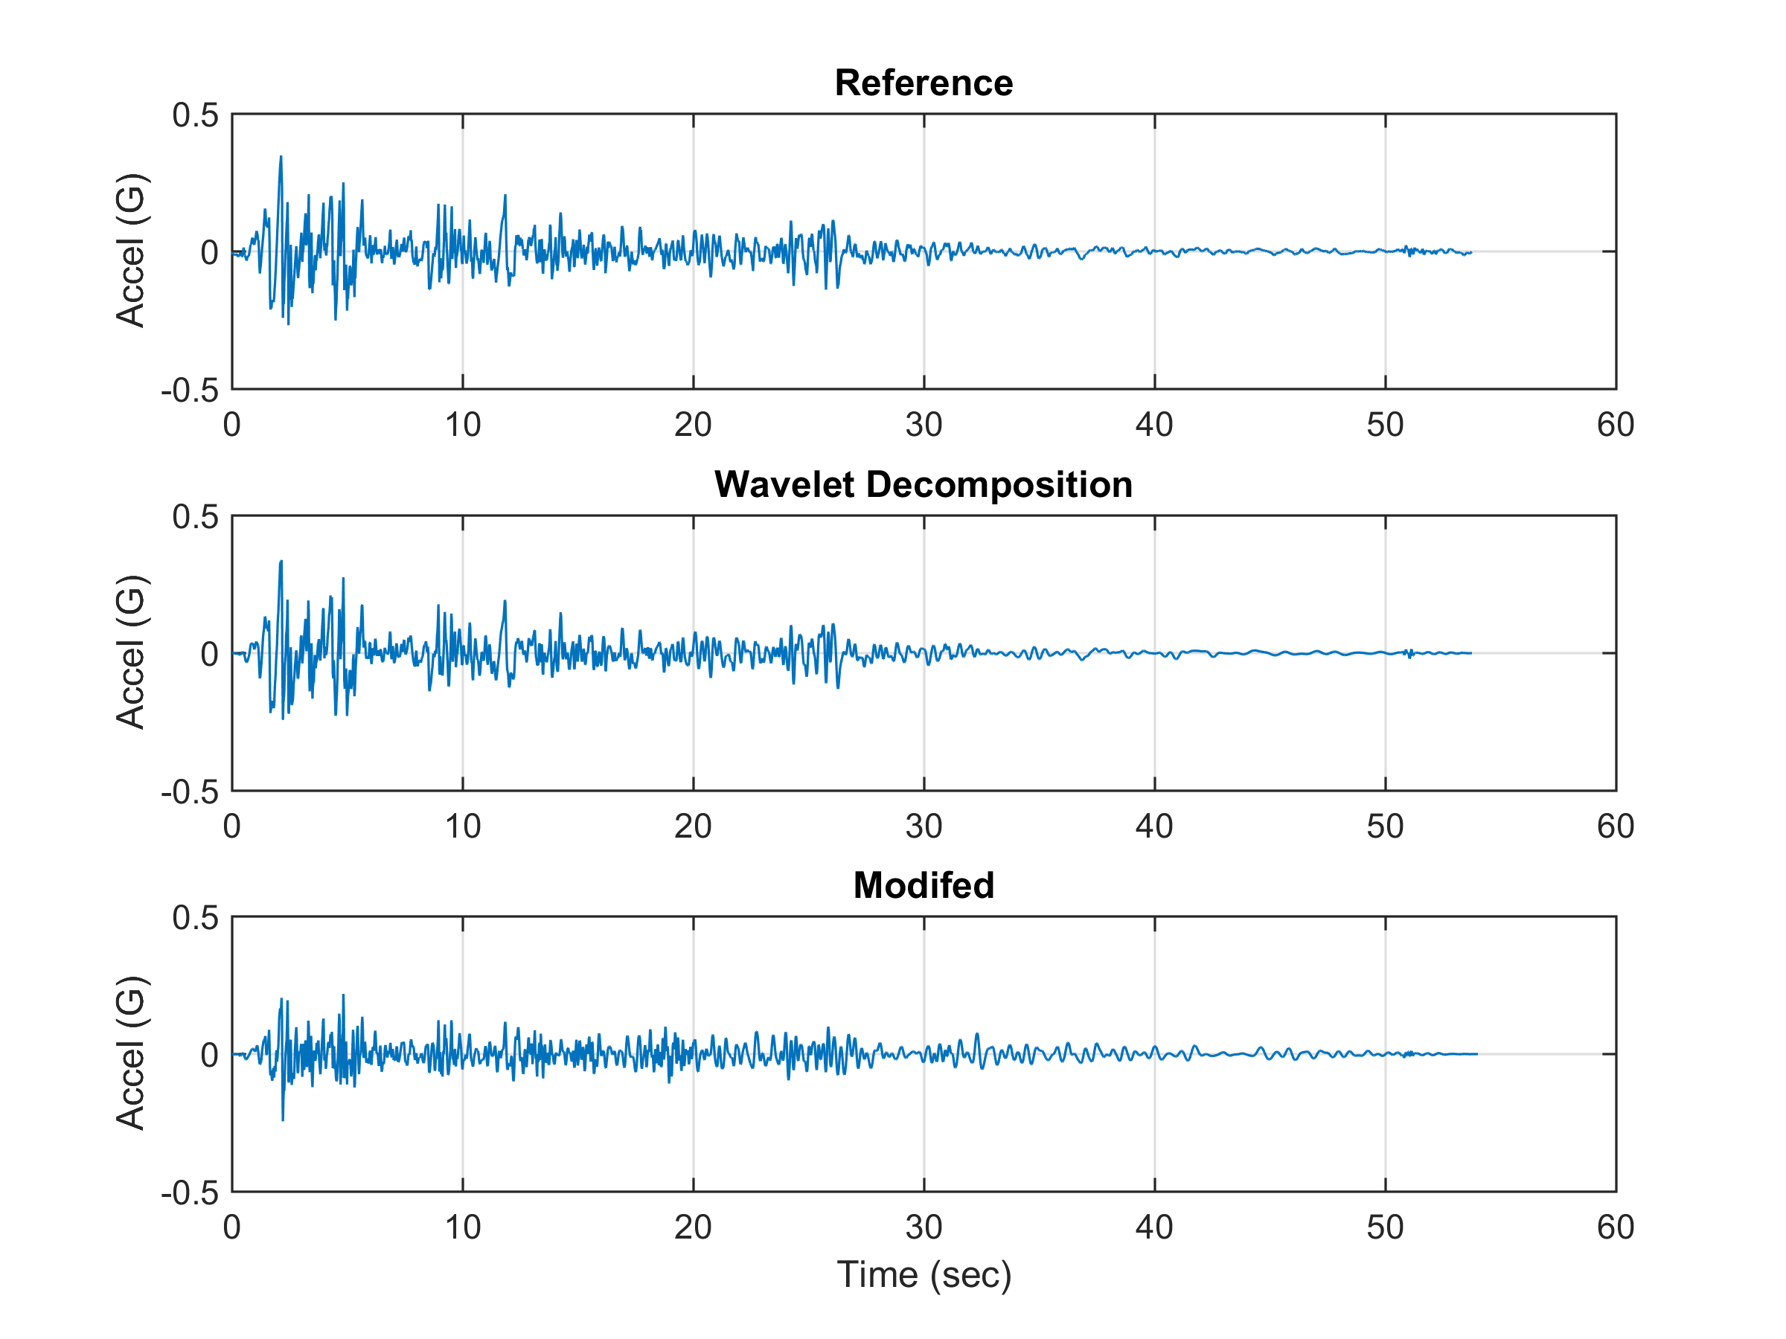
Conclusions
.
The top time history is the measured El Centro NS data
The middle time history is the wavelet series model
The bottom time history has additional wavelets to improve the SRS match, and it is scaled downward since the El Centro SRS plateau is greater than the specification

Slide 17
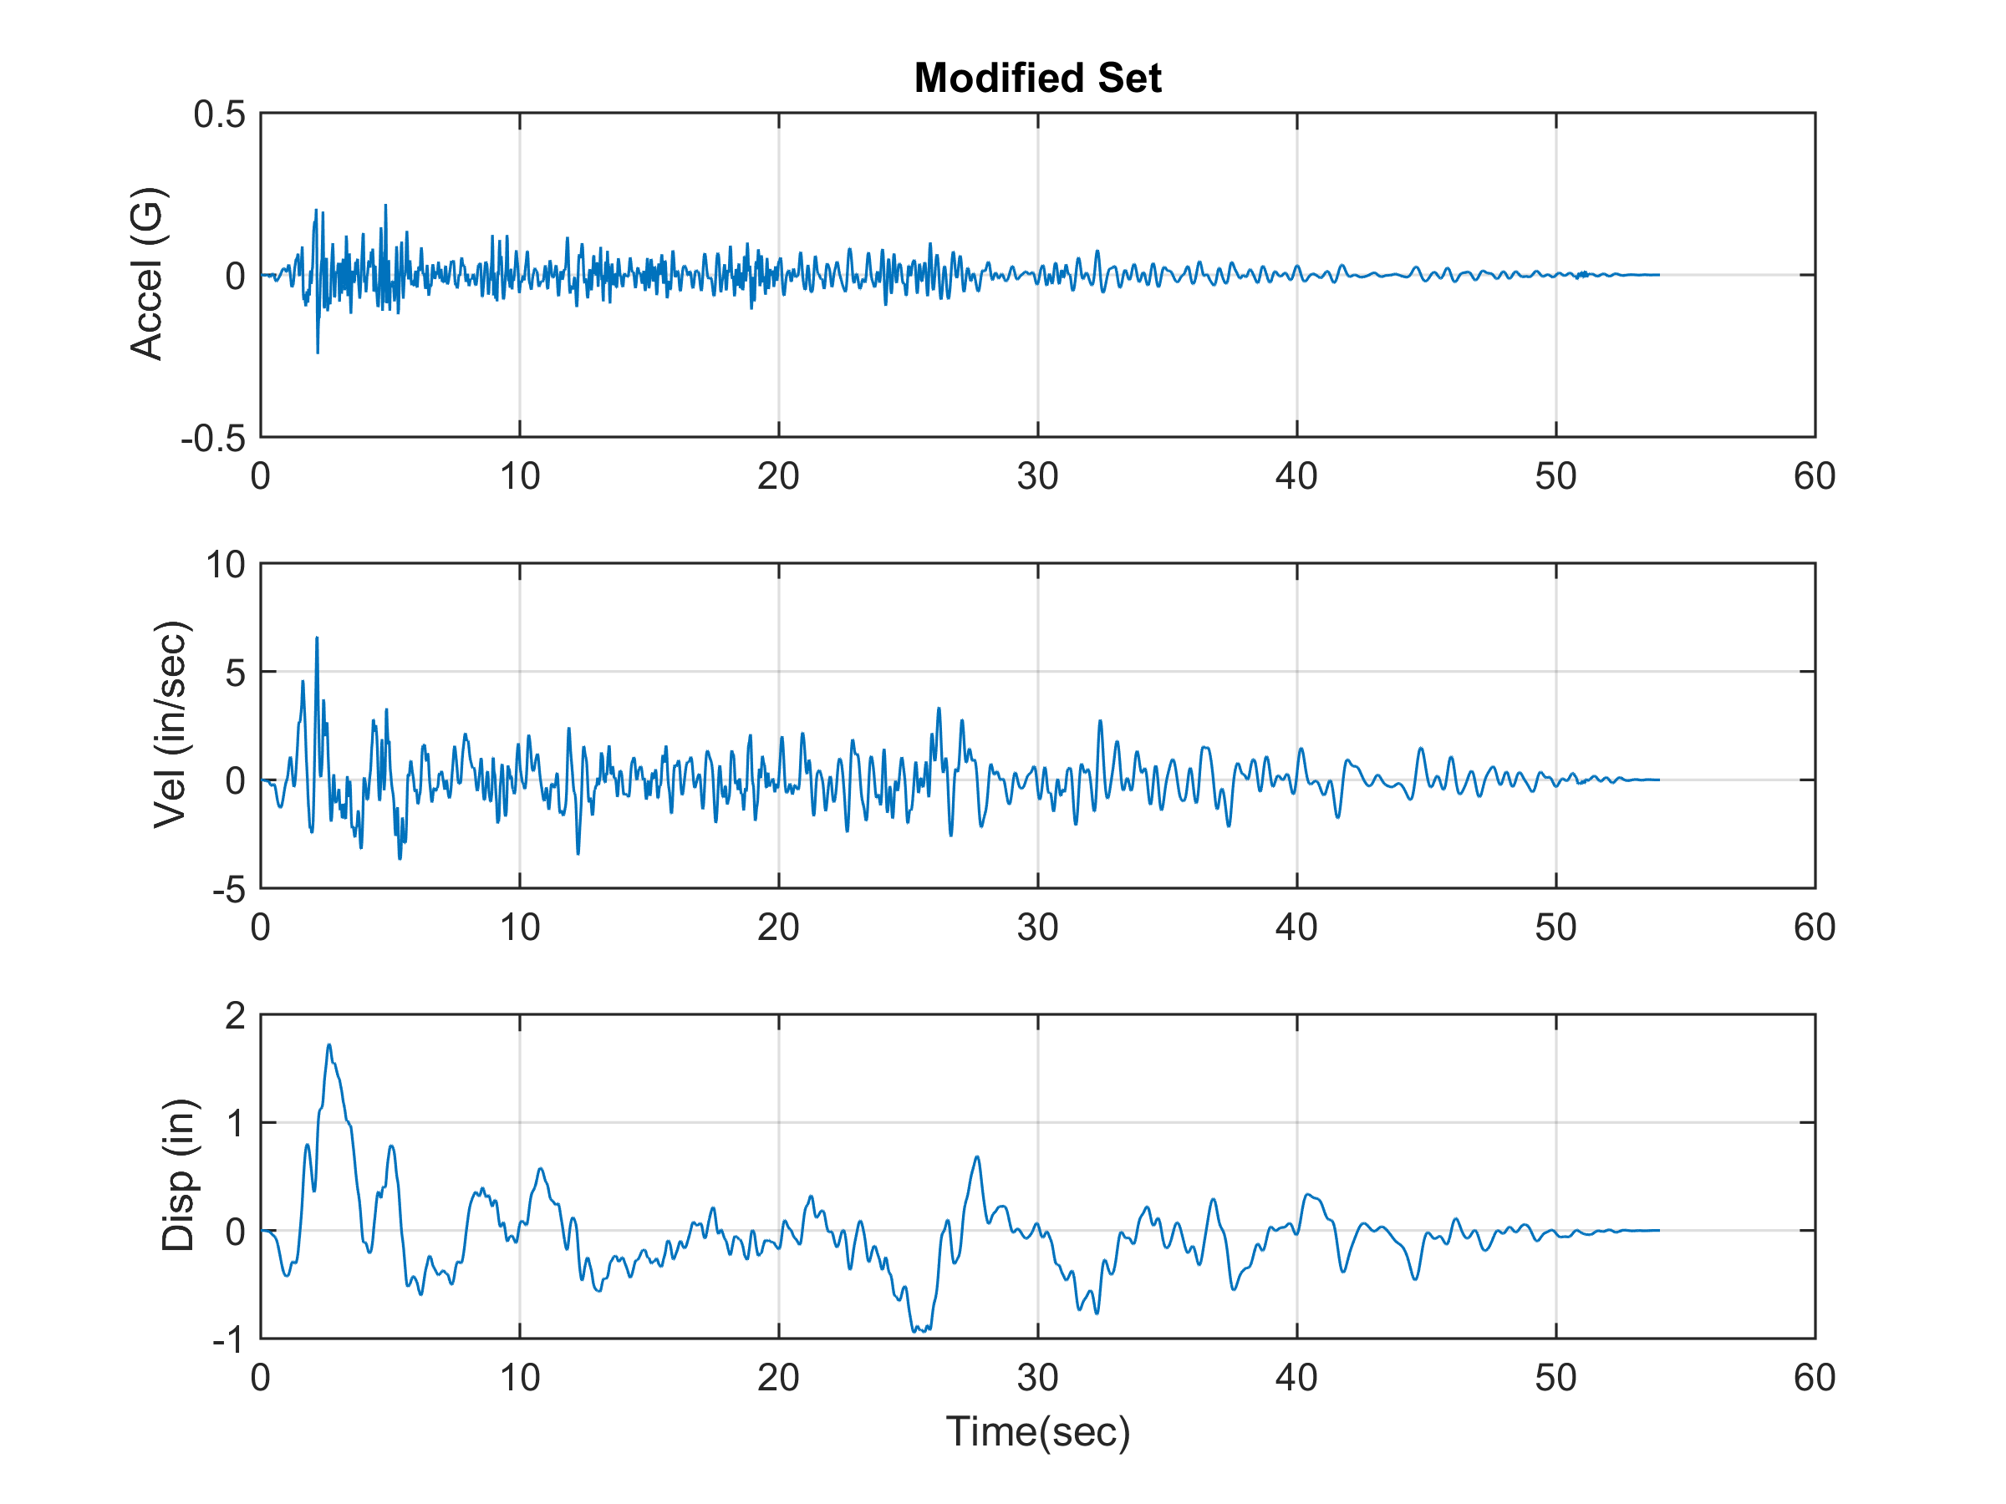
Conclusions
.
The velocity and displacement time histories are well-behaved which is important for both testing and analysis.

Slide 18
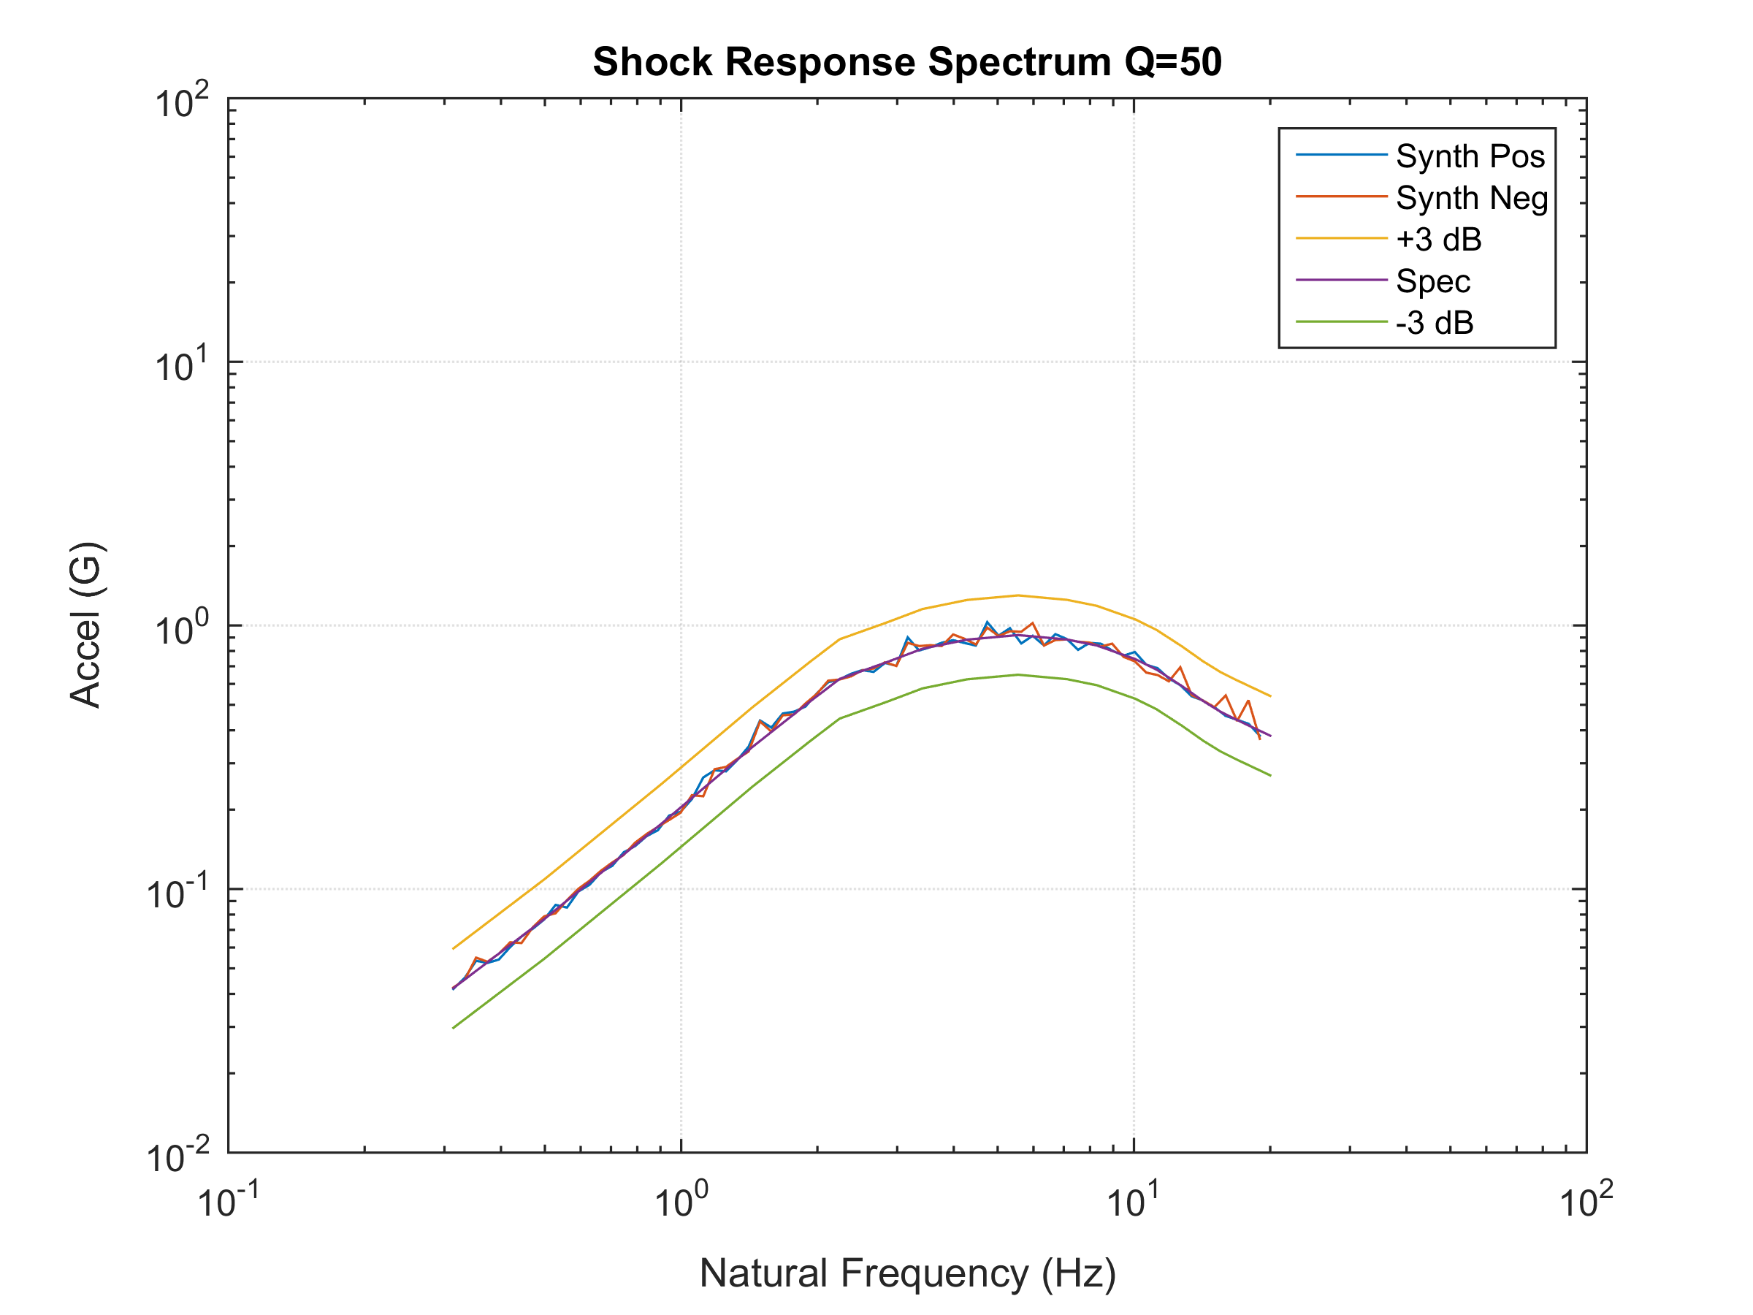
Conclusions
.
The SRS of the modified, synthesized time history is within + 3 dB of the specification
The method is thus successful in generating an El Centro-like time history to meet the specification

Slide 19
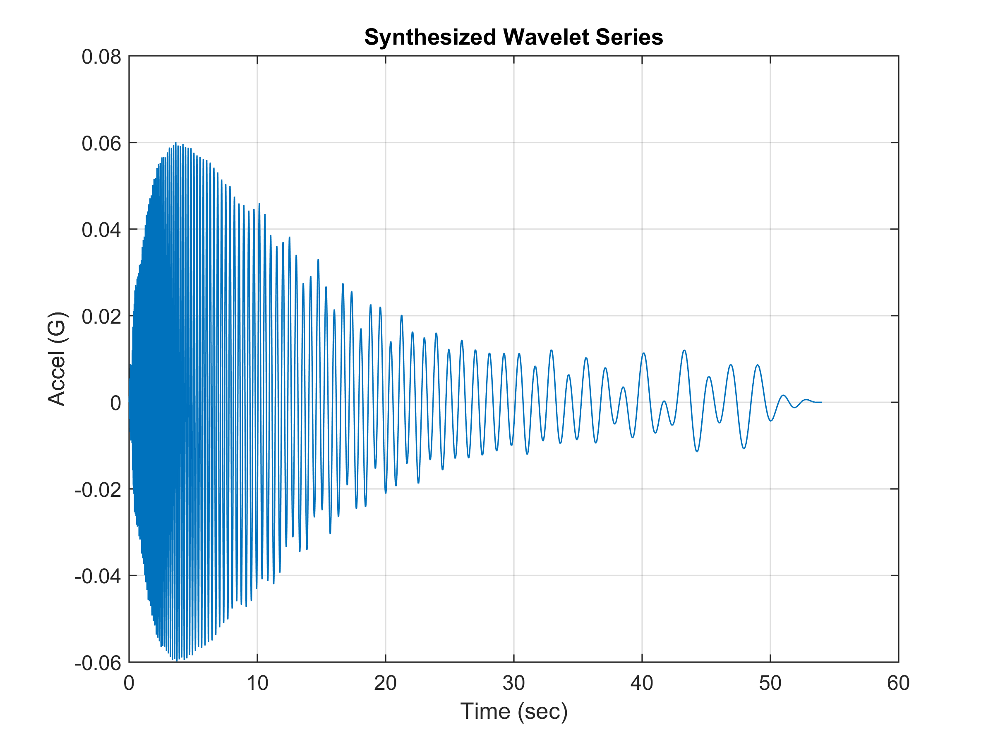
Conclusions
Satisfy Same Specification with Alternate Time History
.
Elegant but does not resemble an earthquake

Slide 20
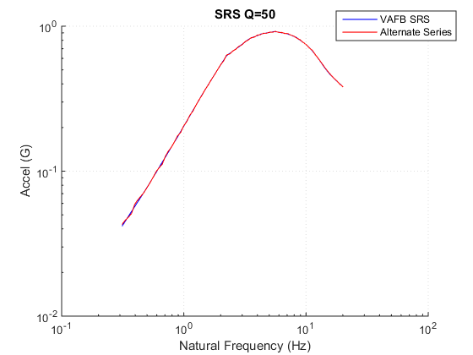
Conclusions
Alternate Time History SRS
.
Excellent compliance, but alternate time history still does not resemble an earthquake

Slide 21
Conclusions
Temporal Moment Comparison
Parameter | El Centro Synthesis | Alternate Synthesis
Energy E | 0.0589 | 0.01935
Root energy amplitude Ae | 0.0731 | 0.04754
Central time T (sec) | 13.56 | 9.687
RMS duration D (sec) | 11.02 | 8.562
Central skewness St (sec) | 10.21 | 11.06
Normalized skewness S | 0.9267 | 1.291
Central kurtosis Kt (sec) | 60.13 | 73.67
Normalized kurtosis K | 5.455 | 8.604
.
The alternate synthesis has about 5 dB less energy and thus may cause an “under test” even though its SRS matches the specification.

Slide 22
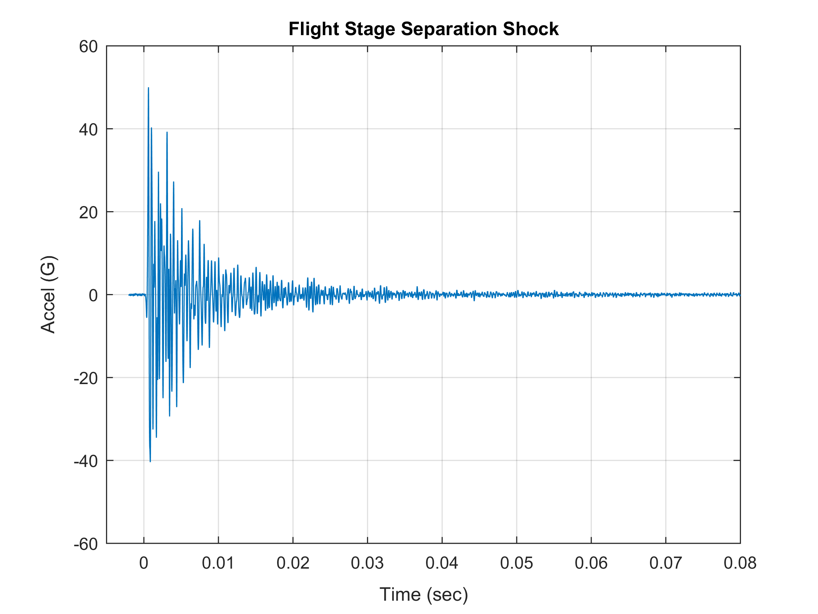
Conclusions
Second Example Suborbital Launch Vehicle Flight Accelerometer Data
.
22

Slide 23
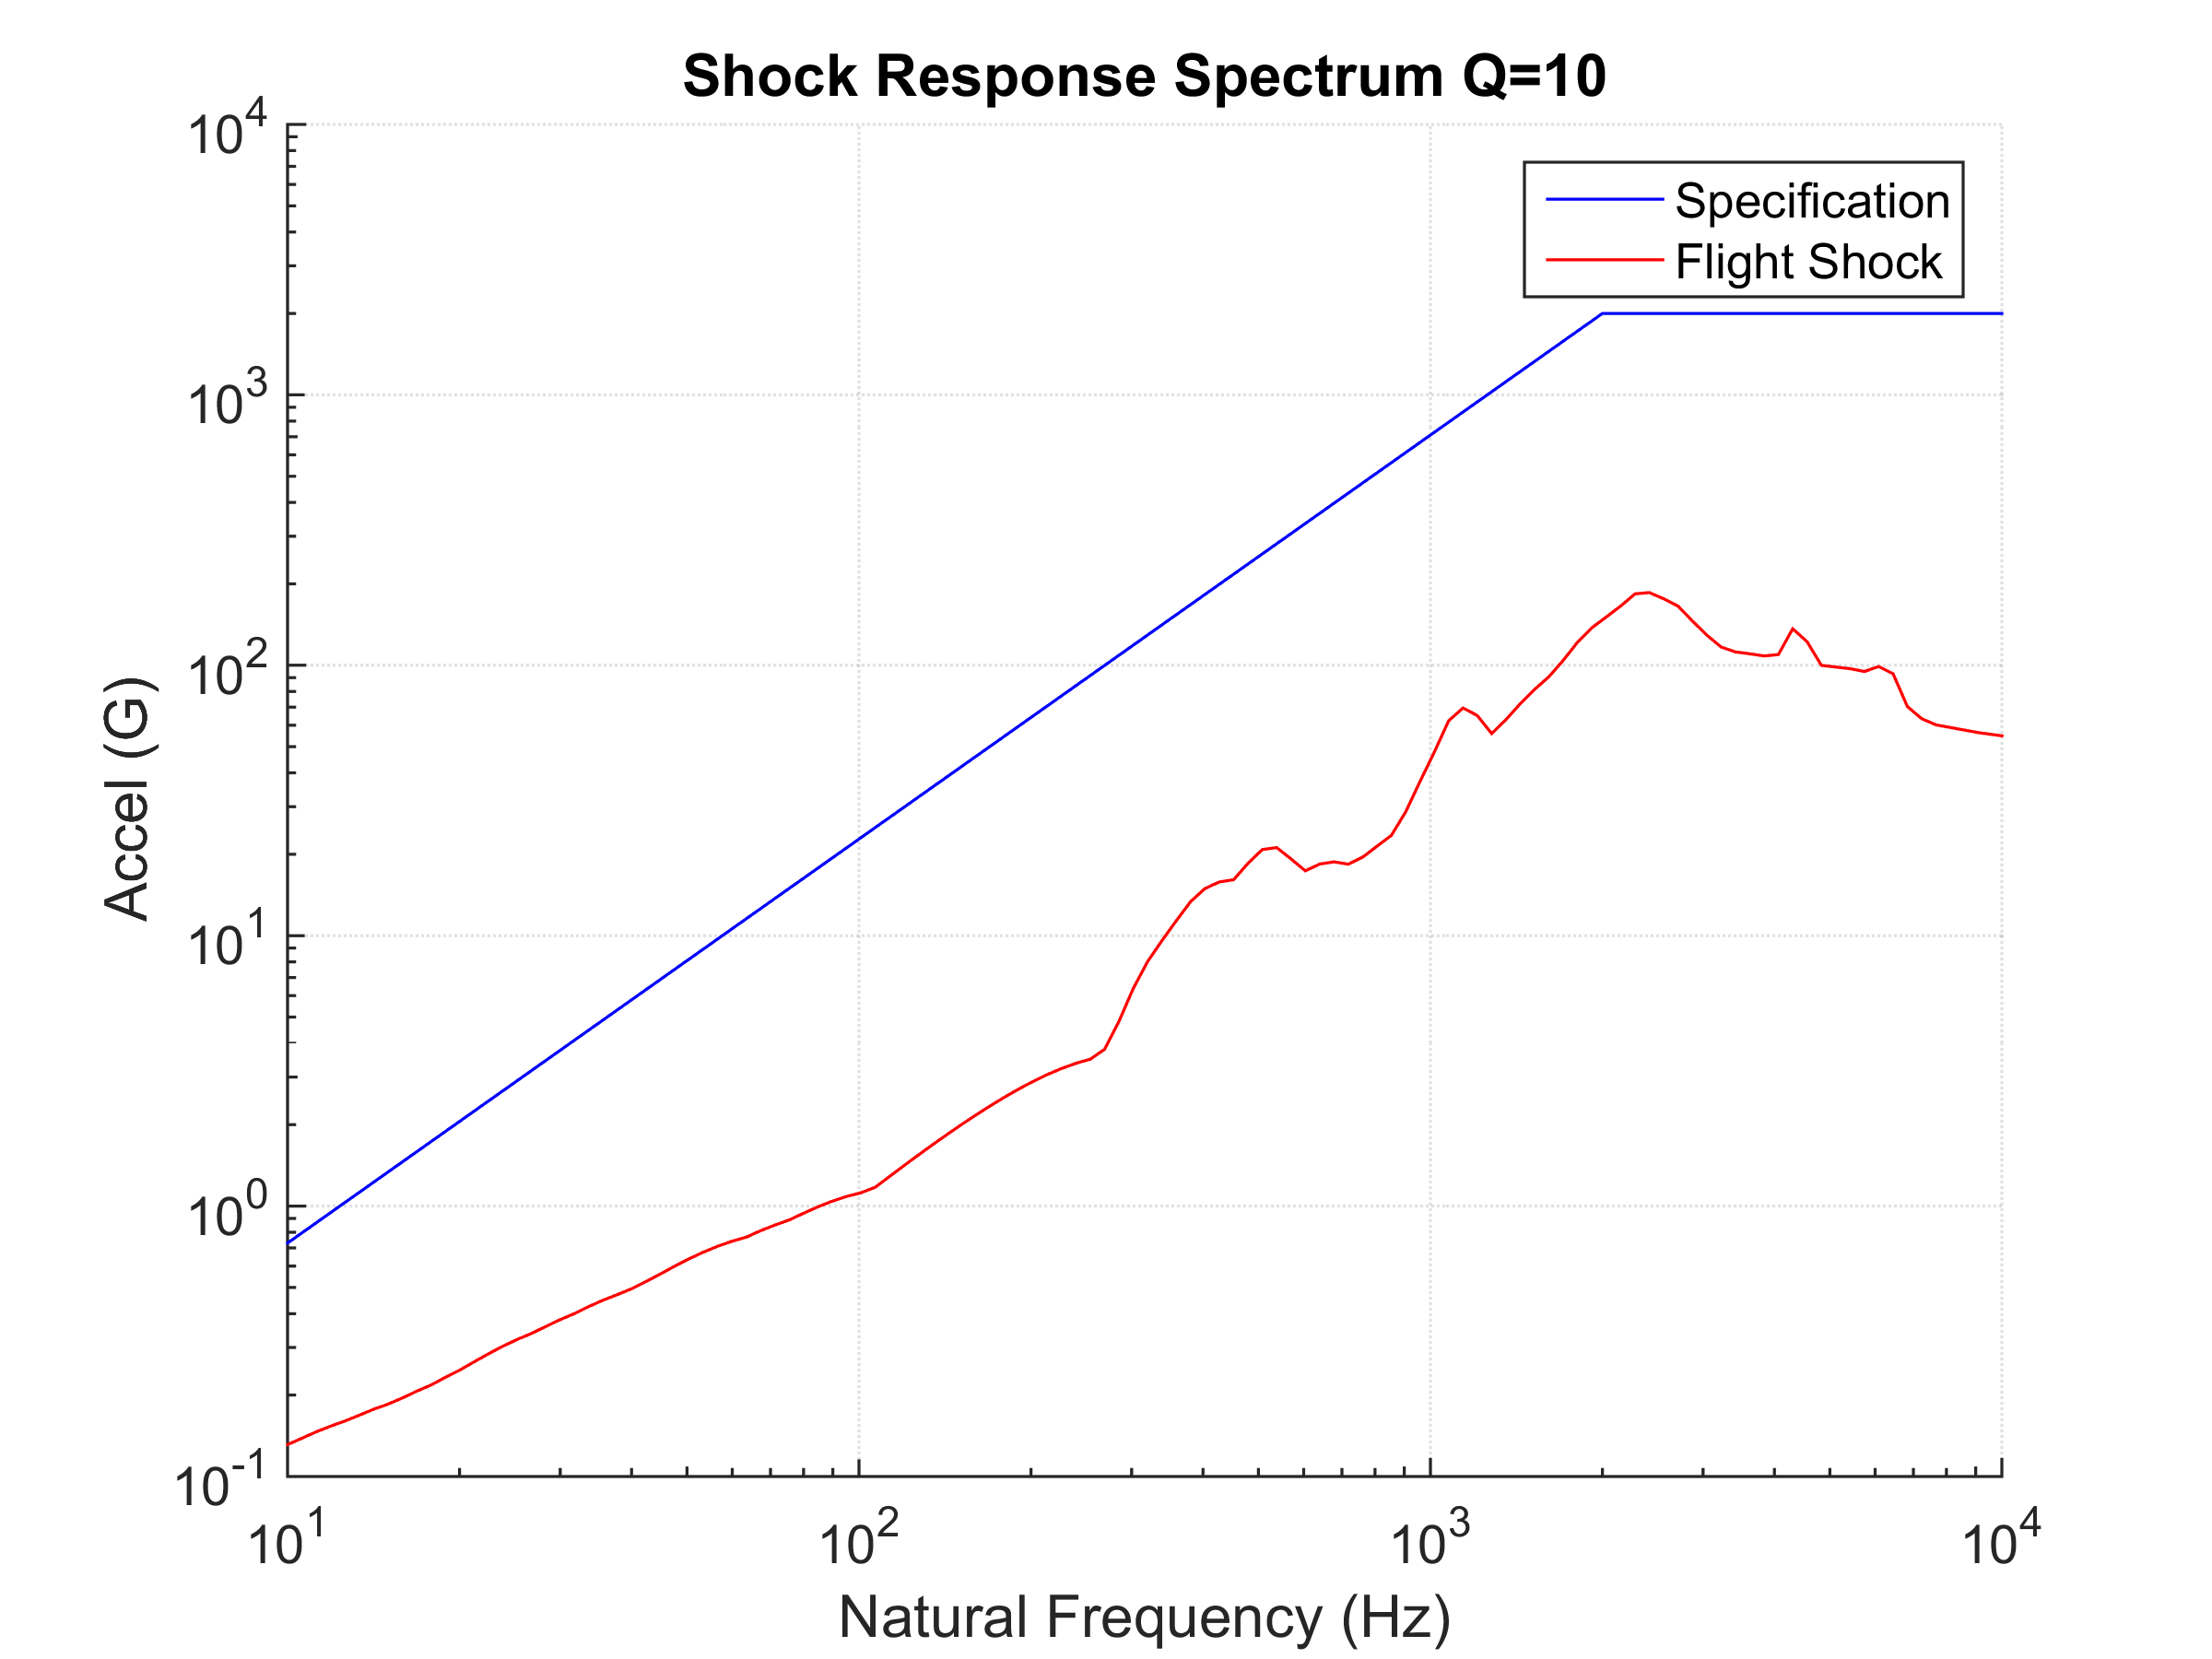
Conclusions
Second Example Suborbital Launch Vehicle Flight Accelerometer Data
.
The Specification is hypothetical, with a plateau of 2000 G and a ramp slope of 9 dB/octave
23

Slide 24
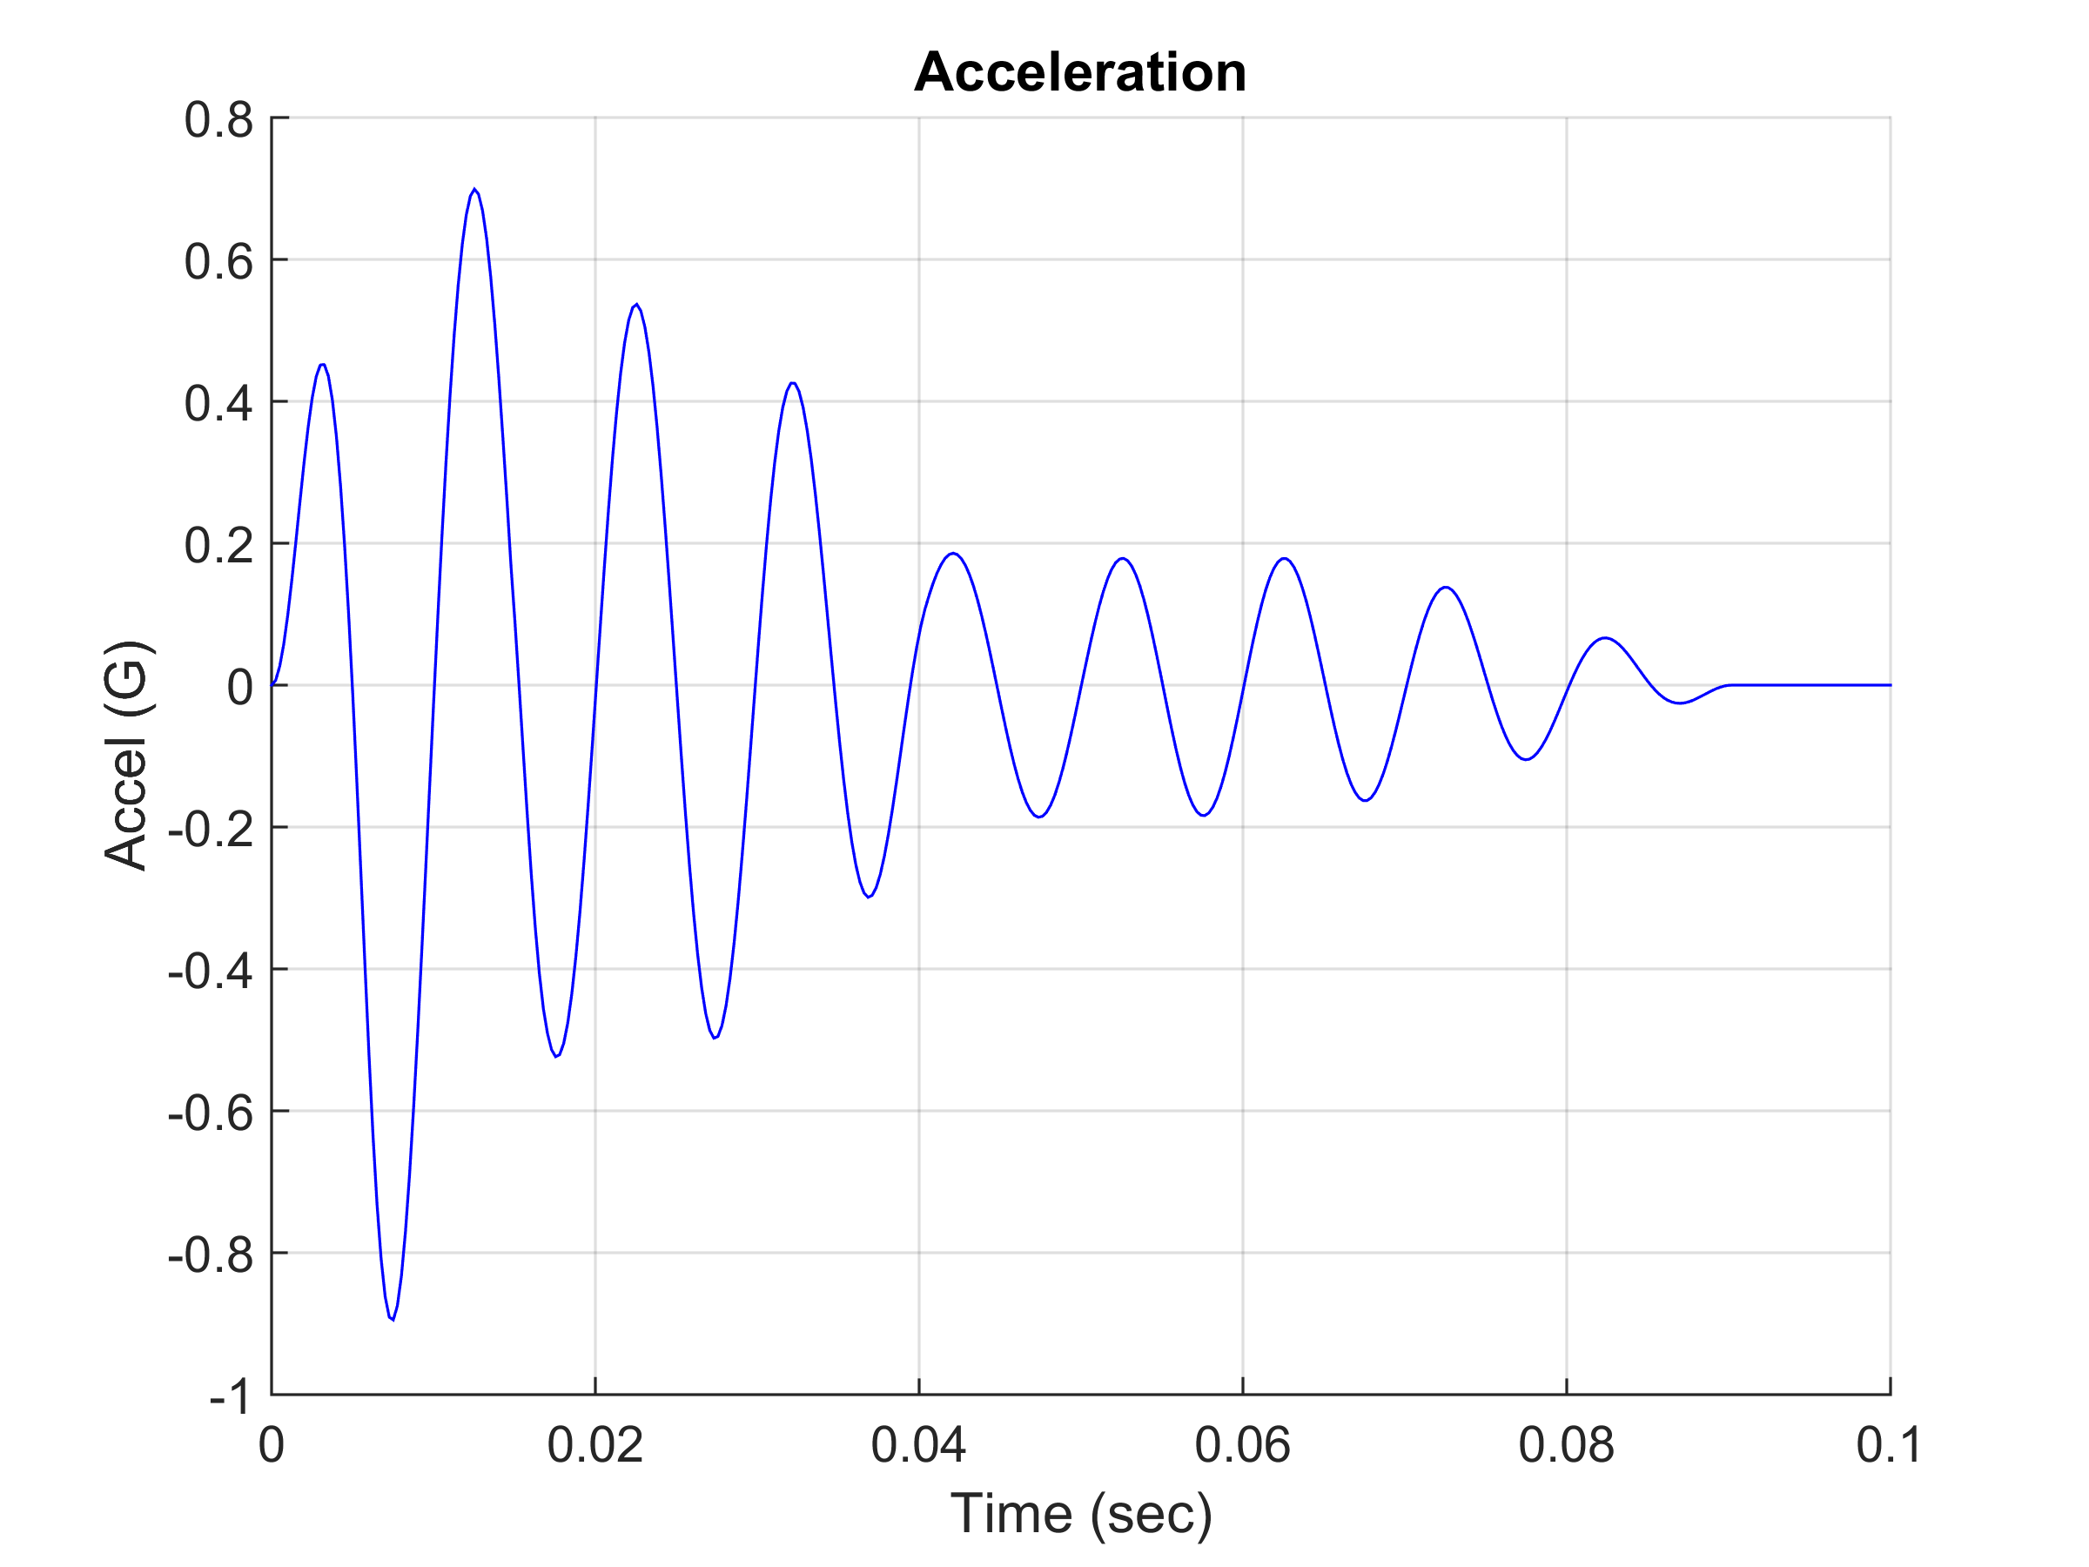
Conclusions
Second Example Wavelet Indirect Approach
Damped sines are more efficient than wavelets for modeling near and mid-field pyrotechnic shock
But damped sines can be modeled via wavelet for desired velocity and displacement control
.
A series of five wavelets were combined to represent a 100 Hz, %5 Damped Sine
The individual wavelet frequencies were uniformly scaled to represent damped sines with various frequencies
Use successive groups of frequency-scaled wavelets to add into synthesis process for SRS compliance
24

Slide 25
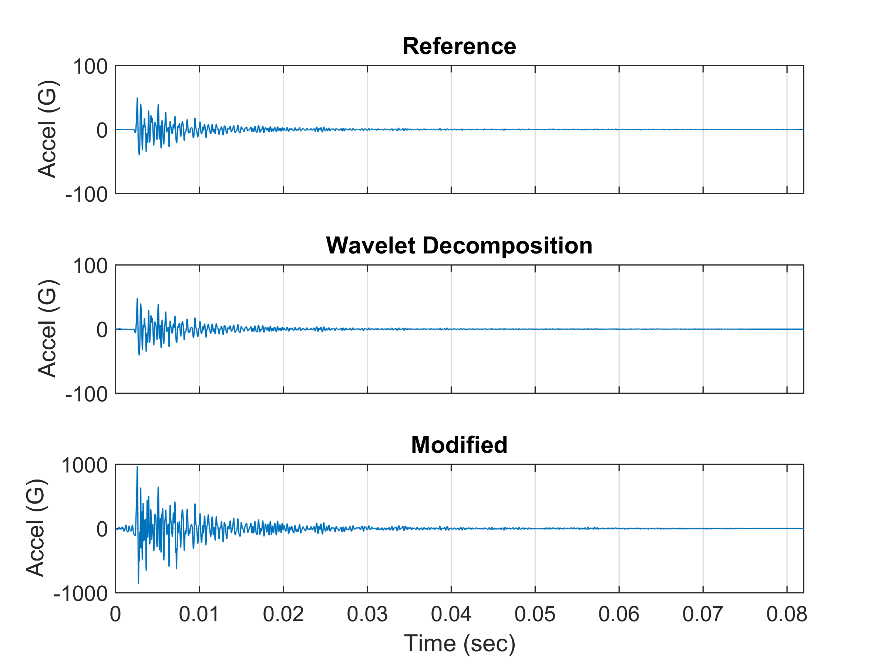
Conclusions
Second Example Suborbital Launch Vehicle Flight Accelerometer Data
.
The top time history is the flight accelerometer data
The middle time history is the wavelet series model
The bottom time history has additional wavelets to improve the SRS match, and it is scaled upward since the SRS specification plateau is greater than the flight data
25

Slide 26
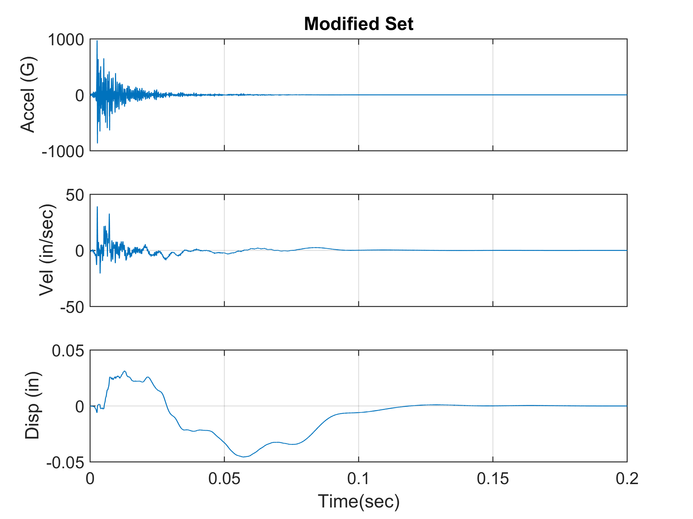
Conclusions
Second Example Suborbital Launch Vehicle Flight Accelerometer Data
.
The velocity and displacement time histories are well-behaved.
26

Slide 27
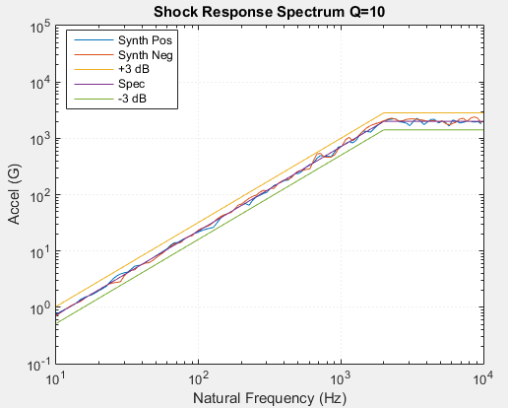
Conclusions
Second Example Suborbital Launch Vehicle Flight Accelerometer Data
.
The SRS of the modified, synthesized time history is within + 3 dB of the specification
The method is thus successful in generating a flight-like time history to meet the specification
27

Slide 28
Conclusions
Conclusions
An historical time history can be modified via wavelets to satisfy an SRS specification using a Rube Goldberg approach
The resulting time history will ideally resemble the reference time history, but some amount of distortion must be accepted
The process works more smoothly for SRS specifications that somewhat resemble the reference data SRS
Good topic for case history experiments, further research, etc!
.

Slide 29
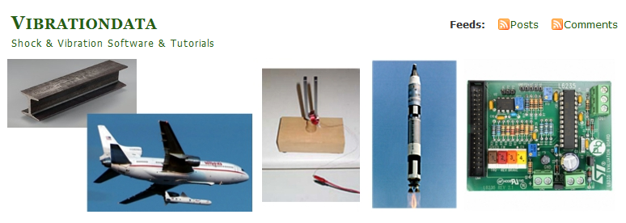
Conclusions
Software
.
Software and papers for applying this method are freely given at:
http://vibrationdata.wordpress.com/

