Slide 1



Pyrotechnic Shock Distance & Joint Attenuation via Wave Propagation Analysis
By Tom Irvine Email: tirvine@dynamic-concepts.com
Dynamic Concepts, Inc. Huntsville, Alabama
Vibrationdata
2nd Workshop on Spacecraft Shock Environment and Verification, 19-20 November 2015, ESA-ESTEC, Noordwijk, The Netherlands

Slide 2
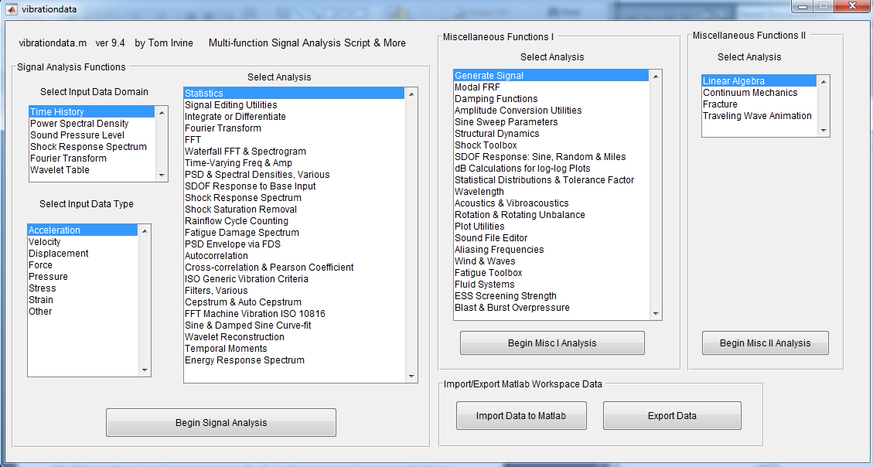
Vibrationdata Matlab GUI Package
All of the synthesis and attenuation methods in this presentation are available in the complimentary GUI package

Slide 3
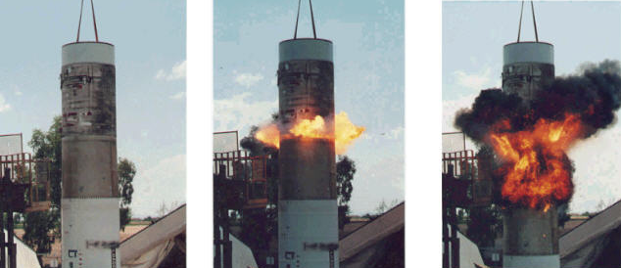
Stage Separation Ground Test
Linear Shaped Charge
But fire and smoke would not occur in near-vacuum of space
Plasma jet would occur instead

Slide 4
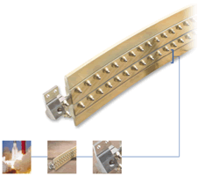
Frangible Joint
The key components of a Frangible Joint:
Mild Detonating Fuse (MDF)
Explosive confinement tube
Separable structural element
Initiation manifolds
Attachment hardware

Slide 5
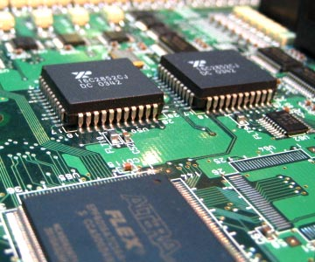
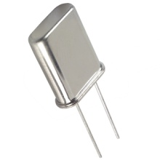
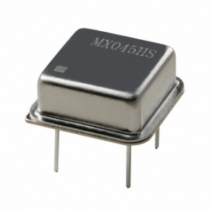
Avionics
Crystal Oscillators
Avionics contain sensitive circuit boards and piece parts which must withstand pyrotechnic shock events

Slide 6
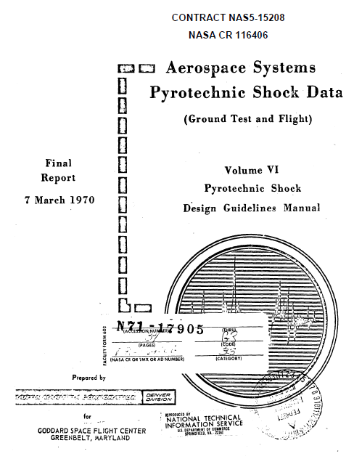
The “famous Martin-Marietta” document
Based on experimental data
Universal agreement that it needs revision due to today’s better instrumentation, different materials, etc.
But no funding to do so
Launch vehicle providers are reluctant to share test data
Maybe the best we can do is to use analytical techniques to better understand its application & limitations

Slide 7

Wave Propagation Reference
L. Cremer and M. Heckl, Structure-Borne Sound, Springer-Verlag, New York, 1988

Slide 8
Propagating Wave Types
Longitudinal
Governed by 2nd Order PDE Non-dispersive
Bending
Governed by 4th Order PDE Dispersive
Cylindrical Shell
Governed by a set of three coupled equations One 4th and two 2nd order May be formed into the Donnell-Mushtari operator matrix
- Low modal density
- Main focus of this presentation
- Topic for future presentation

Slide 9
Beam Model
The following analyses will use a semi-infinite beam as a structural model
Assume a semi-infinite aluminum beam with rectangular cross-section, 1 in x 0.25 in
Pure traveling wave analysis, with no consideration for modes
Source shock applied at free end as prescribed acceleration time history pulse
Responses across distance and joints analyzed

Slide 10
Bending Waves
Phase Speed
Flexural stiffness: B = EI
E | Elastic modulus
I | Area moment of inertia
M | Mass per length
ω | Frequency (rad/sec)
Group Speed
Wave Speed varies with Frequency

Slide 11
Bending Wave Attenuation
The dB attenuation per length D for a bending wave is
η is the loss factor (twice viscous damping ratio)
The wavelength is
f is the frequency (Hz)
By substitution

Slide 12
Wavelets, Bending Wave Simulation
Borrowed from Shaker Shock Testing World
A series of wavelets can be synthesized to satisfy an SRS specification for shaker shock or analytical simulations
Wavelets have zero net displacement and zero net velocity
Non-orthogonal (Different type of Wavelet than Haar, Daubechies, etc. )
Innovation: can be used for dispersive propagation analysis by calculating speed and manipulating delay time

Slide 13
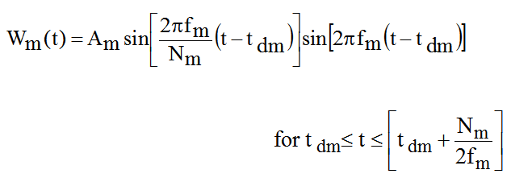
Wavelet Equation
W_{m} (t) = acceleration at time t for wavelet m
A_{m} = acceleration amplitude f _{m} = frequency t _{dm} = delay
N_{m} = number of half-sines, odd integer > 3

Slide 14
Typical Wavelet

Slide 15
Sample Bending Wave Propagation
This is a simplification because the phase and group speeds are equal in the model

Slide 16
Source Corresponding Time History
The synthesized time history is a wavelet series

Slide 17
Source SRS
Table 1. Source Q=10
Natural Frequency (Hz) | Peak Acceleration (G)
10 | 1
5000 | 11000
10000 | 11000
The Q applies to a hypothetical component attached to the beam
The ramp slope is 9 dB/octave, which is midway between the constant velocity and constant displacement lines

Slide 18
Wavelet Filtering
The synthesized time history is a wavelet series
Each wavelet has frequency, amplitude, number of half-sines and delay time
Apply separate attenuation factor to each amplitude based on its frequency
Increase delay time based on the distance from the source and the group speed for the wavelet frequency
Reconstruct time history from modified wavelet table
Calculate SRS for reconstructed time history

Slide 19
Peak Remaining Ratio at 100 inch
Expect ∼ 0.1 from Martin-Marietta curve for Cylindrical Shell with unreferenced damping

Slide 20
Sample Time History Pair, Distance Attenuation
Absolute Peaks:
Source 3000 G
Response 300 G

Slide 21
Sample SRS Pair, Distance Attenuation
For a given beam with uniform material and geometric properties, distance attenuation per length is

Slide 22
Distance Attenuation Comparison
Note that the Martin-Marietta Cylindrical Shell curve is not referenced to:
Waveform type (bending, longitudinal, etc.)
Measurement axis
Damping value
The two curves are somewhat similar
The 3.25% Beam Bending curve appears to be a good, simple model for the Cylindrical Shell curve

Slide 23
Longitudinal Wave Example, 100 inch
Longitudinal Waves are non-dispersive
Phase & Group Speeds are equal
ρ is mass/volume
Same beam and source shock for longitudinal case
Same distance attenuation equation, but longitudinal waves are much faster, hence less attenuation

Slide 24
Wave Speed Comparison

Slide 25
Distance Attenuation Summary
The attenuation/length is directly proportional to the loss factor and hence the damping
Greater attention should be given to measuring the modal damping on launch vehicles
The simplified beam bending model, calibrated to 3.25% damping, proved to be a reasonable representation for the Martin Cylindrical Shell attenuation curve
The 3.25% value is plausible for launch vehicle structures, but damping can vary widely due to structural details, mass properties, frequency, etc.
The longitudinal bending model yielded less attenuation than that given in the Cylindrical Shell attenuation curve because these waves are faster
The modal density for bending modes should be much higher than that for longitudinal modes
Less then expected attenuation in measured data could be due to light damping below 3% or to contribution of longitudinal waves

Slide 26
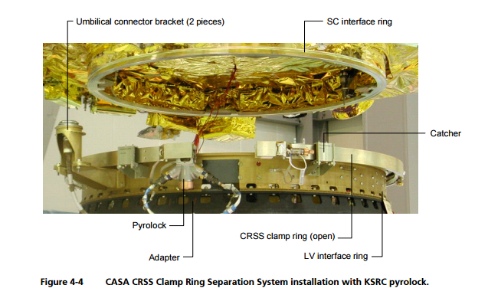
Joint Example
Spacecraft/Launch Vehicle Clamp Ring Joint (Image Courtesy of Eurocket)

Slide 27
Martin-Marietta Joint Attenuation
Interface | Percent Reduction
Solid Joint Riveted butt joint Matched angle joint Solid Joint with layer of different material in Joint | 0 0 30 – 60 0 - 30

Slide 28
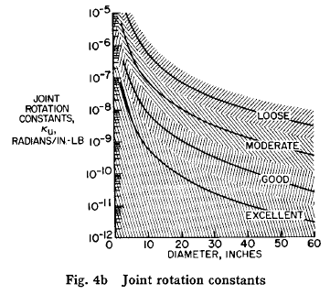
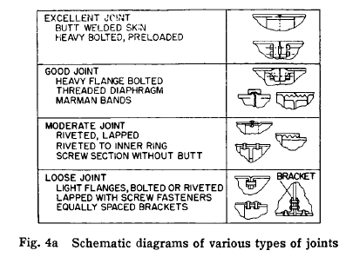
V. Alley and S. Leadbetter, AIAA, 1963
Joints are difficult regions to define and generally are the spaces that contribute a major part to the flexibility
Such contributions are consistently encountered from looseness in screwed joints, thread deflections, flange flexibility, plate and shell deformations that are not within the confines of beam, theory, etc.
Also nonlinearity

Slide 29
Sample Launch Vehicle Stiffness Profile
The EI values are very low at the vehicle’s six joints

Slide 30
Wave Propagation Approach for Joints
Model joint as elastic interlayer
Cremer & Heckl Formula for beam bending with elastic interlayer
Transmission loss across joint R
The coefficients are
Subscripts: 1=beam 2=joint

Slide 31
Transmission Curves, Cremer & Heckl
Same semi-infinite beam as was used for distance attenuation
Each curve has a 10 dB/octave roll-off, which would be a straight line if the plot was log-log
Total transmission frequency occurs where remaining ratio = 1
Does not seem realistic for modeling launch vehicle joint attenuation due to steep roll-off, etc.
So shelved this approach
r = (joint bending stiffness/beam bending stiffness)

Slide 32
Alternate Method, User-Defined Transmission
Assume a vehicle with a 36 inch diameter, aluminum cylindrical module
Ring frequency = 1737 Hz
Experience from numerous separation tests is that there is often a high modal density near the ring frequency, about which the highest transmission occurs
So assume unity gain up to 2000 Hz, with 3 dB/octave roll-off
Apply this transmission to the previous source wavelet table for both longitudinal& bending

Slide 33
SRS Comparison for Joint Near Source
Applied user-defined transmission function to wavelet table for time domain filtering
The plateau attenuation is ∼ 4 dB, which seems reasonable for typical launch vehicle joints

Slide 34
Time History Comparison for Joint Near Source

Slide 35
Joint Attenuation Summary
The user-define transmission function along with the wavelet filtering method seems reasonable as long as the transmission function is conservative
More research is needed…

