Slide 1
Vibrationdata
Launch Vehicle Pogo, Combustion Instability
and Thrust Oscillation
By Tom Irvine

Slide 2
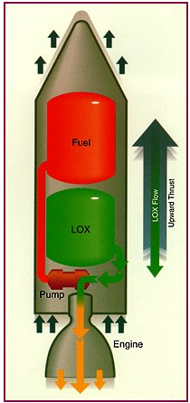
Introduction
Vibrationdata
Pogo is a form of self-excited vibration that sometimes occurs during the launch and ascent of space vehicles powered by liquid propellant rocket engines
The phenomenon is due to a coupling between the first longitudinal resonance of the vehicle and the fuel flow to the rocket engines
As the structure responds to perturbations at its longitudinal resonant frequency, the fuel flow to the rocket engine(s) is accelerated and decelerated, causing the engine thrust to oscillate at the same frequency
These thrust oscillations drive the structural resonance, producing a classical closed-loop instability
Dangerous to the vehicle structure, its payloads, and for manned vehicles, to the astronauts
Coupling between other structural modes may also occur

Slide 3
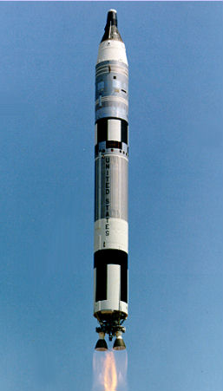
Gemini Program Titan II Pogo
Vibrationdata
The Titan II rocket was used for the Gemini spaceflight program, which was carried out in 1965 and 1966
Two astronauts flew in each Gemini spacecraft
The rocket fuel was a blend of plain hydrazine and unsymmetrical dimethyl hydrazine
The oxidizer was nitrogen tetroxide
This fuel combination is “hypergolic,” which means that the fuels ignite spontaneously when mixed together
Astronaut Michael Collins wrote:
  The first stage of the Titan II vibrated longitudinally, so that someone riding on it would be bounced up and down as if on a pogo stick. The vibration was at a relatively high frequency, about 11 cycles per second, with an amplitude of plus or minus 5 Gs in the worst case.

Slide 4
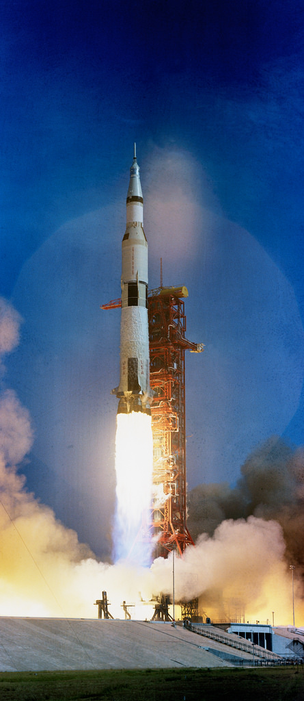
Saturn V
Vibrationdata
The Saturn V booster was used for the Apollo program, which was carried out from 1968 to 1972
Astronauts Neil Armstrong and Buzz Aldrin became the first men to set foot on the Moon, during the Apollo 11 mission in July 1969
Stage | Stage Name | Fuel | Engines | Thrust (lbf)
1 | S-IC | kerosene (RP-1) & liquid oxygen | Five F-1 | 7.5 million
2 | S-II | liquid hydrogen & liquid oxygen | Five J-2 | 1 million
3 | S-IVB | liquid hydrogen & liquid oxygen | Single J-2 | 200,000

Slide 5
Saturn V Pogo
Vibrationdata
Aldrin described an unmanned test flight of the Saturn V in 1968:
The entire 360-foot stack bounced like a giant Pogo stick. This dangerous “Pogo effect” had been seen with smaller boosters but was completely unexpected in Saturn V.
Aldrin summarized the design modifications made by Wernher von Braun’s engineering team:
They discovered that the “Pogo effect” was due to a resonating harmonic frequency in the F-1 engines that closely matched the twanging of the booster stack. They corrected the problem by “detuning” the engines’ vibration frequencies.
A violent Pogo effect nevertheless occurred during first stage burn in the Apollo 10 mission in 1969
The three astronauts were unable to read the vibrating instrument panel
And they were slammed back and forth in their seats, even though they had their restraint straps securely fastened

Slide 6
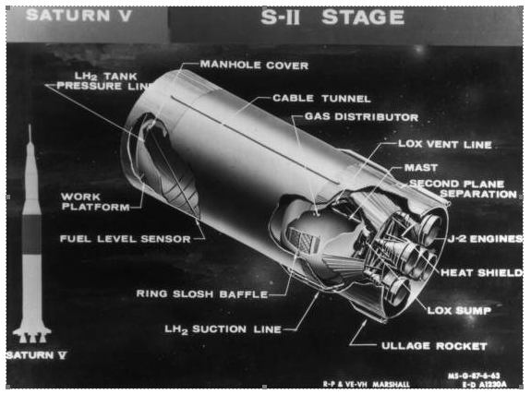
Apollo 13
Vibrationdata
The Apollo 13 vehicle had a severe pogo vibration with the center engine during second stage burn (unrelated to later oxygen tank explosion)
The engine experienced a 34 G vibration at 16 Hz, flexing the thrust frame by 2.6 inches peak-to-peak
This vibration was apparently localized to the engine frame
The engine frame’s natural frequency may have been excited into resonance
The structural vibration coupled with a pressure oscillation, as recorded by the center engine thrust chamber pressure sensor
Also note that the oscillation was accompanied by an unexpected interaction with the cavitation in the turbopumps
Cavitation is the generation of unwanted bubbles
The flight computer shut down the center engine automatically, as the result of a low pressure switch trigger
The outboard engines burned longer, however, compensating for the loss

Slide 7
Stage 2 Design Modifications
Vibrationdata
Engineers made a number of design changes to prevent this problem for Apollo 14
They added a helium gas accumulator in the liquid oxygen (LOX) line of the center engine
The accumulator is also referred to as a suppresser
The accumulator reservoir served to dampen or absorb fluid pressure oscillations, keeping them out of phase with the vibrations of the thrust structure and engines
The accumulator also lowered the first natural frequency of the propellant line, moving it down below the vehicle structural frequencies
The accumulator was actually designed prior to the Apollo 13 mission but was not ready in time for the flight
In addition, the propellant valves on all five second-stage engines were simplified

Slide 8
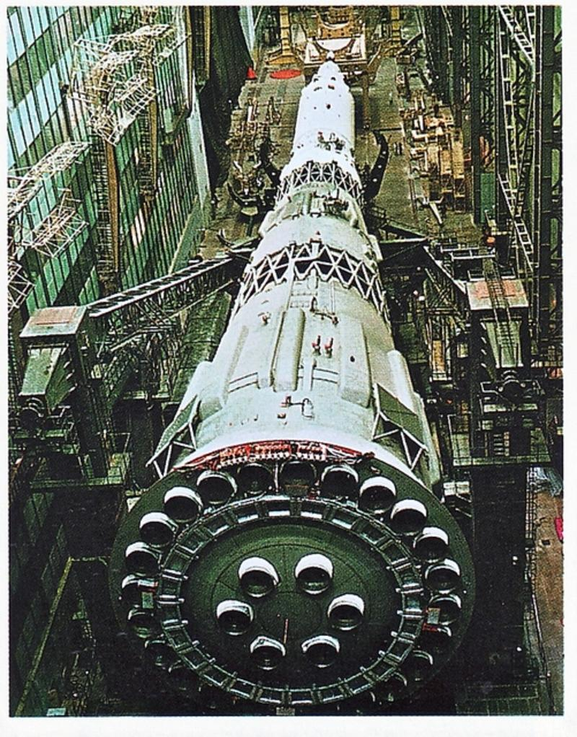
Soviet N-1 Rocket
Vibrationdata
The Soviet N-1 rocket had thirty NK-15 rocket engines
Its height was over 100 meters
The N-1 had four unmanned flight tests. Each resulted in failure before first stage separation
The N-1 never had a successful mission
The N-1 had exhaust plume fluid dynamic problems, as well as vibration problems
Pogo vibration was a particular problem for the fourth launch in November 1972
The pogo occurred at stage 1 initial cutoff in this flight

Slide 9
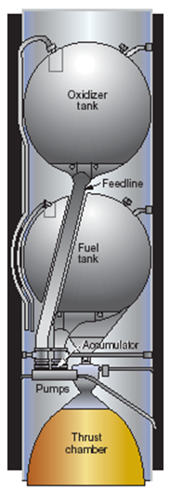
Accumulator
Vibrationdata
A close matching of the propellant and structural frequencies may be prevented by installing an accumulator in the feed line
The accumulator contains a volume of gas that acts like a soft spring to reduce the propellant frequency to well below that of critical structural frequencies
The accumulator volume must be carefully selected to meet this goal

Slide 10
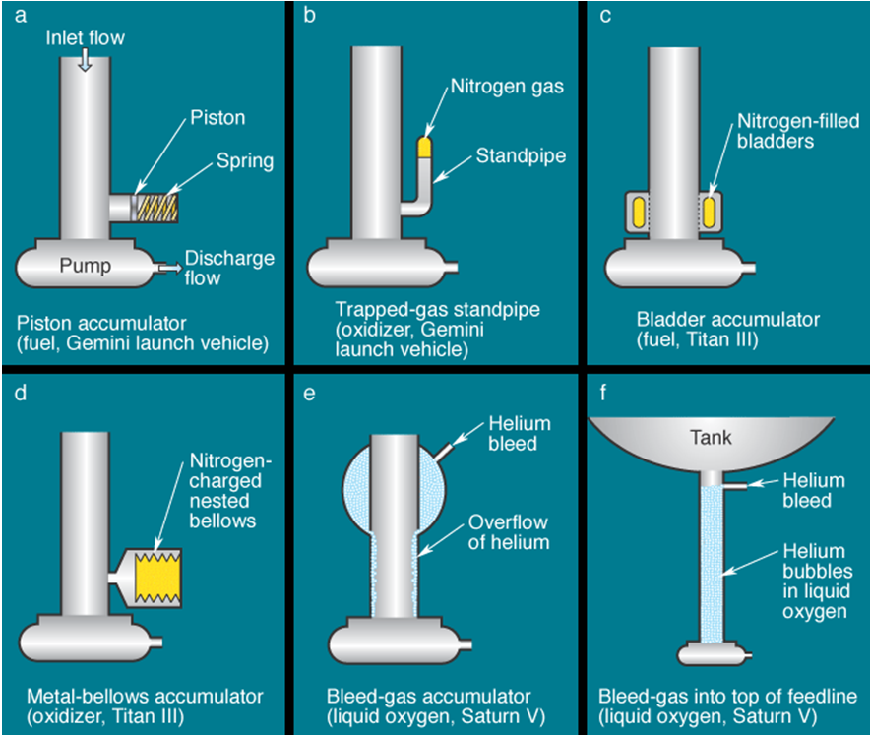
Accumulator Types
Courtesy of the Aerospace Corporation
Some were proposed, others were actually used

Slide 11
Combustion Instabilities
Vibrationdata
Combustion in a liquid rocket engine does not occur in an ideal thermodynamic manner
Thermo-acoustic instabilities are characterized by a detrimental coupling between combustion dynamics and the acoustic modes of the combustion chamber
The pressure, temperature, propellant flow rate, and exhaust velocity each experience fluctuations
Propellant pump cavitation and gas entrapment in propellant flow may contribute to these fluctuations
The pressure fluctuation can interact with the natural frequencies of the propellant feed system or the combustion chamber acoustic volume
This interaction causes instability oscillations
A rocket with “smooth combustion” has pressure fluctuations that do not exceed +5% of the mean chamber pressure, during steady operation

Slide 12
Combustion Instabilities (cont)
Vibrationdata
Type | Frequency Range (Hz) | Cause Relationship
Low frequency called chugging or system instability | 10-200 | Linked with pressure interactions between the propellant feed system and combustion chamber. May excite longitudinal vibration mode of entire vehicle.
Intermediate frequency, called acoustical, buzzing, or entropy waves | 200-1000 | Linked with mechanical vibrations of propulsion structure, injector manifold flow eddies, fuel/oxidizer fluctuations, and propellant feed system resonances.
High frequency called screaming, screeching, or squealing | Above 1000 | Linked with combustion pressure waves and chamber acoustical resonance properties.

Slide 13
Control of Combustion Instabilities
Vibrationdata
Reducing the feedback from the combustion process in the main chamber to the fuel injectors can control instability
Three design fixes are:
1. Modifying the injector design
2. Increasing the injector pressure drop
3. Increasing acoustical damping within the combustion chamber
Injector face baffles can be used to minimize coupling and amplification of gas dynamic forces within the chamber
This solution assumes that the driving source of the oscillations is located at the injector end of the combustion chamber

Slide 14
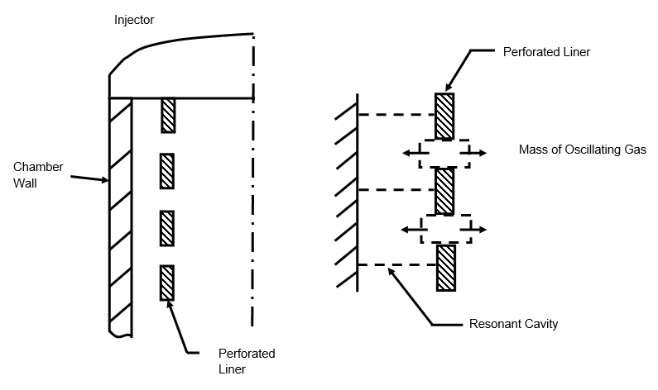
Helmholtz Resonators
Vibrationdata
Perforated liners or cavities may be placed along the wall of a combustion chamber
These devices act as Helmholtz resonators that remove oscillation energy from the pressure fluctuations
Reference: G. Sutton, Rocket Propulsion Elements, Fifth Edition, Wiley, New York, 1986
NASA TN D-3792, D-4968, & D-5171
Similar technology is used in gas turbine engines and automotive mufflers

Slide 15
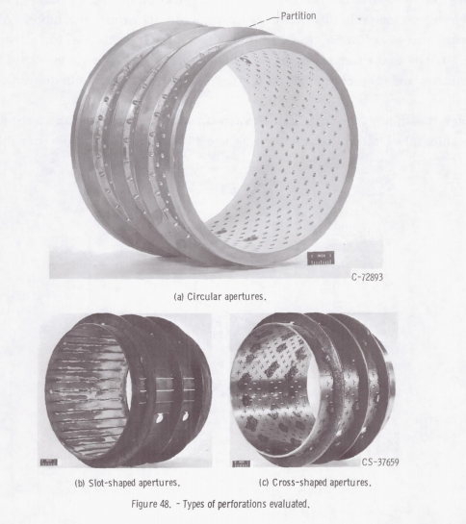
NASA TN D-4968
Vibrationdata
Interim Summary of Liquid Rocket Acoustic-Mode-Instability Studies at a Nominal Thrust of 20,000 Pounds
Acoustic liner test configurations
“Several instances have been reported where unstable engines have been made stable by the use of acoustic liners”

Slide 16
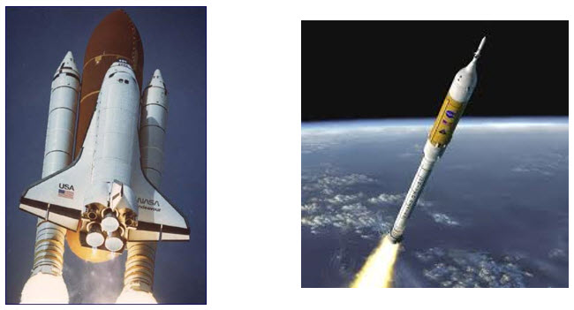
Space Shuttle & Ares I Solid Rocket Boosters
Vibrationdata
Solid rocket boosters have elongated internal combustion cavities which act as organ pipes
Vortex shedding within the hot exhaust gases drives standing pressure waves inside these cavities
These pressure waves have a fundamental thrust oscillation frequency with integer harmonics
The cavities can be modeled as closed-closed pipes because the nozzle throat diameter is relatively small compared to the cavity diameter
The Space Shuttle boosters’ thrust oscillation frequency was 15 Hz
The Ares I vehicle was projected to have a 12 Hz oscillation (but never flew)
Note that the speed of sound in the internal hot exhaust gas is about 3500 ft/sec
Space Shuttle & Ares I Solid Rocket Boosters

Slide 17
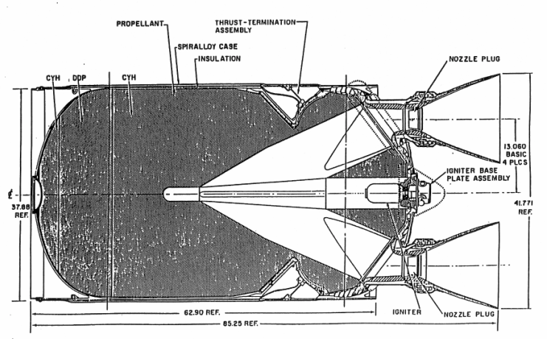
Upper Stage Solid Rocket Motor
Vibrationdata
Solid rocket motors may have standing pressure oscillations which form in the combustion chamber cavities, caused by vortex-shedding and other effects
This condition is called “Resonant Burn” or “Thrust Oscillation”
The sinusoidal oscillation frequency may sweep downward as the cavity volume increases due to the conversion of propellant to exhaust gas

Slide 18
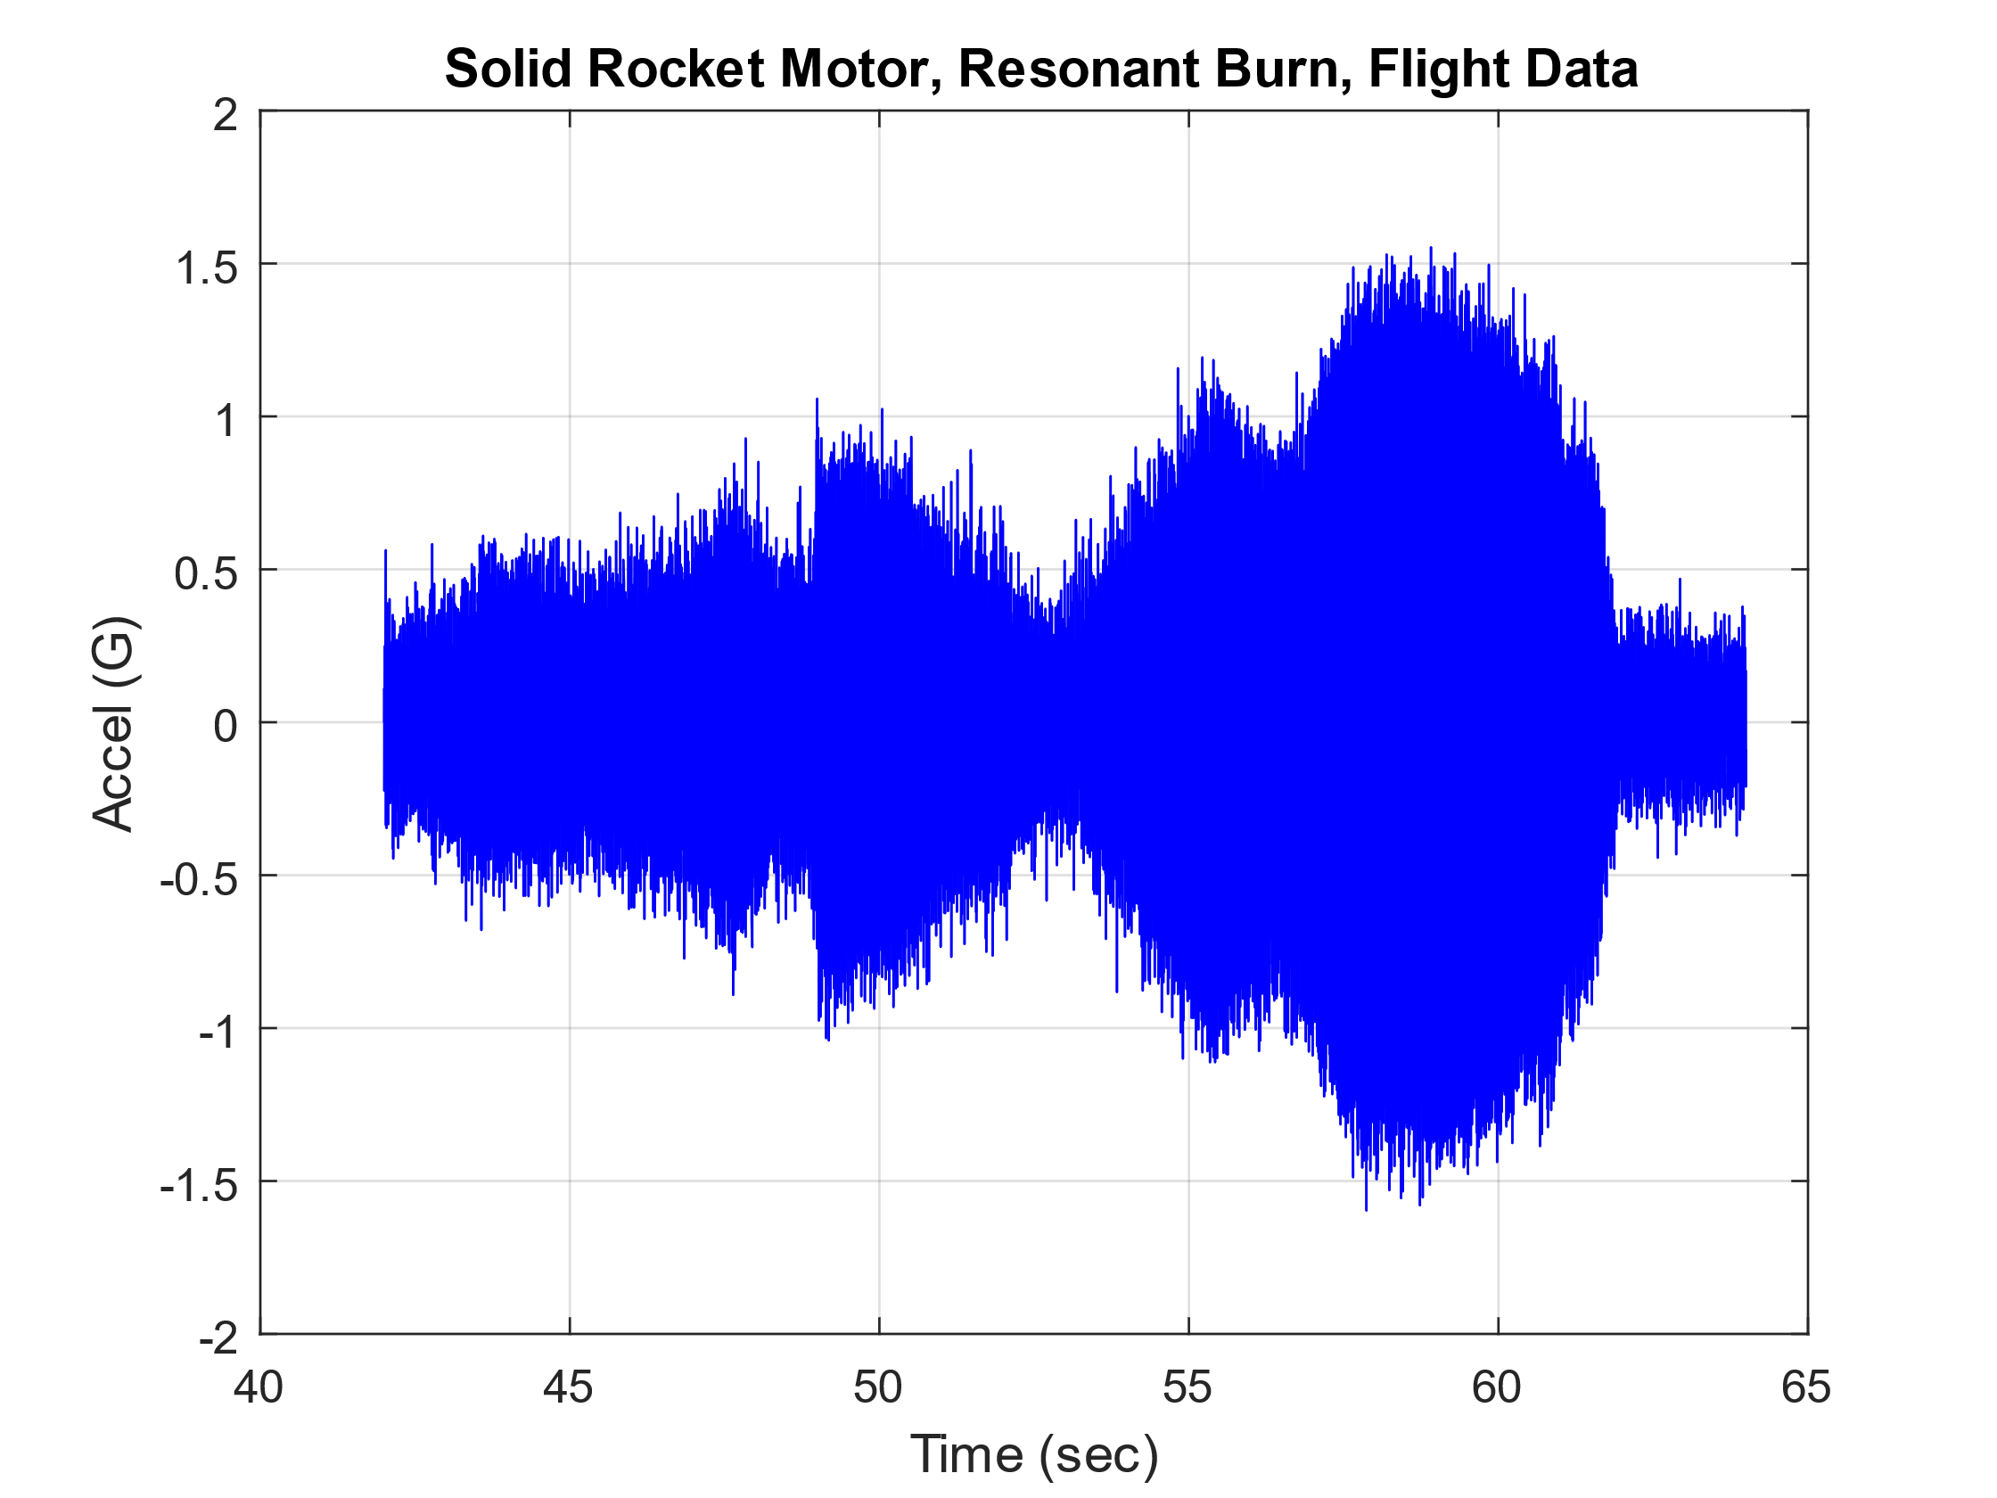
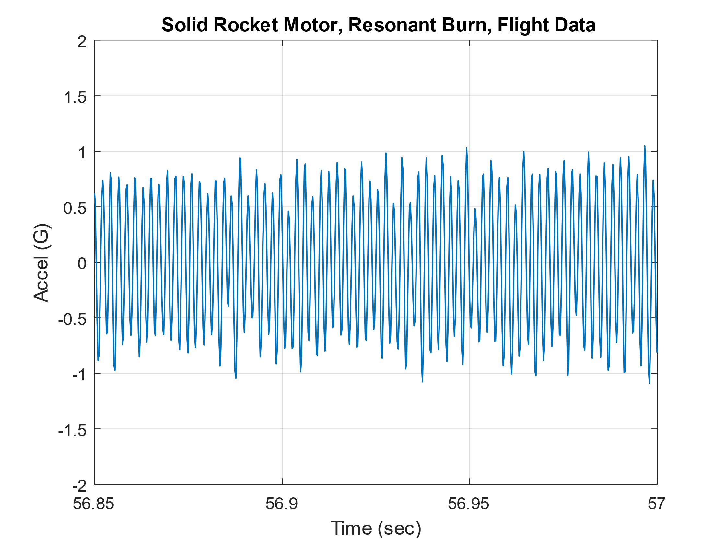
Flight Accelerometer Data, Resonant Burn, Time History
Vibrationdata
Solid Motor Resonance Burn, Accelerometer Data, Full and Close-up Views
The data was collected on a bulkhead in a vehicle with the solid rocket motor on the previous slide

Slide 19
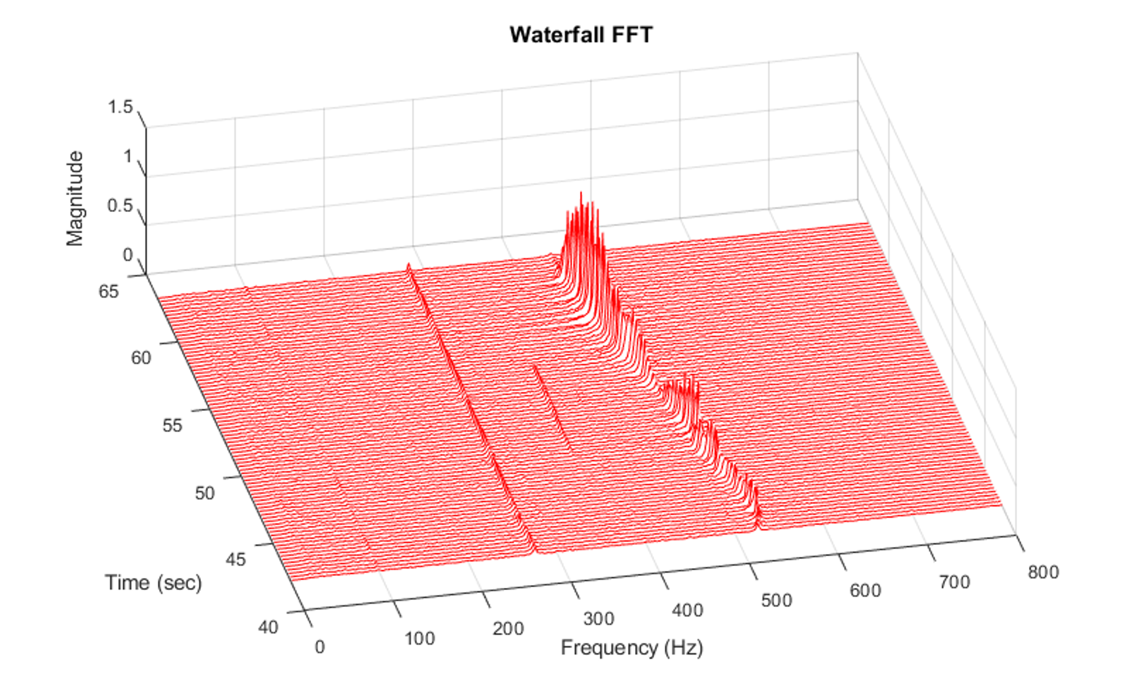
Flight Accelerometer Data, Resonant Burn, Waterfall FFT
Vibrationdata
The resonant burn spectral peaks begin at 520 Hz and then sweep downward to 450 Hz
The corresponding amplitude varies with both frequency and time probably due to structural resonance effects as measured by the bulkhead accelerometer
The causes of peaks at 280 and 350 Hz are unknown

