Slide 1
84th Shock and Vibration Symposium 2013
Rainflow Cycle Counting for Random Vibration Fatigue Analysis
By Tom Irvine

Slide 2


This presentation is sponsored by
NASA Engineering & Safety Center (NESC)
Dynamic Concepts, Inc. Huntsville, Alabama
Vibrationdata

Slide 3
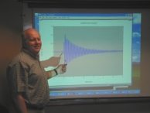
Contact Information
Tom Irvine
Email: tirvine@dynamic-concepts.com
Phone: (256) 922-9888 x343
The software programs for this tutorial session are available at:
http://www.vibrationdata.com
Username: lunar
Password: module

Slide 4
Introduction
Structures & components must be designed and tested to withstand vibration environments
Components may fail due to yielding, ultimate limit, buckling, loss of sway space, etc.
Fatigue is often the leading failure mode of interest for vibration environments, especially for random vibration
Dave Steinberg wrote:
The most obvious characteristic of random vibration is that it is nonperiodic. A knowledge of the past history of random motion is adequate to predict the probability of occurrence of various acceleration and displacement magnitudes, but it is not sufficient to predict the precise magnitude at a specific instant.

Slide 5
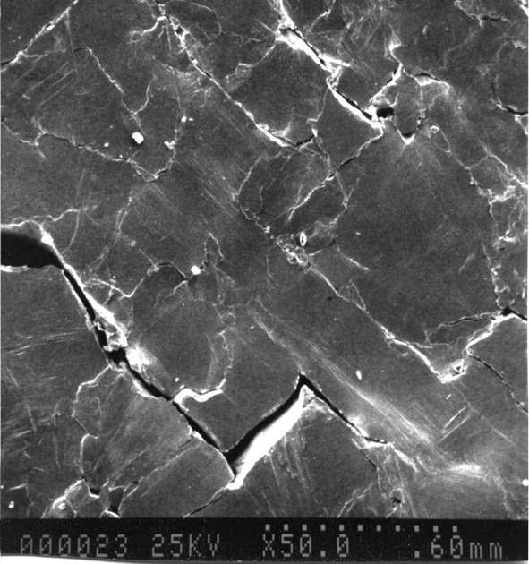
Fatigue Cracks
A ductile material subjected to fatigue loading experiences basic structural changes. The changes occur in the following order:
Crack Initiation. A crack begins to form within the material.
Localized crack growth. Local extrusions and intrusions occur at the surface of the part because plastic deformations are not completely reversible.
Crack growth on planes of high tensile stress. The crack propagates across the section at those points of greatest tensile stress.
Ultimate ductile failure. The sample ruptures by ductile failure when the crack reduces the effective cross section to a size that cannot sustain the applied loads.

Slide 6
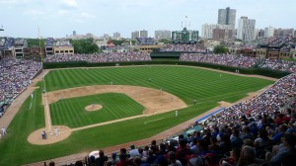
Some Caveats
Vibration fatigue calculations are “ballpark” calculations given uncertainties in S-N curves, stress concentration factors, non-linearity, temperature and other variables.
Perhaps the best that can be expected is to calculate the accumulated fatigue to the correct “order-of-magnitude.”

Slide 7

Rainflow Fatigue Cycles
Endo & Matsuishi 1968 developed the Rainflow Counting method by relating stress reversal cycles to streams of rainwater flowing down a Pagoda. ASTM E 1049-85 (2005) Rainflow Counting Method
Goju-no-to Pagoda, Miyajima Island, Japan

Slide 8
Sample Time History

Slide 9
Rainflow Cycle Counting
Rotate time history plot 90 degrees clockwise
Rainflow Cycles by Path
Path | Cycles | Stress Range
A-B | 0.5 | 3
B-C | 0.5 | 4
C-D | 0.5 | 8
D-G | 0.5 | 9
E-F | 1.0 | 4
G-H | 0.5 | 8
H-I | 0.5 | 6

Slide 10
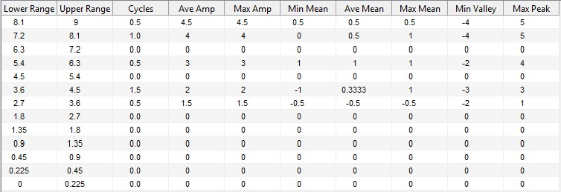
Rainflow Results in Table Format - Binned Data
Range = (peak-valley)
Amplitude = (peak-valley)/2
(But I prefer to have the results in simple amplitude & cycle format for further calculations)

Slide 11
Use of Rainflow Cycle Counting
Can be performed on sine, random, sine-on-random, transient, steady-state, stationary, non-stationary or on any oscillating signal whatsoever
Evaluate a structure’s or component’s failure potential using Miner’s rule & S-N curve
Compare the relative damage potential of two different vibration environments for a given component
Derive maximum predicted environment (MPE) levels for nonstationary vibration inputs
Derive equivalent PSDs for sine-on-random specifications
Derive equivalent time-scaling techniques so that a component can be tested at a higher level for a shorter duration
And more!

Slide 12
Rainflow Cycle Counting – Time History Amplitude Metric
Rainflow cycle counting is performed on stress time histories for the case where Miner’s rule is used with traditional S-N curves
Can be used on response acceleration, relative displacement or some other metric for comparing two environments

Slide 13
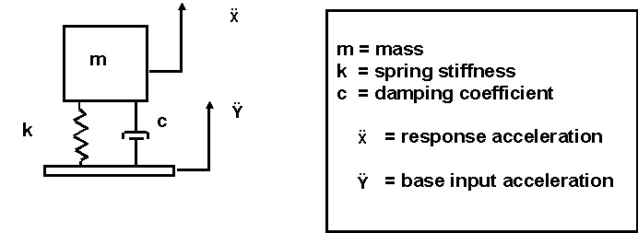
For Relative Comparisons between Environments . . .
The metric of interest is the response acceleration or relative displacement
Not the base input!
If the accelerometer is mounted on the mass, then we are good-to-go!
If the accelerometer is mounted on the base, then we need to perform intermediate calculations

Slide 14
Bracket Example, Variation on a Steinberg Example
Power Supply
Solder Terminal
0.25 in
4.7 in
2.0 in
5.5 in
Aluminum Bracket
Power Supply Mass | M = 0.44 lbm= 0.00114 lbf sec^2/in
Bracket Material | Aluminum alloy 6061-T6
Mass Density | ρ=0.1 lbm/in^3
Elastic Modulus | E= 1.0e+07 lbf/in^2
Viscous Damping Ratio | 0.05

Slide 15
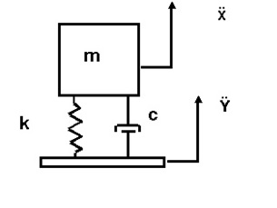
Bracket Natural Frequency via SDOF Model

Slide 16
Base Input PSD
Table 1. Base Input PSD, 6.1 GRMS
Frequency (Hz) | Accel (G^2/Hz)
20 | 0.0053
150 | 0.04
600 | 0.04
2000 | 0.0036
Now consider that the bracket assembly is subjected to the random vibration base input level. The duration is 3 minutes.

Slide 17
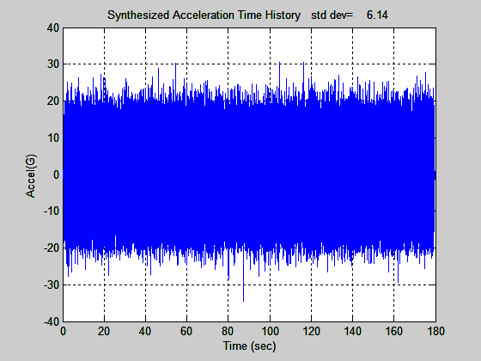
Base Input Time History
An acceleration time history is synthesized to satisfy the PSD specification
The corresponding histogram has a normal distribution, but the plot is omitted for brevity
Note that the synthesized time history is not unique

Slide 18
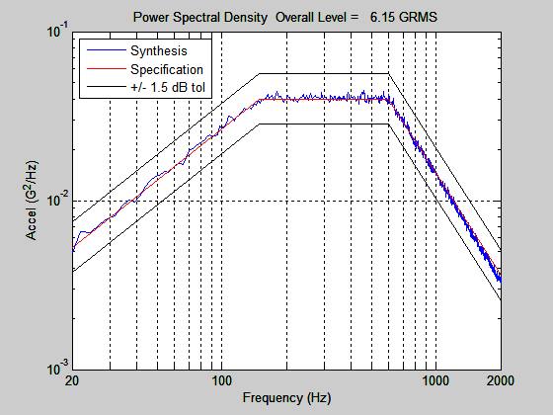
PSD Verification

Slide 19
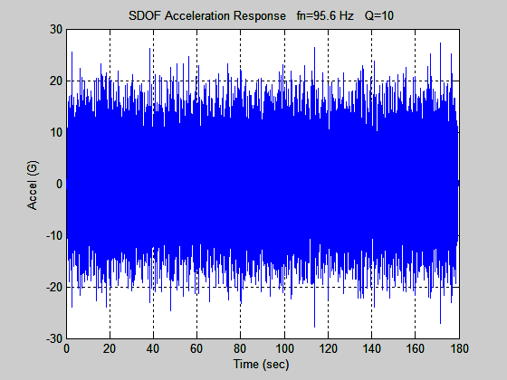
Acceleration Response
The response is narrowband
The oscillation frequency tends to be near the natural frequency of 95.6 Hz
The overall response level is 6.1 GRMS
This is also the standard deviation given that the mean is zero
The absolute peak is 27.8 G, which respresents a 4.52-sigma peak
Some fatigue methods assume that the peak response is 3-sigma and may thus under-predict fatigue damage

Slide 20
Stress & Moment Calculation, Free-body Diagram
L
x
M_{R}
R
F
The reaction moment M _{R} at the fixed-boundary is:
The force F is equal to the effect mass of the bracket system multiplied by the acceleration level.
The effective mass m _{e} is:

Slide 21
Stress & Moment Calculation, Free-body Diagram
The bending moment at a given distance from the force application point is
where A is the acceleration at the force point.
The bending stress S _{b} is given by
The variable K is the stress concentration factor.
The variable C is the distance from the neutral axis to the outer fiber of the beam.
Assume that the stress concentration factor is 3.0 for the solder lug mounting hole.

Slide 22
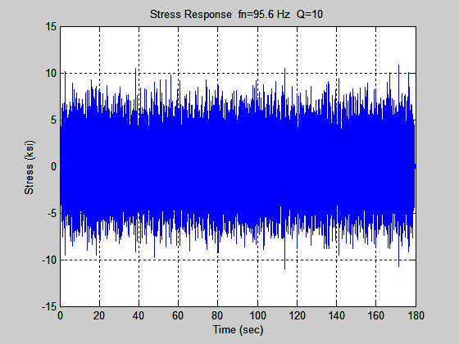
Stress Time History at Solder Terminal
Apply Rainflow Counting on the Stress time history and then Miner’s Rule in the following slides
The standard deviation is 2.4 ksi
The highest absolute peak is 11.0 ksi, which is 4.52-sigma
The 4.52 multiplier is also referred to as the “crest factor.”

Slide 23
Stress Rainflow Cycle Count
Stress Results from Rainflow Cycle Counting, Bin Format, Stress Unit: ksi, Base Input Overall Level = 6.1 GRMS
Range
Upper Limit | Lower Limit | Cycle Counts | Average Amplitude | Max Amp | Min Mean | Average Mean | Max Mean | Min Valley | Max Peak
19.66 | 21.84 | 3.5 | 10.43 | 10.92 | -0.29 | 0.073 | 0.54 | -11.02 | 10.82
17.47 | 19.66 | 21.0 | 9.11 | 9.80 | -0.35 | 0.152 | 0.58 | -9.82 | 10.11
15.29 | 17.47 | 108.0 | 8.07 | 8.70 | -1.36 | 0.002 | 0.67 | -9.53 | 9.09
13.10 | 15.29 | 372.0 | 6.98 | 7.63 | -1.07 | -0.026 | 0.71 | -8.51 | 8.34
10.92 | 13.10 | 943.0 | 5.94 | 6.55 | -1.02 | 0.006 | 1.00 | -7.16 | 7.20
8.74 | 10.92 | 2057.5 | 4.86 | 5.46 | -1.23 | -0.010 | 0.98 | -6.54 | 6.15
6.55 | 8.74 | 3657.0 | 3.79 | 4.37 | -1.19 | -0.002 | 1.15 | -5.30 | 5.20
4.37 | 6.55 | 4809.5 | 2.72 | 3.28 | -1.02 | 0.002 | 1.06 | -4.22 | 4.13
3.28 | 4.37 | 2273.5 | 1.92 | 2.18 | -0.93 | 0.005 | 0.94 | -3.06 | 2.94
2.18 | 3.28 | 1741.5 | 1.39 | 1.64 | -0.89 | 0.002 | 0.92 | -2.36 | 2.56
1.09 | 2.18 | 1140.0 | 0.83 | 1.09 | -1.04 | 0.020 | 1.24 | -2.03 | 1.98
0.55 | 1.09 | 670.0 | 0.40 | 0.55 | -1.63 | -0.003 | 1.86 | -1.92 | 2.40
0.00 | 0.55 | 9743.0 | 0.04 | 0.27 | -6.00 | -0.024 | 5.83 | -6.01 | 5.84
But use amplitude-cycle data directly in Miner’s rule, rather than binned data!

Slide 24
Miner’s Cumulative Fatigue
Let n be the number of stress cycles accumulated during the vibration testing at a given level stress level represented by index i
Let N be the number of cycles to produce a fatigue failure at the stress level limit for the corresponding index.
Miner’s cumulative damage index R is given by
where m is the total number of cycles or bins depending on the analysis type
In theory, the part should fail when Rn (theory) = 1.0
For aerospace electronic structures, however, a more conservative limit is used Rn(aero) = 0.7

Slide 25
S-N Curve
For N>1538 and S < 39.7
log₁₀ (S) = -0.108 log₁₀ (N) +1.95
log₁₀ (N) = -9.25 log₁₀ (S) + 17.99
The curve can be roughly divided into two segments
The first is the low-cycle fatigue portion from 1 to 1000 cycles, which isconcave as viewed from the origin
The second portion is the high-cycle curve beginning at 1000, which is convex as view from the origin
The stress level for one cycle is the ultimate stress limit

Slide 26
SDOF System, Solder Terminal Location, Fatigue Damage Results for Various Input Levels, 180 second Duration, Crest Factor = 4.52
Input Overall Level (GRMS) | Input Margin (dB) | Response Stress Std Dev (ksi) | R
6.1 | 0 | 2.4 | 7.4e-08
8.7 | 3 | 3.4 | 2.0e-06
12.3 | 6 | 4.9 | 5.3e-05
17.3 | 9 | 6.9 | 0.00142
24.5 | 12 | 9.7 | 0.038
27.4 | 13 | 10.89 | Ultimate Failure
Cumulative Fatigue Results
Again, the success criterion was R < 0.7
The fatigue failure threshold is somewhere between the 12 and 13 dB margin
The data shows that the fatigue damage is highly sensitive to the base input and resulting stress levels

Slide 27
SDOF System, Solder Terminal Location, Fatigue Damage Results for Various Durations, 12.2 GRMS Input
Duration (sec) | Stress RMS (ksi) | Crest Factor | R
180 | 4.82 | 4.65 | 5.37e-05
360 | 4.89 | 4.91 | 0.000123
720 | 4.89 | 4.97 | 0.000234
Duration Study
A new, 720-second signal was synthesized for the 6 dB margin case
A fatigue analysis was then performed using the previous SDOF system
The analysis was then repeated using the 0 to 360 sec and 0 to 180 sec segments of the new synthesized time history.
The R values for these three cases are shown in the above table
The R value is approximately directly proportional to the duration, such that a doubling of duration nearly yields a doubling of R

Slide 28
SDOF System, Solder Terminal Location, Fatigue Damage Results for Various Time History Cases, 180-second Duration, 12.2 GRMS Input
Stress RMS (ksi) | Crest Factor | Kurtosis | R
4.86 | 5.44 | 3.1 | 6.99E-05
4.89 | 4.40 | 3.0 | 5.18E-05
4.80 | 4.43 | 3.0 | 4.93E-05
4.90 | 4.46 | 3.1 | 7.06E-05
4.89 | 5.79 | 3.0 | 7.60E-05
4.88 | 4.95 | 3.0 | 6.02E-05
4.84 | 4.64 | 3.0 | 4.76E-05
4.82 | 4.65 | 3.1 | 5.37E-05
4.81 | 4.37 | 3.0 | 4.38E-05
4.86 | 4.57 | 3.0 | 5.30E-05
4.84 | 4.60 | 3.0 | 5.11E-05
4.86 | 4.27 | 3.0 | 4.67E-05
Time History Synthesis Variation Study
A set of time histories was synthesized to meet the base input PSD + 6 dB
Limits for Stress Response Parameters
Parameter | Min | Max
Stress (ksi) | 4.80 | 4.90
Crest Factor | 4.27 | 5.79
Kurtosis | 2.99 | 3.12
R | 4.38E-05 | 7.60E-05
Response peaks above 3-sigma make a significant contribution to fatigue damage.

Slide 29
Time History Synthesis Variation Study, Peak Expected Value
& T = 180-second duration
Again, crest factor is the ratio of the peak to the RMS.
In the previous example, the crest factors varied from 4.27 to 5.79
with an average of 4.71
The maximum expected peak response from Rayleigh distribution is: 4.55
The formula is for the maximum predicated crest factor C is
Please be mindful of potential variation in both numerical experiments, physical tests, field environments, etc!

Slide 30
Continuous Beam Subjected to Base Excitation
EI, ρ
Cross-Section | Rectangular
Boundary Conditions | Fixed-Free
Material | Aluminum
L
Width | = | 2.0 in
Thickness | = | 0.25 in
Length | = | 12 in
Elastic Modulus | = | 1.0e+07 lbf/in^2
Area Moment of Inertia | = | 0.0026 in^4
Mass per Volume | = | 0.1 lbm/in^3
Mass per Length | = | 0.05 lbm/in
Viscous Damping Ratio | = | 0.05 for all modes
y(x, t)
w(t)

Slide 31
Continuous Beam Natural Frequencies
Natural Frequency Results, Fixed-Free Beam
Mode | fn (Hz) | Participation Factor | Effective Modal Mass (lbm)
1 | 55 | 0.031 | 0.368
2 | 345 | 0.017 | 0.113
3 | 967 | 0.010 | 0.039
4 | 1895 | 0.007 | 0.020
5 | 3132 | 0.006 | 0.012

Slide 32
Continuous Beam Stress Levels
Continuous Beam, Stress at Fixed Boundary, Fatigue Damage Results, 180-second Duration, 68.9 GRMS Input
Modes Included | Stress RMS (ksi) | Crest Factor | Kurtosis | R
1 | 6.07 | 5.78 | 3.09 | 0.0004426
2 | 6.41 | 5.33 | 3.08 | 0.001138
3 | 6.42 | 5.37 | 3.08 | 0.001243
4 | 6.42 | 5.40 | 3.08 | 0.001260
Calculate the bending stress at the fixed boundary
Omit the stress concentration factor
The base input time history is the same as that in the bracket example with 21 dB margin
The purpose of this investigation was to determine the effect of including higher modes for a sample continuous system

Slide 33
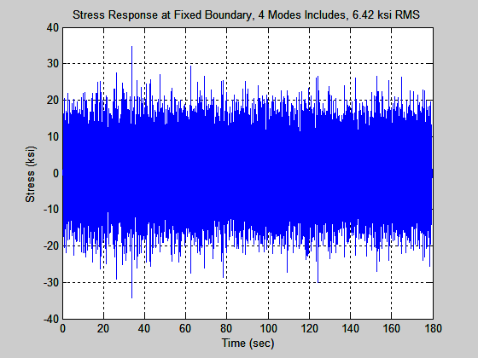
Continuous Beam, Sample Stress Time History

Slide 34
Time Scaling Equivalence
The following applies to structures consisting only of aluminum 6061-T6 material.
Perform some intermediate steps . . .
Assume linear behavior
A doubling of the stress value requires 1/613 times the number of reference cycles
Thus, if the acceleration GRMS level is doubled, then an equivalent test can be performed in 1/613 th of the reference duration, in terms of potential fatigue damage
But please be conservative . . . Add some margin . . .

Slide 35

Extending Steinberg’s Fatigue Analysis
of Electronics Equipment Methodology
via Rainflow Cycle Counting
By Tom Irvine

Slide 36
Project Goals
Develop a method for . . .
Predicting whether an electronic component will fail due to vibration fatigue during a test or field service
Explaining observed component vibration test failures
Comparing the relative damage potential for various test and field environments
Justifying that a component’s previous qualification vibration test covers a new test or field environment

Slide 37
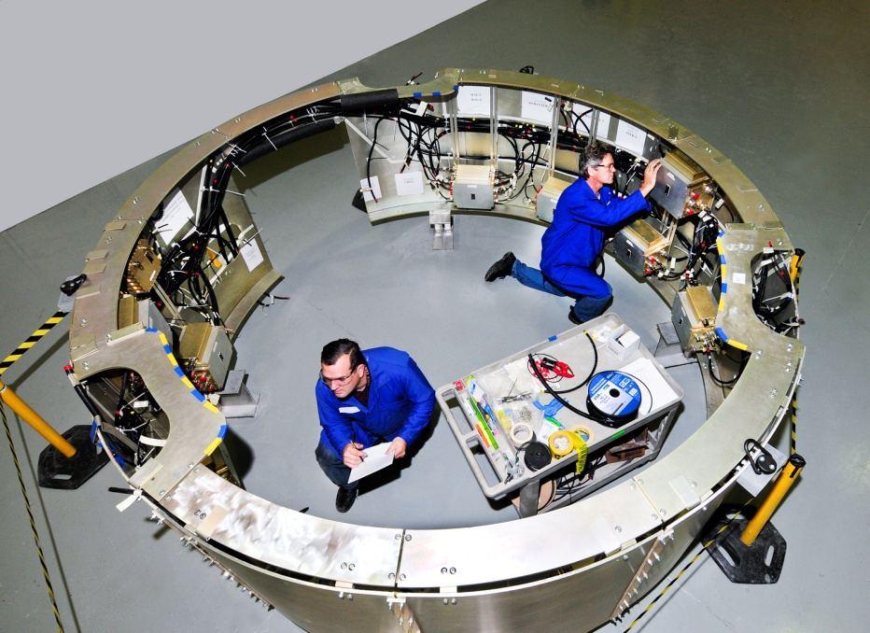
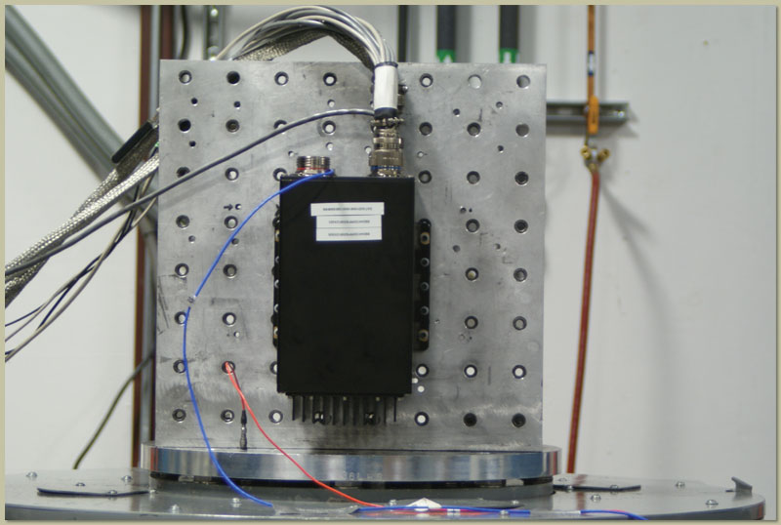
Electronic components in vehicles are subjected to shock and vibration environments.
The components must be designed and tested accordingly
Dave S. Steinberg’s Vibration Analysis for Electronic Equipment is a widely used reference in the aerospace and automotive industries.

Slide 38
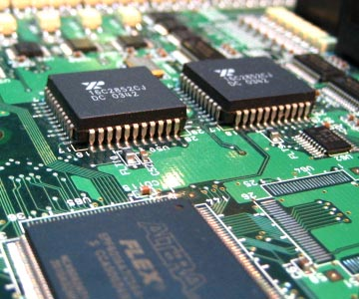
Steinberg’s text gives practical empirical formulas for determining the fatigue limits for electronics piece parts mounted on circuit boards
The concern is the bending stress experienced by solder joints and lead wires
The fatigue limits are given in terms of the maximum allowable 3-sigma relative displacement of the circuit boards for the case of 20 million stress reversal cycles at the circuit board’s natural frequency
The vibration is assumed to be steady-state with a Gaussian distribution

Slide 39
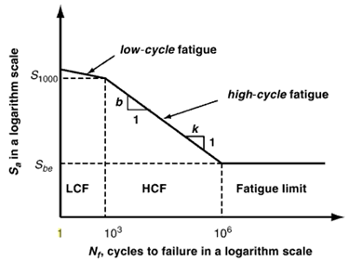
Fatigue Curves
Note that classical fatigue methods use stress as the response metric of interest
But Steinberg’s approach works in an approximate, empirical sense because the bending stress is proportional to strain, which is in turn proportional to relative displacement
The user then calculates the expected 3-sigma relative displacement for the component of interest and then compares this displacement to the Steinberg limit value

Slide 40
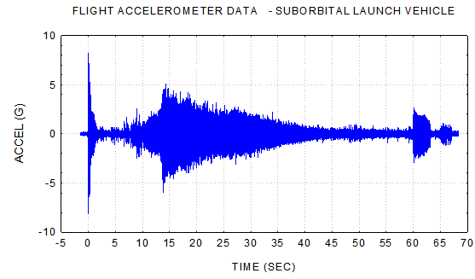
An electronic component’s service life may be well below or well above 20 million cycles
A component may undergo nonstationary or non-Gaussian random vibration such that its expected 3-sigma relative displacement does not adequately characterize its response to its service environments
The component’s circuit board will likely behave as a multi-degree-of-freedom system, with higher modes contributing non-negligible bending stress, and in such a manner that the stress reversal cycle rate is greater than that of the fundamental frequency alone

Slide 41


These obstacles can be overcome by developing a “relative displacement vs. cycles” curve, similar to an S-N curve
Fortunately, Steinberg has provides the pieces for constructing this RD-N curve, with “some assembly required”
Note that RD is relative displacement
The analysis can then be completed using the rainflow cycle counting for the relative displacement response and Miner’s accumulated fatigue equation

Slide 42
Steinberg’s Fatigue Limit Equation
L
Relative Motion
h
Component
Z
B
Relative Motion
Component
Component
Component and Lead Wires undergoing Bending Motion

Slide 43
Let Z be the single-amplitude displacement at the center of the board that will give a fatigue life of about 20 million stress reversals in a random-vibration environment, based upon the 3σ circuit board relative displacement.
Steinberg’s empirical formula for Z _{3σ limit} is
inches
B | = | length of the circuit board edge parallel to the component, inches
L | = | length of the electronic component, inches
h | = | circuit board thickness, inches
r | = | relative position factor for the component mounted on the board, 0.5 < r < 1.0
C | = | Constant for different types of electronic components 0.75 < C < 2.25

Slide 44
Relative Position Factors for Component on Circuit Board
r | Component Location (Board supported on all sides)
1 | When component is at center of PCB (half point X and Y)
0.707 | When component is at half point X and quarter point Y
0.50 | When component is at quarter point X and quarter point Y

Slide 45
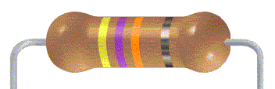
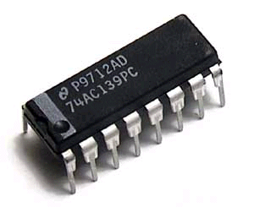
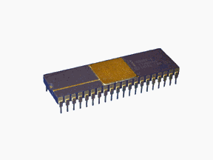
C | Component | Image
0.75 | Axial leaded through hole or surface mounted components, resistors, capacitors, diodes
1.0 | Standard dual inline package (DIP)
1.26 | DIP with side-brazed lead wires

Slide 46
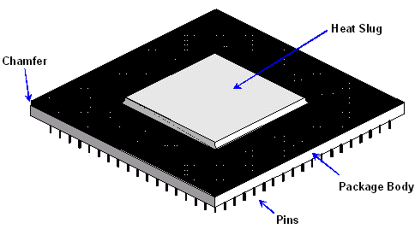
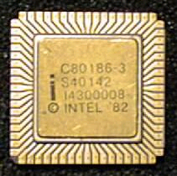
C | Component | Image
1.0 | Through-hole Pin grid array (PGA) with many wires extending from the bottom surface of the PGA
2.25 | Surface-mounted leadless ceramic chip carrier (LCCC) A hermetically sealed ceramic package. Instead of metal prongs, LCCCs have metallic semicircles (called castellations) on their edges that solder to the pads.

Slide 47
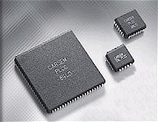

C | Component | Image
1.26 | Surface-mounted leaded ceramic chip carriers with thermal compression bonded J wires or gull wing wires
1.75 | Surface-mounted ball grid array (BGA). BGA is a surface mount chip carrier that connects to a printed circuit board through a bottom side array of solder balls
Additional component examples are given in Steinberg’s book series.

Slide 48
Rainflow Fatigue Cycles
Endo & Matsuishi 1968 developed the Rainflow Counting method by relating stress reversal cycles to streams of rainwater flowing down a Pagoda. ASTM E 1049-85 (2005) Rainflow Counting Method
Develop a damage potential vibration response spectrum using rainflow cycles.

Slide 49
Sample Base Input PSD
An RD-N curve will be constructed for a particular case.
The resulting curve can then be recalibrated for other cases.
Consider a circuit board which behaves as a single-degree-of-freedom system, with a natural frequency of 500 Hz and Q=10. These values are chosen for convenience but are somewhat arbitrary.
The system is subjected to the base input:
Base Input PSD, 8.8 GRMS
Frequency (Hz) | Accel (G^2/Hz)
20 | 0.0053
150 | 0.04
2000 | 0.04

Slide 50
Synthesize Time History
The next step is to generate a time history that satisfies the base input PSD
The total 1260-second duration is represented as three consecutive 420-second segments
Separate segments are calculated due to computer processing speed and memory limitations
Each segment essentially has a Gaussian distribution, but the histogram plots are also omitted for brevity

Slide 52
Synthesized Time History PSDs

Slide 53
SDOF Response
The response analysis is performed using the ramp invariant digital recursive filtering relationship, Smallwood algorithm.
The response results are shown on the next page.

Slide 55
Relative Displacement Response Statistics
No. | 1-sigma (inch) | 3-sigma (inch) | Kurtosis | Crest Factor
1 | 0.00068 | 0.00204 | 3.02 | 5.11
2 | 0.00068 | 0.00204 | 3.03 | 5.44
3 | 0.00068 | 0.00204 | 3.01 | 5.25
Note that the crest factor is the ratio of the peak-to-standard deviation, or peak-to-rms assuming zero mean.
Kurtosis is a parameter that describes the shape of a random variable’s histogram or its equivalent probability density function (PDF).
Assume that corresponding 3-sigma value was at the Steinberg failure threshold.

Slide 56
Rainflow Counting on Relative Displacement Time Histories
The total number of rainflow cycles was 698903
This corresponds to a rate of 555 cycles/sec over the 1260 second duration.
This rate is about 10% higher than the 500 Hz natural frequency
Rainflow results are typically represented in bin tables
The method in this analysis, however, will use the raw rainflow results consisting of cycle-by-cycle amplitude levels, including half-cycles
This brute-force method is more precise than using binned data

Slide 57
Miner’s Accumulated Fatigue
Let n be the number of stress cycles accumulated during the vibration testing at a given level stress level represented by index i.
Let N be the number of cycles to produce a fatigue failure at the stress level limit for the corresponding index.
Miner’s cumulative damage index CDI is given by
where m is the total number of cycles
In theory, the part should fail when CDI=1.0
Miner’s index can be modified so that it is referenced to relative displacement rather than stress.

Slide 58
Derivation of the RD-N Curve
Steinberg gives an exponent b = 6.4 for PCB-component lead wires, for both sine and random vibration.
The goal is to determine an RD-N curve of the form
log₁₀ (N) = -6.4 log₁₀ (RD) + a
N | is the number of cycles
RD | relative displacement (inch)
a | unknown variable
The variable a is to be determined via trial-and-error.

Slide 59
Cycle Scale Factor
Now assume that the process in the preceding example was such that its 3-sigma relative displacement reached the limit in Steinberg’s equation for 20 million cycles.
This would require that the duration 1260 second duration be multiplied by 28.6.
28.6 = (20 million cycles-to-failure )/( 698903 rainflow cycles )
Now apply the RD-N equation along with Miner’s equation to the rainflow cycle-by-cycle amplitude levels with trial-and-error values for the unknown variable a.
Multiply the CDI by the 28.6 scale factor to reach 20 million cycles.
Iterate until a value of a is found such that CDI=1.0.

Slide 60
Numerical Results
The numerical experiment result is
a = -11.20 for a 3-sigma limit of 0.00204 inch
Substitute into equation
log₁₀ (N) = -6.4 log₁₀ (RD) -11.20 for a 3-sigma limit of 0.00204 inch
This equation will be used for the “high cycle fatigue” portion of the RD-N curve.
A separate curve will be used for “low cycle fatigue.”

Slide 61
Fatigue as a Function of 3-sigma Limit for 20 million cycles
The low cycle portion will be based on another Steinberg equation that the maximum allowable relative displacement for shock is six times the 3-sigma limit value at 20 million cycles for random vibration.
But the next step is to derive an equation for a as a function of 3-sigma limit without resorting to numerical experimentation.
Let N = 20 million reversal cycles.
a = log₁₀ (N) + 6.4 log₁₀ (RD)
a = 7.30 + 6.4 log₁₀ (RD)
Let RDx = RD at N=20 million.

Slide 62
RDx = 0.0013 inch for a = -11.20
a = 7.3 + 6.4 log₁₀ (0.0013) = -11.20 for a 3-sigma limit of 0.00204 inch
The RDx value is not the same as the Z _{3σ limit} .
But RDx should be directly proportional to Z _{3σ limit} .
So postulate that
a = 7.3 + 6.4 log₁₀ (0.0026) = -9.24 for a 3-sigma limit of 0.00408 inch
This was verified by experiment where the preceding time histories were doubled and CDI =1.0 was achieved after the rainflow counting.

Slide 63
RD-N Equation for High-Cycle Fatigue
Thus, the following relation is obtained.
(Perform some algebraic simplification steps)
The final RD-N equation for high-cycle fatigue is

Slide 64
The derived high-cycle equation is plotted in along with the low-cycle fatigue limit.
RD is the zero-to-peak relative displacement.

Slide 65
Damage Equivalence
Note that the relative displacement ratio at 20 million cycles is 0.64.
(0.64)(3-sigma) = 1.9-sigma
This suggests that “damage equivalence” between sine and random vibration occurs when the sine amplitude (zero-to-peak) is approximately equal to the random vibration 2-sigma amplitude

Slide 66
Conclusions
A methodology for developing RD-N curves for electronic components was presented in this paper
The method is an extrapolation of the empirical data and equations given in Steinberg’s text
The method is particularly useful for the case where a component must undergo nonstationary vibration, or perhaps a series of successive piecewise stationary base input PSDs
The resulting RD-N curve should be applicable to nearly any type of vibration, including random, sine, sine sweep, sine-or-random, shock, etc.
It is also useful for the case where a circuit board behaves as a multi-degree-of-freedom system
This paper also showed in a very roundabout way that “damage equivalence” between sine and random vibration occurs when the sine amplitude (zero-to-peak) is approximately equal to the random vibration 2-sigma amplitude
This remains a “work-in-progress.” Further investigation and research is needed.

Slide 67
Comparing Different Environments in Terms of Damage Potential
Base Input is Navmat P9492 PSD, 60 sec Duration SDOF Response fn=300 Hz, Q=10
Assume fatigue exponent of 6.4 (Steinberg's value for electronic equipment)
What is equivalent sine level in terms of fatigue damage?

Slide 68
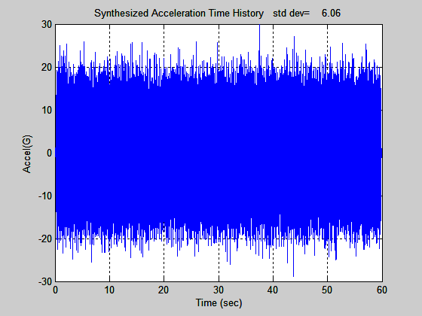
NAVMAT P9492 Synthesized Time History

Slide 69
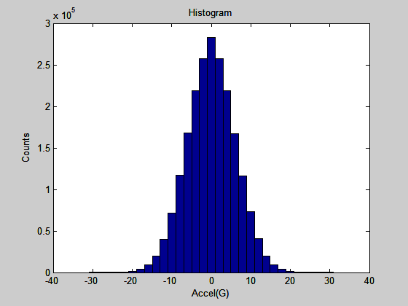
Synthesized Time History Histogram

Slide 70
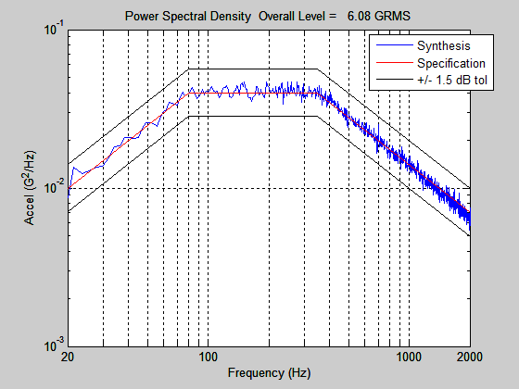
Synthesized Time History PSD Verification

Slide 71
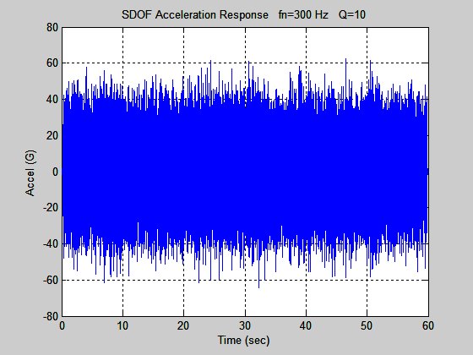
SDOF Response to Synthesis, Narrowband Random
Acceleration Response
absolute peak = 64.33 G
overall = 14.50 GRMS
Std dev = 14.5 G (for zero mean)
Peak response = 4.44 sigma

Slide 72
Statistical Relation
σ = standard deviation
[ RMS ] ² = [ σ ] ² + [ mean ]²
RMS = σ assuming zero mean

Slide 73
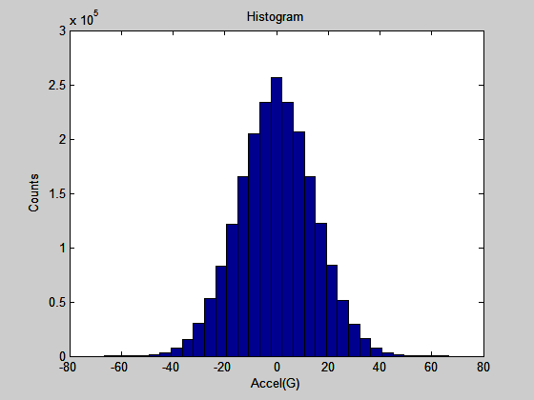
SDOF Response to Synthesis, Narrowband Random, Histogram

Slide 74
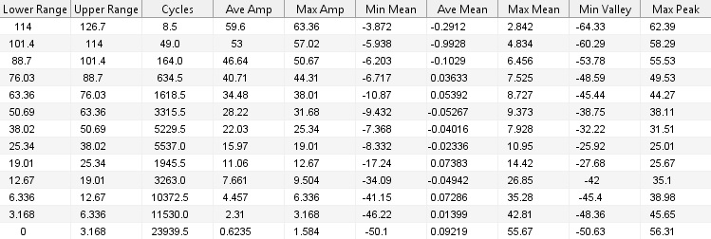
SDOF Response to Synthesis, Rainflow Analysis
>> rainflow_bins
Range = (peak-valley)
Amplitude = (peak-valley)/2
Total Cycles =67607
Output arrays:
range_cycles (range & cycles)
amp_cycles (amplitude & cycles)

Slide 75
Damage Index for Relative Comparisons between Environments
A damage index D was calculated using
where
is the response amplitude from the rainflow analysis
is the corresponding number of cycles
b
is the fatigue exponent

Slide 76
Damage Index for SDOF (fn=300 Hz, Q=10) Response to PSD
>> fatigue_damage_sum
fatigue_damage_sum.m ver 1.0 by Tom Irvine
This script calculates a relative damage index
for a rainflow output.
The input array must have two columns:
amplitude & cycles
Enter the array name: amp_cycles
Enter the fatigue exponent: 6.4
relative damage index = 4.98e+13

Slide 77
Equivalent Sine Level
What is equivalent Sine Input Level at 300 Hz for 60 second duration?
Again, SDOF Response fn=300 Hz, Q=10
Assume fatigue exponent of 6.4
Modified Relative Damage Index for Steady-state Sine Response
is the response
f | Excitation Frequency
T | Duration
Y | Base Input Acceleration
Q | Amplification Factor
b | Fatigue Index

Slide 78
Equivalent Sine Level (cont)
f | 300 Hz
T | 60 sec
Q | 10
b | 6.4
D | 4.98e+13
Y=3 G (Sine Base Input at 300 Hz)
(QY) =30 G (Sine Response)
Random Response overall = 14.50 GRMS = 14.5 G (1-sigma) for zero mean)
Equivalent Sine Response Amplitude ≅ 2-sigma Random Response
Repeat analysis for other Q and b values as needed. Run additional PSD synthesis cases for statistical rigor.

Slide 79
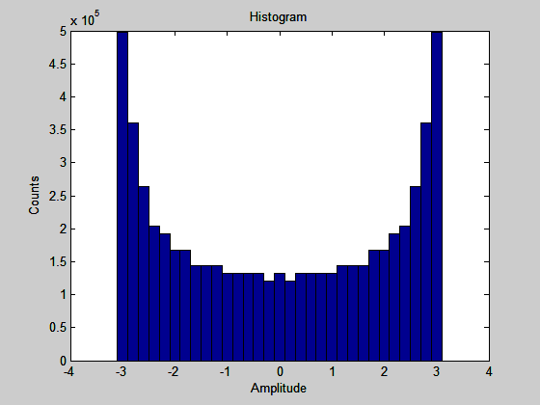
Histogram Comparison, Base Inputs
Random, Normal Distribution
Sine, Bathtub Curve
Even though histograms differ, we can still do equivalent damage calculation for engineering purposes.
This is Engineering not Physics!

Slide 80
Converting a Sine Tone to Narrowband PSD
Assume a case where the base input is a sine tone which must be converted to a narrowband PSD.
The conversion will be made in terms of the acceleration response of the mass to each input.
The conversion formula is
N | Overall GRMS response to narrowband base input
S | Sine base input peak amplitude (G peak)
Q | Amplification Factor
α | Standard deviation scale factor
These equations do not immediately give a corresponding base input PSD level.
The matching PSD is derived in a separate calculation.

Slide 81
Converting a Sine Tone to Narrowband PSD (cont)
Set
N response level is calculated for a given narrowband PSD input using point-by-point multiplication of transmissibility function by base input PSD method (Better than Miles equation).
If the natural frequency of the test item is unknown, then it is taken as the narrowband center frequency, which is the sine input frequency.
The recommended bandwidth for the PSD is one-twelfth octave.
One-twelfth octave appears to be a reasonable bandwidth which would allow a corresponding synthesized time history to have a normal distribution with a kurtosis of 3.0, if proper care is taken.

Slide 82
Converting a Sine Tone to Narrowband PSD (example)
An SDOF system is to be subjected to an 18 G, 100 Hz sine tone for 60 seconds.
Derive an equivalent narrowband PSD with the same duration.
Set the band center frequency equal to 100 Hz. Set Q=10.
Set the bandwidth equal to one-twelfth octave such that the band limits are 97.15 and 102.93 Hz.
The overall response level is 94.7 GRMS per
The corresponding PSD level is 17 G^2/Hz for this band as calculated using Matlab script: sine_to_narrowband.m. (Indirect calculation)

Slide 83
Converting a Sine Tone to Narrowband PSD, Verification
A 60-second time history is synthesized for the narrowband PSD.
The overall level is 9.9 GRMS. The kurtosis is 3.0.

Slide 84
Converting a Sine Tone to Narrowband PSD, Verification (cont)

Slide 85
Converting a Sine Tone to Narrowband PSD, Verification (cont)
Both curves have an overall level of 9.9 GRMS.

Slide 86
Converting a Sine Tone to Narrowband PSD, Verification (cont)
The shock response spectra for the narrowband PSD and the sine tone are shown. The synthesis yields a higher peak acceleration beginning at 73 Hz.
Any system with a natural frequency below, say, 50 Hz would be considered as isolated.

Slide 87
Converting a Sine Tone to Narrowband PSD, Rainflow Cycle Count
The relative displacement response was calculated for each base input using a natural frequency of 100 Hz and Q=10.
Relative displacement is the metric preferred by Steinberg for electronic component fatigue analysis.
Next, a rainflow cycle count was performed on each relative response.
A damage index D was calculated using
is the response amplitude from the rainflow analysis
is the corresponding number of cycles
b
is the fatigue exponent

Slide 88
Converting a Sine Tone to Narrowband PSD, Fatigue Damage
Base Input | Fatigue Damage D, fn=100 Hz, Q=10
Type | b=5.0 | b=6.0 | b=6.4 | b=8.0 | b=10.0 | b=12.0
Sine | 1.01 | 0.18 | 0.089 | 0.0055 | 0.00017 | 5.3e-06
Narrowband PSD | 0.73 | 0.17 | 0.093 | 0.0099 | 0.00067 | 4.9e-05
The damage index is only intended to compare the effects of the two base input types.
The Narrowband PSD is thus has a greater fatigue damage potential that the Sine input for b > 6.4
Un-notched aluminum samples tend to have a value of b ≅ 9 or 10.

Slide 89
Converting a Sine Tone to Narrowband PSD, α Trade Study
Recall the formula for the overall GRMS response to narrowband base input
The response levels are
 | Response GRMS | Base Input PSD (G^2/Hz)
1.9 | 94.7 | 17.0
1.8 | 100.0 | 18.9
1.7 | 105.9 | 21.2
1.6 | 112.5 | 23.9
1.5 | 120.0 | 27.2

Slide 90
Converting a Sine Tone to Narrowband PSD, α Trade Study (cont)
Base Input | Fatigue Damage D, fn=100 Hz, Q=10
Type | b=4.0 | b=4.5 | b=5.0 | b=5.5 | b=6.0 | b=6.4
Sine | 5.75 | 2.41 | 1.01 | 0.42 | 0.18 | 0.089
Narrowband PSD, α = 1.9 | 3.43 | 1.57 | 0.73 | 0.35 | 0.17 | 0.093
Narrowband PSD, α = 1.8 | 4.33 | 2.04 | 0.98 | 0.48 | 0.24 | 0.14
Narrowband PSD, α = 1.7 | 5.40 | 2.61 | 1.29 | 0.65 | 0.33 | 0.19
Narrowband PSD, α = 1.6 | 6.88 | 3.43 | 1.74 | 0.90 | 0.47 | 0.28
Note that some references use smaller fatigue exponents which yield more conservative, higher PSD base input levels.
Old Martin-Marietta document gives a value of b=4.0 for “Electrical Black Boxes.”

Slide 91
Fatigue Damage Spectra
Develop fatigue damage spectra concept similar to shock response spectrum
Natural frequency is an independent variable
Calculate acceleration or relative displacement response for each natural frequency of interest for selected amplification factor Q
Perform Rainflow cycle counting for each natural frequency case
Calculate damage sum from rainflow cycles for selected fatigue exponent b for each natural frequency case
Repeat by varying Q and b for each natural frequency case for desired conservatism, parametric studies, etc.

Slide 92
Response Spectrum Review
The shock response spectrum is a calculated function based on the acceleration time history.
It applies an acceleration time history as a base excitation to an array of single-degree-of-freedom (SDOF) systems.
Each system is assumed to have no mass-loading effect on the base input.

Slide 93
Base Input: Half-Sine Pulse (11 msec, 50 G)
RESPONSE (fn = 30 Hz, Q=10)
SRS Example
RESPONSE (fn = 140 Hz, Q=10)
RESPONSE (fn = 80 Hz, Q=10)

Slide 94
Response Spectrum Review (cont)

Slide 95
Nonstationary Random Vibration
Liftoff Transonic Attitude Control
Max-Q Thrusters
Rainflow counting can be applied to accelerometer data.

Slide 96
Flight Accelerometer Data, Fatigue Damage from Acceleration
The fatigue exponent is fixed at 6.4. The Q=50 curve Damage Index is 2 to 3 orders-of-magnitude greater than that of the Q=10 curve.

Slide 97
Flight Accelerometer Data, Fatigue Damage from Acceleration
The amplification factor is fixed at Q=10. The b=9.0 curve Damage Index is 3 to 4 orders-of-magnitude greater than that of the b=6.4 curve above 150 Hz.

Slide 98
Derive MEFL from Nonstationary Random Vibration
MEFL = maximum envelope + some uncertainty margin
The typical method for post-processing is to divide the data into short-duration segments
The segments may overlap
This is termed piecewise stationary analysis
A PSD is then taken for each segment
The maximum envelope is then taken from the individual PSD curves
Component acceptance test level > MEFL
Easy to do
But potentially overly conservative

Slide 99
Derive MEFL from Nonstationary Random Vibration (cont)
Piecewise Stationary Enveloping Method Concept
Calculate PSD for Each Segment
Segment 1
Segment 2
Segment 3
Power Spectral Density
Maximum Envelope of 3 PSD Curves
Accel
(G^2/Hz)
Would use shorter segments if we were doing this in earnest.
Frequency (Hz)

Slide 100
Derive MEFL from Nonstationary Random Vibration (cont)
Alternate approach:
Use fatigue damage spectra to derive the MEFL!
Derive 60-second PSD as MEFL with Q=10 &b=6.4 to cover flight data.

Slide 101
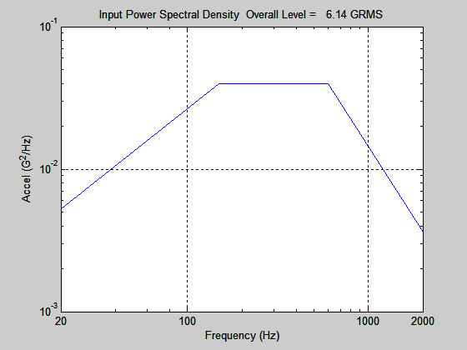
Begin with Mil-Std-1540B Acceptance Test Level

Slide 102
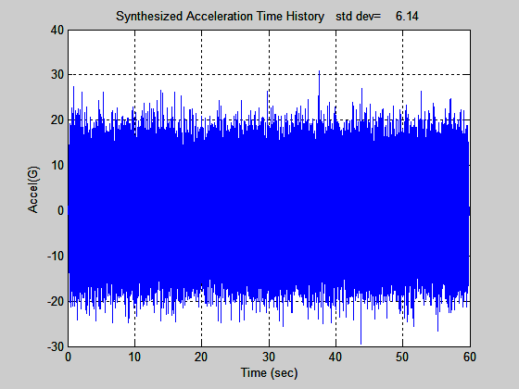
Synthesize Acceleration Time History

Slide 103
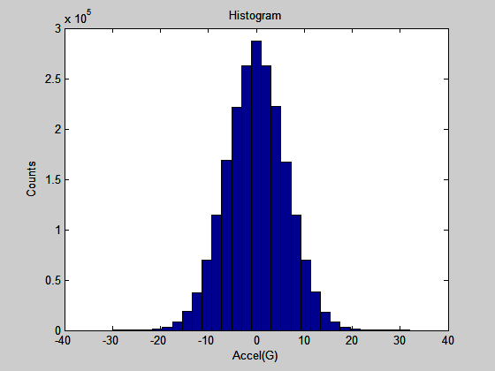
Histogram of Synthesized Time History

Slide 104
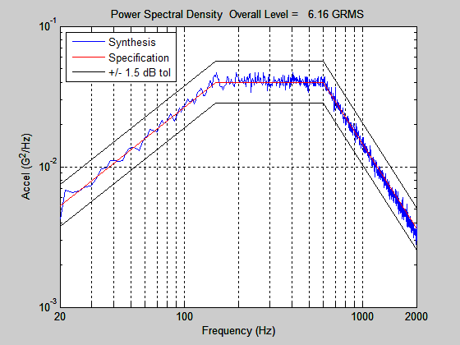
Power Spectral Density Verification

Slide 105
Fatigue Damage Spectra from Rainflow Cycle Count, using Acceleration
The smallest difference is 692 at 190 Hz.
692^(1/6.4) = 2.78
1/2.78 = 0.36
So rescale time history amplitude by 0.36
And PSD (G^2/Hz)
by 0.36^2 = 0.13

Slide 106
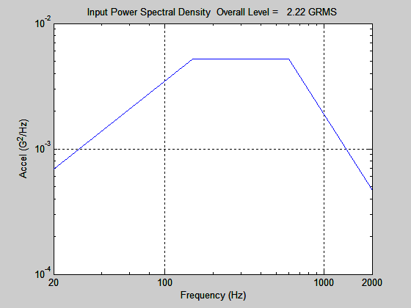
Maximum Expected Flight Level Scaled from Mil-Std-1540B
But may need to add statistical uncertainty margin, run for different Q & b values, etc.

Slide 107
Scaling Verification

Slide 108
CPU Time Comparison
Desktop PC, Intel Core i7 cpu, 860 Processor @ 2.80 GHz, 8192 MB Ram, Windows 7, 64-bit
Synthesize white noise time history with 400 second duration, 10K samples/sec. Then apply as base excitation to SDOF system with fn=400 Hz and Q=10.
Result is 192,797 cycles.
Language | Program | Time (min)
C/C++ | rainflow.exe | 1
Matlab MEX | rainflow_mex.cpp | 1
Fortran | RAINFLOW | 2
Matlab | rainflow_bins.m | 23
Python | rainflow.py | 38
Rainflow calculation requires deleting intermediate data points & their indices from a 1d array, then resizing array.
C/C++ does this best!
MEX files allow Matlab scripts to call user-supplied functions written in C/C++ and Fortran.

Slide 109
Complete paper with examples and Matlab scripts may be freely downloaded from
http://vibrationdata.wordpress.com/
Or via Email request
tom@vibrationdata.com
tirvine@dynamic-concepts.com

