Slide 1
Vibrationdata
Launch Vehicle Ascent Vibroacoustics
Revision A
By Tom Irvine

Slide 2
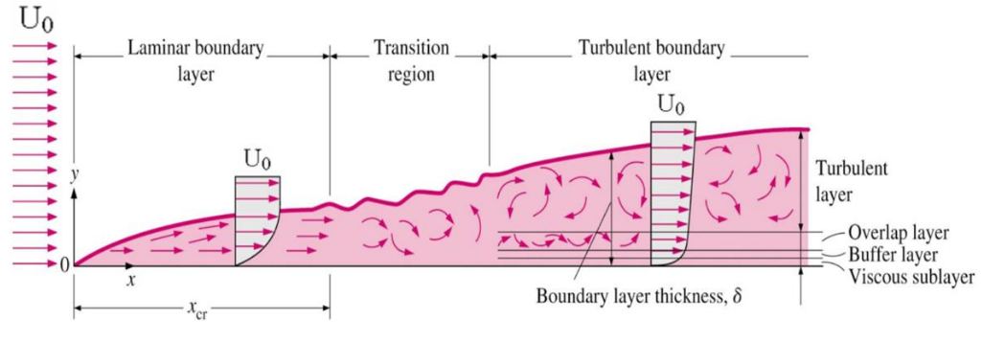
Flow Progression over Flat Plate
Vibrationdata
Unsteady eddies form in turbulent boundary layer due to viscous and compressibility effects
The transition from laminar to turbulent boundary layer occurs at locations where the Reynolds number ≈ 500,000
But my occur at lower Reynold numbers due to surface roughness

Slide 3
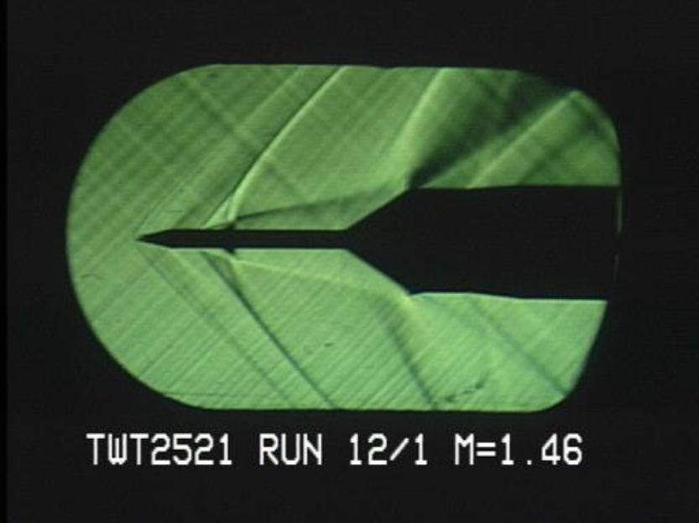
Schlieren Photo, Wind Tunnel Test
Vibrationdata
Wind tunnel testing in June 2006, on a partial model of the Ares I launch vehicle
Included a portion of the upper stage, the spacecraft adapter, the Orion crew module and launch abort system
The photo shows shock and expansion waves

Slide 4
Ascent Excitation Sources
Vibrationdata
Rocket vehicles are subjected to aerodynamic pressure excitation as they ascend in the atmosphere
The excitation sources include aerodynamic shockwaves, turbulent boundary layers, and recirculating flow
The excitation pressure fluctuates, with a broadband random characteristic
Shockwaves begin to form along the rocket body as the vehicle approaches and surpasses the transonic velocity
The local airflow must follow the geometry of the vehicle
Thus the local airflow reaches supersonic speed before the vehicle center-of-gravity reaches supersonic speed
The excitation is also severe as the vehicle encounters its maximum dynamic pressure condition
These slides present empirical methods for determining the aerodynamic pressure power spectral density at stations along a rocket vehicle body for various flow regimes

Slide 5
Analysis Steps
Vibrationdata
Determine flow type
Identify altitude, air density, speed of sound, free stream velocity, Mach number, dynamic pressure, Reynolds number, etc.
Calculate pressure rms against vehicle external skin
Calculate broadband fluctuating pressure PSD
Calculate vibration response to fluctuating pressure PSD using Barrett scaling, Franken method, Statistical Energy Analysis (SEA), etc.

Slide 6
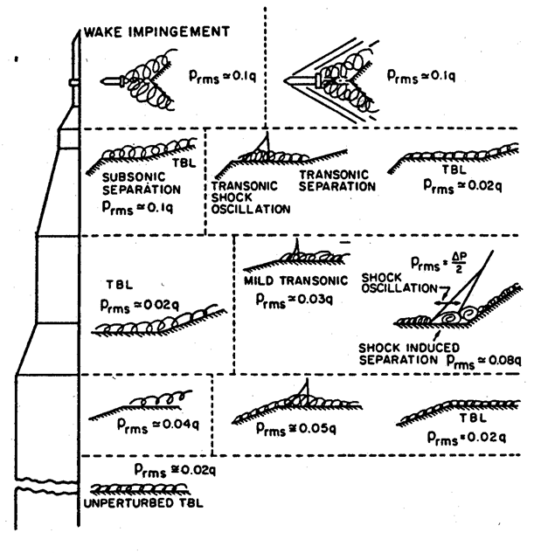
Apollo Era Aeroacoustic Dynamic Pressure Coefficients
Vibrationdata
The dynamic pressure q is
where U∞ is the free stream velocity
ρ is the mass density
P _{rms} is the fluctuating pressure level against the vehicle’s surface
Wilby methods also factor in Mach number, wall temperature, etc.
Chandiramani, K. L., Widnall, S. E., Lyon, R. H., Franken, P. A., "Structural Response to Inflight Acoustic and Aerodynamic Environments", Bolt Beranek and Newman Report 1417, July 1967.

Slide 7
Flow Regimes, 1
Vibrationdata
Cone-Cylinder Geometry, Subsonic, Shoulder Separation
Cone-Cylinder Geometry, Transonic Shockwave Oscillation with Attached Flow

Slide 8
Flow Regimes, 2
Vibrationdata
Cone-Cylinder Geometry, Supersonic, Attached Flow
Cone-Cylinder Geometry with Separated Flow near Compression Corner, Subsonic

Slide 9
Flow Regimes, 3
Vibrationdata
Cone-Cylinder Geometry with Separated Flow near Compression Corner and Shockwaves, Supersonic
Shoulder and Boattail Induced Separation, Subsonic

Slide 10
Flow Regimes, 4
Vibrationdata
Attached Flow with Boattail Induced Separation and Shockwave Oscillation, Supersonic

Slide 11
Attached Flow, Pressure RMS
Vibrationdata
The pressure RMS for attached boundary layer flow is
Mach number is related to the free stream velocity by
where
where c is the speed of sound
Typical simplifying assumption
M is the Mach number
T_{w} is the wall temperature
T_{aw} is the adiabatic wall temperature

Slide 12
Attached Flow, Pressure PSD
Vibrationdata
The pressure power spectral density G(f) for attached flow is
where f = frequency
δ * = boundary layer displacement thickness
R_{ex} = Reynolds number based on distance x
x = distance from the start of boundary layer growth
ν = kinematic viscocity
The boundary layer thickness δ is the thickness for which U = 0.99 U∞
The displacement thickness δ * is the thickness in a frictionless flow that would yield the same mass flow rate in a viscous flow

Slide 13
Separated Flow & Shock Waves, Compression Corner
Vibrationdata
Compression Corner Plateau Region, Transonic Flow
Compression Corner Reattachment Region, Transonic Flow
Compression Corner Pressure PSD
C_{comp} is needed to account for a low frequency shift of energy for separated flow and shockwaves

Slide 14
Separated Flow & Shock Waves, Expansion Corner
Vibrationdata
Expansion Corner Plateau Region, Transonic and Supersonic Flow
Expansion Corner Reattachment Region, Transonic Flow
Expansion Corner Pressure PSD

Slide 15
Further Reading
Vibrationdata
Additional cases are given in:
T. Irvine, Prediction of Sound Pressure Levels on Rocket Vehicles during Ascent, Revision D, Vibrationdata, 2007.

Slide 16
References
Vibrationdata
Wilby, J. and Wilby E., Prediction of External Fluctuating Pressure Field on Taurus During Ascent, AARC Report No. 131, Van Nuys, California, 1991
Laganelli, A.L., Howe, J.R., "Prediction of Pressure Fluctuations Associated with Maneuvering Re-Entry Weapons," AFFDL-TR-77-59, Vol I, July 1977
Incropera and DeWitt, Fundamentals of Heat Transfer, Wiley, New York, 1981
Laganelli, A.L., Wolfe, H.F., "Prediction of Fluctuating Pressure in Attached and Separated Turbulent Boundary Layer Flow," AIAA Paper AIAA-89-1064, April 1989
Robertson, J.E., "Prediction of In-Flight Fluctuation Pressure Environments Including Protuberance Induced Flow," Wyle Laboratories Report WR 71-10, March 1971
Beranek, L. and Ver, I., editors, Noise and Vibration Control Engineering, Principles and Applications, Wiley, New York, 1992. See Chapter 14, Howe M., and Baumann H., Noise of Gas Flows
Training Slides, VA One Vibroacoustics Software Package, ESI Group, 2011

Slide 17
Vibration Calculation
Vibrationdata
Calculate vibration response to fluctuating pressure PSD using Barrett scaling, Franken method, Statistical Energy Analysis (SEA), etc.
Barrett & Franken will be covered in this slide presentation, both NASA methods
SEA will be covered in a future presentation
Use Barrett method if you already have reference pressure and acceleration PSD data from one of your own vehicles
Otherwise, use Franken which comes with its own reference data

Slide 18
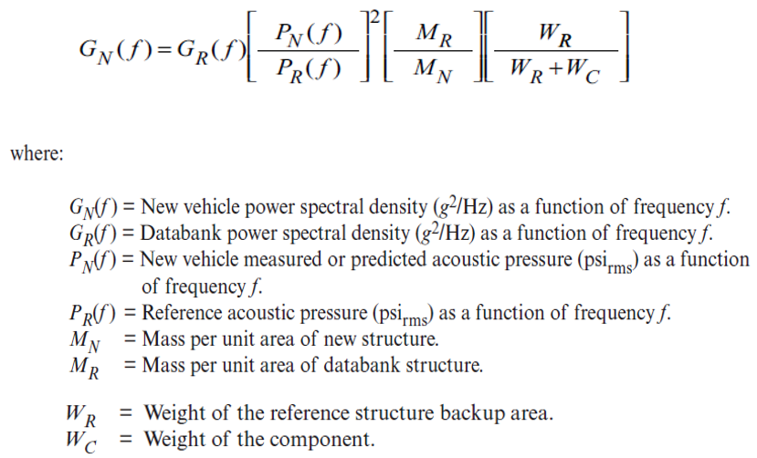
Barrett Method, Empirical Scaling
Vibrationdata
Extrapolation from reference vehicle to new vehicle
NASA/TM-2009-215902, Using the Saturn V and Titan III Vibroacoustic Databanks for Random Vibration Criteria Development, 2009
Mass ratios should be squared per Newton’s law
But taking mass ratios to first power gives better agreement with measured data

Slide 19
Franken, Empirical Scaling
Vibrationdata
NASA CR-1302, Summary of Random Vibration Prediction Procedures, 1969
NASA-HDBK-7005, Dynamic Environmental Criteria, 2001
The function was developed from studies of Jupiter and Titan I acoustic and radial skin vibration data collected during static firings
The function predicts the skin vibration level in GRMS based on the input sound pressure level in dB, vehicle diameter in feet, and surface weight density in pounds per square foot

Slide 20
Franken Assumptions
Vibrationdata
All flight vehicles to which the procedure is applied have similar dynamic characteristics to the Jupiter and Titan I vehicles
Vibration is due to the acoustic noise during liftoff or other pressure fields during flight which can be estimated
The vibration magnitude is directly proportional to the pressure level of the excitation and inversely proportional to the surface weight density of the structure.
Predominant vibration frequencies are inversely proportional of the diameter of the vehicle
Spatial variations in the vibration can be considered as a random variable

Slide 21
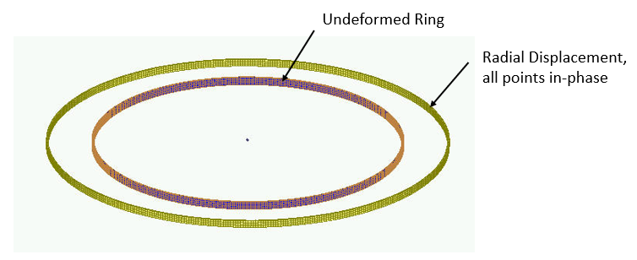
Ring Frequency
Vibrationdata
Consider a thin ring with a rectangular cross section and with completely free boundary conditions
The ring frequency corresponds to the mode in which all points move radially outward together and then radially inward together
This is the first extension mode, analogous to a longitudinal mode in a rod
The ring frequency is the frequency at which the longitudinal wavelength in the skin material is equal to the vehicle circumference
The ring frequency is an idealized concept for a cylindrical shell
In practice, cylindrical shells tend to have a high modal density near the ring frequency
The ring frequency f _{r} is
C_{L} is longitudinal wave speed
d is diameter

Slide 22
Example
Vibrationdata
A launch vehicle forward module is aluminum with 72 inch diameter
Calculate its ring frequency
Derive the fluctuating pressure level at a point on the module which is 240 inches from aft of the nose tip
Also estimate the vibration level using the Franken method
The common approach would be to consider a family of Mach case from, say, Mach 1 to Mach 1.8, including max-q, and then take a maximum envelope of the pressure level
For simplicity, consider these three cases
Alt (ft) | Mach
22000 | 1.0
24000 | 1.1
26000 | 1.2

Slide 23
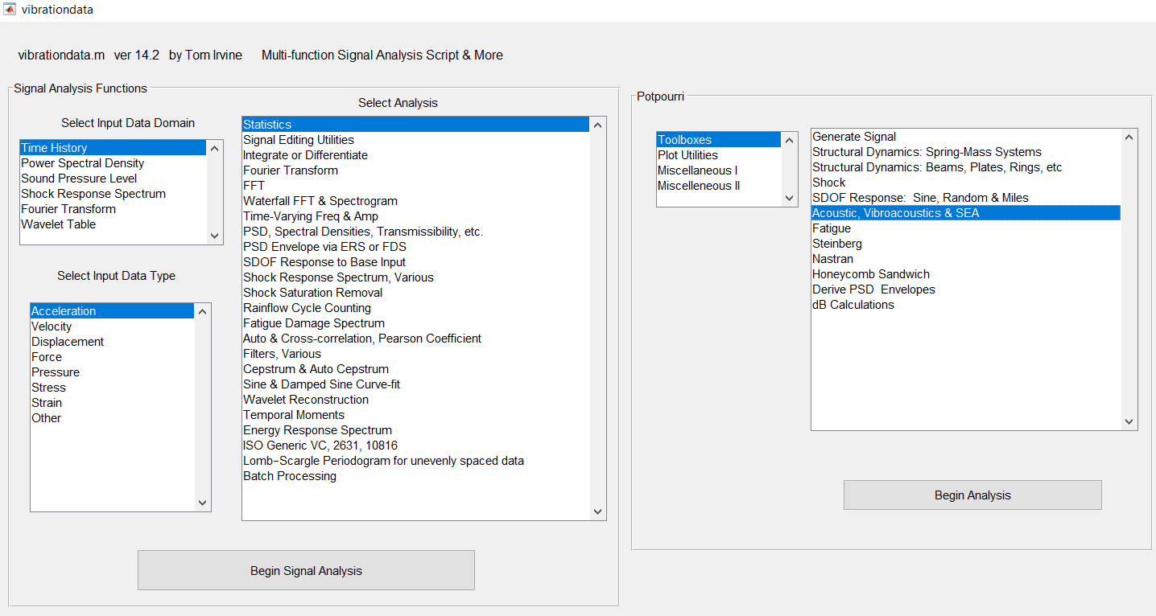

Slide 24
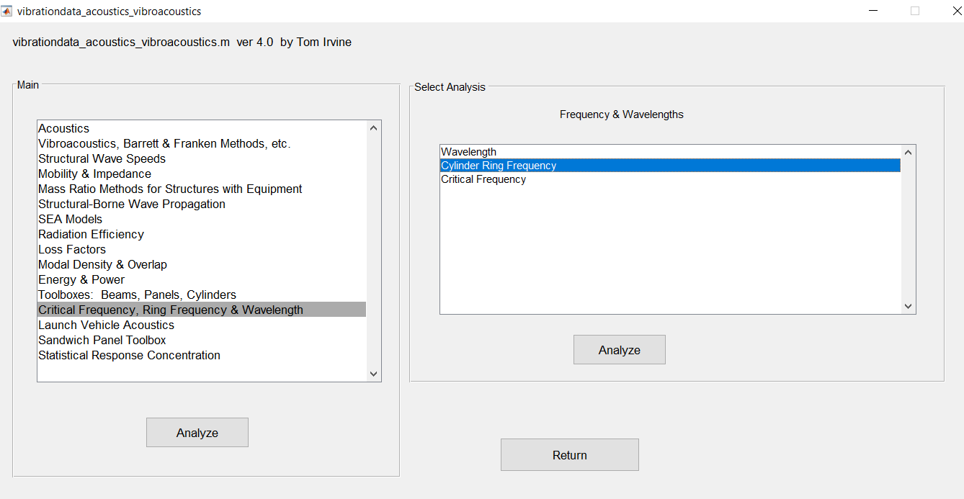

Slide 25
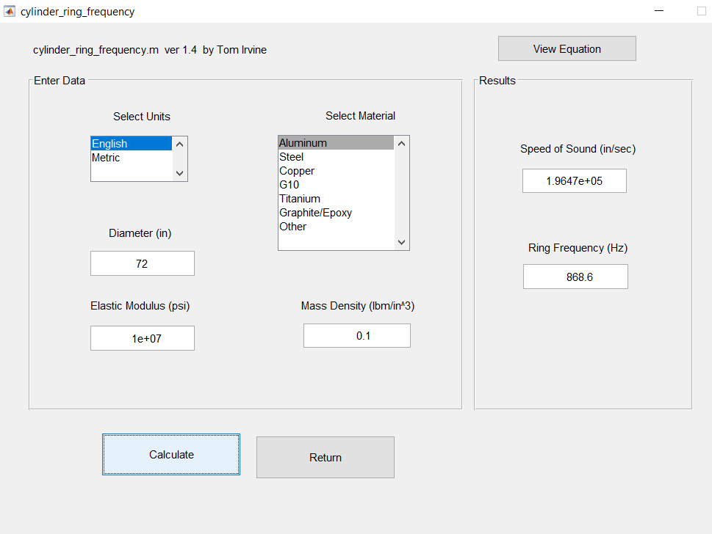

Slide 26
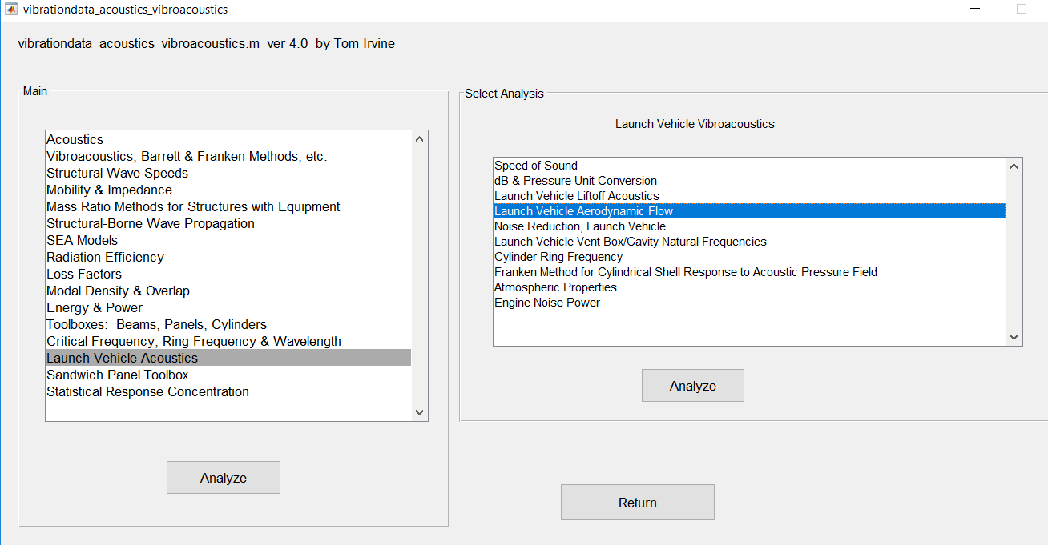

Slide 27
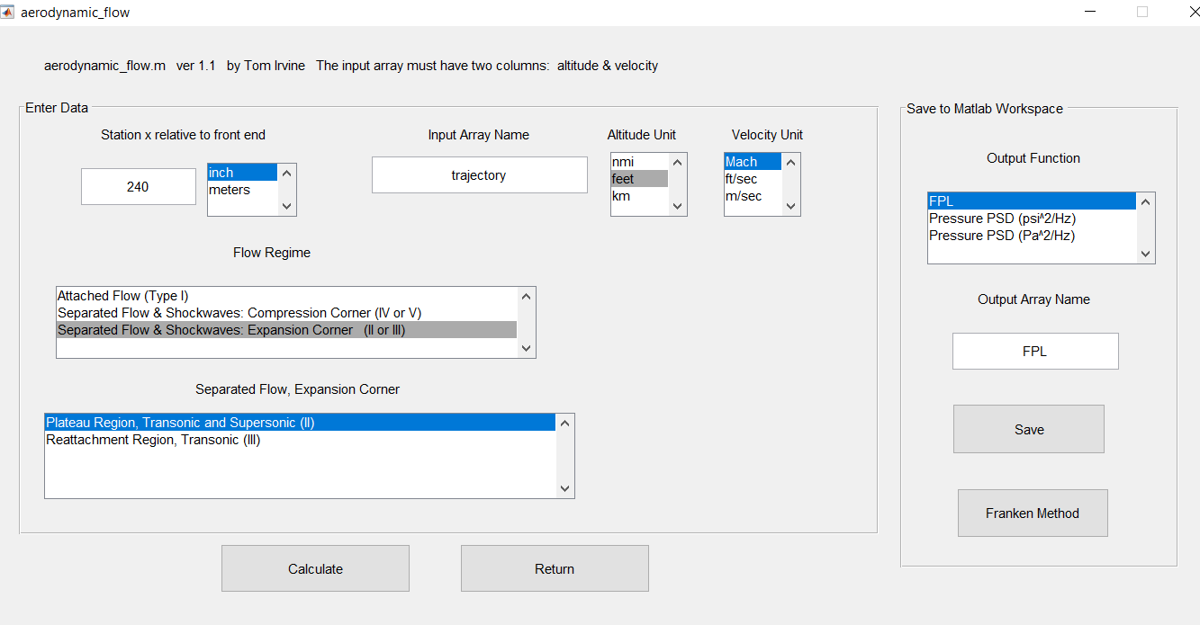
Make this array in Matlab Command Window >> trajectory=[22000 1.0; 24000 1.1; 26000 1.2]

Slide 28
Maximum FPL at Mach 1.1
Vibrationdata
A fluctuating pressure level is conceptually similar to a sound pressure level
“Fluctuating” is used to emphasize convection flow-induced
Typically, 3 dB or some other uncertainty factor is added
But none is added to FPL in this plot
Q is dynamic pressure, C is speed of sound, OAFPL is overall FPL
Alt (ft) | Mach | Q (psf) | C (ft/sec) | OAFPL (dB)
22000 | 1.0 | 626.4 | 1028.6 | 149.1
24000 | 1.1 | 695.6 | 1020.2 | 149.2
26000 | 1.2 | 758 | 1011.8 | 149.1

Slide 29
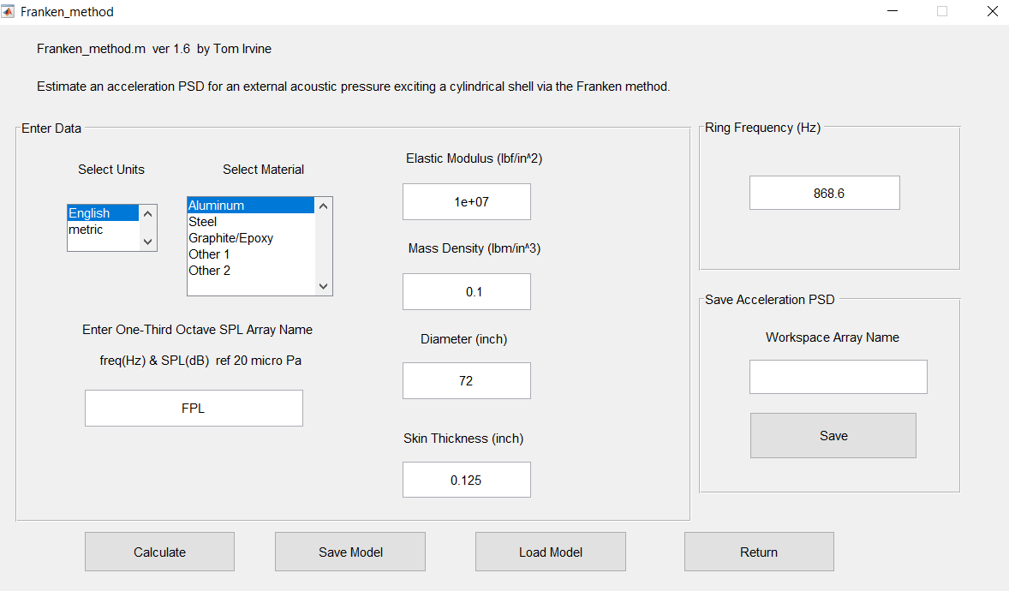

Slide 30
Franken Method Results
Vibrationdata
Again, add some uncertainty factor
Final component test level should also envelope minimum workmanship level

