Slide 1


Avionics Component Shock Sensitivity
& FEA Shock Analysis
By Tom Irvine
Tutorial & Training Oriented Materials

Slide 2
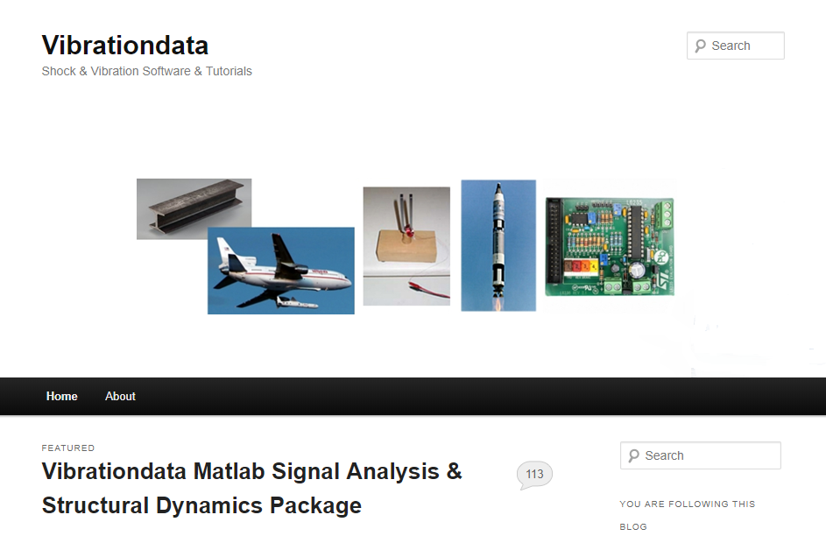
https://vibrationdata.wordpress.com/

Slide 3
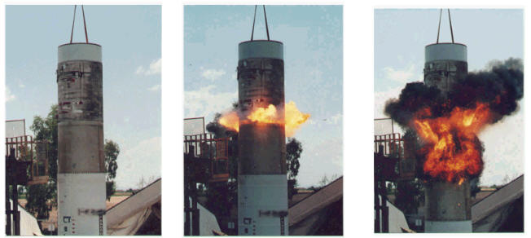
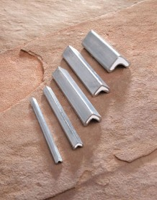
Stage Separation Test
Metal Clad Linear Shaped Charge
Linear Shaped Charge
But fire and smoke would not occur in near-vacuum of space
Plasma jet would occur instead

Slide 4
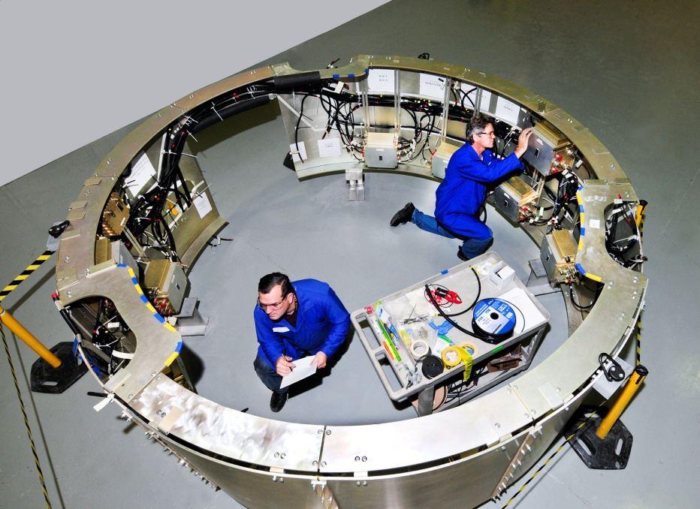
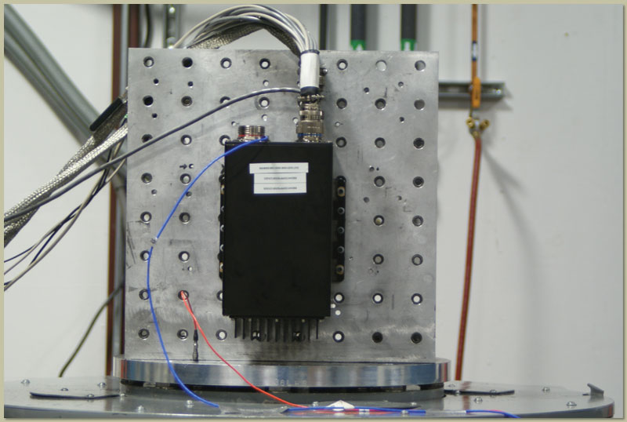
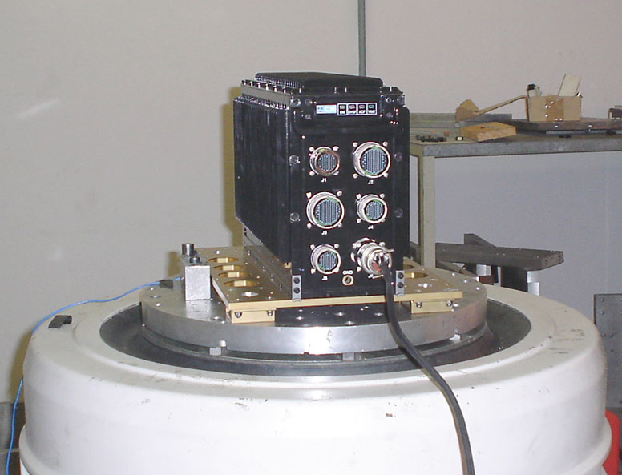
Electronic Boxes
Vibrationdata
Electronic components in vehicles are subjected to shock and vibration environments
The components must be designed and tested accordingly

Slide 5
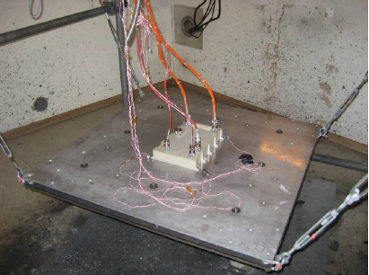
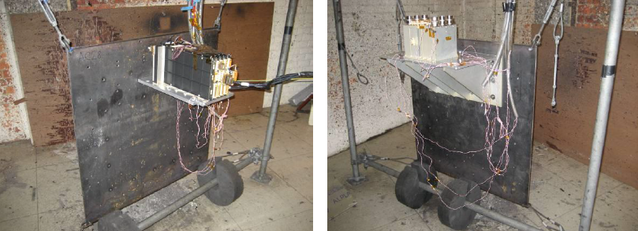
Avionics Component Qualification Testing, Pyrotechnic Excitation
Resonant single or double plate excited by mild detonating cord
Plate made from steel or aluminium
Must over-test in out-of-plane axis in order to meet specification in lateral axis
Used for near-field shock specifications or far-field with very conservative margin

Slide 6
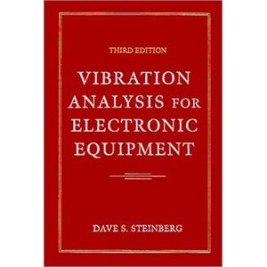
Reference
Vibrationdata
Steinberg’s text

Slide 7
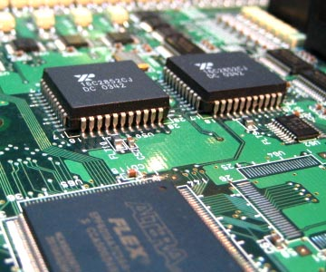
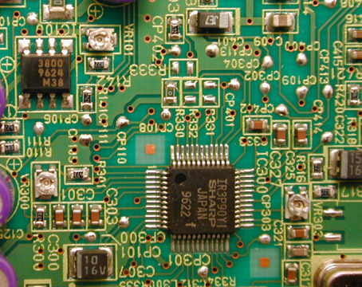
Circuit Boards & Piece Parts
Vibrationdata

Slide 8
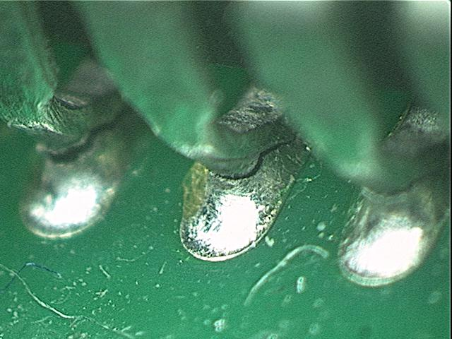
Vibrationdata
Solder Joints
Aerospace and military components must be designed and tested to withstand shock and vibration environments
Cracked solder Joints for Piece Part with “J leads”

Slide 9
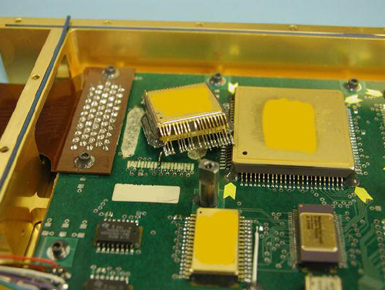
Solder Joint & Lead Wire Failures
Staking needed for parts weighing more than 5 grams
Adhesive failure and rupture of solder joint after a stringent shock test
Large deflection of PCB resulting from an insufficient support/reinforcement of the PCB combined with high shock loads (above 2000g SRS, depending on the induced PCB deflection), can lead to adhesive failure and rupture of solder joint

Slide 10
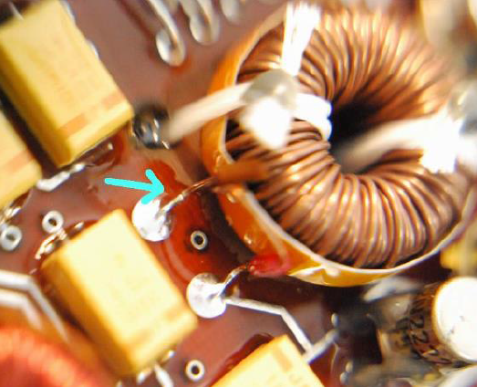
Solder Joint & Lead Wire Failures (cont)
Lacing cords alone are insufficient
Need lacing plus staking
Sheared lead between solder joint and winding of coil

Slide 11
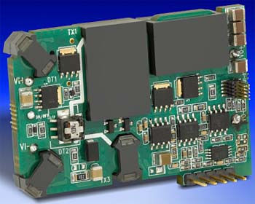
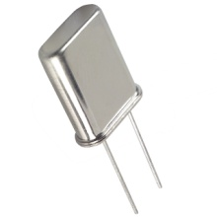
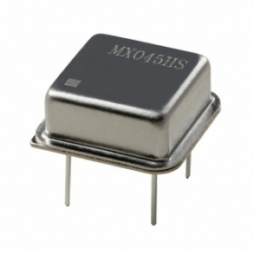
Potential Shock Failure Modes
Crystal oscillators can shatter
Large components such as DC-DC converters can detached from circuit boards

Slide 12

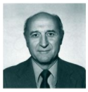

Shock Failure Theories & Proponents
Acceleration – European Space Agency
Pseudo Velocity / Stress – Gaberson
Relative Displacement - Steinberg
Howard A. Gaberson (1931-2013)
Dave S. Steinberg

Slide 13
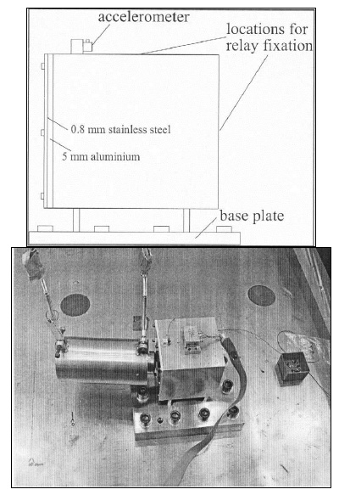
Acceleration: Relay Shock Test
Pendulum hammer impact excitation
Relays were powered and monitored
Accelerometer
Relay
Fixture

Slide 14
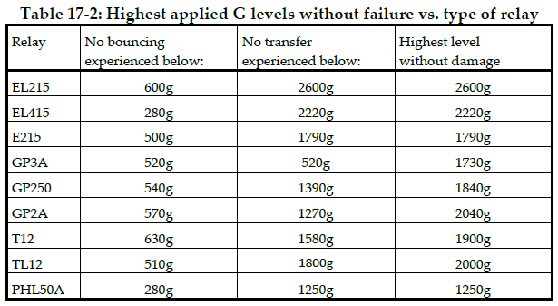
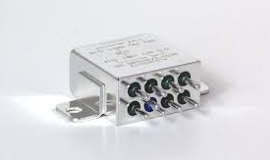
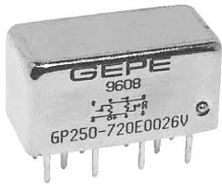
Acceleration: Relay Sensitivity from Shock Testing
EL Series Relay
Note that the levels in the table are maximum values of the time history of the acceleration
The SRS converges to the peak time history acceleration as the natural frequency increases to some high value
GP250 Relay

Slide 15
Acceleration: Part Sensitivity Summary
Electronic Part | Mode 1 | Mode 2 | Mode 3 | Remark
Relays | Bouncing G=200g SRS in all directions | Transfer G=600g SRS in all directions | Mechanical damage G=1200g SRS in all directions
Quartz | Relief residual stress G=600 g SRS in all directions | Solder overstress / adhesive crack G=600 g SRS in all directions | Broken crystal 2000 g SRS at quartz resonances | Criteria to be verified with representative Q factors (>100). These values are typical for quartz with frequencies between 50 and 100MHz.
RM, Transformer and Self | 2000 g SRS (above 3000 Hz) | Lead-wire failure Apply stress relief and staking solutions
Hybrid | Adhesive rupture Design and size dependent | Crack glass feed-thru Design and size dependent | Structural failure Design and size dependent
Tantalum capacitor | Local destruction dielectric Capacitor size and PCB deflection dependent – ensure acceptable deflection | Short circuit Capacitor size and PCB deflection dependent – ensure acceptable deflection | Lead-wire failure Apply stress relief and staking solutions
Heavy or large component | Heavy component / Lead-wire failure Apply stress relief and staking solutions – ensure acceptable deflection | Large component / Lead-wire failure Design and size dependent – ensure acceptable deflection – apply staking solution
Optical components (optical fibre connector…) | Fibre pigtail cleavage 2000g SRS (above 2000 Hz) | Damaged fibre 2000 g SRS (above 2000 Hz)
Low insertion force DIP socket | Disjunction of the component SRS of 1000 to 1300g in OOP
Semiconductors (IC) components, Hybrid components, relays, capacitors with cavities | Dislodging of mobile particle Compare expected levels to the PIND TEST levels if applied, and validate the not covered range of frequencies by the PIND test

Slide 16
Pseudo Velocity: MIL-STD-810E, Shock Velocity Criterion
An empirical rule-of-thumb in MIL-STD-810E states that a shock response spectrum is considered severe only if one of its components exceeds the level
Threshold = [ 0.8 (G/Hz) * Natural Frequency (Hz) ]
For example, the severity threshold at 100 Hz would be 80 G
This rule is effectively a velocity criterion
MIL-STD-810E states that it is based on unpublished observations that military-quality equipment does not tend to exhibit shock failures below a shock response spectrum velocity of 100 inches/sec (254 cm/sec)
Equation actually corresponds to 50 inches/sec. It thus has a built-in 6 dB margin of conservatism
Note that this rule was not included in MIL-STD-810F or G, however

Slide 17
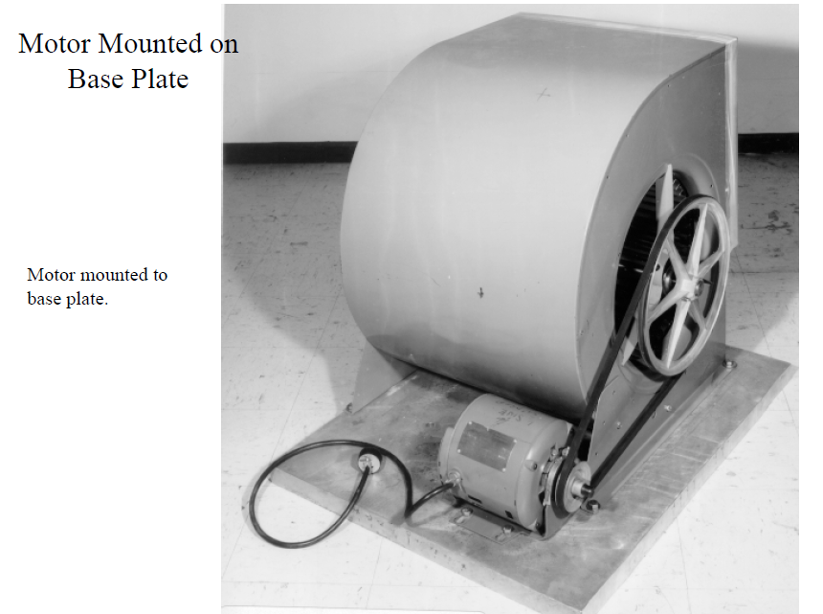
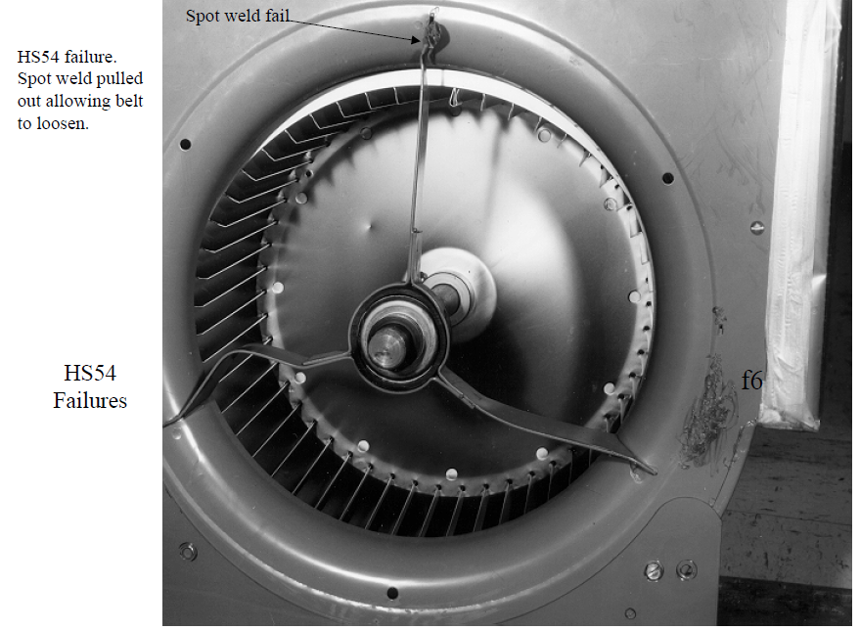
Pseudo Velocity: Historical Notes
The 100 ips limit appears to have been derived from two sources
The first was Gaberson’s shock test of six squirrel cage fans or blowers
The second was a analytical calculation based on the yield stress limit of mild steel

Slide 18
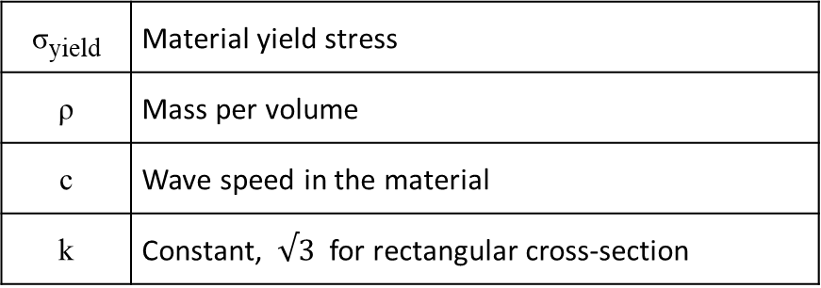
Pseudo Velocity: Historical Notes (cont)
The maximum velocity v _{max} for a given beam undergoing bending vibration is calculated as
σ_{yield} | Material yield stress
ρ | Mass per volume
c | Wave speed in the material
k | Constant, $√3$ for rectangular cross-section
Mild steel beam: σ_{yield} = 33 ksi → v _{max} = 130 in/sec

Slide 19
Pseudo Velocity: Morse Chart
R. Morse, Spacecraft & Launch Vehicle Dynamics Environments Workshop Program, Aerospace Corp., El Segundo, CA, June 2000

Slide 20
Relative Displacement: Circuit Board and Component Lead Diagram
L
Relative Motion
h
Component
Z
B
Relative Motion
Component

Slide 21
Relative Displacement: Empirical Fatigue Formula
Let Z be the single-amplitude displacement at the center of the board that will give a fatigue life of about 20 million stress reversals in a random-vibration environment, based upon the 3σ circuit board relative displacement
Steinberg’s empirical formula for Z _{3σ limit} is
Steinberg’s empirical formula for the shock limit is
Z _{shock} = 6 * Z _{3σ limit}
B | = | length of the circuit board edge parallel to the component, inches
L | = | length of the electronic component, inches
h | = | circuit board thickness, inches
r | = | relative position factor for the component mounted on the board, 0.5 < r < 1.0
C | = | Constant for different types of electronic components, 0.75 < C < 2.25
inches

Slide 22
Relative Displacement: Position Factor r
r | Component Location (Board supported on all sides)
1 | When component is at center of PCB (half point X and Y)
0.707 | When component is at half point X and quarter point Y
0.5 | When component is at quarter point X and quarter point Y
.
0.707
1.0
0.5
0.707

Slide 23
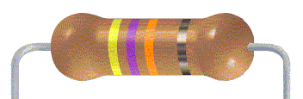
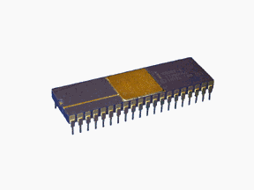
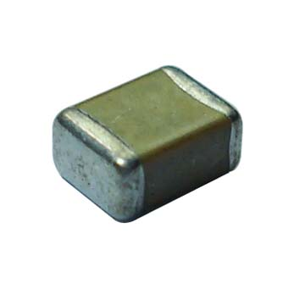
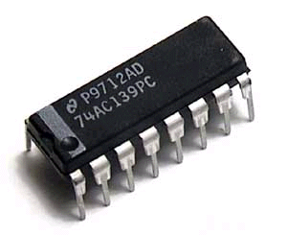
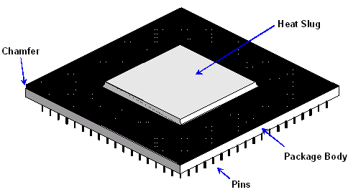
Component Constants
C=1.26 | DIP with side-brazed lead wires
C=1.0 | Through-hole Pin grid array (PGA) with many wires extending from the bottom surface of the PGA
C=0.75 | Axial leaded through hole or surface mounted components, resistors, capacitors, diodes
C=1.0 | Standard dual inline package (DIP)

Slide 24
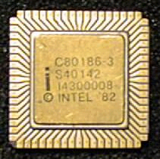
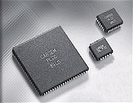
Component Constants (cont)
C=2.25
C=1.26 | Surface-mounted leaded ceramic chip carriers with thermal compression bonded J wires or gull wing wires.
Surface-mounted leadless ceramic chip carrier (LCCC).
A hermetically sealed ceramic package. Instead of metal prongs, LCCCs have metallic semicircles (called castellations) on their edges that solder to the pads.

Slide 25

Component Constants (cont)
C=1.75
Surface-mounted ball grid array (BGA).
BGA is a surface mount chip carrier that connects to a printed circuit board through a bottom side array of solder balls.

Slide 26
Steinberg Circuit Board Damping Equation
Equation for approximating Q for a system is
where
A | = 1.0 for beam-type structures
 | = 0.5 for plug-in PCBs or perimeter supported PCBs
 | = 0.25 for small electronic chassis or electronic boxes
f_{n} | Natural Frequency (Hz)
G_{in} | Sine Base Input (G)

Slide 27
Steinberg Circuit Board Damping, Sample Cases

Slide 28
Tom’s Measured Data from Shaker Tests
Range is 9 to 29

Slide 29
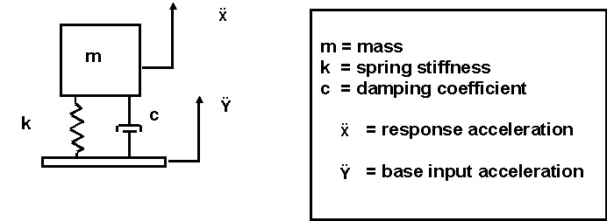
Shock Analysis, Base Excitation
First choice is to model component as an SDOF system
Use FEA for MDOF systems

Slide 30
FEA Shock Analysis Introduction
MDOF Shock analysis can be performed either as:
1. Time domain modal transient
2. Response spectrum modal combination
Both methods are demonstrated in this presentation
The time domain method requires more computation time but is potentially more realistic
It gives insight into understanding the plausible timing of peaks for individual modes
Allows modal Q values to be different than SRS specification Q value
There are two methods for applying the acceleration as shown on the next page
The indirect seismic mass method is the subject for this presentation

Slide 31






Acceleration Excitation Methods
Assume a rectangular plate mounted via posts at each corner
F
Rigid links
Directly enforce acceleration at corners
For uniform base excitation:
Mount plate to heavy seismic mass via rigid links
Apply force to yield desired acceleration at plate corners
31

Slide 32
Time History Synthesis to Meet an SRS Specification
Natural Frequency (Hz) | Accel (G)
100 | 100
2000 | 2000
10,000 | 2000
Typical specification is defined from 100 to 10,000 Hz
Extrapolate down to 10 Hz to cover low frequency modes and for realism
Synthesized acceleration time history and corresponding velocity and displacement should each have zero values for numerical stability

Slide 33
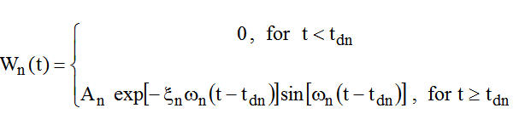

Damped Sinusoids
Synthesize a series of damped sinusoids to satisfy the SRS
Trial-and-error process with random number generation and convergence
Individual damped-sinusoid
Series of damped-sinusoids
Reconstruct damped sine series via wavelets (non-orthogonal, shaker shock variety)

Slide 34
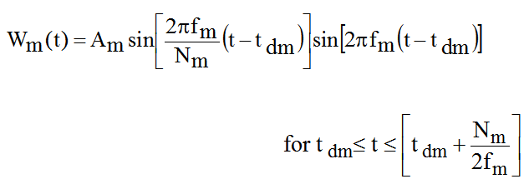
Wavelet Equation
W_{m} (t) = acceleration at time t for wavelet m
A_{m} = acceleration amplitude f _{m} = frequency t _{dm} = delay
N_{m} = number of half-sines, odd integer > 3

Slide 35
Typical Shaker-Shock Wavelet
A shock waveform can be modeled by a series of wavelets:
Ferebee R , Irvine T, Clayton J, Alldredge D, An Alternative Method Of Specifying Shock Test Criteria: NASA/TM-2008-215253
Trial-and-error process using random number generation with convergence

Slide 36
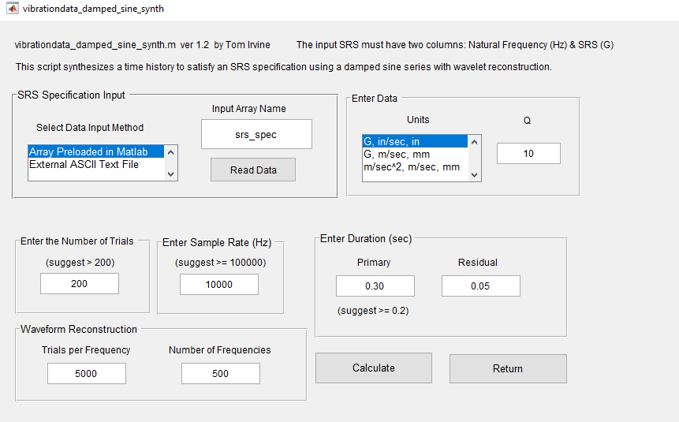
Time History Synthesis Matlab Script
Script included in the Vibrationdata GUI package freely available at: https://vibrationdata.wordpress.com

Slide 37
Synthesized Time History
The sample rate is 100K samples/sec which is 10 x the highest SRS natural frequency
The time histories is composed of a series of damped sinusoids which have been reconstructed in terms of wavelets

Slide 38
Matlab: Time History Set
Maintaining stable velocity & displacement are good engineering practice
Otherwise relative displacement error may occur due to significant digit effects if the displacement has a “ski slope” effect

Slide 39
The synthesized time history satisfies the SRS specification within tolerance bands

Slide 40

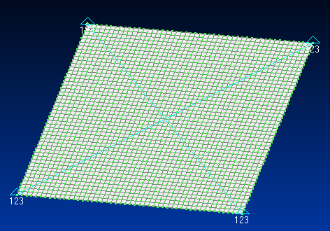
Femap: Plate Nodes, Elements & Corner Constraints
Aluminum 6061-T651
Flat square plate 12 x 12 x 0.25 inch
Constrain all corner nodes for no TX, TY or TZ translation
Node 1201 is at the center in this model
48 elements & 49 nodes per edge
Q=10 for all modes

Slide 41
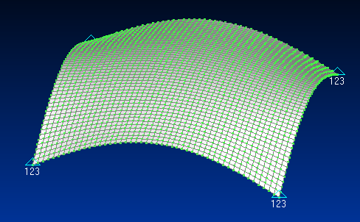
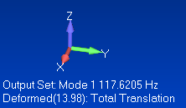
Femap: Mode Shape 1
The fundamental mode at 117.6 Hz has 93.3% of the total modal mass in the T3 axis
The plate appears to behave almost as a single-degree-of-freedom system
But higher modes make a very significant contribution to the overall shock response

Slide 42
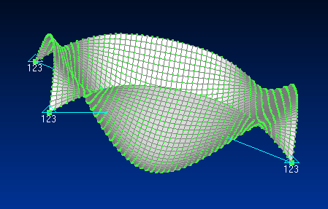
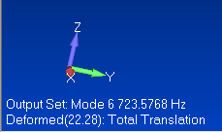
Femap: Mode Shape 6
The sixth mode at 723 Hz has 3.6% of the total modal mass in the T3 axis

Slide 43
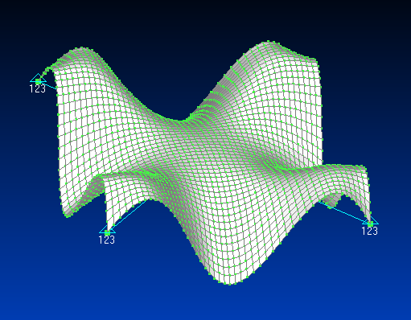
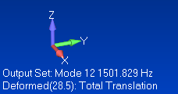
Femap: Mode Shape 12
The twelfth mode at 1502 Hz has 1.6% of the total modal mass in the T3 axis

Slide 44
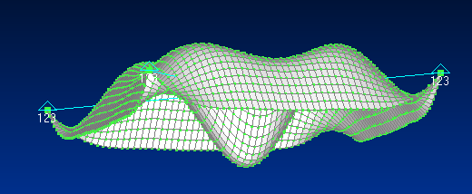
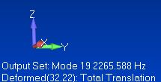
Femap: Mode Shape 19
The 19th mode at 2266 Hz has only 0.3% of the total modal mass in the T3 axis

Slide 45
Matlab: Parameters for T3
n | fn (Hz) | Modal Mass Fraction | Participation Factor | Eigenvector at Node 1201 (center) | Eigenvector at Node 49 (mid edge)
1 | 117.6 | 0.933 | 0.0923 | 13.98 | 9.81
6 | 723.6 | 0.036 | 0.0182 | 22.28 | 17.92
12 | 1502 | 0.017 | 0.0123 | 2.499 | -28.5
19 | 2266 | 0.003 | 0.0053 | 32.22 | -16.6
The Participation Factors & Eigenvectors are shown as absolute values
The Eigenvectors are mass-normalized
The Eigenvectors are the only parameter in the table which depends on location
Modes 1, 6, 12 & 19 account for 98.9% of the total mass

Slide 46
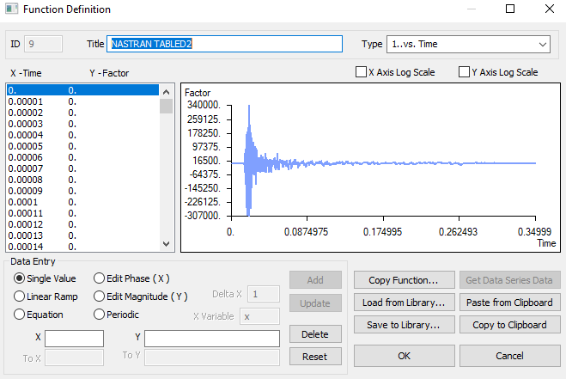
Femap: Synthesized Acceleration Time History
The X-axis is Time (sec)
The Y-axis is Acceleration (in/sec^2)

Slide 47
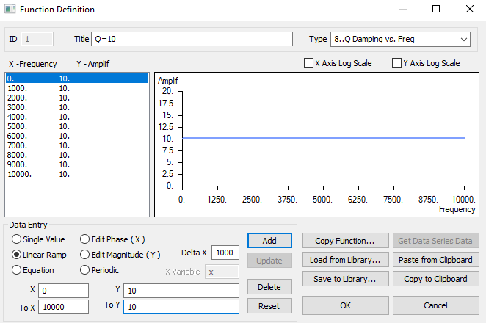
Femap: Q Damping
Customize the damping table according to your analysis problem need
Damping can vary with frequency
Q=10 is equivalent to 5% viscous modal damping

Slide 48
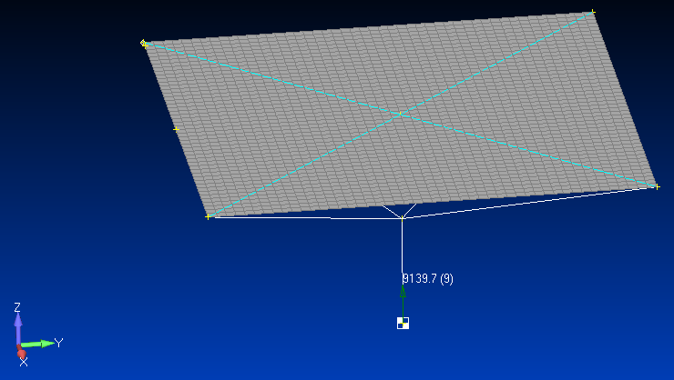
Femap: Node Group
Node 1
Node 49
Node 1201
Node 2402
Node 2403

Slide 49
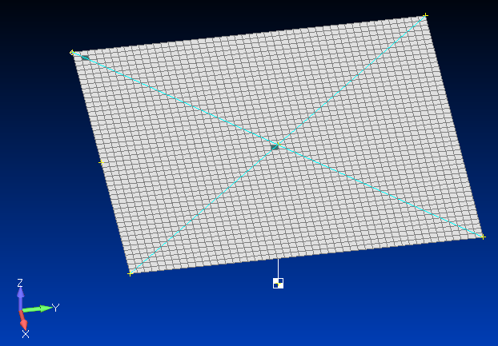
Femap: Element Group
Run the Nastran modal transient analysis
Post-process the *.f06 file
Element 50
Node 1201
Element 1129

Slide 50
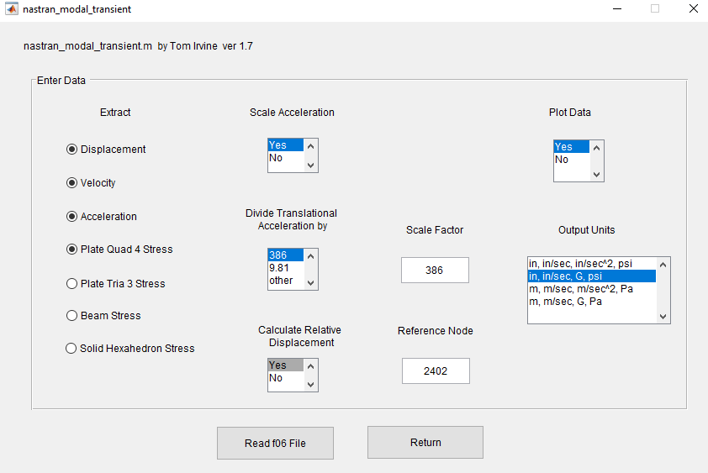
Matlab: Vibrationdata GUI, Modal Transient Extraction
Input File: square_plate_modal_transient_seismic_mass.f06
Node 2402 is base drive node

Slide 51
Matlab: Relative Velocity
Absolute peak: 79.7 in/sec
Absolute peak: 68.9 in/sec
Each peak is below the 100 in/sec threshold

Slide 52
Matlab: Acceleration
Absolute peak: 461 G
Absolute peak: 586 G

Slide 53
Matlab: Stress Response, Near Corner, Element 50
The signed Von Mises stress is useful for fatigue analysis
The absolute peak is 7662 psi
Signed Von Mises Stress=
(Von Mises Stress)*sign(Major Principal Stress

Slide 54
Matlab: Stress Response, Plate Middle, Element 1129
The signed Von Mises stress is useful for fatigue analysis
The absolute peak is 4741 psi

Slide 55
Matlab: Response Peaks
Nodal Response Comparison for T3
Peak Absolute Response | Edge Center Node 49 | Plate Middle Node 1201
Relative Displacement (in) | 0.073 | 0.105
Relative Velocity (in/sec) | 68.9 | 79.7
Absolute Acceleration (G) | 586 | 461
The Plate Middle Node has the highest relative displacement & velocity
The Edge Center Node has the highest acceleration
Von Mises Stress Response Comparison, unit: psi
Near Corner Element 50 | Plate Middle Element 1129
7662 | 4741

Slide 56
Modal Combination Methods
Response spectrum analysis is actually an extension of normal modes analysis
ABSSUM – absolute sum method
SRSS – square-root-of-the-sum-of-the-squares
NRL – Naval Research Laboratory method
The SRSS method is probably the best choice for response spectrum analysis because the modal oscillators tend to reach their respective peaks at different times according to frequency
The lower natural frequency oscillators take longer to peak

Slide 57
ABSSUM Method
Conservative assumption that all modal peaks occur simultaneously
Pick D values directly off of Relative Displacement SRS curve
where is the mass-normalized eigenvector coefficient for coordinate i and mode j
These equations are valid for both relative displacement and absolute acceleration

Slide 58
SRSS Method
Pick D values directly off of Relative Displacement SRS curve
These equations are valid for both relative displacement and absolute acceleration

Slide 59
Acceleration Response Check for Mid Edge Node 49 T3
n | fn (Hz) | MMF | PF | Eigen vector | Specification SRS (G) | | PF x Eig x Spec | (G) | | PF x Eig x Spec |² (G²)
1 | 117.6 | 0.933 | 0.0923 | 9.81 | 117.6 | 106.5 | 11339
6 | 723.6 | 0.036 | 0.0182 | 17.92 | 723.6 | 236.0 | 55695
12 | 1502 | 0.017 | 0.0123 | -28.5 | 1502 | 526.5 | 277230
19 | 2266 | 0.003 | 0.0053 | -16.6 | 2000 | 176.0 | 30962
 |  |  |  |  |  | sum = 1045 G | sum = 375,225 G²
 |  |  |  |  |  |  | sqrt of sum = 613 G
This checking method is an approximation for the response of a multi-degree-of-freedom system to an SRS input
The table is taken from the plate model modal analysis results prior to the addition of the seismic mass, with three added columns
The set composed of modes 1, 6, 12 & 19 accounts for almost 99% of the total mass
The seventh column is the participation factor times the eigenvector times the SRS specification
The sum of the absolute responses is 1045 G, which conservatively assumes that each mode reaches its peak at the same time as the others
The “square root of the sum of the squares” is 613 G
The FEA modal transient peak response was 586 G which passes the “sanity check”

Slide 60
Acceleration Response Check for Center Node 1201 T3
n | fn (Hz) | MMF | PF | Eigen vector | Specification SRS (G) | | PF x Eig x Spec | (G) | | PF x Eig x Spec |² (G²)
1 | 117.6 | 0.933 | 0.0923 | 13.98 | 117.6 | 152 | 23104
6 | 723.6 | 0.036 | 0.0182 | -22.28 | 723.6 | 293 | 85849
12 | 1502 | 0.017 | 0.0123 | 2.499 | 1502 | 46 | 2116
19 | 2266 | 0.003 | 0.0053 | 32.22 | 2000 | 342 | 116964
 |  |  |  |  |  | sum = 833 G | sum = 228033 G²
 |  |  |  |  |  |  | sqrt of sum = 478 G
The table is taken from the plate model modal analysis results prior to the addition of the seismic mass, with three added columns
The sum of the absolute responses is 833 G, which conservatively assumes that each mode reaches its peak at the same time as the others
The “square root of the sum of the squares” is 478 G
The FEA modal transient peak response was 461 G which passes the “sanity check”

Slide 61

Vibrationdata SRS Modal Combination
Matlab Command Window >> spec=[10 10; 2000 2000; 10000 2000]

Slide 62
Vibrationdata SRS Modal Combination Results, Center Node 1201 T3
SRS Q=10
fn(Hz) Accel(G)
10.0 10.0
2000.0 2000.0
10000.0 2000.0
fn Q=10
(Hz) SRS(G)
117.6 117.6
723.6 723.6
1502 1502
2266 2000
fn Part Eigen SRS Modal Response
(Hz) Factor vector Accel(G) Accel(G)
117.6 0.0923 13.98 117.6 151.7
723.6 0.0182 -22.28 723.6 293.4
1502 0.0123 2.499 1502 46.17
2266 0.0053 32.2 2000 341.3
ABSSUM= 832.7 G SRSS= 477.2 G

Slide 63
Stress-Velocity Equation
The stress [σ_{n}]_{max} for mode n is:
E | Elastic modulus
ρ | Mass per volume
[V_{n}]_{max} | Modal velocity
Ĉ is a constant of proportionality dependent upon the geometry of the structure, often assumed for complex equipment to be 4 < Ĉ < 8
Ĉ ≈ 2 for all normal modes of homogeneous plates and beams

Slide 64

Matlab: Vibrationdata Shock Toolbox

Slide 65

Matlab: MDOF SRS Stress Analysis for Node 1201
Matlab Command Window >> spec=[10 10; 2000 2000; 10000 2000]
The peak velocity response occurs at center Node 1201
The peak stress occurs near each of the four corners
The stress-velocity calculation accounts for this difference

Slide 66
Matlab: Peak MDOF SRS Stress from Node 1201 velocity
SRS Q=10
fn(Hz) Accel(G)
10.0 10.0
2000.0 2000.0
10000.0 2000.0
fn Q=10
(Hz) SRS(G)
117.6 117.6
723.6 723.6
1502 1502
2266 2000
fn Q Part Eigen Accel PV SRS Modal Response
(Hz) Factor vector SRS(G) (in/sec) Stress(psi)
117.6 10 0.0923 13.98 117.6 61.43 8070
723.6 10 0.0182 -22.28 723.6 61.43 2536
1502 10 0.0123 2.499 1502 61.43 192.2
2266 10 0.0053 32.2 2000 54.22 942
ABSSUM= 11740 psi SRSS= 8513.1 psi
Hybrid Gaberson Stress-Velocity Relationship
The peak FEA response spectrum stress for the whole plate was 7662 psi
FEA stress passes sanity check, but a lower Ĉ value may be justified so that the SRSS agrees more closely with the FEA results

Slide 67
Unit 201
Nastran FEA Base Excitation Response Spectrum

Slide 68
Introduction
Shock and vibration analysis can be performed either in the frequency or time domain
Continue with plate from Unit 200
Aluminum, 12 x 12 x 0.25 inch
Translation constrained at corner nodes
Mount plate to heavy seismic mass via rigid links
Use response spectrum analysis
SRS is “shock response spectrum”
Compare results with modal transient analysis from Unit 200
The following software steps must be followed carefully, otherwise errors will result
Rigid links

Slide 69

Femap: Add Constraints to Current Constraint Set
All DOF fixed except TZ

Slide 70

Femap: Create New Constraint Set Called Kinematic

Slide 71


Femap: Add Constraint to Kinematic Set
Constrain TZ
The seismic mass is constrained in TZ which is the response spectrum base drive axis

Slide 72
Shock Response Spectrum Q=10
fn (Hz) | Peak Accel (G)
10 | 10
2000 | 2000
10000 | 2000
Good practice to extrapolate specification down to 10 Hz if it begins at 100 Hz
Because model may have modes below 100 Hz
Aerospace SRS specifications are typically log-log format
So good practice to perform log-log interpolation as shown in following slides
Go to Matlab Workspace and type:
>> spec=[10 10; 2000 2000; 10000 2000]

Slide 73

Femap: View Response Spectrum Function
Change title from TABLED2 to SRS_Q10

Slide 74

Femap: Define Response Function vs. Critical Damping
For simplicity, the model damping and SRS specification are both Q=10 or 0.05 fraction critical
Function 7 is the SRS specification
Specifications for other damping values could also be entered as functions and referenced in this table, as needed for interpolation if the model has other damping values
Multiple SRS specifications is covered in Unit 202

Slide 75


Femap: Define Normal Modes Analysis with Response Spectrum

Slide 76

Femap: Define Normal Modes Analysis Parameters
Solve for 20 modes

Slide 77

Femap: Define Nastran Output for Modal Analysis

Slide 78

Femap: SRS Cross-Reference Function
This is the function that relates the SRS specifications to their respective damping cases
“Square root of the sum of the squares”
The responses from modes with closely-spaced frequencies will be lumped together

Slide 79

Femap: Define Boundary Conditions
Main Constraint function
Base input constraint, TZ for this example

Slide 80

Femap: Define Outputs
Quick and easy to output results at all nodes & elements for response spectrum analysis
Only subset of nodes & elements was output for modal transient analysis due to file size and processing time considerations
Get output f06 file

Slide 81

Femap: Export Nastran Analysis File
Export analysis file
Run in Nastran

Slide 82

Matlab: Vibrationdata GUI

Slide 83

Matlab: Nastran Toolbox

Slide 84

Matlab: Response Spectrum Results from f06 File

Slide 85

Matlab: Response Spectrum Acceleration Results
Center node 1201 has T3 peak acceleration = 475.9 G from response spectrum analysis
Modal transient result from Unit 200 was 461 G for this node

Slide 86

Matlab: Response Spectrum Acceleration Results (cont)
Node 49
Node 1201
Center node 1201 had T3 peak acceleration = 475.9 G
Edge node 49 had highest T3 peak acceleration = 612.5 G
By symmetry, three other edge nodes should have this same acceleration
But node 1201 had highest displacement and velocity responses

Slide 87
Matlab: Response Spectrum Results - SRSS
Maximum Displacements:
node value
T1: 2376 0.00000 in
T2: 931 0.00000 in
T3: 1201 0.10746 in
R1: 1 0.02054 rad/sec
R2: 1 0.02054 rad/sec
R3: 1 0.00000 rad/sec
Maximum accelerations:
node value
T1: 2376 0.000 G
T2: 931 0.000 G
T3: 49 612.541 G
R1: 1 116739.700 rad/sec^2
R2: 1 116739.700 rad/sec^2
R3: 1 0.000 rad/sec^2
Maximum velocities:
node value
T1: 2376 0.000 in/sec
T2: 931 0.000 in/sec
T3: 1201 83.665 in/sec
R1: 1 20.246 rad/sec
R2: 1 20.246 rad/sec
R3: 1 0.000 rad/sec
Maximum Quad4 Stress:
element value
NORMAL-X : 1105 6047.053 psi
NORMAL-Y : 24 6047.053 psi
SHEAR-XY : 50 4798.865 psi
MAJOR PRNCPL: 24 6047.816 psi
MINOR PRNCPL: 1128 4997.801 psi
VON MISES : 50 8400.833 psi

Slide 88
Acceleration Response Check for Node 1201 T3
n | fn (Hz) | PF | Eigen vector | Q | Interpolated SRS (G) | | PF x Eig x Spec | (G) | | PF x Eig x Spec |² (G²)
1 | 117.6 | 0.0923 | 13.98 | 10 | 117.6 | 151.7 | 23027
6 | 723.6 | 0.0182 | -22.28 | 10 | 723.6 | 293.4 | 86093
12 | 1502 | 0.0123 | 2.499 | 10 | 1502 | 46.2 | 2131
19 | 2266 | 0.0053 | 32.22 | 10 | 2000 | 341.5 | 116644
 |  |  |  |  |  | sum = 833 G | sum = 227896 G²
 |  |  |  |  |  |  | sqrt of sum = 477 G
Center node 1201 had T3 peak acceleration = 475.9 G from the FEA SRSS
The FEA value passes the modal combination check

Slide 89

Vibrationdata GUI

Slide 90

Vibrationdata Shock Toolbox

Slide 91
Vibrationdata SRS Modal Combination
>> spec=[10 10; 2000 2000; 10000 2000]

Slide 92
Vibrationdata SRS Modal Combination Results
SRS Q=10
fn(Hz) Accel(G)
10.0 10.0
2000.0 2000.0
10000.0 2000.0
fn Q=10
(Hz) SRS(G)
117.6 117.6
723.6 723.6
1502 1502
2266 2000
fn Part Eigen SRS Modal Response
(Hz) Factor vector Accel(G) Accel(G)
117.6 0.0923 13.98 117.6 151.7
723.6 0.0182 -22.28 723.6 293.4
1502 0.0123 2.499 1502 46.17
2266 0.0053 32.2 2000 341.3
ABSSUM= 832.7 G SRSS= 477.2 G

Slide 93
Acceleration Response Check for Node 49 T3
n | fn (Hz) | PF | Eigen vector | Q | Interpolated SRS (G) | | PF x Eig x Spec | (G) | | PF x Eig x Spec |² (G²)
1 | 117.6 | 0.0923 | 9.81 | 10 | 117.6 | 106.5 | 11339
6 | 723.6 | 0.0182 | 17.92 | 10 | 723.6 | 236.0 | 55695
12 | 1502 | 0.0123 | -28.5 | 10 | 1502 | 526.5 | 277230
19 | 2266 | 0.0053 | -16.6 | 10 | 2000 | 176.0 | 30962
 |  |  |  |  |  | sum = 1045 G | sum = 375225 G²
 |  |  |  |  |  |  | sqrt of sum = 613 G
Edge node 49 had T3 peak acceleration = 612.5 G from the FEA SRSS
The FEA value passes the modal combination check

Slide 94

Femap: T3 Acceleration Contour Plot, unit = in/sec^2
Import the f06 file into Femap and then View > Select

Slide 95

Femap: T3 Velocity Contour Plot, unit = in/sec

Slide 96

Femap: T3 Translation Contour Plot, unit = inch
This is actually the relative displacement

Slide 97
Matlab: Response Spectrum Stress Elements
Node 101
Element 50
Node 1201
Element 1129
Element 50 had the highest Von Mises stress = 8401 psi
Element 1129 had Von Mises stress = 5001 psi

Slide 98


Matlab: Response Spectrum Stress Results

Slide 99

Femap: Von Mises Stress Contour Plot

Slide 100
Matlab: Vibrationdata Shock Toolbox

Slide 101

Matlab: MDOF SRS Stress Analysis for Node 1201
The peak velocity response occurs at center Node 1201
The peak stress occurs near each of the four corners
The stress-velocity calculation accounts for this difference

Slide 102
Stress-Velocity Equation
The stress [σ_{n}]_{max} for mode n is:
E | Elastic modulus
ρ | Mass per volume
[V_{n}]_{max} | Modal velocity
Ĉ is a constant of proportionality dependent upon the geometry of the structure, often assumed for complex equipment to be 4 < Ĉ < 8
Ĉ ≈ 2 for all normal modes of homogeneous plates and beams

Slide 103
Matlab: Peak MDOF SRS Stress from Node 1201 velocity
SRS Q=10
fn(Hz) Accel(G)
10.0 10.0
2000.0 2000.0
10000.0 2000.0
fn Q=10
(Hz) SRS(G)
117.6 117.6
723.6 723.6
1502 1502
2266 2000
fn Q Part Eigen Accel PV SRS Modal Response
(Hz) Factor vector SRS(G) (in/sec) stress(psi)
117.6 10 0.0923 13.98 117.6 61.43 8070
723.6 10 0.0182 -22.28 723.6 61.43 2536
1502 10 0.0123 2.499 1502 61.43 192.2
2266 10 0.0053 32.2 2000 54.22 942
ABSSUM= 11740 psi SRSS= 8513.1 psi
The peak FEA response spectrum stress for the whole plate was 8401 psi
FEA stress passes sanity check, but a lower Ĉ value may be justified so that the SRSS agrees more closely with the FEA results

