Slide 1
Vibrationdata
Damping & Isolation
Revision A
By Tom Irvine

Slide 2
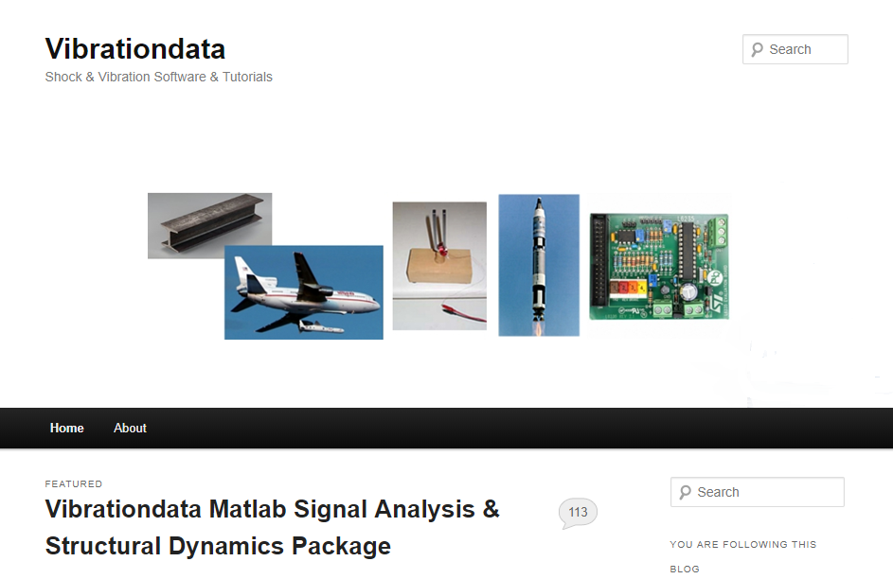
https://vibrationdata.wordpress.com/

Slide 3
Damping Mechanisms
Vibrationdata
Damping occurs as vibration energy is convert to heat, sound or some other loss mechanism
Damping is needed to limit the structural resonant response
Common sources are:
viscous effects
Coulomb damping, dry friction
aerodynamic drag
acoustic radiation
air pumping at joints
boundary damping
The dominant source for assembled structures is usually joint friction, which may be nonlinear due to joint microslip effects

Slide 4
SDOF System Free Vibration
Vibrationdata
x
The resulting equation of motion is a second-order, ordinary differential equation, linear, homogenous with constant coefficients
The viscous damping coefficient is c
The viscous damping ratio is
The angular natural frequency in radians/sec is
The natural frequency in cycles/second or Hz is
The damping coefficient divided by mass can be represented as
x
m
m
k
c
k x

Slide 5
Damping Cross-References
Vibrationdata
The viscous damping ratio is defined in terms of the damping coefficients as
The critical damping coefficient is
The amplification factor is
The amplification factor can be calculated from measured frequency response function data via the half-power method
where f is the center frequency and Δf is the difference between the two -3 dB points on either side of the peak
The loss factor is

Slide 6
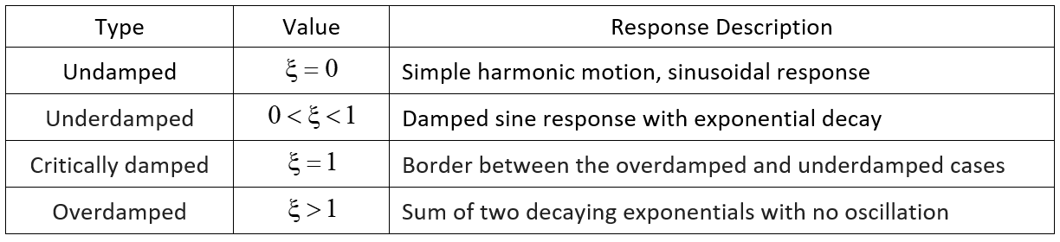
Four Damping Cases
Vibrationdata
The description is for the free vibration of a single-degree-of-freedom system due to initial displacement or velocity
The underdamped case is the common concern for aerospace engineering

Slide 7
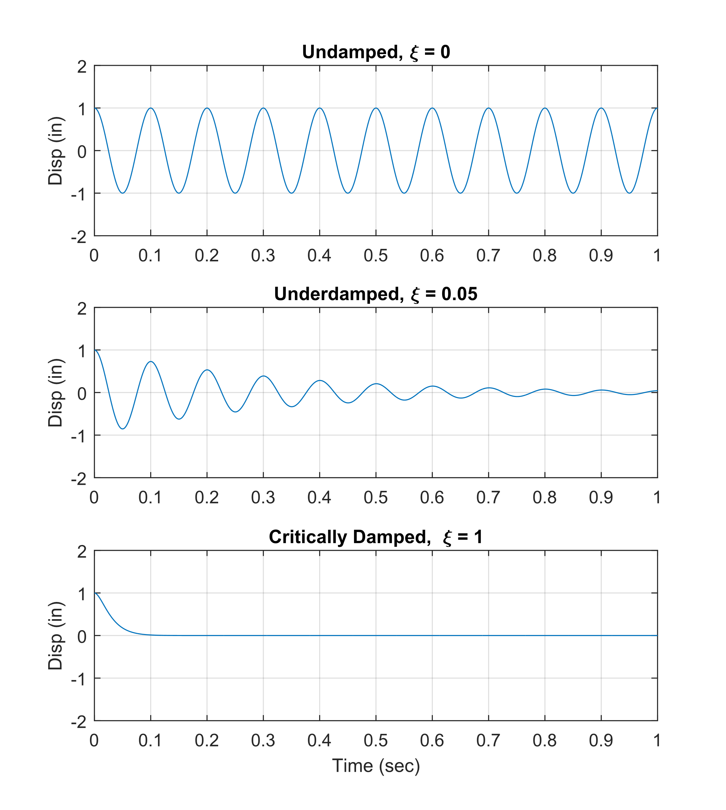
Vibrationdata
SDOF Response to Initial Displacement for Three Damping Cases

Slide 8
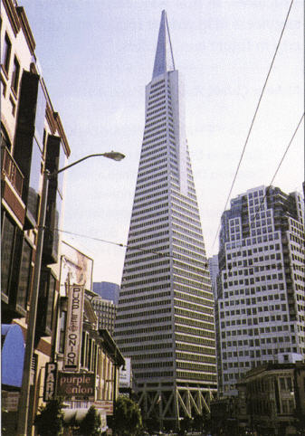
Transamerica Pyramid
Vibrationdata
The Transamerica Pyramid is built from a steel frame, with a truss system at the base, height is 850 ft (260 m)
Natural frequency and damping as obtained in the 1989 Loma Prieta earthquake and from ambient vibration
The ambient vibration was presumably due to wind, low level micro-tremors, mechanical equipment, outside street traffic, etc.
The results show non-linear behavior with an increase in damping during the severe earthquake relative to the benign ambient vibration
Direction | Loma Prieta Earthquake |  | Ambient Vibration
 | fn (Hz) | Damping | fn (Hz) | Damping
North-South | 0.28 | 4.9% | 0.34 | 0.8%
East-West | 0.28 | 2.2% | 0.32 | 1.4%

Slide 9
Nonlinear Damping
Vibrationdata
The damping value tends to increase at higher excitation levels
Damping may also decrease as the natural frequency increases, such that the amplification factor increases with natural frequency
Steinberg formula for circuit boards
Beam structures: several electronic components with some interconnecting wires or cables.
PCB: printed circuit board well-populated with an assortment of electronic components.
Small electronic chassis: 8-30 inches in its longest dimension, with a bolted cover to provide access to various types of electronic components such as PCBs, harnesses, cables, and connectors.
A | = 1.0 for beam-type structures = 0.5 for plug-in PCBs or perimeter supported PCBs = 0.25 for small electronic chassis or electronic boxes
G_{in} | Sine Base Input (G)

Slide 10
Steinberg Circuit Board Damping, Sample Cases
Vibrationdata
Damping can be nonlinear due to microslip at joints, etc.

Slide 11
Tom’s Measured Circuit Board Damping Data from Shaker Tests
Vibrationdata
Range is 9 to 29

Slide 12
Typical Q values for Launch Vehicle Structures and Components
Vibrationdata
System | fn (Hz) | Damping Ratio | Q
Pegasus XL Launch Vehicle Body-Bending during Drop Transient | 9.9 | 1.0% | 50
Fairing Ring Frequency | 897 | 3.7% | 13.5
Battery Cells inside Foam-lined Box | 80 | 15.2% | 3.3
Avionics Circuit Boards, Hardmounted Boxes | 220 to 650 | 1.7% to 5.6% | 9 to 29
Component Mounting Brackets | 70 to 2000 | 2% to 50% | 1 to 25
Avionics Boxes Mounted via Lord Isolators | 27 to 31 | 8.3% | 6
Flexible Confined Detonating Cord (FCDC) | 8 to 107 | 6% | 8.3
Space Integrated GPS/INS (SIGI) Inertial Sensor Assembly (ISA) Isolators | 55 | 13.5% | 3.7

Slide 13
Excerpt from NASA SP-8050, Structural Vibration Prediction
Vibrationdata
Type of Structure | Percent of Critical Viscous Damping | Remarks
Homogeneous-element configurations (machined brackets, solid beams, welded construction) | 1 to 2 | Damping factor depends on stress levels induced during vibration
Riveted or bolted structures | 3 to 10 | Damping cause by friction at joints significantly reduces the vibration amplification
Laminated plastics | 4 to 10 | Phenolic laminate
Honeycomb-core panels | 3 to 6 | Damping factor depends on method of fabrication (brazed versus adhesive bond) and on acoustic radiation
Vibration-isolated components | 10 to 20 | Damping factor depends on the isolator design
Nonviscous fluids | 0.5 1.0 1.5 | Frequency < 5 Hz 5 Hz < Frequency < 15 Hz Frequency > 15 Hz

Slide 14
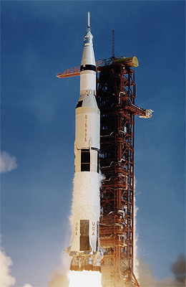
NASA SP-8079, Structural Interaction with Control Systems
Vibrationdata
Saturn V / Apollo Modal Test Results
Vibration Mode | Frequency (Hz) | Damping Ratio
First | 1.0 | 0.005
Second | 1.7 | 0.007
Third | 2.3 | 0.006
Fourth | 3.0 | 0.010

Slide 15
Typical Damping Ratios
Vibrationdata
System | Viscous Damping Ratio ξ
Metals (in elastic range) | <0.01
Continuous Metal Structures | 0.02 to 0.04
Metal Structure with Joints | 0.03 to 0.07
Aluminum / Steel Transmission Lines | 0.0004
Small Diameter Piping Systems | 0.01 to 0.02
Large Diameter Piping Systems | 0.02 to 0.03
Auto Shock Absorbers | 0.30
Rubber | 0.05
Large Buildings during Earthquakes | 0.01 to 0.05
Reference: V. Adams and A. Askenazi, Building Better Products with Finite Element Analysis, OnWord Press, Santa Fe, N.M., 1999

Slide 16

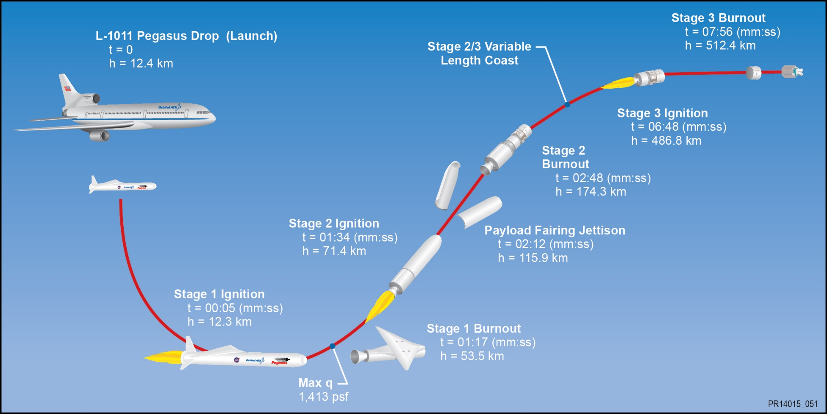
Pegasus Launch Vehicle
Pegasus Vehicle

Slide 17
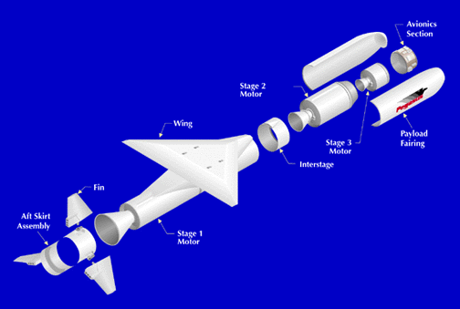
Pegasus Vehicle

Slide 18
FEA Fundamental Bending Mode Shape

Slide 19
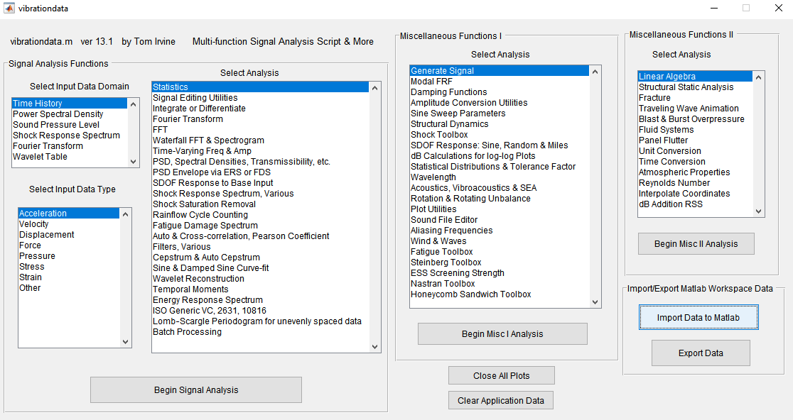

Slide 20
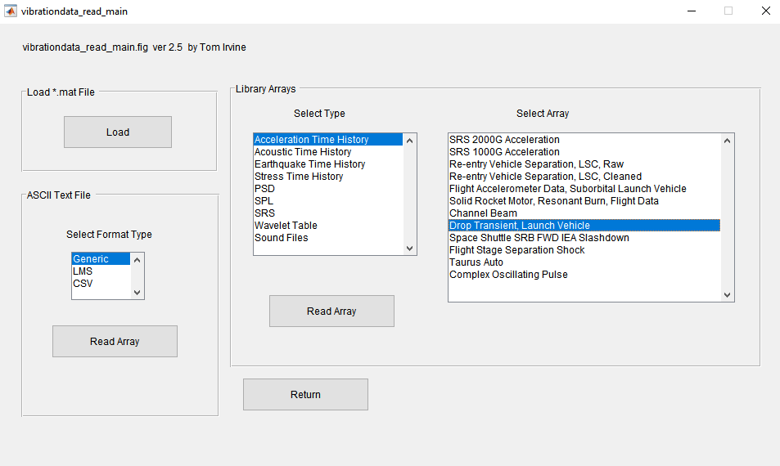

Slide 21
Flight accelerometer data
Almost textbook quality
Identify natural frequency & damping via damped sine curve-fit
Array Name: drop units: time(sec) & accel(G)

Slide 22
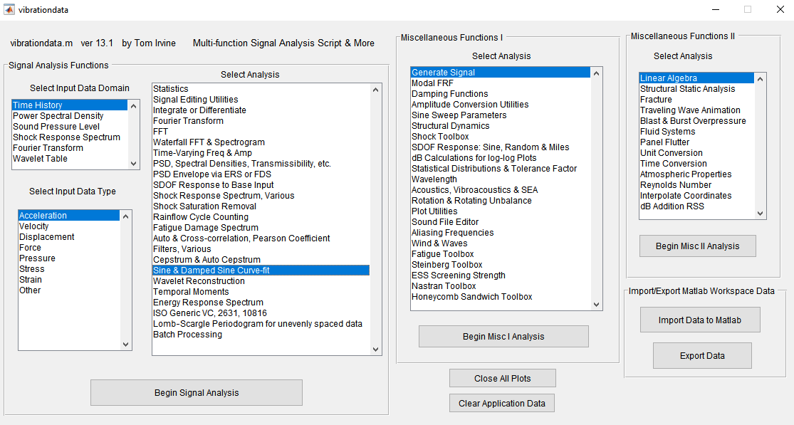

Slide 23
fn = 9.6 Hz, 1.2% damping
Case Amplitude fn(Hz) damp Phase(rad) Delay(sec)
1 0.6895 9.5736 0.0115 5.5695 0.0084

Slide 24
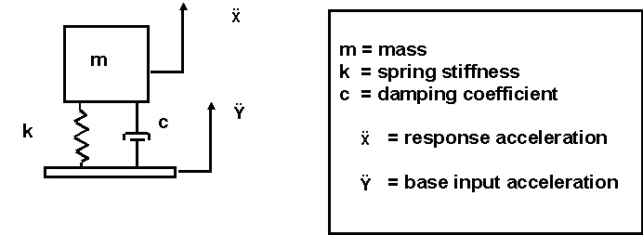
SDOF System Subjected to Base Excitation
Vibrationdata

Slide 25
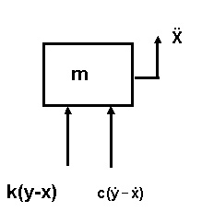
Free Body Diagram
Vibrationdata
Summation of forces in the vertical direction
Let z = x - y. The variable z is thus the relative displacement.
Substituting the relative displacement yields

Slide 26
Equation of Motion
Vibrationdata
By convention,
 | is the natural frequency (rad/sec)
ξ | is the damping ratio
Substituting the convention terms into equation,
This is a second-order, linear, non-homogenous, ordinary differential equation with constant coefficients.

Slide 27
Equation of Motion (cont)
Vibrationdata
could be a sine base acceleration or an arbitrary function
Solve for the relative displacement z using Laplace transforms.
Then, the absolute acceleration is

Slide 28
Equation of Motion (cont)
Vibrationdata
A unit impulse response function h(t) may be defined for this homogeneous case as
A convolution integral can be used for the case where the base input is arbitrary.
where

Slide 29
Equation of Motion (cont)
Vibrationdata
The convolution integral is numerically inefficient to solve in its equivalent digital-series form.
Instead, use…
Smallwood, ramp invariant, digital recursive filtering relationship!

Slide 30
Equation of Motion (cont)
Vibrationdata

Slide 31
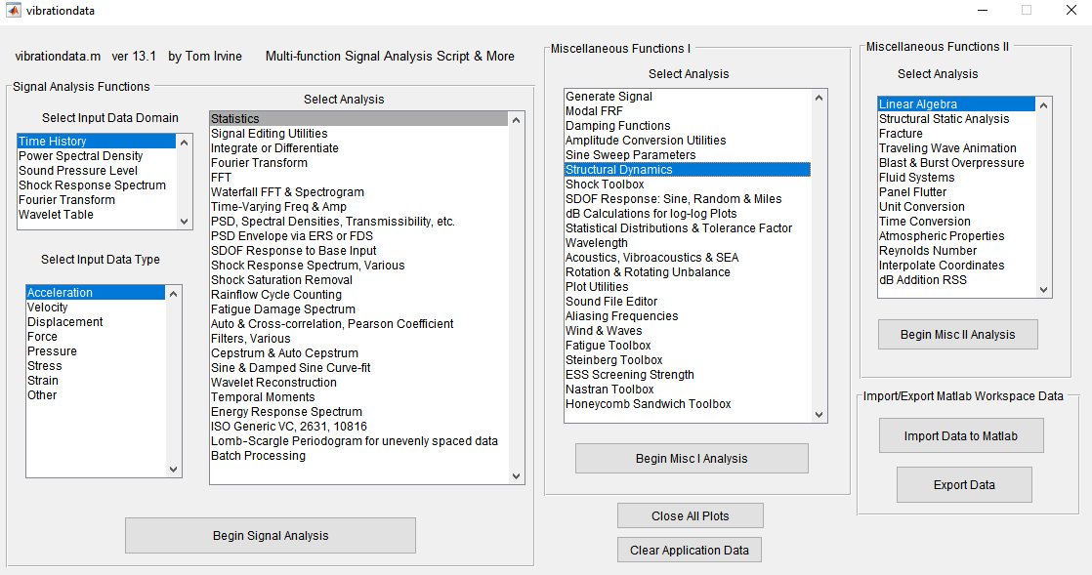

Slide 32
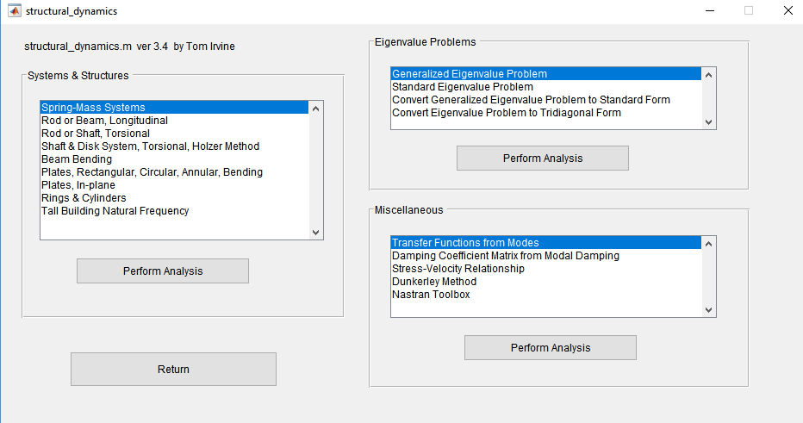

Slide 33
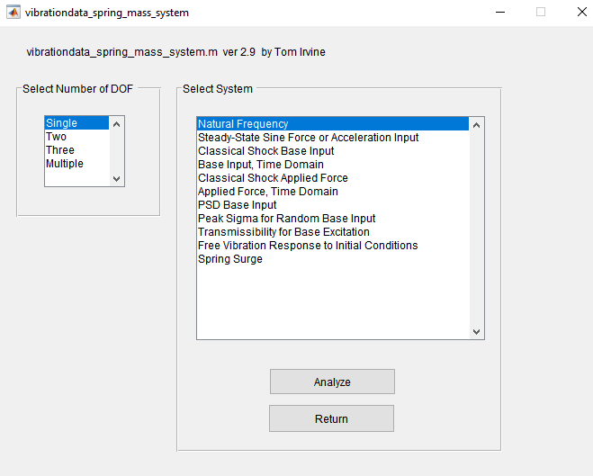

Slide 34
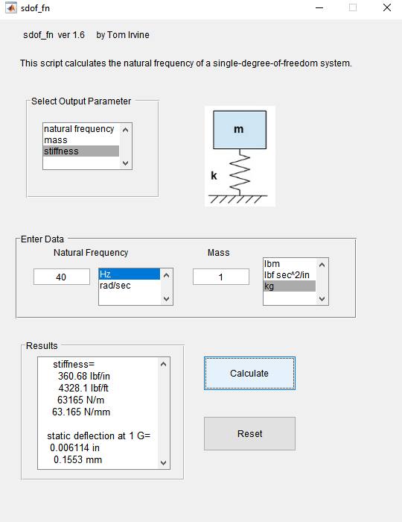
Design 40 Hz SDOF system with 1 kg mass
Set Q=10
Generate sine sweep base input
Calculate acceleration response of mass
Form transmissibility function
Use half-power method to measure damping
Numerical simulation of sine sweep shaker table test

Slide 35
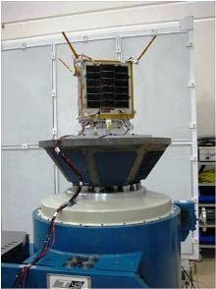
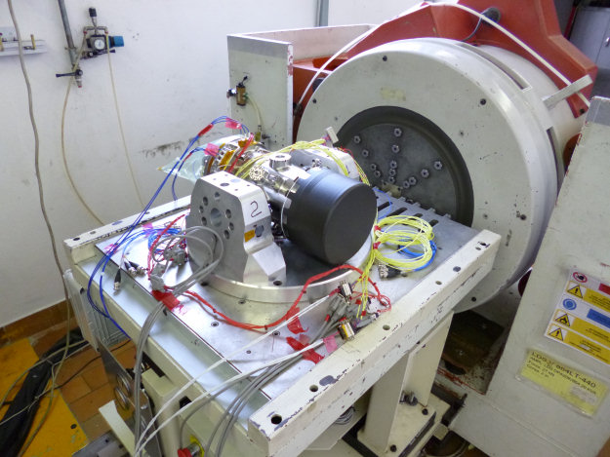
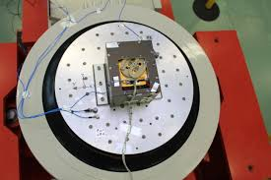
Numerical Simulation of Identifying Natural Frequencies & Damping via Shaker Base Excitation Tests

Slide 36
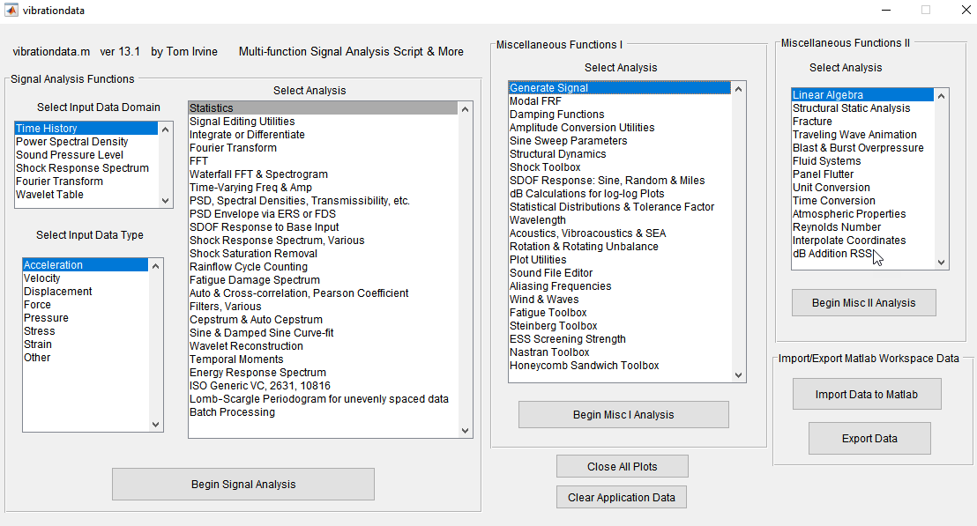

Slide 37
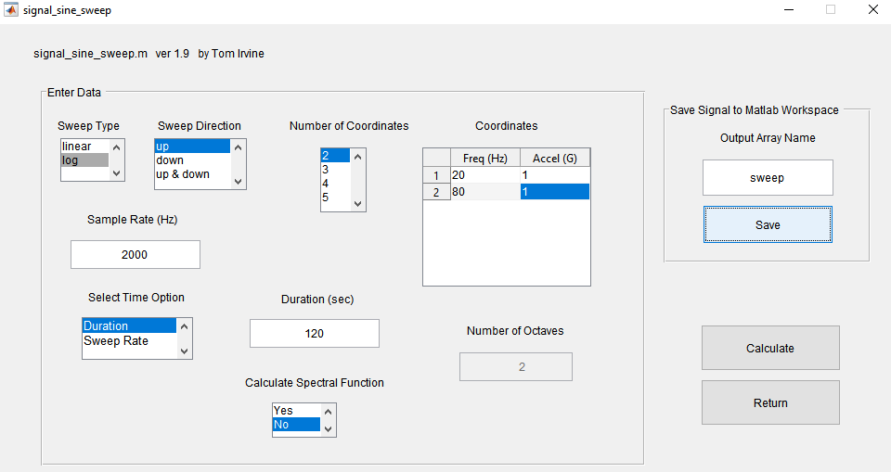
1 G from 20 Hz to 80 Hz, One octave per minute sweep rate

Slide 39
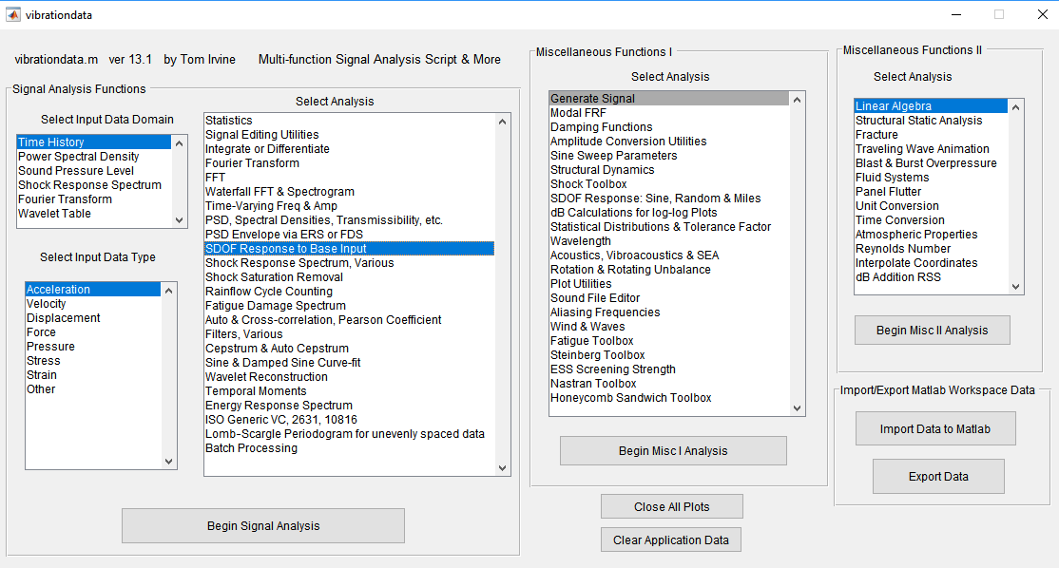

Slide 40
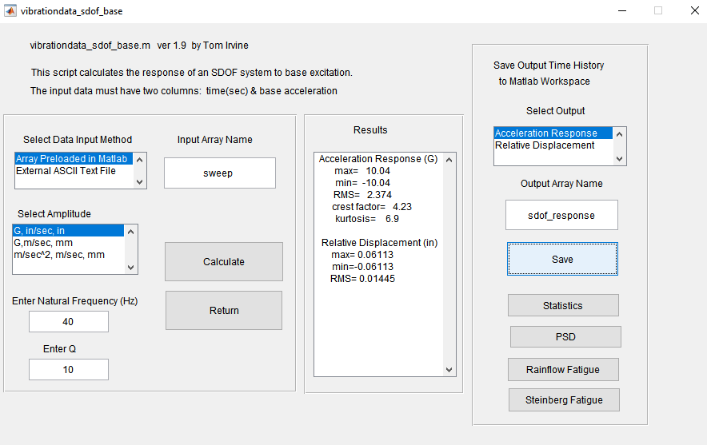

Slide 42
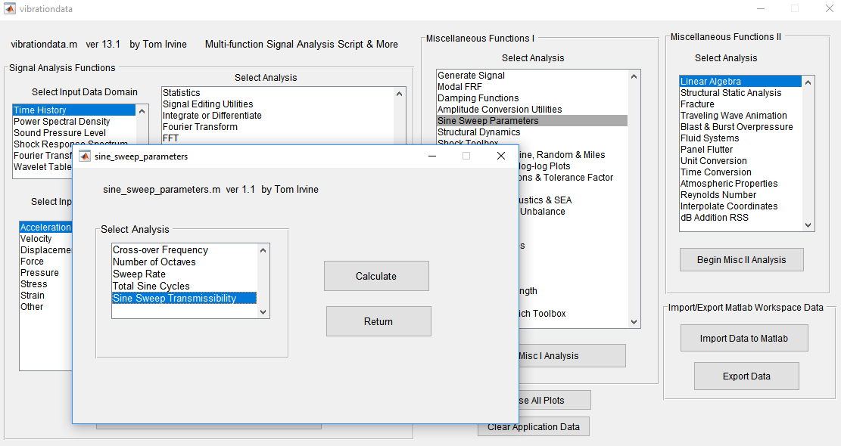

Slide 43
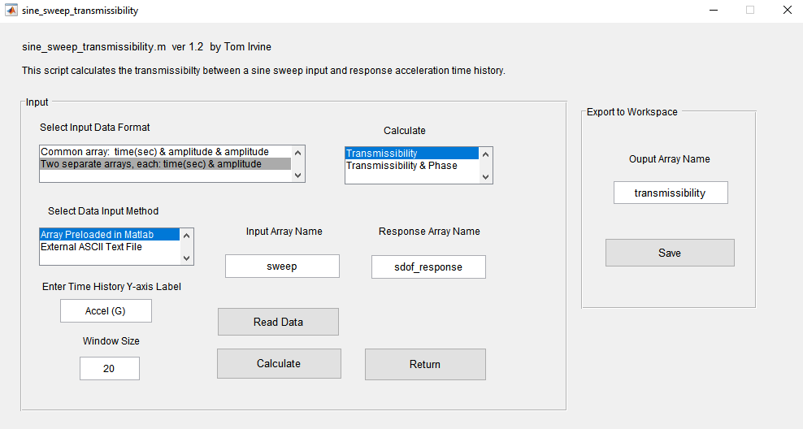

Slide 44
Half-Power Bandwidth Damping
Δf = 41.92 – 37.85
= 4.07 Hz
Q = fn / Δf
= 40/4.07
= 9.8
ξ = 1/(2*Q)
= 1/(2*9.8)
= 0.051
About 5% damping
The half-power points are 1/sqrt(2) for transmissibility
The Q is also equal to the peak transmissibility at resonance for the SDOF system, but this is a special case
Half-power bandwidth method is a more rigorous method for determining damping and is especially needed for MDOF & continuous systems

Slide 46
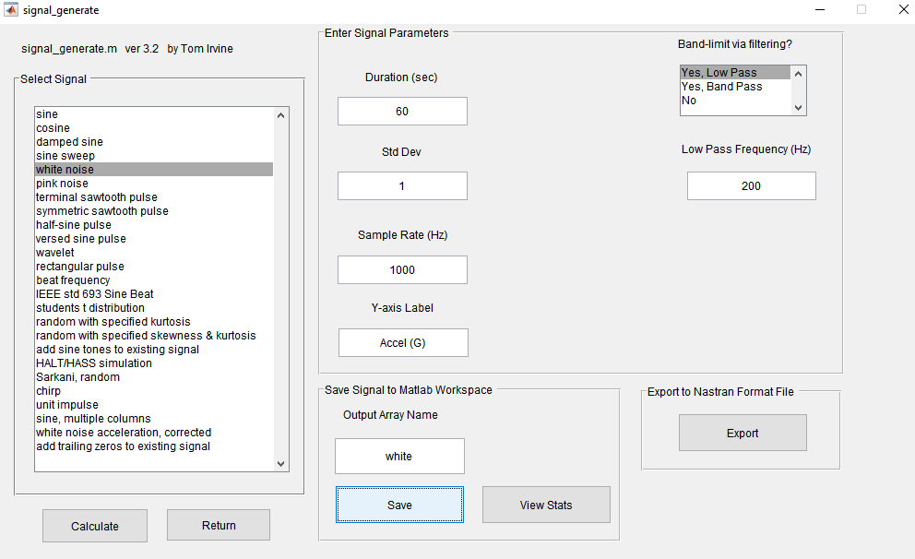

Slide 48
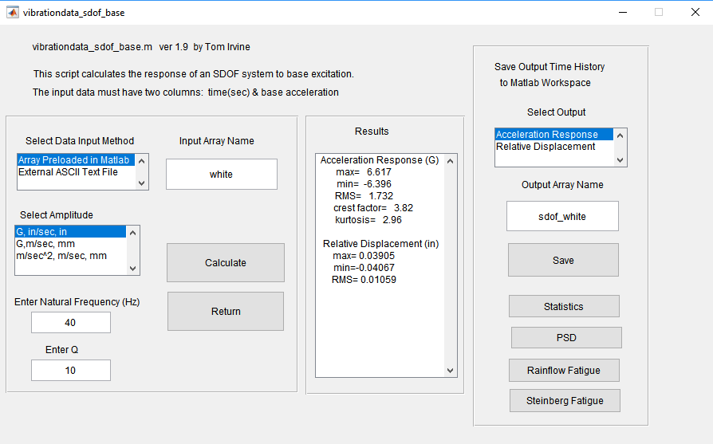

Slide 49
White Noise Base Input & SDOF Response

Slide 50
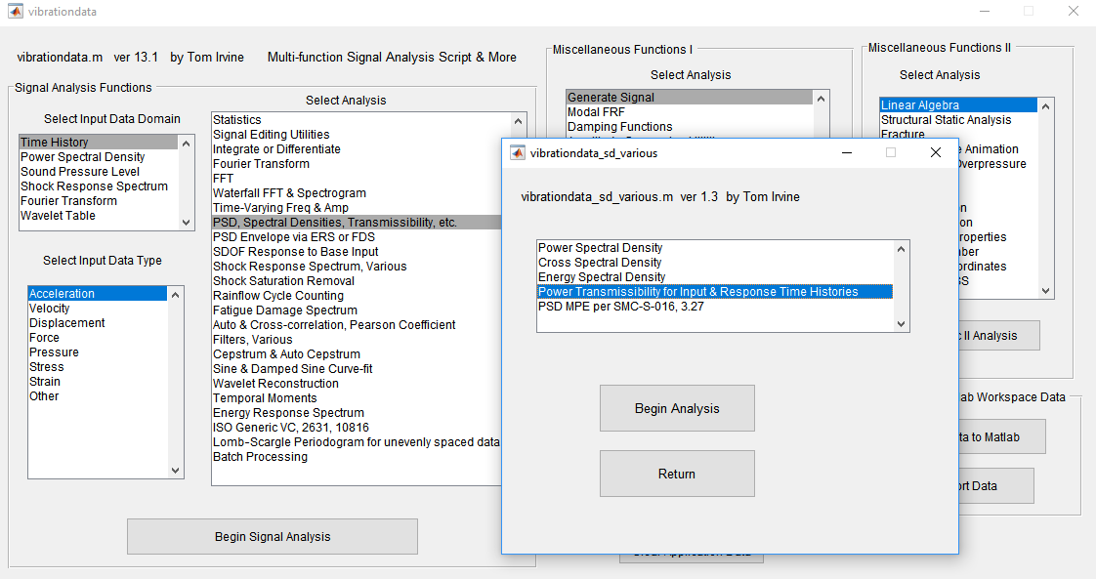

Slide 51
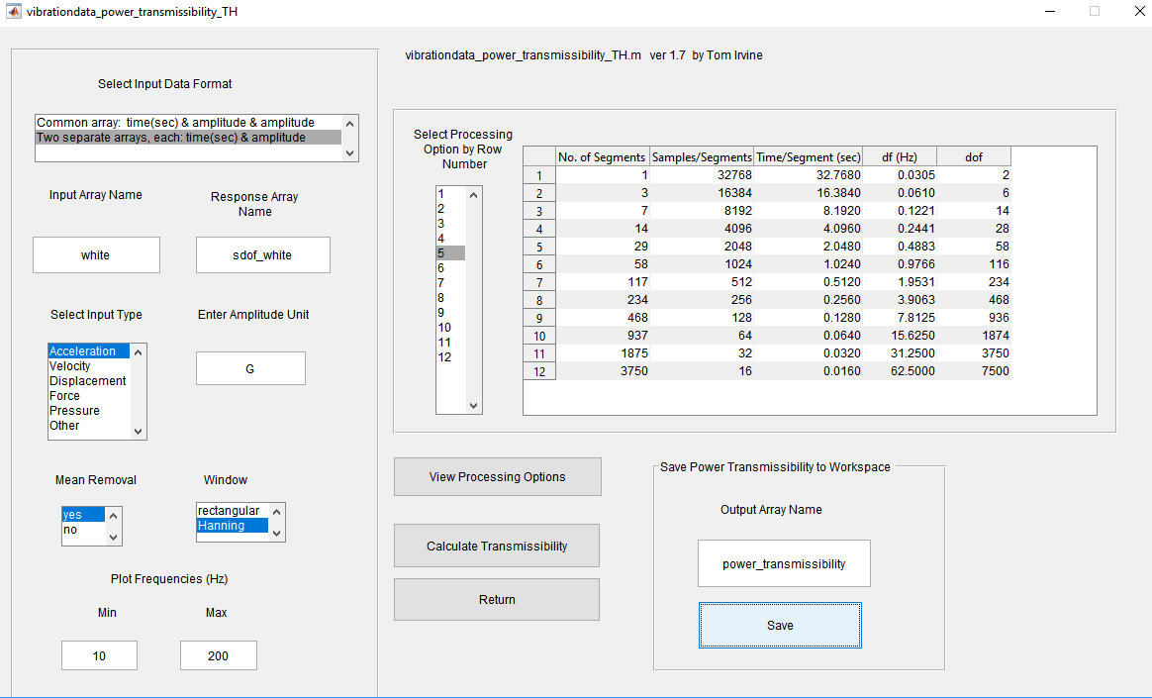

Slide 52
PSD curves are little noisy
But power transmissibility calculation cleans up noise

Slide 53
Power Transmissibility
Half-Power Bandwidth Damping
Δf = 41.91 – 37.71
= 4.2 Hz
Q = fn / Δf
= 40/4.2
= 9.5
ξ = 1/(2*Q)
= 1/(2*9.5)
= 0.053
5% damping
The half-power points are 0.5 for power transmissibility

Slide 54
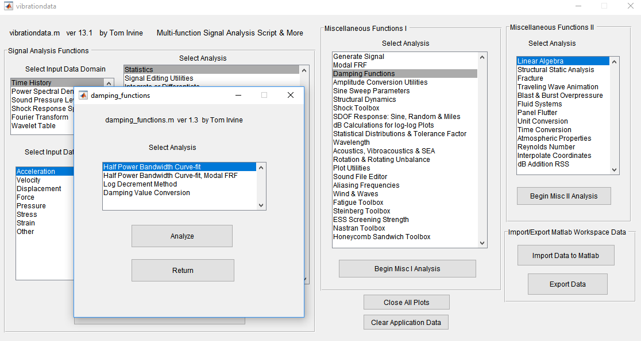

Slide 55
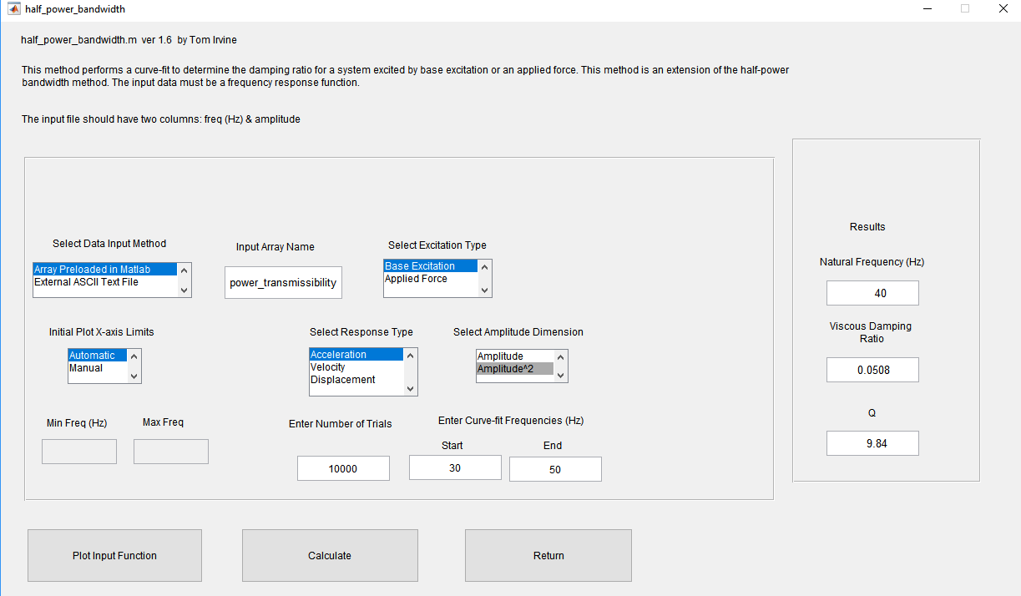

Slide 56
Extension of the Half-Power Bandwidth Method
Trial-and-error curve-fit with convergence using textbook transmissibility function

Slide 57
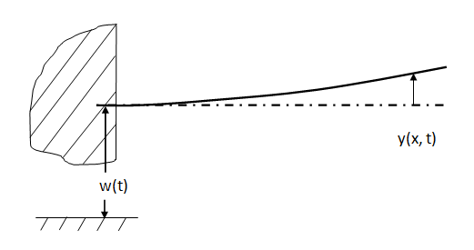
Beam Response to Base Excitation

Slide 58
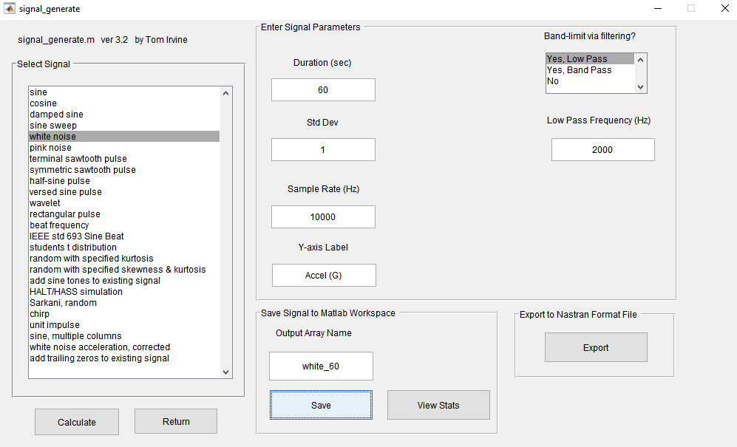

Slide 60
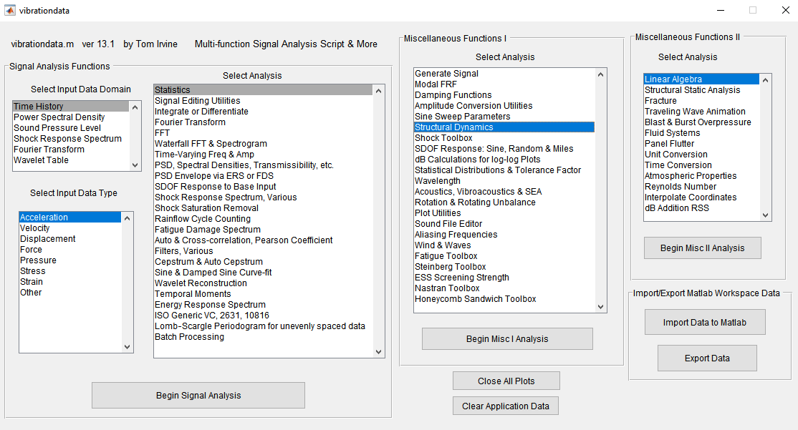

Slide 61
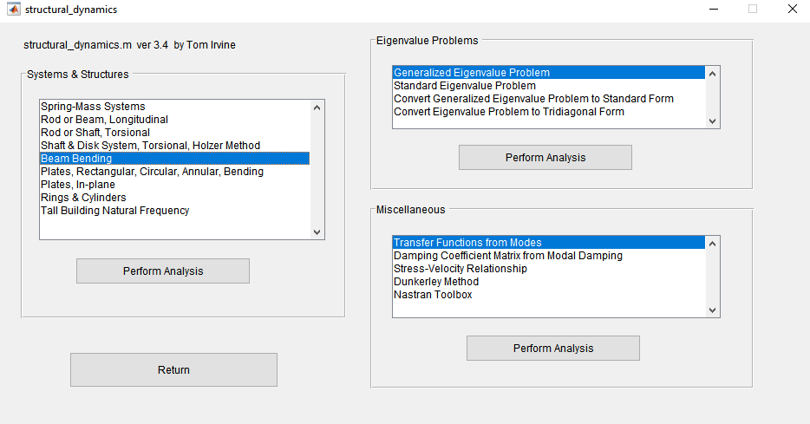

Slide 62
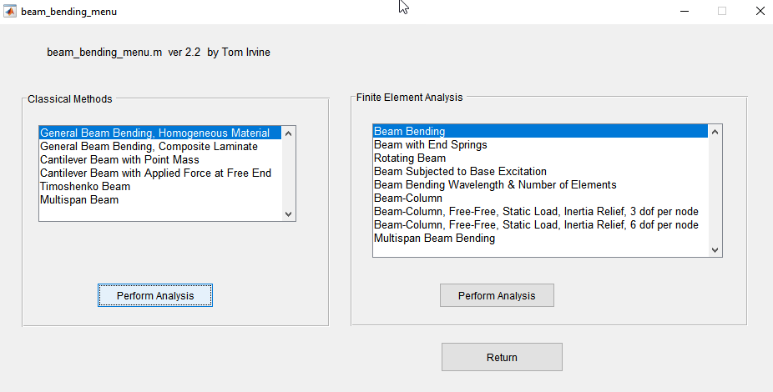

Slide 63
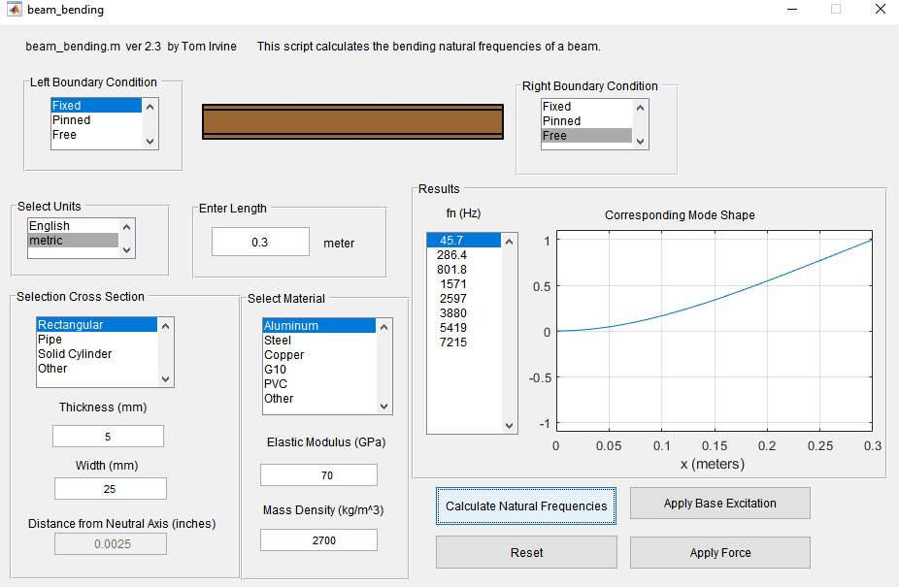
Step 1
Step 2

Slide 64
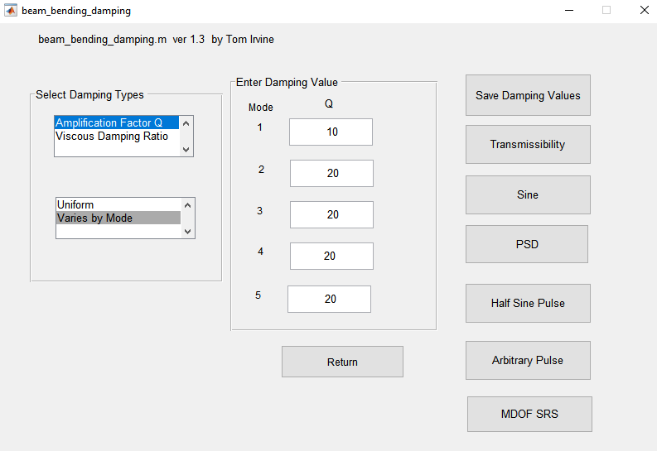
Step 3
Step 4

Slide 65
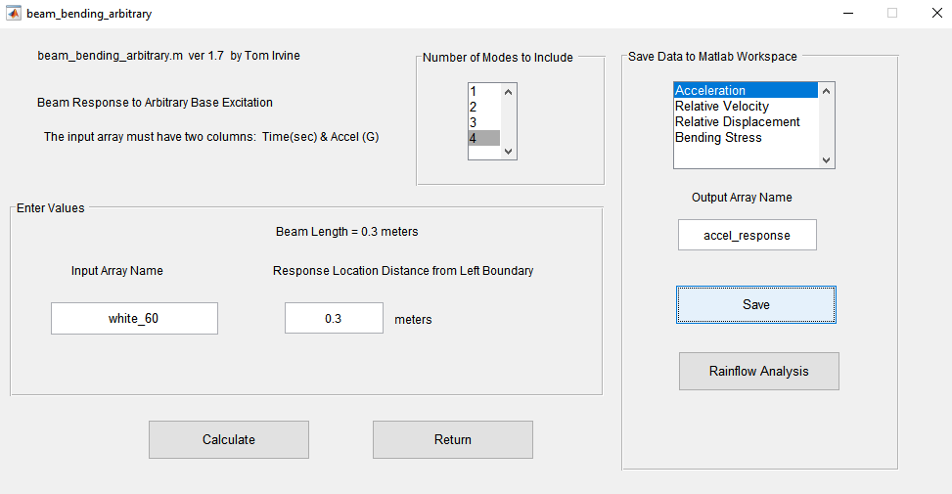

Slide 66
Base Input & Beam Response at Free End

Slide 67
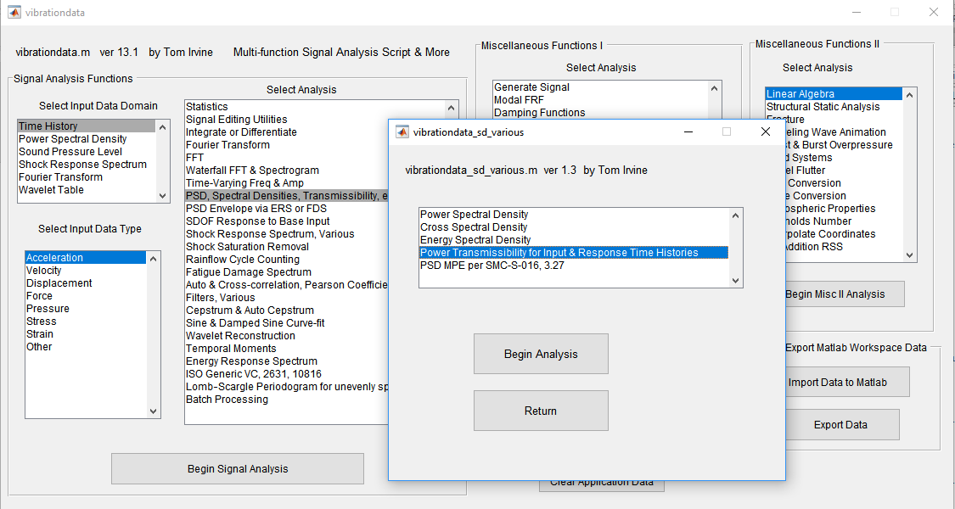

Slide 68
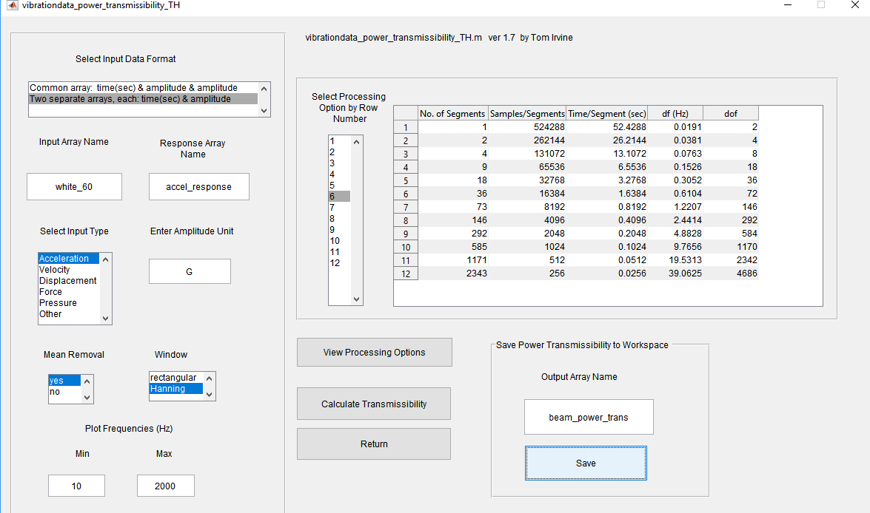

Slide 69
Beam Response at Free End

Slide 70
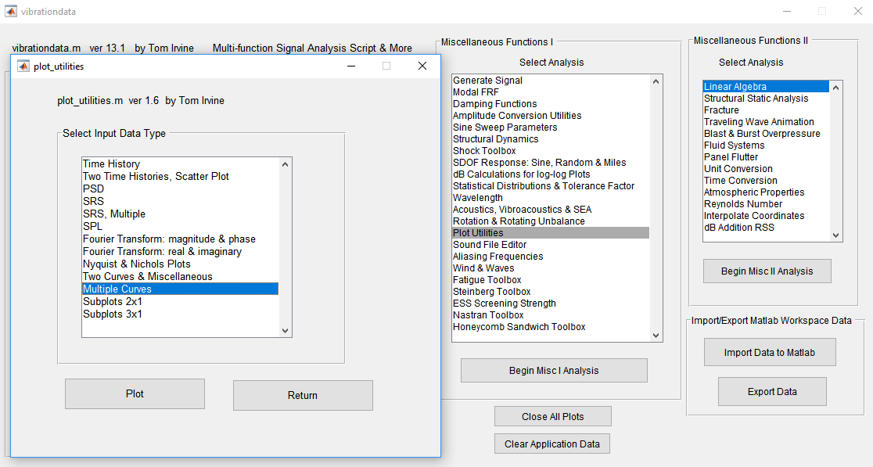

Slide 71
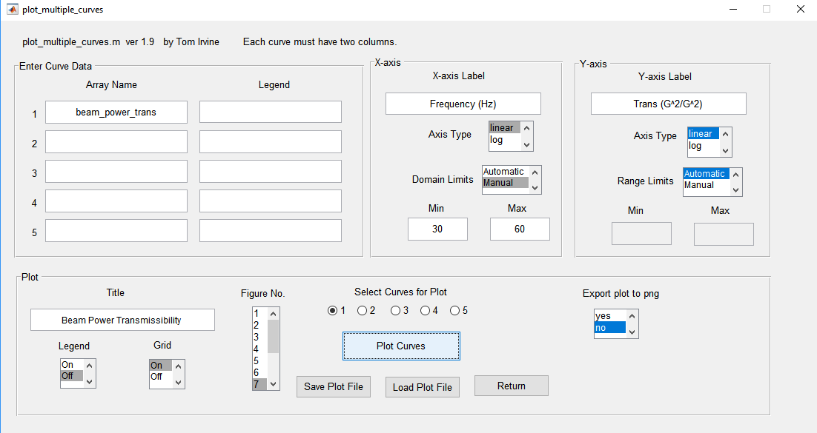

Slide 72
Half-Power Bandwidth Damping
Δf = 48.0 – 43.3
= 4.6 Hz
Q = fn / Δf
= 45.78/4.6
= 9.95
ξ = 1/(2*Q)
= 1/(2*9.95)
= 0.050
5% damping

Slide 73
Half-Power Bandwidth Damping
Δf = 293.5 – 279.2
= 14.3 Hz
Q = fn / Δf
= 286.9/14.3
= 20.1
ξ = 1/(2*20.1)
= 1/(2*9.95)
= 0.025
2.5% damping

Slide 74
Half-Power Bandwidth Guidelines
The half-power bandwidth for a frequency separation Δf is
Δf = 2 ξ f _{n}
where ξ is the damping ratio and f _{n} is the natural frequency
As a rule-of-thumb, the frequency resolution of the FRF should be such that there are at least five points within the Δf bandwidth (per Mary Baker, Jim Akers, et al)
The test duration T for a single Fourier transform or FRF covering the entire time history is
T = α / Δf = α / ( 2 ξ f _{n} ) , α > 5 recommended

Slide 75
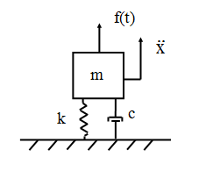
SDOF System, Applied Force
m | = | mass
c | = | viscous damping coefficient
k | = | stiffness
x | = | displacement of the mass
f(t) | = | applied force
The force can be applied by an impulse hammer or a small shaker for modal testing

Slide 76
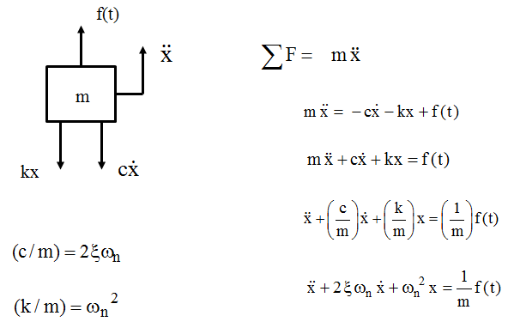
Free Body Diagram
Solve using Laplace transform
Convolution integral for case of arbitrary excitation
Convolution integral can be solved in terms of a digital recursive filtering relationship for efficiency

Slide 77
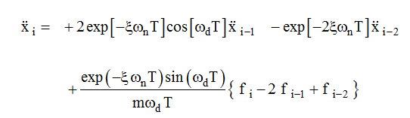
SDOF Acceleration
For an arbitrary applied force, the acceleration is

Slide 78
Frequency Response Function
Dimension | Displacement/Force | Velocity/Force | Acceleration/Force
Name | Admittance, Compliance, Receptance | Mobility | Accelerance, Inertance
Dimension | Force/Displacement | Force/Velocity | Force/Acceleration
Name | Dynamic Stiffness | Mechanical Impedance | Apparent Mass, Dynamic Mass

Slide 79
FRF Estimators
Cross spectrum between force and response divided by autospectrum of force
Cross spectrum is complex conjugate of first variable Fourier transform times the second variable Fourier transform.
* Denotes complex conjugate
The response can be acceleration, velocity or displacement.

Slide 80
FRF Estimators (cont)
Autospectrum of response divided by cross spectrum between response and force
Coherence Function γ is used to assess linearity, measurement, noise, leakage error, etc. Coherence is ideally equal to one.

Slide 81
Time Domain Calculation for SDOF Response to Applied Force
fn = 100 Hz
Q=10
mass = 2 kg
Apply white noise time history force

Slide 82


Slide 84
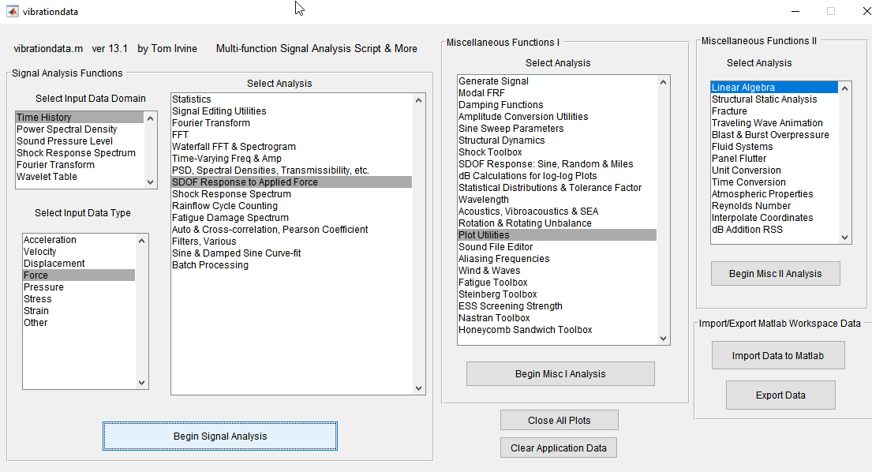

Slide 85
SDOF Velocity Response to Applied Force

Slide 86
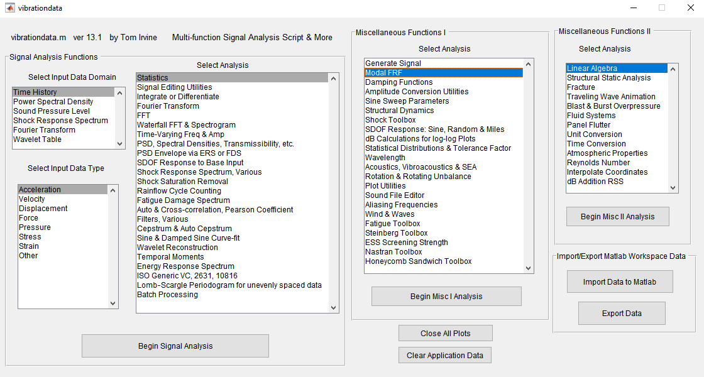

Slide 87
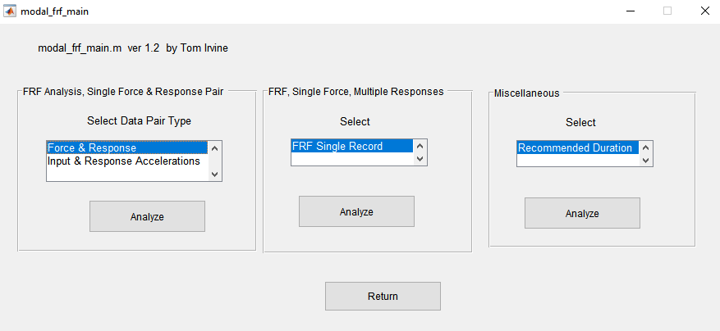

Slide 88
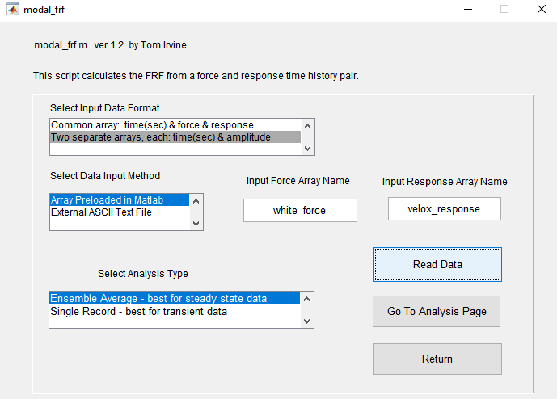
Step 1
Step 2

Slide 89

SDOF Velocity Response to Applied Force

Slide 90
SDOF Velocity Response to Applied Force

Slide 91


Slide 92


Slide 93
The curve-fit is made for real and imaginary, which is equivalent to magnitude & phase

Slide 94
Vibrationdata
Shock Isolation

Slide 95

SCUD-B Typical Avionics Component
The avionics shelves were made from hardwood
The wooden fibers may provide better damping then, say, an aluminum shelf
A possible disadvantage of wood is that the shelf would be unable to serve as an electrical or thermal ground plane
The bushings are made from some type of rubber or elastomeric compound
The bushings provide damping, but their main benefits are:
To render the isolated system as a single-degree-of-freedom system
To lower the natural frequency of the system
The isolators thus attenuate the shock and vibration energy which flows from the instrument shelf into the avionics component

Slide 96

European Space Agency Inertial Measurement Unit (IMU)
Mounted to outer bracket via four black conical isolators, vibration test
Conical isolator, 1 of 4

Slide 97


Launch vehicle avionics components contain sensitive electronic parts that my fail when subjected to shock and vibration excitation during flight
A crystal oscillator may shatter or a solder joint may fail
Mechanical relays may chatter
The failure mode may be ultimate stress, yielding, buckling, fatigue, relative displacement, or loss-of-clearance
Fatigue is usually the most critical mode for vibration

Slide 98



Avionics components may be mounted via isolators to reduce the shock and vibration energy transmitted from the mounting location to the component itself
The isolators are typically made from a rubber-like elastomeric or thermoplastic material
Elastomeric materials are considered as incompressible since their volume tends to remains constant regardless of the load
Nevertheless, the elastomeric isolator’s deflection depends on the load
The isolator’s edges bulge outward to maintain the constant volume during loading
Wire rope is another isolator type

Slide 99

NASA/JPL, Mars Science Laboratory
Ideally, the isolators render the component as a single-degree-of-freedom (SDOF) system with respect to each axis
Ideal avionics components have a well-behaved center-of-gravity (CG) to minimize static coupling
The isolators also lower the component’s natural frequency
The isolators also provide damping
Damping reduces the amplitude of resonant vibration by converting a portion of the energy into low-grade heat
Internal friction is the mechanism for this energy conversion
This is hysteretic damping, although it can be modeled as viscous damping for calculation purposes
Sensor Support Electronics mounted on wire rope isolators

Slide 100

A single-degree-of-freedom system attenuates energy above √2 times its natural frequency
The isolators thus filter out high-frequency shock and vibration energy
As a trade-off, some amplification occurs at the isolated system’s natural frequency
Ideally, there is sufficient damping to minimize this amplification
Relative displacement may be another trade-off

Slide 101

Elastomeric isolator mounts are used to break metal-to-metal contact between the avionics component mounting foot and the vehicle mounting structure
The bolt may be a shoulder bolt in order to control the initial compression of the isolator
The initial static deflection is typically 5% to 15%, depending on the vendor’s recommendation
Usually, four isolator grommets are used for mounting an avionics component
The isolators are mounted in parallel with one isolator at each corner
Note that small components, with mass less than say 3 lbm (1.4 kg), should be mounted via an isolated base plate, which serves as a ballast mass
A base plate may also be required if the component’s feet are too small to accommodate the isolators directly

Slide 102

Octave Rule
The difference between two frequencies is one octave if the higher frequency is twice the lower frequency
Now assume that one SDOF system is to be attached to another SDOF system
A design rule-of-thumb is that the difference between the individual natural frequencies should be at least one octave
The goal is to avoid dynamic coupling of the modes
Example
Assume that an avionics box has a circuit board with a natural frequency of 200 Hz
The box is to be mounted via isolators
The natural frequency of the isolated box should thus be less than or equal to 100 Hz per the octave rule
(Typical avionics isolation frequencies are around 20 Hz)

Slide 103

Isolator Deflection
The isolators must be able to withstand quasi-static and dynamic loads
A quasi-static load results from the rigid-body acceleration of the launch vehicle
This acceleration is primarily in the vehicle’s thrust axis, but lateral acceleration should also be considered.
The avionics component may “bottom out” if the isolator is overloaded
A related concern is the clearance or “sway space” between the component and adjacent structures
The clearance should be considered with respect to all sides of the component, undergoing its various peak positive and peak negative relative displacements

Slide 104
Flight Shock & Vibration Environments
Isolated Components must withstand
Shock Environments
Motor ignition Stage and shroud separation
Random Vibration
Liftoff vibroacoustics
Turbulent boundary layers
Shock waves at transonic & Max-Q
Sine Vibration
POGO
Thrust Oscillation
Liftoff Transonic Attitude Control
Max-Q Thrusters

Slide 105



Additional Considerations
Transponder
Transmitter
Hard Drive
The stiffness properties of elastomeric isolators vary frequency
Wire rope isolators are insensitive to temperature
Isolator stiffness may vary with load in nonlinear manner
Some components such as C-band transponders and telemetry transmitters generate significant heat energy and must be hard-mounted to a heat sink
Components with servo-control mechanisms may require hard-mounting
Other components must be hard-mounted in order to maintain optical or mechanical alignment

Slide 106

Isolation Option
Vibrationdata
Circuit Board
Isolator
Single Stage: Circuit Board in Hard-mounted Avionics Box
Two Stage: Circuit Board Mounted in Isolated Avionics Box

Slide 107
SDOF Circuit Board Model
Assume a circuit board with:
Mass = 0.5 kg, Stiffness = 1000 N/mm, fn = 225 Hz, Q=10

Slide 108


Slide 109


Slide 110


Slide 111


Slide 112


Slide 114


Slide 115


Slide 117


Slide 118


Slide 119
Acceleration Response (G)
max= 230.2
min= -197.2
RMS= 46.92
crest factor= 4.91
kurtosis= 8.62
Relative Displacement (mm)
max= 0.9633
min= -1.122
RMS= 0.2292

Slide 120


Slide 121


Slide 122


Slide 123


Slide 124

Step 1
Step 2
Step 3
Step 4

Slide 125
Natural Frequency Results
Natural Participation Effective
Mode Frequency Factor Modal Mass
1 19.27 Hz 2.121 4.5
2 238.8 Hz -0.004917 2.418e-05
modal mass sum = 4.5
ModeShapes =
0.4710 -0.1678
0.4745 1.3322
Modes Shapes are in column format

Slide 126


Slide 127


Slide 129


Slide 130
Acceleration Response (G)
max min
Mass 1: 17.56 -18.38
Mass 2: 17.75 -18.41

Slide 131
Relative Displacement Response (mm)
max min
Mass 1: 12.22 -11.65
Mass 2: 12.31 -11.73
The response curves are nearly identical for the two masses
Verify that the isolation can undergo the relative displacement without bottoming-out

Slide 132
Circuit Board
Single Stage: Circuit Board in Hard-mounted Avionics Box
Isolator
Two Stage: Circuit Board Mounted in Isolated Avionics Box
Circuit Board Peak Response to Shock
Hard-mounted | Isolated
230 G | 18.4 G

Slide 133
Isolated Avionics Component Example
y
x
m, J
z
kz1
kz2
kx1
0
kx2
ky2
ky1
kz3
kz4
kx3
ky3
kx4
ky4

Slide 134
Isolated Avionics Component Example (cont)
a1
a2
y
x
z
C. G.
b
0
c1
c2

Slide 135
Isolated Avionics Component Example (cont)
y
α
0
θ
v
ky
ky
m_{b}
ky
ky

Slide 136
Isolated Avionics Component Example (cont)
M | 4.28 lbm | 1.94 kg
Jx | 17.5 lbm in^2 | 0.00511 kg m^2
Jy | 32.4 lbm in^2 | 0.00948 kg m^2
Jz | 0.0107 lbm in^2 | 0.0107 kg m^2
Kx | 80 lbf/in | 14.0 N/mm
Ky | 80 lbf/in | 14.0 N/mm
Kz | 80 lbf/in | 14.0 N/mm
a1 | 6.18 in | 157 mm
a2 | 2.68 in | 68.1 mm
b | 3.85 in | 97.8 mm
c1 | 3 in | 76 mm
c2 | 3 in | 76 mm
Assume uniform 8% damping

Slide 137


Slide 138


Slide 139


Slide 140


Slide 141

Step 1
Step 2
Step 3
Step 4
Step 5
Step 6
Step 7
Step 8

Slide 142

Viscous
Mode Q Damping Ratio
1 6.25 0.08
2 6.25 0.08
3 6.25 0.08
4 6.25 0.08
5 6.25 0.08
6 6.25 0.08

Slide 143
Natural Frequencies =
1. 15.45 Hz
2. 18.47 Hz
3. 27.04 Hz
4. 51.05 Hz
5. 59.99 Hz
6. 72.11 Hz
Modes Shapes (rows represent modes)
x y z alpha beta theta
1. 0.000 0.000 -0.680 -4.417 0.586 0.000
2. 0.613 -0.279 0.000 0.000 0.000 -3.345
3. 0.297 0.654 0.000 0.000 0.000 0.000
4. 0.000 0.000 -0.060 5.807 9.304 0.000
5. 0.226 -0.103 0.000 0.000 0.000 9.070
6. 0.000 0.000 0.222 -11.936 4.310 0.000
Effective Modal Mass (rows represent modes)
x y z alpha beta theta
1. 0.000 0.000 1.740 0.001 0.000 0.000
2. 1.415 0.292 0.000 0.000 0.000 0.001
3. 0.332 1.608 0.000 0.000 0.000 0.000
4. 0.000 0.000 0.014 0.001 0.008 0.000
5. 0.192 0.040 0.000 0.000 0.000 0.009
6. 0.000 0.000 0.186 0.004 0.002 0.000
Total Modal Mass
1.940 1.940 1.940 0.005 0.009 0.011

Slide 144


Slide 146


Slide 147
Y-axis input 50 G 0.011 sec Half-Sine Pulse
Acceleration Response (G)
max min
X-axis: 19.38 -16.63
Y-axis: 45.73 -32.85
Z-axis: 0 0
Relative Displacement Response (mm)
max min
X-axis: 7.818 -9.474
Y-axis: 11 -17.08
Z-axis: 0 0

Slide 148


Slide 149
Y-axis input 100 G 0.005 sec Half-Sine Pulse
Acceleration Response (G)
max min
X-axis: 18.87 -16.51
Y-axis: 44.29 -32.13
Z-axis: 0 0
Relative Displacement Response (mm)
max min
X-axis: 7.422 -9.022
Y-axis: 10.68 -16.46
Z-axis: 0 0

Slide 150
Typical SRS Specification
Natural Frequency (Hz) | Accel (G)
100 | 100
2000 | 2000
10,000 | 2000
Typical specification is defined from 100 to 10,000 Hz
Extrapolate down to 10 Hz to cover low frequency modes and for realism
Synthesized acceleration time history and corresponding velocity and displacement should each have zero values for numerical stability

Slide 154


Slide 155


Slide 157


Slide 158
Y-axis input
Acceleration Response (G)
max min
X-axis: 9.193 -8.485
Y-axis: 21.4 -19.77
Z-axis: 0 0

Slide 159
Relative Displacement Response (mm)
max min
X-axis: 3.878 -3.448
Y-axis: 6.595 -7.125
Z-axis: 0 0

Slide 160

Rigid-Body Acceleration (G)
x y z
0 5 0
C.G. Displacement
x y z
(mm) (mm) (mm)
-0.583 1.962 0.000
C.G. Rotation
theta-x theta-y theta-z
(rad) (rad) (rad)
0.000 0.000 0.006
Mounting Displacement
n x y z
(mm) (mm) (mm)
1 -0.582 1.961 0.000
2 -0.582 1.963 0.000
3 -0.582 1.961 0.000
4 -0.582 1.963 0.000

