Slide 1
Vibrationdata
Equivalent Static Loads for Random Vibration
By Tom Irvine

Slide 2

https://vibrationdata.wordpress.com/

Slide 3
Introduction
Vibrationdata
A particular engineering design problem is to determine the equivalent static load for equipment subjected to base excitation random vibration
The goal is to determine peak response values
The resulting peak values may be used in a quasi-static analysis, or perhaps in a fatigue calculation
The response levels could be used to analyze the stress in brackets and mounting hardware, for example
A particular concern for either a multi-degree-of-freedom system or a continuous system is that the static deflection shape may not properly simulate the predominant dynamic mode shape
In this case, the equivalent static load may be as much as one order of magnitude more conservative than the true dynamic load in terms of the resulting stress levels

Slide 4
Relevant Parameters
Vibrationdata
Ideally, the dynamics engineer and the static stress engineer would mutually understand, agree upon, and document the following parameters for the given component:
Mass, center-of-gravity, and inertia properties Effective modal mass and participation factors Stiffness Damping Natural frequencies Dynamic mode shapes Static deflection shape Response acceleration Modal velocity |  | Relative displacement Transmitted force from the base to the component in each of three axes Bending moment at the base interface about each of three axes The manner in which the equivalent static loads and moments will be applied to the component, such as point load, body load, distributed load, etc. Dynamic stress and strain at critical locations if the component is best represented as a continuous system Response limit criteria, such as yield stress, ultimate stress, fatigue, or loss of clearance

Slide 5
Stress-Velocity Relationship
Vibrationdata
Refer to Howard Gaberson’s papers, and Vesta Bateman’s chapter in Harris’ Shock and Vibration Handbook, 6th edition
Of the three motion parameters (displacement, velocity, and acceleration) describing a shock spectrum, velocity is the parameter of greatest interest from the viewpoint of damage potential
This is because the maximum stresses in a structure subjected to a dynamic load typically are due to the responses of the normal modes of the structure, that is, the responses at natural frequencies
At any given natural frequency, modal stress in a system is proportional to the modal (relative) response velocity
= mass density
c = speed of sound in the material v = particle velocity at a given point
is a constant of proportionality dependent upon the geometry of the structure
Some additional research is needed to further develop this equation so that it can be used for equivalent quasi-static loads for random vibration
Bateman, complex equipment
or more Gaberson

Slide 6
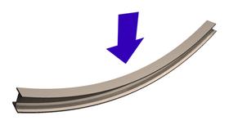
Stress-Velocity Relationship for Beams
Vibrationdata
Distance from neutral axis
E
Elastic modulus
A
Cross-section Area
Mass per volume
I
Area moment of inertia
Same formula for all common boundary conditions
Maximum stress and maximum velocity may occur at different locations
Assume stress is due to first mode response only
Response may be due to initial conditions, applied force, or base excitation

Slide 7
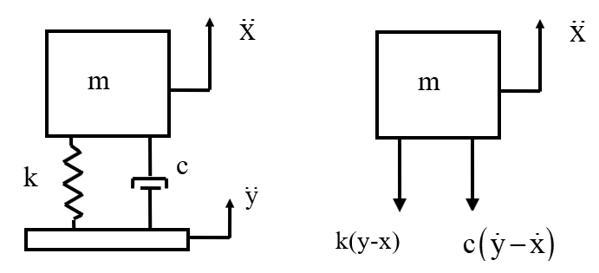
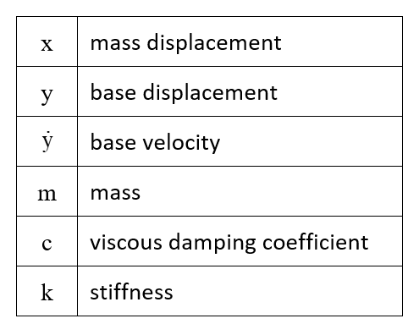
SDOF Response to Base Excitation
Vibrationdata

Slide 8
SDOF Response to Base Excitation (cont)
Vibrationdata
The base velocity and base displacement terms on the righthand side are usually unknown
But the base acceleration is known
Define a relative displacement
z = x - y
Through substitution and algebraic manipulation, the following ordinary differential equation is derived in terms of the relative displacement

Slide 9
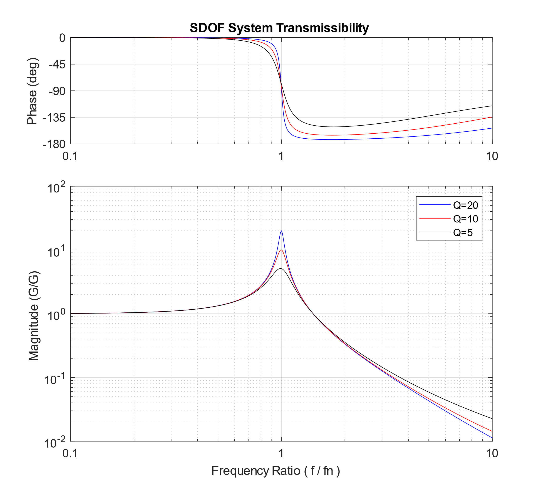
SDOF Response to Base Excitation, Transmissibility
Vibrationdata
The equation of motion can be solved in the frequency domain using Fourier or Laplace transforms
After many steps, the complex transmissibility function is
The magnitude function is
The phase angle is

Slide 10
Miles Equation
Vibrationdata
The Miles equation is a simplified method of calculating the response of a single-degree-of-freedom system to a random vibration base input, where the input is in the form of a power spectral density
It can be derived from the equation of motion on the previous slide
Furthermore, the Miles equation is an approximate formula which assumes a flat power spectral density from zero to infinity Hz
As a rule-of-thumb, it may be used if the power spectral density is flat over at least two octaves centered at the natural frequency
The overall response acceleration is
f_{n} = natural frequency
P = PSD level at fn
Q = amplification factor

Slide 11
General Method
Vibrationdata
Note that the Miles equation, may lead to error, particularly if the acceleration power spectral density function has significant variation with frequency
Thus, the general method is preferred
The general method allows the power spectral density to vary with frequency
It also allows for power spectral density inputs with finite frequency limits
Not a hand-calculation, but easy to implement via software code

Slide 12
NASA Experience
Vibrationdata
NASA engineers performed experimental static and vibration testing an “AEPI fiberglass pedestal” structure with The following conclusions
Strain, in general, is lower during random testing than during an equivalent static loading as predicted by Miles’ equation.
The Miles’ equation equivalent static loading clearly develops stresses an order of magnitude above those created by the random environments
The reference also noted:
A study completed in 1993 by the Marshall Space Flight Center (MSFC) Random Loads/Criteria Issues Team concluded, after an extensive literature search, that almost no analytical or empirical documentation exists on the subject of the relationship between random limit load (stress) and static limit load (stress). The consensus of the team was that it is a complex subject and requires a carefully planned effort to produce and effective, yet practical solution.
H. Lee, Testing for Random Limit Load Versus Static Limit Load, NASA TM-108542, 1997
H. Lee, A Simplistic Look at Limit Stresses from Random Loading, NASA TM-108427, 1993
Tom Irvine needs to do further investigation to verify this

Slide 13
Relative Displacement & Spring Force
Vibrationdata
Consider a single-degree-of-freedom (SDOF) system subject to a white noise base input and with constant damping
The Miles’ equation set shows the following with respect to the natural frequency f_{n}
Response Acceleration ∝ f _{n}^{0.5}
Relative Displacement ∝ 1/ f _{n}^{1.5}
Relative Displacement = Response Acceleration / ω_{n}²
Consider that the stress is proportional to the force transmitted through the mounting spring
The spring force F is equal to the stiffness k times the relative displacement z
^{F = k z}
The

Slide 14
RMS and Standard Deviation
Vibrationdata
The RMS value is related the mean and standard deviation σ values as follows:
RMS² = mean² + σ²
Note that the RMS value is equal to the 1σ value assuming a zero mean
A 3σ value is thus three times the RMS value for a zero mean
There is no method to predict the exact peak acceleration value for a random time history
An instantaneous peak value of 3σ is often taken as the peak equivalent static acceleration
A higher or lower value may be appropriate for given situation

Slide 15
Sample Design Guidelines for Peak Response Acceleration or Transmitted Force
Vibrationdata
Reference | Design Level | Comment
Himelblau, et al | 3σ | However, the response may be non-linear and non-Gaussian
Fackler | 3σ | 3σ is the usual assumption for the equivalent peak sinusoidal level
Luhrs | 3σ | Theoretically, any large acceleration may occur
NASA | 3σ for STS Payloads 2σ for ELV Payloads | Minimum Probability Level Requirements
McDonnell Douglas | 4σ | Equivalent Static Load
Scharton & Pankow | 5σ | Upcoming slide
DiMaggio, Sako, Rubin | Nσ | Upcoming slide
Ahlin | Cn | Upcoming slide

Slide 16
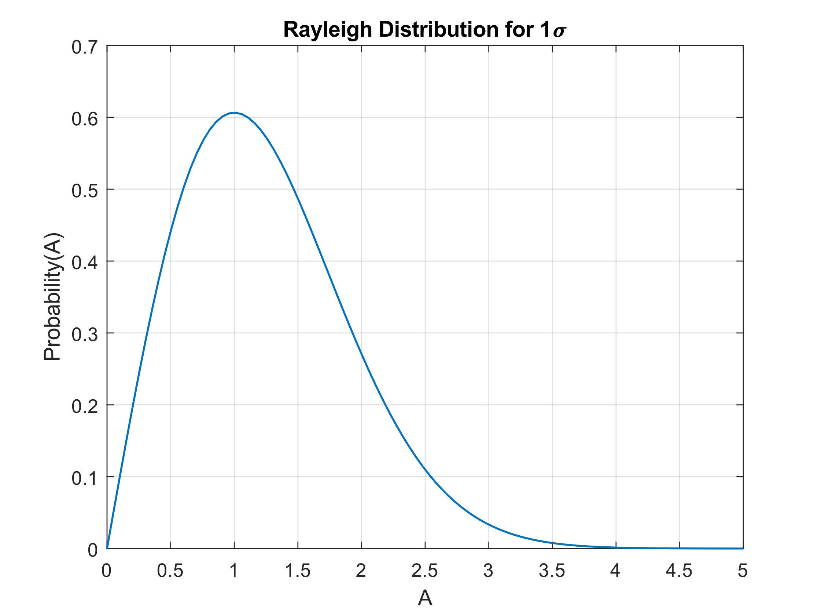
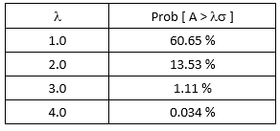
Rayleigh Distribution, Absolute Local Peaks
Vibrationdata
The probability density function for instantaneous peak values in narrowband random vibration response
The X-axis represents a scale factor A times the standard deviation, as denoted by which is used to denote the absolute value of x
The area under the curve from zero to a given A value represents probability of occurrence
The total area under the curve is one
Probability table

Slide 17
Expected Peak Value, Derived from Rayleigh Distribution
Vibrationdata
Oscillator standard deviation response is: σ Natural frequency: f_{n} Test duration is: T
Natural frequency is replaced by positive slope zero-crossing rate for MDOF system response
Expected crest factor λ:
A _{peak} = λσ
DiMaggio, Sako, Rubin:
Ahlin:
(Ahlin used C_{n} in place of λ)

Slide 18
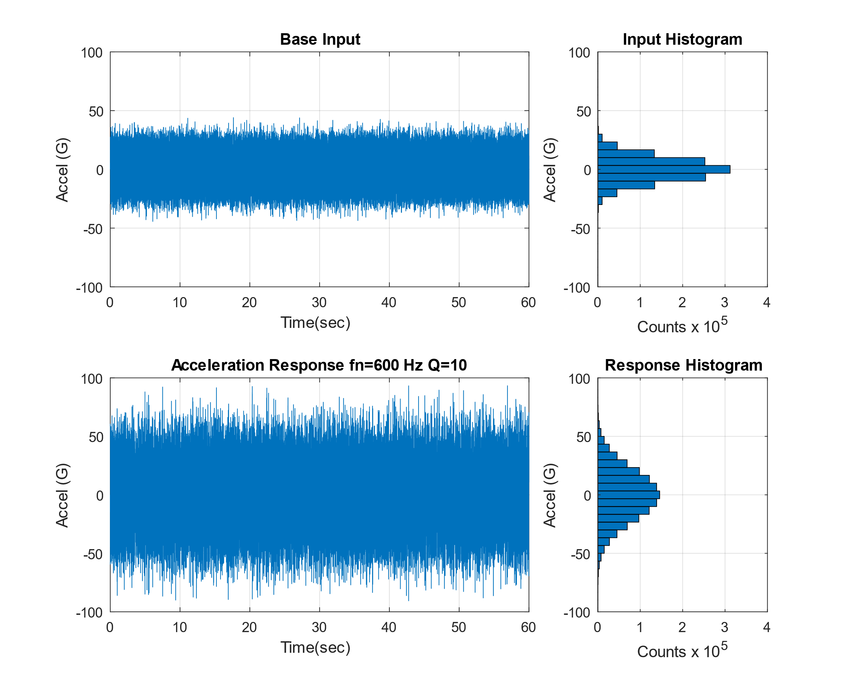
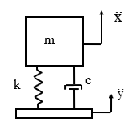
White Noise Input & Response Example
Vibrationdata
Stationary white noise base input excitation is applied to the SDOF model
The system has a natural frequency of 600 Hz and an amplification factor of Q equal to 10, or 5% damping
The input time history has a Gaussian distribution and a standard deviation of 10 G
The response is calculated using the Smallwood ramp invariant digital recursive filtering relationship
The response likewise has a Gaussian distribution

Slide 19
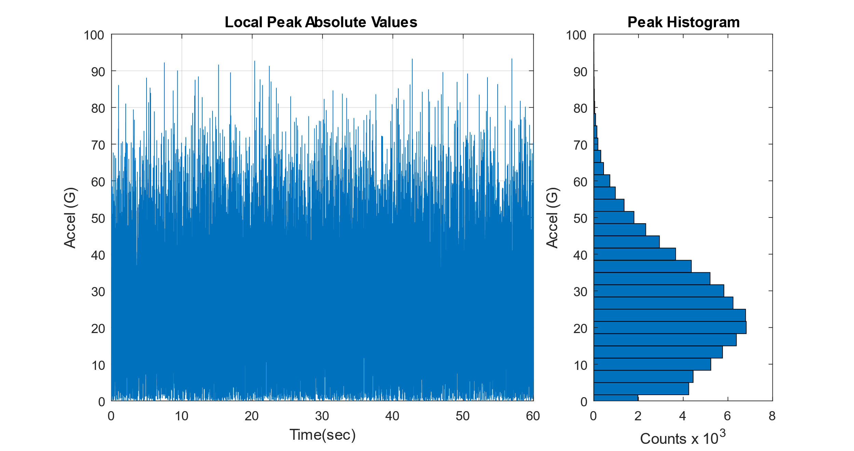
Rayleigh Distribution of Local Response Peaks
Vibrationdata

Slide 20
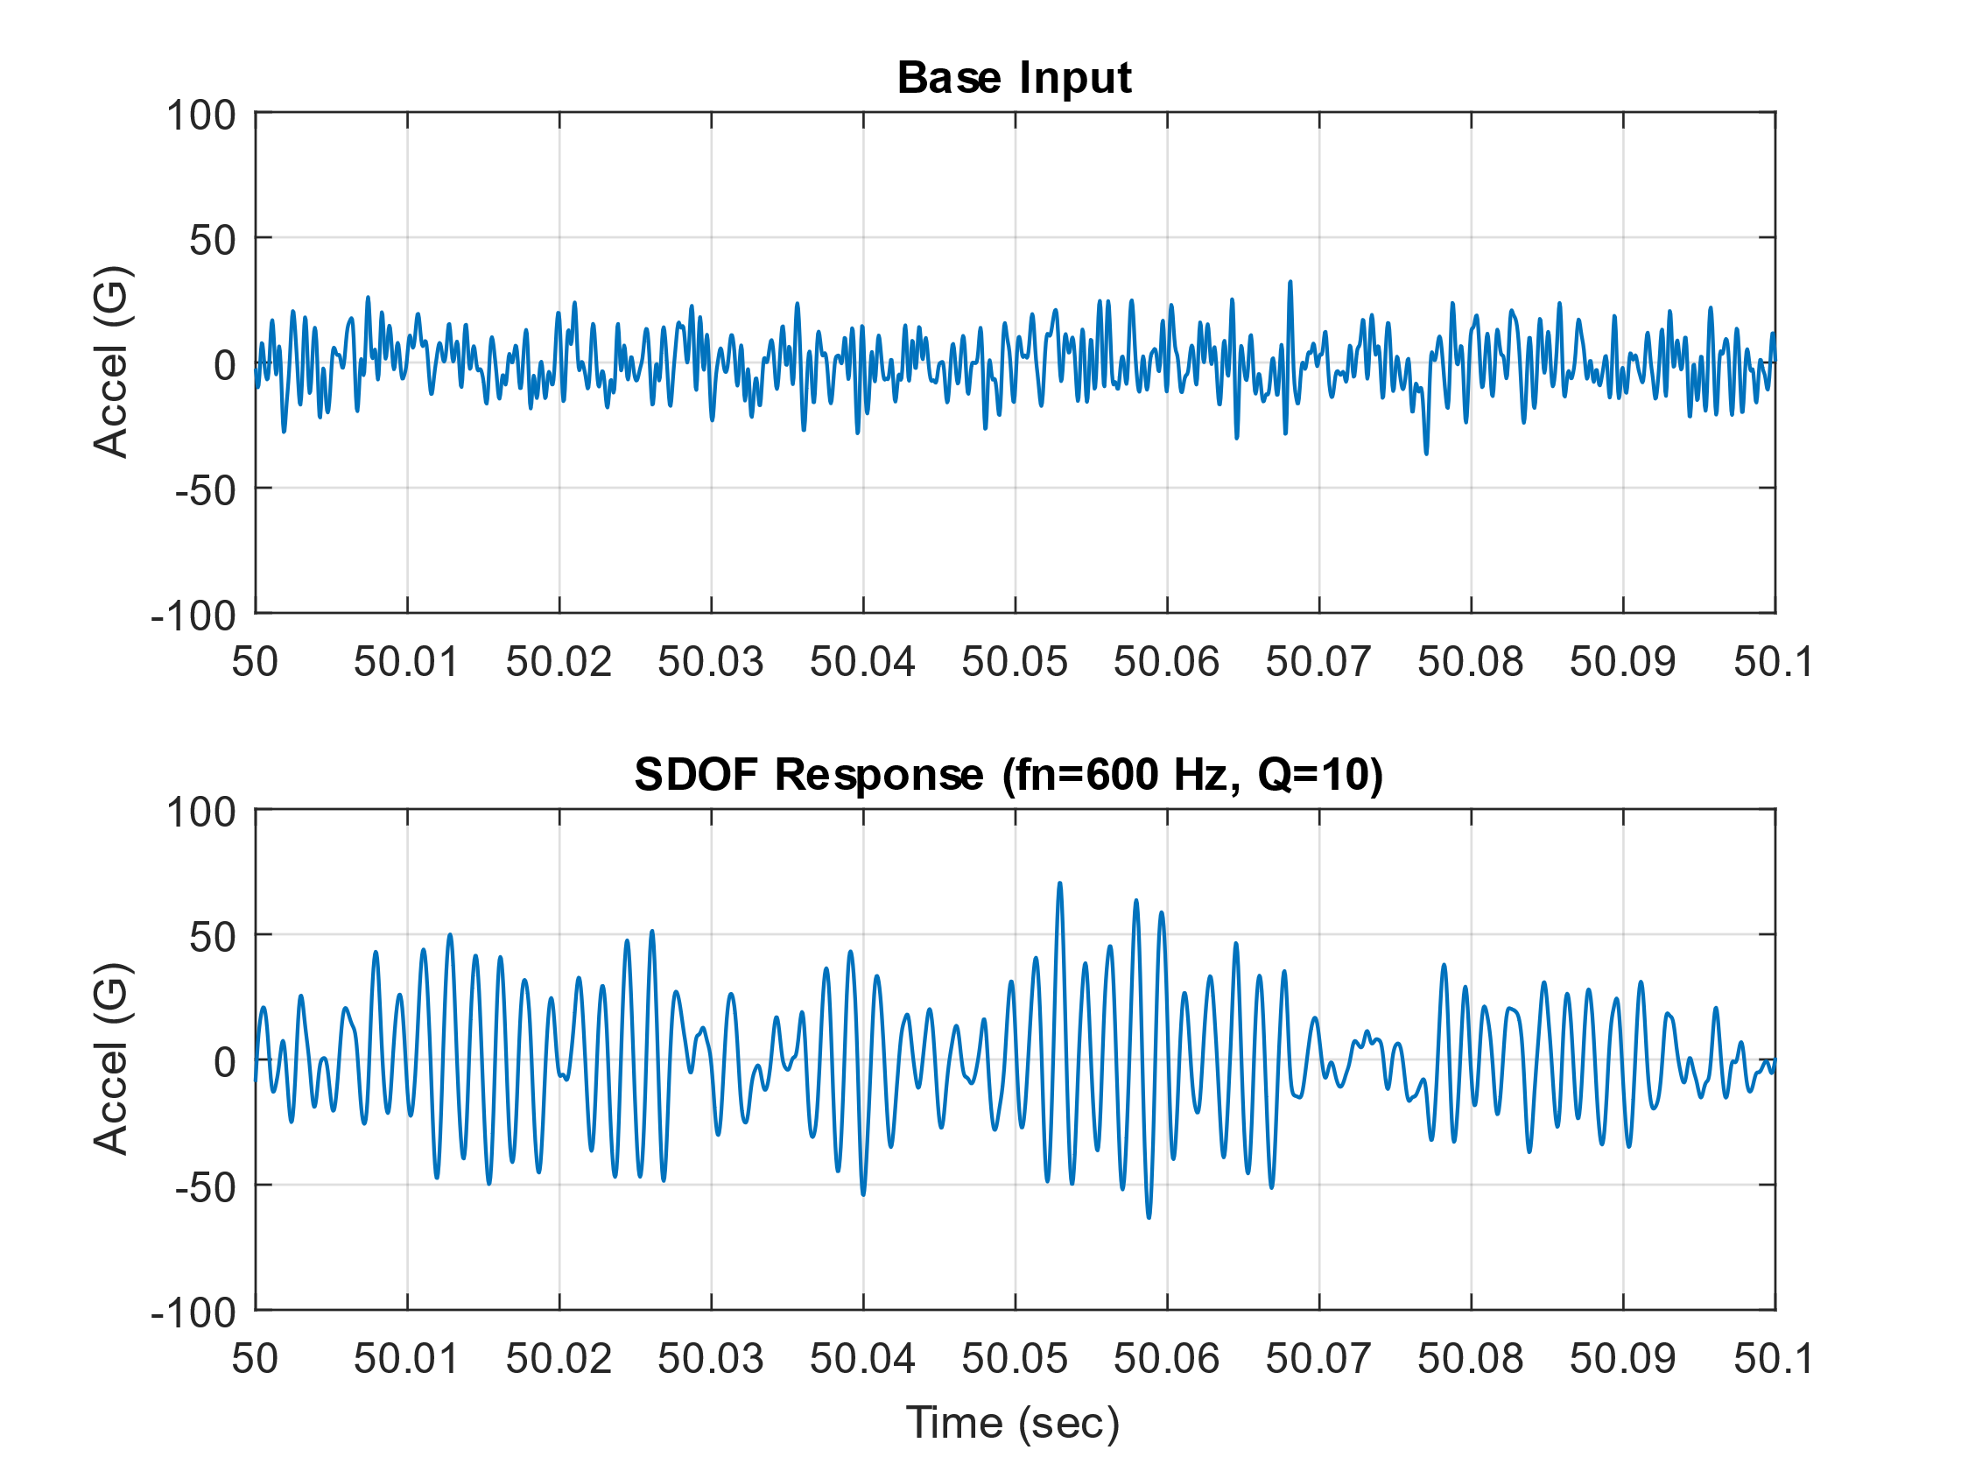
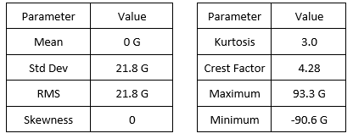
Close-up View
Vibrationdata
Narrowband random response with statistics
Expected crest factor
The crest factor for sample problem was 4.28, which is 10% lower than the expected value

Slide 21
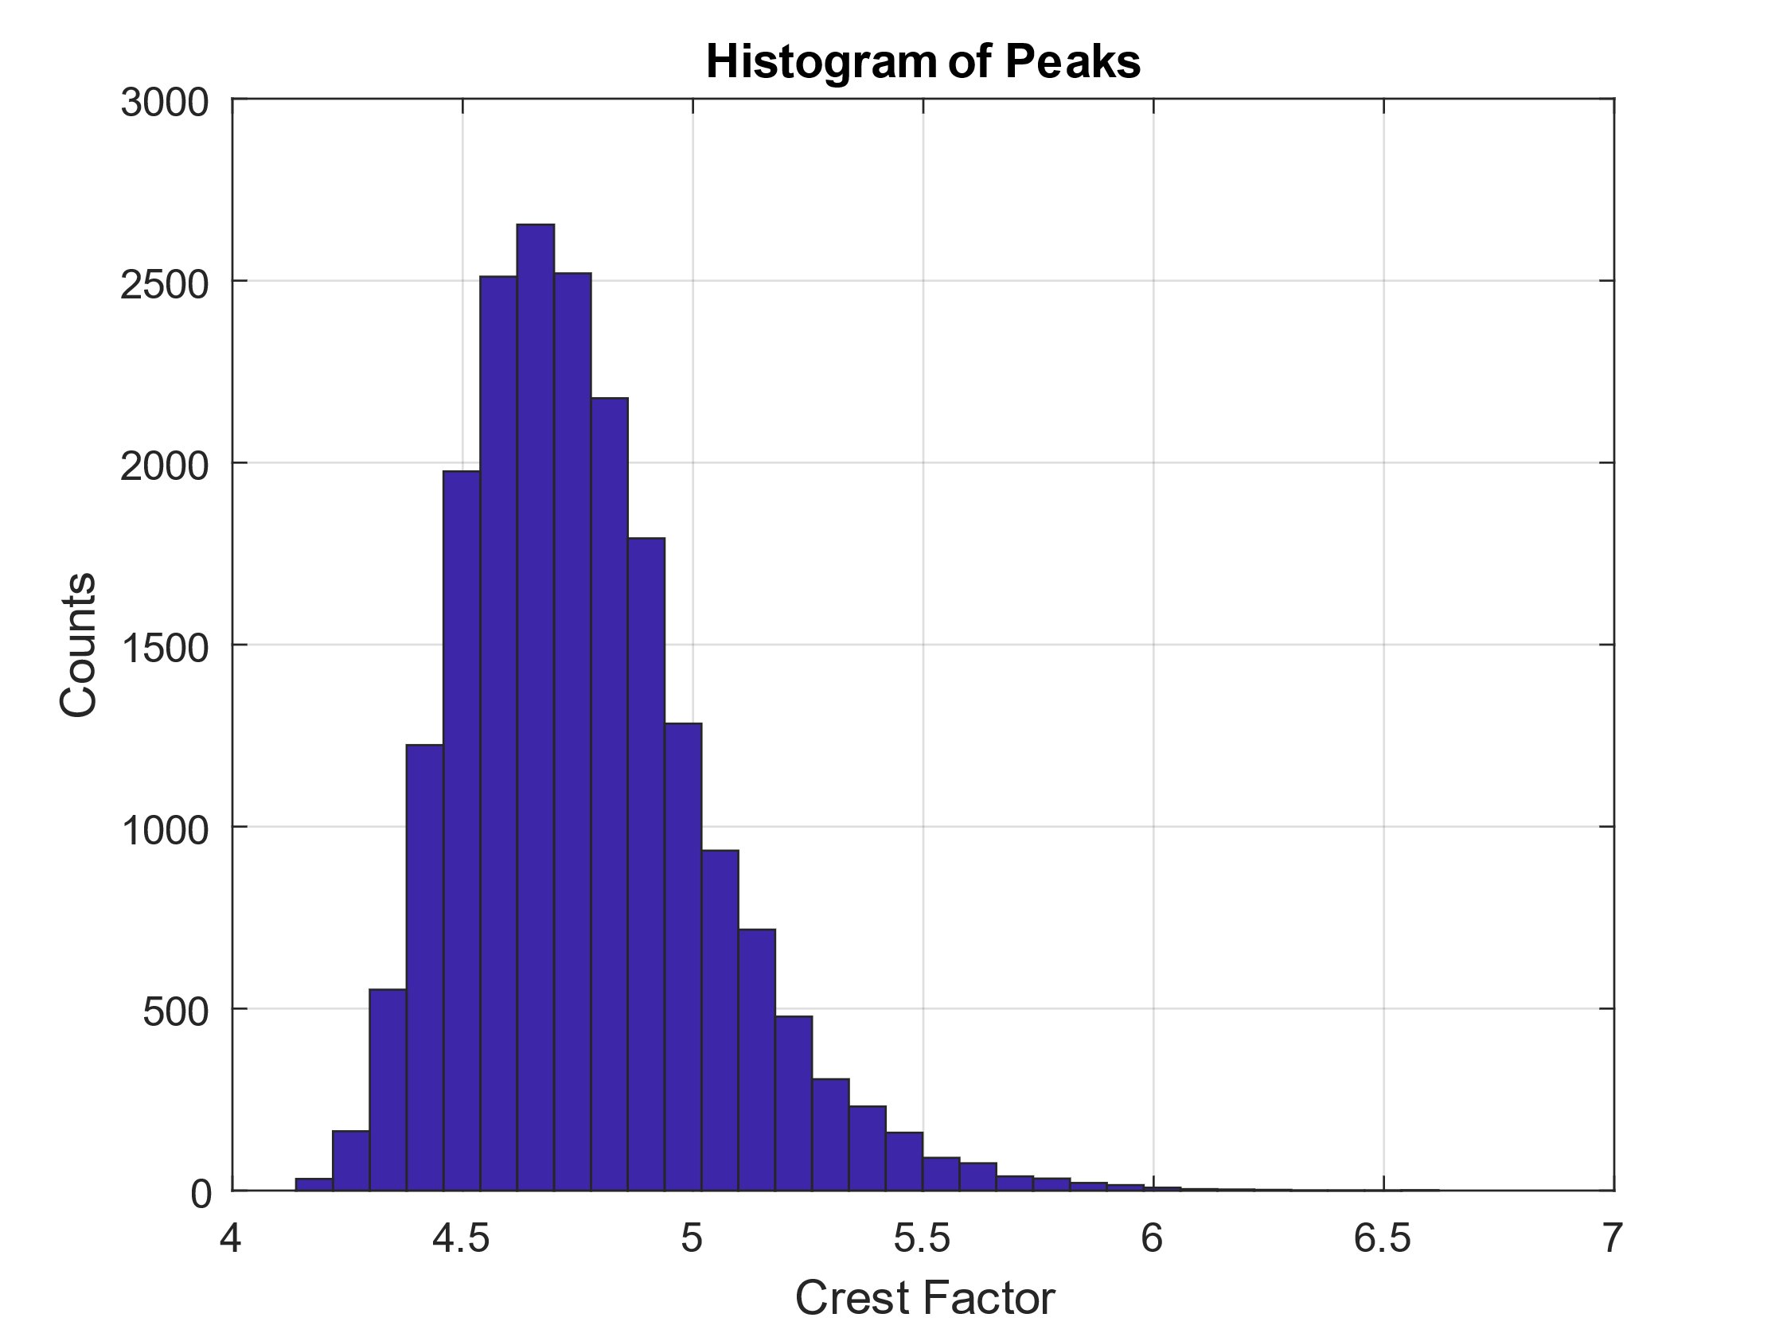
Crest Factor Numerical Study
Vibrationdata
The white noise synthesis and response calculation steps for the previous example were repeated 20,000 times
A crest factor was calculated for each trial
The crest factor histogram has a shape somewhat similar to a Rayleigh distribution, but further investigation is needed to properly characterize it
The crest factors ranged from 4.14 to 6.62, with a mean of 4.76
This experimental mean value was 1.1% higher than the theoretical 4.71 value
Stationary random vibration time history with Gaussian distributions typically have peaks ranging from 4σ to 5σ, but higher crest values may also occur
This is true both for broadband inputs and narrowband responses
Designing structures and components for 3σ vibration loads is thus insufficient, even though this is a common rule-of-thumb

Slide 22
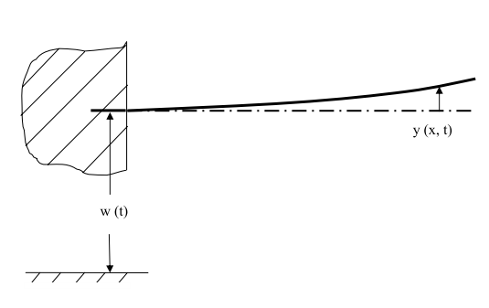
Cantilever Beam, Base Excitation Example
Vibrationdata
The relative displacement Y(x,ω) to base excitation is
The bending moment is
The bending stress is
Reference: T. Irvine, Steady-State Vibration Response of a Cantilever Beam Subjected to Base Excitation, Rev A, 2009

Slide 23
Cantilever Beam Parameters
Vibrationdata
Aluminum Beam with Circular Cross-Section
Parameter | Label | Value
Diameter | D | 0.5 inch
Cross-Section Area | A | 0.1963 in^2
Length | L | 24 inch
Area Moment of Inertia | I | 0.003068 in^4
Elastic Modulus | E | 1.0e+07 lbf/in^2
Stiffness | EI | 30680 lbf in^2
Mass per Volume | ρ_{V} | 0.1 lbm / in^3 ( 0.000259 lbf sec^2/in^4 )
Mass per Length | ρ_{L} | 0.01963 lbm/in (5.08e-05 lbf sec^2/in^2)
Mass | L | 0.471 lbm (1.22E-03 lbf sec^2/in)
Viscous Damping Ratio | ξ | 0.05

Slide 24
Cantilever Beam Natural Frequencies
Vibrationdata
Mode | fn (Hz) | Participation Factor | Effective Modal Mass ( lbf sec^2/in ) | Effective Modal Mass (lbm)
1 | 23.86 | 0.02736 | 0.000748 | 0.289
2 | 149.53 | 0.01516 | 0.00023 | 0.089
3 | 418.69 | 0.00889 | 7.90E-05 | 0.031
4 | 820.47 | 0.00635 | 4.04E-05 | 0.016
5 | 1356 | 0.00494 | 2.443e-05 | 0.0094

Slide 25
Acceleration Transmissibility
Vibrationdata

Slide 26
Velocity & Bending Stress Transmissibility
Vibrationdata

Slide 27
Base Input PSD to Cantilever Beam & Accel VRS
Vibrationdata
Base Input PSD
14.1 GRMS Overall
180 seconds
Freq (Hz) | Accel (G^2/Hz)
10 | 0.1
2000 | 0.1
VRS is for an Single-degree-of-freedom (SDOF) System

Slide 28
PV & Relative Displacement VRS
Vibrationdata

Slide 29
Stress at Fixed End from Equivalent Static Analysis, 1
Vibrationdata
Method 1 – Convert free end acceleration to static force, Use Entire Beam Mass
F = m a = ( 0.471 lbm )( 25.7 G peak ) = 12.1 lbf peak
The bending moment M_{a} at the fixed boundary for a uniform load from handbook formula is
M_{a} = ( F L / 2 ) = ( 12.1 lbf peak)( 24 inch / 2 ) = 145 inch lbf peak
The bending stress at the fixed boundary for a uniform load is
σ = (M_{a} C / I) = (145 inch lbf peak )(0.25 inch)/(0.003068 in^4 ) = 11,820 psi

Slide 30
Stress at Fixed End from Equivalent Static Analysis, 2
Vibrationdata
Method 2 – Convert free end acceleration to static force, Use First Modal Mass Only
F = m a = ( 0.289 lbm )( 25.7 G peak ) = 7.43 lbf peak
The bending moment M_{a} at the fixed boundary for a uniform load from handbook formula is
M_{a} = ( F L / 2 ) = ( 7.43 lbf peak)( 24 inch / 2 ) = 89.2 inch lbf peak
The bending stress at the fixed boundary for a uniform load is
σ = (M_{a} C / I) = (89.2 inch lbf peak )(0.25 inch)/(0.003068 in^4 ) = 7270 psi peak

Slide 31
Stress at Fixed End from Equivalent Static Analysis, 3
Vibrationdata
Method 3 – Convert free end relative displacement to static force
Let Y be the relative displacement. The distributed load W from handbook formula is
The corresponding bending moment at the fixed boundary is
The bending stress at the fixed boundary for a uniform load is
σ = (M_{a} C / I) = (93.0 inch lbf peak )(0.25 inch)/(0.003068 in^4 ) = 7580 psi peak
M_{a} = [ 0.323 (lbf/in) peak ] [ 24 inch]^2 / 2 = inch lbf peak = 93.0 inch lbf peak

Slide 32
Stress at Fixed End from Stress Velocity, 4
Vibrationdata
Stress-Velocity relationship for beam

Slide 33
Cantilever Beam Base Input & Response
Vibrationdata

Slide 34
Cantilever Beam Stress Response at Fixed-End
Vibrationdata
Continuous Model, One Mode Solution
Continuous Model, Five Mode Solution

Slide 35
Continuous Model, Expected Peak Stress
Vibrationdata
The expected crest factor is
Expected peak stress from continuous beam mode with one mode is
(1977 psi RMS )(4.23) = 8366 psi peak

Slide 36
Peak Stress Comparison
Vibrationdata
The continuous beam value is considered as the “exact” value
Methods 1 through 4 each used a SDOF model approach from vibration response spectrum
Method 1 over-predicted the stress
Methods 2 through 4 under-predicted the stress
Fundamental bending mode shape is not the same as static deflection shape
Cantilever beam is not a spring-mass SDOF system
Method | Stress (psi peak)
Method 1, VRS Acceleration | 11820
Method 2, VRS Acceleration | 7270
Method 3, VRS Relative Displacement | 7580
Method 4, VRS Pseudo Velocity | 6686
Method 5, Continuous Beam | 8366

