Slide 1
Vibrationdata
Launch Vehicle Liftoff Vibroacoustics
Revision A
By Tom Irvine

Slide 2
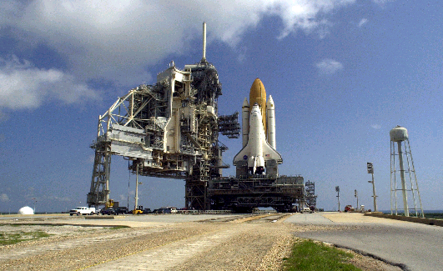
Space Shuttle Liftoff Environments
Vibrationdata
The ignition of the Space Shuttle’s three main engines followed by the ignition of the twin solid rocket boosters generated the thrust necessary for the Space Shuttle liftoff
The ignition and liftoff events create a tremendous amount of overpressure and acoustic noise
Overpressure is a shock wave that appears as a short duration transient as measured by a pressure sensor
The frequency content of this overpressure pulse is typically below 40 Hz.
Acoustic noise is typically dominated by energy above 20 Hz
The acoustic noise at launch may persist for several seconds
Flame trenches and a water suppression system are used to attenuate the acoustic and overpressure environments
Water Supply Tank Adjacent to Launch Pad

Slide 3
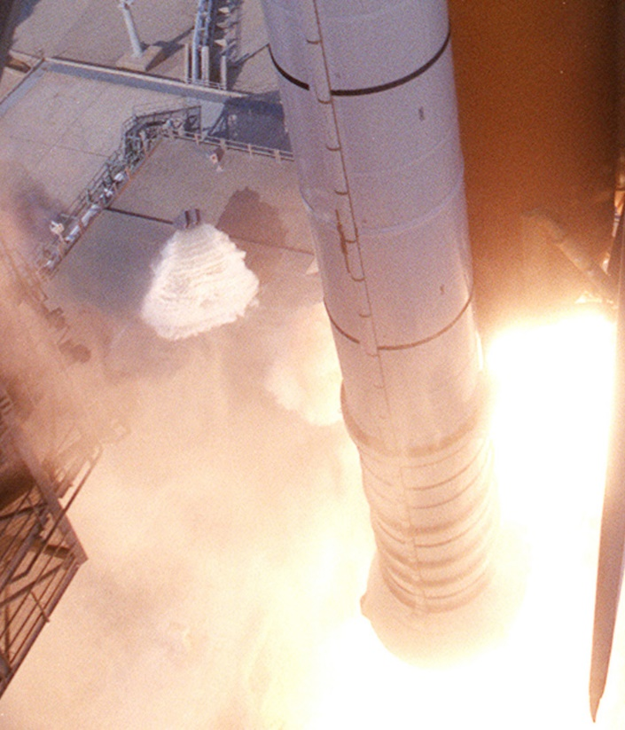
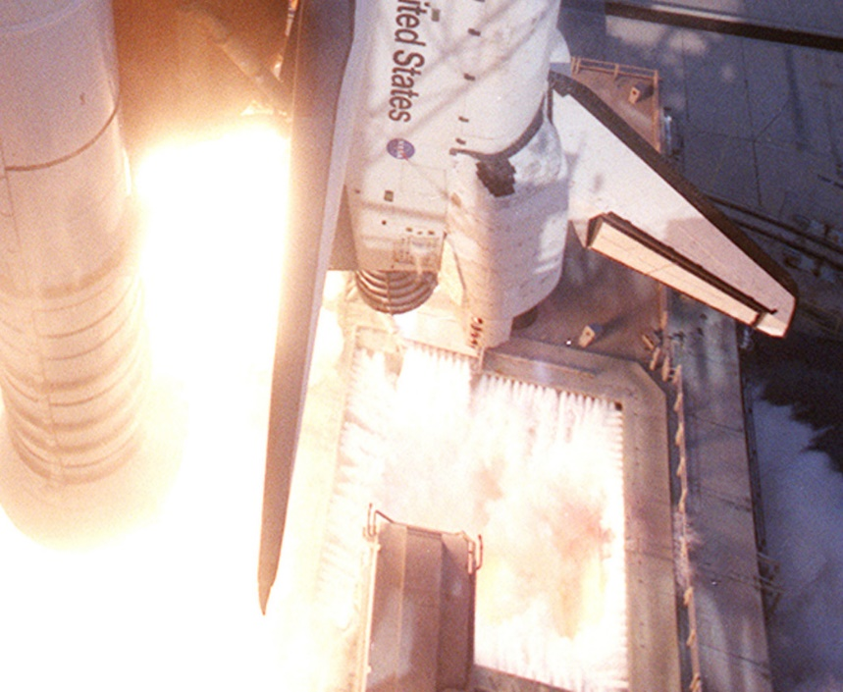
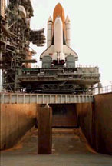
Space Shuttle Water Suppression
Vibrationdata
Main Engine Exhaust Hole and Water Spray
Rainbird, Left of the Solid Rocket Booster
Flame Trench

Slide 4
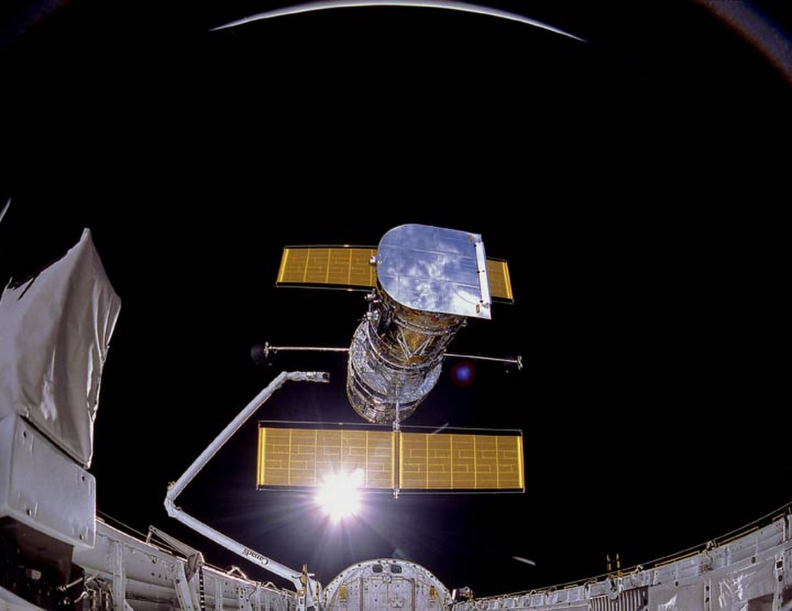
Damage Potential
Vibrationdata
The overpressure and acoustic environments had the potential to dislodge the shuttle’s thermal tiles
This problem occurred on the STS-1 Columbia mission, launched on April 12, 1981
Modifications to water suppression system mitigated this problem for following flights
The acoustic environment could have also damaged spacecraft payloads inside the shuttle’s cargo bay
These spacecraft usually have numerous components that are sensitive to sound and vibration
Solar panels are a particular concern, because they usually have a large surface area relative to their volume. Fatigue cracks can thus form and propagate in the panels under harsh environments
A similar concern exists for high-gain, dish antennas
Deployment of the Hubble Space Telescope from Space Shuttle Discovery 1990

Slide 5
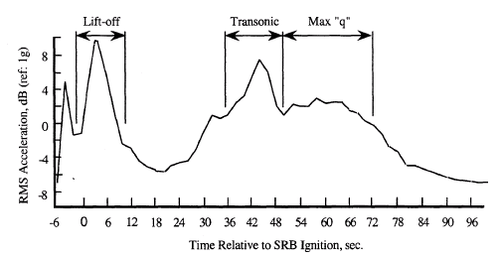
Typical Space Shuttle Vibration Response
Vibrationdata
Acoustic noise is generated in the exhaust plumes flowing from the nozzles as the vehicle lifts off
The rocket exhaust is channeled the flame deflectors and into the flame trench during the ignition and early liftoff phase
The flame deflectors and trench system are effective until the shuttle reaches about 300 feet altitude above the launch platform
The acoustical levels reach their peak when the Space Shuttle reaches about 300 feet in altitude, about five second after liftoff
As the shuttle ascends above 300 feet, sound is reflected off the metal plates of the mobile launcher platform's surface

Slide 6
Acoustic Test Levels for Space Shuttle Payloads
Vibrationdata

Slide 7
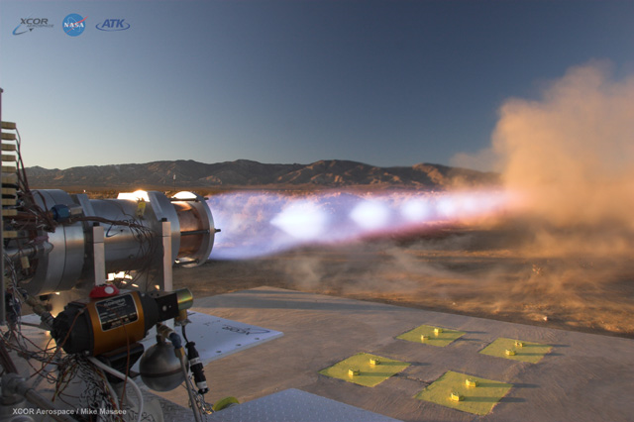
High-Intensity Sound Fields Background
XCOR Aerospace, LOX/LNG Rocket Engine, Test Firing
Shock cells form in the plume core
Shock waves are the dominant source of sound radiation at higher frequencies
Also referred to as Mach waves.
Crackle is a special case of pressure shock waves where the skewness exceeds 0.3

Slide 8
Supersonic Rocket Exhaust Plume, Sound Sources I
Turbulent eddies form along the interface between the plume and the surrounding ambient air
Eddies propagate at a supersonic velocity which is very roughly 80% of the jet exhaust velocity
Ffowcs Williams wrote that crackle correlates with convecting eddies and is predominant in the Mach wave direction
The resulting pressure spikes are formed because of local convective steepening within the eddying motion
Crackling results in distinct bursts of strong narrow positive pressure transients in the time domain

Slide 9
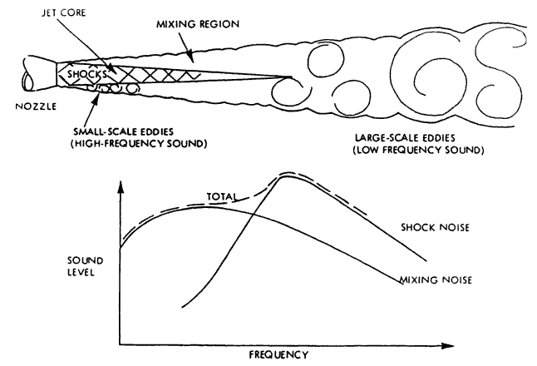
Supersonic Rocket Exhaust Plume, Sound Sources II
Turbulent mixing the wake of the potential core
Supersonic exhaust jets are imperfectly expanded, or “choked”
They contain shock cells through which the flow repeatedly expands and contracts
The cells from a pattern inside the jet which appears as a series of diamonds

Slide 10
NASA SP-8072
Rocket Vehicle Liftoff Acoustics and Skin Vibration Acoustic Loads Generated by the Propulsion System, NASA SP-8072, Monograph N71-33195, 1971
Turbulent mixing in the wake of the core

Slide 11
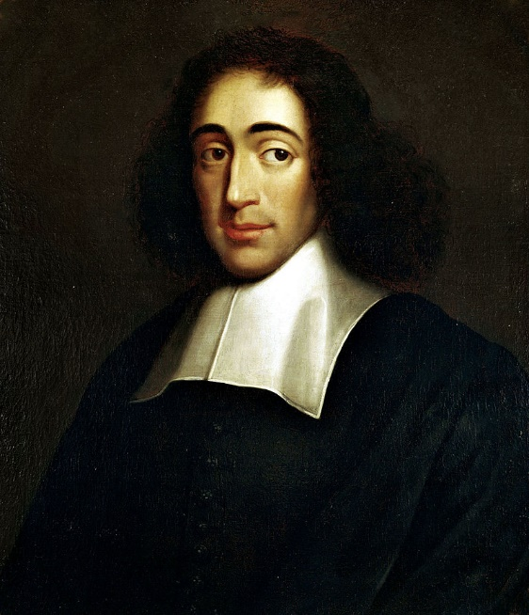
Baruch Spinoza “Nature Abhors a Vacuum”
Atmospheric pressure at sea level is around 14.7 psi absolute ( 1 atmosphere)
Lowest possible theoretical acoustic pressure is -14.7 psi gage, or zero absolute
Highest possible pressure is > +14.7 psi gage in the case of shock wave, ignition overpressure, explosions, etc.
Consider the special case of a hypothetical (but unrealistic) rectangular wave where the peak and the RMS values are the same
The maximum pressure limits for this case would be +14.7 psi gage
The maximum overall pressure level would be 194.1 dB (ref 20 micro Pa)
This is the theoretical limit for undistorted sound at 1 atmosphere environmental pressure
But distortion begins at levels as low as 159 dB, or 0.25 psi RMS, as nonlinear restraining mechanisms, such as molecular friction, begin to counteract the forming void
Sound pressure histogram becomes skewed as a result of distortion
But vibration level tends to still have normal histogram due to central limit theorem
(1632-1677)

Slide 12
NASA Launch Abort System
The purpose of the Launch Abort System (LAS) is to pull the Orion Crew Module and its astronauts safely away from the launch vehicle in the event of an emergency on the launch pad or during ascent
The abort acoustic environment is a concern
As is the abort motor plume impingement on the crew module

Slide 13
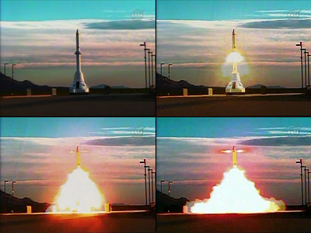
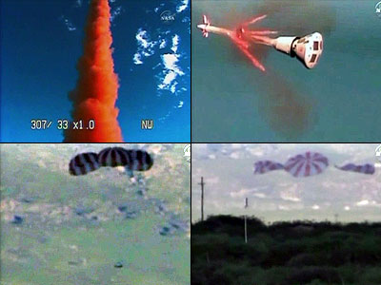
NASA Launch Abort System Test
An unmanned test of this system was performed at White Sands Missile Range, New Mexico, on May 6, 2010

Slide 14
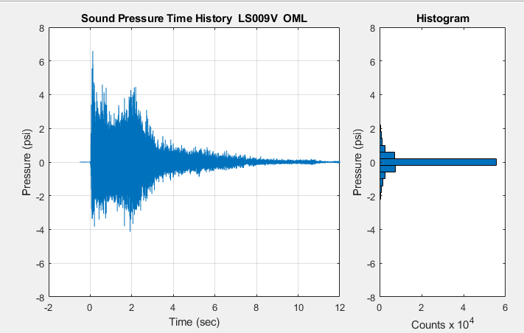
NASA Launch Abort System Test, Skewed Time History
skewness = 0.52
kurtosis = 13.2

Slide 15
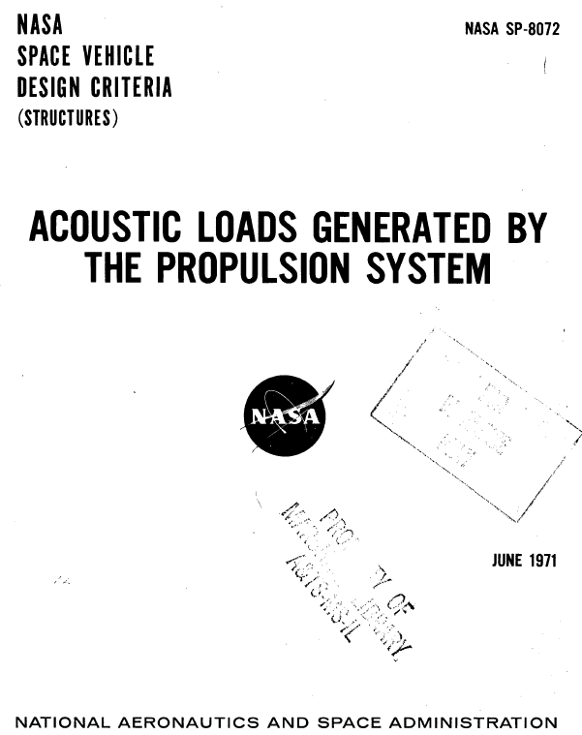
NASA SP-8072
The approach in this presentation is taken from this NASA document along with enhancements from Wilby

Slide 16
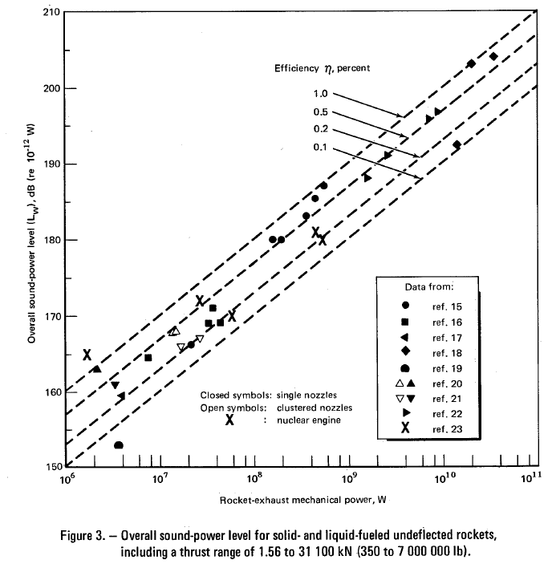
NASA SP-8072 Acoustic Efficiency
Acoustic efficiency is the ratio of the sound power to the rocket exhaust’s mechanical power
Generally, less than 1% of a rocket plume’s kinetic energy is converted into acoustic energy as it interacts with the atmosphere and/or surrounding structures
The overall sound power is distributed along the plume axis using empirical curves

Slide 17
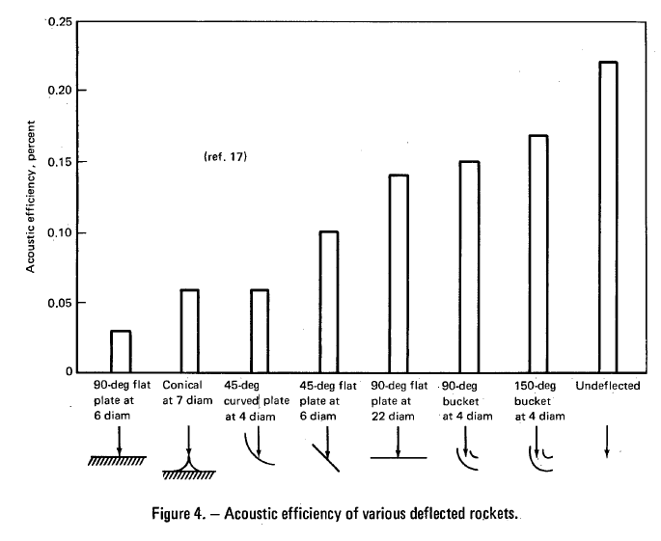
Vibrationdata
Acoustic efficiency of deflected and undeflected exhaust plumes
η = acoustic efficiency

Slide 18
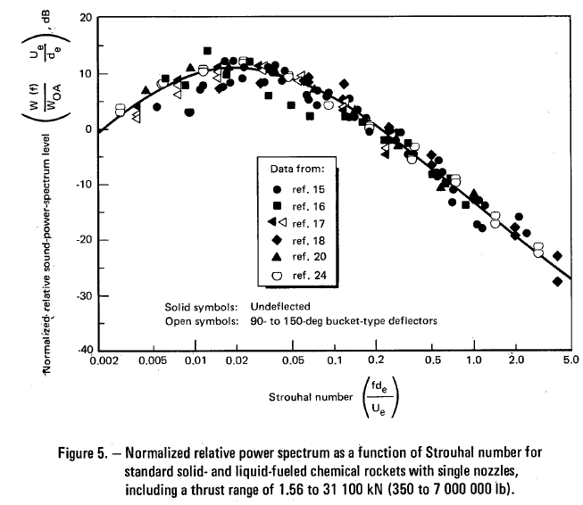
Vibrationdata
Rocket noise power spectrum curve as a function of Strouhal number
Symbol | Description
f | frequency
d_{e} | effective nozzle diameter in meters
U_{e} | fully expanded exit exhaust velocity in (m/sec)
W(f) | sound power (Watts) in a one-third octave band with center frequency f
W_{OA} | overall acoustic power in Watts

Slide 19
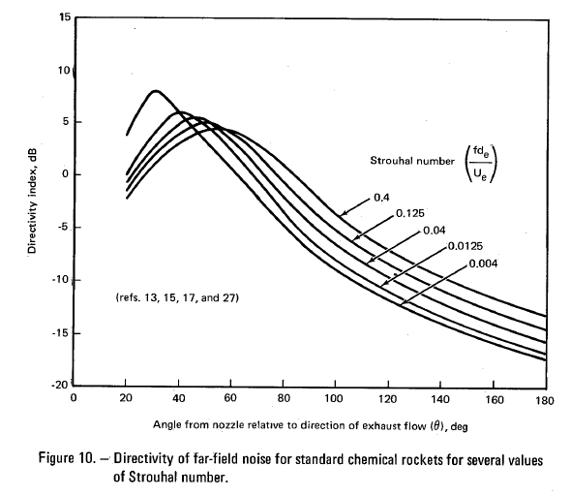
Vibrationdata
Far-field directivity
In the far field, the sound pressure level decreases 6 dB for a double of the distance from the source

Slide 20
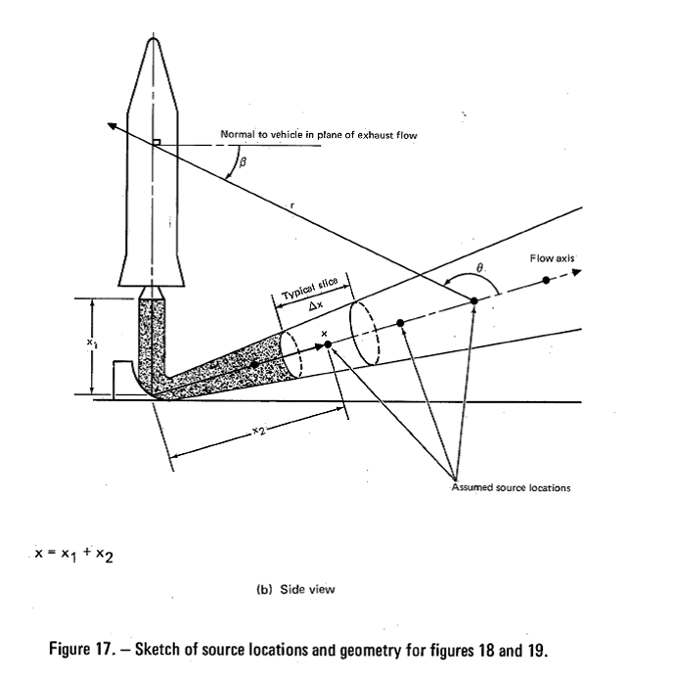
Source Allocation
Assume a single source location for each one-third octave band frequency
SPL at external vehicle skin is highly dependent on angles and directivity

Slide 21
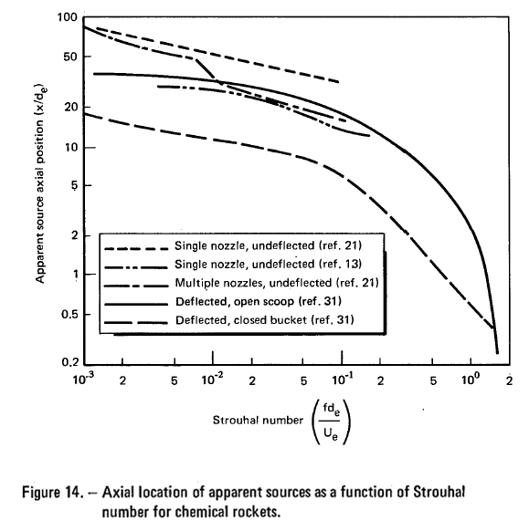
Source Allocation
Source location as a function of Strouhal number

Slide 22
NASA SP-8072 Liftoff Example
Vibrationdata
NASA SP-8072 First Source Allocation Method is demonstrated by example
Goal is to estimate the sound pressure level at selected vehicle station
Parameter | Value
Thrust at Liftoff per Engine | 391,500 lbf (1.742e+06 N)
Specific Impulse, Sea Level | 300 lbf-sec/lbm
Exhaust Velocity | 10,000 ft/sec (3048 meter/sec)
Acoustic Efficiency | 0.01
Angle from Deflected Flow to Ground | 5 deg
Number of Nozzles | 2
Nozzle Exit Diameter | 58.7 inch (1.491 meters)
Parameter | Value
Nozzle Exit Area | 2706 in^2
Distance from Ground to Nozzle Exit Plane | 240 inch (6.1 meters)
Geometry | 90 deg flat plate
Station of Interest, Diameter | 154 inch (3.9 meters)
Station of Interest, length above nozzle exit plane | 1246 inch (31.6 meters)

Slide 23
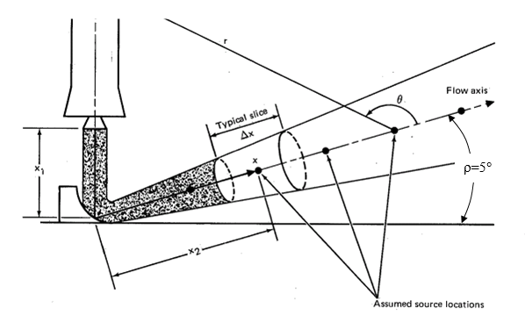
Step 1 Flow Axis
Vibrationdata
Determine the flow axis relative to the vehicle and stand
Define an angle ρ and set it equal to 5°

Slide 24
Step 2 Overall Acoustic Power in Watts
Vibrationdata
Symbol | Description
W_{OA} | overall acoustic power in Watts
η | Acoustic efficiency
n | Number of nozzles
F | Thrust per engine
U_{e} | fully expanded exit exhaust velocity in (m/sec)

Slide 25
Step 3 Overall Acoustic Power in dB
Vibrationdata
Zero dB Reference 10⁻¹² W
Subtract 3 dB for: deflected, 90 deg flat plate, conical diffuser, or wedge

Slide 26
Step 4 Effective Nozzle Diameter
Vibrationdata

Slide 27
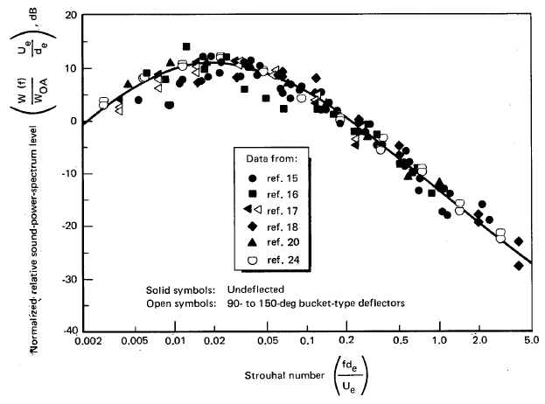
Step 5 Strouhal Number & Power for each Frequency Band
Vibrationdata
The band centered at 20 Hz is used an example
The normalized power spectrum for his Strohaul number is

Slide 28
Step 5 Continued with Power Calculation
Vibrationdata
The bandwidth for the one-third octave band centered at 20 Hz (band b=1) is
Δf₁ = 0.232 f₁ = 0.232 (20 Hz) = 4.63 Hz
The sound power level for a given one-third octave band is
The sound power level for the 20 Hz band is

Slide 29
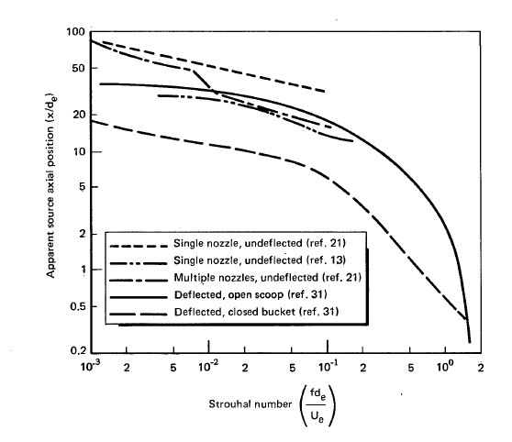
Step 6 Source Allocation
Vibrationdata
Allocate the sources along the exhaust flow centerline for each frequency band
Use graph at left if applicable
Use Eldred-Wilby method for
deflected, single 45° plate
deflected, 90° flat plate, conical diffuser, or wedge
S = 0.0138 for 20 Hz
Example problem is 90° flat plate and requires Eldred-Wilby method
The calculation steps are omitted for brevity
The resulting axial position for 20 Hz is 62.8 meters

Slide 30
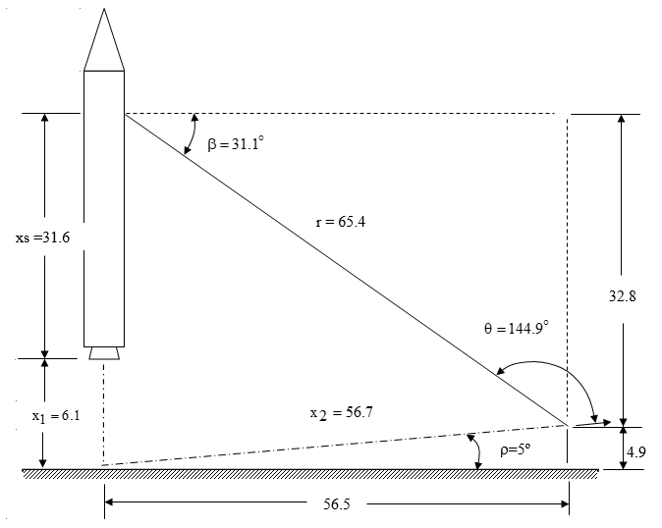
Step 7 Radius and θ Identification
Identify geometry for 20 Hz case
Non-angle dimensions in meters
Not to scale
Recall that x is the axial position of the source
x = x₁ + x₂
x = 6.1 + 56.7 = 62.8 m
x₁ is taken initially as the launch stand height
The analysis is repeated at height increments as the liftoff progresses

Slide 31
Step 7 Further Notes
Progressive height increments during ascent
The axial position x remains constant
x₁ increases
x₂ decreases
θ decreases, eventually to 90°
β increases, eventually to 90°
The directivity changes as θ changes
The radius r changes
The height at which the peak sound pressure level occurs varies with frequency
Source is moved to the ground with β=90° if it occurs between the nozzle exit plane and the ground

Slide 32
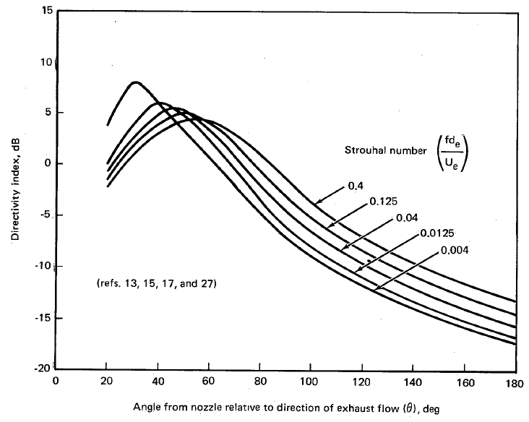
Step 8 Directivity
Vibrationdata
Calculate the directivity for the initial height at time zero
Again
The interpolated directivity from the curves is
DI = -15.5 dB
Variable | Value
x₁ | 6.1 meters
f | 20 Hz
S | 0.0138
θ | 144.9°

Slide 33
Step 9 Wilby Blocked Correction Factor
Vibrationdata
Correct for pressure reflections at the surface of the vehicle
The result for the 20 Hz case is W_{c} = 3.6 dB
The formula is shown as follows using and intermediate variable Z
Symbol | Description
f | Frequency
d | Station diameter
c | Speed of sound
β | Angle from a previous diagram

Slide 34
Step 10 Sound Pressure Level Calculation
Vibrationdata
Calculate the sound pressure level in for the 20 Hz case (b=1) and for the initial height of 6.1 meters above the ground
Note that the -8 factor corresponds to radiation into a hemisphere with a flat ground plane
Repeat Steps 5 through 10 for each band of interest and at each height of interest

Slide 35
SPL at 20 Hz Comparison
Vibrationdata
The peak response at 20 Hz actually occurs at x₁ = 60.07 meters above the ground as shown in the following table
Parameter | Initial | Later
x₁ (meters) | 6.1 | 60.07
L_{w,1} (dB) | 179.8 | 179.8
r (meters) | 65.4 | 91.5
-10 log r² | -36.3 | -39.2
Theta (deg) | 144.9 | 86.7
Beta (deg) | 31.1 | 88.3
DI (dB) | -15.5 | -11.1
W_{c} | 3.60 | 4.36
SPL1(dB) | 123.6 | 125.8

Slide 36
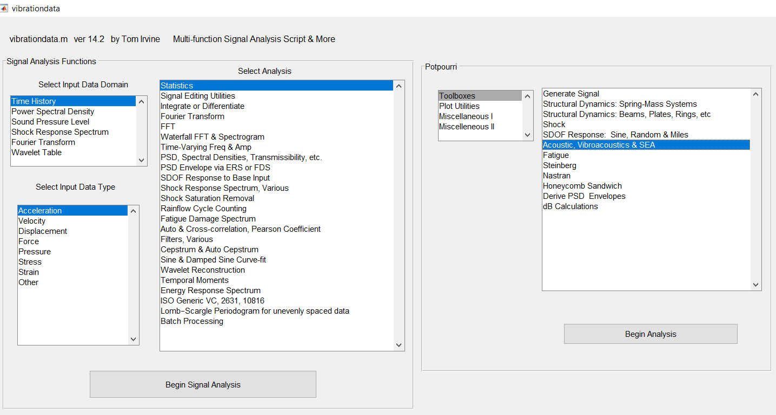

Slide 37
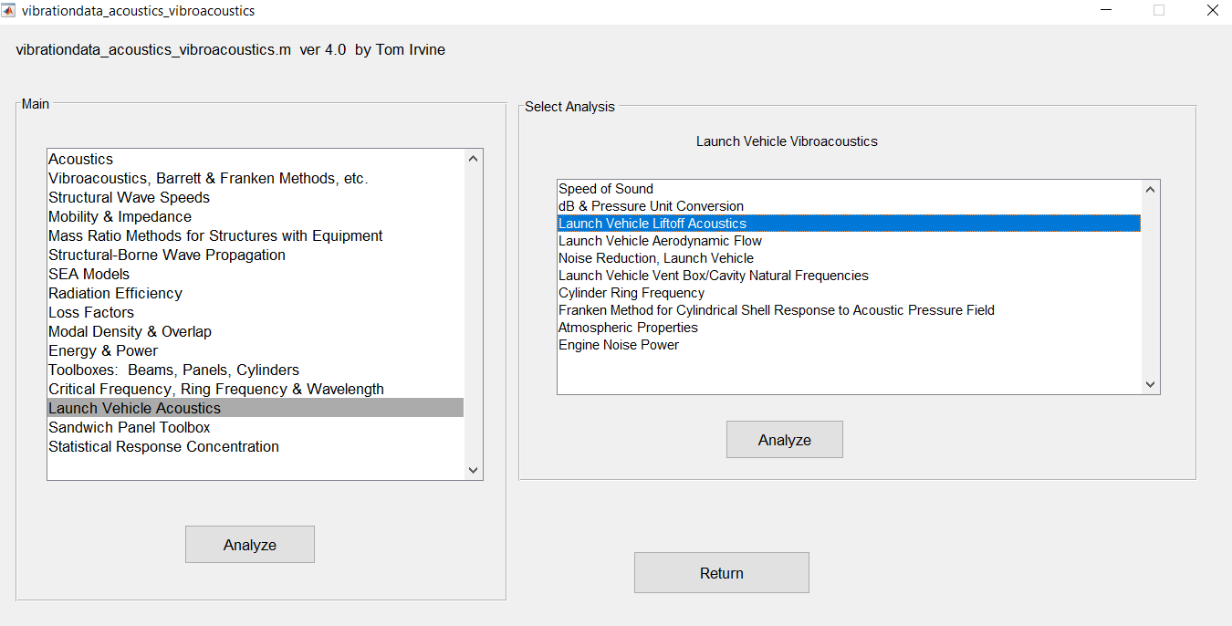

Slide 38
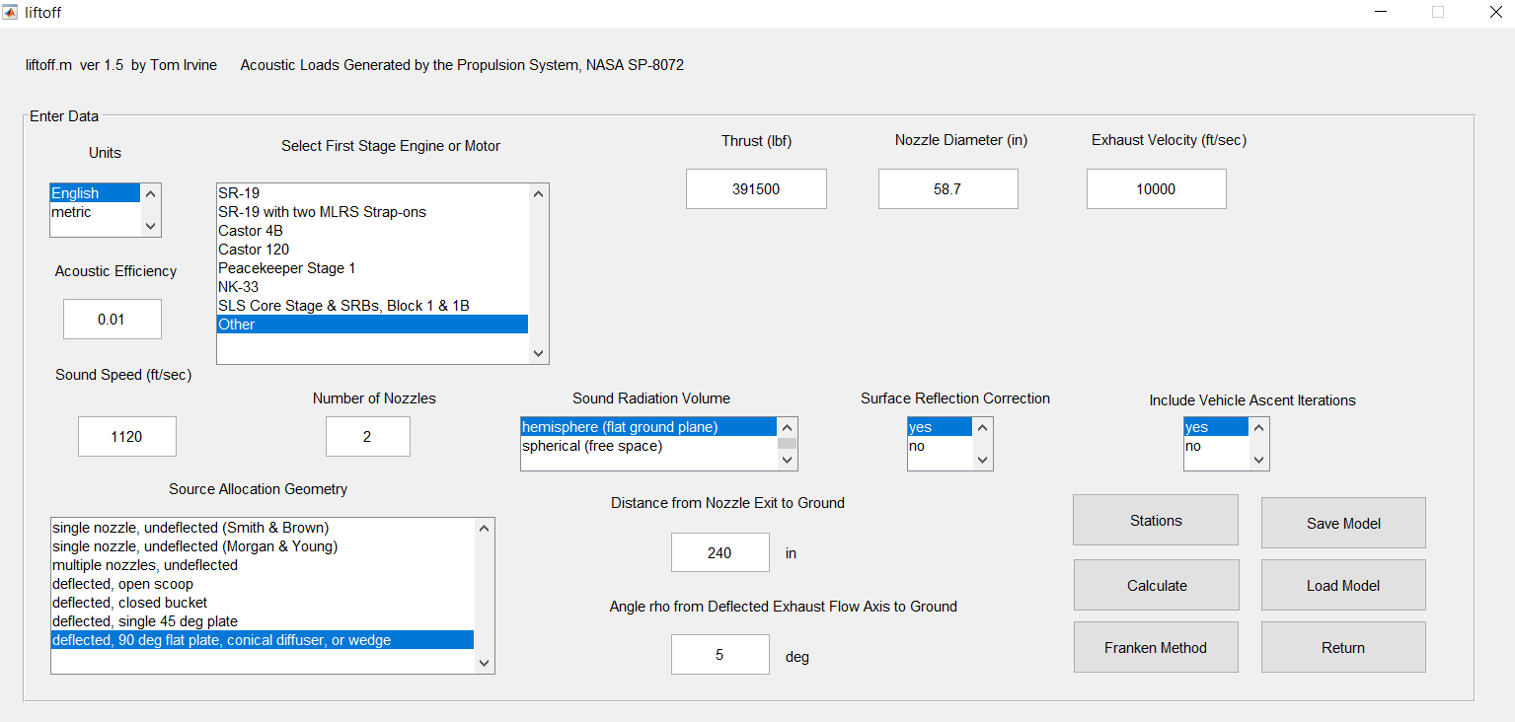

Slide 39
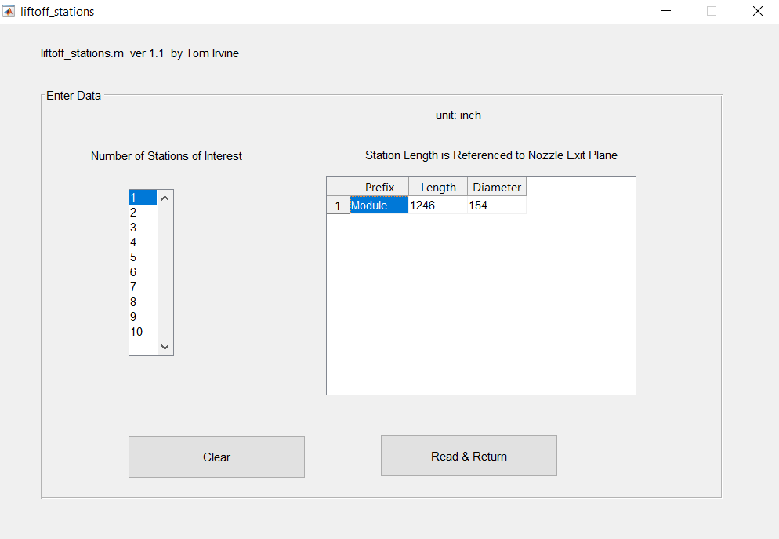

Slide 40
Sound Pressure Level Maximum Envelope at Module Location
Vibrationdata
SPL Output format: freq(Hz) & spl(dB) ref 20 micro Pa
Matlab Output arrays:
Module_spl_1
PSD Output format: freq(Hz) & psd(psi^2/Hz)
Matlab Output arrays:
Module_psd_1
SPL ASCII text arrays (tab delimited):
Module_spl_1.txt
Consider adding, say, 3 dB uncertainty factor

Slide 41
Vibration Calculation
Vibrationdata
Calculate vibration response to liftoff pressure PSD using Barrett scaling, Franken method, Statistical Energy Analysis (SEA), etc.
Barrett & Franken will be covered in this slide presentation, both NASA methods
SEA will be covered in a future presentation
Use Barrett method if you already have reference pressure and acceleration PSD data from one of your own vehicles
Otherwise, use Franken which comes with its own reference data

Slide 42
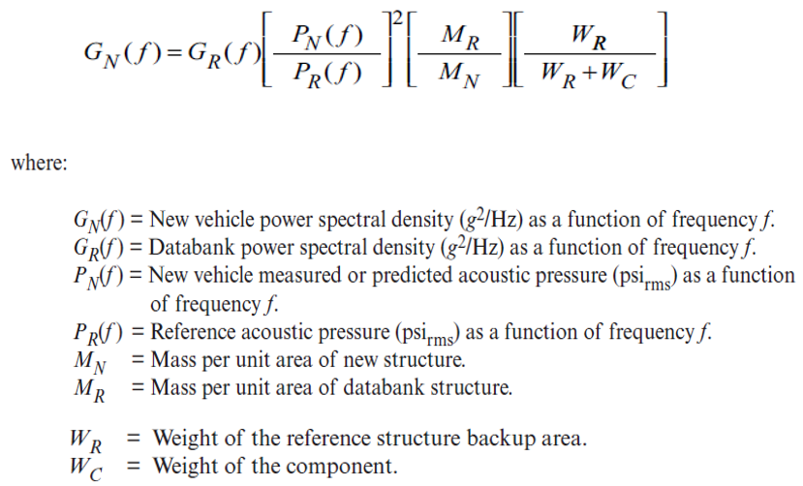
Barrett Method, Empirical Scaling
Vibrationdata
Extrapolation from reference vehicle to new vehicle
NASA/TM-2009-215902, Using the Saturn V and Titan III Vibroacoustic Databanks for Random Vibration Criteria Development, 2009
Mass ratios should be squared per Newton’s law
But taking mass ratios to first power gives better agreement with measured data

Slide 43
Franken, Empirical Scaling
Vibrationdata
NASA CR-1302, Summary of Random Vibration Prediction Procedures, 1969
NASA-HDBK-7005, Dynamic Environmental Criteria, 2001
The function was developed from studies of Jupiter and Titan I acoustic and radial skin vibration data collected during static firings
The function predicts the skin vibration level in GRMS based on the input sound pressure level in dB, vehicle diameter in feet, and surface weight density in pounds per square foot

Slide 44
Franken Assumptions
Vibrationdata
All flight vehicles to which the procedure is applied have similar dynamic characteristics to the Jupiter and Titan I vehicles
Vibration is due to the acoustic noise during liftoff or other pressure fields during flight which can be estimated
The vibration magnitude is directly proportional to the pressure level of the excitation and inversely proportional to the surface weight density of the structure.
Predominant vibration frequencies are inversely proportional of the diameter of the vehicle
Spatial variations in the vibration can be considered as a random variable

Slide 45
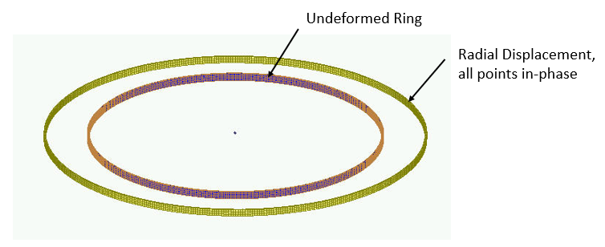
Ring Frequency
Vibrationdata
Consider a thin ring with a rectangular cross section and with completely free boundary conditions
The ring frequency corresponds to the mode in which all points move radially outward together and then radially inward together
This is the first extension mode, analogous to a longitudinal mode in a rod
The ring frequency is the frequency at which the longitudinal wavelength in the skin material is equal to the vehicle circumference
The ring frequency is an idealized concept for a cylindrical shell
In practice, cylindrical shells tend to have a high modal density near the ring frequency
The ring frequency f _{r} is
C_{L} is longitudinal wave speed
d is diameter

Slide 47
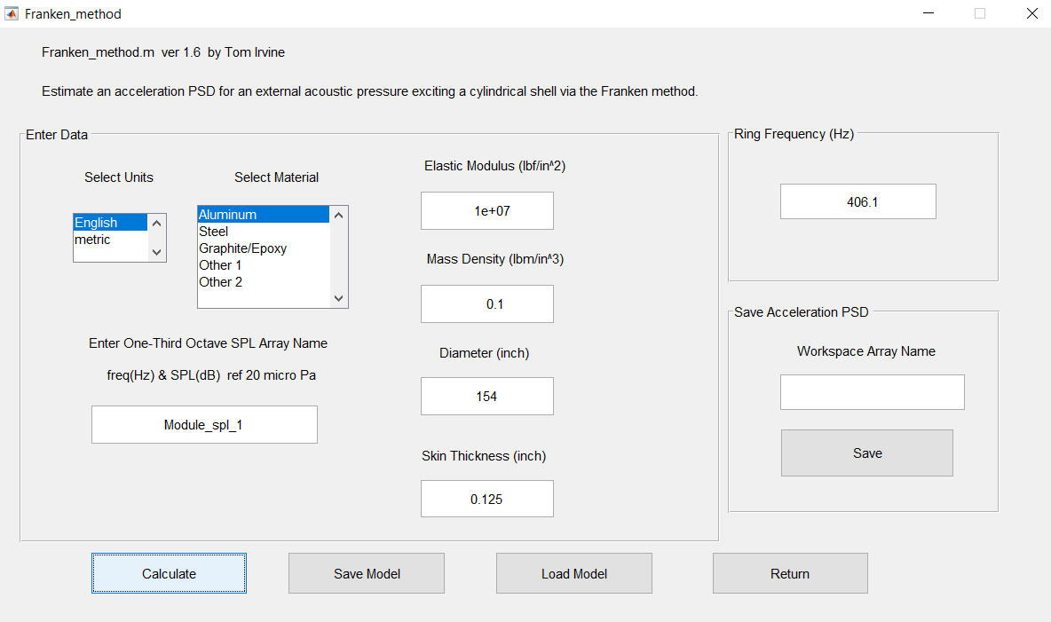
Continue with previous example and assume 0.125 inch thick aluminum skin

Slide 48
Liftoff Vibration Response
Vibrationdata
Again an uncertainty factor should probably be added to either the liftoff SPL or the resulting vibration PSD

