Slide 1
Vibrationdata
Modal Testing, Part I
By Tom Irvine

Slide 2
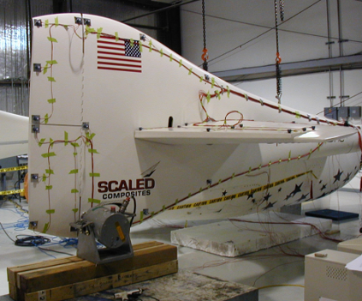
Objectives
Vibrationdata
Measure natural frequencies, damping and mode shapes
Natural frequencies and mode shapes can be predicted using analytical model
But Damping can only be measured
Also, joint stiffness is difficult to predict with analytical models
Use results to calibrate finite element modal
One goal of both testing and analysis is to determine the extent to which a structure’s natural frequencies will be excited by the field environment

Slide 3
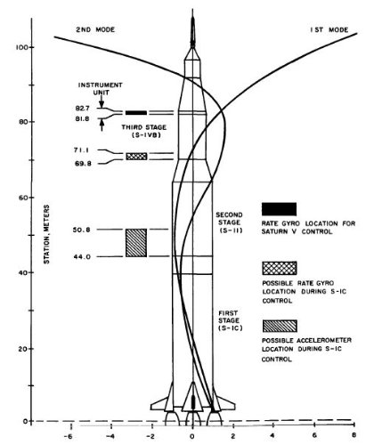
Objectives (continued)
Vibrationdata
Total response of a system to external excitation may be represented as a superposition of individual modal responses
Resonant vibration can result in fatigue failure, performance degradation, etc.
For launch vehicles, guidance, control and navigation engineers need vehicle modal data to design stable autopilot algorithms
A payload may have a “stiffness” requirement for a particular launch vehicle so that the payload’s own natural frequency is above a certain minimum to avoid dynamic coupling with launch vehicle
Saturn V Body Bending Modes

Slide 4
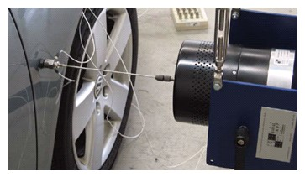


Excitation Methods
Vibrationdata
A small shaker applies a force excitation to an automobile fender via a stinger rod
The stinger has high axial stiffness but low transverse and rotational stiffness, giving good directional control of the excitation
The stinger also decouples the shaker’s rotary inertia from the structure
The applied force and resulting acceleration at the input point are measured by an impedance head transducer
Response accelerometers may be mounted at various locations on the vehicle
A structures can also be excited by an impact hammer
Excitation may be sine, sine sweep, random or transient

Slide 5
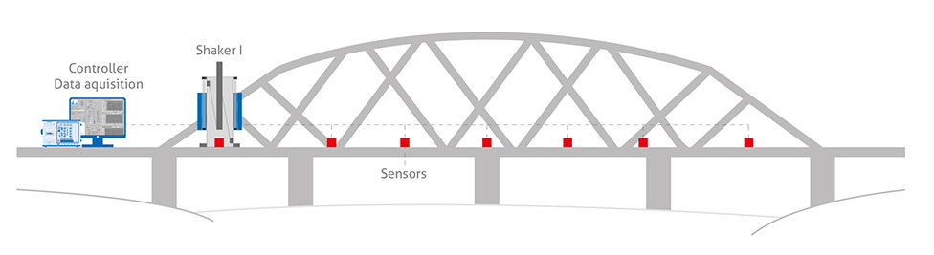
Excitation Methods (continued)
Vibrationdata
Floor mounted shakers are available for testing large structures
These shakers may be reciprocating or rotational with eccentric mass
Data acquisition and shaker systems shown with exaggerated relative dimension

Slide 6
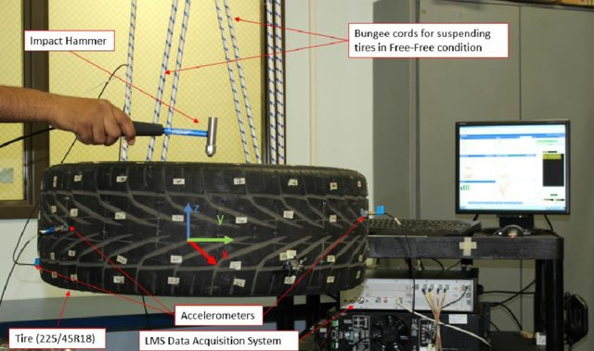
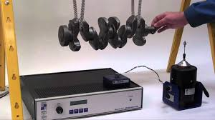
Boundary Conditions
Vibrationdata
Bungee cords or air spring mounts are often used to approximate free-free boundary conditions

Slide 7
Frequency Response Functions (FRFs)
Vibrationdata
Block diagram
Response is usually measured via accelerometers
Laser vibrometers could be used to measure velocity if line-of-sight is available
Commercial modal curve-fitting software may require mobility or admittance
Let ω be angular excitation frequency (rad/sec)
Integration in the frequency domain for ω > 0
Mobility = Accelerance / ω
Admittance = Accelerance / ω²
FRFs are complex with real and imaginary components, or magnitude and phase
The physical interpretation of the FRF is that a sinusoidal input force, at a frequency ω, will provoke a response at the same frequency multiplied by the FRF magnitude with a phase shift
Input Force
Transfer Function
Displacement Response
Transfer Function Nomenclature
Displacement / Force | Velocity / Force | Acceleration / Force
Admittance, Compliance, Receptance | Mobility | Accelerance, Inertance
Force / Displacement | Force / Velocity | Force / Acceleration
Dynamic Stiffness | Mechanical Impedance | Apparent Mass, Dynamic Mass

Slide 8
Single-degree-of-freedom System, Applied Force
Vibrationdata
f
f
x
The Laplace transform can used to solve the equation of motion and to derive the steady-state admittance frequency response function
This FRF can be represented in the frequency domain by setting:
s =jω , where j = sqrt(-1)
An equivalent form is
x
m
m
k
c
k x
Derive equation of motion using Newton’s law

Slide 9
Single-degree-of-freedom System, Applied Force (cont)
Vibrationdata
f
f
The mobility FRF is
The accelerance FRF is
x
x
m
m
k
c
k x

Slide 10
SDOF Example
Vibrationdata

Slide 11
SDOF Example (cont)
Vibrationdata

Slide 12
FRF Measurement Concerns
Vibrationdata
Non-linear structural response
The response signal not only contains the response due to the measured excitation, but also the response due to the ambient random excitation
Electrical noise in the instrumentation
Limited analysis resolution

Slide 13
Half-Power Bandwidth Guidelines
Vibrationdata
The half-power bandwidth for a frequency separation Δf is
Δf = 2 ξ f _{n}
where ξ is the damping ratio and f _{n} is the natural frequency
As a rule-of-thumb, the frequency resolution of the FRF should be such that there are at least five points within the Δf bandwidth (per Mary Baker, Jim Akers, et al)
The test duration T for a single Fourier transform or FRF covering the entire time history is
T = α / Δf = α / ( 2 ξ f _{n} ) , α > 5 recommended

Slide 14
FRF Estimator H1
Vibrationdata
Take long measurements of force and response and then divide into segments
Use principle of least squares to minimize the effect of noise at the output
H₁ is equal to the cross spectrum between the response and the force divided by the auto-spectrum of the force
H₁(ω) = Σ F* ⋅ X / Σ F* ⋅ F
H₁(ω) = G_{FX} (ω) / G_{FF} (ω)
F is the force Fourier transform, and X is the response Fourier transform
The * indicates complex conjugate
An important point about H₁ is that random noise in the output is removed during the averaging process of the cross spectrum
H₁ converges to H as the number of averages is increased

Slide 15
FRF Estimator H2
Vibrationdata
Take long measurements of force and response and then divide into segments
Use principle of least squares to minimize the effect of noise at the input
H₂(ω) = Σ X* ⋅ X / Σ X* ⋅ F
H₂(ω) = G_{XX} (ω) / G_{XF} (ω)
An important point about H₂ is that random noise in the output is removed during the averaging process of the cross spectrum

Slide 16
H1 and H2 Estimators
Vibrationdata
H₁ and H₂ form the confidence interval for the true H when noise is present in both the input and output
H₁ < H < H₂
The above inequality is not valid for the nonlinear leakage error, or for noise which is coherent in the input and output
H₂ is the best estimator for random excitation and resonances because it cancels noise at the input and is less sensitive to leakage
H₁ is the best estimator for anti-resonances since the dominant problem is noise at the output
H₁ is preferred for impact excitation

Slide 17
Coherence Function
Vibrationdata
The coherence function provides a means of assessing the degree of linearity between the input and output signals
The Coherence is 1 for no noise in the measurement
It is 0 for pure noise
The interpretation of the coherence function is that for each frequency ω it shows the degree of linear relationship between the measured input and output signals
The Coherence Function is analogous to the squared correlation coefficient used in statistics
where

Slide 18
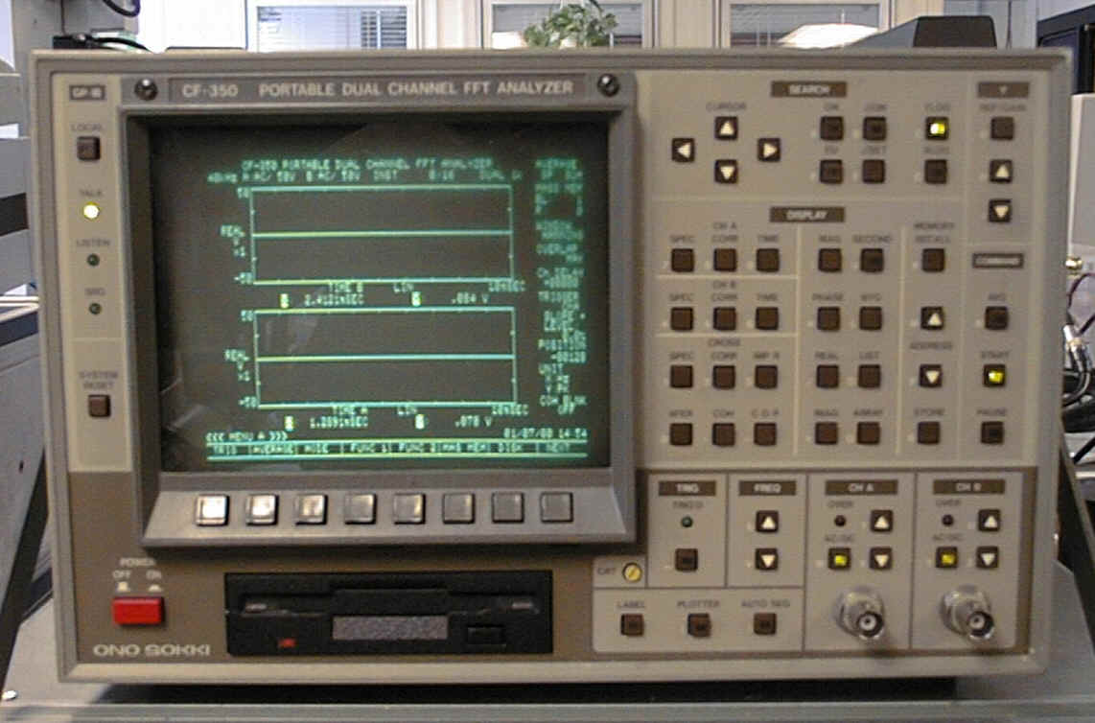
Dual Channel FFT Analyzer
Vibrationdata
Used to measure H₁, H₂ and coherence
The analog input signals are filtered, sampled, and digitized to give a series of digital sequences or time history records
The sampling rate and the record lengths determine the frequency range, and the resolution, of the analysis
Each record from a continuous sequence may be multiplied (weighted) by a Hanning window, or some other type
The window tapers the data at both the beginning and end of each record to make the data more suitable for block analysis
The weighted sequence is transformed to the frequency domain as a complex spectrum, by the use of a Discrete Fourier Transformation
To estimate the spectral density of a signal, some averaging technique has to be used to remove noise and improve statistical confidence

Slide 19
Dual Channel FFT Analyzer (cont)
Vibrationdata
An autospectrum is calculated by multiplying a spectrum by its complex conjugate (opposite phase sign), and by averaging a number of independent products
The cross spectrum is the complex conjugate of one spectrum multiplied by a different spectrum
The cross Spectrum is complex, showing the phase shift between the output and input, and a magnitude representing the coherent product of power in the input and output

Slide 20
Random Excitation Notes
Vibrationdata
Random excitation should have a flat spectrum such as band-limited white noise with a normal distribution
The structure is excited over a wide force range at each frequency due to the random characteristic of the signal
This randomizes any non-linear effects, and averaging then gives a best linear approximation
The excitation is random and continuous in time, but the record length is finite, so leakage errors may occur
Use Hanning window to mitigate leakage error
Crest factor is ratio of absolute peak in the time domain to the standard deviation
Peak for random vibration with normal distribution is typically 4 to 5-sigma

Slide 21
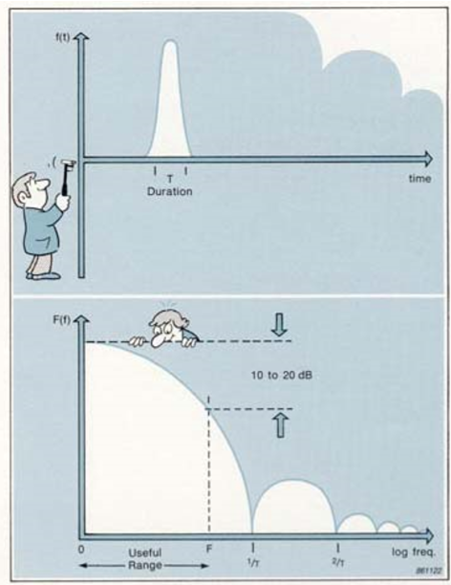
Impact Hammer Testing
Vibrationdata
The waveform produced by an impact is a transient (short duration) energy transfer event
The spectrum is continuous, with a maximum amplitude at 0 Hz and decaying amplitude with increasing frequency
The spectrum has a periodic structure with zero force at frequencies at n/T intervals, where n is an integer and T is the effective duration of the transient
The useful frequency range is from 0 Hz to a frequency F, at which point the spectrum magnitude has decayed by 10 to 20 dB
The duration, and thus the shape of the spectrum, of an impact is determined by the mass and stiffness of both the impactor and the structure
The stiffness of the hammer tip acts as a mechanical filter and determines the spectrum
(images courtesy of Bruel & Kjaer)

Slide 22
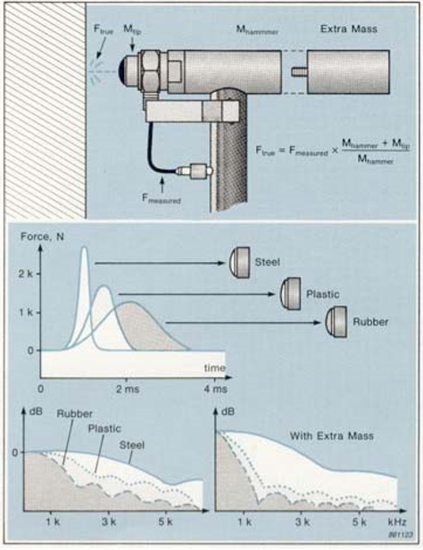
Impact Hammer Testing Pros & Cons
Vibrationdata
Pros
Speed - only a few averages are needed
No elaborate fixtures are required
There is no variable mass loading of the structure
This is of particular advantage with light structures, since changing the mass loading from point to point can cause shifts in modal frequencies from one measurement to another
It is portable and very suitable for measurements in the field
It is relatively inexpensive
Cons
The structure may rebound at the hammer producing double impacts if the hammer is to heavy
Any frequency response functions measured with a double hit will be erroneous and must be excluded from the data set

Slide 23
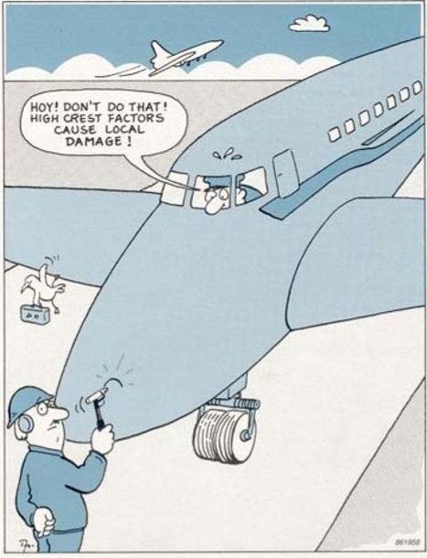
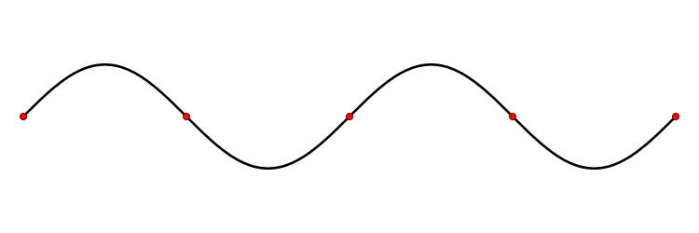
Impact Hammer Testing Pros & Cons (cont)
Vibrationdata
Cons
Impact testing can have high crest factor which provokes nonlinearity
Possible damage to structure
The deterministic character of impact excitation limits the use of the Coherence Function
The coherence function will show a "perfect" value of 1 unless there is an anti-resonance, where the signal-to-noise ratio is rather poor
An anti-resonance occurs at a modal frequency when the hammer impacts a nodal point
Coherence ≅ 0 at modal frequency if impact location is near node
hammer
node

Slide 24
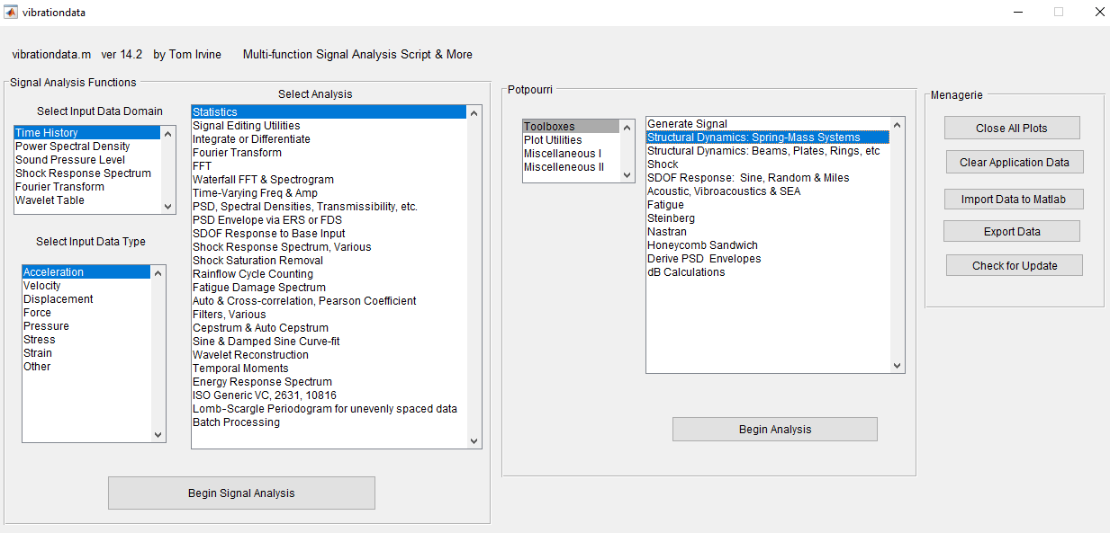
Vibrationdata GUI
Vibrationdata

Slide 25
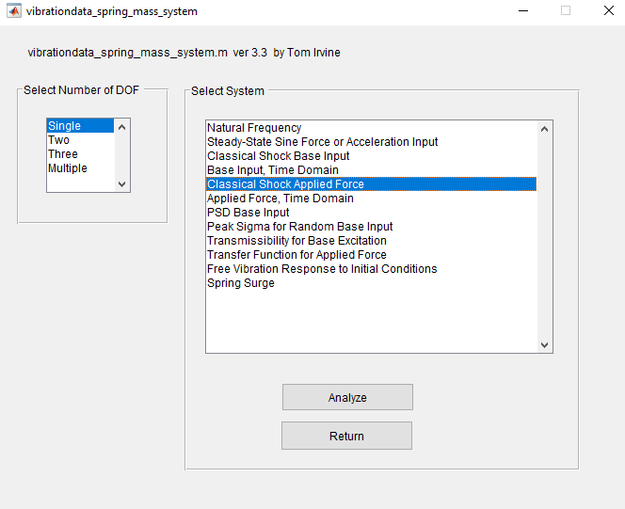
Spring Mass System
Vibrationdata

Slide 26
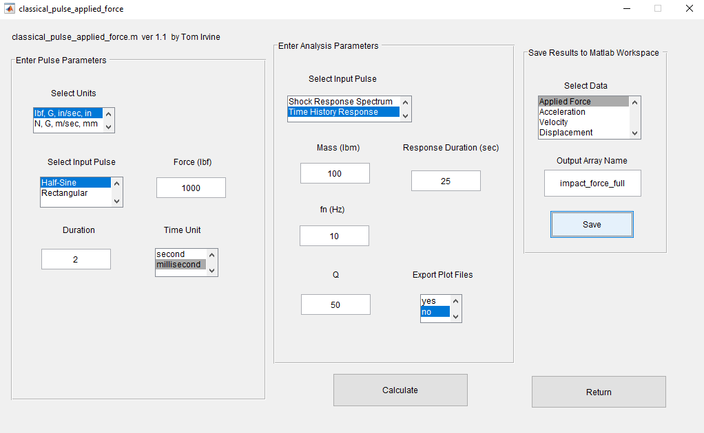
Classical Pulse Applied Force for SDOF System, Full
Vibrationdata
Save Applied Force
impact_force_full
Save Displacement
displacement_full

Slide 27
Impact Hammer Testing Response Leakage
Vibrationdata
If the record length is shorter than the decay time, the measurement will exhibit a leakage error resulting in the observed resonances being too low

Slide 28
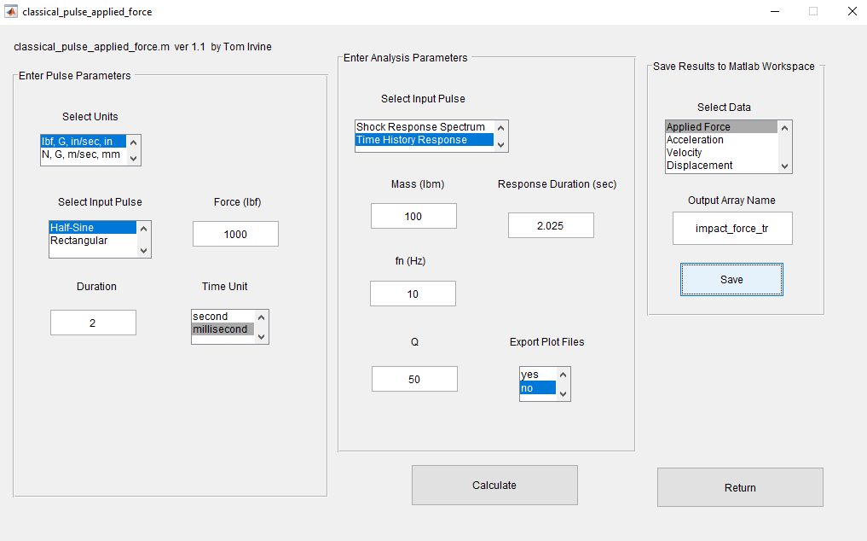
Classical Pulse Applied Force for SDOF System, Truncated
Vibrationdata
Save Applied Force
impact_force_tr
Save Displacement
displacement_tr

Slide 29
Impact Hammer Testing Response Leakage
Vibrationdata
The response to an impact is a free decay of all the modes of vibration
Consider a lightly damped structure giving sharp resonances that ring for a long time due to an impulse force
If the record length is shorter than the decay time, the measurement will exhibit a leakage error resulting in the observed resonances being too low
The recommended minimum test duration is
T = 5 / ( 2 ξ f _{n} )
= 5 / [ (2)(0.01)(10 Hz) ] = 25 sec

Slide 30
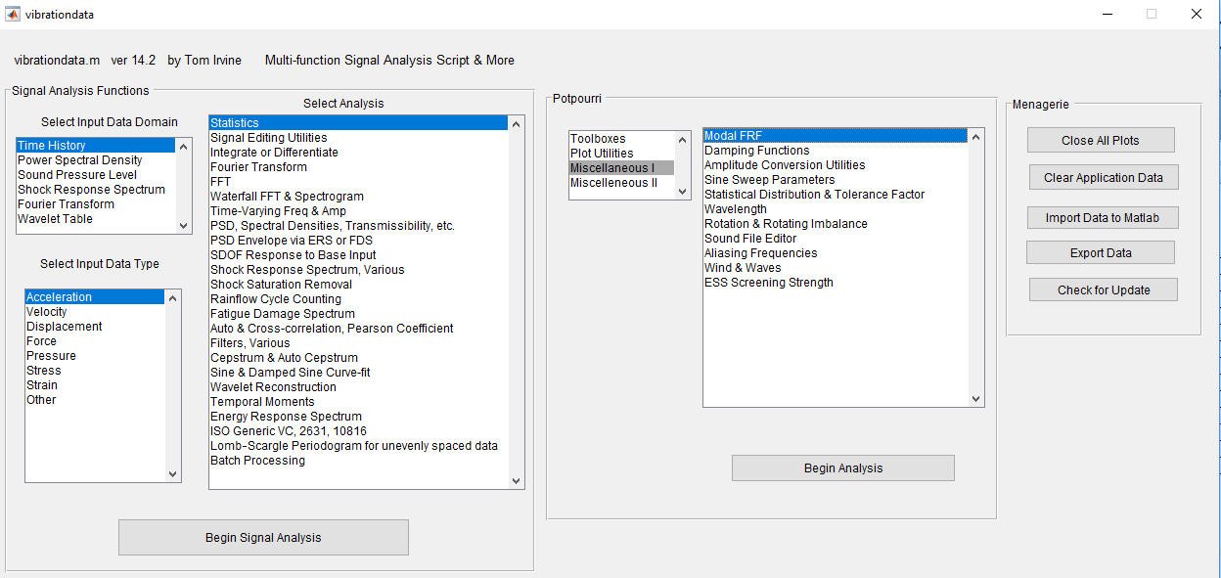
Vibrationdata GUI
Vibrationdata

Slide 31
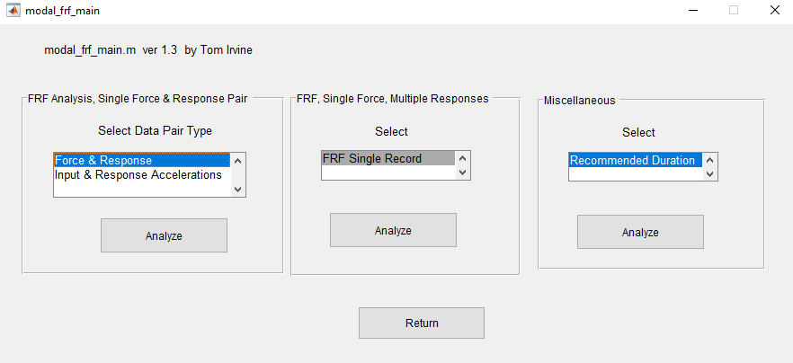
Modal FRF Main
Vibrationdata

Slide 32
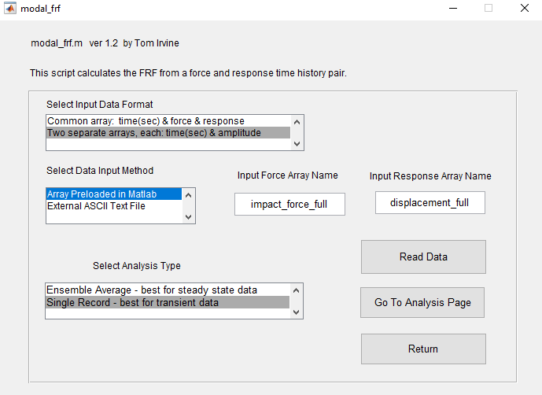
Modal FRF, Read Data, Single Record
Vibrationdata

Slide 33
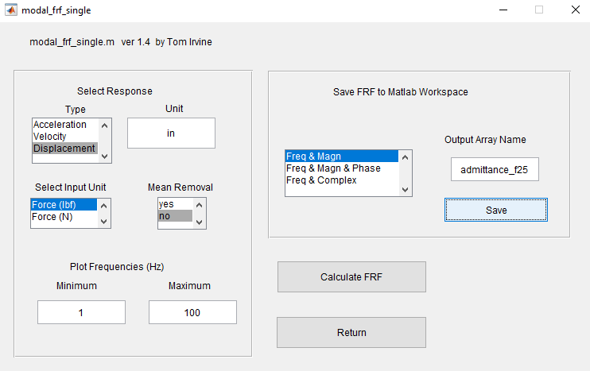
Modal FRF
Vibrationdata

Slide 34
Impact Hammer Testing Response FRF Comparison
Vibrationdata
The Truncated curve has a wider frequency resolution than the Full curve
The Truncated curve also has some minor leakage
The damping and natural frequency could still be estimated from the Truncated curve but there would be some error

Slide 35
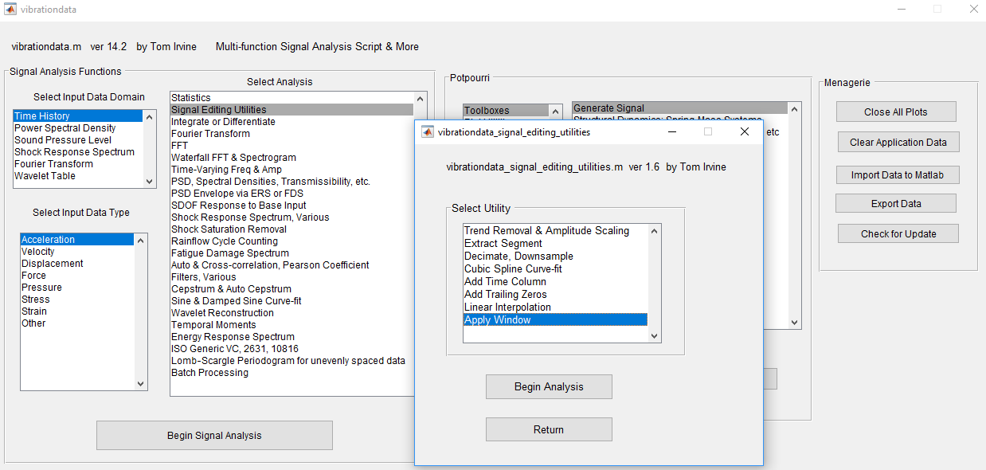
Vibrationdata GUI
Vibrationdata

Slide 36
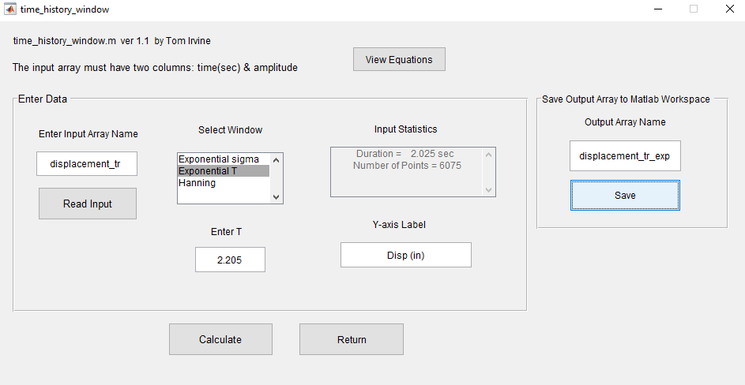
Apply Exponential Window
Vibrationdata

Slide 37
Exponential Window
Vibrationdata
Apply exponential window to mitigate leakage and to bring more points into the half-power bandwidth
Window function is
W(t)=exp( - σ t )

Slide 38
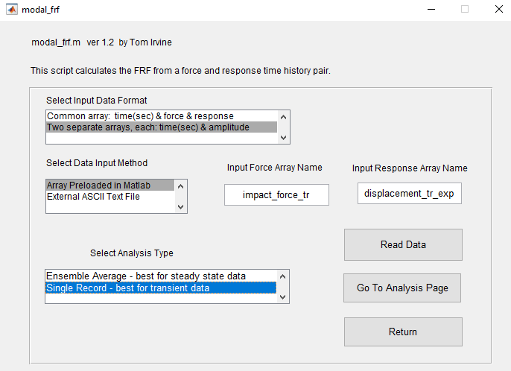
Modal FRF, Truncated Response with Exponential Window
Vibrationdata

Slide 39
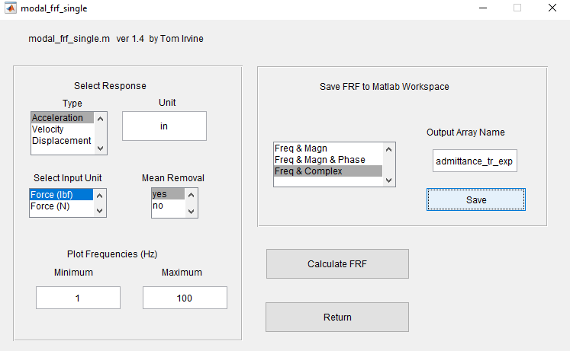
Modal FRF, Truncated Response with Exponential Window
Vibrationdata
Save complex FRF

Slide 40
Admittance FRF
Vibrationdata

Slide 41
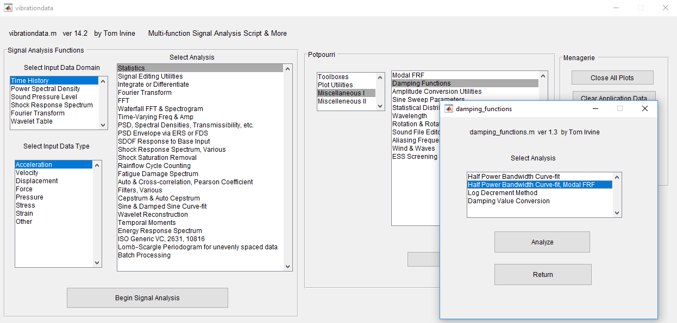
Vibrationdata GUI
Vibrationdata

Slide 42
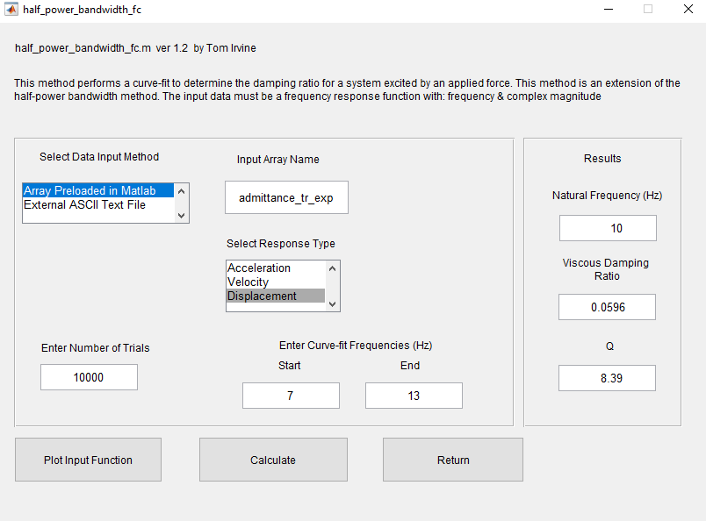
FRF Curve-fit
Vibrationdata

Slide 43
Exponential Window Complex FRF Curve-fit
Vibrationdata
Curve-fit parameters, natural frequency and measured damping
True damping estimate
Actual damping ratio = 0.010
f _{n} = 10.0 Hz
ξ _{m} = 0.064
ξ = ξ _{m} – σ / ( 2 π f _{n} )
= 0.060 – 3.142 /[2 π (10 Hz) ]
= 0.010

