Slide 1

Vibrationdata
PSD Fatigue Damage Severity Criteria
Revision A
By Tom Irvine
July 6, 2020

Slide 2
Introduction
Vibrationdata
The following method is intended for components which are to be tested to power spectral density (PSD) specifications on shaker tables
The method can be applied to sine-on-random specifications as well
The purpose of this document is to recommend velocity severity categories for PSD base inputs in terms of Stress-Velocity Relationship (SVR) fatigue damage
The categories can then be used to plan the design and analysis efforts required to ensure that a component will pass its PSD test, or at least mitigate risk of failure with associated cost and schedule delays
The method draws from Gaberson, Steinberg, Morse and Dirlik
The 50 ips velocity line is typically plotted on SRS specifications as a reference severity threshold, based in part on the SVR
The SVR is a global method (Gaberson) for predicting the maximum stress in a structure due to shock & vibration as given at:
https://vibrationdata.wordpress.com/2013/04/15/howard-gaberson-papers/

Slide 3
Introduction (continued)
Vibrationdata
The Dirlik method calculates the fatigue damage from a response PSD as given at: https://vibrationdata.wordpress.com/2013/11/08/dirlik-rainflow-counting-method-from-response-psd/
An innovation of this report is to substitute pseudo velocity for stress in the Dirlik calculation, since Gaberson showed that velocity is proportional to stress
Effectively, an S-N curve is transformed into a PV-N curve where a velocity limit such as 50 ips is substituted for the ultimate stress limit
The PV-N curve has a fatigue exponent and is a straight line in log-log format
The method takes a roundabout approach by adjusting the ultimate velocity limit so that the cumulative fatigue index is one which is the fatigue failure threshold
This adjusted limit is then the minimum velocity which the component must be able to withstand in order to pass the test

Slide 4

Howard Gaberson
Vibrationdata
Howard A. Gaberson (1931-2013) was a shock and vibration specialist with more than 45 years of dynamics experience
He was with the U.S. Navy Civil Engineering Laboratory and later the Facilities Engineering Service Center from 1968 to 2000, mostly conducting dynamics research
Gaberson specialized in shock and vibration signal analysis and has published more than 100 papers and articles

Slide 5
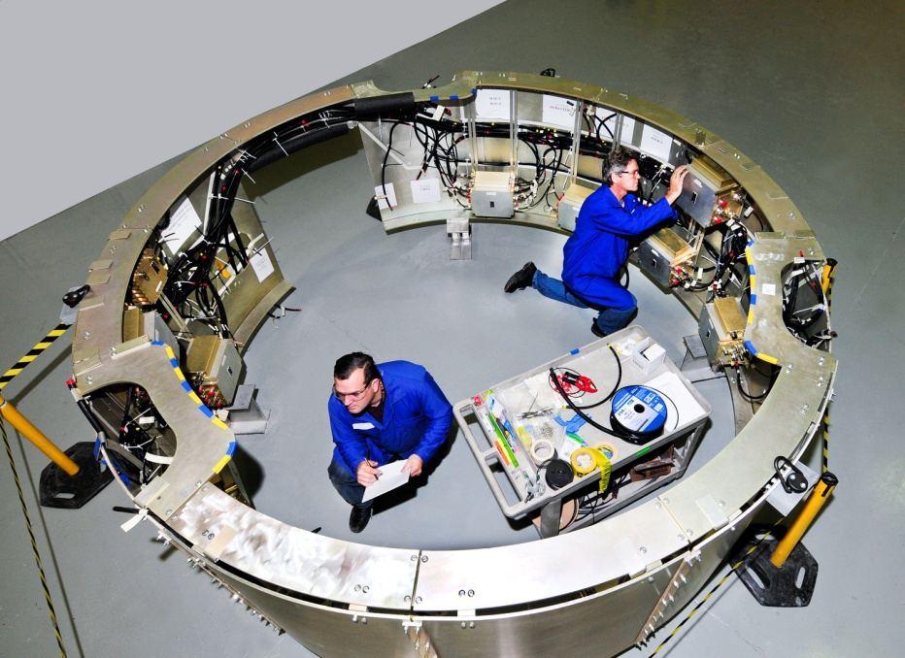
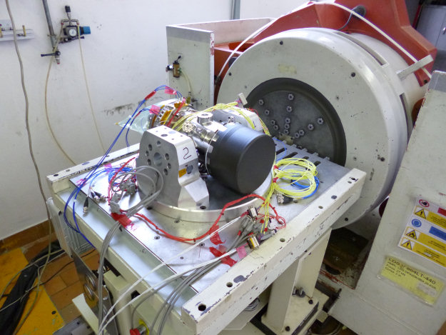
Avionics Components
Vibrationdata
Electronic components in vehicles are subjected to shock and vibration environments
The components must be designed and tested accordingly
Dave S. Steinberg’s Vibration Analysis for Electronic Equipment is a widely used reference in the aerospace and automotive industries

Slide 6
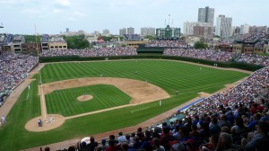
Some General Caveats
Vibrationdata
Vibration fatigue calculations are “ballpark” calculations given uncertainties in S-N curves, stress concentration factors, non-linearity, temperature, surface finish, load sequence, multi-axis loading and other variables.
Perhaps the best that can be expected is to calculate the accumulated fatigue to the correct “order-of-magnitude.”

Slide 7
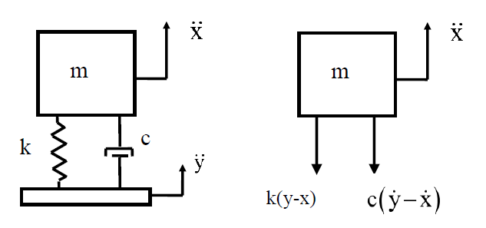
Pseudo Velocity
Vibrationdata
A = absolute acceleration response of an SDOF System
PV = pseudo velocity
Z = relative displacement between mass and base input
ω = angular natural frequency
The relative displacement is: Z = X -Y
The preferred method of calculating pseudo velocity is: PV = ω Z
Another, approximate method is: PV ≈ A / ω
Also note: A ≈ ω² Z
As an example, calculate the acceleration corresponding to a pseudo velocity of 50 in/sec at 100 Hz
A ≈ ω PV
A ≈ ( 2 π )(100 Hz)( 50 in/sec ) ( 1 G / 386 in/sec^2) = 81 G

Slide 8
Shock Severity Limit
Vibrationdata
An empirical rule-of-thumb in MIL-STD-810E states that a shock response spectrum is considered severe only if one of its components exceeds the level:
Threshold = [ 0.8 (G/Hz) * Natural Frequency (Hz) ]
For example, the severity threshold at 100 Hz would be approximately 80 G
This rule is effectively a velocity criterion
MIL-STD-810E states that it is based on unpublished observations that military-quality equipment does not tend to exhibit shock failures below a shock response spectrum velocity of 100 inches/sec (254 cm/sec)
The above actually corresponds to 50 inches/sec
It thus has a built-in 6 dB margin of conservatism
Note that this rule was not included in MIL-STD-810F or G, however

Slide 9
Shock Severity Limit (cont)
Vibrationdata
SMC-TR-06-11 AEROSPACE REPORT NO. TR-2004(8583)-1 REV. A, Test Requirements for Launch, Upper-Stage, and Space Vehicles, Section 10.2.6
Threshold Response Spectrum for Shock Significance
A response velocity to the shock less than 50 inches/second is judged to be non-damaging
This is the case if the shock response spectrum value in G is less than 0.8 times the frequency in Hz

Slide 10
100 ips Threshold
Vibrationdata
The 100 ips threshold is defined in part by the observation that the severe velocities which cause yield point stresses in mild steel beams turn out to be about 130 ips
Mild Steel Yield stress is: 36 ksi
Speed of sound in Steel is: c = 200,000 ips
ρ = 0.0007512 lbf sec^2/in^4
khat = sqrt(3) for beam with rectangular cross-section
Vmax = (yield stress)/(khat * ρ * c)
= 36,000 lbf/in^2 /( sqrt(3) * 0.0007512 lbf sec^2/in^4 * 200,000 ips)
= 130 ips for beam (rounded slightly downward)

Slide 11
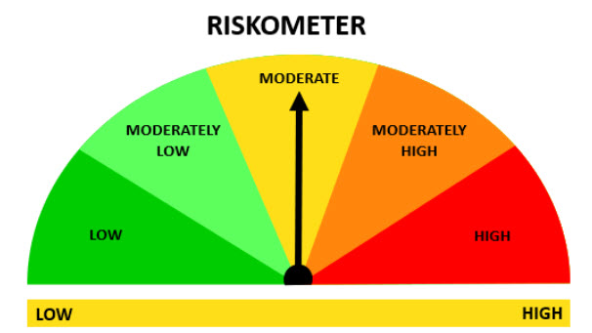
Pseudo Velocity Riskometer
Vibrationdata
Risk Category | PV (ips)
Low | PV < 100
Moderately Low | 100 < PV < 150
Moderate | 150 < PV < 200
Moderately High | 200 < PV < 250
High | PV > 250
The pseudo velocity is calculated at the natural frequency if the frequency is known
Otherwise, the pseudo velocity is the peak value for a family of natural frequencies between estimated lower and upper frequency limits
Extra analysis and design precautions are needed as the needle turns clockwise
Assigning these extra steps by risk category is currently beyond the scope of this effort
But some general guidelines are given later in this document

Slide 12
Morse Severity Limits
Vibrationdata
The pseudo velocity limits on the previous slide are loosely based on the Morse chart
R. Morse, Spacecraft & Launch Vehicle Dynamics Environments Workshop Program, Aerospace Corp., El Segundo, CA, June 2000

Slide 13
Hypothetical PV-N Fatigue Curve
Vibrationdata
A component’s ultimate limit and fatigue exponent depend on the material, geometry, stress concentration and myriad other factors
Ideally, these variables could be measured
Engineering judgment can be cautiously used as needed to estimate these variables otherwise
The pseudo velocity threshold line equation is:
  PV = [ ( PV _{ult} )^{b} / N ]^{1/b}
  where
  PV _{ult} = PV threshold at 1 cycle
  N = number of cycles
  b = fatigue exponent

Slide 14
Parameters
Vibrationdata
The base input PSD and duration are both independent variables
The test item is assumed to be an SDOF system with three variables: natural frequency, amplification factor and fatigue exponent
The natural frequency can be set to a specific value or allowed to vary in between two limits, as previously mentioned
Conservative values can be set for the amplification factor Q and fatigue exponent b
But some test cases have shown that conservative Q & b values indicate fatigue failure even at lower PSD test levels
Recommended moderate values are Q=20 & b=6.4
The b=6.4 value comes from Steinberg’s Vibration Analysis for Electronic Equipment
Actual Q & b values for the test item can be used but are seldom known
Matlab scripts are used to calculate the pseudo velocity that the test item needs to withstand in terms of fatigue for the given set of input parameters
The velocity is then referenced to a risk category as shown in the previous Riskometer slide

Slide 15
Sample Input PSD
Vibrationdata
The SMC-S-016 PSD is used as the PSD base input in the following examples with a duration of 750 sec
The fact that it represents minimum workmanship is irrelevant for the example
The PSD level is also increased by uniform dB levels to study the variation between fatigue and input level
Matlab Command Window:
>> input_psd=[20 0.0053; 150 0.04; 800 0.04; 2000 0.0064]

Slide 16
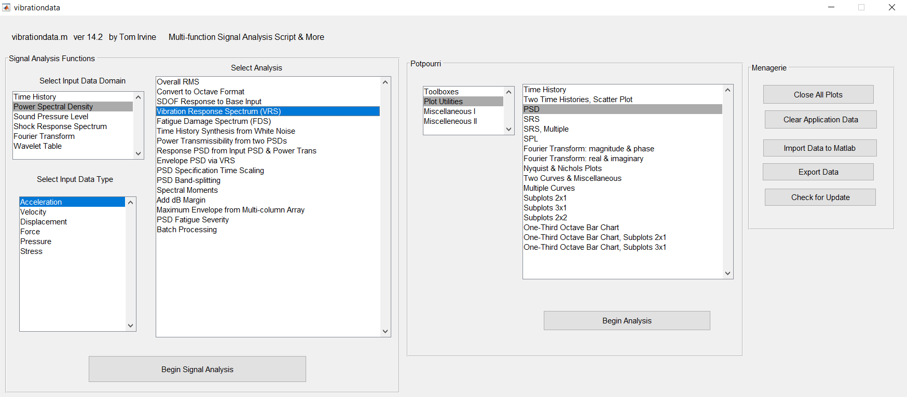
Main GUI
Vibrationdata

Slide 17
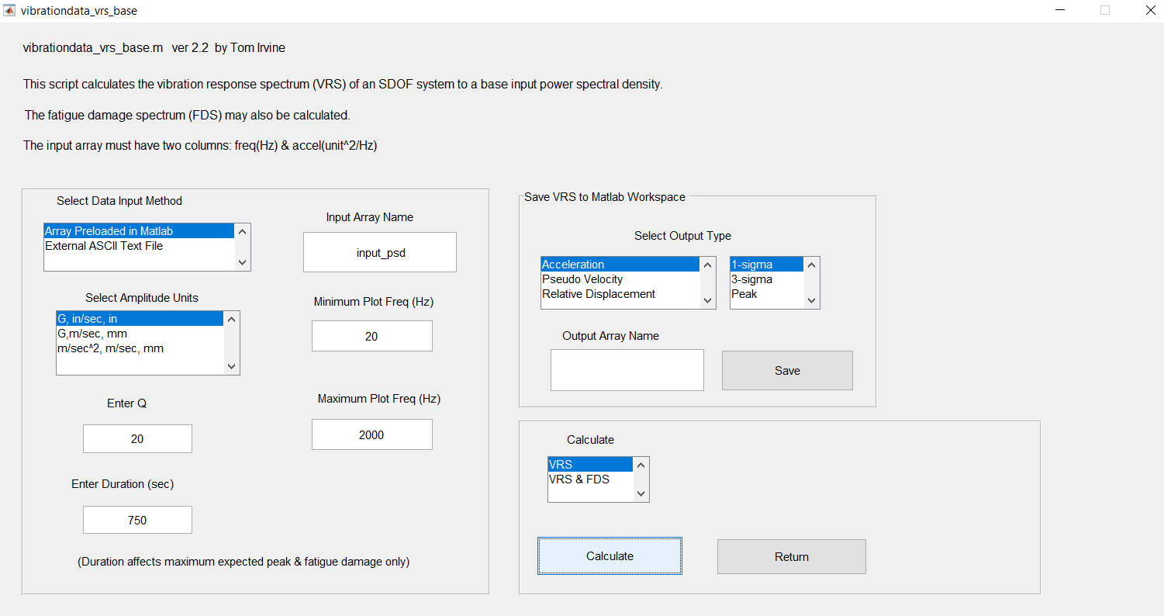
VRS for Acceleration PSD Base Input
Vibrationdata

Slide 18
VRS for SMC-S-016 Base Input PSD
Vibrationdata
The peak curve is based on the Rayleigh distribution of the response peaks and is the only curve dependent on duration

Slide 19
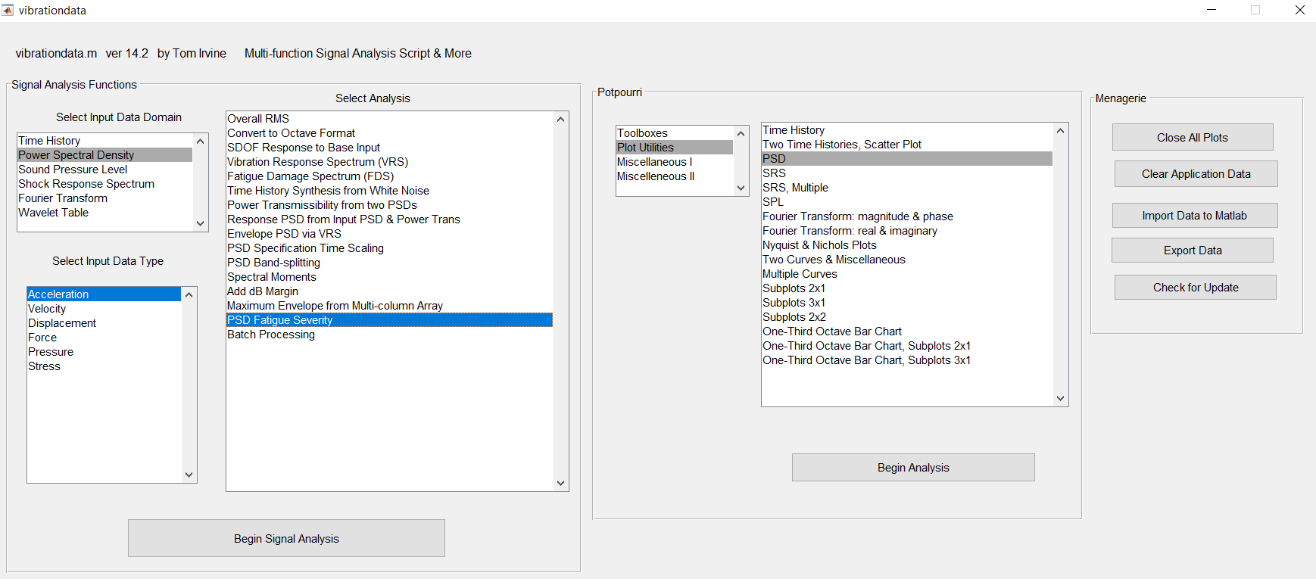
Main GUI
Vibrationdata

Slide 20
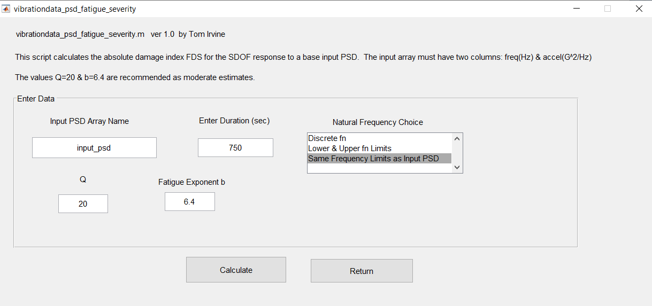
PSD Severity Function
Vibrationdata

Slide 21
Results, Q=20, b=6.4
Vibrationdata
Input PSD | Input Overall GRMS | Minimum Velocity Limit (ips) | Risk Category
SMC-S-016 | 6.9 | 68 | Low Risk
SMC-S-016 +6 dB | 13.8 | 136 | Moderately Low Risk
SMC-S-016 +12 dB | 27.6 | 271 | High Risk
SMC-S-016 +18 dB | 55.1 | 540 | High Risk
The threshold is based on a Palmgren-Miner cumulative damage index of 1
The frequency spacing is 1/24th octave between the 20 and 2000 Hz limits
The component must have the ability to withstand the minimum velocity in order to pass the random vibration test
The Minimum Limit is actually the maximum velocity for the family of natural frequency cases
The worst-case natural frequency was 145.8 Hz for each of the cases in the table
The limits would be lowered if the natural frequency was known to have some spacing away from 145.8 Hz
The Risk Category is intended as a rough guide for determining the level of analysis needed as well as for design precautions

Slide 22
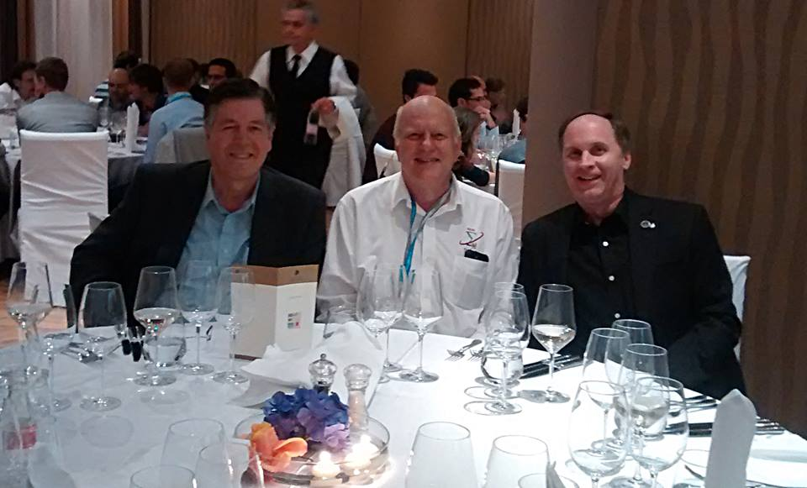
Vibrationdata
Left to Right: Turan Dirlik, Tom Irvine, Curtis Larsen
International Conference on Engineering Vibration, Ljubljana, Slovenia, 2015

Slide 23
APPENDIX A
Sine-on-Random Example

Slide 24
SMC-S-016 Base Input PSD + Sine Tones
Vibrationdata
The sine tones are (200 Hz, 12 G) & (400 Hz, 6 G)
The duration is 750 seconds
This combined specification is for demonstration purposes only
The analysis is performed by synthesizing a sine-on-random time history
The synthesis duration is 60 seconds
A 12.5 multiplier is used in the fatigue calculation to scale the damage from 60 to 750 secons
Then the fatigue analysis is performed in the time domain using rainflow cycle counting

Slide 25
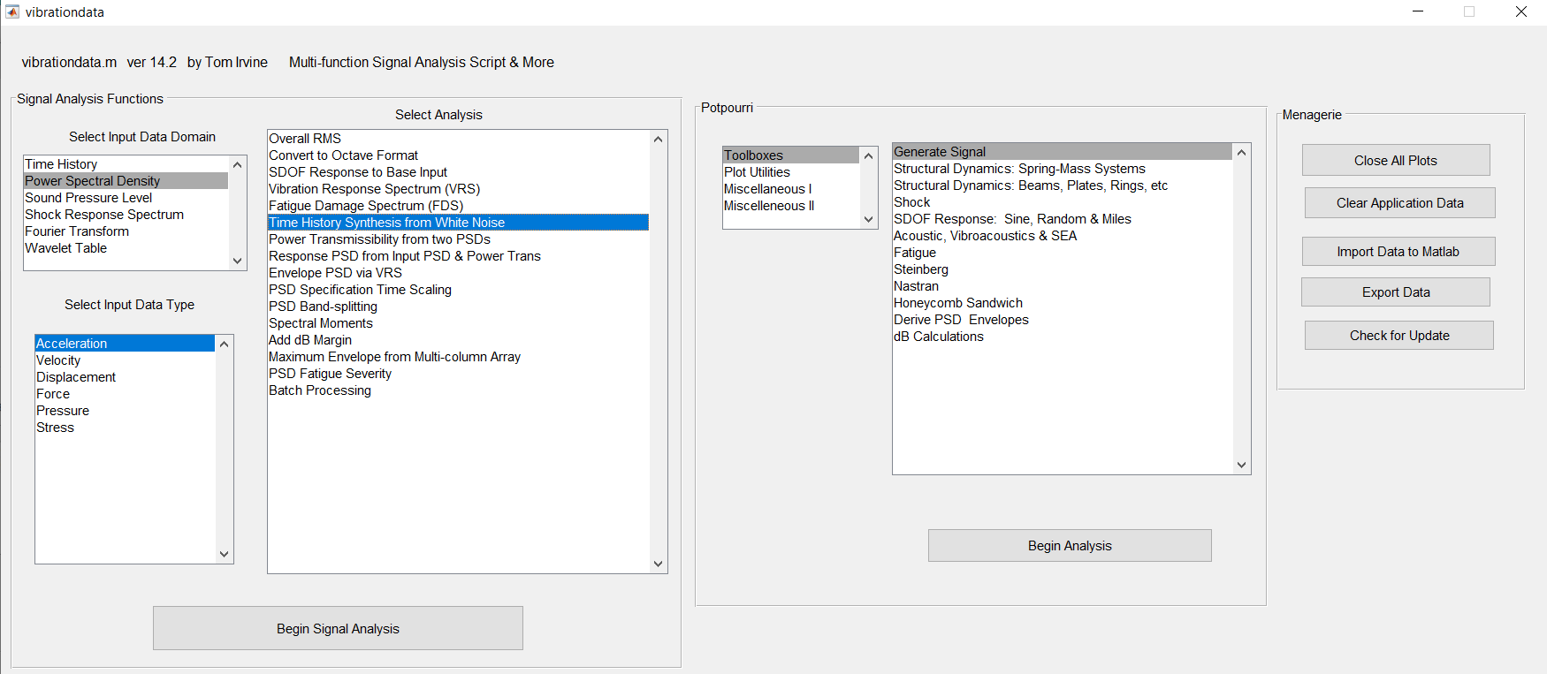
Main GUI
Vibrationdata

Slide 26
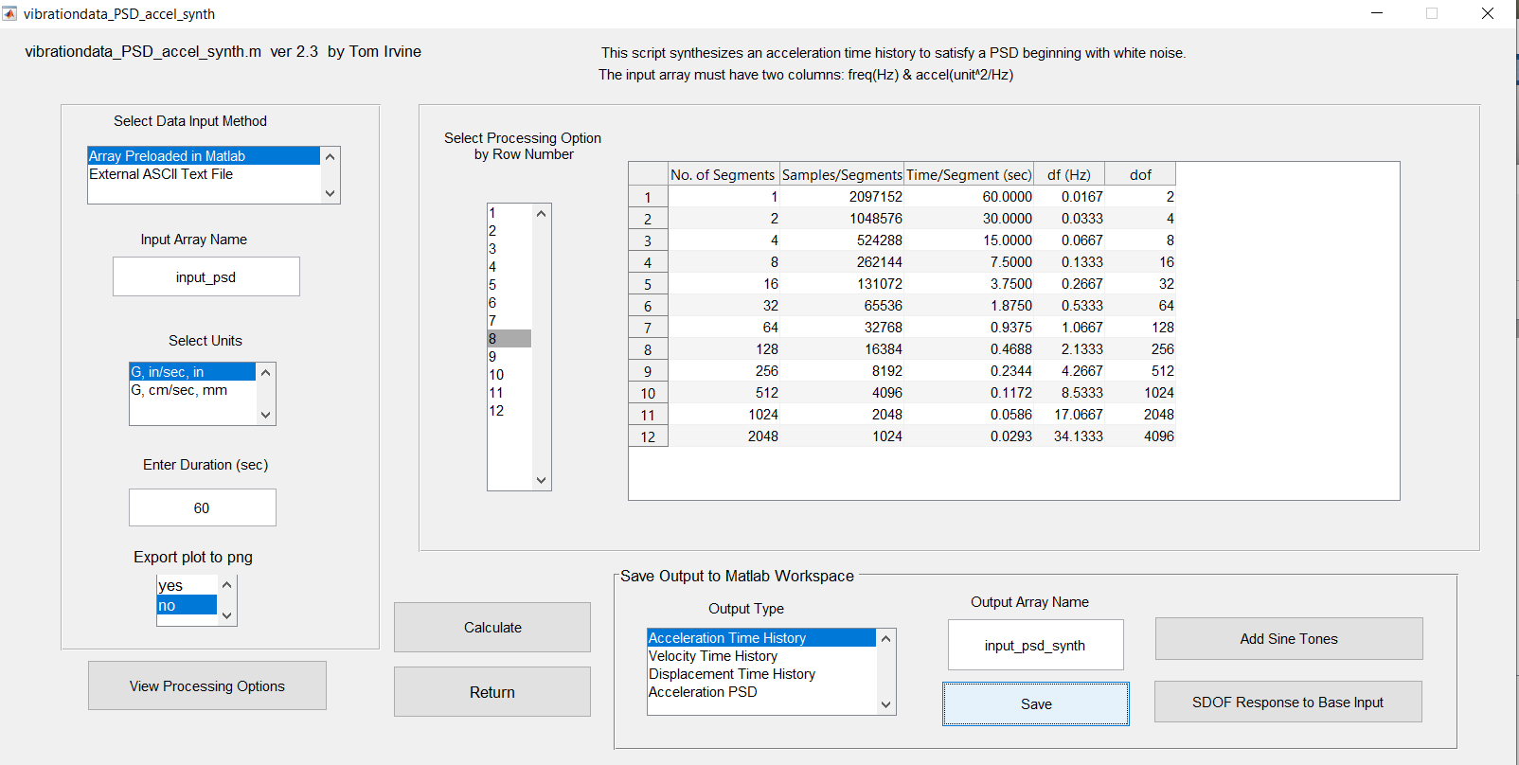
Time History Synthesis
Vibrationdata
Step 2
Step 4
Step 1
Step 3

Slide 27
Base Input: Synthesized Time History & PSD
Vibrationdata

Slide 28
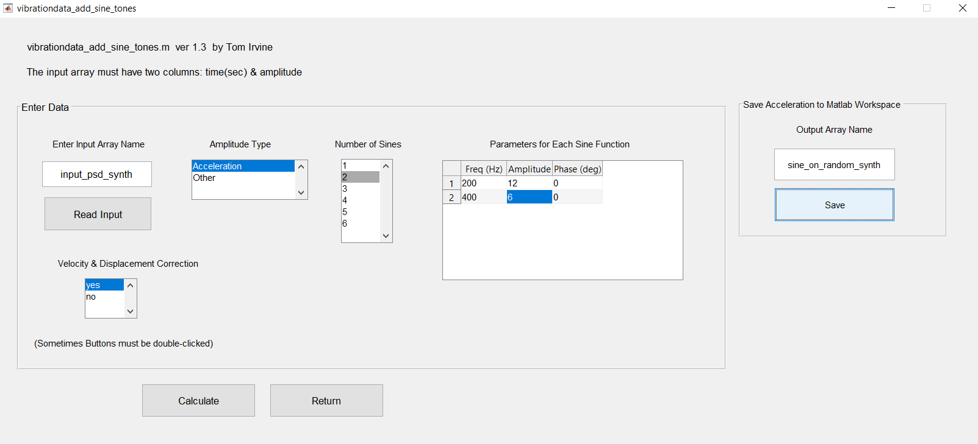
Add Sine Tones
Vibrationdata
Step 3
Step 1
Step 2

Slide 29
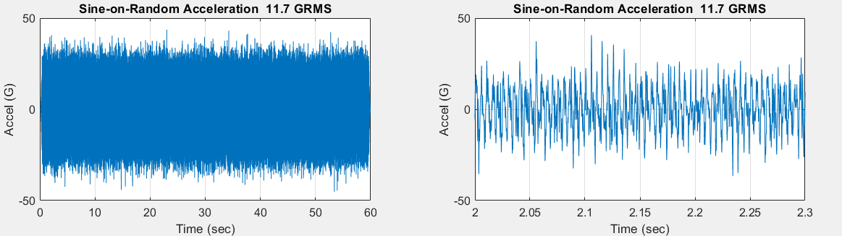
SDOF Response: Sine-on-Random Time History
Vibrationdata
Full and Close-up Views
Next calculate VRS and then perform ASTM E 1049-85, section 5.4.4, Rainflow Counting

Slide 30
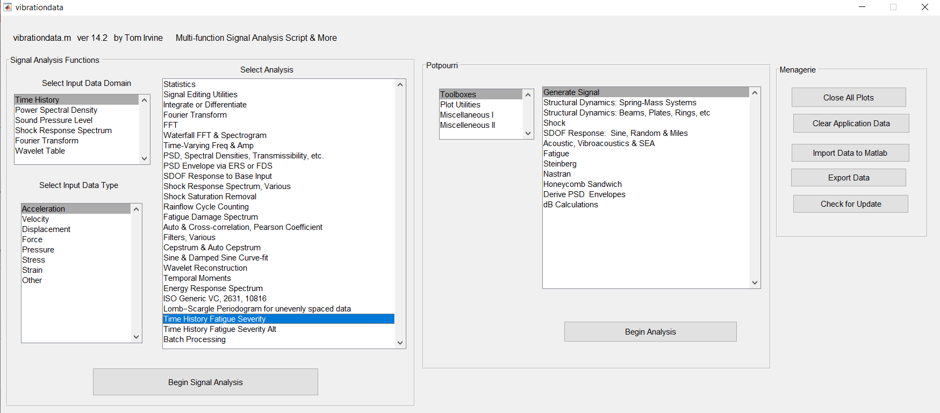
Main GUI
Vibrationdata

Slide 31
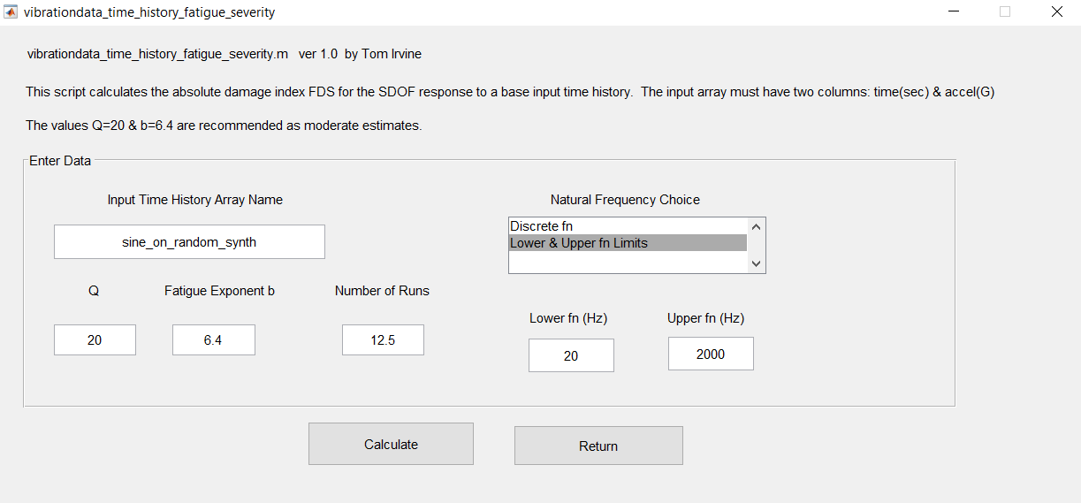
Response Time History Fatigue Severity
Vibrationdata

Slide 32
VRS
Vibrationdata
1/24th octave spacing

Slide 33
Results, Sine-on-Random, Selected Natural Frequency Cases
The input time history is: SMC-S-016 + Sine Tones, 11.7 GRMS overall
The table shows the importance of design a component so that its natural frequency is way from the 200 Hz sine tone
Natural Frequency (Hz) | Minimum Velocity Limit (ips) | Risk Category
20 to 2000 | 479 | High risk
20 to 150 | 83.4 | Low risk
250 to 2000 | 147 | Moderately low risk

Slide 34
APPENDIX B
Pseudo Velocity Limit Notes & Design Tips

Slide 35
Pseudo Velocity Limit Notes
Vibrationdata
The results in the previous table are particularly useful if the velocity limits of the component’s materials are known
Some components such as avionics boxes have piece parts with unknown velocity limits, as well as unknown fatigue exponents
Steinberg has established fatigue analysis techniques for circuit boards which are included in: https://vibrationdata.wordpress.com/2013/02/15/extending-steinbergs-fatigue-method/
A program could decide for example that a certain avionics box be subjected to a Steinberg analysis if its risk category for a given PSD is moderate or greater
A program might also decide that a metallic, mechanical component be subjected to a finite element analysis depending on its risk category
The decision for further analysis in each case should also be based on the criticality of the component
Some design tips for components subjected to, say, moderate or higher risk velocities are given in the next slides

Slide 36
Material Limits
Vibrationdata
Material | Yield Stress (ksi) | E (psi) | rho (lbm^3) | C (in/sec) | V Rod (in/sec) | V Beam (in/sec) | V Plate (in/sec)
Aluminum 6061-T6 | 35 | 10e+06 | 0.1 | 1.96e+05 | 695 | 402 | 347
Aluminum 7075-T6 | 66 | 10e+06 | 0.1 | 1.96e+05 | 1300 | 751 | 650
Magnesium AZ80A-T5 | 38 | 6.5e+06 | 0.065 | 1.96e+05 | 1015 | 586 | 507
CRES 303 | 60 | 28e+06 | 0.289 | 1.93e+05 | 414 | 239 | 207
A286 | 40 | 29e+06 | 0.286 | 1.98e+05 | 273 | 158 | 136
Monel K500 | 40 | 26e+06 | 0.305 | 1.81e+05 | 279 | 161 | 140
Monel 400 | 25 | 26e+06 | 0.318 | 1.78e+05 | 171 | 99 | 85
Inconel 625 | 40 | 30e+06 | 0.305 | 1.95e+05 | 260 | 150 | 130
Inconel 718 | 100 | 30e+06 | 0.296 | 1.98e+05 | 659 | 381 | 330

Slide 37
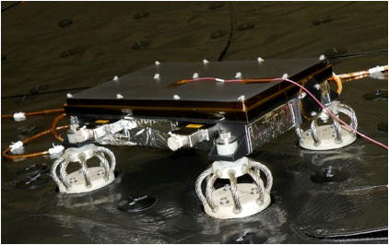
Common Notes for Electronic & Mechanical Components
Tune the component’s natural frequency away from the dominant base input MPE frequency to mitigate resonant response
The tuning is achieved by changing the mass, stiffness or geometry
Add damping mechanisms to control resonant response
Design the component with isolator mounts if possible
The isolators can be wire rope or elastomeric bushings or grommets
Determine whether the component can moved to a location in the vehicle with a lower base input MPE PSD
Use proven, flight heritage components if possible
NASA/JPL, Mars Science Laboratory
Sensor Support Electronics mounted on wire rope isolators

Slide 38
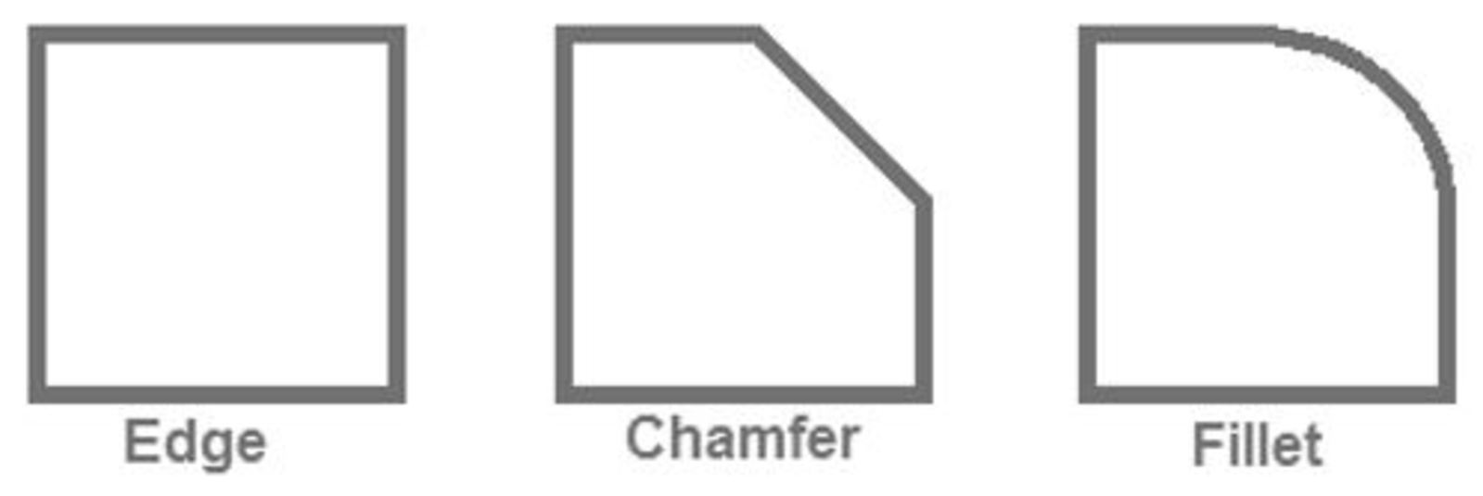
Mechanical Components
Vibrationdata
Parts should be designed to minimize stress concentration factors
Changes in cross-section should have smooth transitions
Metallic part edges should have either chamfers or fillets rather than sharp edges to reduce stress concentration
Fillets give superior mitigation although a chamfer may be sufficient in most cases
Select materials with high fracture toughness and slow crack growth
Choose proper surface finishes, such as polishing to prevent small surface scratches
Shot peening and cold rolling are good for the fatigue life in general
Avoid metallic plating with widely different properties than underlying material

Slide 39
Electronic Components
Vibrationdata
Use Mil-Spec piece parts rather than commercial-off-the-shelf ones
Medium and larger size piece parts should be staked down to the circuit board using epoxy, silicone or some other adhesive to prevent the part from detaching
Thick conformal coating of the entire board is beneficial for reducing the vibration response by adding damping, although this makes rework difficult
Electromagnetic relays are prone to chatter, so use solid state switches if possible
The highest deflection will usually occur at the center of the circuit board, and this zone should be reserved for smaller, lighter parts
Heavier parts should be mounted along the outer perimeter
IC socket mounts should not be used in avionics due to the potential of the IC to dislodge

Slide 40
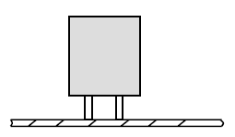

Electronic Parts, Lesson Learned from another Rocket Program
The oscillator's structural response is similar to a cantilever beam
Resonant excitation may occur during shock and vibration
High stress levels may develop in the crystal and in the leads as a result
The oscillator is bent over so that it is parallel to the board
Then it is staked down with an RTV or epoxy compound
Furthermore, a Mil-Spec oscillator should be used rather than a commercial part

