Slide 1
Vibrationdata
An Introduction to Statistical Energy Analysis
for Launch Vehicles
By Tom Irvine

Slide 2
SEA Approach
Vibrationdata
Statistical energy analysis (SEA) is a vibratory energy-flow technique which provides prediction procedures that are suitable for high frequencies, and in some case mid frequencies
A Vibroacoustic system can be divided into a series of connected subsystems
SEA solves for the subsystem energy as function of the external applied acoustic or mechanical power
The acoustic power can be calculated from the sound pressure level
The statistical prediction gives energy averages over spatial locations and bands of frequency
Velocity, acceleration, stress and other response metrics can be calculated from each subsystem’s energy

Slide 3
SEA Approach (cont)
Vibrationdata
SEA depends heavily on a series of mostly empirical and semi-empirical parameters for each subsystem, including
Mass
Driving Point Impedance & Mobility
Modal Density
Wave Speed for both Dispersive & Non-Dispersive Waveforms
Radiation Efficiency & Resistance
Dissipation Loss Factor
Coupling Loss Factor between Subsystems
Critical Frequency & Cylinder Ring Frequency
Each parameter should be measured
But empirical data can be cautiously used as needed
SEA is essentially a bookkeeping method for these input parameters
The SEA calculation is a simple linear algebra problem of Ax=B matrix format
The real challenge is correcting estimating or measuring the input parameters

Slide 4
Some SEA Assumptions
Vibrationdata
The subsystems in SEA are finite, linear, elastic structures or fluid cavities
For a system with two subsystems, the energy flow is proportional to the acoustic or vibrational energies of the two subsystems
Subsystem modes in each band must be uncoupled from one another or have equal energies
Subsystems have small modal damping, equal for all modes in a given frequency band
The primary response is resonant
Acoustical fields are diffuse
Acoustic volumes have much higher modal density than the structures in models
A cylindrical shell behaves as a flat plate above its ring frequency
Traditional SEA has assumed steady-state incoherent broadband random excitation
Transient SEA methods have also been developed
Boundary conditions become less relevant at higher frequencies
A circular plate has the same modal density as a rectangular plate of the same surface area

Slide 5
Power Flow for One System
Vibrationdata
The velocity-power equation is
The left hand side of the equation represents dissipated power
The calculation is typically performed in one-third octave bands
The loss factor is twice the viscous damping ratio: η = 2ξ
A challenging prerequisite for vibroacoustic analysis is to convert the liftoff sound pressure level and the ascent fluctuating pressure level into corresponding power levels
See T. Irvine, Statistical Energy Analysis Parameters, Revision X, Vibrationdata, 2018
Π _{in}
M
Π _{diss}
M | Mass
η | Loss factor
Π_{in} | Power input
< v² > | Spatial average mean velocity
ω | Angular frequency (rad/sec)

Slide 6
Power Flow for Two Subsystems
Vibrationdata
Π _{in,1}
Π _{in,2}
The spatial average energy < E_{i} > in subsystem i is calculated via
Note that the (2 x 2) coefficient matrix is typically nonsymmetrical
The velocity for each system can then be calculated as a post-processing step
Acceleration can be calculated from velocity and frequency
Π₁₂, Π₂₁
(1)
(2)
Π _{diss,1}
Π _{diss,2}
Π_{in,i} | Power input to subsystem i
Π_{diss,i} | Power dissipated by subsystem i
Π_{i j} | Power transferred from subsystem i to j
η_{i} | Dissipation loss factor in subsystem i
η_{ij} | Coupling loss factor from subsystem i to j

Slide 7
Basic Concepts
Vibrationdata
Modal Density
Coupling Loss Factors
Modal Overlap
SEA relationship with Boundary Conditions
Dispersive Bending Waves

Slide 8
Modal Density Introduction
Vibrationdata
Modal density is number of modes in a frequency band divided by the bandwidth
Modal density is used for the following SEA-related calculations
modal overlap
mobility & impedance
coupling loss factors
convert pressure to power for diffuse field
response of panel to diffuse acoustic pressure field

Slide 9
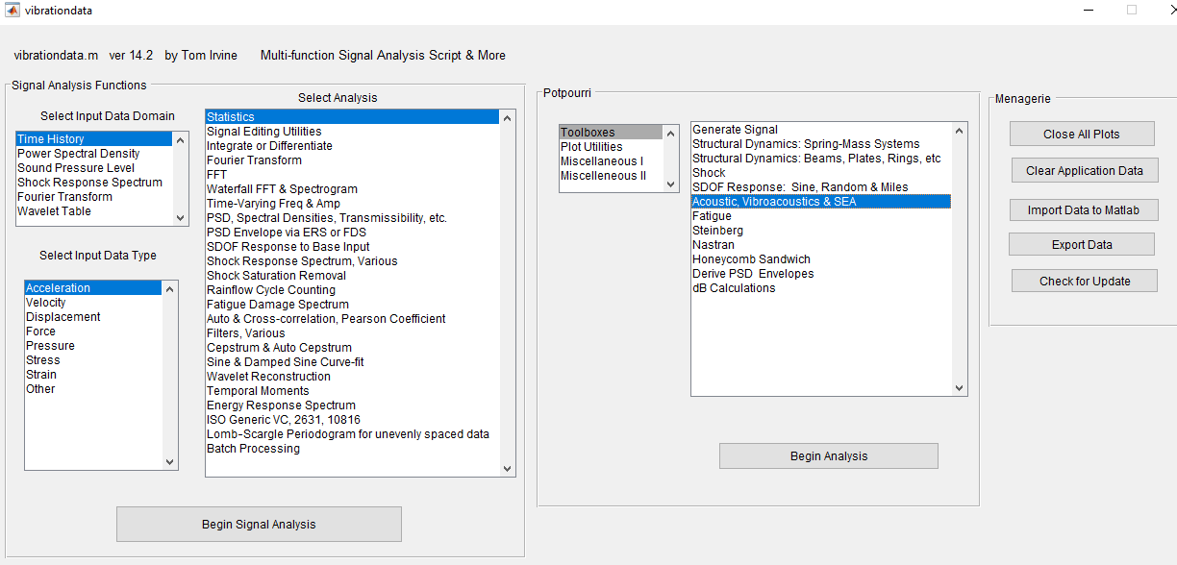
Vibrationdata GUI
Vibrationdata

Slide 10
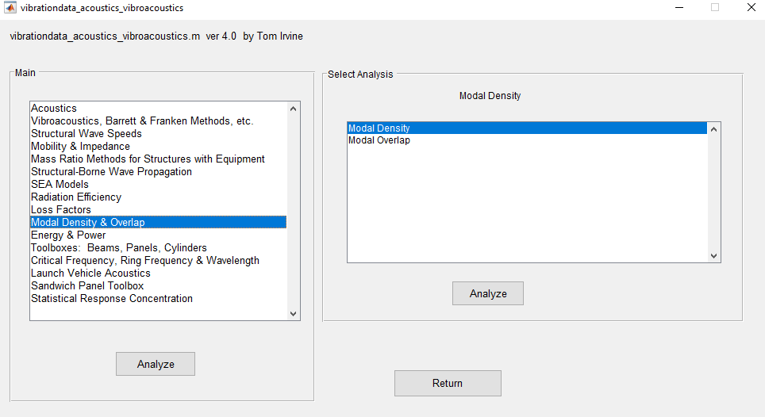
Vibroacoustics Listbox
Vibrationdata

Slide 11
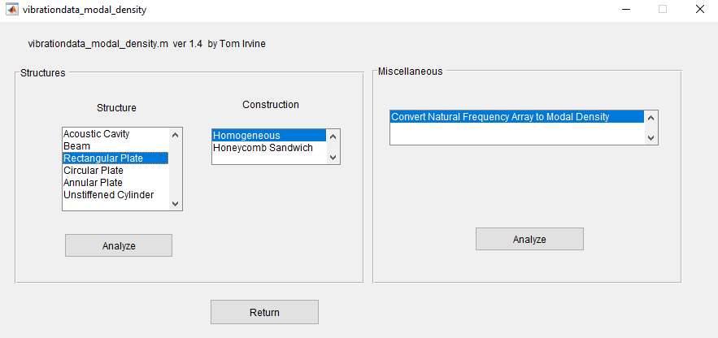
Modal Density, Rectangular Plate
Vibrationdata

Slide 12
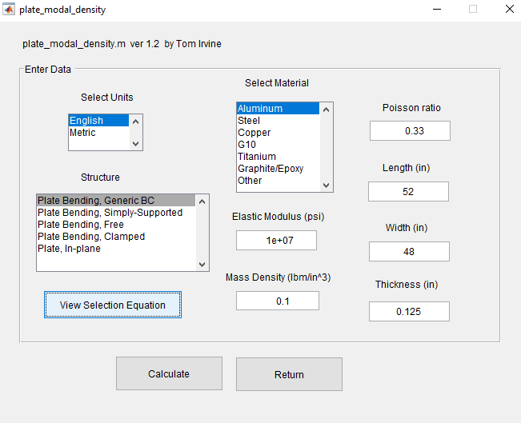
Modal Density, Rectangular Plate, Example
Vibrationdata

Slide 13
Modal Density Results
Vibrationdata

Slide 14
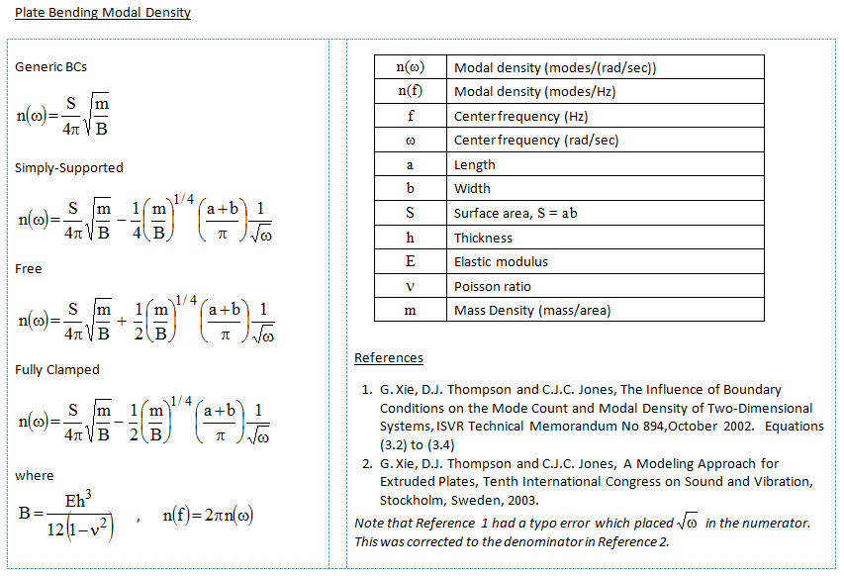
Vibrationdata

Slide 15
Modal Overlap
Vibrationdata
Modal overlap is defined as the ratio of the damping bandwidth to the average separation of the natural frequencies of the modes
It measures the ‘smoothness’ of the frequency response function.
A high modal overlap factor implies either high damping or high modal density, or both.
The modal overlap M calculated for each band is M = n η f
Deterministic methods, such as finite element or boundary element method, can be used for M < 1.
Statistical energy analysis can be used for M > 1.
n | Modal density (modes/Hz)
η | Loss factor
f | Band center frequency

Slide 16
Coupling Loss Factors
Vibrationdata
A coupling loss factor is similar to an energy transmission coefficient
The transmission of energy from a source to a receiver is also the energy lost by the source via the transmission path
Reciprocity: the coupling loss factor η_{ji} for power flow from subsystem j to i is
where n _{i} is the modal density for subsystem i

Slide 17
SEA Relationship with Boundary Conditions
Vibrationdata
Wave propagation and finite element models can be used to estimate modal frequencies and modal densities
(simplified formulas are also available for certain structures)
Low frequency modes are discarded in SEA due to low modal density and modal overlap (but can be included in hybrid methods)
The mode shapes and frequencies tend to converge at higher frequencies
So modal density at higher frequencies is somewhat insensitive to boundary conditions
Example: aluminum beam, rectangular cross section, 36 in length, 1 in width, 0.125 in thick
Two boundary cases, pinned-pinned & fixed-fixed
Calculate modal frequencies and mode shapes
12th and 16th modes are shown in the following two slides

Slide 18
SEA Relationship with Boundary Conditions, 12th Mode
Vibrationdata
The natural frequencies have a 7.9% difference

Slide 19
SEA Relationship with Boundary Conditions, 16th Mode
Vibrationdata
The natural frequencies have a 5.9% difference
Boundary conditions for higher modes are less important in SEA

Slide 20
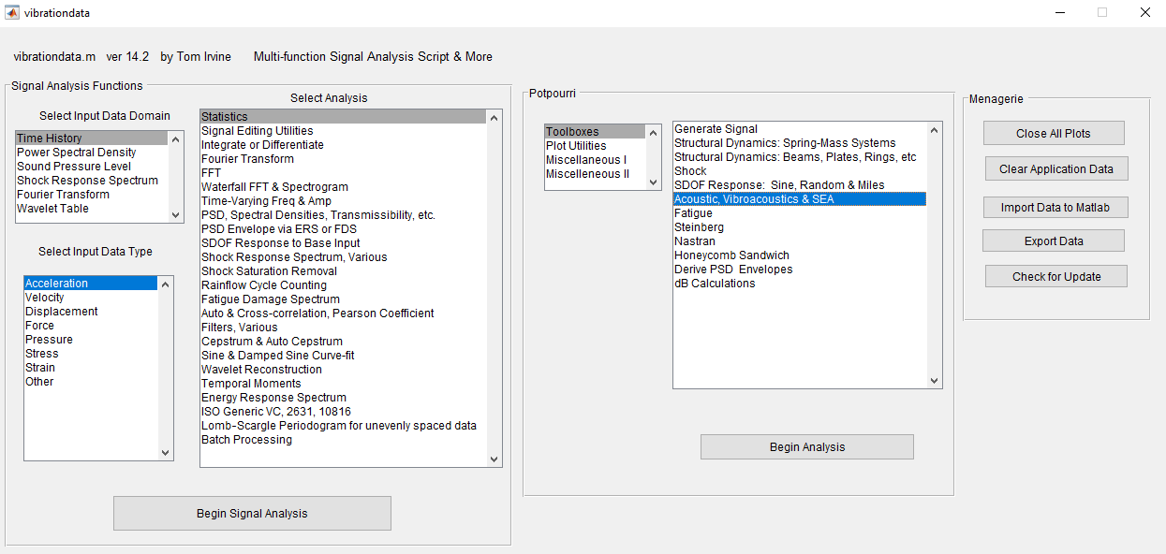
Vibrationdata GUI Main Page, Structural Wave Speed Example
Vibrationdata

Slide 21
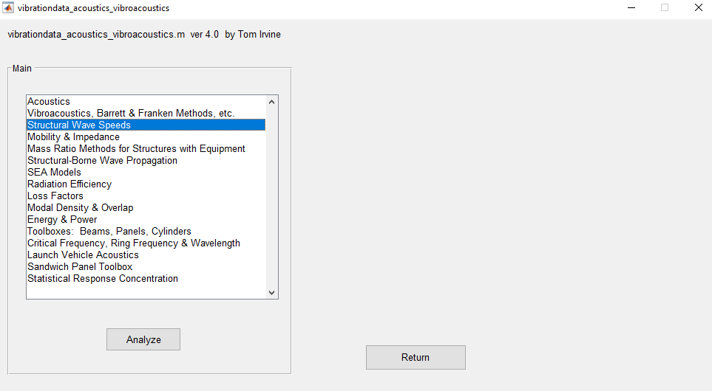
Vibroacoustic Dialog Box, Structural Wave Speed Example
Vibrationdata

Slide 22
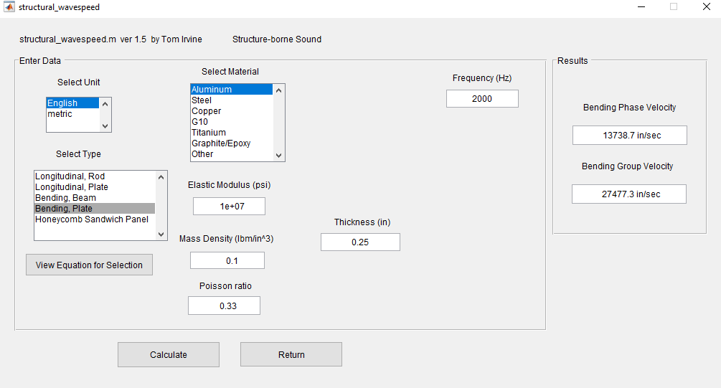
Structural Wave Speed Parameter
Vibrationdata

Slide 23
Structural Wave Speed Results
Vibrationdata
Bending waves are dispersive
Bending wave speed varies with frequency
Bending, Plate
Phase Speed
c = 13738.7 in/sec
= 1144.89 ft/sec
Freq = 2000 Hz
Wavelength = 6.869 in

Slide 24
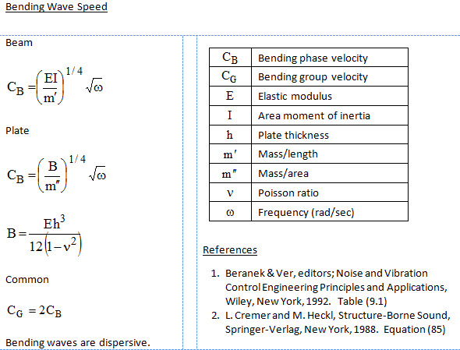
Structural Wave Speed Equations
Vibrationdata

Slide 25
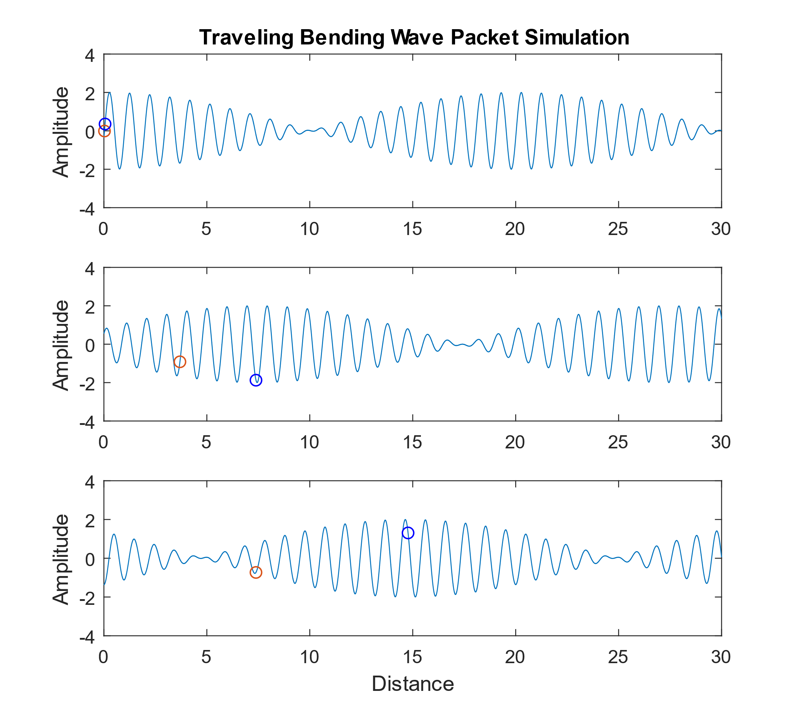
Vibrationdata
Traveling bending wave packet dispersion, snapshots at three different times
Both the red and blue circles oscillate in the vertical axis
The red circle travels at the phase velocity
The blue circle propagates twice as fast at the group velocity and is always at or near the positive or negative peak in the wave packet
The phase speed is the more important of the two speeds for vibroacoustics analyses where the bending waves are excited by the external sound field, or vice versa

Slide 26
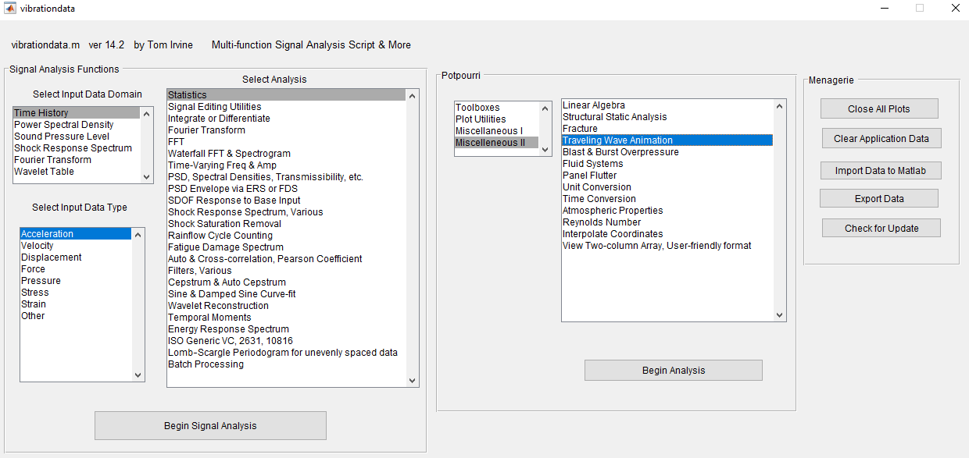
Vibrationdata GUI, Generate Bending Wave Animation
Vibrationdata

Slide 27
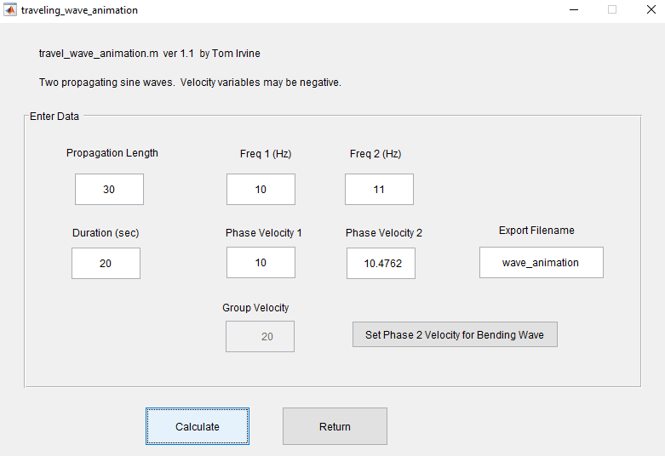
Generate Bending Wave Animation
Vibrationdata

Slide 28
Bending Wave Snapshot from Animation
Vibrationdata
Bending waves are dispersive
Group speed is twice phase speed

Slide 29
Launch Vehicle Example
Vibrationdata
Fairing with Instrument Shelf

Slide 30
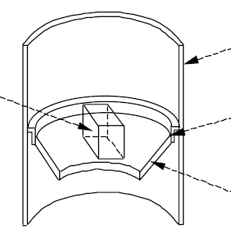
NASA-HDBK-7005 Example
Vibrationdata
Launch Vehicle Fairing
Electronic Component
Π _{a,d}
Ring Frame
Π _{in}
Acoustic Cavity
Equipment Shelf
Fairing
Equipment Shelf
Subject Fairing to External Liftoff SPL
Actual field is oblique incidence but model as a diffuse field
Lump Ring frame in with Fairing
Rename Fairing as Cylindrical Shell
Direct Mechanical Path
Π _{f,d}
Π _{s,d}

Slide 31
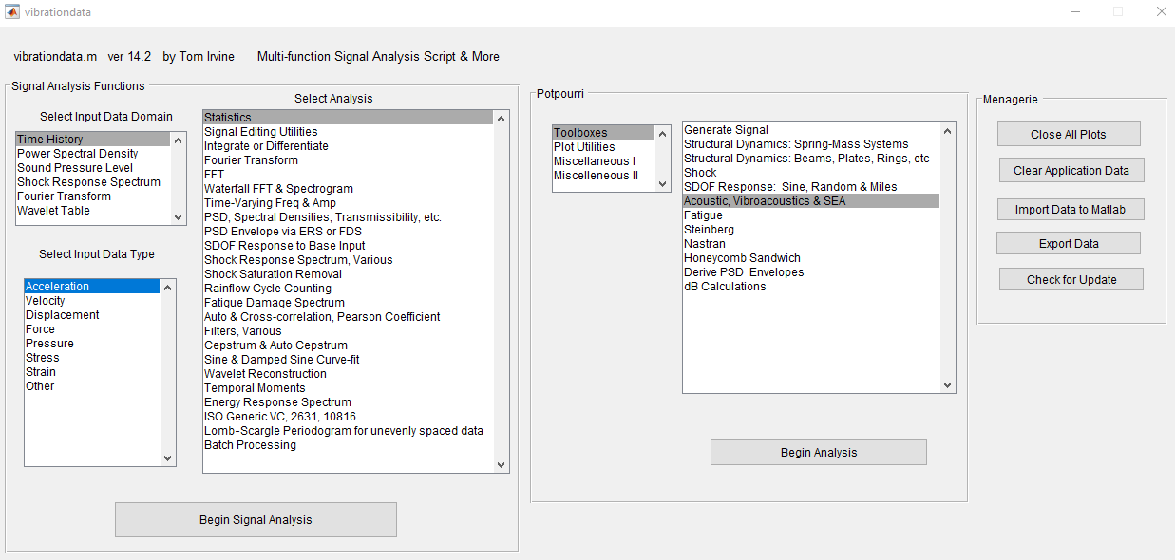
Import Data
Vibrationdata

Slide 32
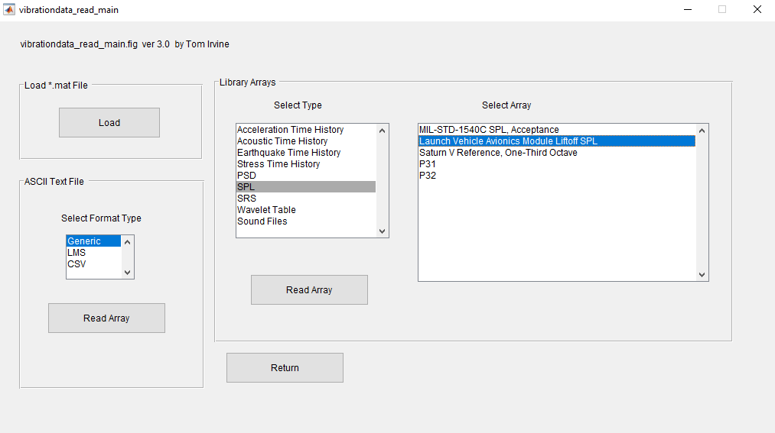
Import Sample Liftoff SPL
Vibrationdata

Slide 33
Sample Liftoff SPL
Vibrationdata
Array Name:
avionics_module_liftoff_spl
units: f(Hz) & SPL(dB)

Slide 34
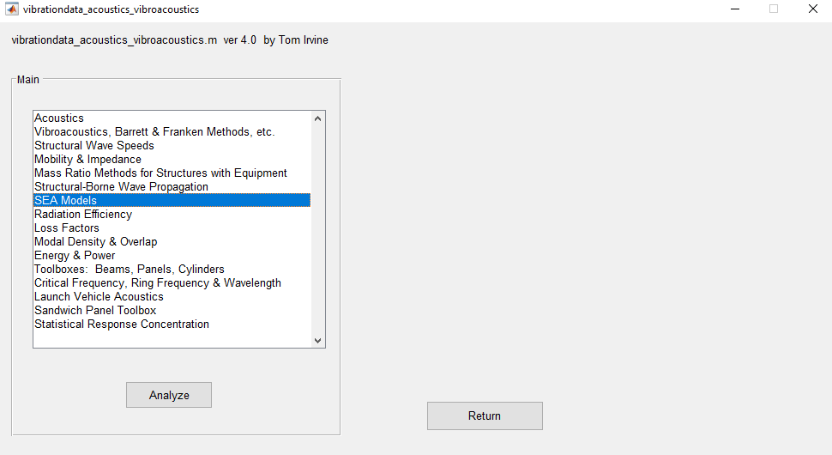
SEA Models
Vibrationdata

Slide 35
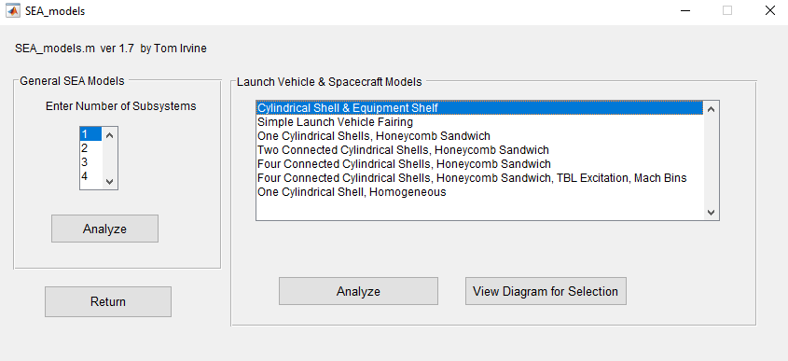
Cylindrical Shell & Equipment Shelf
Vibrationdata

Slide 36
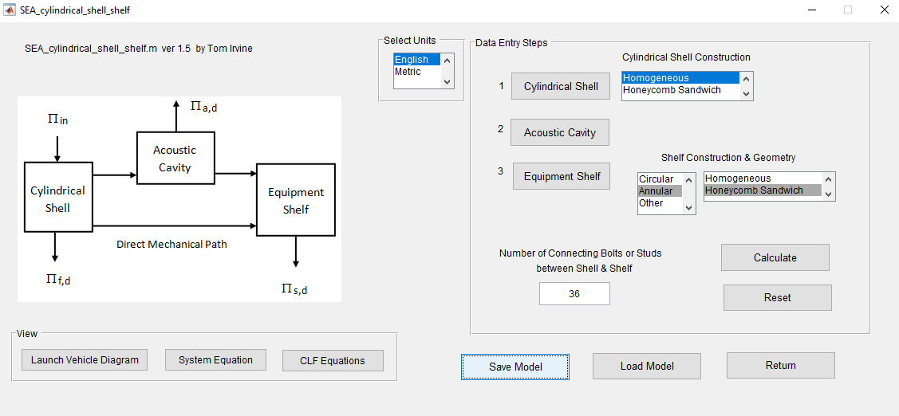
SEA Cylindrical Shell & Shelf Example Dialog Box
Vibrationdata
Options are available for the cylindrical shell and equipment shelf construction and geometry

Slide 37
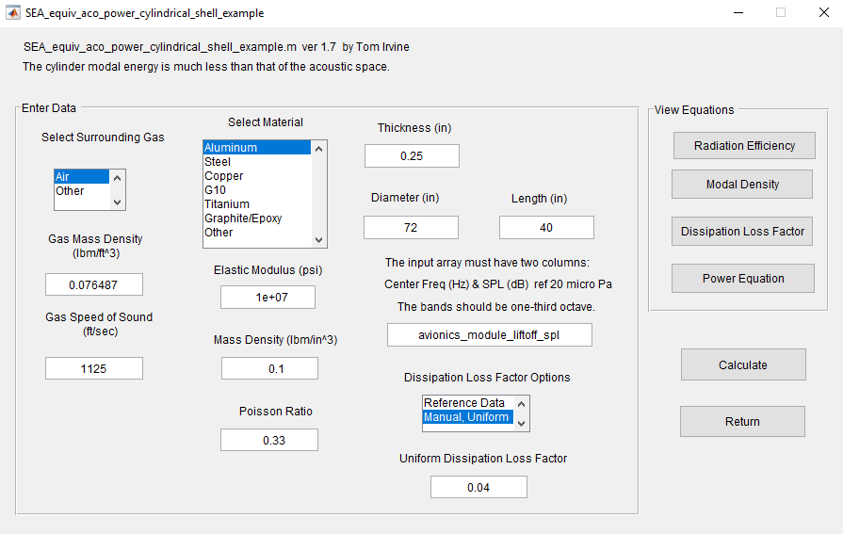
Cylindrical Shell Dialog Box
Vibrationdata

Slide 38
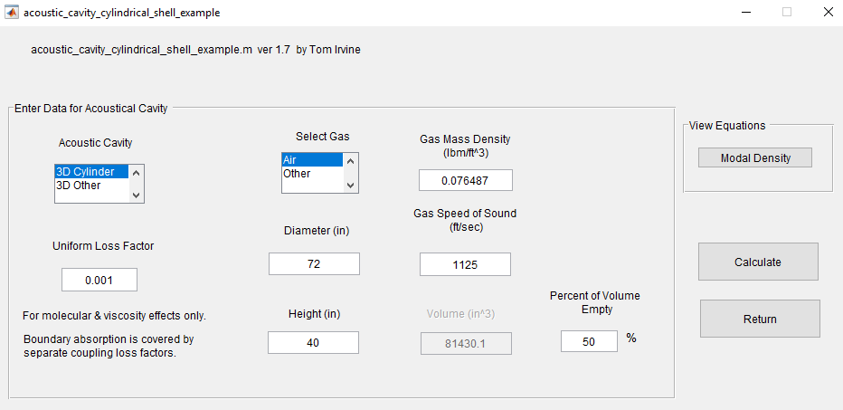
Acoustic Cavity Dialog Box
Vibrationdata
Assume 50% of volume is filled by equipment or other structures
So 50% is empty

Slide 39
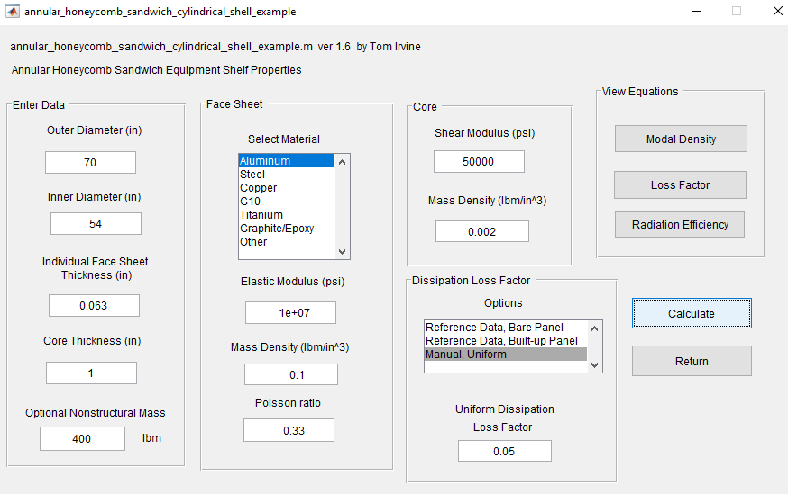
Annular Honeycomb Sandwich Dialog Box
Vibrationdata

Slide 40
Modal Overlap
Vibrationdata
Each curve needs to be > 1 for SEA per a rule-of-thumb
Each curve reaches this value near 100 Hz
Note that the Shell’s ring frequency is 870 Hz
So the 800 Hz band will be the starting band for the energy, power and other response plots
Modal overlap M
n | Modal density (modes/Hz)
η | Total Loss factor
f | Frequency (Hz)
J. Wijker, Random Vibrations in Spacecraft Structure Design, Springer, New York, 2009

Slide 41
Vibrationdata
SPL Input & Results, Liftoff Simulation
The External curve is taken from the author’s prediction for a certain launch vehicle years ago
Was based on: NASA SP-8072, Acoustic Loads Generated by the Propulsion System

Slide 42
Transmission Loss from Outside to Inside
Vibrationdata
The actual transmission loss would be lower if the shell has any vents
The curve also accounts for the flanking noise as transmitted from the shelf, which is very low in this example
Dip at the 2000 Hz critical frequency

Slide 43
Energy
Vibrationdata

Slide 44
Power Flow
Vibrationdata
Power flow depends on the modal densities, coupling loss factors and energies of the subsystem pair
The shelf receives more power through its structural connection with the cylindrical shell than it does from the airborne noise in the cavity

Slide 45
Modal Density
Vibrationdata
The cylindrical shell curve reaches its peak near its ring frequency 870 Hz

Slide 46
Radiation Efficiency
Vibrationdata
The radiation efficiency relates the radiated sound power to the spatially averaged vibration
Radiation efficiencies are needed for coupling loss factors between structure and air
The cylindrical shell has two peaks
The first is at the 870 ring frequency
The second is near its 1930 Hz critical frequency

Slide 47
Dissipation Loss Factors
Vibrationdata
Loosely based on the author’s experience
Loss factor = 2X viscous damping ratio
Cylindrical Shell 2% damping
Equipment Shelf 2.5% damping
Would be good idea to vary damping to “bound the problem”
Repeat when measured damping data becomes available

Slide 48
Vibrationdata
Coupling Loss Factors
The strongest coupling occurs from the cylindrical shell to the shelf
Enforce reciprocity rule via modal density pairs

Slide 49
Spatially Averaged Acceleration PSD
Vibrationdata
The velocity is calculated from the energy
The acceleration is calculate from the velocity
The results are plausible in terms of the author’s experience analyzing flight accelerometer data

Slide 50
Acceleration PSD Comparison
Vibrationdata
The SEA method accounts for the critical frequency effect near 2000 Hz
The Franken method is an extrapolation technique based on historical data
Damping effects are included as a variable in SEA
The Franken method includes undocumented damping from its historical database
Each of the two methods has its strengths and weaknesses

Slide 51
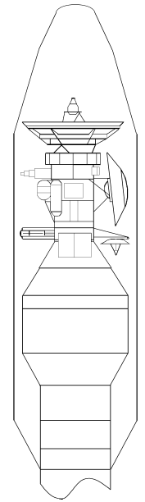
Launch Vehicle Example
Vibrationdata
Payload Fairing Acoustical Transmission

Slide 52
Some Formulas for Noise Reduction
Vibrationdata
The average transmission coefficient τ_{ave} is | The Noise Reduction NR is
f | Frequency (Hz)
V | Volume
c | Speed of sound, interior
S | Fairing surface area
τ_{blanket} | Blanket transmission coefficient from insertion loss
 | Coupling loss factor, interior to exterior (mass law)
 | Coupling loss factor, fairing to interior
 | Coupling loss factor, fairing to exterior
 | Dissipation loss factor, fairing
α | Average absorption coefficient, as calculated from the area-weighted section absorption coefficients for the case of added blankets
B | Ratio of surface area covered by blankets
References
NASA-HDBK-7005 Dynamic Environmental Criteria, 2001. Equations (4.36) & (4.41)
K. Weissman, M. McNelis, W. Pordan, Implementation of Acoustic Blankets in Energy Analysis Methods with Application to the Atlas Payload Fairing, Journal of the IES, July, 1994.

Slide 53
Payload Fill Factor
Vibrationdata
The fill factor FF is
f | Frequency (Hz)
V_{r} | Ratio of acoustic volume inside fairing or with and without the payload present
H | Clearance between fairing inner wall and the payload exterior
c | Speed of sound in the acoustical volume
Reference: NASA-HDBK-7005 Dynamic Environmental Criteria, 2001. Eq (4.46)

Slide 54
Vibrationdata GUI
Vibrationdata

Slide 55
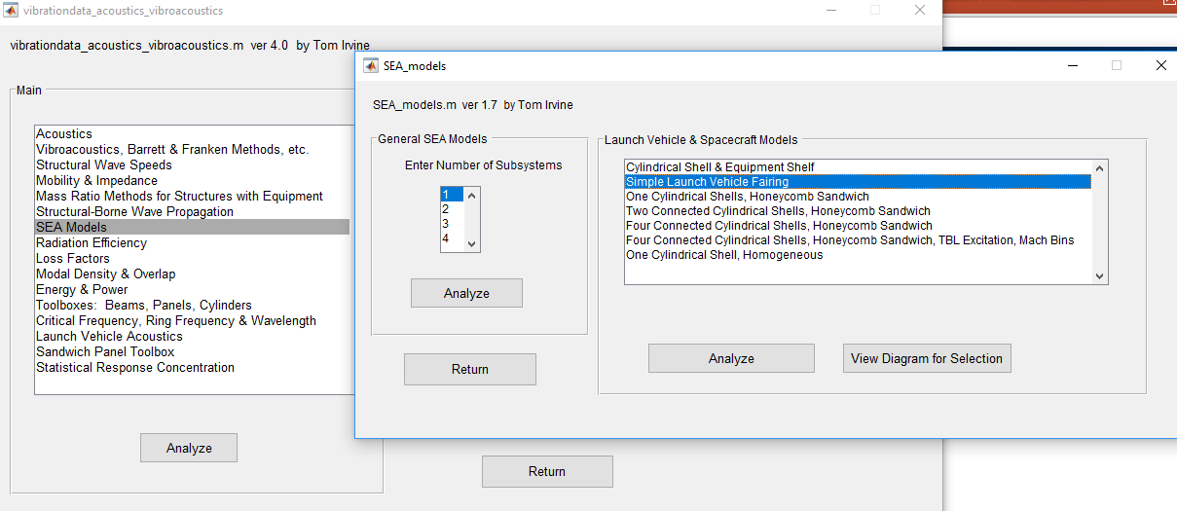
SEA Model, Simple Launch Vehicle Fairing
Vibrationdata

Slide 56
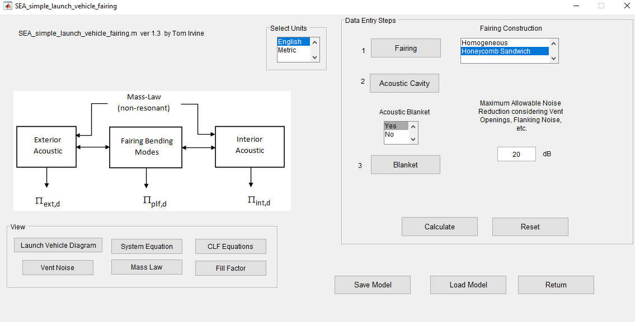
SEA Model, Simple Launch Vehicle Fairing, Main Dialog
Vibrationdata

Slide 57
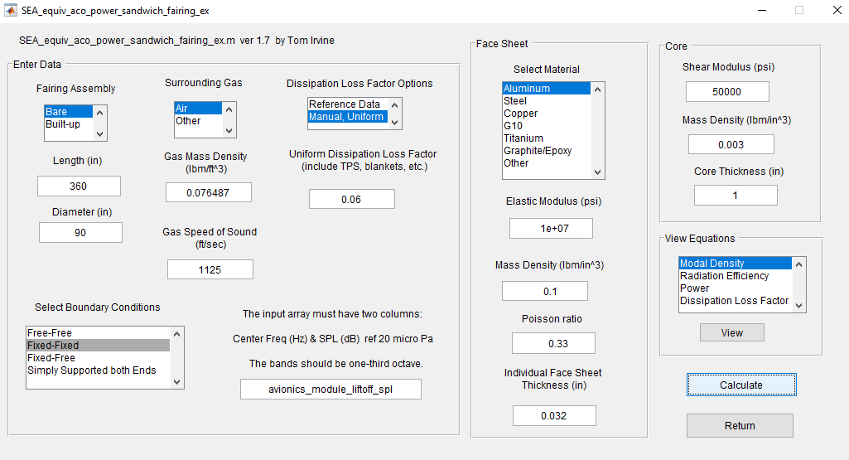
SEA Model, Simple Launch Vehicle Fairing, Main Dialog
Vibrationdata

Slide 58
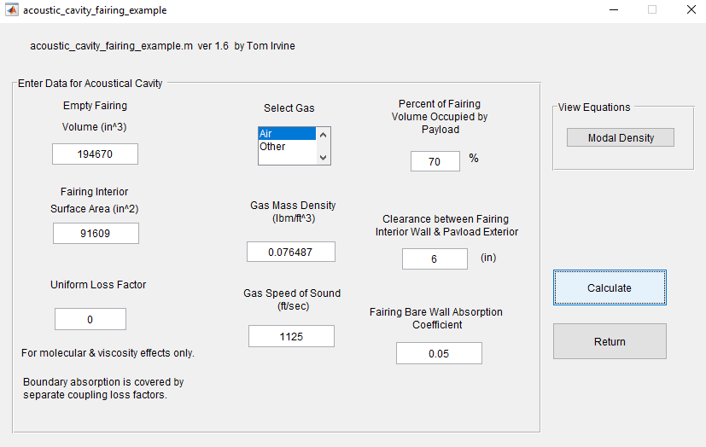
SEA Model, Simple Launch Vehicle Fairing, Main Dialog
Vibrationdata

Slide 59
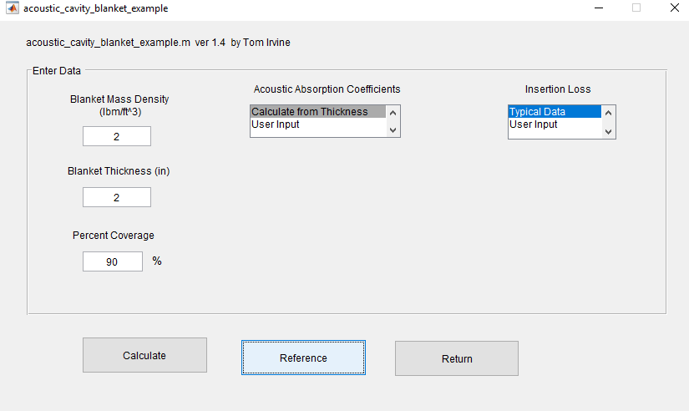
SEA Model, Simple Launch Vehicle Fairing, Main Dialog
Vibrationdata

Slide 60
Radiation Efficiency, Bare Fairing
Vibrationdata
The radiation efficiency approaches unity near the critical frequency which is 288 Hz
The critical frequency is the frequency at which the speed of the free bending wave in a structure becomes equal to the speed of the airborne acoustic wave
The acoustic and structural wavelengths are likewise equal at this frequency

Slide 61
Payload Fill Factor, 70% Case
Vibrationdata
The fill factor is the SPL increase due to the payload’s presence relative to an empty fairing.

Slide 62
Transmission Loss for Non-resonant Mass Law
Vibrationdata
The transmission loss from the mass law is not realized across the middle and higher frequencies due to the resonant-mode transmission
In addition, the fill factor reduced the transmission loss, especially at low frequencies

Slide 63
Fairing and Internal Cavity Parameters, alpha & tau
Vibrationdata
alpha is the average absorption coefficient
tau is the average transmission coefficient
The ratio of alpha over tau is needed for the noise reduction calculation
A higher (alpha/tau) ratio yields a higher noise reduction

Slide 64
Coupling Loss Factors
Vibrationdata
A coupling loss factor is similar to an energy transmission coefficient
The transmission of energy from a source to a receiver is also the energy lost by the source via the transmission path
The blue curve is the transmission ratio for sound due to the non-resonant mass law.
The red curve represents the resonant energy transmission ratio from the fairing to the interior cavity

Slide 65
Total Transmission
Vibrationdata
The transmission loss from the mass law is not realized across the middle and higher frequencies due to the resonant-mode transmission
In addition, the fill factor reduced the transmission loss, especially at low frequencies

Slide 66
Fairing Net Noise Reduction
Vibrationdata
The net noise reduction includes the transmission loss, internal absorption and fill factor
Again, the transmission loss includes both resonant and non-resonant effects

Slide 67
SPL Results, External & Internal
Vibrationdata
The key frequencies are:
Ring Frequency | = | 711.3 Hz
Critical Frequency | = | 288.2 Hz
Shear region | = | 4410 to 2.4634e+05 Hz

