Slide 1
Unit 43
Vibrationdata
Two-Degree-of-Freedom Systems
Two Stage Isolation
Cross-reference with Webinar 28 Multi-degree-of-freedom System Shock Response Spectrum

Slide 2
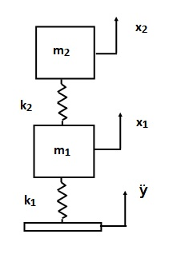
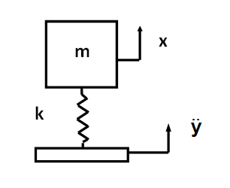
Isolation Options
Vibrationdata
Single Stage
Two Stage

Slide 3
SDOF System
Vibrationdata
m = 5 lbm
k= 4.6e+04 lbf/in
Q=10

Slide 4
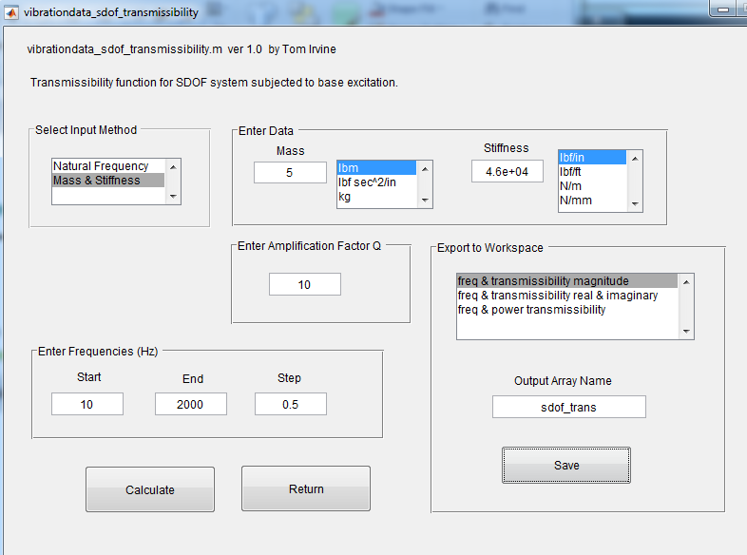
Vibrationdata
vibrationdata > Structural Dynamics > Spring-Mass Systems > SDOF Transmissibility for Base Excitation

Slide 5
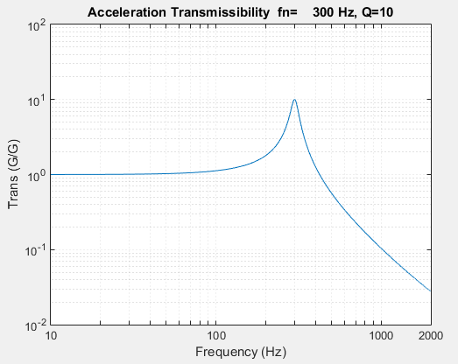
SDOF Transmissibility
Vibrationdata

Slide 6
Two Stage Isolation System
Vibrationdata
k= 4.6e+04 lbf/in for both springs
m₂ = 5 lbm
Q=10 for both modes
Perform
normal modes
Transmissibility analysis
m₁ =
2, 5, 10 lbm
Attach the previous SDOF system to a base spring-mass system. Calculate the transmissibility for three difference base mass cases.

Slide 7
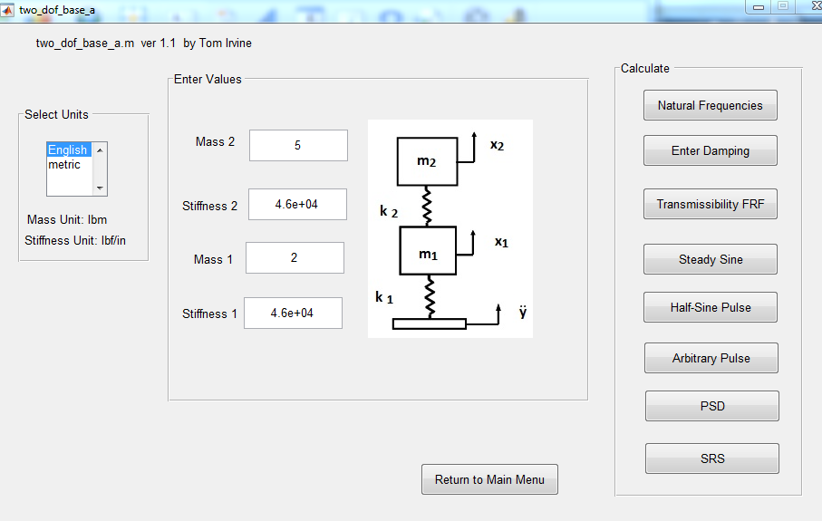
Vibrationdata
1
2
3
vibrationdata > Structural Dynamics > Spring-Mass Systems > Two-DOF System Base Excitation

Slide 8
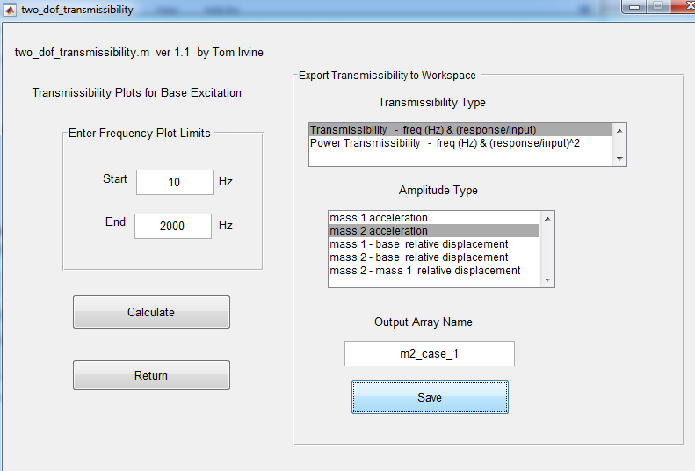
Vibrationdata
Calculate the transmissibility for each of the three base mass cases.

Slide 9
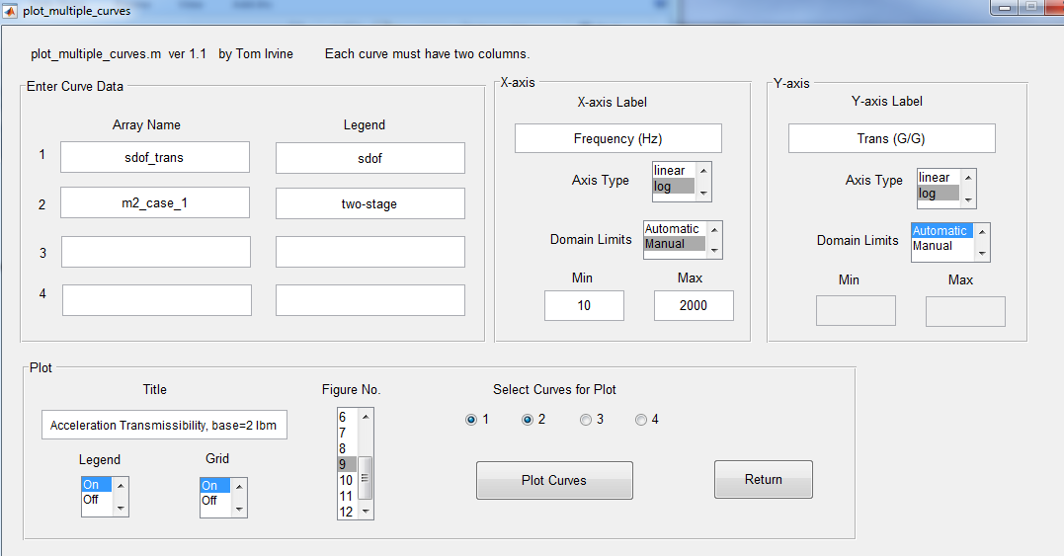
Vibrationdata

Slide 10
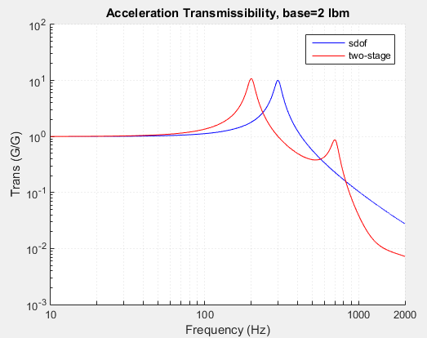
Case 1
Vibrationdata
Natural Frequencies
Sdof
300 Hz
Two-stage
201.3 Hz
706.5 Hz

Slide 11
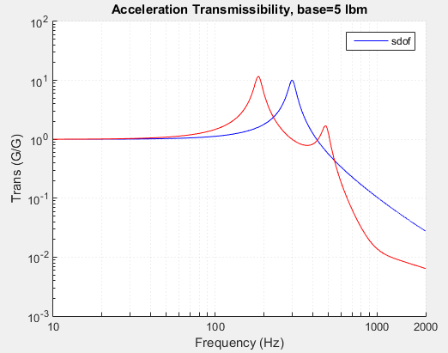
Case 2
Vibrationdata
Natural Frequencies
Sdof
300 Hz
Two-stage
185 Hz
485 Hz

Slide 12
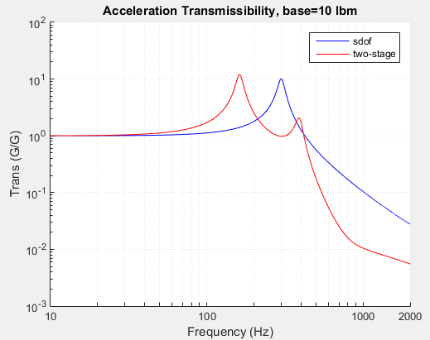
Case 3
Vibrationdata
Natural Frequencies
Sdof
300 Hz
Two-stage
162 Hz
392 Hz

Slide 13
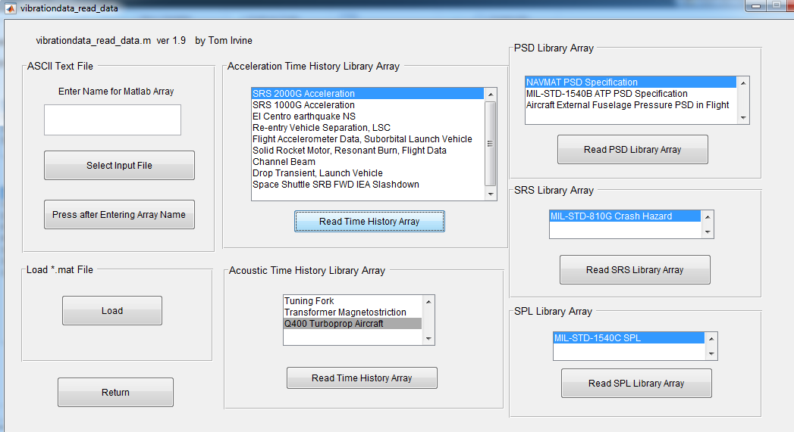
Conclusions
Vibrationdata
Read: SRS 2000 G Acceleration
Workspace name: srs2000G_accel

Slide 14
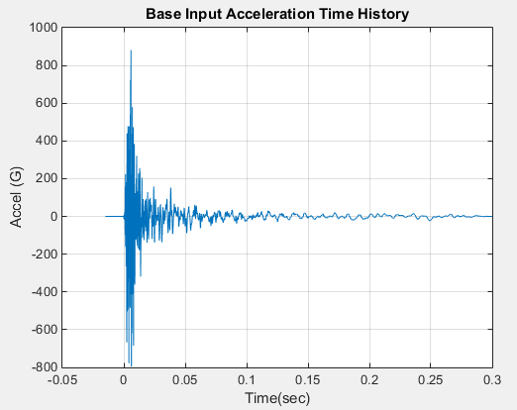
srs2000G_accel
Vibrationdata

Slide 15
Conclusions
Vibrationdata
srs2000G_accel is base input for time domain analysis
Calculate response of SDOF system
Time History > SDOF Response to Base Input
or Miscellaneous > Structural Dynamics > Spring-Mass Systems >
SDOF Response to Base Input, Time Domain
(Two paths to same dialog function)
Calculate response of mass 2 for the two-stage system for base mass=10 lbm, as shown on next slide

Slide 16
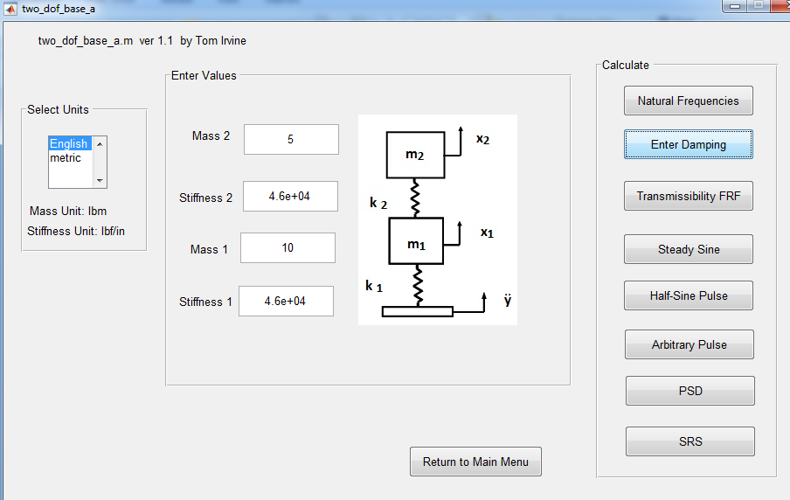
Conclusions
Vibrationdata
Apply srs2000G_accel

Slide 17
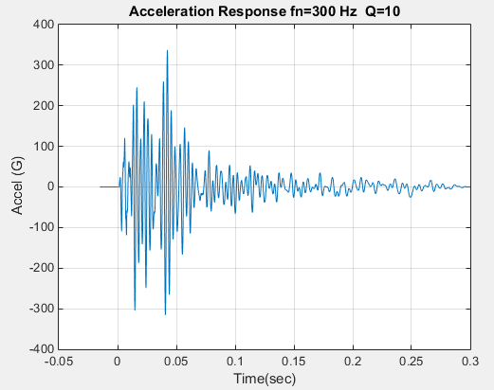
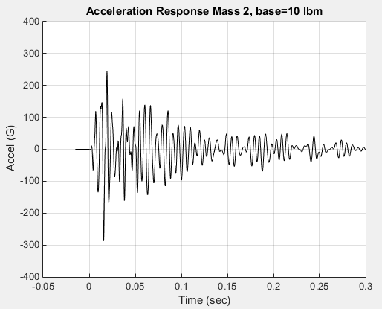
Avionics Mass Shock Response
Vibrationdata
SDOF peak response: 337 G
Mass 2 peak response: 288 G
1.4 dB reduction by mounting avionics box on base spring-mass system
(Good, but not great)

Slide 18
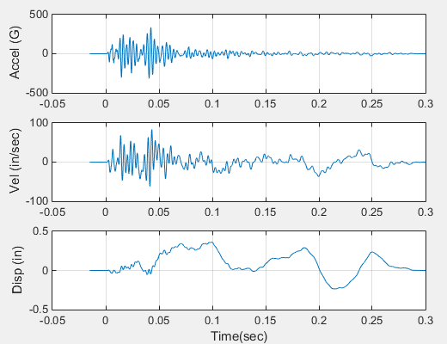
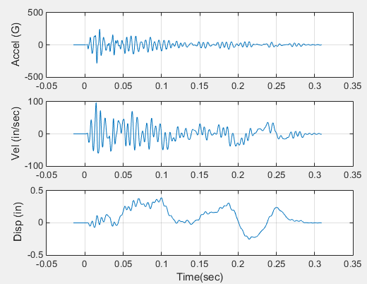
Velocity Comparison
Vibrationdata
SDOF peak velocity = 84 in/sec
Mass 2, 10 lbm base, peak velocity = 97 in/sec
1.3 dB increase by mounting avionics box on base spring-mass system

Slide 19
Conclusions
Vibrationdata
Increasing the base mass tends to give better isolation in terms of acceleration
But need to look at “big picture” of all dynamic environments
Also consider velocity and relative displacement

