Slide 1

Welded Joint Concerns for Shock, Vibration & Fatigue
By Tom Irvine

Slide 2
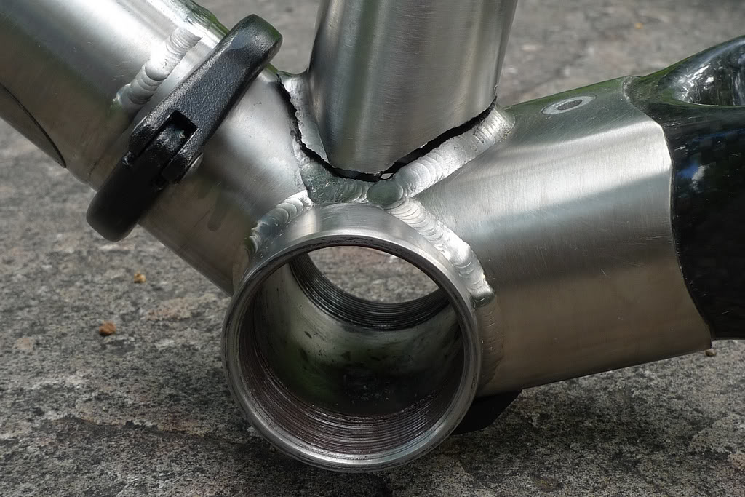
Fatigue Crack along Welded Joint, Mountain Bike Frame

Slide 3
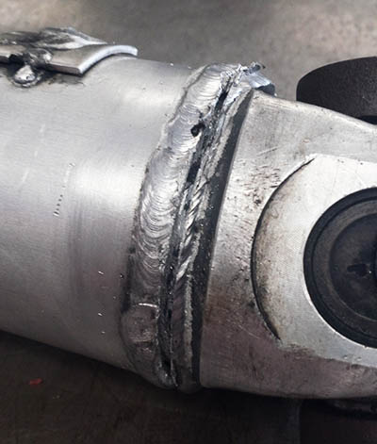
Broken Tube Weld
Causes
Shock load
Excessive vibration
Improper welding procedure
Attachment of the balance weights too close to the weld
https://daytonclutch.com/driveline/failures

Slide 4
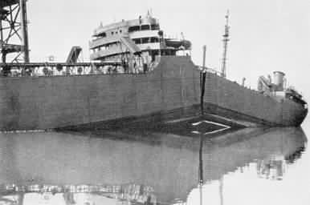
1942 – Liberty Ships
All-welded structures to reduce cost and construction time
1500 instances of cracking noted
Several ships broke in the center of hull during use
Low grade steel material was found to be susceptible to cracking in cold weather
Material changed from ductile to brittle at cold temperatures
Fatigue cracks nucleated at the corners of square hatches and propagated rapidly by brittle fracture
Welding defects also contributed to fracture
Riveted joints are more crack resistant than welded joints in ship hulls
SS Schenectady
Ships were often over-loaded with cargo, resulting in high stress levels
Had to withstand high winds and rough waves

Slide 5
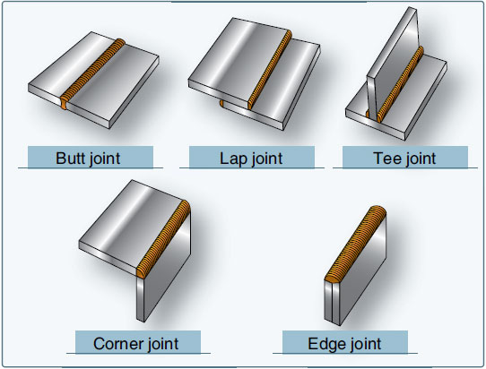
Welded Joint Types

Slide 6
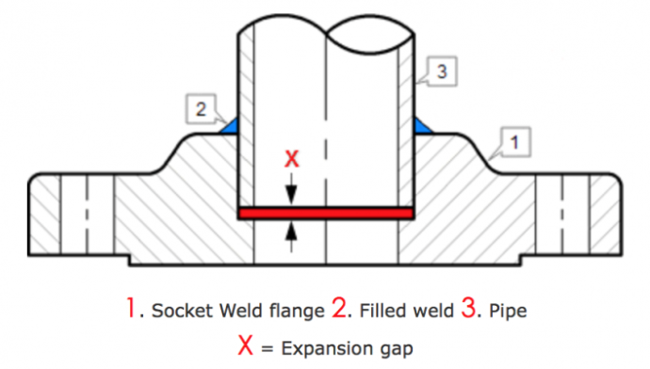
Socket Weld Flange

Slide 7
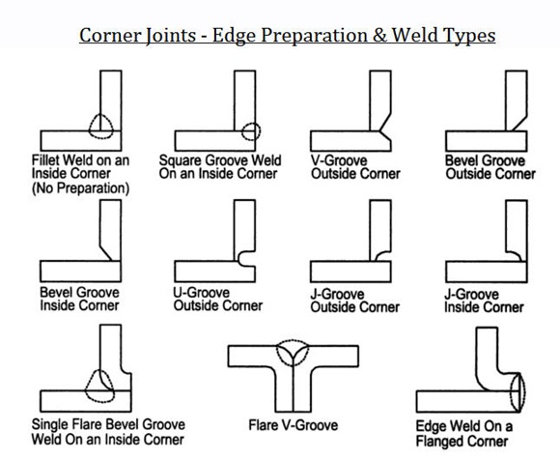
Welded Joint Edge Preparation

Slide 8
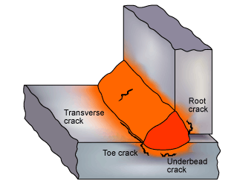
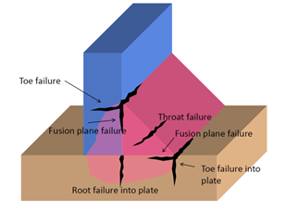
Fatigue Crack Initiation in Welded Joints
Hydrogen cracking may also be called cold cracking or delayed cracking
The principal distinguishing feature of this type of crack is that it occurs in steel, most often immediately on welding or a short time after welding

Slide 9
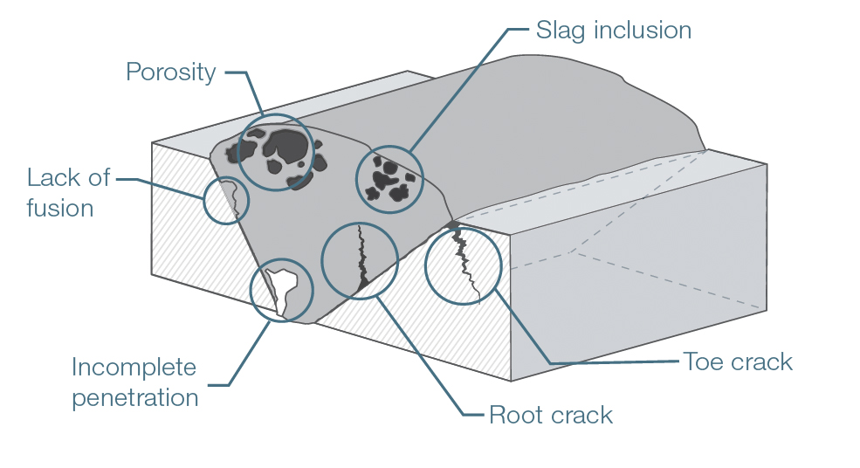

Weld Cracks & Flaws
Centerline (Longitudinal) crack
Compounds such as oxides, fluxes and electrode materials get trapped in the weld zone as slag inclusions
Inclusions are stress concentration factors
All welds contain microcracks
Need to determine whether existing cracks will grow to the point of fracture

Slide 10
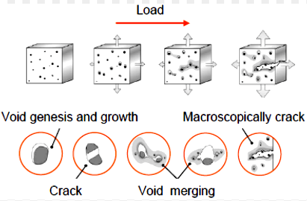
Crack Merging
Microvoids may merge causing crack propagation

Slide 11
Damage Tolerance
Damage tolerance is a property of a structure relating to its ability to sustain defects safely until repair can be effected
Assumes that flaws can exist in any structure and such flaws propagate with usage
Crack growth is characterized by three regions: Initiation and growth Slow growth Rapid crack growth
Manage the extension of cracks in structure through the application of the principles of fracture mechanics
Implement maintenance program that will result in the detection and repair of accidental damage, corrosion and fatigue cracking before such damage reduces the residual strength of the structure below an acceptable limit
Can be used with “fail-safe” designs that have redundant load paths for survival followed by repair

Slide 12
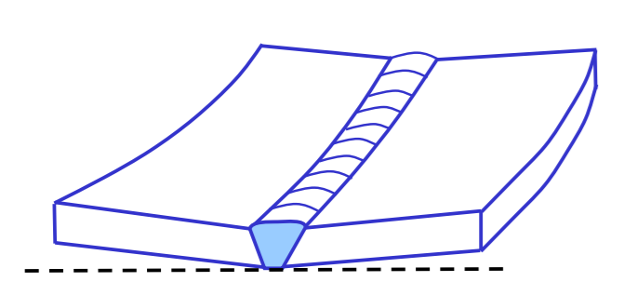
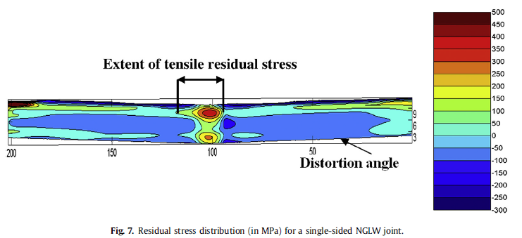
Welding Distortion
Multi-pass gas-tungsten arc (GTA) welding
Max residual stress
~ 500 MPa
~ 73 ksi
Welding causes distortion & residual stress due to differential thermal expansion and contraction of the weld metal and parent material
X-ray diffraction is a non-destructive technique which can be used to determine the residual stresses at the surface in crystalline materials
https://www.escholar.manchester.ac.uk/api/datastream?publicationPid=uk-ac-man-scw:292583&datastreamId=POST-PEER-REVIEW-PUBLISHERS.PDF

Slide 13
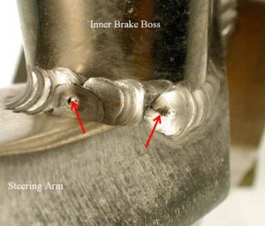
Crater Cracks
Most common in aluminum welds, the crater crack is due to lack of fill at the end of the weld
Carbon steel and stainless steel welds are not as susceptible to crater cracks, but care must still be taken when welding these materials.

Slide 14
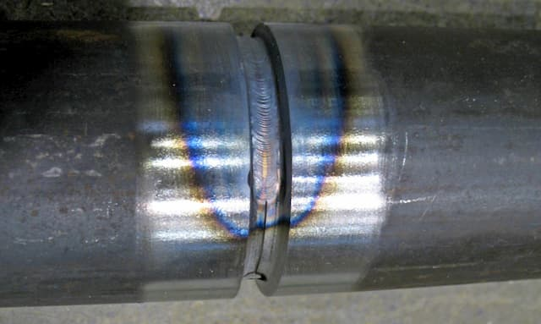
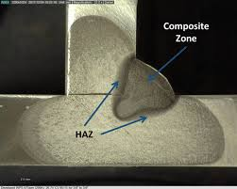
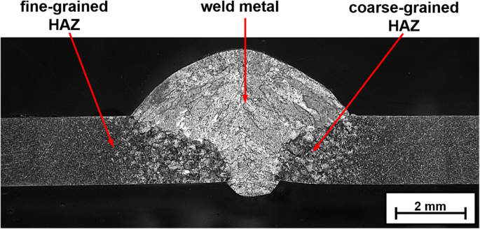
Heat Affected Zone (HAZ)
A heat affected zone is formed between the melted metal and the unaffected base metal
The metal in this zone is not melted, but the heat has led to changes in the metal’s micro-structure
These changes in structure can reduce the metal’s strength
The HAZ can be identifiable in some cases by a series of brightly colored bands between the cutting/welding interface and the unaffected base metal

Slide 15
Non-Destructive Inspection Techniques
Visual Inspection (VT)
Radiographic Inspection (RT)
Magnetic Particle Inspection (MT)
Dye or Liquid Penetrant Inspection (PT)
Ultrasonic Inspection (UT)

Slide 16
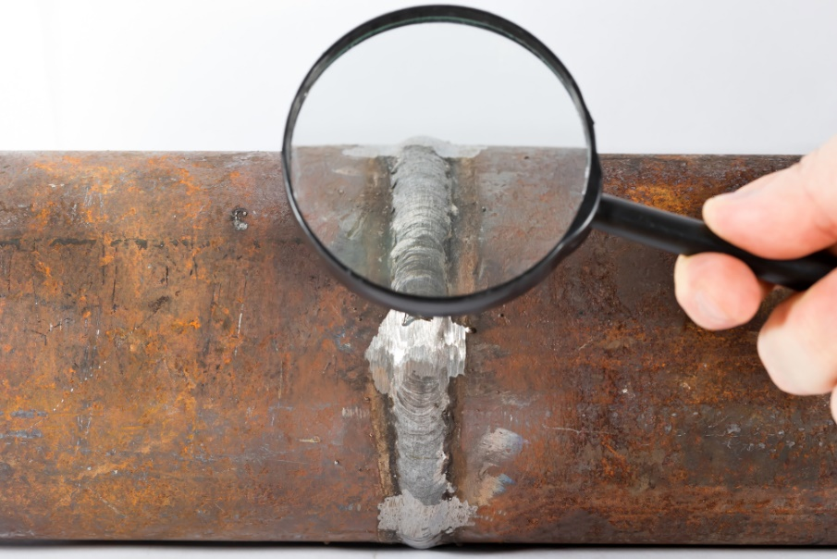
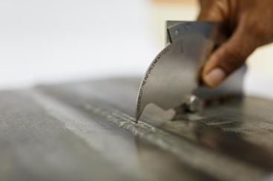
Visual Inspection
Check for cracks, pits, surface pores, undercut, underfill, missed joints, and other aspects of the weld
Right image: Visual inspection of a weld using a bridge cam gage (Cambridge gage)
The gage has a rotating dial and a sliding pointer to measure weld features
It can measure fillet weld leg length and throat thickness, height of weld reinforcement, depth of undercut, misalignment and the angle of preparation

Slide 17
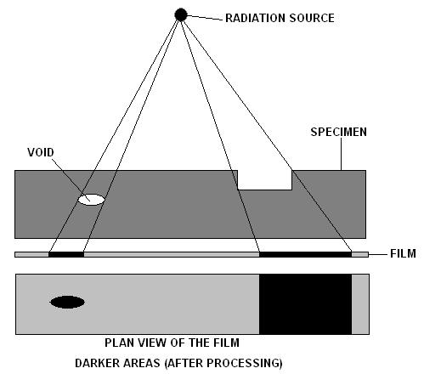
Radiographic Inspection (X-ray or gamma rays)

Slide 18
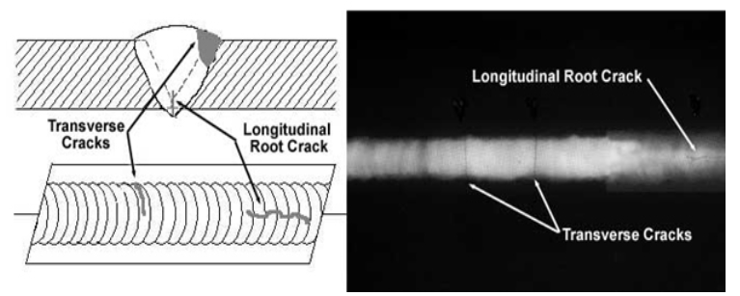
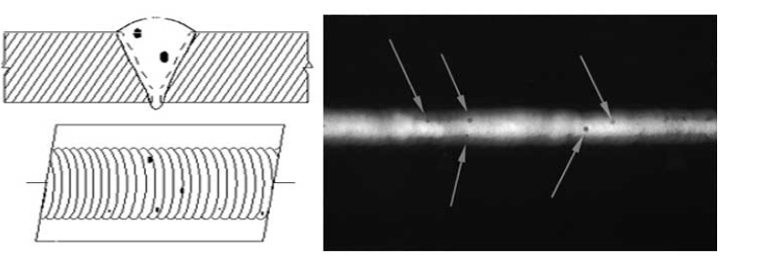
Radiographic Inspection (cont)
Porosity

Slide 19
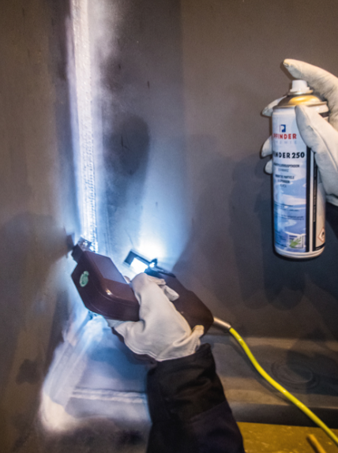
Magnetic Particle Inspection
Magnetic particle Inspection process for detecting surface and shallow subsurface discontinuities in ferromagnetic materials such as iron, nickel, cobalt, and some of their alloys
Nonferrous materials (aluminum, titanium, magnesium, copper, etc.) cannot be inspected using this method
The process puts a magnetic field into the part
The piece can be magnetized by direct or indirect magnetization
The presence of a surface or subsurface discontinuity in the material allows the magnetic flux to leak, since air cannot support as much magnetic field per unit volume as metals.
To identify a leak, ferrous particles, either dry or in a wet suspension, are applied to a part
These are attracted to an area of flux leakage and form what is known as an indication, which is evaluated to determine its cause

Slide 20
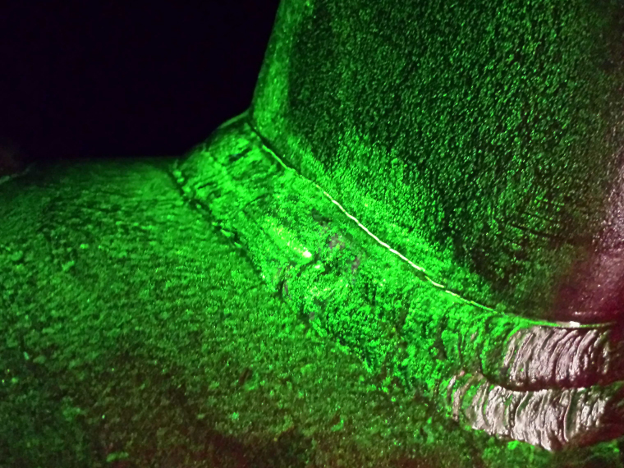
Fluorescent Magnetic Particle Inspection
Requires the use of UV light in a darkened environment
Wet fluorescent magnetic particles are sharper than dry particle indications formed on similar defects

Slide 21
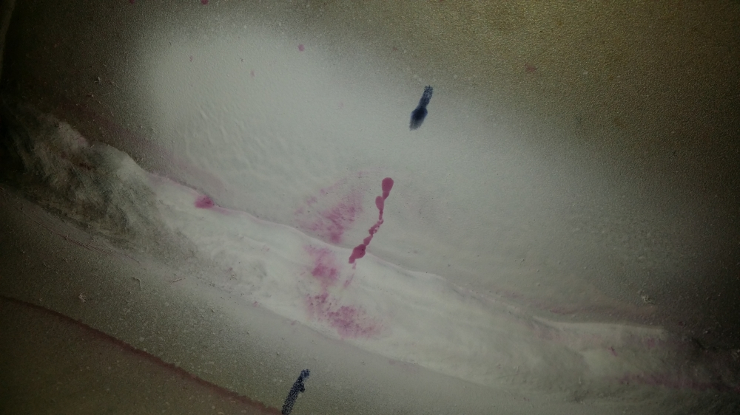
Dye or Liquid Penetrant Inspection
Detects cracks from fatigue, quenching, and grinding, porosity, incomplete fusion, and flaws in joints
Penetrant solution is applied to the surface of a precleaned component. The liquid is pulled into surface-breaking defects by capillary action
Excess penetrant material is carefully cleaned from the surface
A developer is applied to pull the trapped penetrant back to the surface where it is spread out and forms an indication
The indication is much easier to see than the actual defect

Slide 22
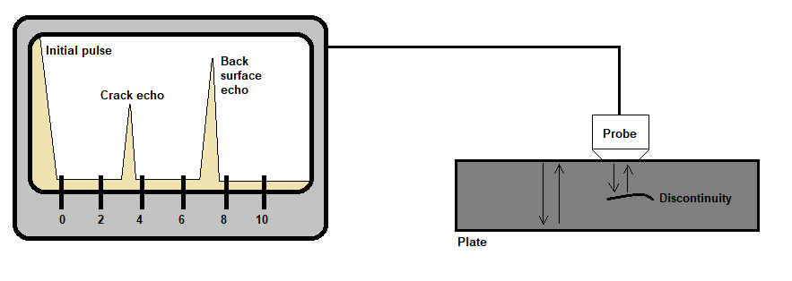
Ultrasonic Inspection
Ultrasonic testing is based on transmitting high frequency sound waves to materials and receiving them back in order to detect any discontinuities

Slide 23
U.S. Nuclear Regulatory Commission Damping
Some interfacial friction damping effects also occur in welded joints, but welded joints are much stiffer than the bolted joints
The U.S. Nuclear Regulatory Commission gives the damping ratios for nuclear plant structures
The values are intended for analysis purposes when measured damping values are unavailable.
Damping Values for Steel Buildings, Operating-Basis Earthquake
Joint Type | Damping Ratio
Welded Joints | 2%
Bolted Joints | 5%

Slide 24
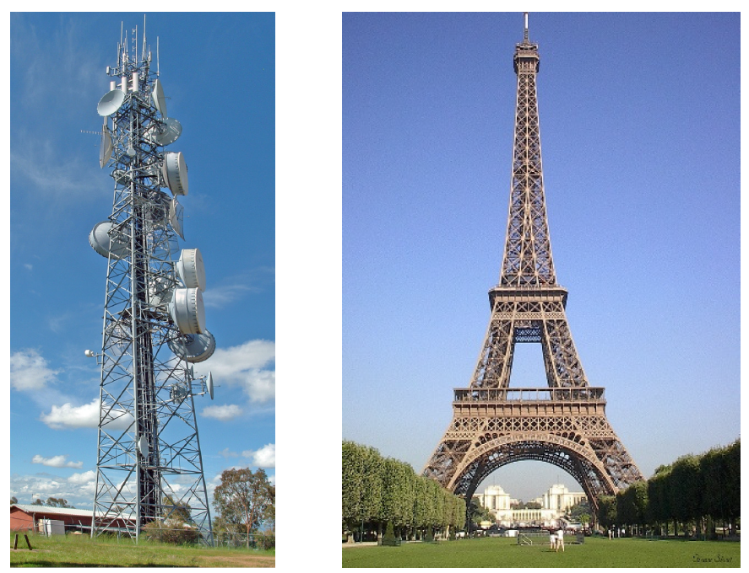
The International Association for Shell and Spatial Structures, IASS 1991
Type | Damping
Fully Welded Steelwork | 1.2%
High Strength Friction Bolted Steelworks | 2.0%
Normal Bolted and Riveted Steelwork | 3.0%

Slide 25
NASA SP-8050, Damping
Type of Structure | Percent of Critical Viscous Damping | Remarks
Homogeneous-element configurations (machined brackets, solid beams, welded construction) | 1 to 2 | Damping factor depends on stress levels induced during vibration
Riveted or bolted structures | 3 to 10 | Damping cause by friction at joints significantly reduces the vibration amplification

Slide 26
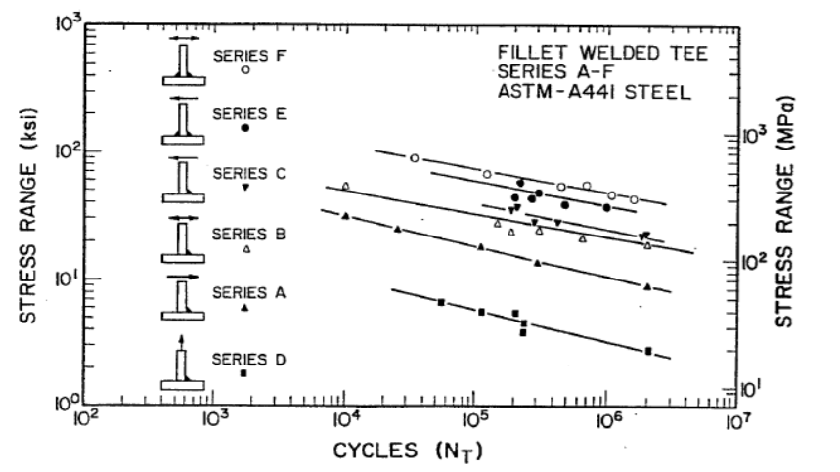
Fatigue Curves

