Slide 1
Unit 10
Sample Rate, Nyquist Frequency & Aliasing

Slide 2
Nyquist Frequency
The Nyquist frequency is equal to one-half the sampling rate.
Shannon’s sampling theorem states that a sampled time signal must not contain components at frequencies above the Nyquist frequency.

Slide 3
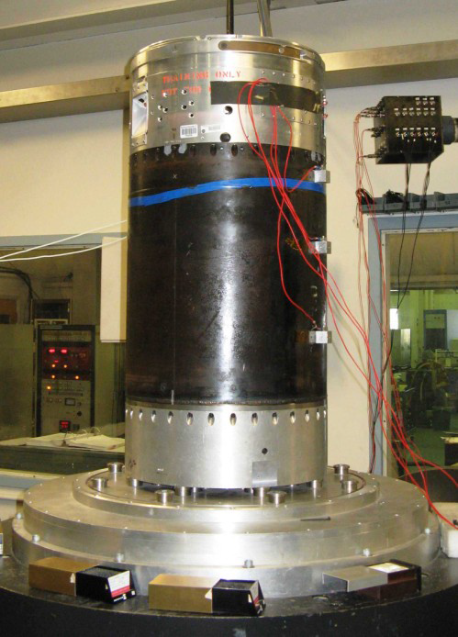
Accelerometer Data
Engineers collect accelerometer data in a variety of settings
Examples from the launch vehicle industry include:
Launch vehicle flight data
Stage separation and other ground tests where pyrotechnic devices are initiated
Static fire test of solid motor or liquid engine
Component shock and vibration tests performed in the lab

Slide 4
Analog-to-digital Conversion
Accelerometer
Signal Conditioner
& Lowpass Filter
Analog-to-Digital Converter
The accelerometers measure the data in analog form
The accelerometer may have an integral mechanical lowpass filter
Furthermore, the signal conditioning unit may have an analog lowpass filter
Lowpass filtering of the analog signal is necessary to prevent aliasing
Eventually, the data is passed through an analog-to-digital converter
The proper lowpass frequency and sampling rate must be selected to ensure that the digitized data is accurate

Slide 5
First Requirement for Sample Rate
The sampling rate must be greater than the maximum analysis frequency
(minimum sampling rate) > ( N )( maximum analysis frequency )
Analysis Type | N
Frequency Domain | 2
Time Domain | 10

Slide 6
First Requirement for Sample Rate (cont)
The frequency domain requirement is based on the fact that at least two time-domain coordinates per cycle are required to resolve a sine wave
The frequency domain analysis thus extends up to the Nyquist frequency which is one-half the sample rate
Note that some conservative references specify an N of 2.5 for frequency domain calculation

Slide 7
First Requirement for Sample Rate (cont)
A sampling rate of 100 KHz is thus required for a shock response spectrum analysis extending to 10 KHz
Recall that the shock response spectrum is calculated in the time domain
Smallwood, ramp invariant, digital recursive filtering relationship

Slide 8
First Requirement for Sample Rate (cont)
The IES Handbook for Dynamic Data Acquisition and Analysis gives the following guidelines:
Unlike other spectral quantities evolving from the discrete Fourier transform computations, the SRS is essentially a time domain quantity.
Hence, the digital sampling rate given by Rs=1/(delta t), introduces errors beyond those associated with aliasing about the Nyquist frequency.
Thus, Rs must be high enough to accurately describe the response of the SRS oscillators.
To minimize potential error, it is recommended that the SRS computations be performed with a sampling rate of Rs > 10 fh, where fh is the highest natural frequency of the SRS computation.

Slide 9
Second Requirement for Sample Rate
The second requirement is that the sampling rate must be greater than the maximum frequency present in the source energy at the measurement location
This requirement is independent of the maximum analysis frequency
(minimum sampling rate) > ( M )( maximum frequency in source energy )
Analysis Type | M
Frequency Domain | 2
Time Domain | 10

Slide 10
Maximum Frequency
What is the maximum frequency in source energy? Don’t Know!
Use analog lowpass anti-aliasing filter
The cut-off frequency is typically set at, or slightly above, the maximum analysis frequency

Slide 11
Lowpass Filter
The IES Handbook for Dynamic Data Acquisition and Analysis gives the following guidelines:
Let
f_{c} be the cutoff frequency
f_{N} be the Nyquist frequency
A lowpass anti-aliasing filter with a cutoff rate of at least 60 dB/octave should be used for the analog-to-digital conversion of all dynamic data
With a 60 dB/octave cutoff rate, the half-power point cutoff frequency of the filter should be set at f_{c} < 0.6 f_{N}
If the anti-aliasing filter has a more rapid cutoff rate, a higher cutoff frequency can be used, but the bound f_{c} < 0.8 f_{N} should never be exceeded

Slide 12
Two Sine Functions
The 200 Hz sine function is sampled at 2000 samples per second. There are 10 points per period. The Nyquist frequency is 1000 Hz.

Slide 13
Two Sine Functions
There is a distinct spectral line at 200 Hz as expected.

Slide 14
Two Sine Functions
The 1800 Hz sine function is sampled at 2000 samples per second, as shown by the red markers. There are 1.11 points per period.
The Nyquist frequency is 1000 Hz. Aliasing occurs!

Slide 15
Two Sine Functions

Slide 16
Two Sine Functions
The 1800 Hz signal is folded about the Nyquist frequency which is 1000 Hz. The resulting energy is deposited at 200 Hz.

Slide 17
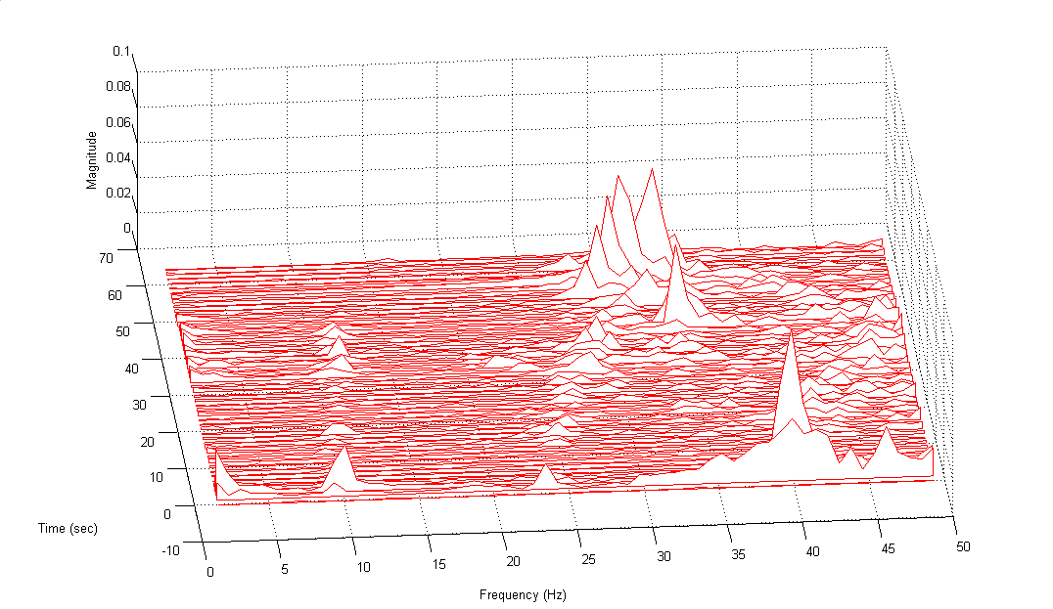
ALIASING CASE HISTORY
Waterfall FFT Launch Vehicle X Delta Velocity
Aliased peaks from 65 to 75 Hz
First Body-Bending Mode
Time (sec)
Frequency (Hz)
Second Body-Bending Mode
50 Hz Nyquist Frequency

Slide 18
Previous Plot Notes
The sensor was from an Inertial Navigation System (INS)
The data was sampled at 100 samples per second with no anti-aliasing filter
The waterfall FFT is given up to 50 Hz, which is the Nyquist frequency
The spectral peaks from 25 to 35 Hz and from 50 to 60 seconds are due to aliasing about the Nyquist frequency.
The source energy was a motor pressure oscillation that swept downward from 75 to 65 Hz
As an aside, the spectral peaks near 10 Hz were due to the fundamental body bending frequency

