Slide 1
Unit 12
Power Spectral Density Functions
of Measured Data

Slide 2
PSD Examples
Practice PSD calculations using both measured and synthesized data

Slide 3
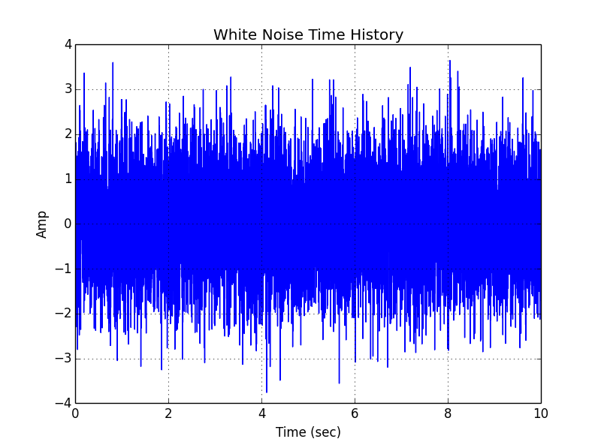
Exercise 1
Use the vibrationdata GUI script to synthesize a white noise time history with 1 G standard deviation, 10 second duration, and 1000 samples per second, no lowpass filtering.

Slide 4
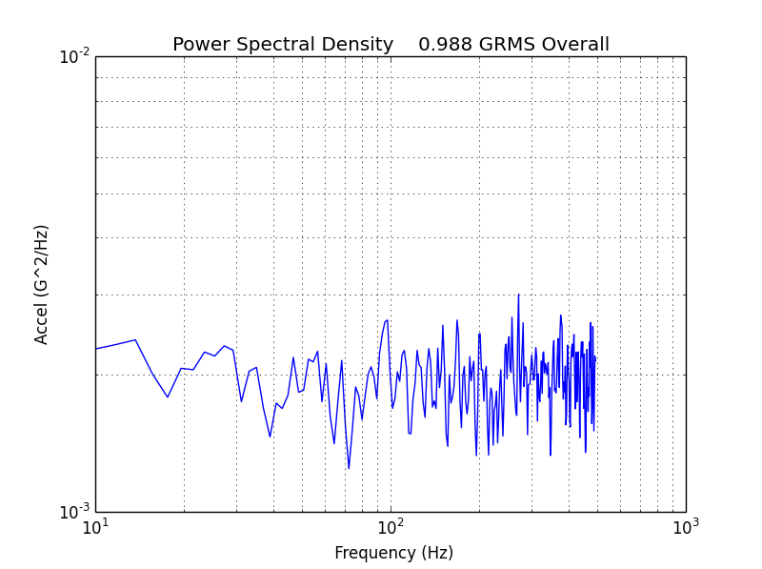
Exercise 1
Use vibrationdata GUI script to calculate the power spectral density.
Choose 512 samples per segment, which corresponds to 38 dof and Δf = 1.95 Hz. Select the mean removal and Hanning window options

Slide 5
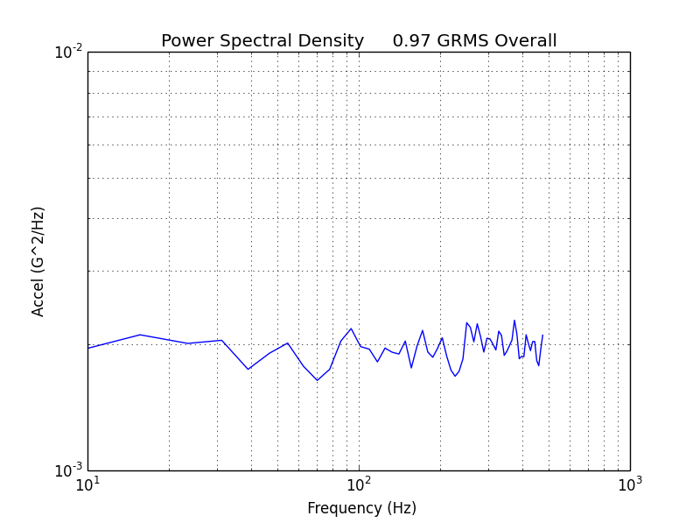
Exercise 1
Repeat the power spectral density calculation for 128 samples per segment, which corresponds to 156 dof and Δf = 7.8 Hz.

Slide 6
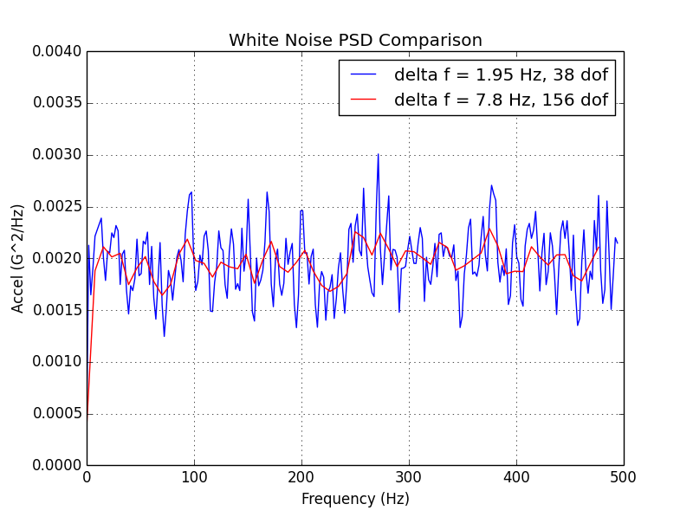
Note linear-linear format. The red curve smoothes the data using a wider delta f with higher statistical dof.

Slide 7
Exercise 2
Octave bands
Relationship between two adjacent frequencies is
f₂ = f₁ * 2^{n}
Typical n values: 1, 1/3, 1/6, 1/12
The frequency step has a “proportional bandwidth” which increases as the band center frequency increases.
Acoustic Sound Pressure Levels (SPL) typically are in one-third octave format.
Piano keys have one-twelfth octave spacing.

Slide 8
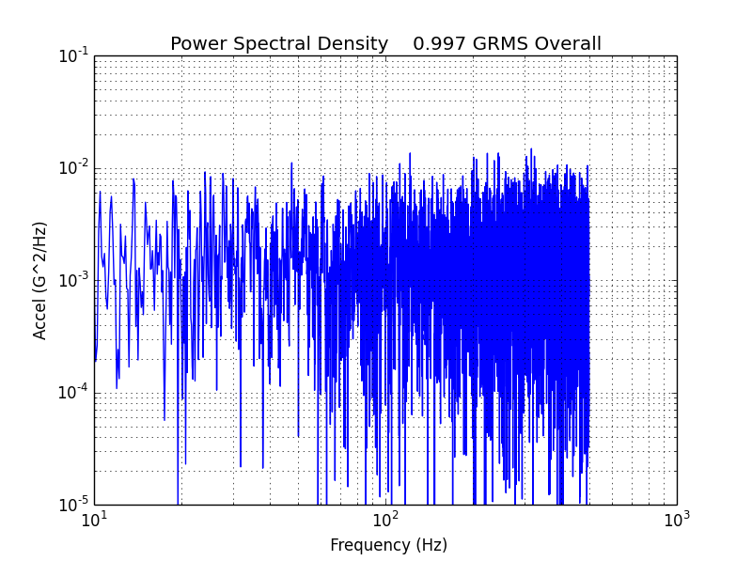
500
Calculate the PSD of the 10-second white noise time history using only one segment,
Δf = 0.12 Hz, 2 dof. Save PSD.

Slide 9
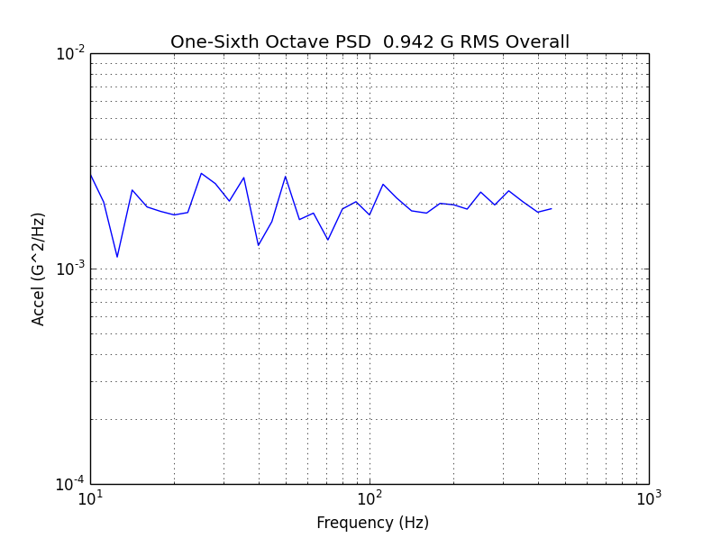
Convert the PSD to one-sixth octave format via:
Select PSD Analysis > Convert to Octave Format
Note that the PSD of ideal white noise is a flat, horizontal line.

Slide 10
Exercise 3
Generate pink noise, 10-second duration, std dev=1, Sample Rate = 20000 Hz, No Band Limit
Export time history
Take PSD with one segment.
Calculate one-third octave PSD.
Plot from 10 to 10,000 Hz.

Slide 11
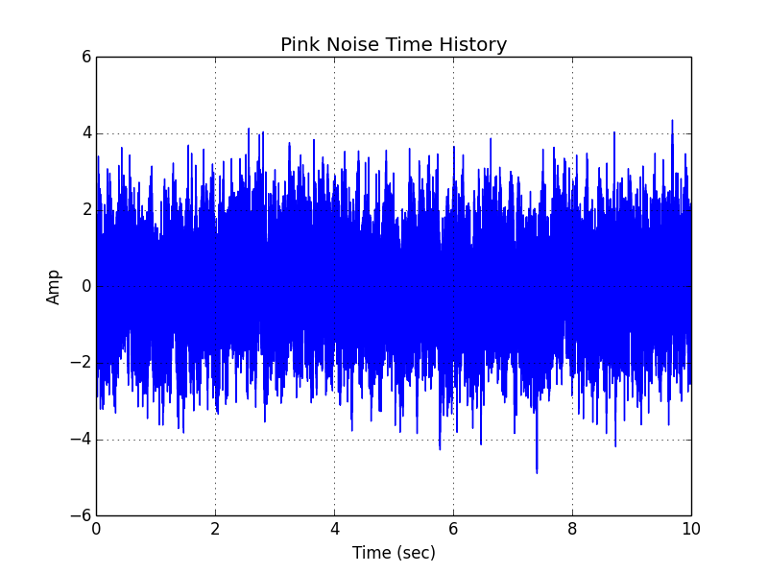

Slide 12
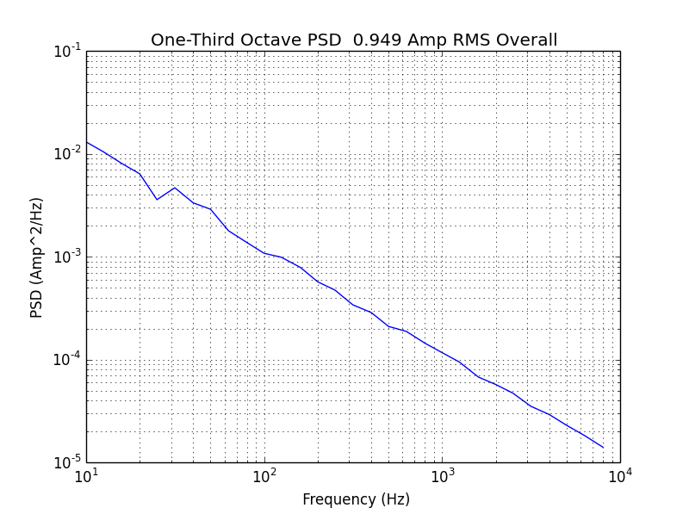
The PSD slope is -3 dB/octave

Slide 13
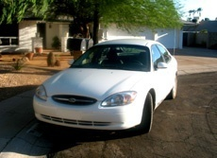
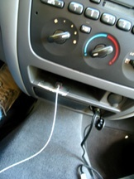
Exercise 4
Taurus auto with accelerometer mounted in console.

Slide 14
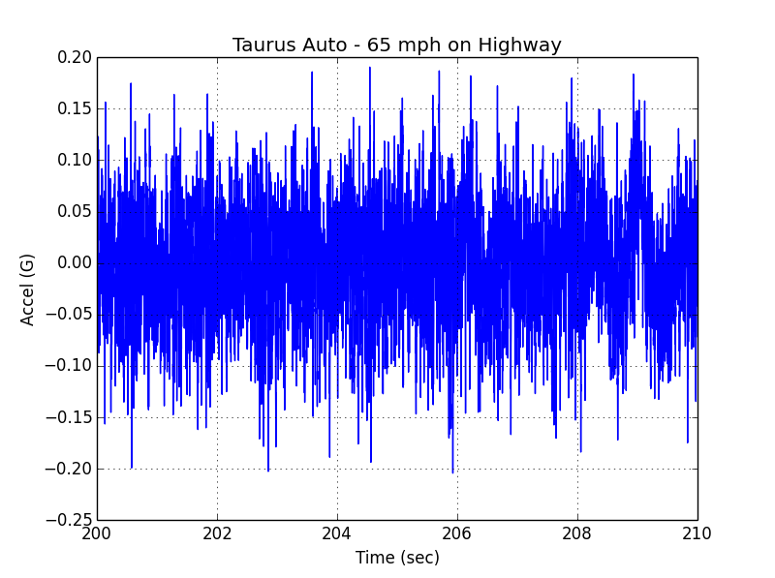
Calculate PSD using Δf=0.3 Hz processing case.
Identify the spectral peaks.

Slide 15
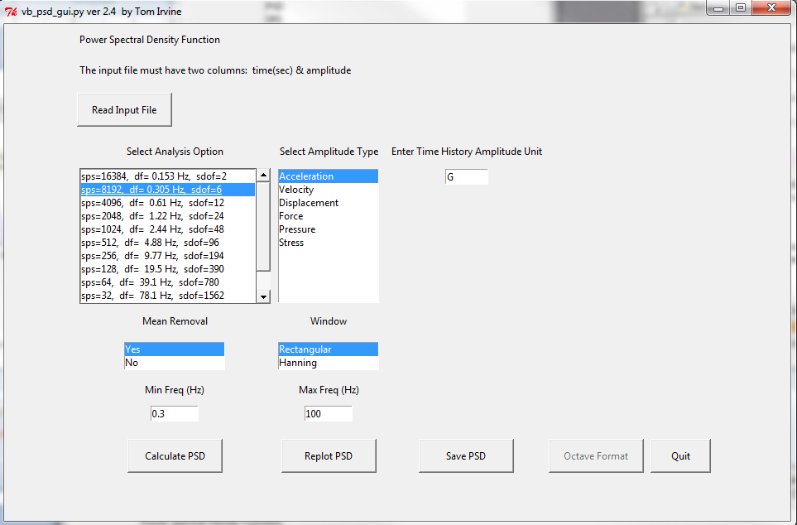

Slide 16
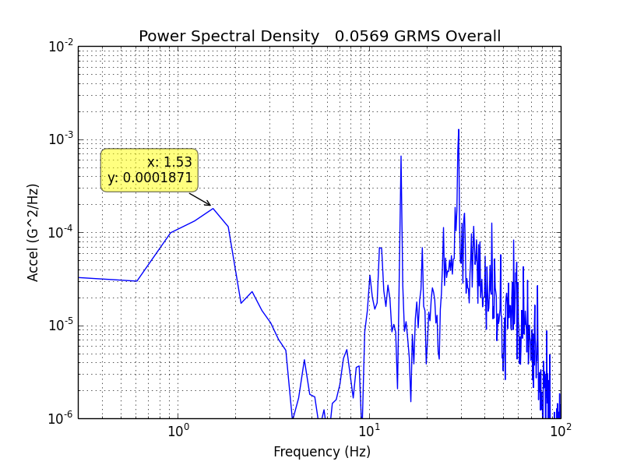
Taurus Auto PSD, peaks at 1.5, 14.6, and 29.2 Hz
29.2
14.6

Slide 17
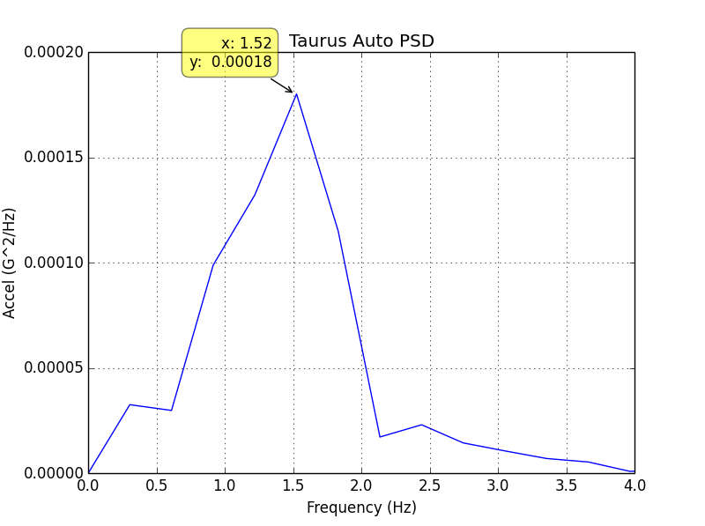
Half-power Bandwidth Points
(-3 dB)
Δf = (1.9 – 0.89) Hz
= 1.0 Hz
Viscous
Damping Ratio
= Δf / (2 f )
= 1.0 / (2*1.5)
= 0.33
Auto Spring-Mass Frequency is
1.5 Hz with 33% damping
(shock absorbers)
0.89 Hz
1.9 Hz
9.0e-05 G^2/Hz

Slide 18
Automobile Natural Frequencies
Vehicle | Fundamental Frequency
Passenger Car | 1 to 1.5 Hz
Sports Car | 2 to 2.5 Hz
Hummer | 4.5 Hz

Slide 19
Tire Imbalance Frequency
Assume 25 inch tire outer diameter at 65 mph.
Circumference = π ( 25 inch ) = 78.5 inch
65 mph = 1144 in/sec
( 1144 in/sec ) / 78.5 in = 14.6 Hz
2X harmonic = 29.1 Hz

Slide 20
Exercise 5
Generate a white noise time history:
Duration = 40 sec
Std Dev = 1
Sample Rate=10000 Hz
Lowpass Filter at 2500 Hz
Export Signal: white_40_input_th.txt

Slide 21
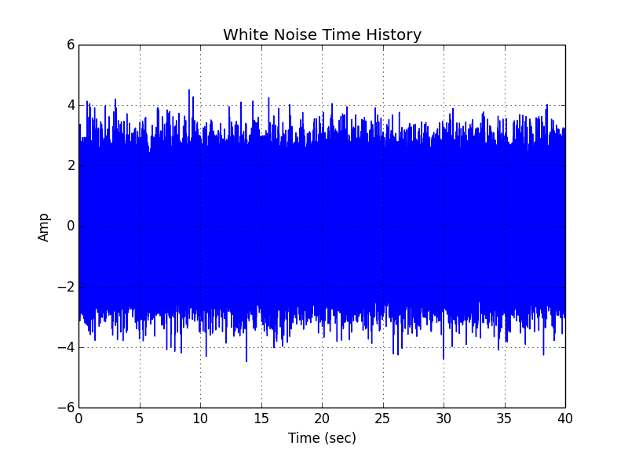
Base Input Time History: white_40_input_th

Slide 22
Exercise 5 (cont)
Generate the PSD of the 40-second white noise time history
Input: white_40_input_th.txt
Use case which has Δf ≅ 5 Hz
Mean Removal Yes & Hanning Window
Plot from 10 to 2000 Hz
Export PSD – white_40_input_psd.txt

Slide 23
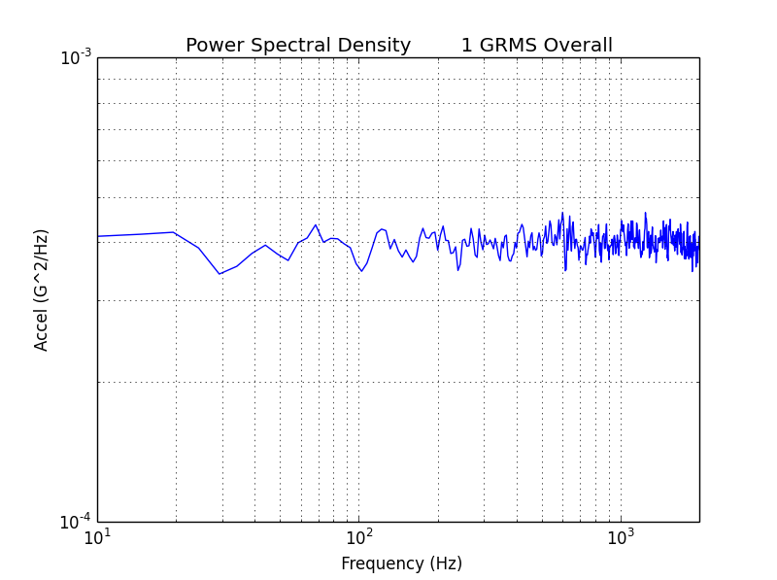
2K
Base Input PSD: white_40_input_th

Slide 24
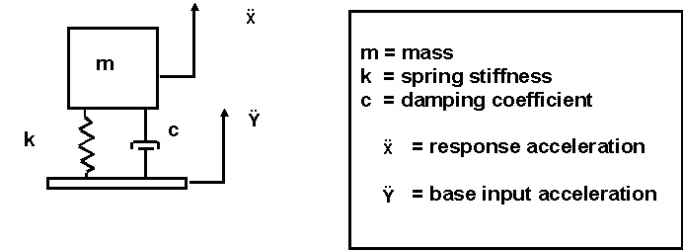
Recall SDOF Subjected to Base Input

Slide 25
SDOF Response to White Noise
Subjected a SDOF System (fn=400 Hz, Q=10) to the 40-second white noise time history.
Input: white_40_input_th.txt
Use Vibrationdata GUI option:
SDOF Response to Base Input
Export Acceleration Response: white_40_response_th.txt

Slide 26
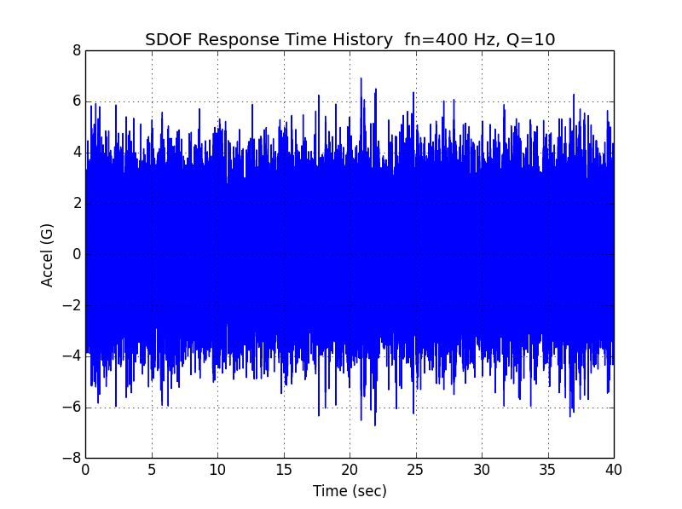
Response Time History: white_40_response_th.txt

Slide 27
SDOF Response to White Noise PSD
Take a PSD of the Response Time History
Input: white_40_response_th.txt
Mean Removal Yes & Hanning Window
Use case which has Δf ≅ 5 Hz
Plot from 10 to 2000 Hz
Export Response PSD: white_40_response_psd.txt

Slide 28
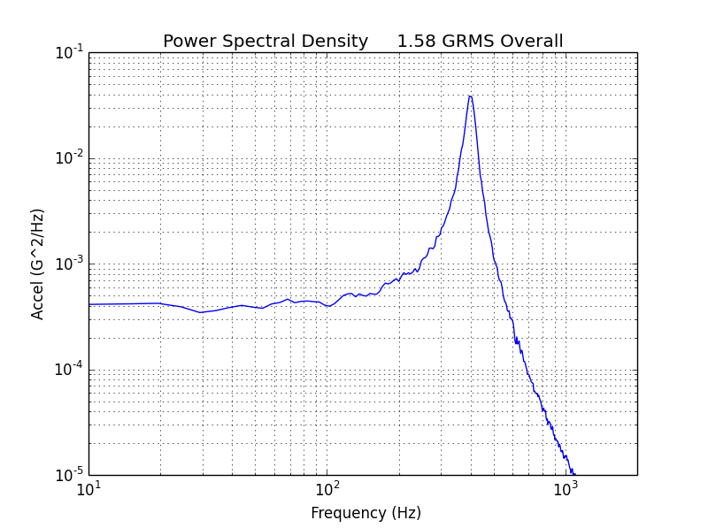
2K
Response PSD: white_40_response_psd.txt

Slide 29
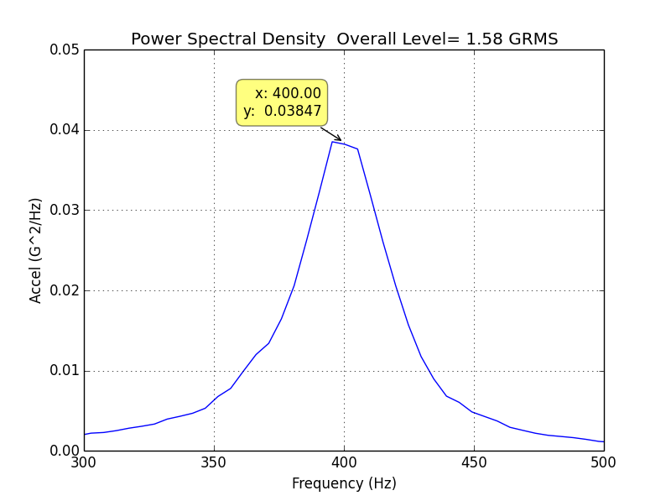
Half-power Bandwidth Points (-3 dB)
Δf = (420 – 380) Hz
= 40 Hz
Viscous Damping Ratio
= Δf / (2 f )
= 40 / (2*400)
= 0.05
Q = 1 / ( 2 * 0.05)
Q=10
Response PSD: white_40_response_psd.txt

Slide 30
Plot Both PSDs
Go to:
Miscellaneous Functions > Plot Utilities
Select Input > Two Curves
Curve 1: white_40_input_psd Color: Red Legend: Input
Curve 2: white_40_response_psd Color: Blue Legend: Response
Format: log-log X-axis: 10 to 2000 Hz
X-label: Frequency (Hz) Y-label: Accel (G^2/Hz)

Slide 31
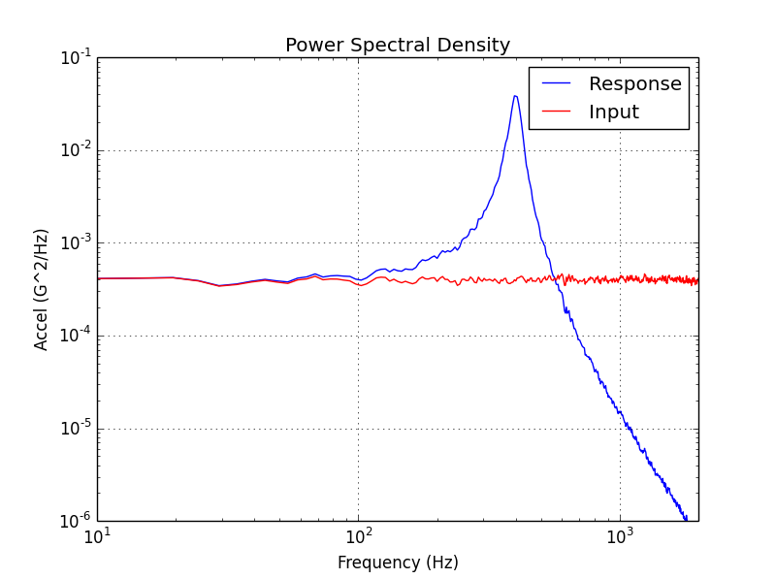
2K

