Slide 1
Unit 13
SDOF Response to Power Spectral Density Base Input

Slide 2
Exercise 5
Generate a white noise time history:
Duration = 60 sec
Std Dev = 1
Sample Rate=10000 Hz
Lowpass Filter at 2500 Hz
Save Signal to Matlab Workspace: white_60_input_th

Slide 3
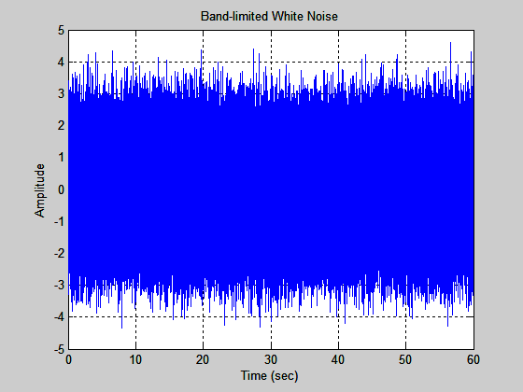
Base Input Time History: white_60_input_th

Slide 4
Exercise 5 (cont)
Generate the PSD of the 60-second white noise time history
Input: white_60_input_th
Use case 9 which has Δf ≅ 5 Hz
Mean Removal Yes & Hanning Window
Plot from 10 to 2000 Hz
Save PSD to Matlab Workspace – white_60_input_psd

Slide 5
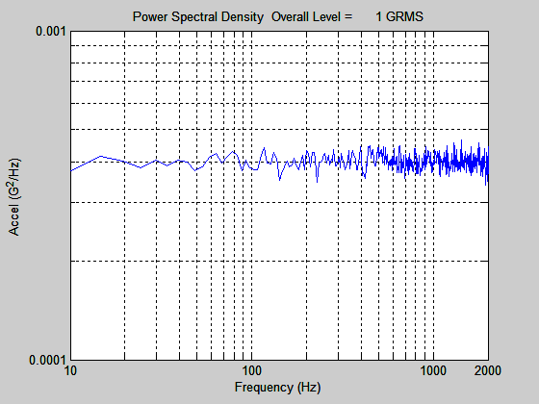
Base Input PSD: white_60_input_th
The plateau is 0.0004 G²/Hz.

Slide 6
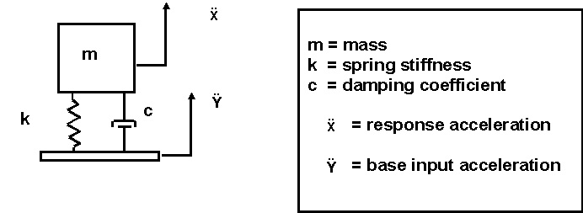
Recall SDOF Subjected to Base Input

Slide 7
SDOF Response to White Noise
Subjected a SDOF System (fn=400 Hz, Q=10) to the 60-second white noise time history.
Input: white_60_input_th
Use Vibrationdata GUI option:
SDOF Response to Base Input
Save Acceleration Response time history to Matlab Workspace – pick a name

Slide 8
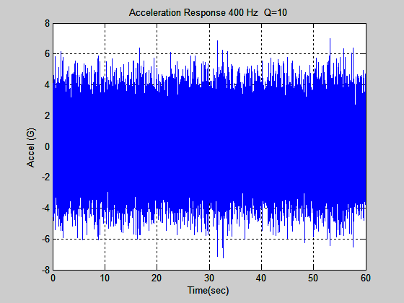
Response Time History: white_60_response_th

Slide 9
SDOF Response to White Noise PSD
Take a PSD of the Response Time History
Input: white_60_response_th
Mean Removal Yes & Hanning Window
Use case 8 which has Δf ≅ 5 Hz
Plot from 10 to 2000 Hz
Save Response PSD to Matlab Workspace: white_60_response_psd

Slide 10
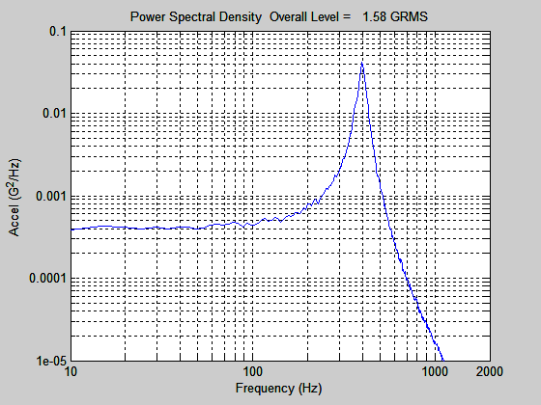
Response PSD: white_60_response_psd

Slide 11
Plot Both PSDs
Go to:
Miscellaneous Functions > Plot Utilities
Select Input > Two Curves
Curve 1: white_60_input_psd Color: Red Legend: Input
Curve 2: white_60_response_psd Color: Blue Legend: Response
Format: log-log X-axis: 10 to 2000 Hz
X-label: Frequency (Hz) Y-label: Accel (G^2/Hz)

Slide 12
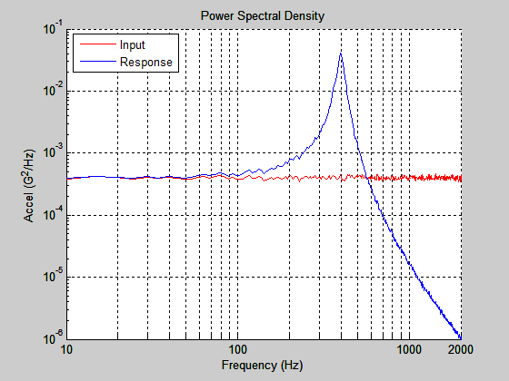
The SDOF system response has unity gain at low frequencies, below, say 50 Hz.
Dynamic amplification occurs at the 400 Hz natural frequency.
Attenuation occurs at frequencies beginning near 600 Hz.

Slide 13
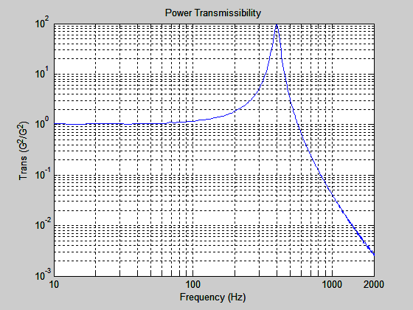
Matlab array name
Power Transmissibility: trans
Calculate Power Transmissibility from the response and input PSDs using the Vibrationdata GUI package.
The peak has a magnitude of Q² =100, but this relationship usually only works for SDOF response.
The 3 dB bandwidth method is more reliable for estimating the Q value.

Slide 14
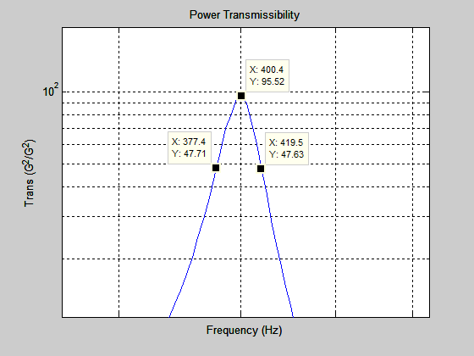
Half-power Bandwidth Points (-3 dB)
Δf = (419.5-377.4) Hz
= 42.1 Hz
Viscous Damping Ratio
= Δf / (2 f )
= 42.1/ (2*400)
= 0.0526
Q = 1 / ( 2 * 0.0526 )
Q = 9.5
5% lower than true value Q=10
Response PSD: white_60_response_psd

Slide 15
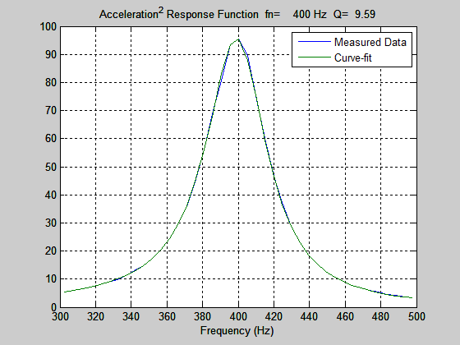
Curve-fit method using the Power Transmissibility Function
Input Matlab array name: trans
Miscellaneous Functions > Damping Functions > Half Power Bandwidth Damping
This curve-fitting method is actually an extension of the half power bandwidth method.

Slide 16
Miles Equation
The Miles equation is a simplified method of calculating the response of a single-degree-of-freedom system to a random vibration base input, where the input is in the form of a power spectral density.
Furthermore, the Miles equation is an approximate formula which assumes a flat power spectral density from zero to infinity Hz.
As a rule-of-thumb, it may be used if the power spectral density is flat over at least two octaves centered at the natural frequency.

Slide 17
Miles Equation
The Miles equation is a simplified method of calculating the response of a single-degree-of-freedom system to a random vibration base input, where the input is in the form of a power spectral density.
Furthermore, the Miles equation is an approximate formula which assumes a flat power spectral density from zero to infinity Hz.
As a rule-of-thumb, it may be used if the power spectral density is flat over at least two octaves centered at the natural frequency.

Slide 18
Miles Equation (cont)
The overall response acceleration is
where
fn = natural frequency
P = PSD level at fn
Q = amplification factor

Slide 19
Miles Equation Example
SDOF System (fn = 400 Hz, Q=10)
= 1.59 GRMS

Slide 20
Miles Equation, Relative Displacement
The 3σ relative displacement is
inch
where
fn = natural frequency
P = PSD G^2/Hz level at fn
Q = amplification factor

Slide 21
Better Method
We will learn a method that is better than Miles equation in an upcoming Webinar!

