Slide 1
Unit 16
Vibrationdata
General Method for Calculating the Vibration Response Spectrum

Slide 2
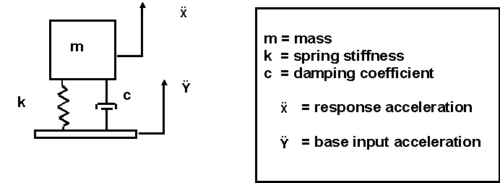
SDOF System, Base Excitation
Vibrationdata
The natural frequency fn is
Determine the response of a single-degree-of-freedom system subjected to base excitation, where the excitation is in the form of a power spectral density.
Do this for a family of natural frequencies. Plot results as Vibration Response Spectrum (VRS).

Slide 3
General Method Equation
Vibrationdata
Recall that he general method gives a more accurate response value than the Miles equation.
where f is the base excitation frequency and fn is the natural frequency

Slide 4
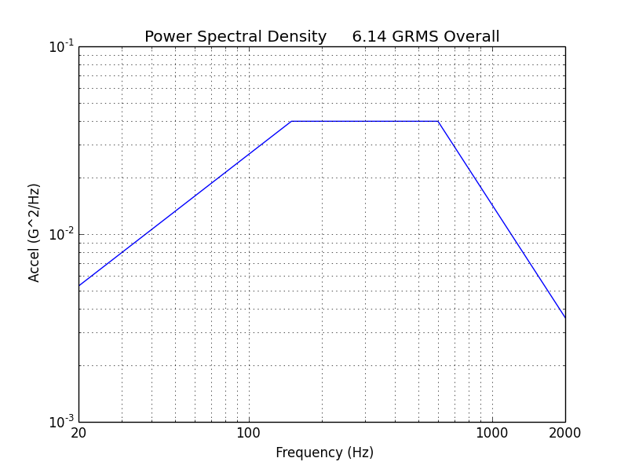
Frequency (Hz) | Accel (G^2/Hz)
20 | 0.0053
150 | 0.04
600 | 0.04
2000 | 0.0036
Consider the base input vibration test level from MIL-STD-1540B.
This level is used to test avionics components on shaker tables.
Array name: MILSTD1540B_ATP.txt

Slide 5
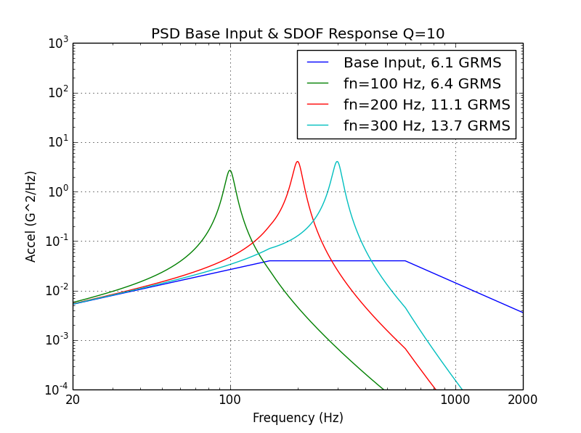
Use: vibrationdata > power spectral density > SDOF Response to Base Input
Save each response (Duration does not affect these curves)
Plot family of curves using:
vibrationdata > Miscellaneous Functions > Plot Utilities > Multiple Curves

Slide 6
GRMS Values for Response Curves
Vibrationdata
Vibration Response Spectrum Q=10
Natural Frequency (Hz) | Response Acceleration (GRMS)
100 | 6.4
200 | 11.1
300 | 13.7

Slide 7
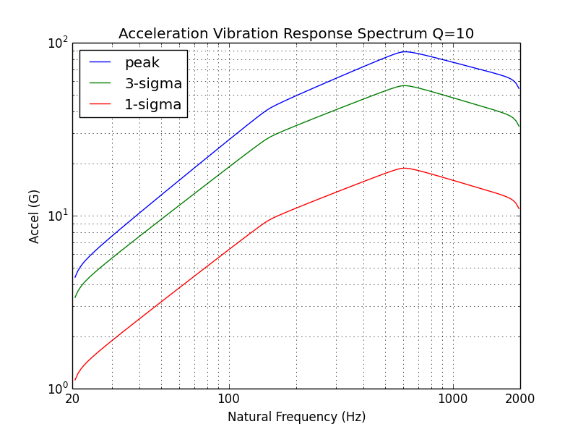
13.7 G
11.1 G
6.4 G
vibrationdata > Power Spectral Density > Vibration Response Spectrum (VRS)
Base Input is the MIL-STD1540B level. Duration is 60 seconds.

Slide 8
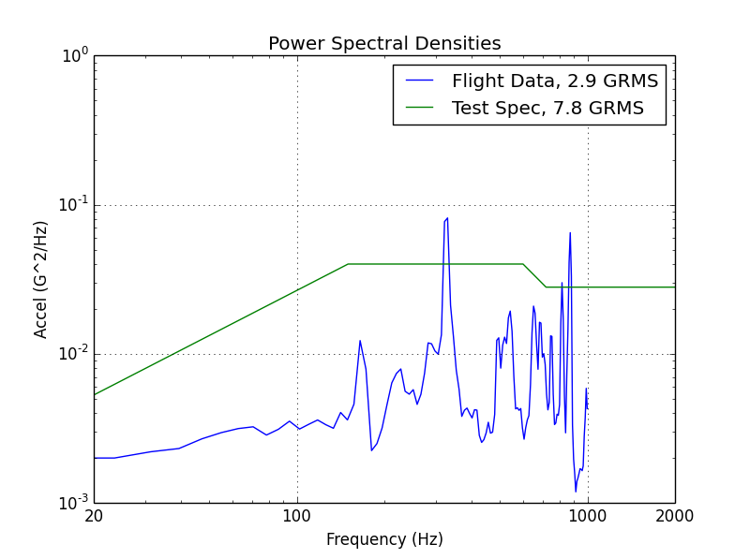
PSD Arrays:
flight_data.psd
test_spec.psd
330 Hz
872 Hz
Actual Case History
The accelerometer was mounted near the component in flight.
The component natural frequency is unknown.
Was the component under-tested?
Plot family of curves using:
vibrationdata > Miscellaneous Functions > Plot Utilities > Multiple Curves

Slide 9
Vibrationdata
VRS Calculation
Calculate VRS for both flight_data & test_spec
Duration = 60 seconds (but does not matter for this calculation)
Save each VRS, 1-sigma (1-sigma = GRMS for zero mean)
Plot the two VRS curves using:
vibrationdata > Miscellaneous Functions > Plot Utilities > Multiple Curves

Slide 10
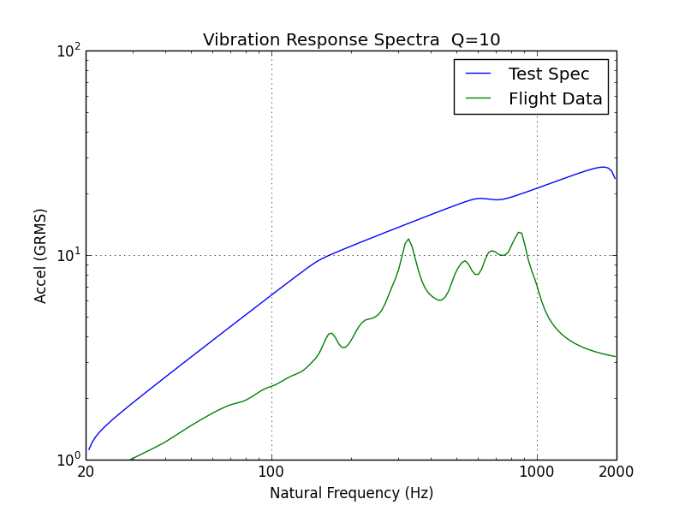
Assumptions:
SDOF Response, Q=10
Both PSDs are stationary with normal distribution.
PSD Durations:
Test > Flight
The SDOF response to the Test Spec is greater than that of the Flight Data across all natural Frequencies, with margin to spare.
So the component was not under-tested!

Slide 11
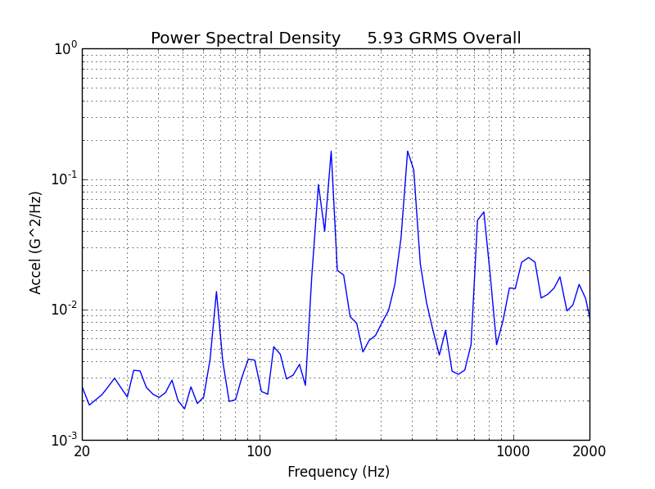
Vibrationdata
Flight Accelerometer Data
Python array name:
sub_bulkhead.txt
Task: Derive a simplified envelope using four coordinates.
This envelope will then be used to specify a design and test level after uncertainty margin has been added.

Slide 12
Vibrationdata
Envelope Derivation, Method 1
Dark red line is a candidate envelope.
Overall level = 10.3 GRMS
Too Conservative!

Slide 13
Envelope Derivation Method
Vibrationdata
Allow the envelope PSD to clip the flight data peaks as long as the envelope VRS meets or exceeds the flight data VRS
Use trial-and-error to derive the least possible PSD which meets the VRS requirement
This only cover GRMS response – fatigue will be covered in a future Webinar
Python >> vibrationdata > Power Spectral Density > Envelope PSD via VRS

Slide 14
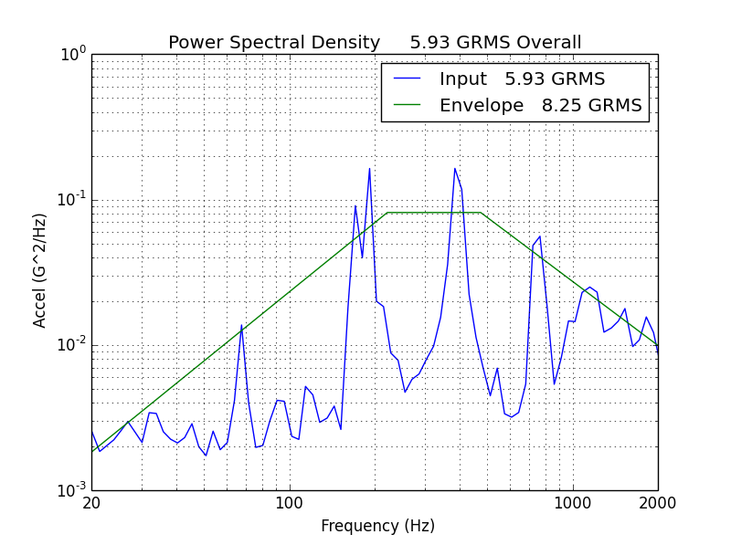
Vibrationdata
PSD Comparison
Envelope
Frequency (Hz) | Accel (G^2/Hz)
20 | 0.0018
222 | 0.081
474 | 0.081
2000 | 0.010
The Envelope allows for peak clipping.

Slide 15
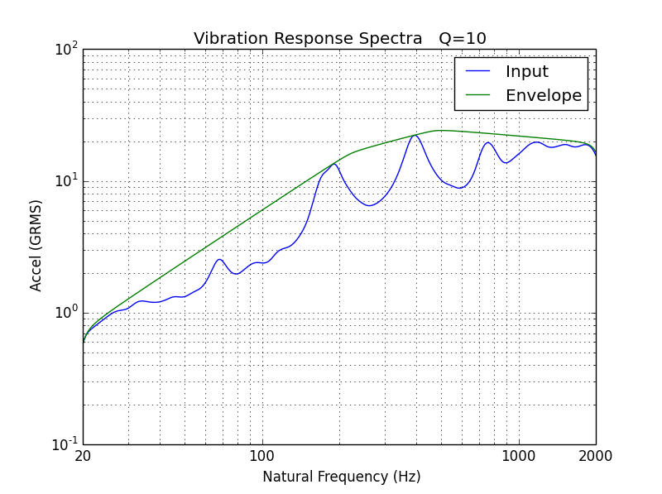
Vibrationdata
VRS Comparison
Assumptions:
SDOF Response, Q=10
Both PSDs are stationary with normal distribution.
PSD Durations:
Envelope > Input
The Envelope is greater than or equal to the Flight Data Input across all natural frequencies.

Slide 16
Conclusions
Vibrationdata
The Vibration Response Spectrum (VRS) is a useful tool for comparing the effects of different PSDs on a SDOF system, where the natural frequency and amplification factors are independent variables
The VRS can be used to determine whether a component previously tested to one PSD specification needs to be re-testing for a new specification
The VRS can be used for deriving envelopes for measured PSDs
The VRS will be extended to fatigue damage in future webinars

