Slide 1
Unit 17
SDOF Response to Applied Force Revision A

Slide 2
Introduction
SDOF systems may be subjected to an applied force
Modal testing, impact or steady-state force
Wind, fluid, or gas pressure
Acoustic pressure field
Rotating or reciprocating parts
Rotating imbalance
Shaft misalignment
Bearings
Blade passing frequencies
Electromagnetic force, magnetostriction

Slide 3
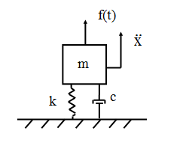
SDOF System, Applied Force
m | = | mass
c | = | viscous damping coefficient
k | = | stiffness
x | = | displacement of the mass
f(t) | = | applied force

Slide 4
Free Body Diagram
f(t)
Summation of forces
m
kx
Solve using Laplace transform.

Slide 5
For an arbitrary applied force, the displacement x is
Smallwood-type, ramp invariant, digital recursive filtering relationship
T = time step

Slide 6
SDOF Acceleration
For an arbitrary applied force, the displacement is

Slide 7
Time Domain Calculation for Applied Force
Let
fn = 10 Hz
Q=10
mass = 20 lbm
Calculate response to applied force:
F = 4 lbf, freq = 10 Hz, 4 sec duration, 400 samples/sec
First: vibrationdata > Generate Signal > Sine Export time history as: sine_force.txt
Next: vibrationdata > Select Input Data Type > Force
> Select Analysis > SDOF Response to Applied Force

Slide 8
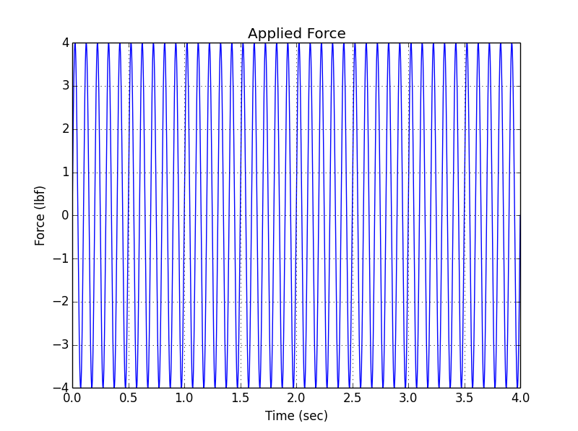
Applied Force Time History

Slide 9
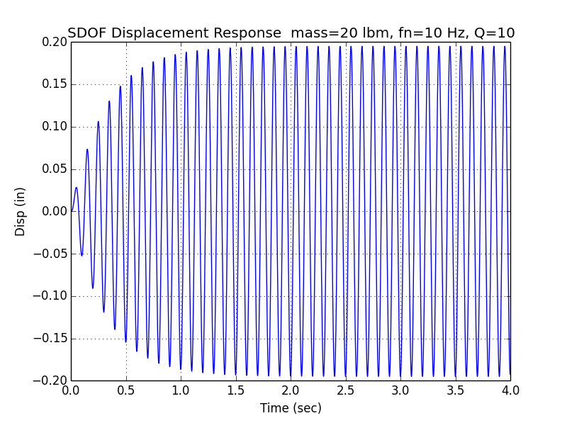
Displacement

Slide 10
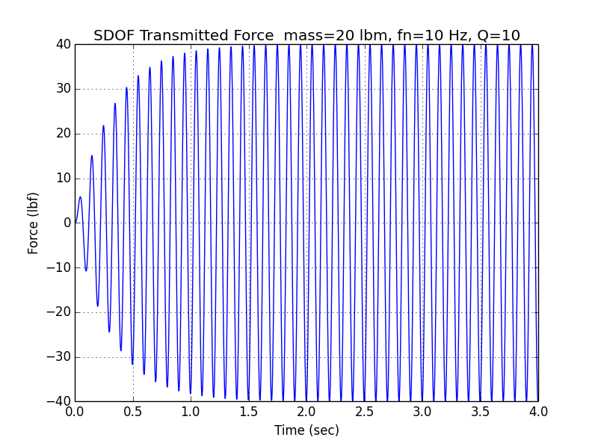
Transmitted Force
Special case:
SDOF driven at resonance
Transmitted force
= ( Q )( applied force )

Slide 11
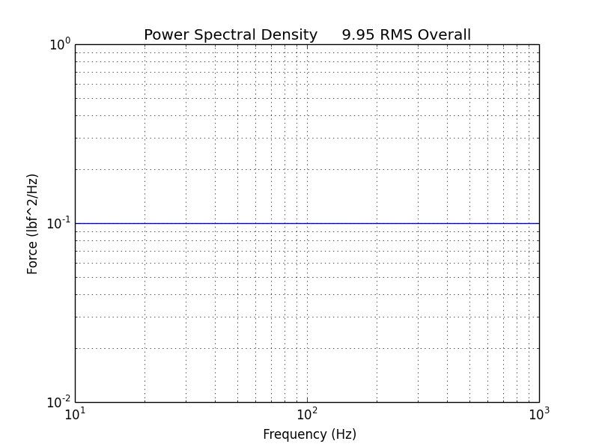
Synthesize Time History for Force PSD
Frequency (Hz) | Force (lbf^2/Hz)
10 | 0.1
1000 | 0.1
Duration = 60 sec
Similar process to synthesizing a time history for acceleration PSD.
But the integrated force time history does not need to have a mean value of zero.

Slide 12
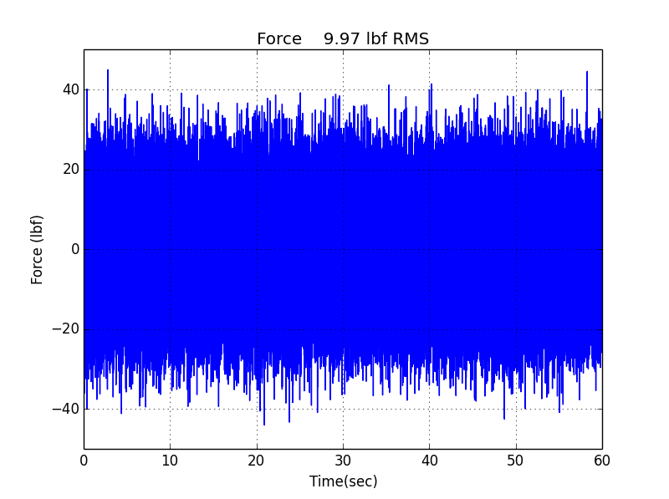
Synthesized Time History for Force PSD
Export as:
force_th.txt
vibrationdata > Power Spectral Density > Force > Time History Synthesis from White Noise
Δf = 4.26 Hz

Slide 13
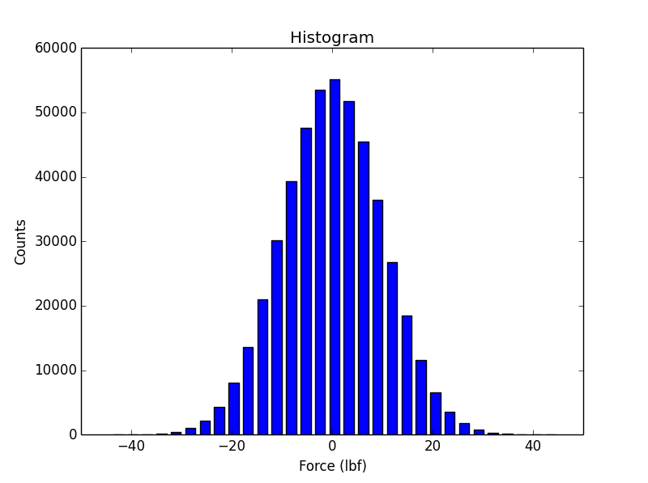
Histogram of Force Time History

Slide 14
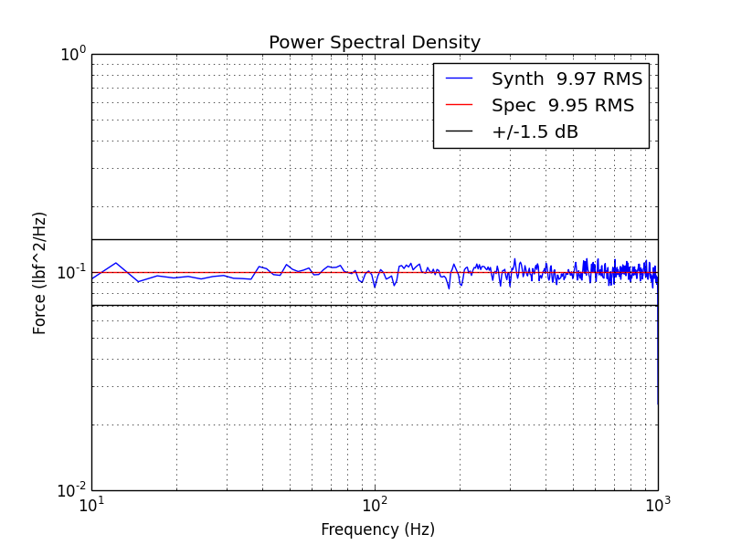
PSD Verification

Slide 15
SDOF Response
Let
fn = 400 Hz
Q=10
mass = 20 lbm
Calculate response to the previous synthesized force time history.
vibrationdata > Select Input Data Type > Force
> Select Analysis > SDOF Response to Applied Force

Slide 16
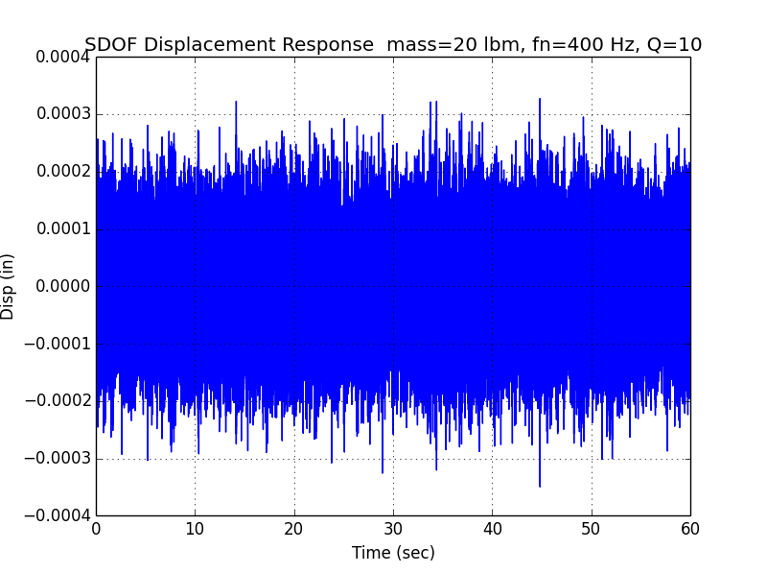
Displacement
Export:
disp_resp_th.txt
Overall Level =
7.4e-05 in RMS

Slide 17
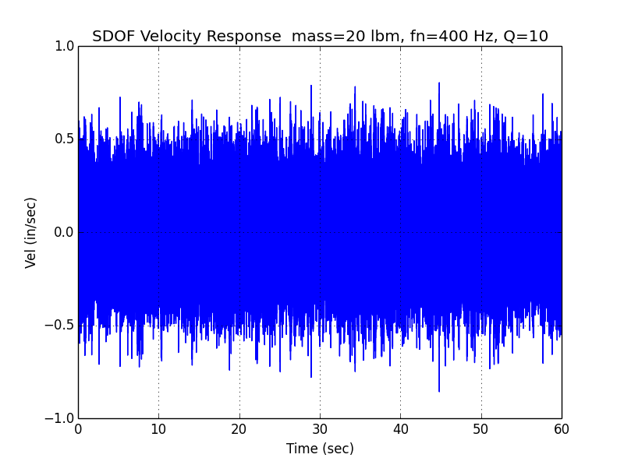
Velocity
Export array:
vel_resp_th.txt
Overall Level =
0.18 in/sec RMS

Slide 18
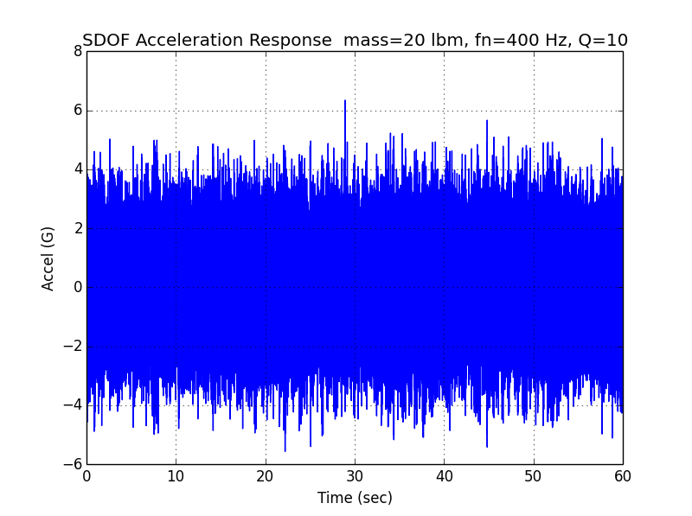
Acceleration
Export array:
accel_resp_th.txt
Overall Level = 1.3 GRMS
Crest Factor = 5.0
Theoretical Rayleigh Distribution
Crest Factor = 4.6

Slide 19
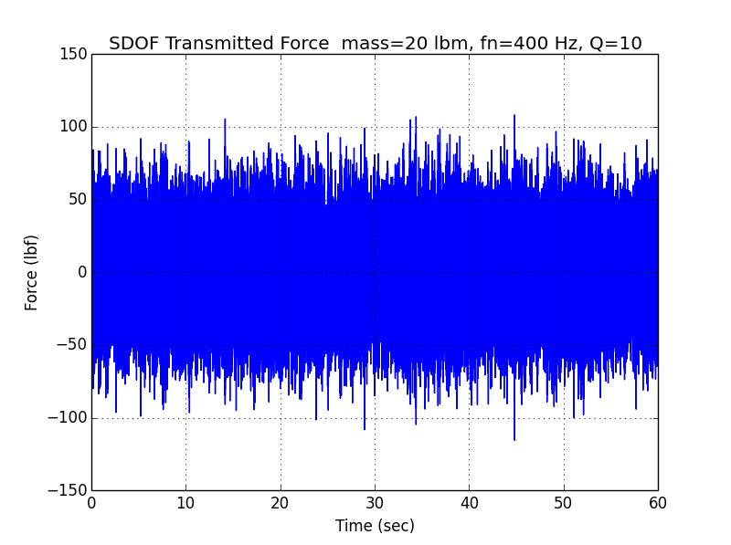
Transmitted Force
Export array:
tf_resp_th.txt
Overall Level =
24.3 lbf RMS

Slide 20
Frequency Response Function
Dimension | Displacement/Force | Velocity/Force | Acceleration/Force
Name | Admittance, Compliance, Receptance | Mobility | Accelerance, Inertance
Dimension | Force/Displacement | Force/Velocity | Force/Acceleration
Name | Dynamic Stiffness | Mechanical Impedance | Apparent Mass, Dynamic Mass

Slide 21
FRF Estimators
Cross spectrum between force and response divided by autospectrum of force
Cross spectrum is complex conjugate of first variable Fourier transform times the second variable Fourier transform.
* Denotes complex conjugate
The response can be acceleration, velocity or displacement.

Slide 22
FRF Estimators (cont)
Autospectrum of response divided by cross spectrum between response and force
Coherence Function γ is used to assess linearity, measurement, noise, leakage error, etc. Coherence is ideally equal to one.

Slide 23
Frequency Response Function Exercise
Calculate mobility function (velocity/force) using:
vibrationdata > miscellaneous > modal frf
- Two separate Arrays – Ensemble Averaging
Arrays: force_th.txt & vel_resp_th.txt
df = 3.91 Hz & use Hanning Window Important!
Plot H1 Freq & Mag & Phase

Slide 24
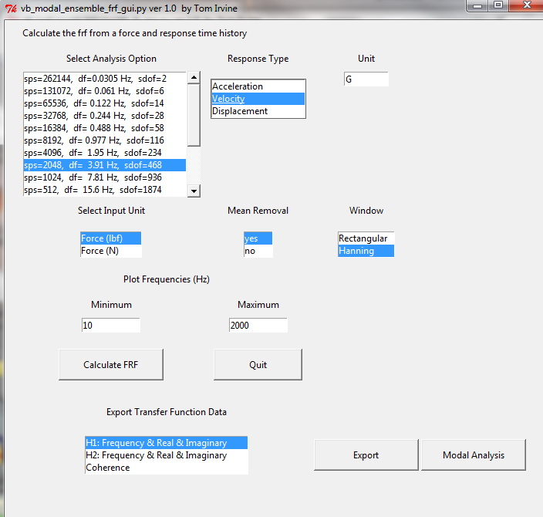

Slide 25
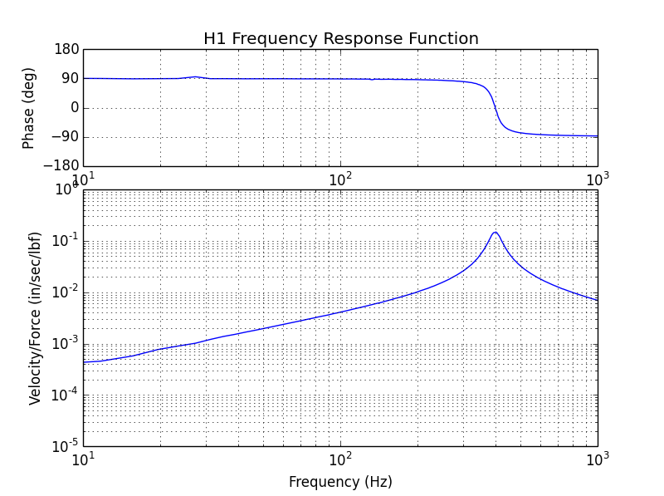
Mobility H1 SDOF fn=400 Hz, Q=10
Save Complex Array:
H1_mobility _complex.txt

Slide 26

Mobility H2 SDOF fn=400 Hz, Q=10

Slide 27
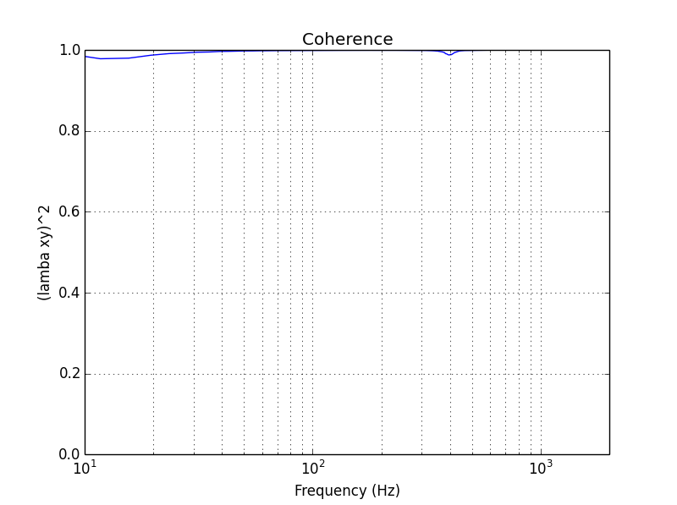
Coherence from Mobility
Coherence = 0.98
at 400 Hz

Slide 28
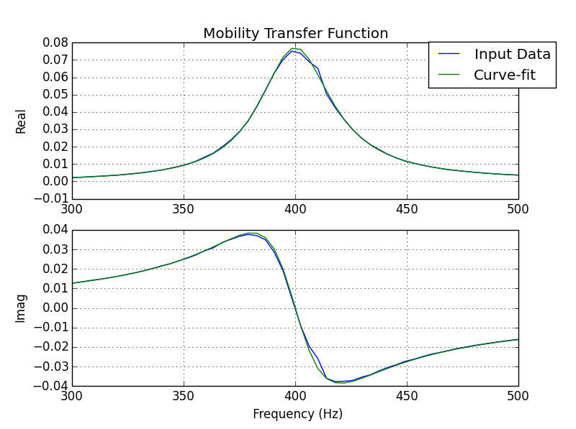
Estimate Q from H1 Mobility, Curve-fit
fn=400 Hz
Q=10.1
H1_mobility _complex.txt
vibrationdata > Damping Functions > Half-power Bandwidth Curve-fit, Modal FRF

Slide 29
Homework
Repeat the examples in the presentation using the Matlab scripts
Read:
T. Irvine, Machine Mounting for Vibration Attenuation, Rev B, Vibrationdata, 2000
Bruel & Kjaer Booklets:
Mobility Measurement
Modal Testing

