Slide 1
Unit 24
Seismic Shock

Slide 2
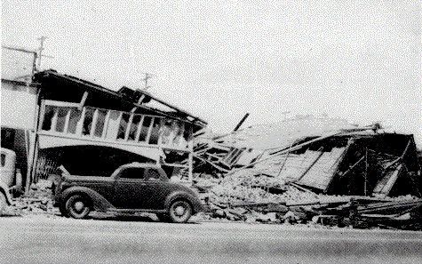
El Centro, Imperial Valley, Earthquake
Nine people were killed by the May 1940 Imperial Valley earthquake. At Imperial, 80 percent of the buildings were damaged to some degree. In the business district of Brawley, all structures were damaged, and about 50 percent had to be condemned. The shock caused 40 miles of surface faulting on the Imperial Fault, part of the San Andreas system in southern California. Total damage has been estimated at about $6 million. The magnitude was 7.1.

Slide 3
El Centro Time History
File: elcentro_NS.dat

Slide 4
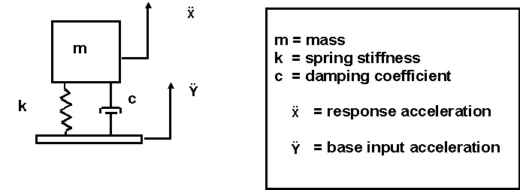
SDOF System Subjected to Base Excitation

Slide 5
Algorithm
Problems with arbitrary base excitation are solved using a convolution integral.
The convolution integral is represented by a digital recursive filtering relationship for numerical efficiency.

Slide 6
Smallwood Digital Recursive Filtering Relationship

Slide 7
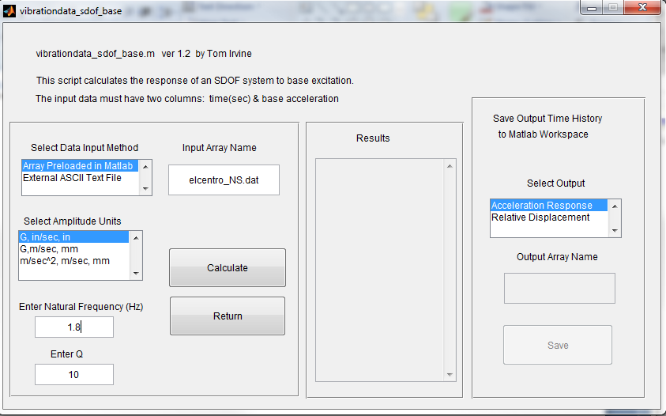
El Centro Earthquake Exercise I
ASCII text file: elcentro_NS.dat Natural Frequency (Hz): 1.8 Q=10

Slide 8
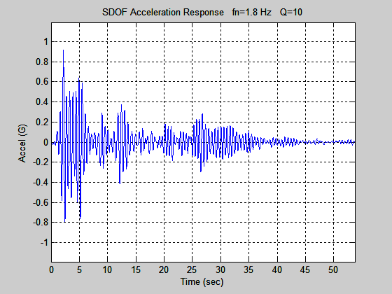
El Centro Earthquake Exercise I
Peak Accel = 0.92 G

Slide 9
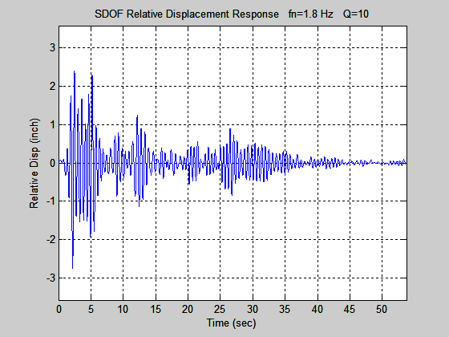
El Centro Earthquake Exercise I
Peak Rel Disp = 2.8 in

Slide 10
Pseudo Velocity
The pseudo velocity PV is
where Z is the relative displacement
is the natural frequency (rad/sec)
Dr. Howard Gaberson and others have written papers showing that dynamic stress is proportional to pseudo velocity.

Slide 11
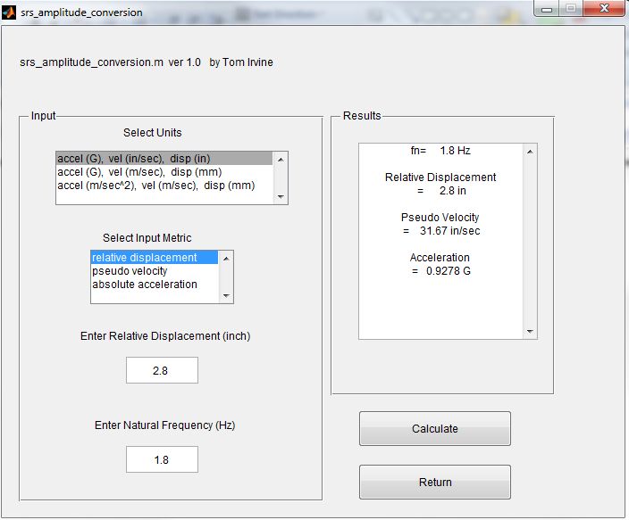
vibrationdata > Miscellaneous > Amplitude Conversion Utilities > SRS Amplitude Conversion

Slide 12
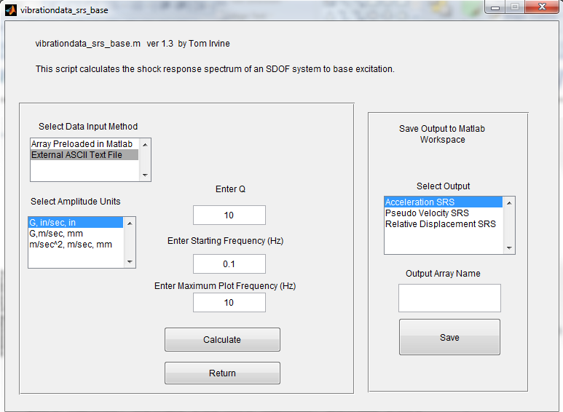
vibrationdata > Shock Response Spectrum

Slide 13
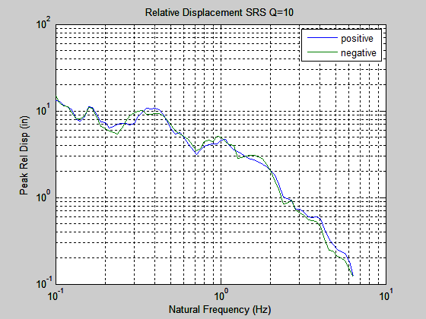
El Centro Earthquake SRS

Slide 14
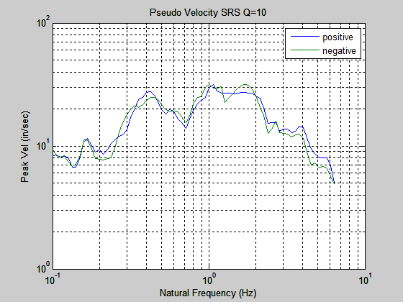
El Centro Earthquake SRS

Slide 15
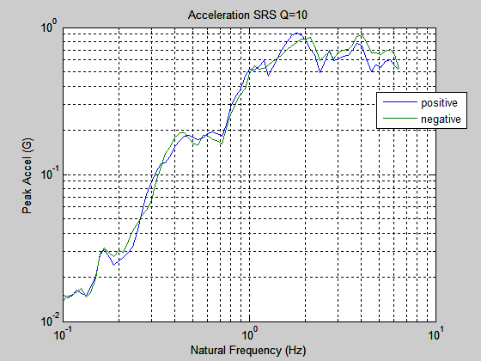
El Centro Earthquake SRS

Slide 16
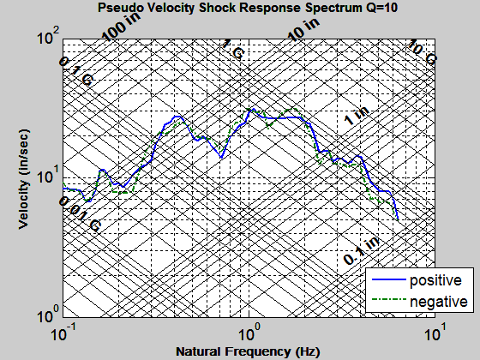
SRS Q=10 El Centro NS
fn = 1.8 Hz
Accel = 0.92 G
Vel = 31 in/sec
Rel Disp = 2.8 in

Slide 17
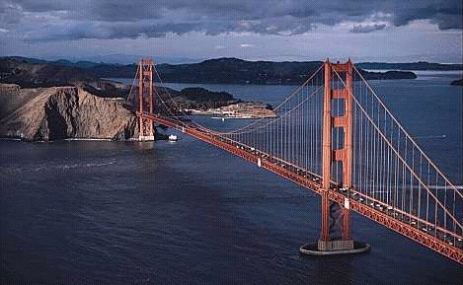
Golden Gate Bridge
Note that current Caltrans standards require bridges to withstand an equivalent static earthquake force (EQ) of 2.0 G.
May be based on El Centro SRS peak Accel + 6 dB.

Slide 18
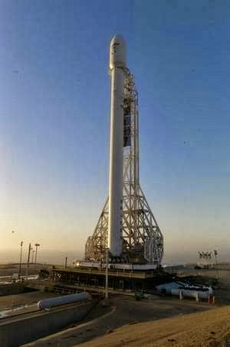
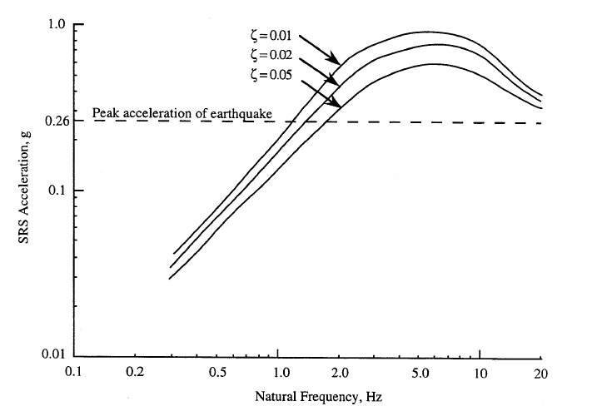
Vandenberg, California SRS
NASA-HDBK-7005, Shock Response Spectrum for Typical Central California Earthquake

Slide 19
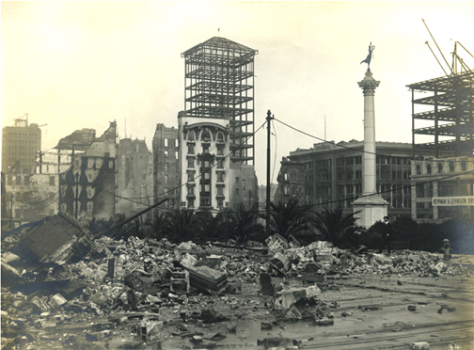
1906 San Francisco Quake
The San Francisco earthquake occurred at 5:12 A.M. on April 18, 1906
The source was a rupture of the San Andreas Fault
The duration of severe shaking was about 40 seconds
Reference sources give magnitude estimates ranging from 7.7 to 8.25
Many people died in the quake and in the fires which followed
The fires resulted from ruptured gas lines
Death toll estimates range from 700 to 3000

Slide 20
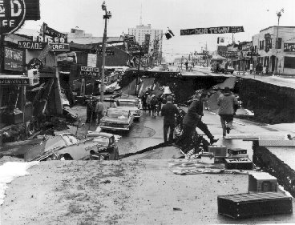
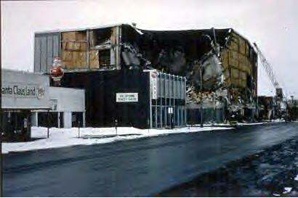
1964 Prince William Sound, Alaskan Quake
The Alaskan earthquake occurred on Good Friday, March 27, 1964, at 5:36 PM
It was the largest earthquake ever recorded in North America
Duration estimates range from 3 to 5 minutes
Bruce Bolt lists it as 8.6 Ms, where Ms is the surface-wave magnitude
The USGS gives it a 9.2 Mw, where Mw is the moment magnitude
The death toll was 131, mostly due to tsunami

Slide 21
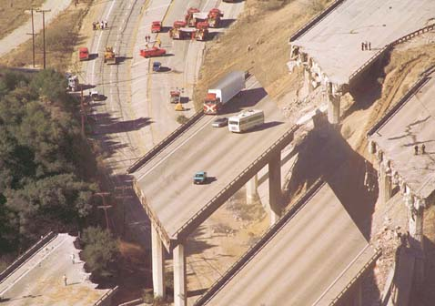
1994 Northridge Quake
Occurred at 4:30 a.m. local time on January 17, 1994
Had a 6.9 moment magnitude
Duration was about 20 second
Had the highest Peak Ground Acceleration (PGA) for USA at 1.7 G
Death toll was 57
The earthquake occurred along a previously unknown "blind" thrust fault, close to the San Andreas fault
Blind fault does break Earth’s surface and is thus not visible
Los Angeles basin was once one of the most prolific oil fields in the world
Oil companies had known about this blind fault but had not publically disclosed information

Slide 22
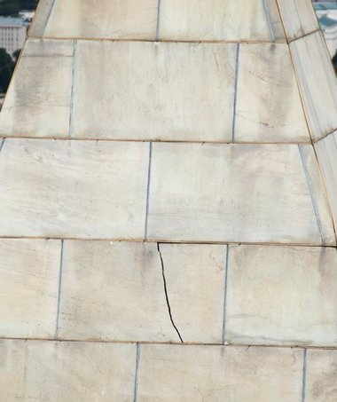
2011 Virginia Earthquake
Occurred on August 23, 2011
Epicenter was near Mineral, Virginia
(Piedmont region)
5.8-magnitude quake
A one-inch wide, four-foot long crack formed in the Washington Monument, near the top of the 555-foot obelisk
Distance from quake epicenter to Washington Monument is about 90 miles

Slide 23
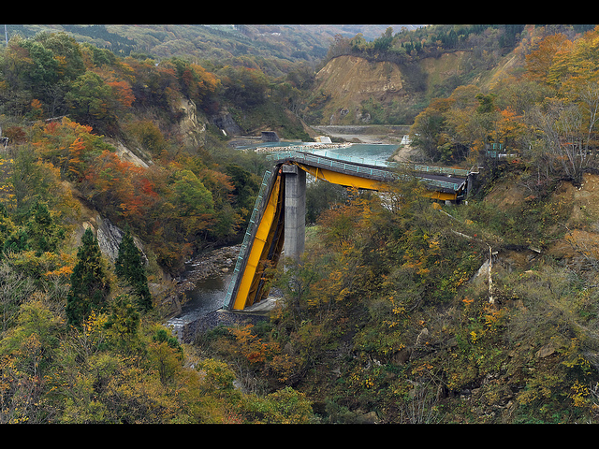
Highest Peak Ground Acceleration
The Iwate-Miyagi Nairiku earthquake struck northeast Honshu, Japan, on 14 June 2008
This earthquake had a moment magnitude Mw 6.9 according to the USGS
The peak ground acceleration (PGA) had a maximum vector sum (3 component) value of 4278 cm/sec^2 (4.36 G)
This is the highest ever recorded PGA, although other quakes have had higher moment magnitudes
The Richter and moment magnitudes are a measure of the total energy released by a quake
The PGA is measured at a point
PGA depends on soil conditions, distance from the hypocenter, and other factors

