Slide 1

Unit 29
The Stress-Velocity Relationship for Shock & Vibration
By Tom Irvine
Dynamic Concepts, Inc.

Slide 2
Introduction
The purpose of this presentation is to give an overview of the velocity-stress relationship metric for structural dynamics
Kinetic energy is proportional to velocity squared.
Velocity is relative velocity for the case of base excitation, typical represented in terms of pseudo-velocity
The pseudo-velocity is a measure of the stored peak energy in the system at a particular frequency and, thus, has a direct relationship to the survival or failure of this system
Build upon the work of Hunt, Crandall, Eubanks, Juskie, Chalmers, Gaberson, Bateman et al.
But mostly Gaberson!

Slide 3

Dr. Howard Gaberson
Howard A. Gaberson (1931-2013) was a shock and vibration specialist with more than 45 years of dynamics experience. He was with the U.S. Navy Civil Engineering Laboratory and later the Facilities Engineering Service Center from 1968 to 2000, mostly conducting dynamics research.
Gaberson specialized in shock and vibration signal analysis and has published more than 100 papers and articles.

Slide 4
Historical Stress-Velocity References
F.V. Hunt, Stress and Strain Limits on the Attainable Velocity in Mechanical Systems, Journal Acoustical Society of America, 1960
S. Crandall, Relation between Stress and Velocity in Resonant Vibration, Journal Acoustical Society of America, 1962
Gaberson and Chalmers, Modal Velocity as a Criterion of Shock Severity, Shock and Vibration Bulletin, Naval Research Lab, December 1969
R. Clough and J. Penzien, Dynamics of Structures, McGraw-Hill, New York, 1975

Slide 5
Infinite Rod, Longitudinal Stress-Velocity for Traveling Wave
Compression zone
Rarefaction zone
Direction of travel
The stress σ is proportional to the velocity as follows
ρ is the mass density, c is the speed of sound in the material,
v is the particle velocity at a given point
The velocity depends on natural frequency, but the stress-velocity relationship does not.

Slide 6
Finite Rod, Longitudinal Stress-Velocity for Traveling or Standing Wave
Direction of travel
Same formula for all common boundary conditions
Maximum stress and maximum velocity may occur at different locations
Assume stress is due to first mode response only
Response may be due to initial conditions, applied force, or base excitation

Slide 7
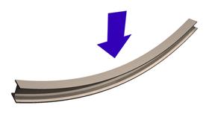
Beam Bending, Stress-Velocity
Distance to neutral axis
E
Elastic modulus
A
Cross section area
Mass per volume
I
Area moment of inertia
Again,
Same formula for all common boundary conditions
Maximum stress and maximum velocity may occur at different locations
Assume stress is due to first mode response only
Response may be due to initial conditions, applied force, or base excitation

Slide 8
Plate Bending, Stress-Velocity
Hunt wrote in his 1960 paper:
It is relatively more difficult to establish equally general relations between antinodal velocity and extensionally strain for a thin plate vibrating transversely, owing to the more complex boundary conditions and the Poisson coupling between the principal stresses.
But he did come up with a formula for higher modes for intermodal segments.
Z(x,y)
Ly
Lx
Y
X

Slide 9
Formula for Stress-Velocity
where
is a constant of proportionality dependent upon the geometry of the structure
Bateman, complex equipment
or more Gaberson
To do list: come up with case histories for further investigation & verification

Slide 10
MIL-STD-810E, Shock Velocity Criterion
An empirical rule-of-thumb in MIL-STD-810E states that a shock response spectrum is considered severe only if one of its components exceeds the level
Threshold = [ 0.8 (G/Hz) * Natural Frequency (Hz) ]
For example, the severity threshold at 100 Hz would be 80 G
This rule is effectively a velocity criterion
MIL-STD-810E states that it is based on unpublished observations that military-quality equipment does not tend to exhibit shock failures below a shock response spectrum velocity of 100 inches/sec (254 cm/sec)
Equation actually corresponds to 50 inches/sec. It thus has a built-in 6 dB margin of conservatism
Note that this rule was not included in MIL-STD-810F or G, however

Slide 11
V-band/Bolt-Cutter Shock
The time history was measured during a shroud separation test for a suborbital launch vehicle.

Slide 12
SDOF Response to Base Excitation Equation Review
Let
A | = | Absolute Acceleration
PV | = | Pseudo Velocity
Z | = | Relative Displacement
ω_{n} | = | Natural Frequency (rad/sec)
PV ≅ A / ω_{n}
PV ≅ ω_{n} Z

Slide 13
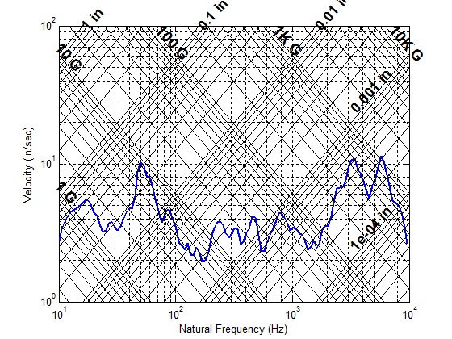
SRS Q=10 V-band/Bolt-Cutter Shock

Slide 14
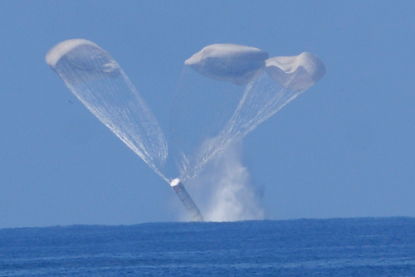
Space Shuttle Solid Rocket Booster Water Impact

Slide 15
Space Shuttle Solid Rocket Booster Water Impact
The data is from the STS-6 mission. Some high-frequency noise was filtered from the data.

Slide 16
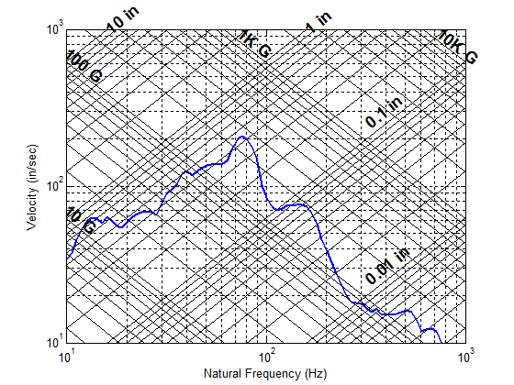
SRS Q=10 SRB Water Impact, Forward IEA

Slide 17
SR-19 Solid Rocket Motor Ignition
The combustion cavity has a pressure oscillation at 650 Hz.

Slide 18
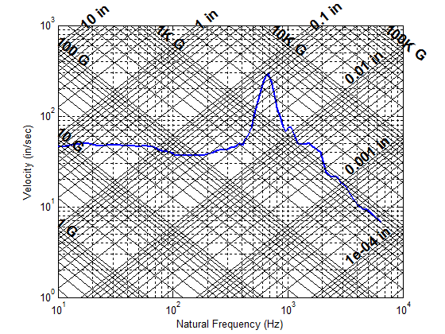
SRS Q=10 SR-19 Motor Ignition

Slide 19
RV Separation, Linear Shaped Charge
The time history is a near-field, pyrotechnic shock measured in-flight on an unnamed rocket vehicle.

Slide 20
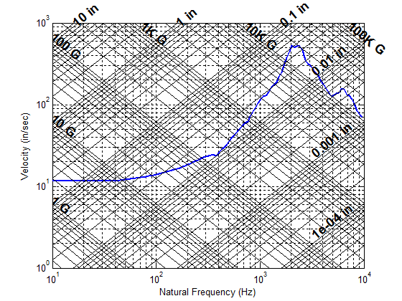
SRS Q=10 RV Separation Shock

Slide 21
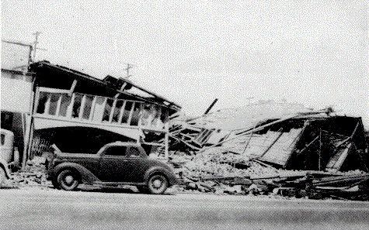
El Centro (Imperial Valley) Earthquake, 1940
The magnitude was 7.1
First quake for which good strong motion engineering data was measured

Slide 22
El Centro (Imperial Valley) Earthquake

Slide 23
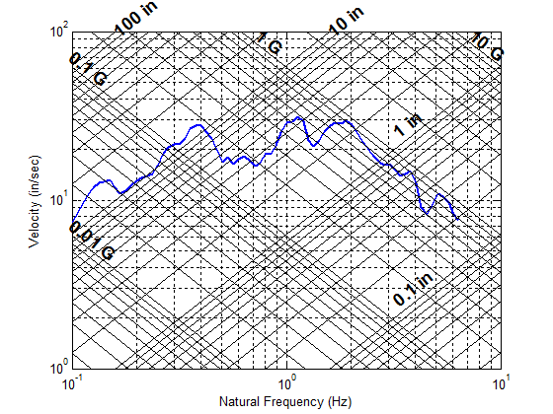
SRS Q=10 El Centro Earthquake North-South Component

Slide 24
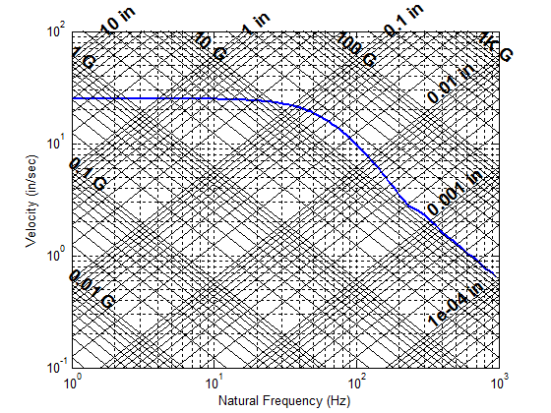
SRS Q=10, Half-Sine Pulse, 10 G, 11 msec

Slide 25
Maximum Velocity & Dynamic Range of Shock Events
Event | Maximum Pseudo Velocity (in/sec) | Velocity Dynamic Range (dB)
RV Separation, Linear Shaped Charge | 526 | 31
SR-19 Motor Ignition, Forward Dome | 295 | 33
SRB Water Impact, Forward IEA | 209 | 26
Half-Sine Pulse, 50 G, 11 msec | 125 | 32
El Centro Earthquake, North-South Component | 31 | 12
Half-Sine Pulse, 10 G, 11 msec | 25 | 32
V-band/Bolt-Cutter Source Shock | 11 | 15
But also need to know natural frequency for comparison.

Slide 26
Cantilever Beam Subjected to Base Excitation
y(x, t)
w(t)
Aluminum, Length = 9 in Width = 1 in Thickness=0.25 inch
5% Damping for all modes
Analyze using a continuous beam mode.

Slide 27
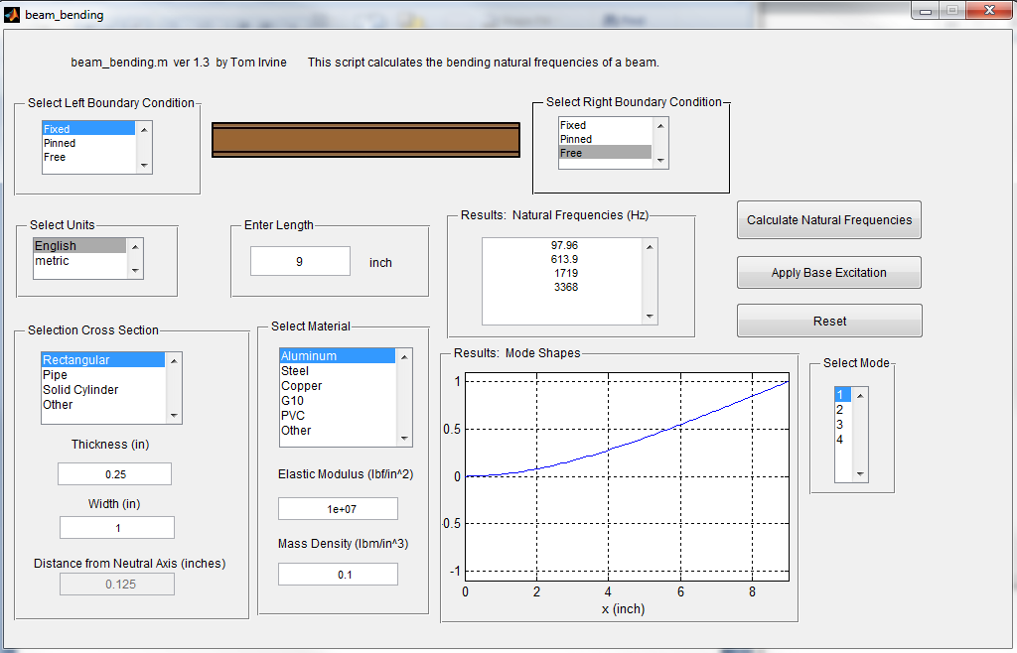
Vibrationdata > Structural Dynamics > Beam Bending

Slide 28
Modal Analysis
Natural Participation Effective
Mode Frequency Factor Modal Mass
1 97.96 Hz 0.0189 0.0003574
2 613.9 Hz 0.01048 0.0001098
3 1719 Hz 0.006143 3.773e-05
4 3368 Hz 0.004392 1.929e-05
modal mass sum = 0.0005241

Slide 29
Base Excitation
SRS Q=10
Perform:
Modal Transient using Synthesized Time History
Natural Frequency (Hz) | Peak Accel (G)
10 | 10
1000 | 1000
10,000 | 1000
srs_spec =[10 10; 1000 1000; 10000 1000]

Slide 30
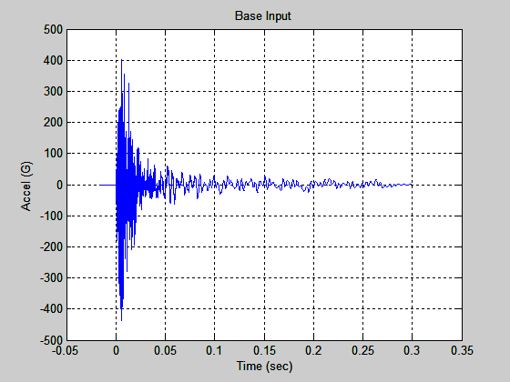
Synthesized Base Acceleration Input
Filename: srs1000G_accel.txt (import to Matlab workspace)

Slide 31
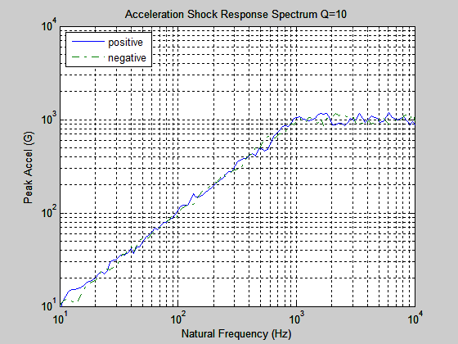
Synthesize Pulse SRS

Slide 32
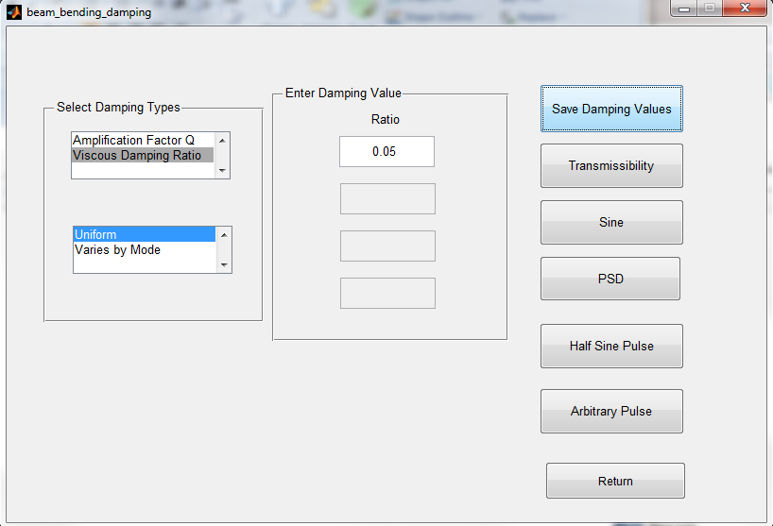
Enter Damping (Click on Apply Base Excitation on Previous Dialog)

Slide 33
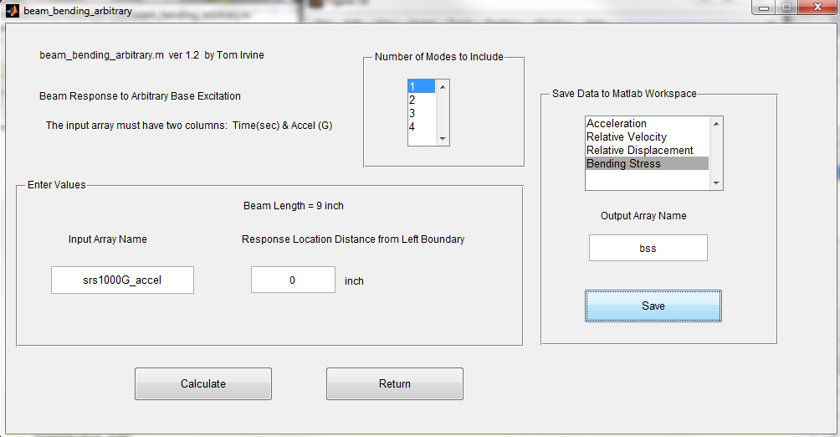
Apply Arbitrary Pulse

Slide 34
Single Mode, Modal Transient, Results
Absolute Acceleration = 437.1 G at 0 in
= 210.6 G at 4.5 in
= 255.3 G at 9 in
Relative Velocity = 0 in/sec at 0 in
= 34.09 in/sec at 4.5 in
= 100.4 in/sec at 9 in
Relative Displacement = 0 in at 0 in
= 0.05563 in at 4.5 in
= 0.1639 in at 9 in
Bending Moment = 92.61 in-lbf at 0 in
= 31.44 in-lbf at 4.5 in
= 0 in-lbf at 9 in
Distance from neutral axis = 0.125 in
Bending Stress = 8891 psi at 0 in
= 3019 psi at 4.5 in
= 0 psi at 9 in

Slide 35
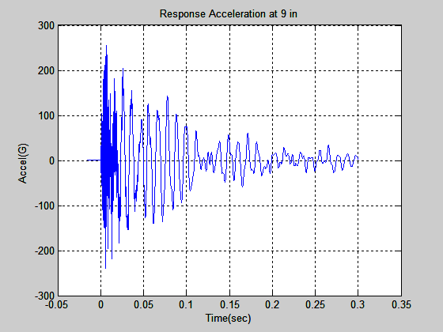
Single Mode, Modal Transient, Acceleration

Slide 36
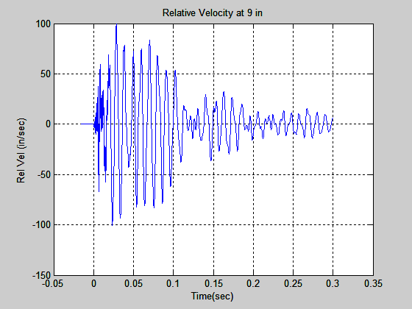
Single Mode, Modal Transient, Relative Velocity

Slide 37
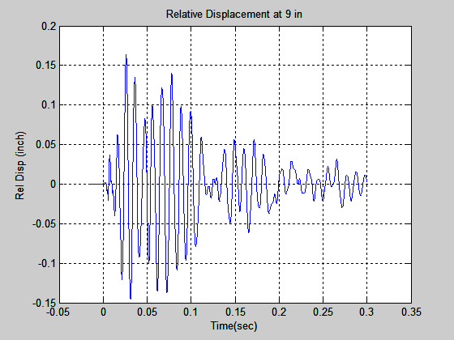
Single Mode, Modal Transient, Relative Displacement

Slide 38
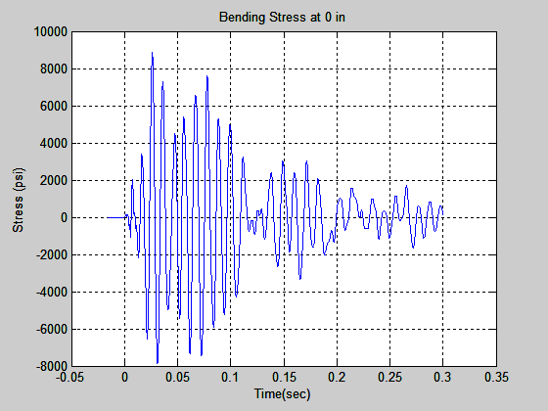
Single Mode, Modal Transient, Bending Stress

Slide 39
Cantilever Beam Response to Base Excitation, First Mode Only
x=0 is fixed end. x=L is free end.
Response Parameter | Location | Value
Relative Displacement | x=L | 0.16 in
Relative Velocity | x=L | 100.4 in/sec
Acceleration | x=L | 255 G
Bending Moment | x=0 | 92.6 lbf-in
Bending Stress | x=0 | 8891 psi
Both the bending moment and stress are calculated from the second derivative of the mode shape

Slide 40
Stress-Velocity for Cantilever Beam
The bending stress from velocity is thus
= 8851 psi
This is within 1% of the bending stress from the second derivative.
This is about 12 dB less than the material limit for aluminum on an upcoming slide.

Slide 41
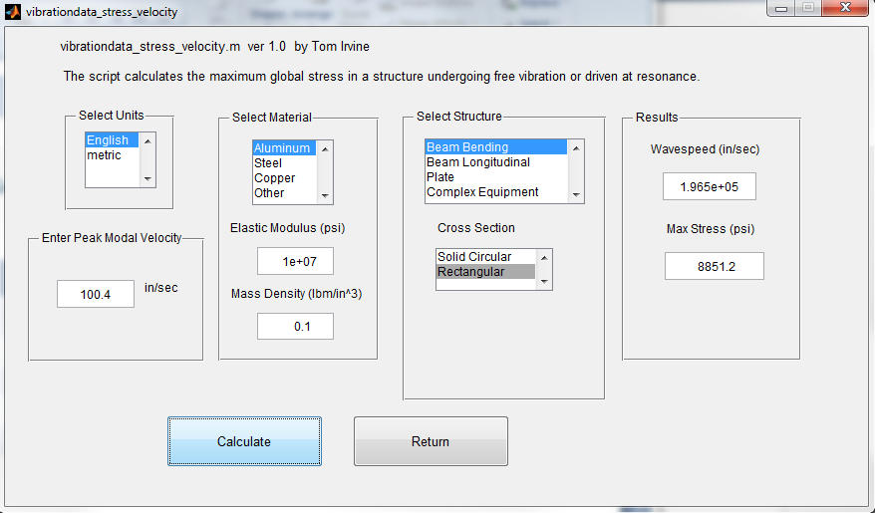
Stress-Velocity for Cantilever Beam
Vibrationdata > Structural Dynamics > Stress Velocity Relationship

Slide 42
Bending Stress at x=0 (fixed end) by Number of Included Modes
Modes | Relative Velocity at Free End (in/sec) | Velocity-Stress (psi) | Modal Transient Stress (psi)
1 | 100.4 | 8851 | 8891
2 | 116.1 | 10235 | 9505
3 | 117.5 | 10359 | 9467
4 | 117.5 | 10359 | 9483
Good agreement. There may be some “hand waving” for including multiple modes. Needs further consideration.

Slide 43
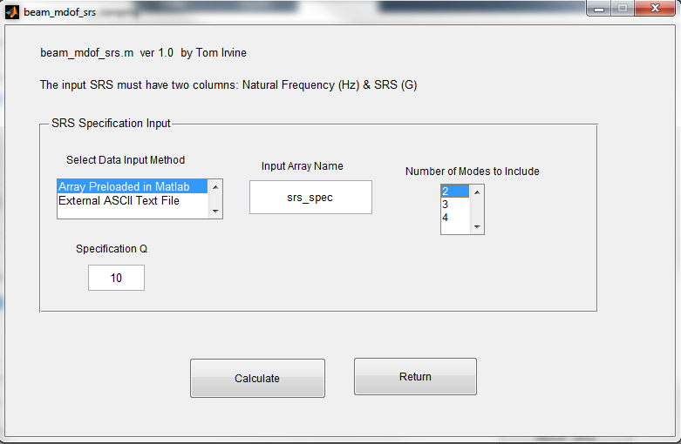
MDOF SRS Analysis
srs_spec =[10 10; 1000 1000; 10000 1000]

Slide 44
MDOF SRS Analysis Results at x = L (free end)
Included Modes | Modal Transient Velocity (in/sec) | SRSS Velocity (in/sec) | ABSSUM Velocity (in/sec)
2 | 116 | 110 | 150
3 | 118 | 112 | 168
4 | 118 | 112 | 174
Good agreement between Modal Transient and SRSS methods.

Slide 45
Sample Material Velocity Limits, Calculated from Yield Stress
Material | E (psi) | σ (psi) | ρ (lbm/in^3) | Rod V_{max} (in/sec) | Beam V_{max} (in/sec) | Plate V_{max} (in/sec)
Douglas Fir | 1.92e+06 | 6450 | 0.021 | 633 | 366 | 316
Aluminum 6061-T6 | 10.0e+06 | 35,000 | 0.098 | 695 | 402 | 347
Magnesium AZ80A-T5 | 6.5e+06 | 38,000 | 0.065 | 1015 | 586 | 507
Structural Steel | 29e+06 | 33,000 | 0.283 | 226 | 130 | 113
High Strength Steel | 29e+06 | 100,000 | 0.283 | 685 | 394 | 342

Slide 46
Material Stress & Velocity Limits Needs Further Research
A material can sometimes sustain an important dynamic load without damage, whereas the same load, statically, would lead to plastic deformation or to failure. Many materials subjected to short duration loads have ultimate strengths higher than those observed when they are static.
C. Lalanne, Sinusoidal Vibration (Mechanical Vibration and Shock), Taylor & Francis, New York, 1999
Ductile (lower yield strength) materials are better able to withstand rapid dynamic loading than brittle (high yield strength) materials. Interestingly, during repeated dynamic loadings, low yield strength ductile materials tend to increase their yield strength, whereas high yield strength brittle materials tend to fracture and shatter under rapid loading.
R. Huston and H. Josephs, Practical Stress Analysis in Engineering Design, Dekker, CRC Press, 2008

Slide 47
Industry Acceptance of Pseudo-Velocity SRS
MIL-STD-810G, Method 516.6
The maximax pseudo-velocity at a particular SDOF undamped natural frequency is thought to be more representative of the damage potential for a shock since it correlates with stress and strain in the elements of a single degree of freedom system...
It is recommended that the maximax absolute acceleration SRS be the primary method of display for the shock, with the maximax pseudo-velocity SRS the secondary method of display and useful in cases in which it is desirable to be able to correlate damage of simple systems with the shock.
See also ANSI/ASA S2.62-2009: Shock Test Requirements for Equipment in a Rugged Shock Environment

Slide 48
Conclusions
Global maximum stress can be calculated to a first approximation with a course-mesh finite element model
Stress-velocity relationship is useful, but further development is needed including case histories, application guidelines, etc.
Dynamic stress is still best determined from dynamic strain
This is especially true if the response is multi-modal and if the spatial distribution is needed
The velocity SRS has merit for characterizing damage potential
Tripartite SRS format is excellent because it shows all three amplitude metrics on one plot

Slide 49
Areas for Further Development of Velocity-Stress Relationship
Only gives global maximum stress
Cannot predict local stress at an arbitrary point
Does not immediately account for stress concentration factors
Need to develop plate formulas
Great for simple structures but may be difficult to apply for complex structure such as satellite-payload with appendages
Unclear whether it can account for von Mises stress, maximum principal stress and other stress-strain theory metrics

Slide 50
Related software & tutorials may be freely downloaded from
http://vibrationdata.wordpress.com/
The tutorial papers include derivations.
Or via Email request
tom@vibrationdata.com
tirvine@dynamic-concepts.com

