Slide 1
Unit 3
Vibrationdata
Sine Sweep Vibration

Slide 2
Sine Sweep Testing Purposes
Vibrationdata
Sine Sweep Testing of Components and Systems
Identify natural frequencies and amplification factors or damping ratios
Perform sine sweep before and after random vibration test to determine if any parts loosened, etc.
Check for linearity of stiffness and damping
Workmanship screen for defective parts and solder joints
Represent an actual environment such as a rocket motor oscillation
NASA/GSFC typically uses sine sweep vibration for spacecraft testing

Slide 3
Vibrationdata

Slide 4
Sine Sweep Characteristics
Vibrationdata
The essence of a sine sweep test is that the base excitation input consists of a single frequency at any given time.
The frequency itself, however, is varied with time.
The sine sweep test may begin at a low frequency and then sweep to a high frequency, or vice-versa.
Some specifications require several cycles, where one cycle is defined as from low to high frequency and then from high back to low frequency.

Slide 5
Sine Sweep Rate
Vibrationdata
The specification might require either a linear or a logarithmic sweep rate.
The sweep will spend greater time at the lower frequency end if the sweep is logarithmic.
The example in the previous figure had a logarithmic sweep rate.
The amplitude in the previous is constant.
Nevertheless, the specification might require that the amplitude vary with frequency.

Slide 6
Sine Sweep Specification Example
Vibrationdata
A vendor has a product that must withstand sinusoidal vibration with an amplitude of 12 G.
The desired frequency domain is 10 Hz to 2000 Hz.
The shaker table has a displacement limit of 1.0 inch peak-to-peak, or 0.5 inch zero-to-peak.
Recall that the displacement limit is a constraint at low frequencies.
How should the test be specified?
The answer is to use a specification with two amplitude segments.
The first segment is a constant displacement ramp.
The second segment is a constant acceleration plateau.

Slide 7
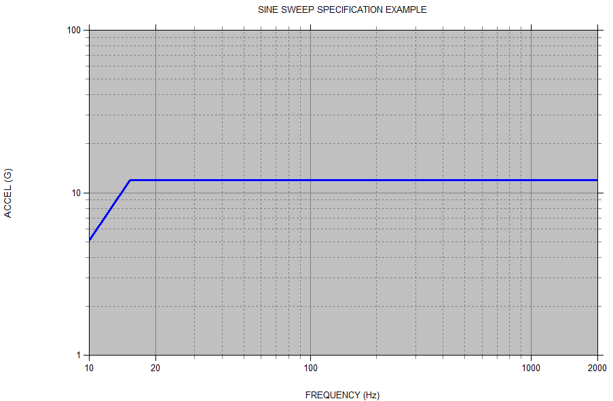
Sine Amplitude Metrics
Vibrationdata
Ramp is 1.0 inch peak-peak. Plateau is 12 G.

Slide 8
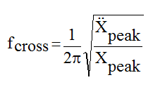
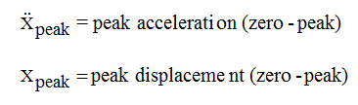
Crossover Frequency
Vibrationdata
The "crossover" frequency is 15.3 Hz. This is the frequency at which a 12 G acceleration has a corresponding displacement of 1.0 inch peak-to-peak. The crossover frequency f_{cross} is calculated via
Furthermore, the acceleration should be converted from G to in/sec² or G to m/sec², as appropriate.
8

Slide 9
Octaves
Vibrationdata
One octave is defined as a frequency band where the upper frequency limit is equal to twice the lower frequency limit.
Thus a band from 10 Hz to 20 Hz is one octave.
Likewise, the band from 20 Hz to 40 Hz is an octave.
A concern regarding sine sweep testing is the total number of octaves.
As an example consider the following frequency sequence in Hertz.
10 - 20 - 40 - 80 -160 - 320 - 640 - 1280 – 2560
The sequence has a total of eight octaves.

Slide 10

Octave Formulas
Vibrationdata
Now consider a sine sweep test from 10 Hz to 2000 Hz.
How many octaves are in this example?
A rough estimate is 7.5.
Nevertheless, the exact number is needed.
The number of octaves n can be calculated in terms of natural logarithms as
where f₁ and f₂ are the lower and upper frequency limits, respectively.
Thus, the frequency domain from 10 Hz to 2000 Hz has 7.64 octaves

Slide 11
Rate & Duration
Vibrationdata
The number of octaves is then used to set the sweep rate, assuming a logarithmic rate.
For example, the rate might be specified as 1 octave/minute.
The duration for 7.64 octaves would thus be: 7 minutes 38 seconds
The excitation frequency at any time can then be calculated from this rate.
Or perhaps the total sweep time from 10 Hz to 2000 Hz is specified as 8 minutes.
Thus, the sweep rate is 0.955 octaves/min.

Slide 12
SDOF Response Example
Vibrationdata
Apply sine sweep base input to an SDOF system (fn=40 Hz, Q=10)
Input Specification:
10 Hz, 1 G
80 Hz, 1 G
Duration 180 seconds
Sample Rate = 1000 Hz
3 octaves
Log sweep 1 octave/min
Synthesize time history with Python GUI script: vibrationdata.py
vibrationdata > Miscellaneous Analysis > Generate Signal > Sine Sweep
Then export time history as: sine_sweep.txt

Slide 13
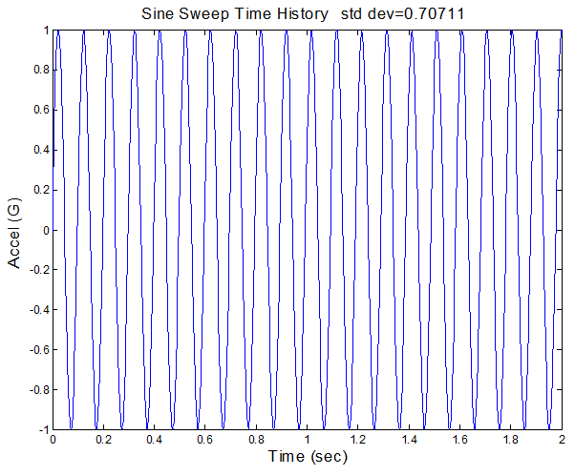
Input Sine Sweep, Segment
Vibrationdata
Entire time history is 180 seconds

Slide 14
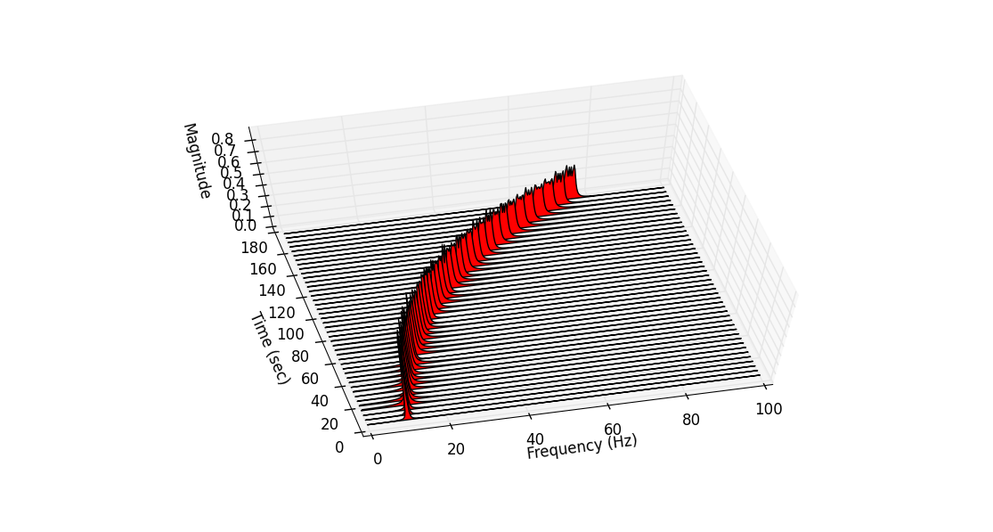
Input Sine Sweep, Waterfall FFT
Vibrationdata
Waterfall FFT
The series of peaks forms a curved line because the sweep rate is logarithmic.

Slide 15
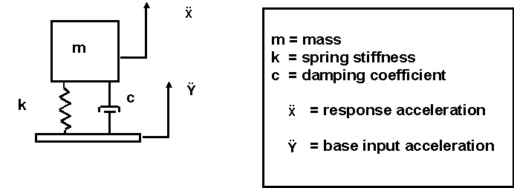
SDOF System Subjected to Base Excitation
Vibrationdata
The equation of motion was previously derived in Webinar 2.
Highlights are shown on the next slide.

Slide 16
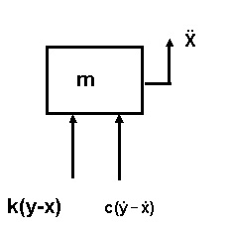
Free Body Diagram
Vibrationdata
Summation of forces in the vertical direction
Let z = x - y. The variable z is thus the relative displacement.
Substituting the relative displacement yields

Slide 17
Solving the Equation of Motion
Vibrationdata
A convolution integral is used for the case where the base input acceleration is arbitrary.
The convolution integral is numerically inefficient to solve in its equivalent digital-series form.
Instead, use…
Smallwood, ramp invariant, digital recursive filtering relationship!
Synthesize time history with Python GUI script: vibrationdata.py
Select Signal Analysis > SDOF Response to Base Input

Slide 18
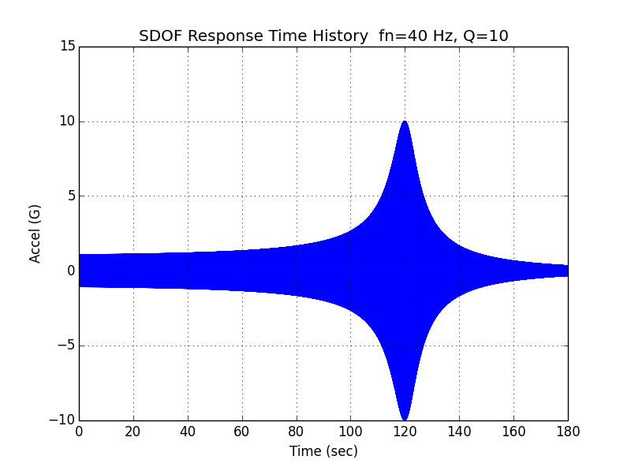
SDOF Response
Vibrationdata

Slide 19
Solid Rocket Pressure Oscillation
Vibrationdata
Solid rocket motors may have pressure oscillations which form in the combustion chamber
Various vortex-shedding and other effects cause standing waves to form in the combustion cavity
This effect is sometimes called “Resonant Burn” or “Thrust Oscillation”
The sinusoidal oscillation frequency may sweep downward as the cavity volume increases due to the conversion of propellant to exhaust gas

Slide 20
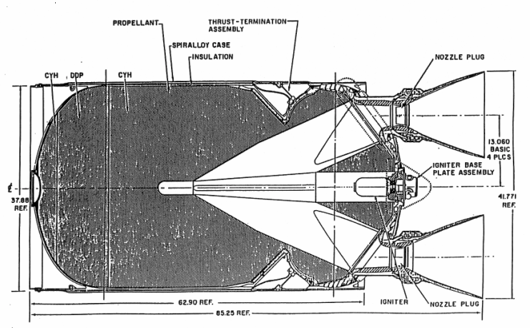
Solid Rocket Motor Example
Vibrationdata

Slide 21
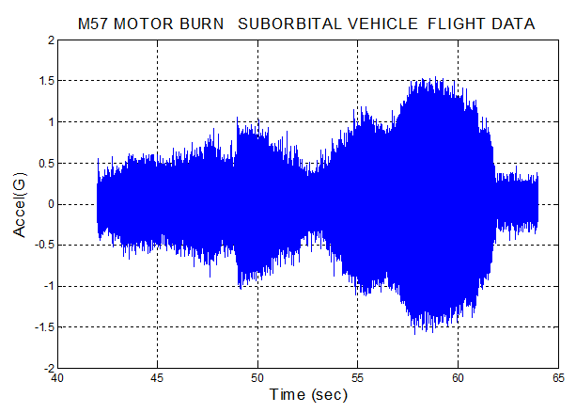
Flight Accelerometer Data
Vibrationdata
File: solid_motor_flight.txt

Slide 22
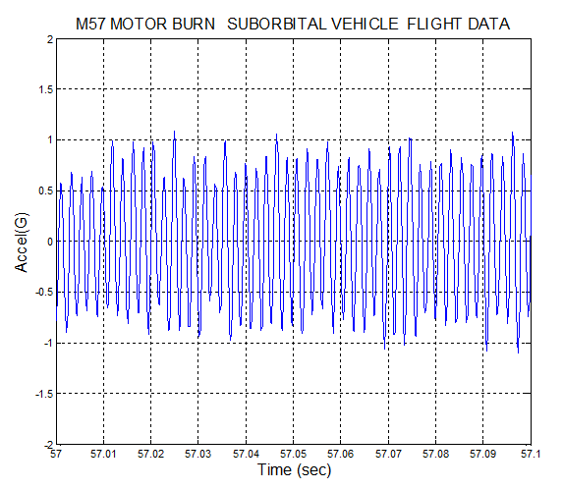
Flight Accelerometer Data, Segment
Vibrationdata

Slide 23
Time-Varying Statistics
Vibrationdata
Calculate statistics for each consecutive 0.5-second segment
Use Python GUI script: vibrationdata.py
Select Signal Analysis > Time-Varying Freq & Amp

Slide 24
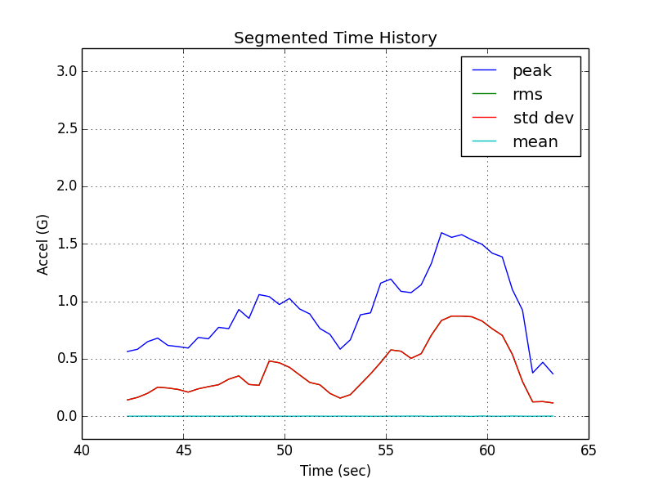

Slide 25
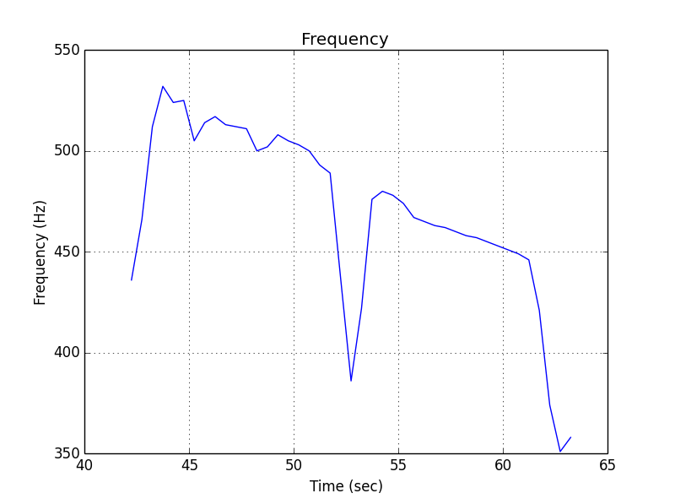

Slide 26
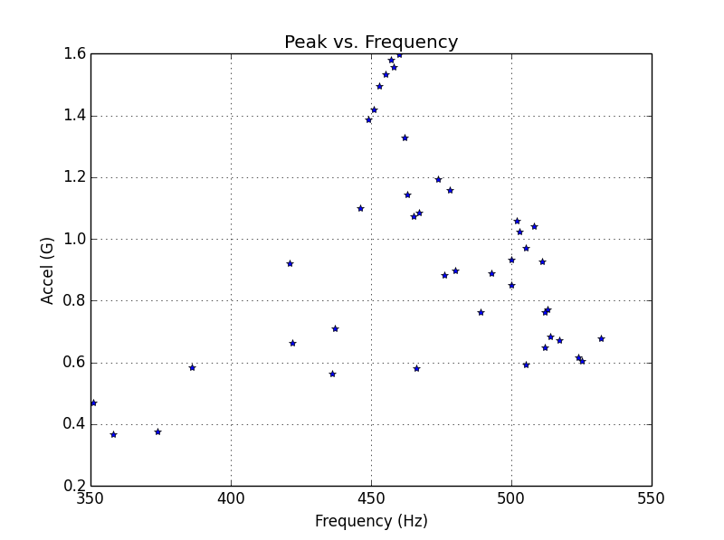

Slide 27
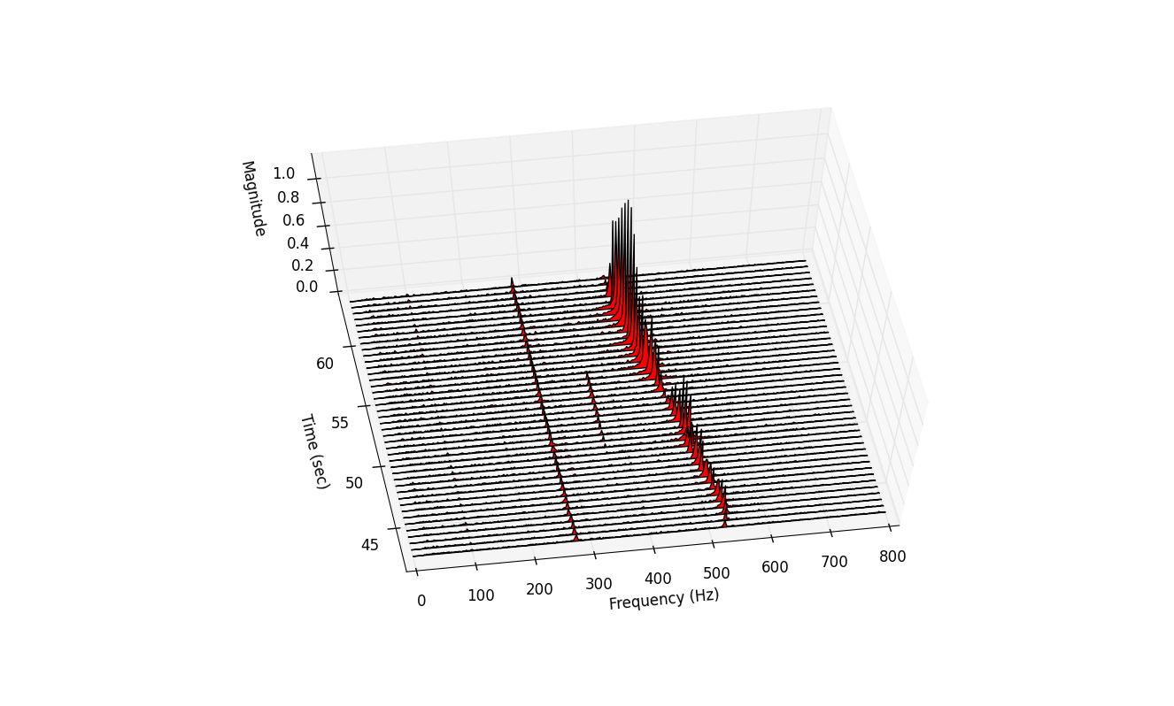
Solid Rocket Motor Flight Data – Waterfall FFT
Waterfall FFTs will be covered in a future webinar

Slide 28
Exercise 1
Vibrationdata
A shaker table has a displacement limit of 1.5 inch peak-to-peak, or 0.75 inch zero-to-peak.
An amplitude of 28 G is desired from 10 Hz to 2000 Hz.
The specification will consist of a displacement ramp and an acceleration plateau.
What should the crossover frequency be?
Use Python GUI script: vibrationdata.py
vibrationdata > Miscellaneous Analysis > Sine Sweep Parameters > Cross-over Frequency
What is the maximum acceleration at 10 Hz?
vibrationdata > Miscellaneous Analysis > Amplitude Conversion Utilities > Steady-State Sine Amplitude

Slide 29
Exercise 2
Vibrationdata
Apply sine sweep base input to an SDOF system (fn=60 Hz, Q=10)
Input Specification:
10 Hz, 1 G
80 Hz, 1 G
Duration 180 seconds, Sample Rate = 2000 Hz
3 octaves
Log sweep 1 octave/min
Synthesize time history with Python GUI script: vibrationdata.py
vibrationdata > Miscellanous Functions > Generate Signal > Sine Sweep
Save time history in Python workspace as: sine_sweep
Then calculate SDOF Response (fn=60 Hz, Q=10) to the sine sweep
vibrationdata > SDOF Response to Base Input

Slide 30
Exercise 3
Vibrationdata
Calculate statistics for each consecutive 0.5-second segment
Use Python GUI script: vibrationdata.py
Vibrationdata > Time-Varying Freq & Amp
Call in external ASCII file:
solid_motor.dat - time (sec) & accel (G)

