Slide 1
Unit 30
Rectangular Plate Shock & Vibration
By Tom Irvine
Dynamic Concepts, Inc.

Slide 2
Introduction
This unit will present plate bending shock & vibration
Plates modeled as continuous systems
(Finite element analysis for plates will be covered in a future unit)
The plate may represent a circuit board with added uniform nonstructural mass from electronic piece parts
First perform normal modes analysis
Next Plates will be subjected to base excitation (enforced acceleration)
Also consider Hunt’s stress-velocity relationship for plates

Slide 3
References
Arthur W. Leissa, NASA SP-160, Vibration of Plates
Steinberg, Vibration Analysis for Electronic Components
Papers posted at Vibrationdata blog

Slide 4
Hunt Plate Bending, Stress-Velocity for Simply-Supported Plates
Hunt wrote in his 1960 paper:
It is relatively more difficult to establish equally general relations between antinodal velocity and extensionally strain for a thin plate vibrating transversely, owing to the more complex boundary conditions and the Poisson coupling between the principal stresses.
But he did come up with a formula for higher modes for intermodal segments.
Z(x,y)
Ly
Lx
Y
X

Slide 5
Hunt Plate Bending, Stress-Velocity for Simply-Supported Plates
The intermodal stress σ_{int, max} is
Z(x,y)
Ly
Lx
Y
X
Combine both stress components into a von Mises-type stress
is the mass density
c is the speed of sound in the material
is the Poisson ratio v_{int, max} is the intermodal particle velocity

Slide 6
Stress-Velocity for Plates with Other Boundary Conditions
Need to develop relationships for other cases!

Slide 7
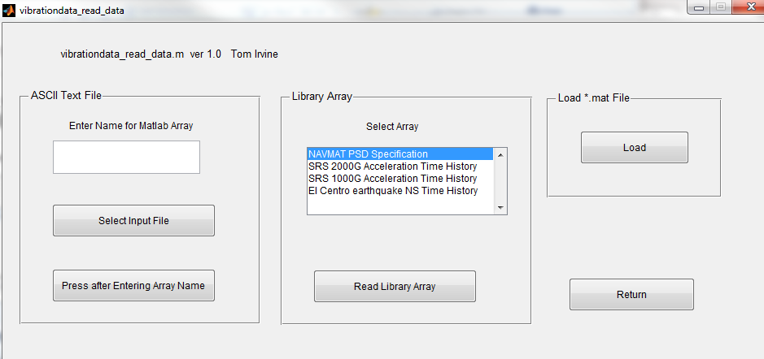
Read Input Arrays
vibrationdata > Import Data to Matlab
Read in Library Arrays: NAVMAT PSD Specification & SRS 1000G Acceleration Time History

Slide 8
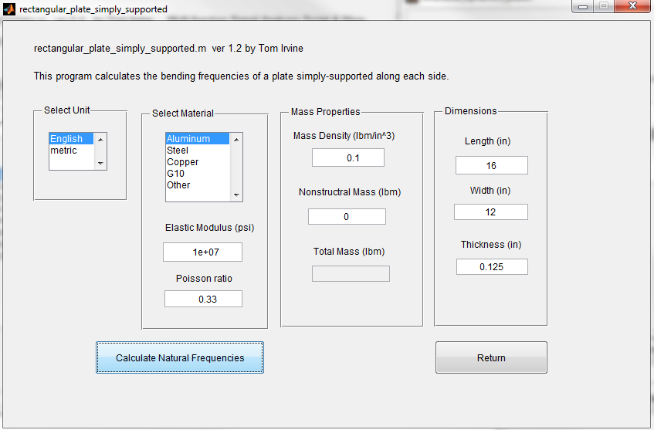
Rectangular Plate Simply Supported on All Edges, Aluminum, 16 x 12 x 0.125 inches
vibrationdata > Structural Dynamics > Plates, Rectangular & Circular > Rectangular Plate, Simply-Supported

Slide 9
Simply-Supported Plate, Normal Modes
fn(Hz) m n PF EMM ratio
128.01 1 1 0.06391 0.657
266.25 2 1 -0 0
373.77 1 2 -0 0
496.66 3 1 0.0213 0.073
512.02 2 2 0 0
742.43 3 2 -0 0
783.39 1 3 0.0213 0.073
819.23 4 1 -0 0
921.64 2 3 -0 0
1065 4 2 0 0
1152 3 3 0.007102 0.008111
1234 5 1 0.01278 0.02628
1356.9 1 4 -0 0
1474.6 4 3 -0 0
1479.7 5 2 -0 0
1495.1 2 4 0 0

Slide 10
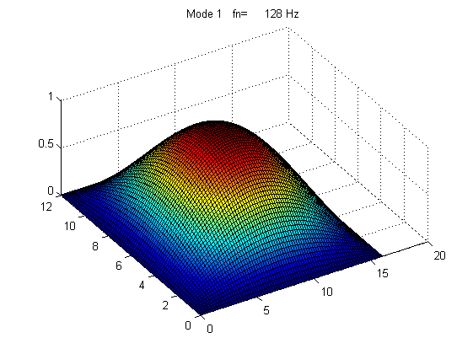
Simply-Supported Plate, Fundamental Modes

Slide 11
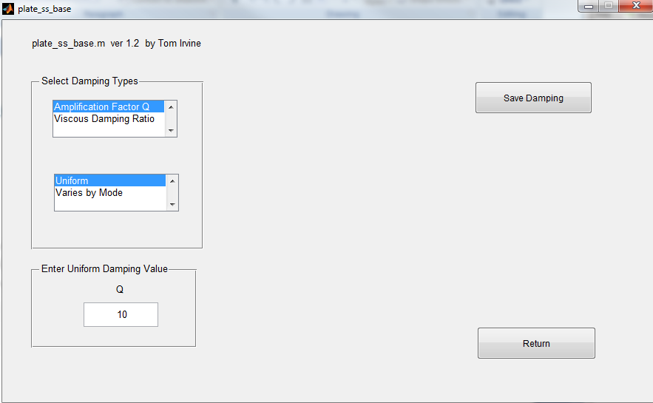
Simply-Supported Plate, Apply Q=10 for All Modes

Slide 12
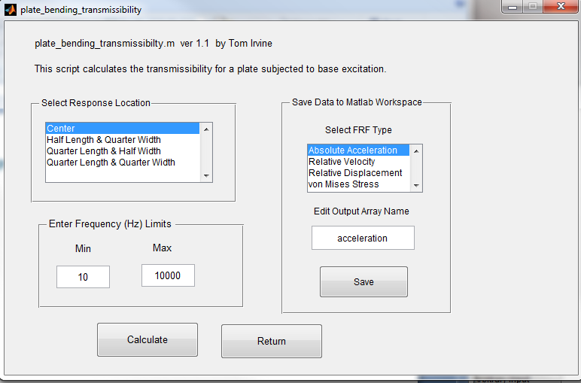
Simply-Supported Plate, Transmissibility
Save option appears after Calculate.

Slide 13
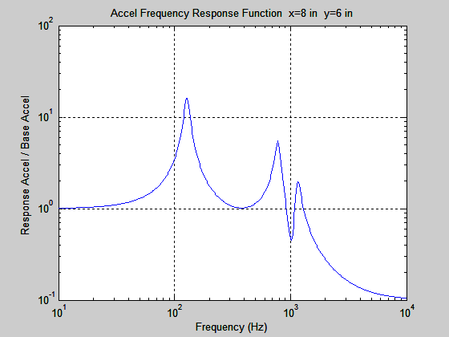
Simply-Supported Plate, Acceleration Transmissibility
max Accel FRF = 16.08 (G/G) at 128.8 Hz

Slide 14
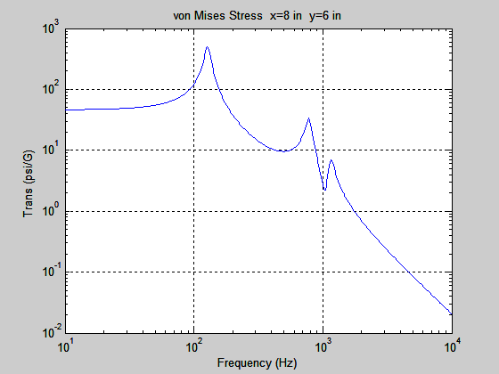
Simply Supported Plate, Bending Stress Transmissibility
max von Mises Stress FRF = 495 (psi/G) at 127 Hz

Slide 15
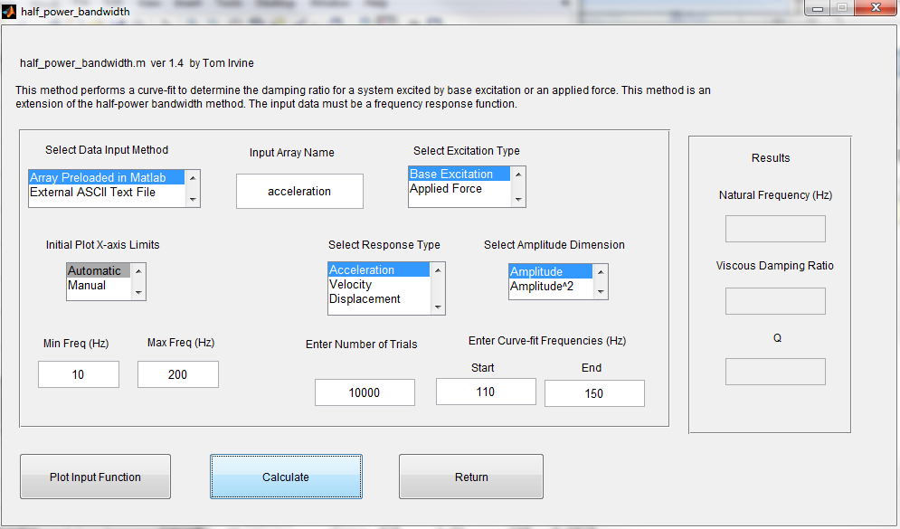
Half-Power Bandwidth from Plate Transmissibility
vibrationdata > Damping Functions > Half Power Bandwidth Curve-fit

Slide 16
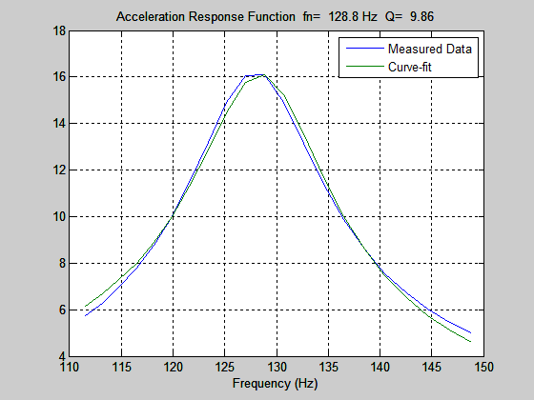
Half-Power Bandwidth Results from Plate Transmissibility

Slide 17
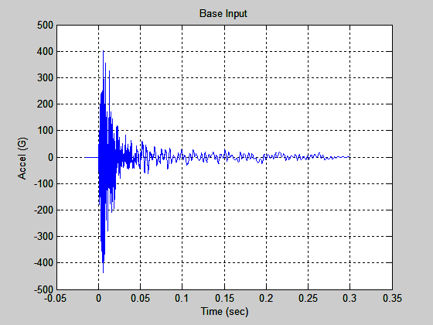
Synthesized Pulse for Base Input
Filename: srs1000G_accel.txt (import to Matlab workspace)

Slide 18
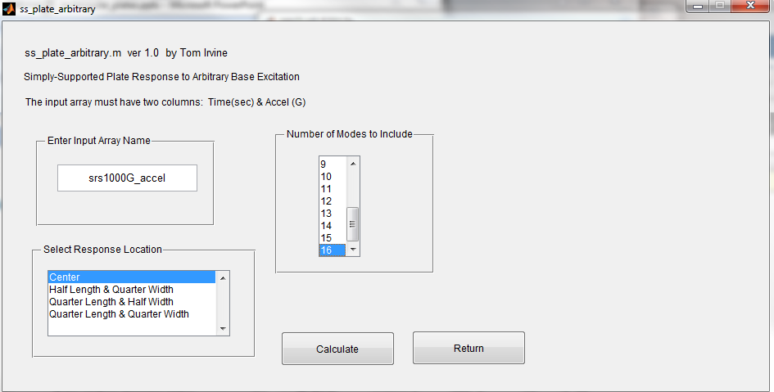
Simply-Supported Plate, Shock Analysis

Slide 19
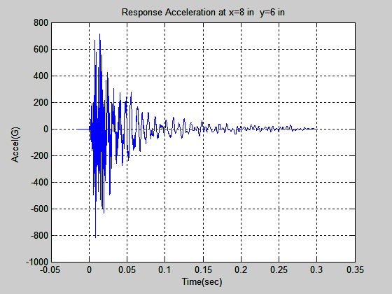
Simply-Supported Plate, Acceleration

Slide 20
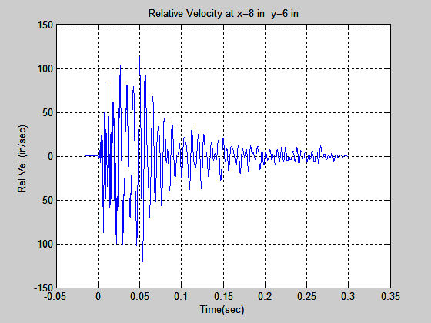
Simply-Supported Plate, Relative Velocity

Slide 21
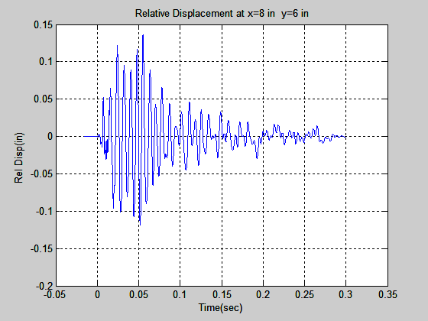
Simply-Supported Plate, Relative Displacement

Slide 22
Simply-Supported Plate Shock Results
Peak Response Values
Acceleration = 816.3 G
Relative Velocity = 120.6 in/sec
Relative Displacement = 0.1359 in
von Mises Stress = 7222 psi
Hunt Maximum Global Stress = 7711 psi

Slide 23
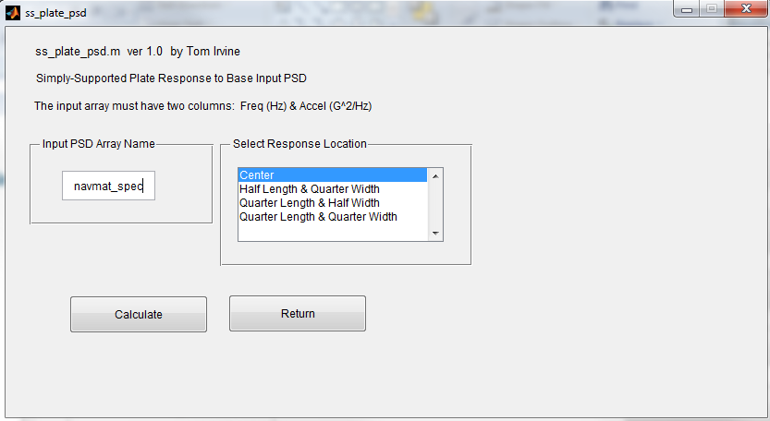
Simply-Supported Plate, PSD Base Input
Base input: navmat_spec

Slide 24
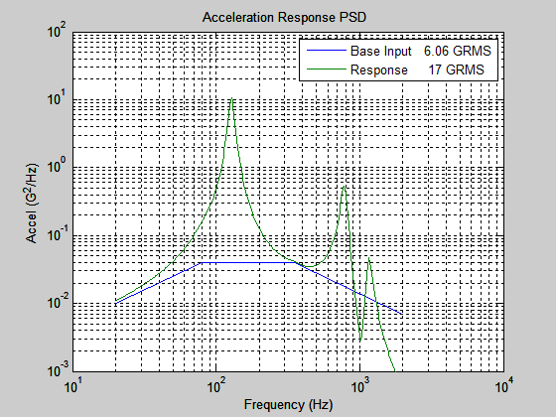
Simply-Supported Plate, Acceleration PSD

Slide 25
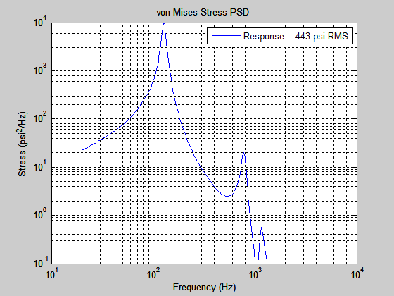
Simply-Supported Plate, Stress PSD

Slide 26
Simply-Supported Plate, PSD Results
Acceleration Response
16.96 GRMS
Relative Velocity Response
6.965 in/sec RMS
Relative Displacement Response
0.008554 in RMS
von Mises Response
443.4 psi RMS
Hunt Maximum Global Stress
445.3 psi RMS

Slide 27
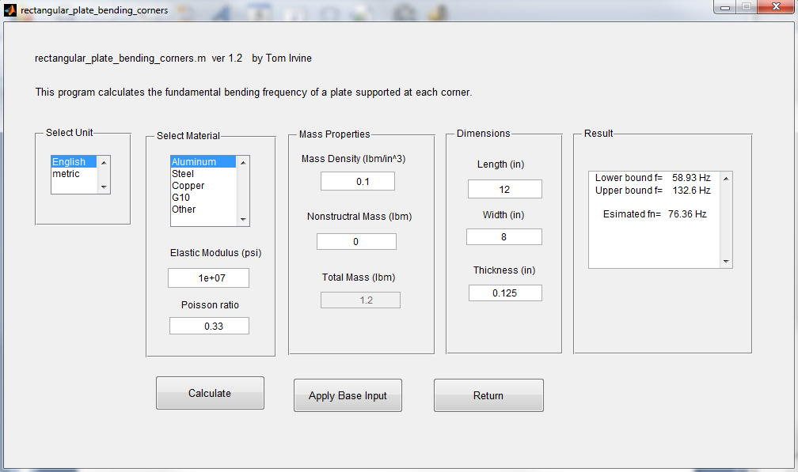
Rectangular Plate Fixed at Each Corner, Aluminum, 12 x 8 x 0.125 inch

Slide 28
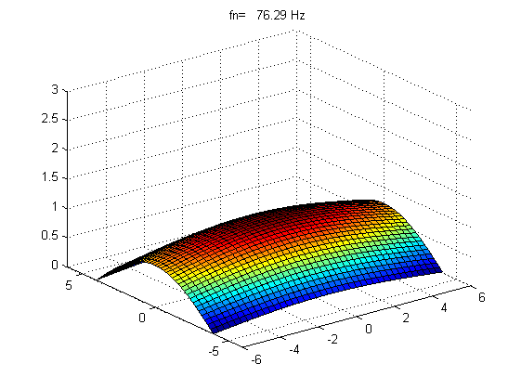
Plate Fixed at Each Corner, Mode Shape
The solution is a single mode via the Rayleigh method.

Slide 29
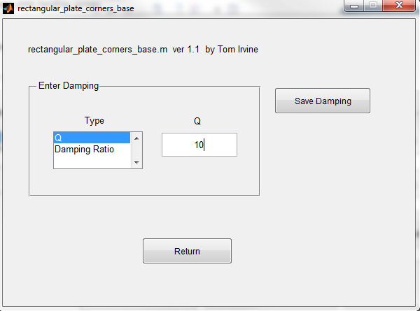
Plate Fixed at Each Corner, Q=10

Slide 30
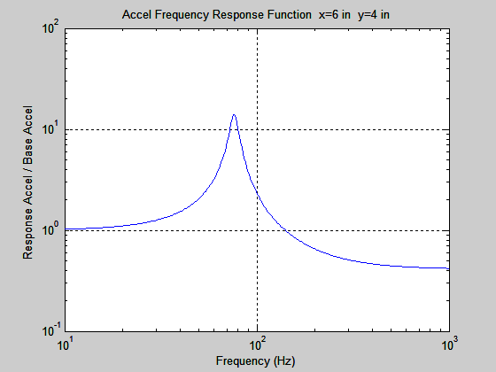
Plate Fixed at Each Corner, Acceleration Transmissibility

Slide 31
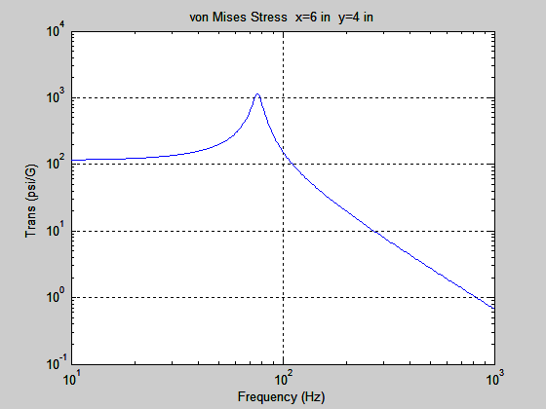
Plate Fixed at Each Corner, Stress Transmissibility

Slide 32
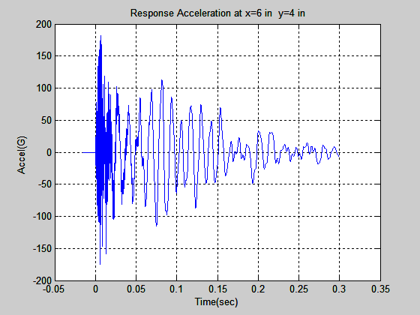
Plate Fixed at Each Corner, Shock Analysis

Slide 33
Plate Fixed at Each Corner, Shock Results
Peak Response Values
Acceleration = 182 G
Relative Velocity = 106 in/sec
Relative Displacement = 0.1843 in
von Mises Stress = 9147 psi

Slide 34
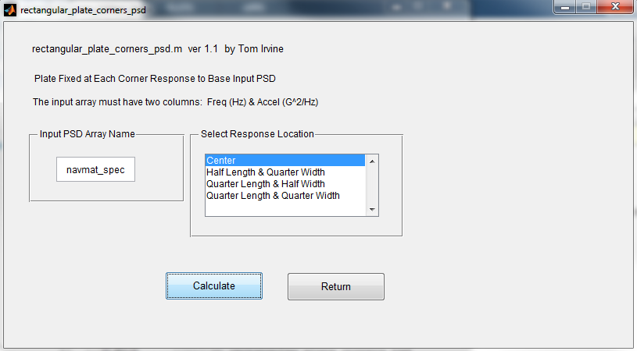
Plate Fixed at Each Corner, PSD Input

Slide 35
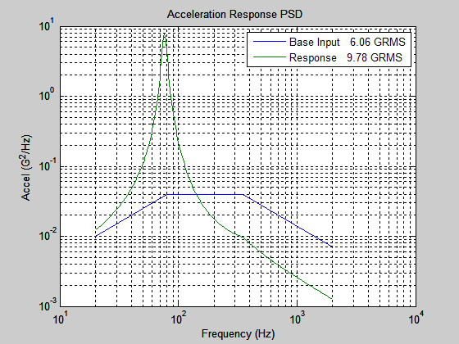
Plate Fixed at Each Corner, Response PSD

Slide 36
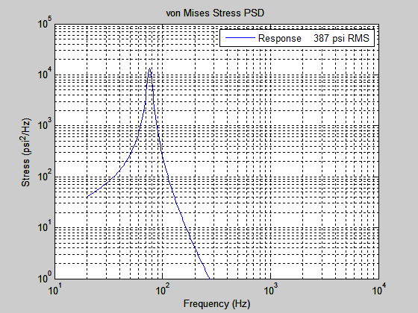
Plate Fixed at Each Corner, Response PSD, Stress

Slide 37
Plate Fixed at Each Corner, Response PSD Results
Acceleration Response
9.775 GRMS
Relative Velocity Response
7.65 in/sec RMS
Relative Displacement Response
0.01561 in RMS
von Mises Response
387.4 psi RMS

