Slide 1
Unit 36
Non-Gaussian Random
Fatigue and Peak Response

Slide 2
Introduction
Perform a fatigue and peak response analysis for a non-Gaussian random time history base input
Compare results to Gaussian time history which matches the PSD of the non-Gaussian case
Broadband random, stationary, Gaussian time histories have kurtosis=3
Higher kurtosis time history will be demonstrated
Develop critical thinking skills about signal analysis, statistical parameters, fatigue damage, etc

Slide 3
Statistical Formulas
Skewness =
Kurtosis =
Mean =
Variance =
Standard Deviation is the square root of the variance
where Y_{i} is each instantaneous amplitude, n is the total number of points,
μ is the mean, σ is the standard deviation

Slide 4
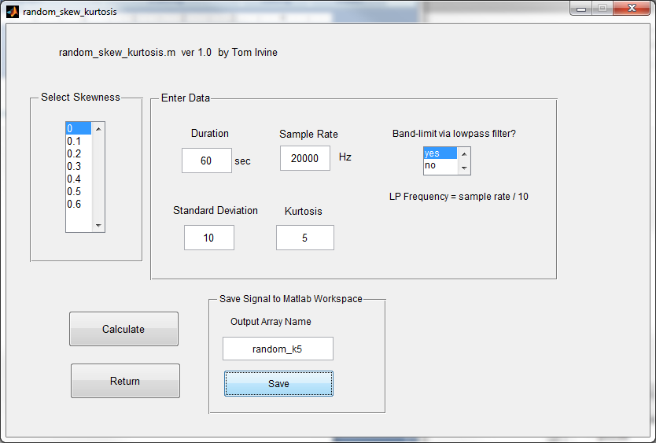
Non-Gaussian Time History, std dev=10, skewness=0, kurtosis=5, 60 seconds
vibrationdata > Generate Signal > random with specified skewness & kurtosis

Slide 5
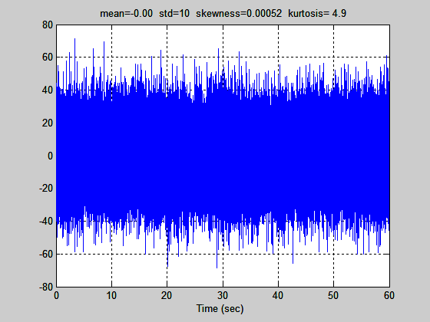
Non-Gaussian Time History
Also, crest factor = 7.1
Array name: random_k5

Slide 6
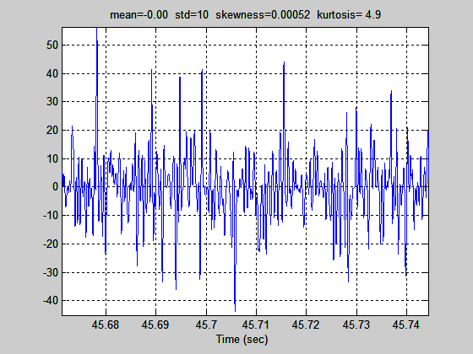
Non-Gaussian Time History, Close-up View

Slide 7
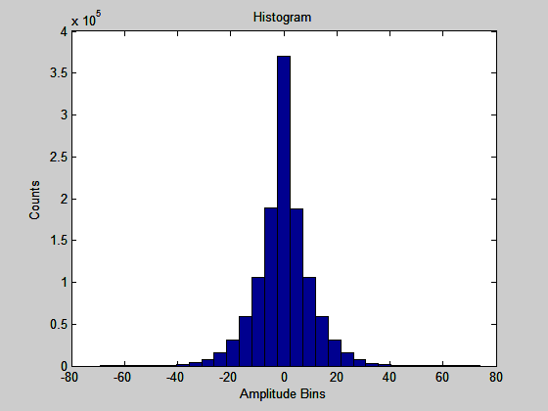
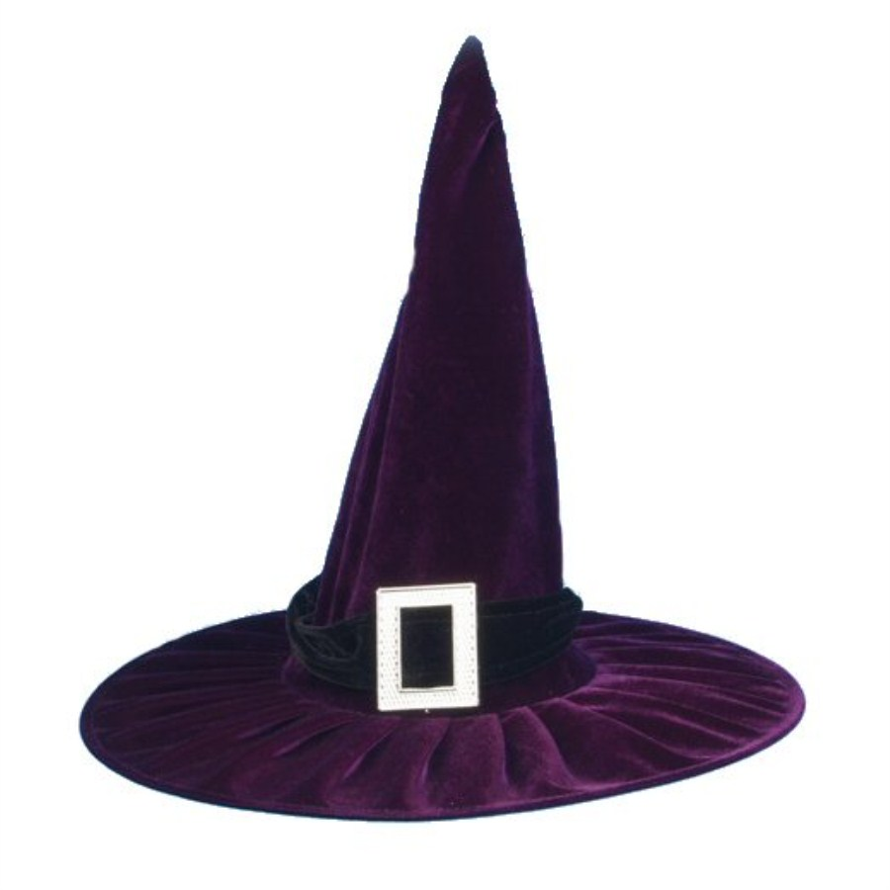
Non-Gaussian Time History, kurtosis = 5
Resembles witch hat!

Slide 8
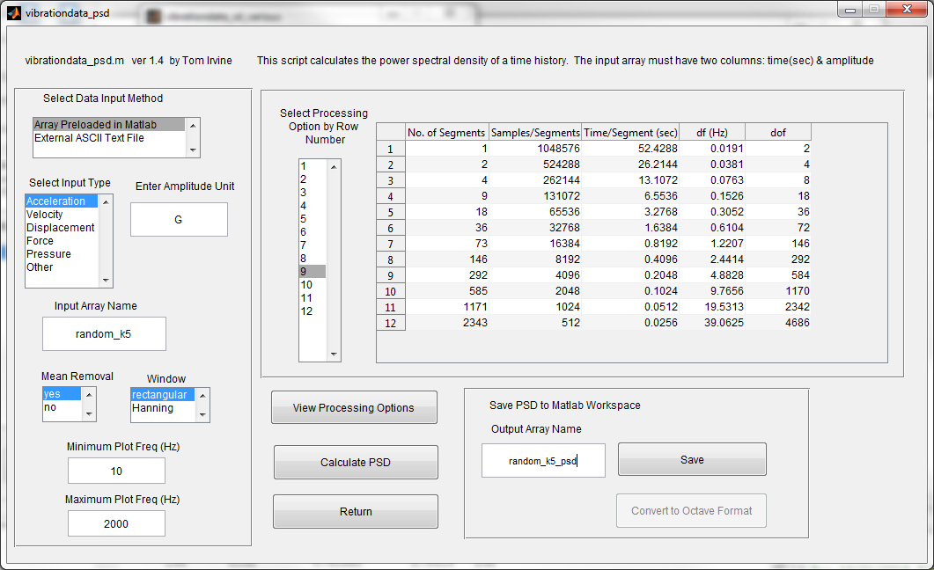
Take PSD of Non-Gaussian Time History

Slide 9
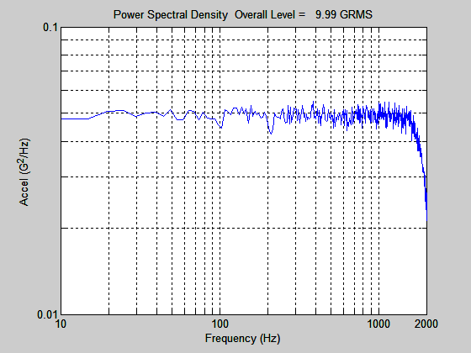
PSD of Non-Gaussian Time History
Roll-off is due to band limiting

Slide 10
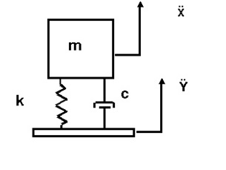
Response to Base Input
fn = 600 Hz
Q=10
Fatigue exponent b=6.4

Slide 11
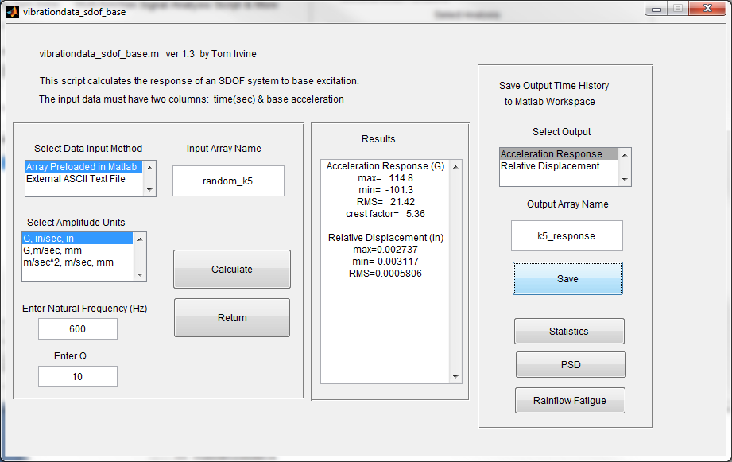
SDOF Response to Non-Gaussian Base Input, fn=600 Hz, Q=10

Slide 12
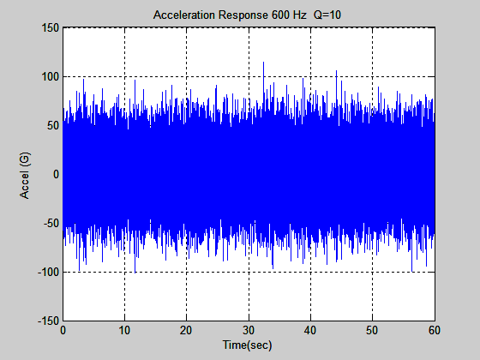
SDOF Response to Non-Gaussian Base Input, fn=600 Hz, Q=10

Slide 13
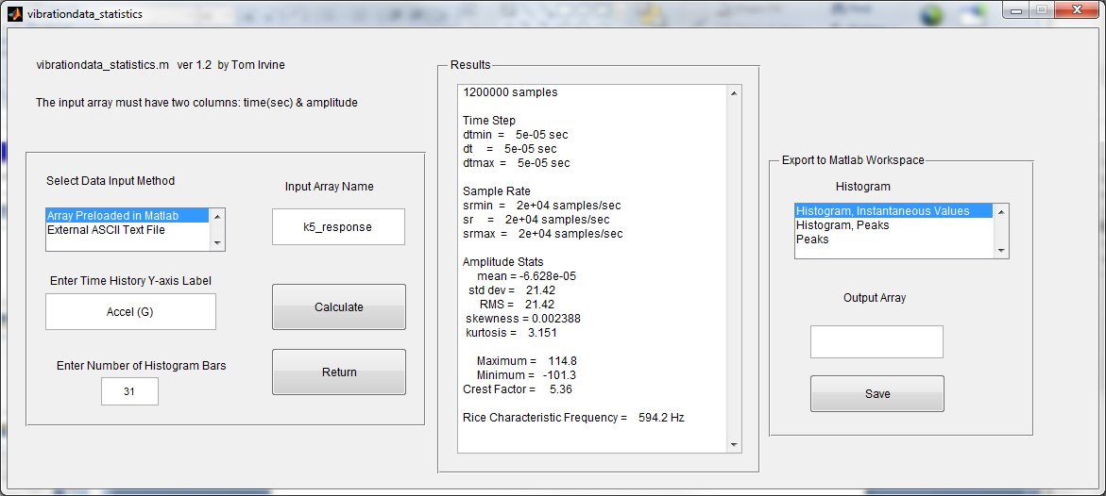
SDOF Response to Non-Gaussian Base Input, Statistics
Absolute Peak Response = 115 G, std dev = 21.4 G, Crest Factor = 5.4 , kurtosis= 3.15

Slide 14
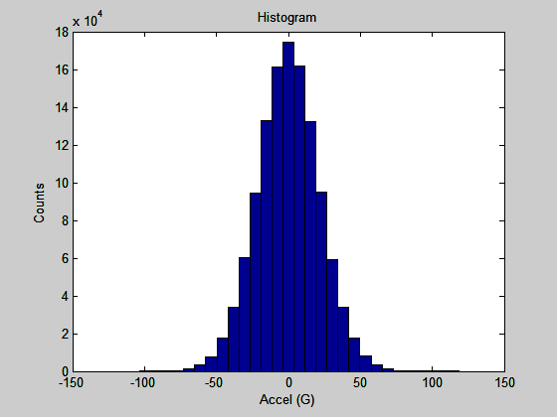
SDOF Response to Non-Gaussian Base Input, Histogram
The histogram approaches a Gaussian shape even though the input is non-Gaussian.
See: Central Limit Theorem

Slide 15
Central Limit Theorem
For a strongly resonant system subjected to broad band excitation, the central limit theorem makes it possible to establish that the response tends to be Gaussian even if the input is not.
This applies when the excitation is not white noise, provided that it is a broad band process covering the resonant peak.
Christian Lalanne

Slide 16
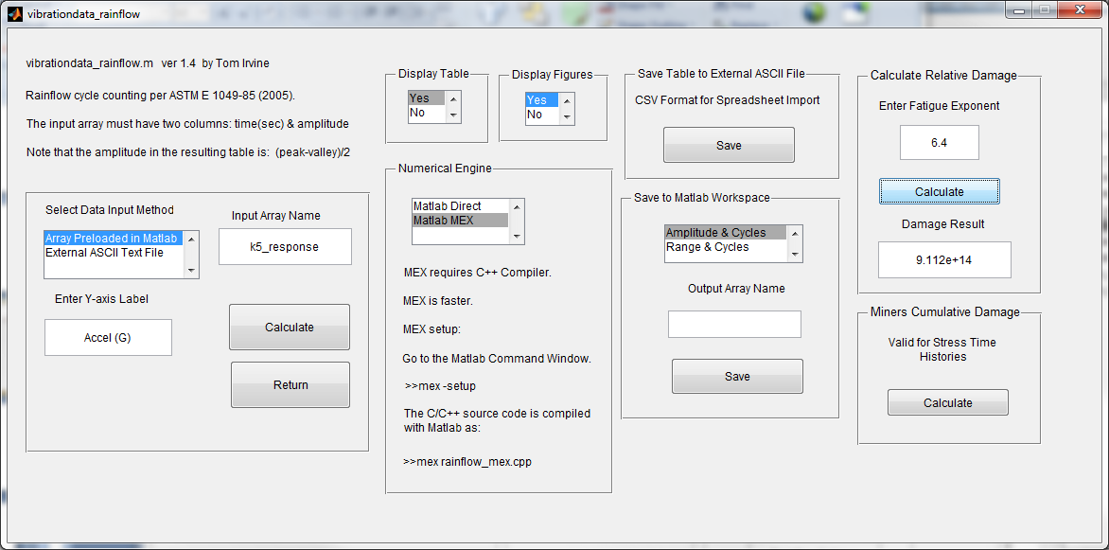
SDOF Response to Non-Gaussian Base Input, Relative Damage
Relative Damage = 9.1e+14

Slide 17
Derive Test Spec from PSD of Non-Gaussian Base Input
0.05 G^2/ Hz
from 10 to 2000 Hz
>> psd_spec
=[10 0.05; 2000 0.05]
psd_spec =
1.0e+03 *
0.0100 0.0001
2.0000 0.0001
But the PSD spec will assume Gaussian histogram with kurtosis = 3

Slide 18
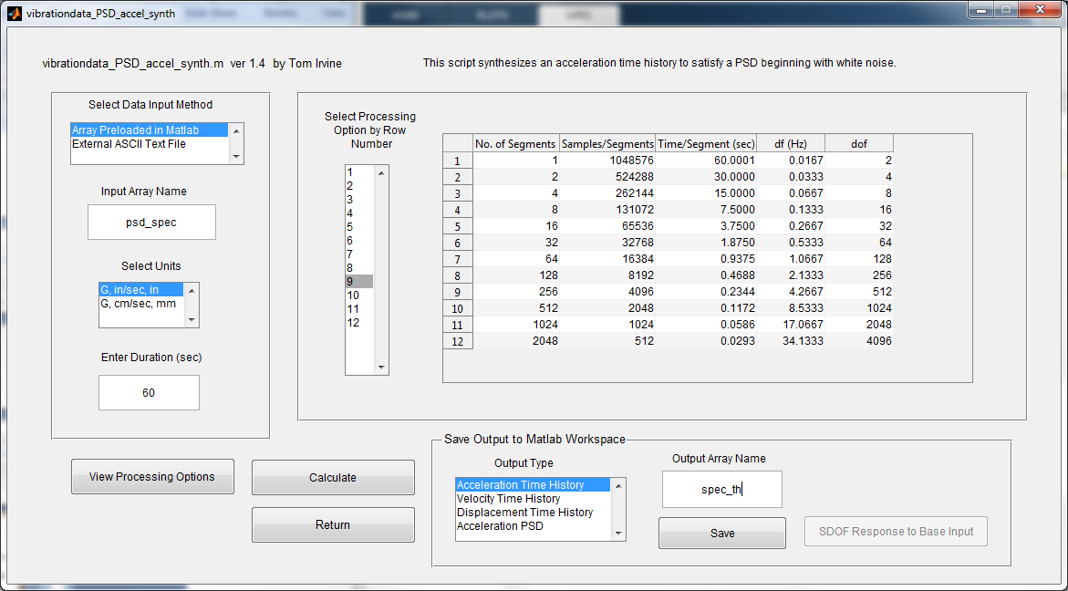
Synthesize Time History for Test Specification, with Gaussian Histogram

Slide 19
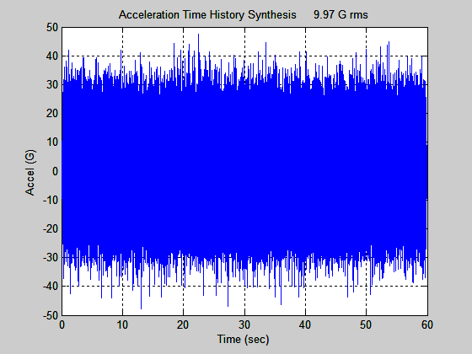
Synthesized Time History for Test Specification

Slide 20
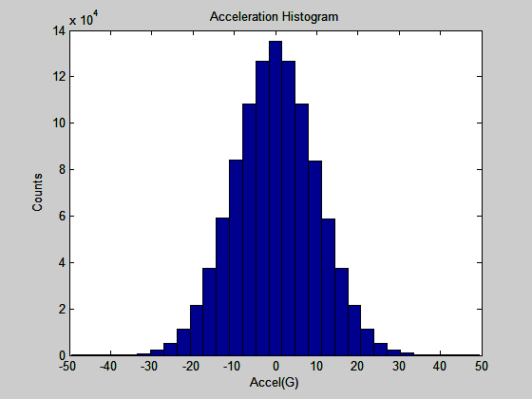
Synthesized Time History for Test Specification, Histogram

Slide 21
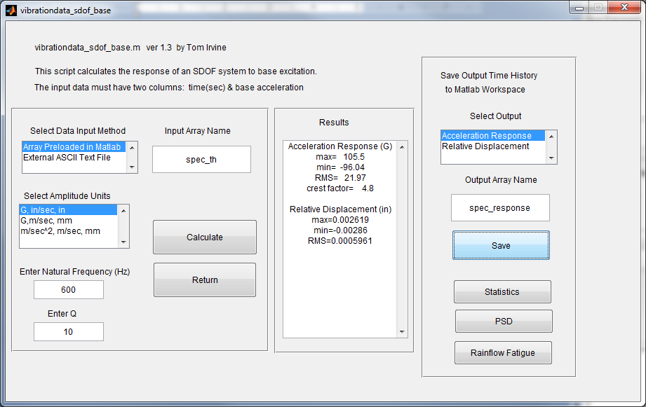
SDOF Response to Synthesized Time History for Test Specification

Slide 22
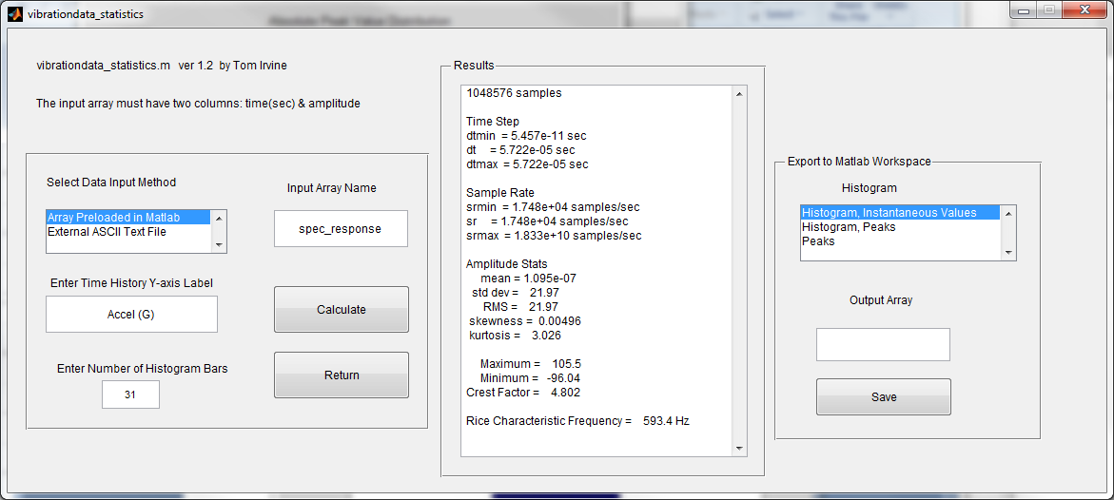
SDOF Response to Synthesized Time History for Test Specification, Statistics
Absolute Peak Response = 106 G, std dev = 22.0 G, Crest Factor = 4.8 , kurtosis= 3.03

Slide 23
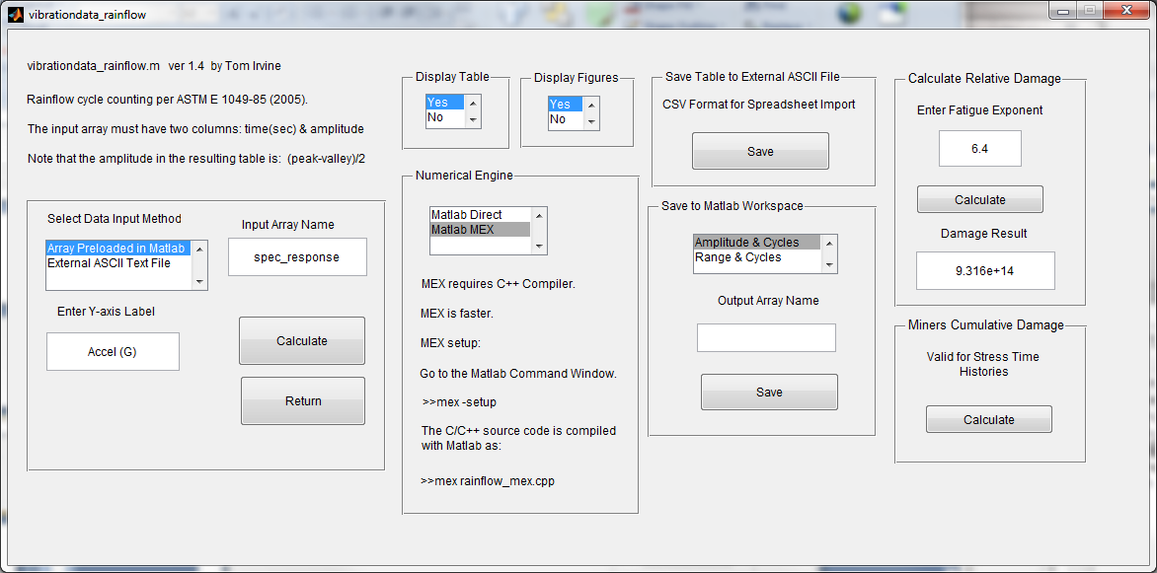
SDOF Response to Synthesized Time History for Test Specification, Relative Damage
Relative Damage = 9.3e+14

Slide 24
Response Parameters by Input Type
SDOF System, fn = 600 Hz, Q = 10, b = 6.4
Parameter | Non-Gaussian | Gaussian
GRMS | 21.4 | 22.0
Peak G | 115 | 106
Crest Factor | 5.4 | 4.8
Kurtosis | 3.15 | 3.03
Damage (G^6.4) | 9.1e+14 | 9.3e+14
The non-Gaussian base input causes a higher peak acceleration response
The Gaussian input yields a slightly higher fatigue damage

Slide 25
Fatigue Damage Spectrum (FDS)
The fatigue damage spectrum can be calculated if the natural frequency is unknown
Natural frequency is an independent variable
The FDS is conceptually similar to the SRS and VRS functions

Slide 26
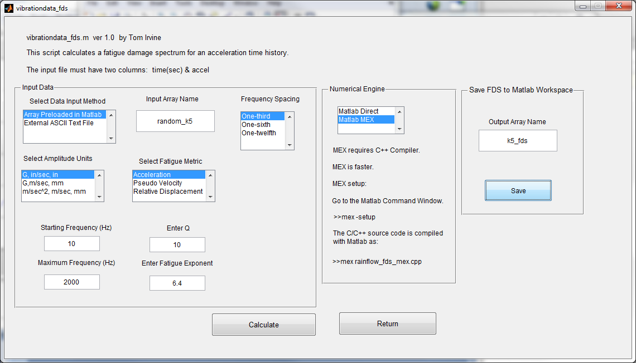
Calculate the Fatigue Damage Spectrum for the SDOF Response to Non-Gaussian Input

Slide 27
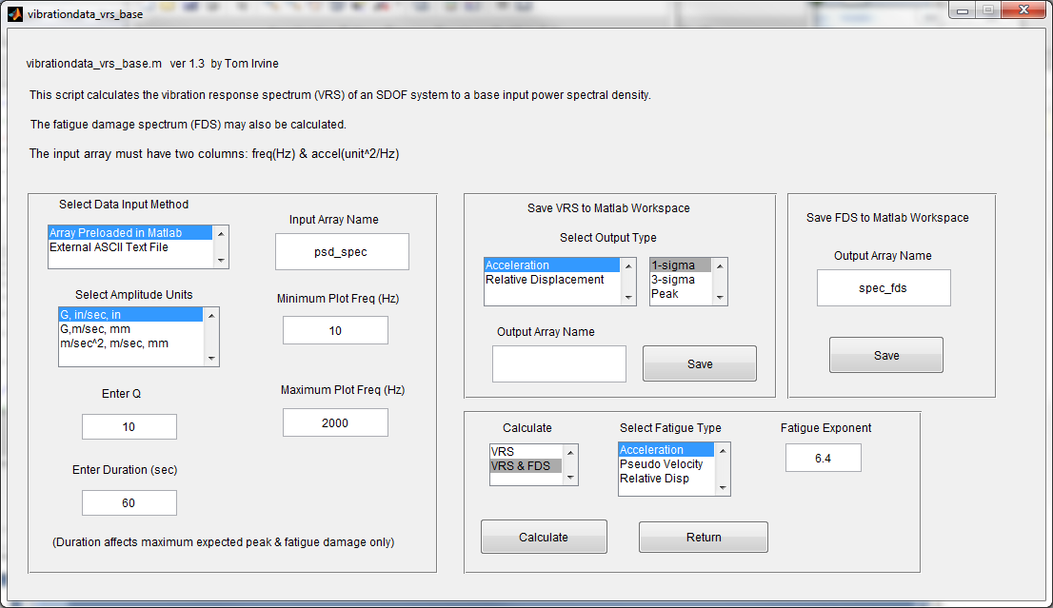
Calculate the Fatigue Damage Spectrum for the SDOF Response to Gaussian Input

Slide 28
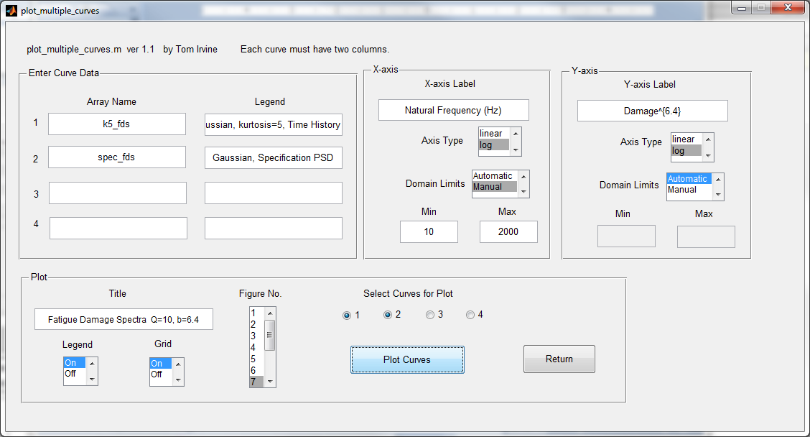
Plot the Fatigue Damage Spectra

Slide 29
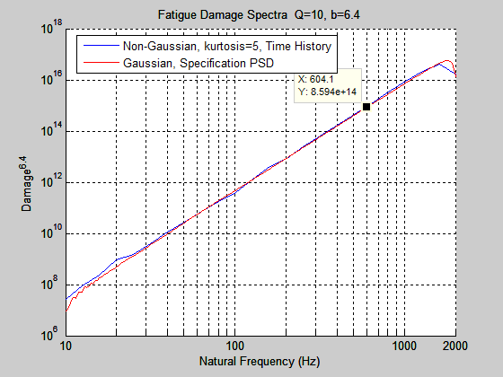
Comparing Different Environments in Terms of Damage Potential
In this example, the kurtosis difference did not really affect the damage level.
But may not always be the case! So be careful!

