Slide 1
Unit 39
Sine-on-Random Vibration

Slide 2
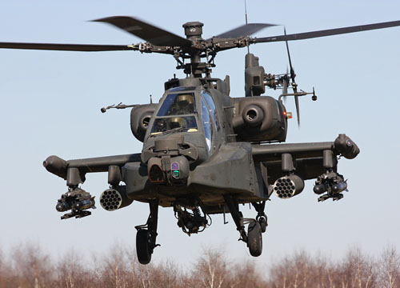
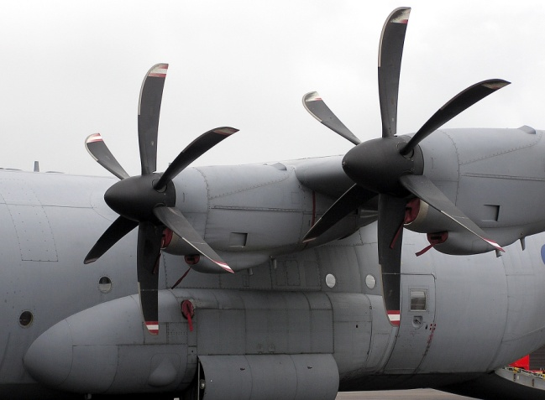
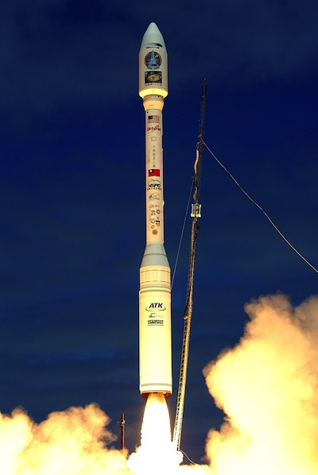
Potential Sine-on-Random Environments
Helicopter Vibration
Propeller-driven Aircraft
Gunfire
Launch Vehicle with Thrust Oscillation
Mil-Std-810G addresses some of these scenarios

Slide 3
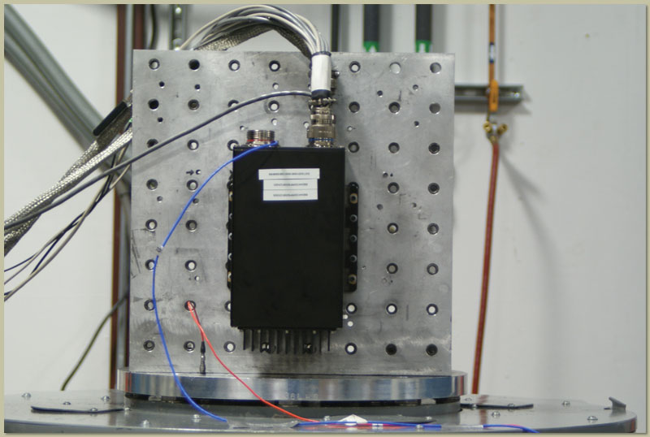
Sine-on-Random Analysis and Testing
Certain electronic components must be designed and tested to withstand sine-on-random environments.
The following can be done for test or analysis purposes:
Synthesize time history to satisfy sine-on-random specification
Convert sine-on-random to equivalent PSD

Slide 4
Hypothetical Sine-on-Random Specification
NAVMAT PSD + Two Sine Tones: (100 Hz, 10 G) & (180 Hz, 10 G)

Slide 5
Synthesis Process
Synthesize 60-second time history to satisfy the sine-on-random specification
Read in the NAVMAT PSD as a library function
Then perform this two-step process:
1. Synthesis a time history for the PSD only
2. Add sine tones to the time history

Slide 6
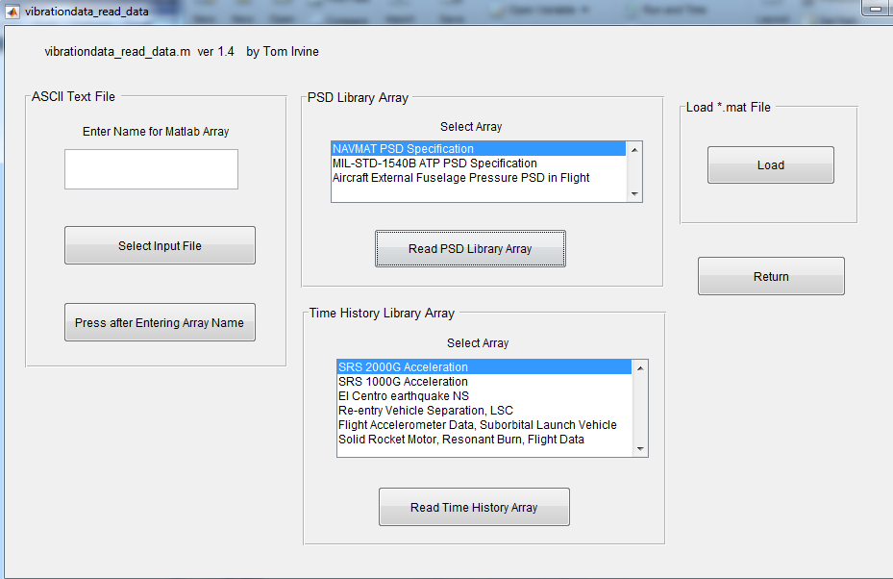
Read NAVMAT PSD

Slide 7
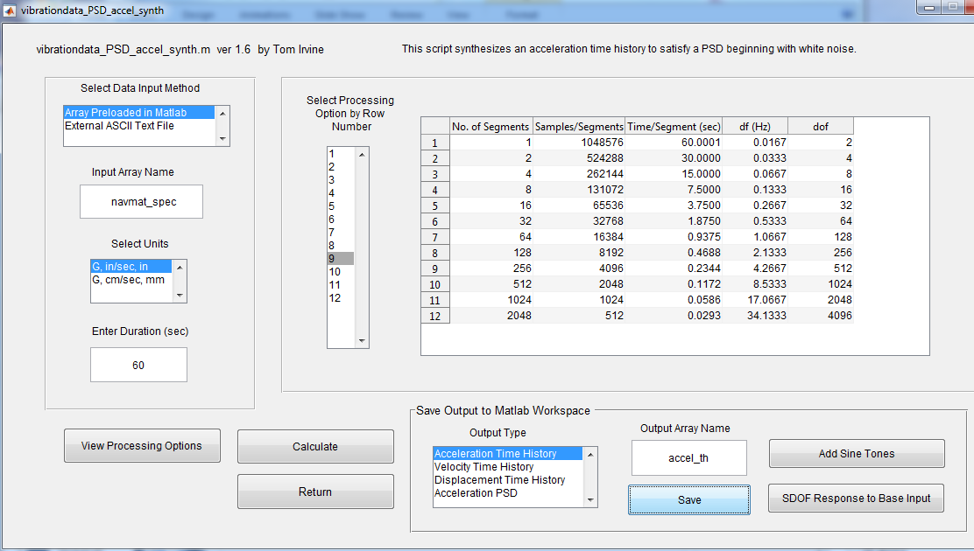
Synthesize Time History for PSD, Save, then Add Sine Tones

Slide 8
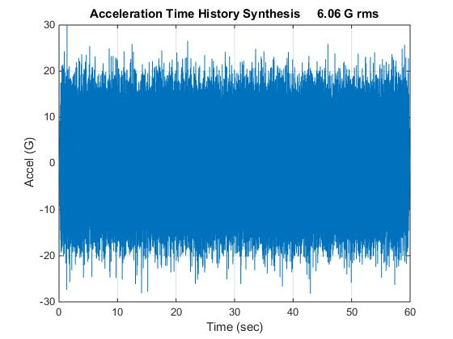
Acceleration Time History for PSD Only

Slide 9
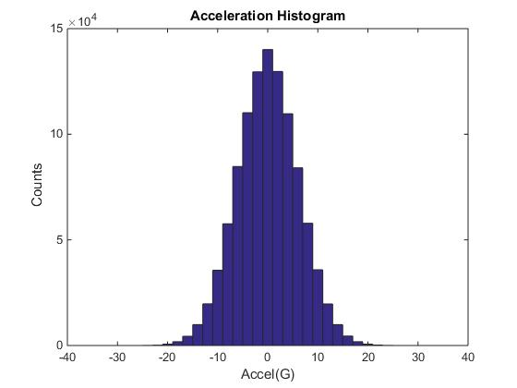
Acceleration Histogram for PSD Only

Slide 10
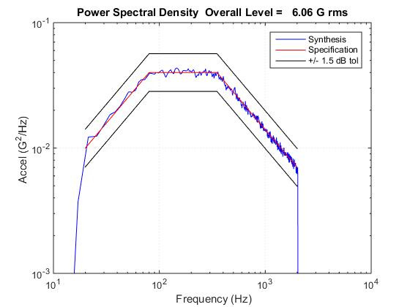
PSD Verification

Slide 11
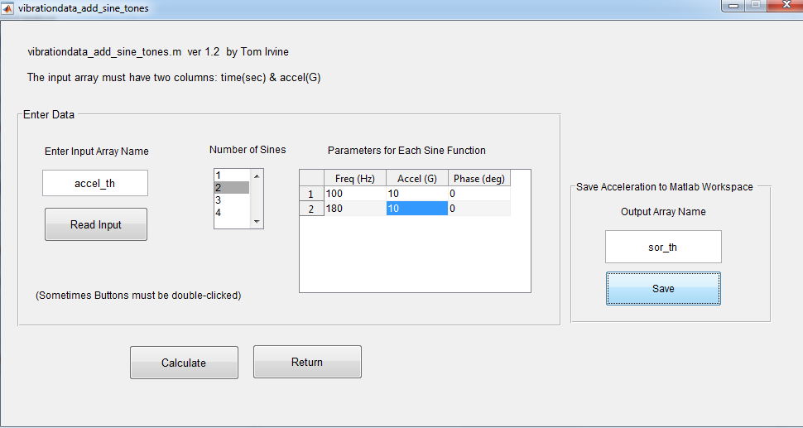
Add Sine Tones

Slide 12
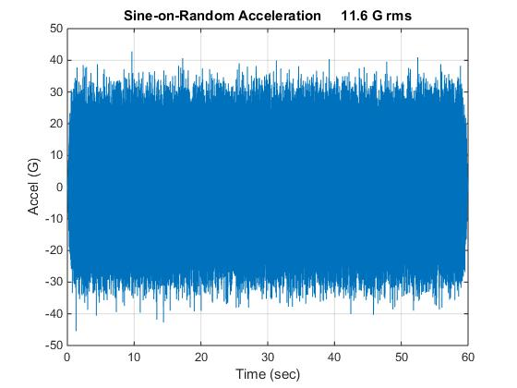
Sine-on-Random Acceleration Time History
Kurtosis = 2.6
Crest Factor = 3.9

Slide 13
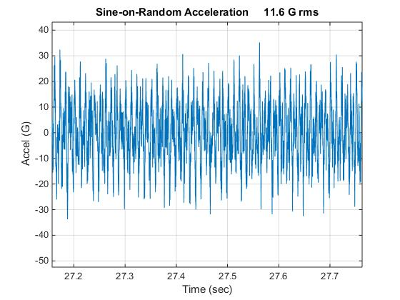
Sine-on-Random Time History, Close-up View

Slide 14
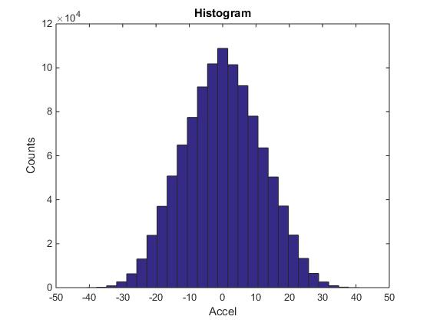
Sine-on-Random Histogram
Departs from Gaussian ideal

Slide 15
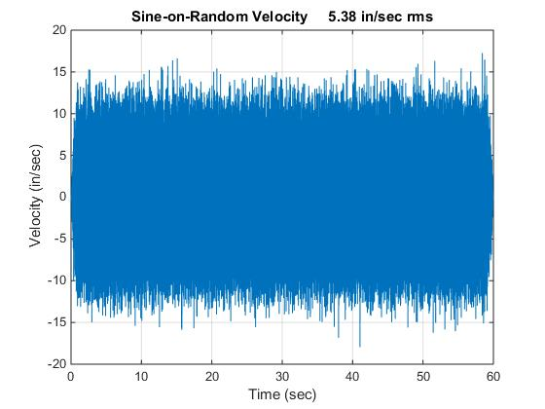
Sine-on-Random Velocity Time History

Slide 16
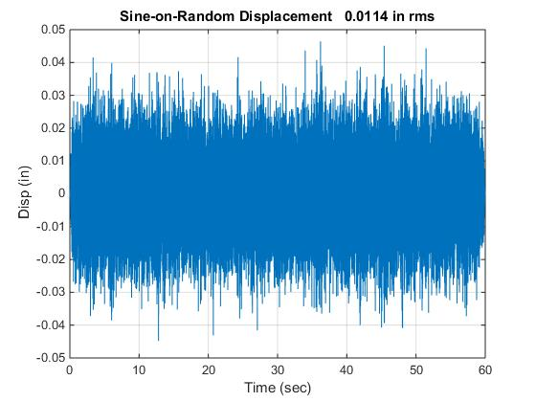
Sine-on-Random Displacement Time History

Slide 17
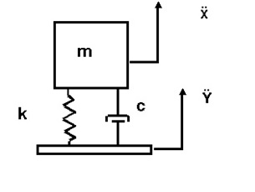
SDOF Response to Sine-on-Random
Apply sine-on-random time history as base input to SDOF system
(fn=200 Hz, Q=10)

Slide 18
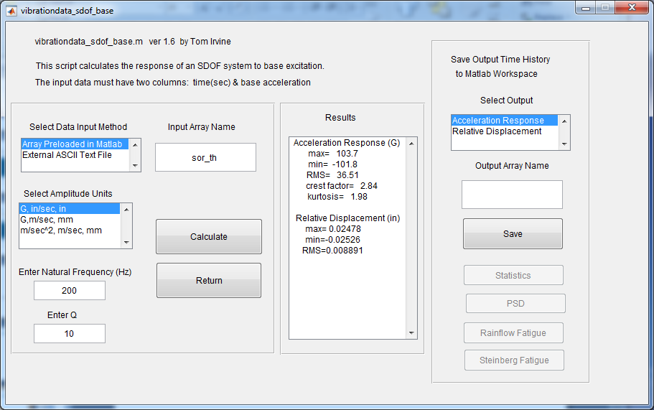
Apply Base Excitation

Slide 19
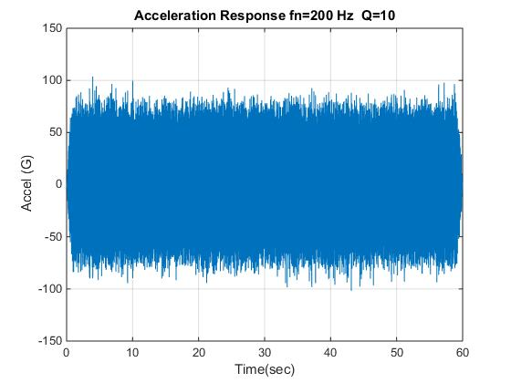
Sine-on-Random Response

Slide 20
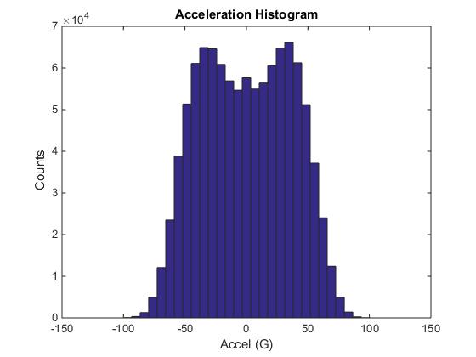
Sine-on-Random Response Histogram

Slide 21
Further Analysis for Sine-on-Random Time History
Next calculate:
SRS, Q=10
FDS with fatigue, Q=10, b=6.4
Save each results for later use

Slide 22
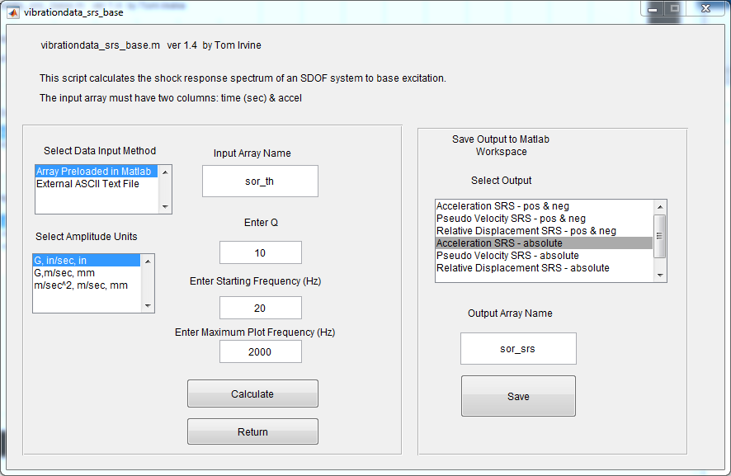
SRS Calculation

Slide 23
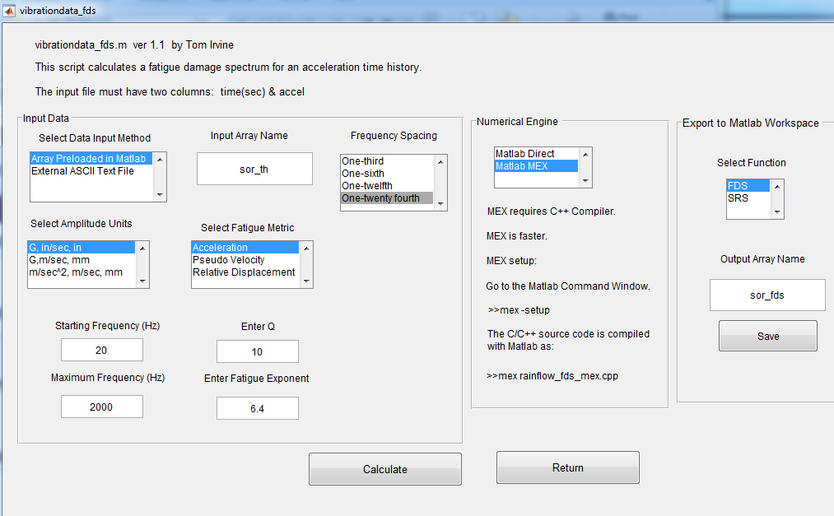
FDS Calculation

Slide 24
Equivalent PSD
Derive an equivalent PSD to cover the sine-on-random specification using the FDS method
Replace sine tones with narrow bands
Assume that the component is an SDOF system
The natural frequency is an independent variable
Set
Amplification factor Q=10
Fatigue exponent b=6.4

Slide 25
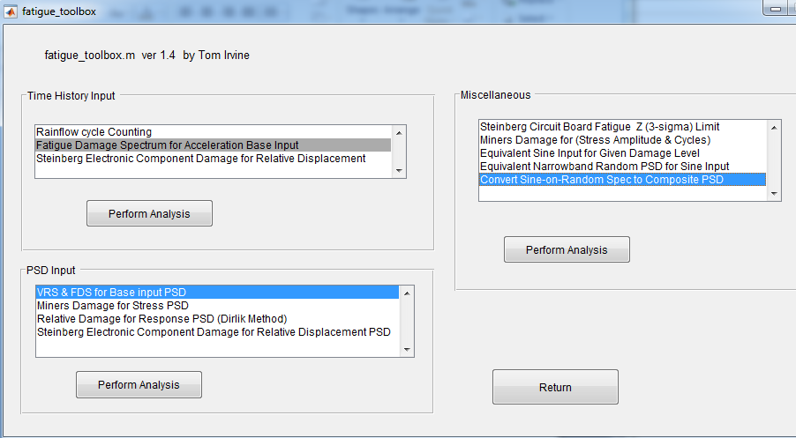
Conversion to PSD

Slide 26
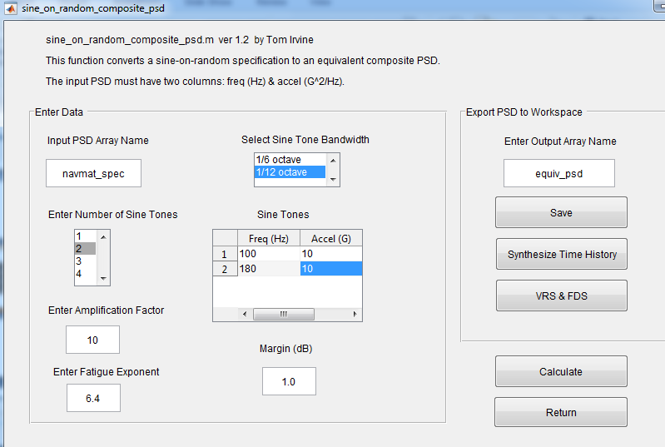
Conversion to PSD (cont)

Slide 27
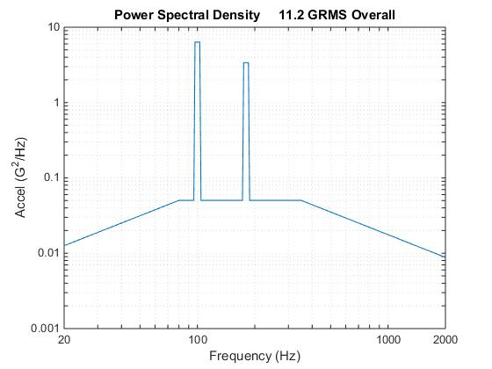
Candidate Equivalent PSD
Freq(Hz) | Accel(G^2/Hz)
20 | 0.01259
80 | 0.05036
95.76 | 0.05036
97.15 | 6.342
102.9 | 6.342
104.4 | 0.05036
172.4 | 0.05036
174.9 | 3.383
185.3 | 3.383
188 | 0.05036
350 | 0.05036
2000 | 0.008812

Slide 28
Comparison & Verification
Calculate the FDS of the equivalent PSD
Compare equivalent PSD FDS with synthesized time history FDS

Slide 29
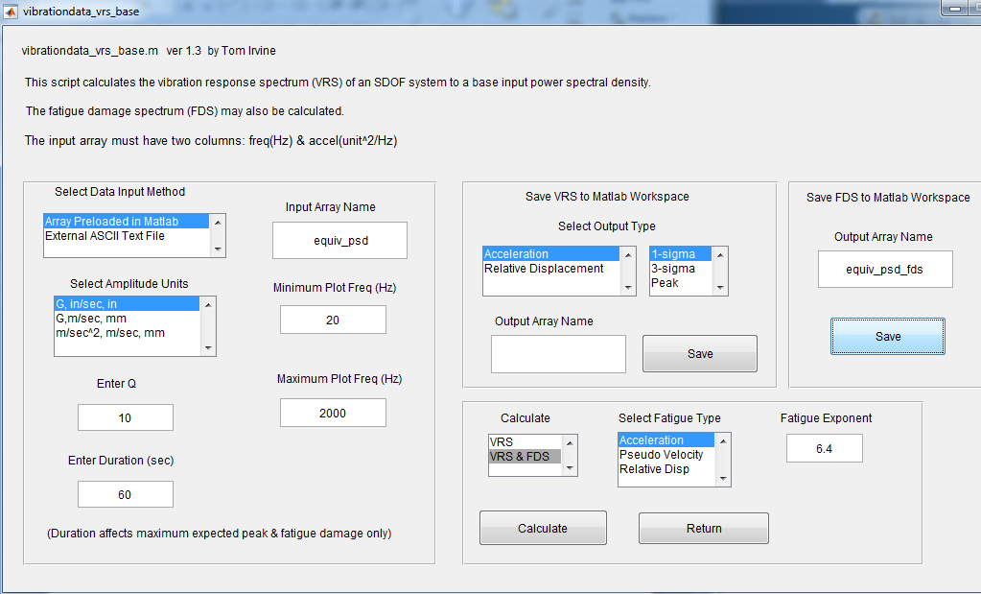
FDS Calculation for Candidate PSD

Slide 30
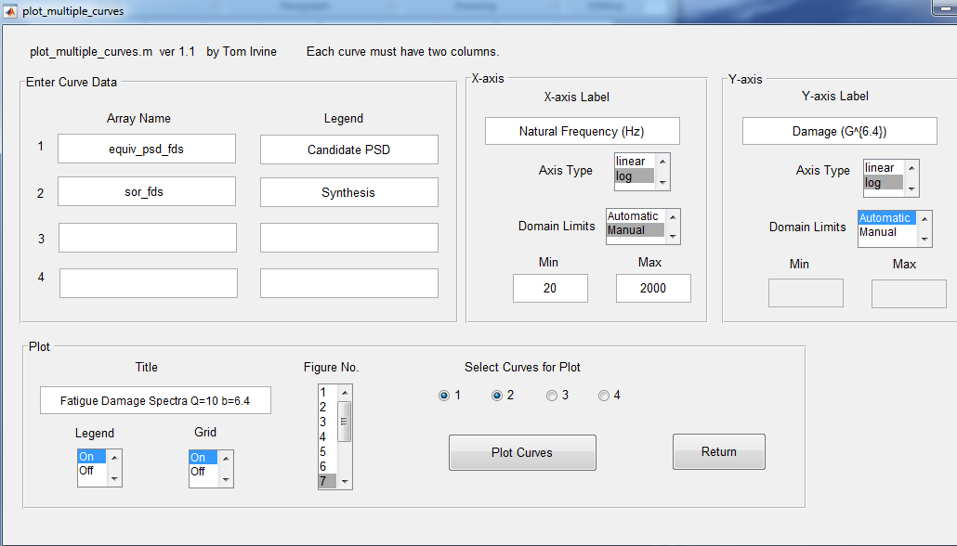
FDS Comparison

Slide 31
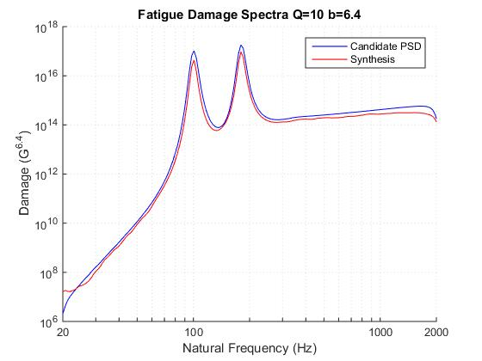
FDS Comparison

Slide 32
Comparing Different Environments of Peak Response
Calculate the peak VRS of the equivalent PSD
The peak VRS assumes a Rayleigh distribution and is conceptually similar to an SRS
Compare equivalent PSD peak VRS with synthesized time history SRS

Slide 33
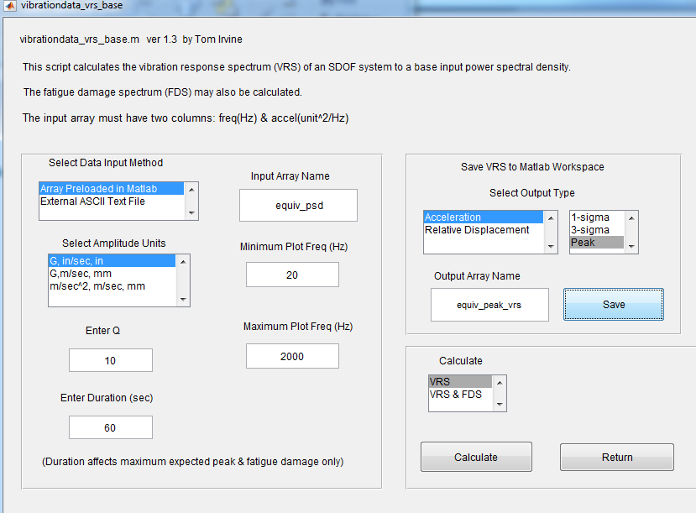
Comparing Different Environments in Terms of Damage Potential

Slide 34
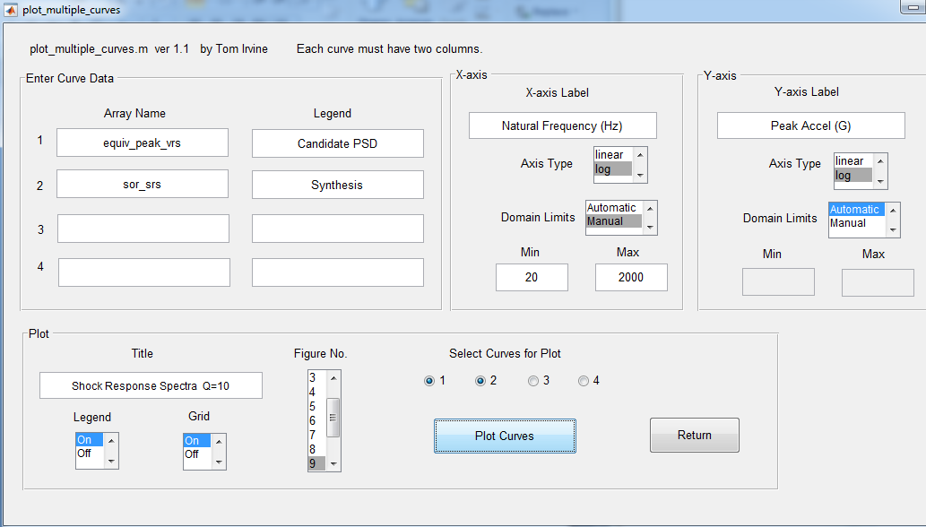
SRS Comparison Plotting

Slide 35
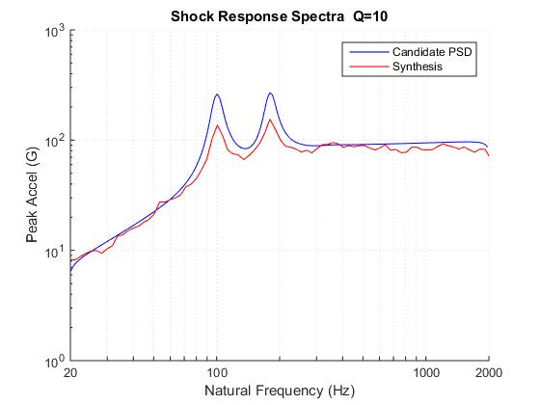
SRS Comparison

Slide 36
Conclusion
An equivalent PSD was derived for the sine-on-random specification
The equivalent PSD replaced the sine tones with narrow bands
The equivalent PSD was
1. Realistic in terms of fatigue damage
2. Conservative in terms of peak response level
As an extra homework exercise, synthesis a time history to satisfy the equivalent PSD

