Slide 1
Unit 40
Vibrationdata
Shock Fatigue
Determine whether a given PSD can cover an SRS Specification
Derive an Optimized PSD which will cover an SRS

Slide 2
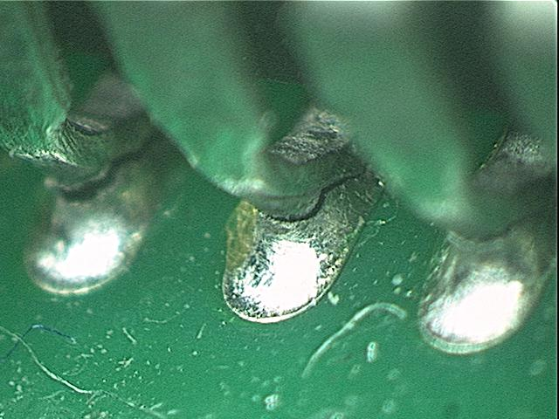
Introduction
Vibrationdata
Aerospace and military components must be designed and tested to withstand shock and vibration environments
Cracked solder Joints for Piece Part with “J leads”

Slide 3

Introduction
Vibrationdata
Consider a launch vehicle component which will be exposed to random vibration and pyrotechnic shock during flight
The random vibration occurs primarily during liftoff and the transonic and maximum dynamic pressure phases of ascent.
The corresponding random vibration specification is in the form of a base excitation power spectral density (PSD)
The pyrotechnic shock is due to staging and separation events, with the resulting shock requirement given as a shock response spectrum (SRS)

Slide 4
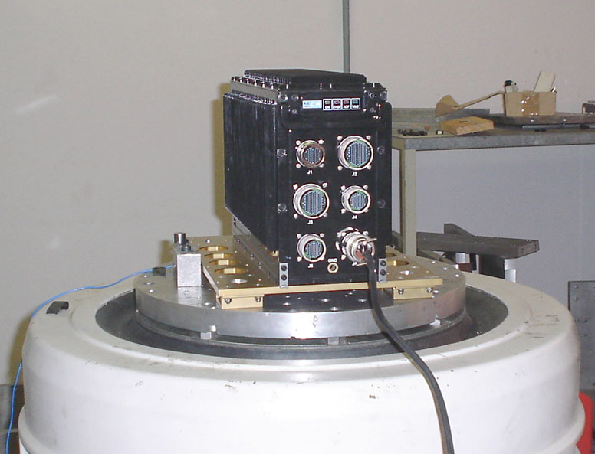
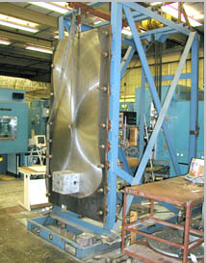
Shock & Vibration Testing
Vibrationdata
Shaker Table Vibration Test
Usually straightforward to meet specification
Shock Testing using a Resonant Plate
Typically excited by mechanical impact from pneumatic piston. Requires trial-an-error configuration to meet specification

Slide 5
Test Concerns
Vibrationdata
Aerospace Pyrotechnic-type SRS tests are almost always more difficult to configure and control in the test lab and are thus more expensive than shaker table PSD tests
Some lower and even mid-level SRS specifications may not have the true damage potential to justify shock testing
The purpose of this webinar is to demonstrate a shock and vibration comparison method based on the fatigue damage spectrum (FDS)
The comparison results can be used with other considerations to determine whether the random vibration test covers the shock requirement
A related method is also demonstrated for deriving an optimized PSD to envelop an SRS
These methods are found to be effective comparison and derivation tools within a framework of assumptions

Slide 6
Test Concerns
Vibrationdata
Gaberson, et al, have characterized shock damage potential in terms of pseudo velocity
A typical velocity severity threshold is 100 in/sec (254 cm/sec) for military quality equipment
some references apply a 6 dB margin which reduces this limit by one-half.
This threshold is defined in part by the observation that the velocity which causes yielding in mild steel beams is about 130 in/sec
Also note that some aerospace and military standards for electronic equipment define a shock severity threshold as 0.8 G/Hz times the natural frequency in Hz, which is equivalent to 50 in/sec
References: MIL-STD-810E & SMC-TR-06-11

Slide 7
Test Concerns
Vibrationdata
Shock tests may be omitted for some components if the pseudo velocity is < 50 in/sec
The argument to skip shock testing can be strengthened if the random vibration test is rigorous enough to cover the shock requirement
The study in this webinar uses numerical simulations to compare the effects of random vibration and shock via rainflow cycle counting and fatigue damage spectra
The comparison can then be used with other factors to determine whether a random vibration test covers a shock requirement

Slide 8
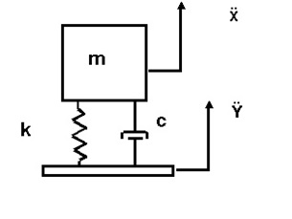
Assumptions
Vibrationdata
The component can be modelled as a linear single-degree-of-freedom (SDOF) system
The peak shock and vibration pseudo velocity response levels fall below the threshold for the corresponding material, or below 100 in/sec for an electronic component
The resulting shock and vibration response stress levels are below the material yield point
Fatigue is the only potential failure mode
The lower level, longer duration random vibration test may be effectively substituted for the high-amplitude, brief-duration shock test

Slide 9
Assumptions (cont)
Vibrationdata
There are no failure modes due to peak relative displacement, such as misalignment, loss of sway space, mechanical interference, etc
There are no shock-sensitive mechanical switches, relays or reed valves, which might experience chatter or change-of-state during shock
There are no extra-sensitive piece parts such as crystal oscillators, klystrons, travelling wave tubes, magnetrons, etc
The piece parts are Mil-spec quality and have been previously qualified to shock levels similar to those in MIL-STD-202, MIL-STD-883, etc
The natural frequency, amplification factor Q and fatigue exponent b, can be estimated between respective limits

Slide 10
Rainflow Cycle Counting
Vibrationdata
SDOF responses must be calculated for each fn and Q of interest, for both the PSD and the for SRS
A representative time history can be synthesized for the SRS
The Smallwood, ramp invariant, digital recursive filtering relationship is then used for the response calculation per Reference
The rainflow cycles can be calculated from the time domain response
In addition, response PSDs can be calculated for the base input PSD using the textbook SDOF power transmissibility function
The rainflow cycles are then tabulated from the response PSDs via the Dirlik method

Slide 11
Fatigue Damage Spectrum
Vibrationdata
A relative damage index can be calculated from the response rainflow cycles using
The FDS expresses the damage D as a function of natural frequency with the Q and b values duly noted
The amplitude convention for this paper is: (peak-valley)/2

Slide 12
Example
Vibrationdata
Determine whether a given PSD envelops an SRS in terms of fatigue damage
Natural frequency is an independent variable
Vary amplification factor Q = 10 or 30
Vary fatigue exponent b = 4 or 9

Slide 13
PSD Specification
Vibrationdata
Freq (Hz) | Accel (G^2/Hz)
20 | 0.04
150 | 0.30
2000 | 0.30
>> psd_spec=[20 0.04; 150 0.3; 2000 0.3]
Duration 180 sec/axis

Slide 14
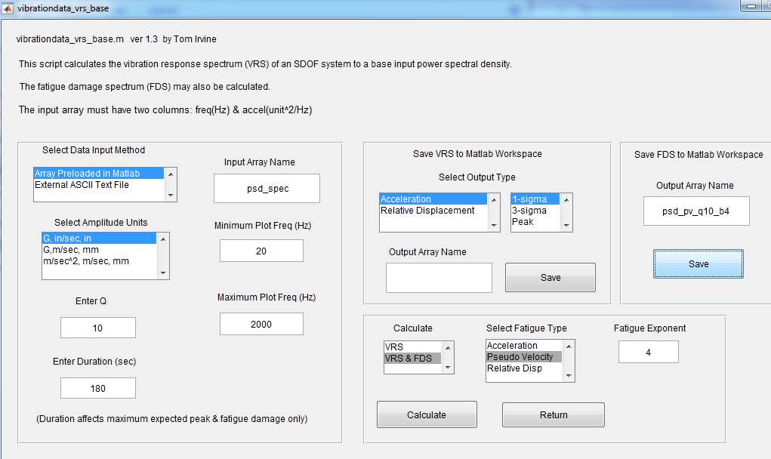
Miscellaneous > Fatigue Toolbox > PSD Input > VRS & FDS for Base Input PSD
Run this for all four (Q, b) permutations. Save each Pseudo Velocity FDS.

Slide 15
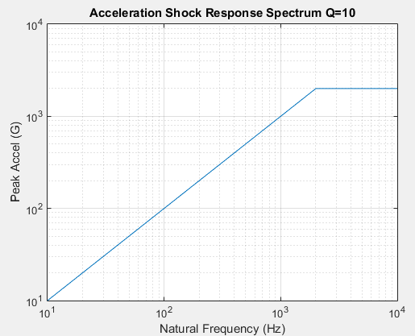
SRS Specification
Vibrationdata
Natural Frequency (Hz) | Accel (G)
10 | 10
2000 | 2000
10,000 | 2000
>> srs_spec=[10 10; 2000 2000; 10000 2000]
Three shocks/axis

Slide 16
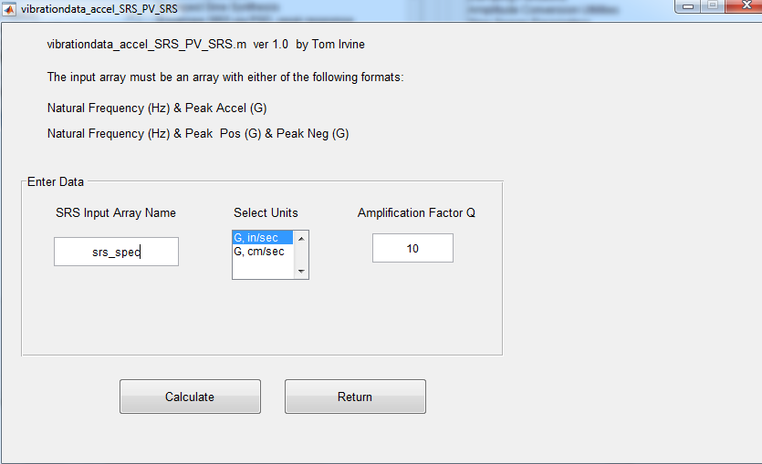
SRS Specification Pseudo Velocity
Vibrationdata
Shock Response Spectrum > Convert Accel SRS to Pseudo Velocity SRS

Slide 17
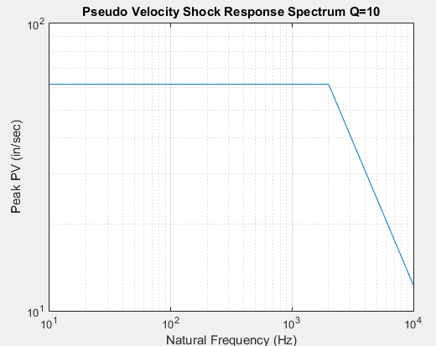
SRS Specification Pseudo Velocity
Vibrationdata
Maximum PV = 61 in/sec

Slide 18
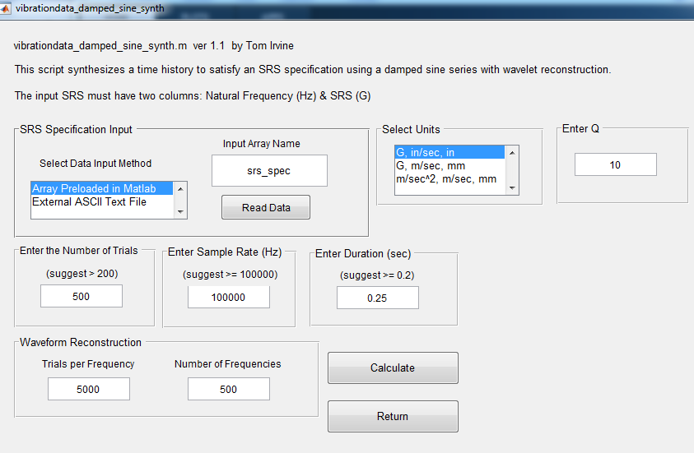
Synthesize a time history from scratch or use library file: srs2000G_accel
Only need one time history because spec is always Q=10 even though two Q values are used for FDS

Slide 19
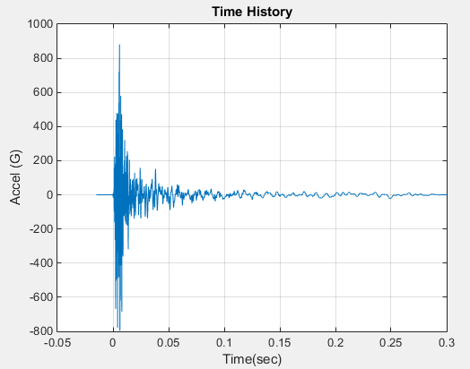
Synthesized Time History
Vibrationdata

Slide 20
SRS Specification
Vibrationdata
Natural Frequency (Hz) | Accel (G)
10 | 10
2000 | 2000
10,000 | 2000
Three shocks/axis
>> srs_spec=[10 10; 2000 2000; 10000 2000]

Slide 21
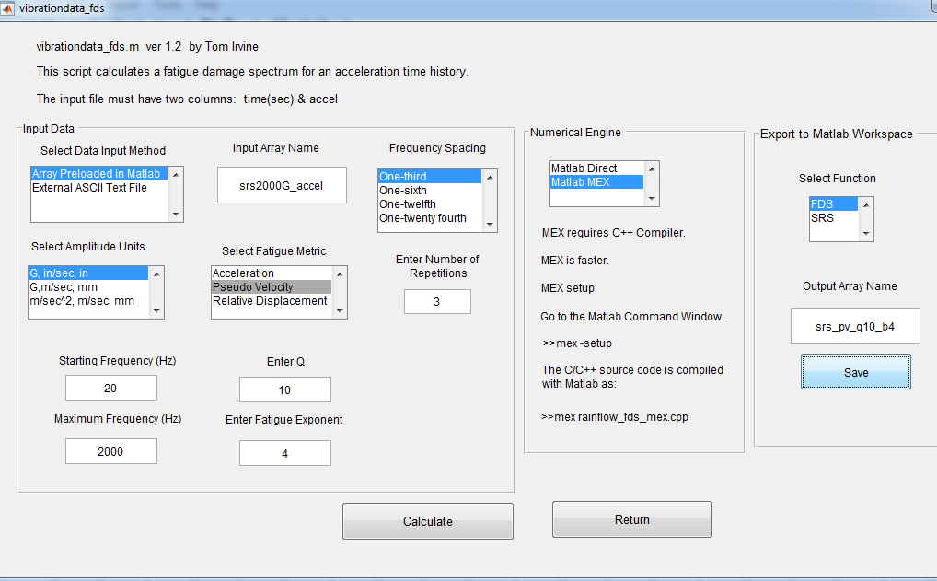
Miscellaneous > Fatigue Toolbox > Time History Input > Fatigue Damage Spectrum for Accel
Run this for all four (Q, b) permutations. Save each Pseudo Velocity FDS.

Slide 22
Legend: PSD SRS
PSD Covers SRS for b = 4 (plots in left column)

Slide 23
SRS Specification
Vibrationdata
Now consider the case where a PSD is to be derived to cover an SRS requirement.
The component will be assumed to have Q=30 and b=6.4 (single pair for brevity)
The natural frequency is left as an independent variable.
Candidate PSD functions can be derived via trial-and-error
Each PSD is scaled so that its pseudo velocity FDS just envelops that of the time history synthesized for the SRS specification
The optimal PSD is that which satisfies the enveloping with the least possible acceleration, velocity and displacement RMS levels

Slide 24
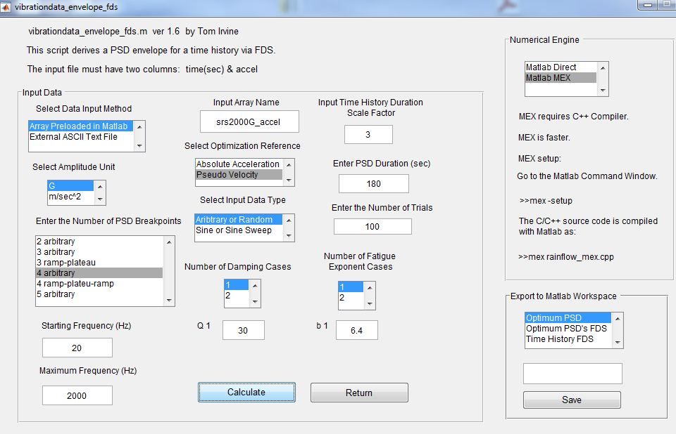
Time History > PSD Envelope via FDS

Slide 25
Freq (Hz) | Accel (G^2/Hz)
20 | 0.026
137 | 0.65
2000 | 1.476
The equivalent PSD is conservative in terms of fatigue damage.

Slide 26
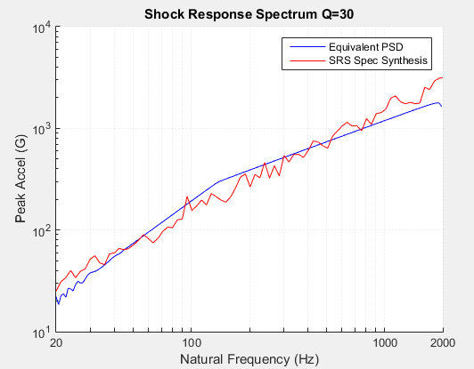
The equivalent PSD does not completely envelop the SRS.
Increase the level or duration if peak enveloping is required.

Slide 27
Peak Enveloping
Vibrationdata
A conservative PSD can be generated to envelop an SRS in terms of peak response
But PSD is limited to about 2000 Hz for practical shaker test
This limitation is okay as long as component is an SDOF system with fn < 2000 Hz

Slide 28
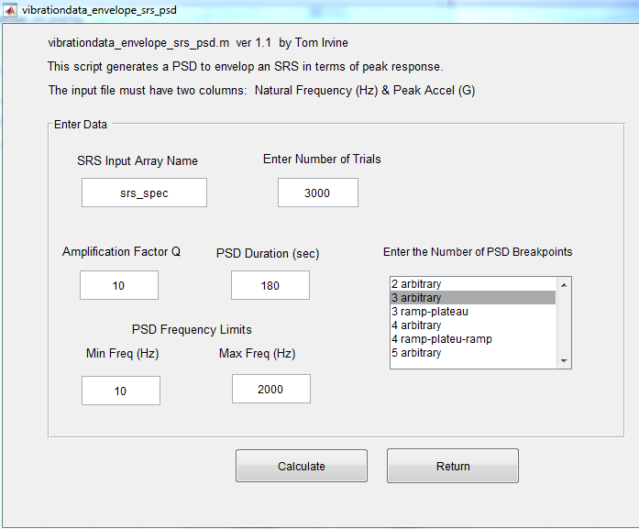
Shock Response Spectrum > Envelope SRS via PSD, peak response

Slide 29
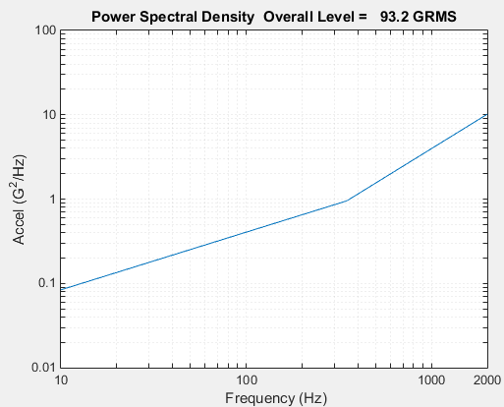
Peak Envelope PSD
Vibrationdata
But too high for a shaker table test!

Slide 30
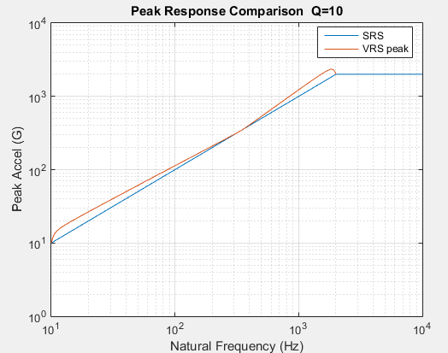
Comparison
Vibrationdata
The peak VRS is based on the Rayleigh distribution.

