Slide 1
Unit 45
Vibrationdata
Two-degree-of-freedom System with Translation & Rotation

Slide 2
Introduction
Vibrationdata
Rotational degree-of-freedom dynamic problem requires mass moment of inertia
Measure, calculate, or estimate MOI

Slide 3
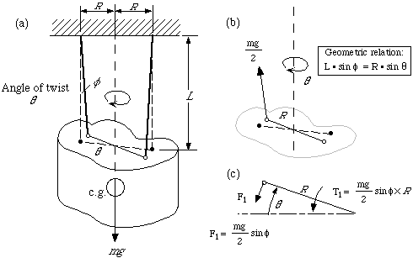
Measure Inertia via Bifilar Pendulum
Vibrationdata

Slide 4
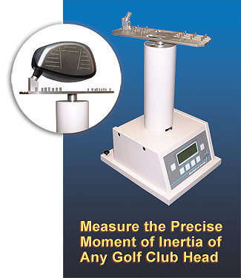
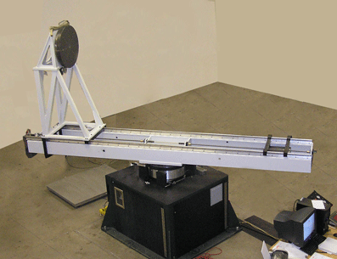
Two-Plane Spin Balance
Vibrationdata

Slide 5
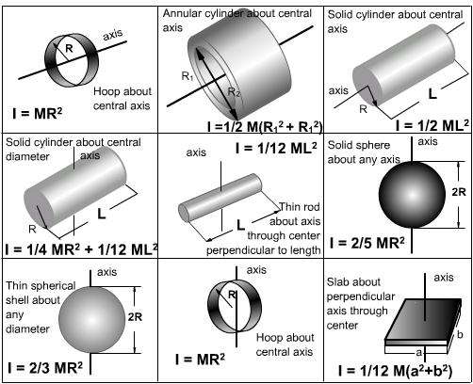
Inertia & Radius of Gyration
Vibrationdata

Slide 6
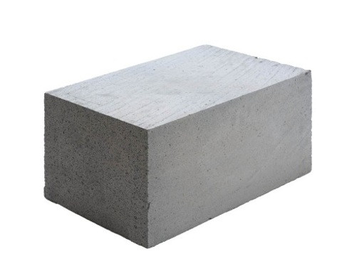
Rectangular Prism
Vibrationdata
Y
a
c
b
Z
X

Slide 7
Inertia & Radius of Gyration
Vibrationdata
The mass moment of inertia J
m is the mass
r is the radius of gyration -
The distance from an axis at which the mass of a body may be assumed to be concentrated and at which the moment of inertia will be equal to the moment of inertia of the actual mass about the axis, equal to the square root of the quotient of the moment of inertia and the mass.

Slide 8
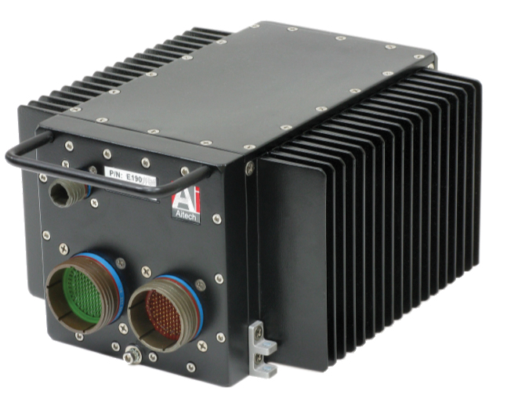
Avionics Component
Vibrationdata
What is mass moment of inertia?
Seldom if ever have measurements
Could treat as solid block with constant mass density
Or just estimate radius of gyration

Slide 9
Two DOF Example
Vibrationdata
L₁
L₂
m | mass
J | mass moment of inertia about the C.G.
k | spring stiffness
L | length from spring attachment to C.G.
θ
x
m, J
k ₁
k ₂
k ₁

Slide 10
Free Body Diagram
Vibrationdata
L₂
L₁
θ
k₂ (x+L₂θ)
x
k₁ (x-L₁θ)
Reference
Derive two equations of motion

Slide 11
Equations of Motion
Vibrationdata
Assemble equation into matrix form.
The vibration modes have translation and rotation which will be coupled if
The natural frequencies are found via the eigenvalue problem:

Slide 12
Sample Values
Vibrationdata
Variable | Value | Value
m | 3200 lbm | -
L₁ | 4.5 ft | 54 in
L₂ | 5.5 ft | 66 in
k₁ | 2400 lbf / ft | 200 lbf/in
k₂ | 2600 lbf / ft | 217 lbf/in
R | 4.0 ft | 48 in
From Thomson, Theory of Vibration with Applications

Slide 13
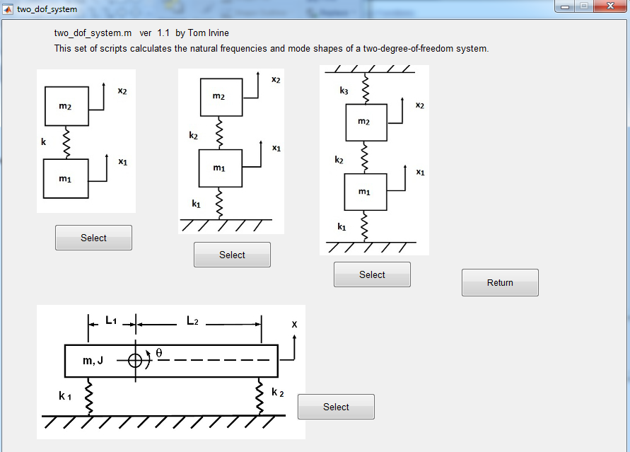
Vibrationdata
vibrationdata > Structural Dynamics > Two-DOF System Natural Frequencies

Slide 14
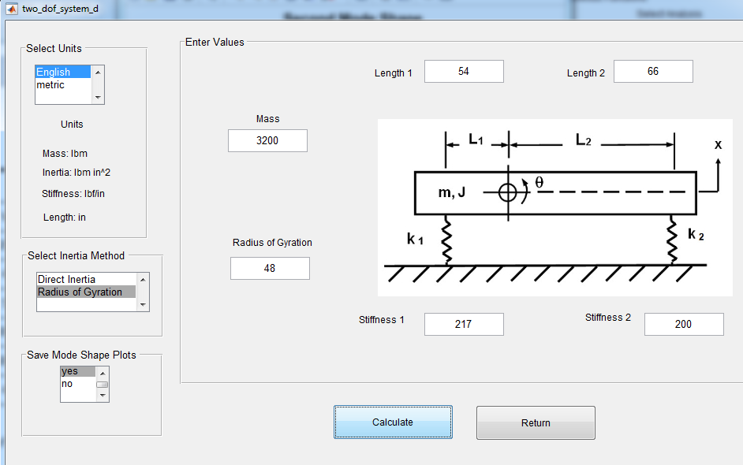
Vibrationdata

Slide 15
Natural Frequency Results
Vibrationdata
mass matrix
8.29 0
0 1.91e+04
stiffness matrix
417 1482
1482 1.504e+06
Natural Frequencies
No. f(Hz)
1. 1.1234
2. 1.4166
Modes Shapes (column format)
0.3445 0.0444
-0.0009 0.0072

Slide 16
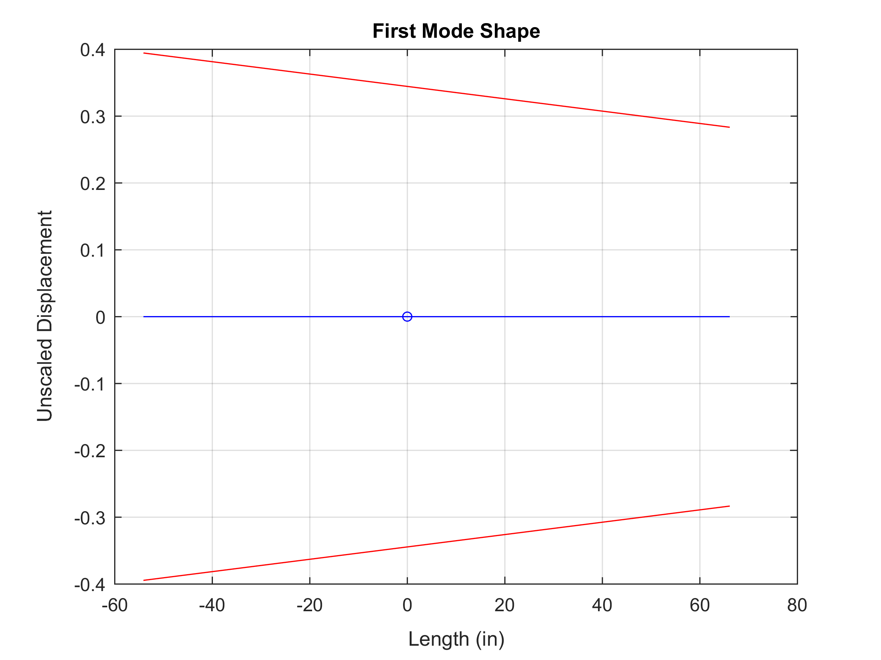
Vibrationdata
C.G.
Combined rotation and translation

Slide 17
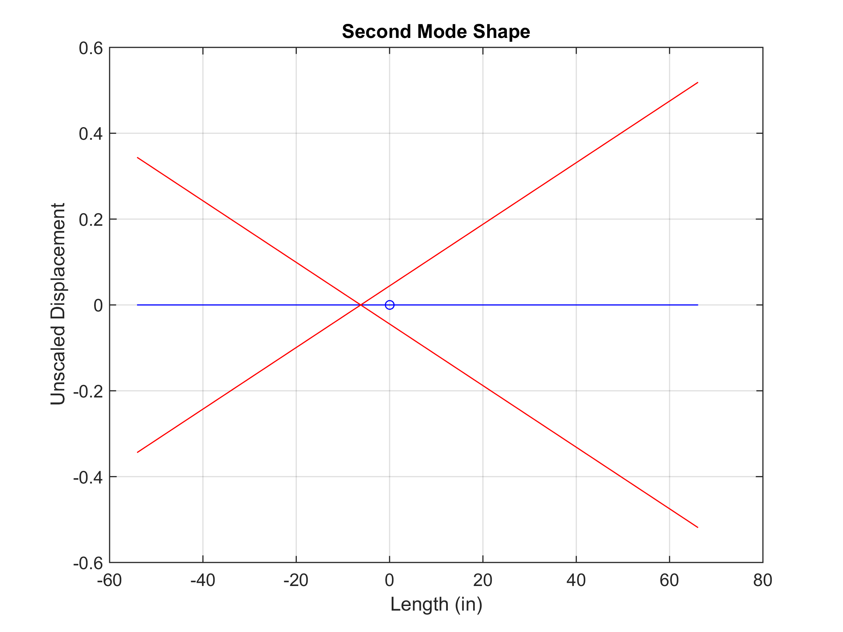
Vibrationdata
C.G.
Combined rotation and translation

Slide 18
Apply Base Excitation
Vibrationdata
The corresponding base excitation problem is complicated because the base motion directly couples with each of the two different degree-of-freedom types
Thus use an “enforced motion” approach
Must add a base mass for this method
Motion will then be enforced on the base degree-of-freedom
The mass value of the base is arbitrary

Slide 19
Three Dof System
Vibrationdata
L₁
L₂
θ
x₂
m₂, J
k ₁
k ₂
k ₁
m₁
x₁

Slide 20
Free Body Diagram
Vibrationdata
L₂
L₁
θ
k₂ (x₂+L₂θ - x₁)
k₁ (x₂-L₁θ - x₁)
k₂ (x₂+L₂θ - x₁)
k₁ (x₂-L₁θ - x₁)

Slide 21
Derive Equation of Motion
Vibrationdata
Homogeneous for now

Slide 22
Avionics Component
Vibrationdata
Partition the matrices and vectors as follows
where the displacement vector is
Subscripts
d is driven
f is free

Slide 23
Transformation Matrix
Vibrationdata
Transformation matrix Π
where
I is the identify matrix

Slide 24
Decoupling via Transformation Matrix
Vibrationdata
Intermediate goal is to decouple the partition-wise stiffness matrix.
Let
Substitute transformed displacement and pre-multiply mass and stiffness matrices by Π^{T} as follows

Slide 25
Apply Transformation Matrix
Vibrationdata

Slide 26
Avionics Component
Vibrationdata
The equation of motion is thus
Non-homogenous term due to enforce acceleration
The final displacement are found via
The equation of motion can solved either in the frequency or time domain.

Slide 27
Reference
Vibrationdata
Too many equations for a Webinar!
Further details given in:
T. Irvine, Spring-Mass System Subjected to Enforced Motion, Vibrationdata, 2015
Similar to Craig-Bampton modeling
Damping can be applied later as modal damping

Slide 28
Sample Avionics Box with C.G. Offset
Vibrationdata
Variable | Value
m | 5 lbm
L₁ | 3 in
L₂ | 5 in
k₁ | 2000 lbf/in
k₂ | 2000 lbf/in
R | 2 in
Calculate natural frequencies, modes, shapes and frequency response functions for base excitation
Q= 10 for both modes

Slide 29
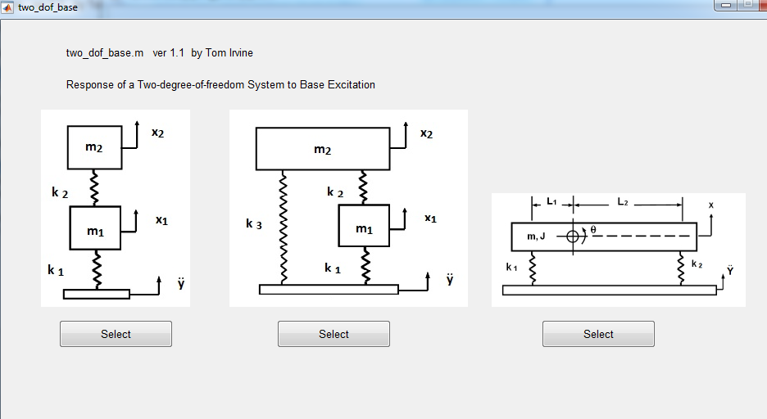
Vibrationdata
vibrationdata > Structural Dynamics > Two-DOF System Base Excitation

Slide 30
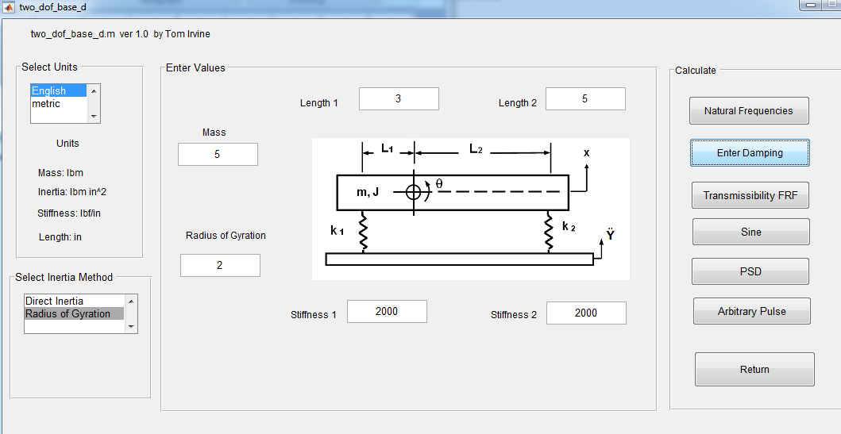
Avionics Component
Vibrationdata
Next Enter Uniform Damping Q=10

Slide 31
Natural Frequency Results
Vibrationdata
mass matrix
0.01295 0
0 0.05181
stiffness matrix
4000 4000
4000 6.8e+04
Natural Frequencies
No. f(Hz)
1. 85.052
2. 183.93
Modes Shapes (column format)
8.6887 1.3065
-0.6532 4.3443

Slide 32
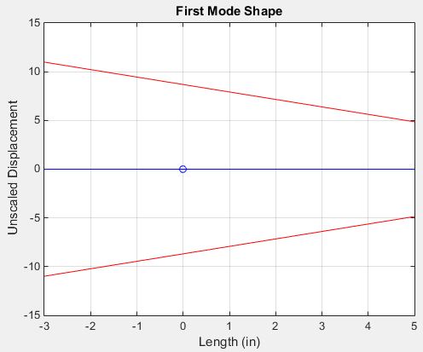
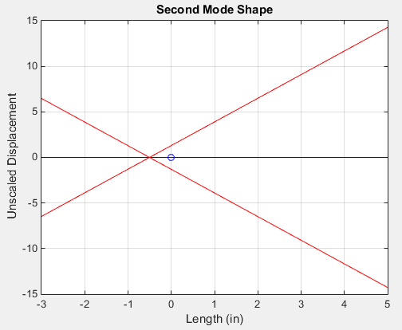
Vibrationdata

Slide 33
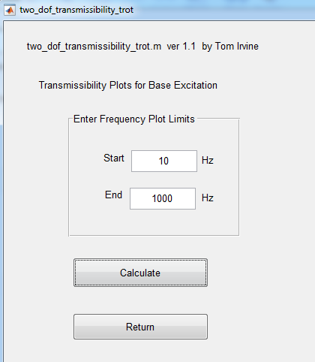
Transmissibility
Vibrationdata

Slide 34
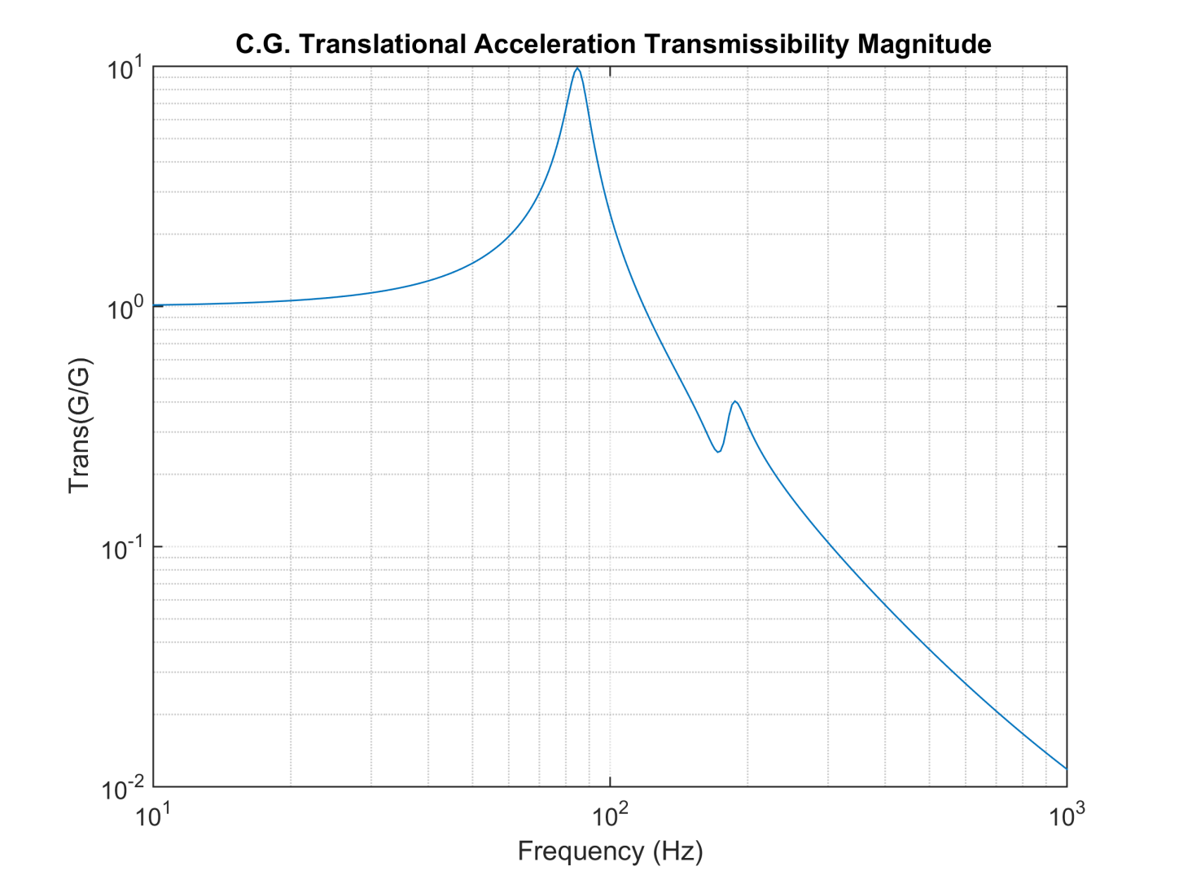
Translational Acceleration Transmissibility
Vibrationdata

Slide 35
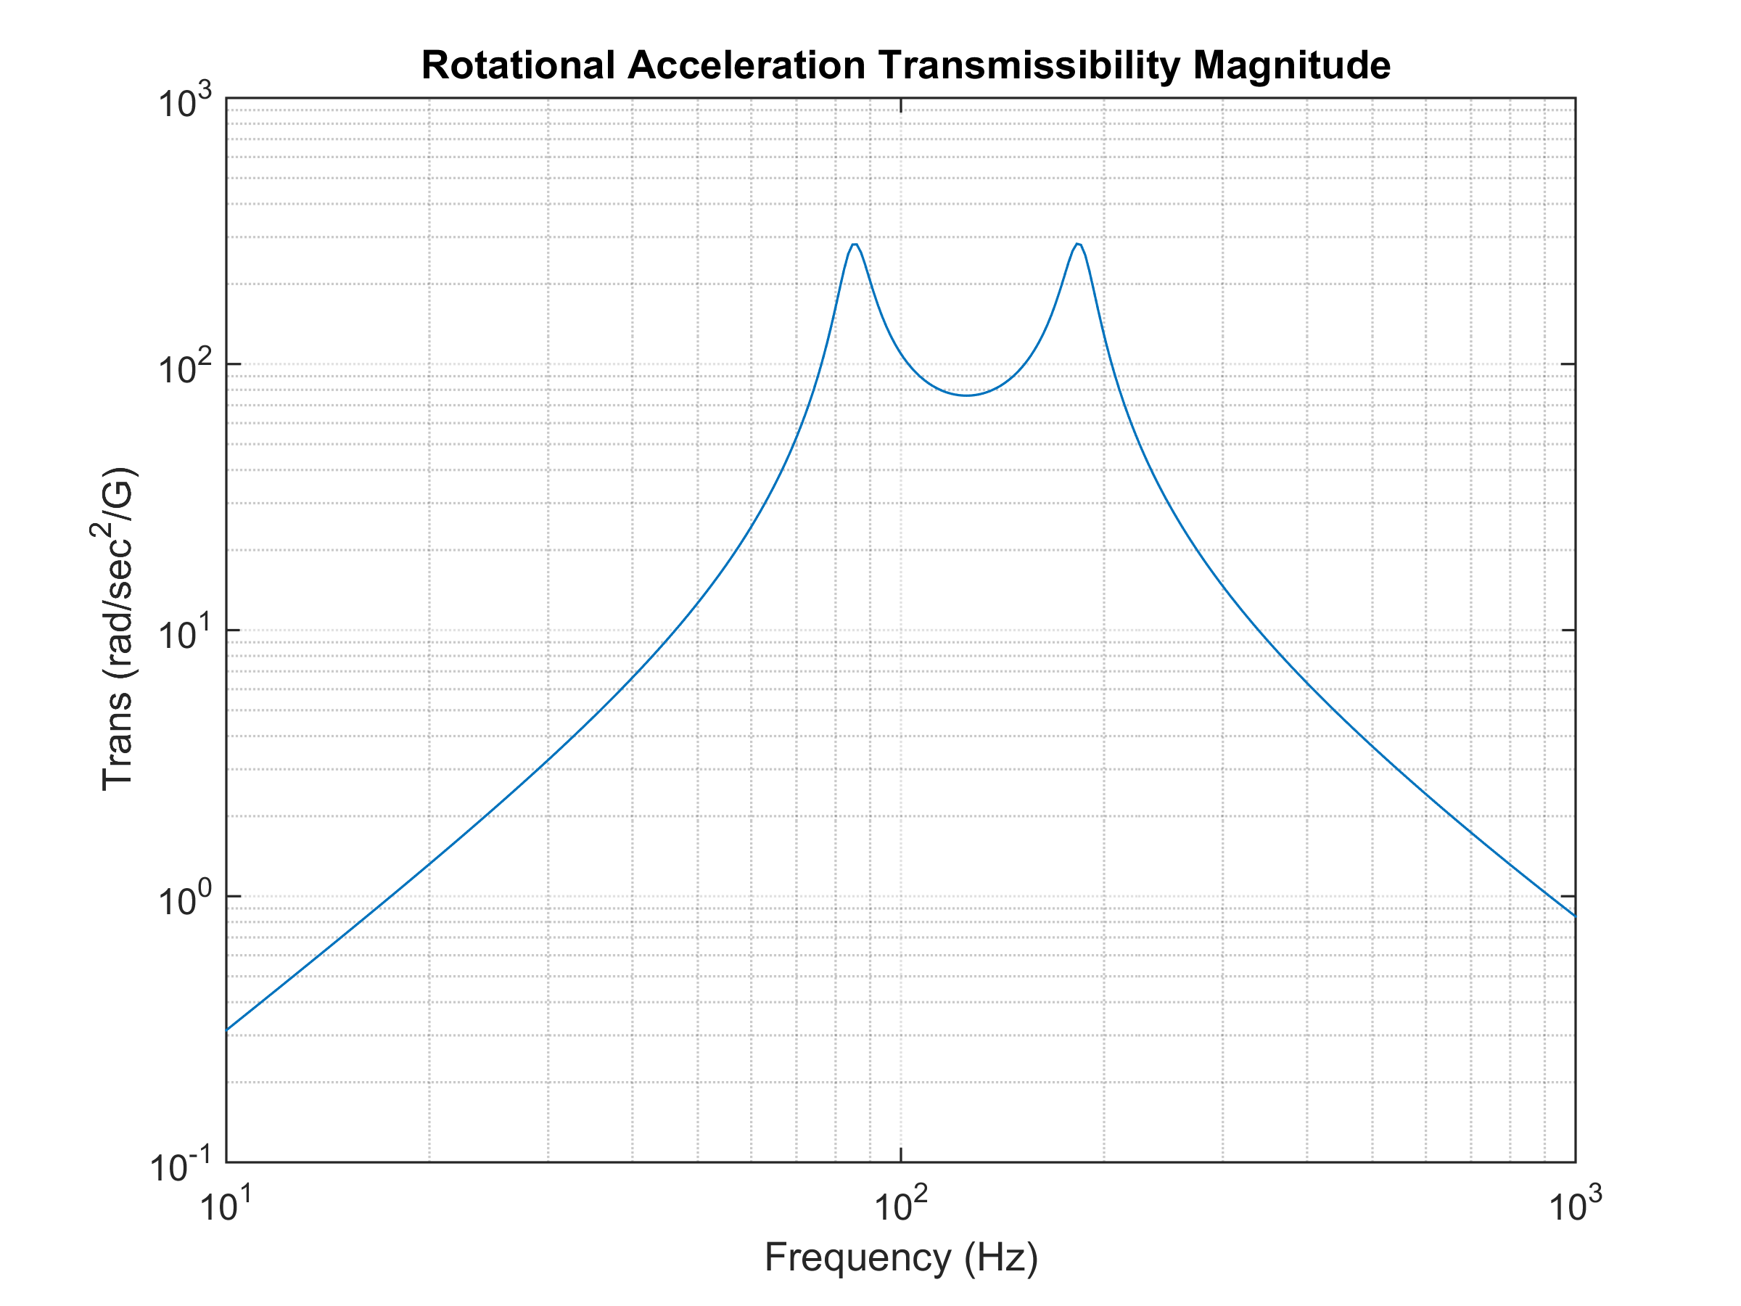
Rotational Acceleration Transmissibility
Vibrationdata

Slide 36
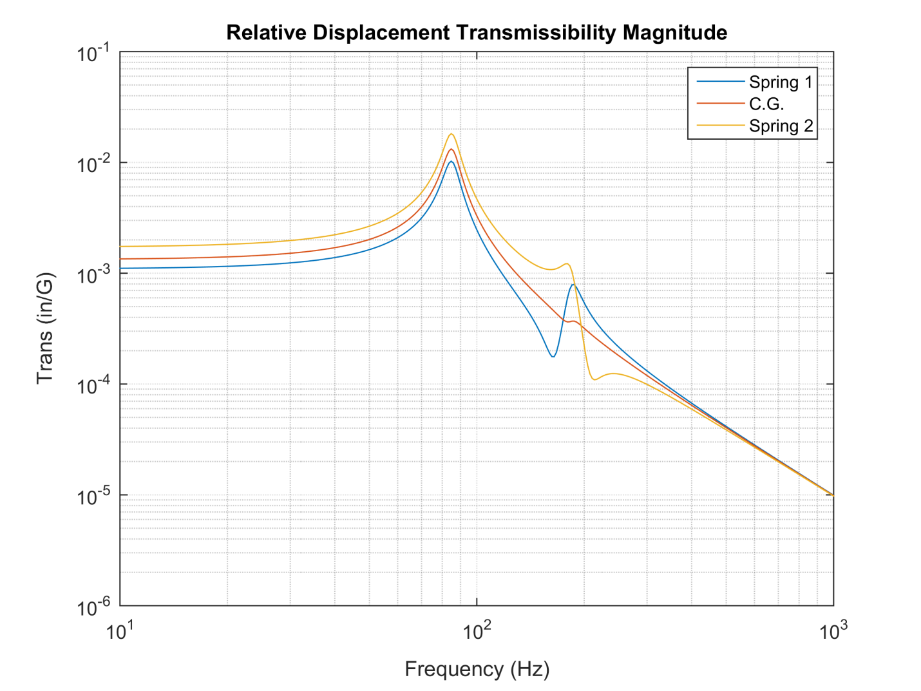
Relative Displacement Transmissibility
Vibrationdata

Slide 37
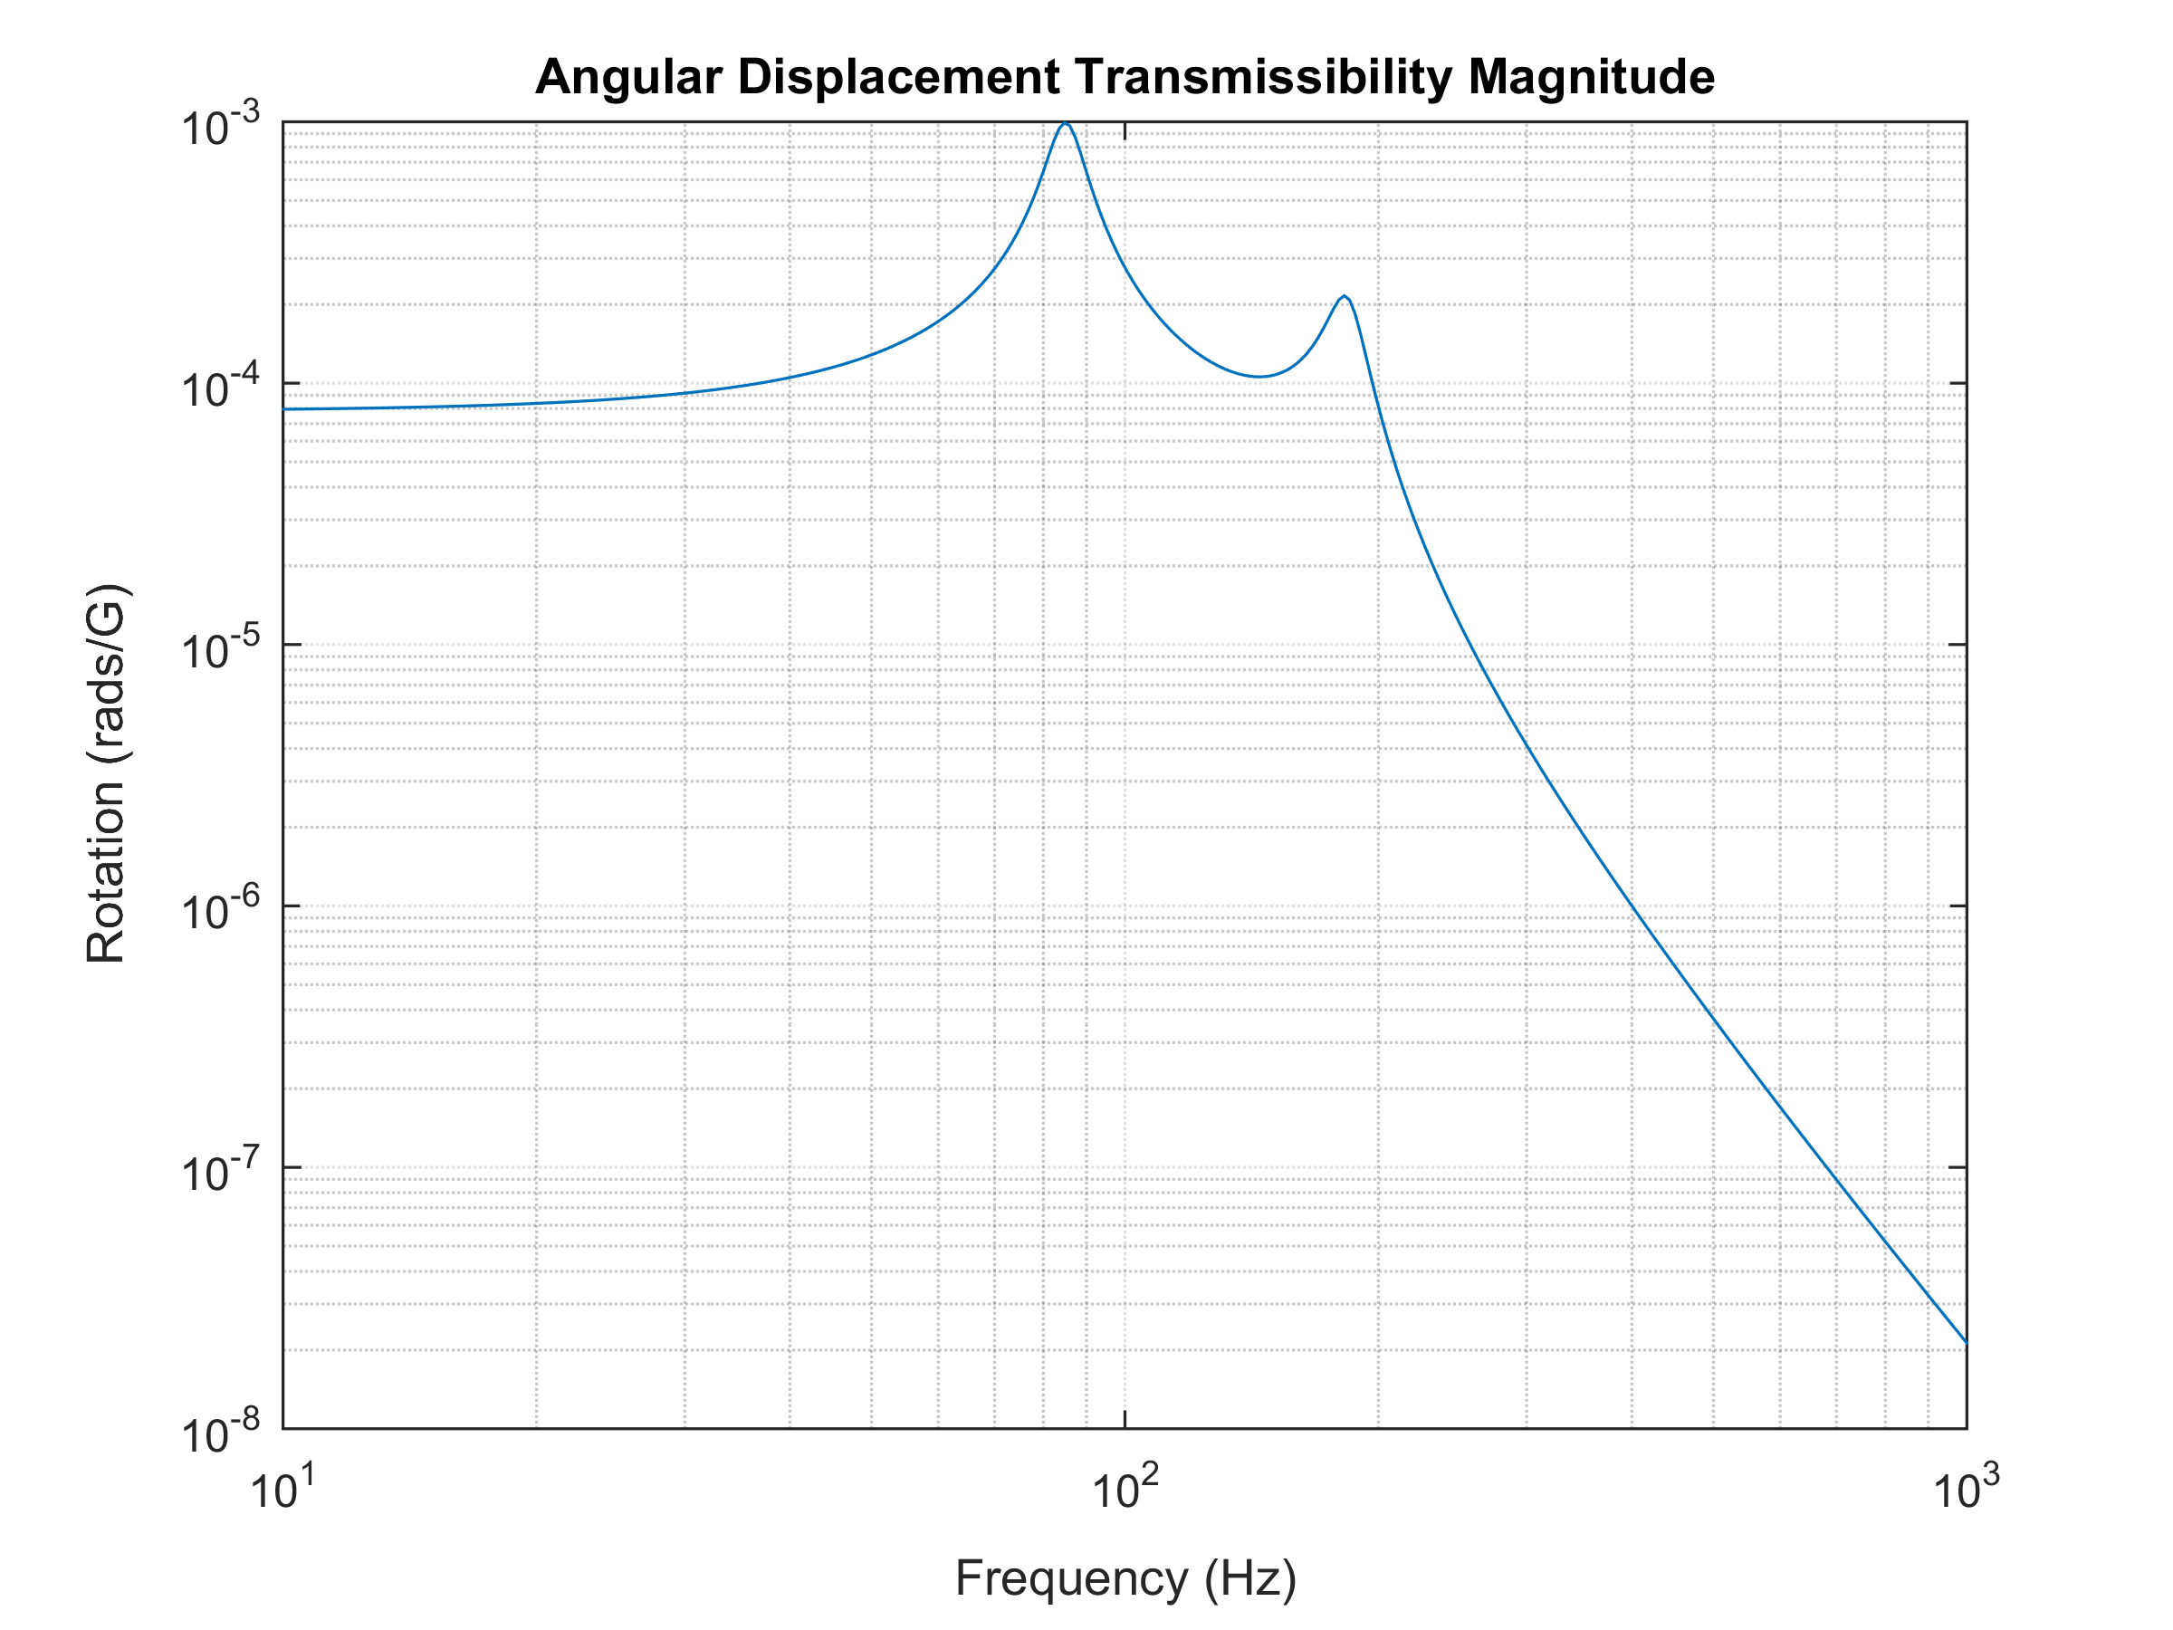
Angular Displacement Transmissibility
Vibrationdata

Slide 38
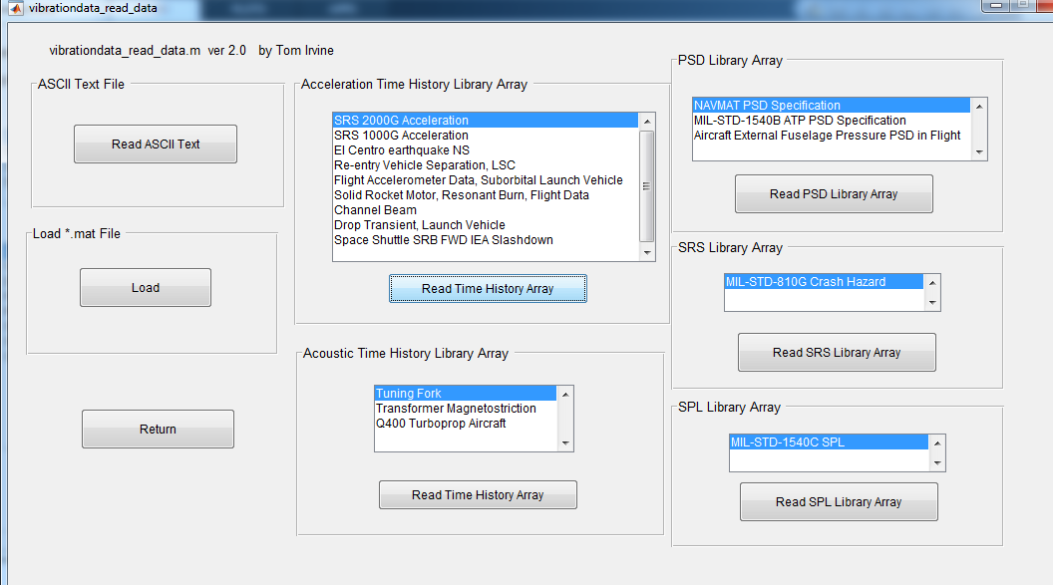
Vibrationdata
Import: SRS 2000G Acceleration & NAVMAT PSD Specification

Slide 39
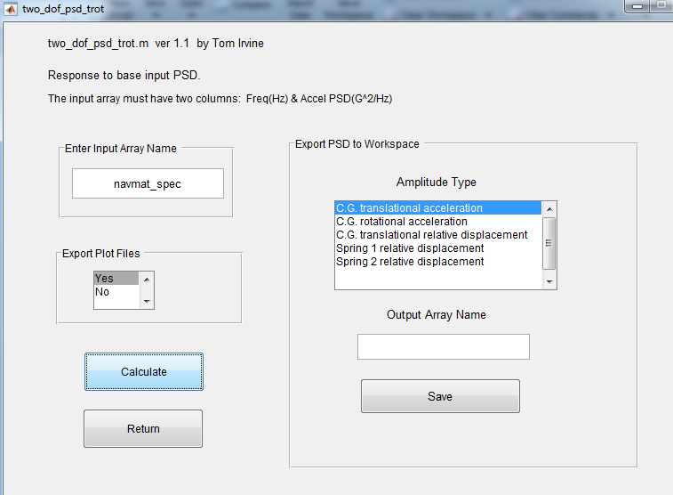
Vibrationdata
Apply the Navmat PSD as the base input.

Slide 40
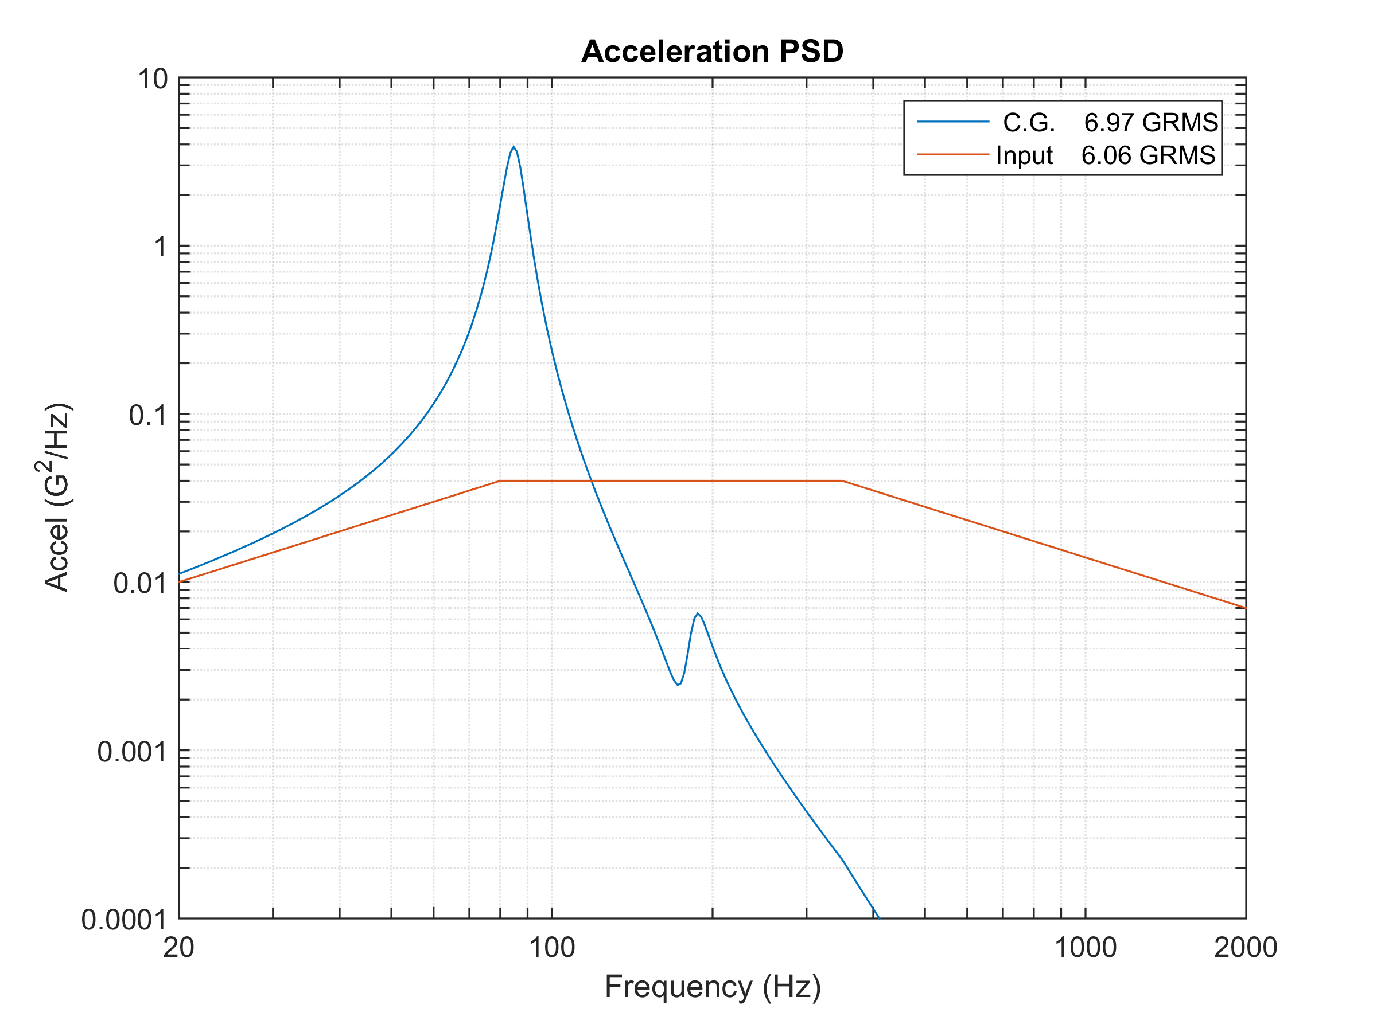
Angular Displacement Transmissibility
Vibrationdata

Slide 41
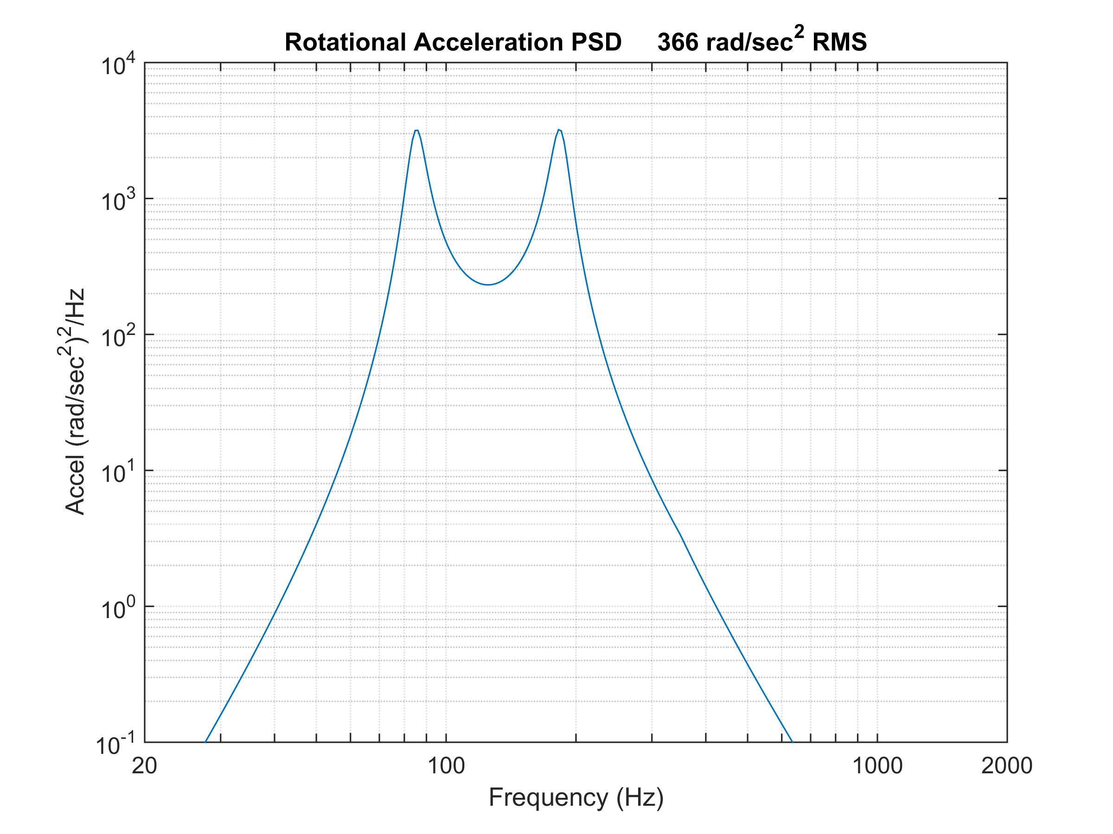
Vibrationdata

Slide 42
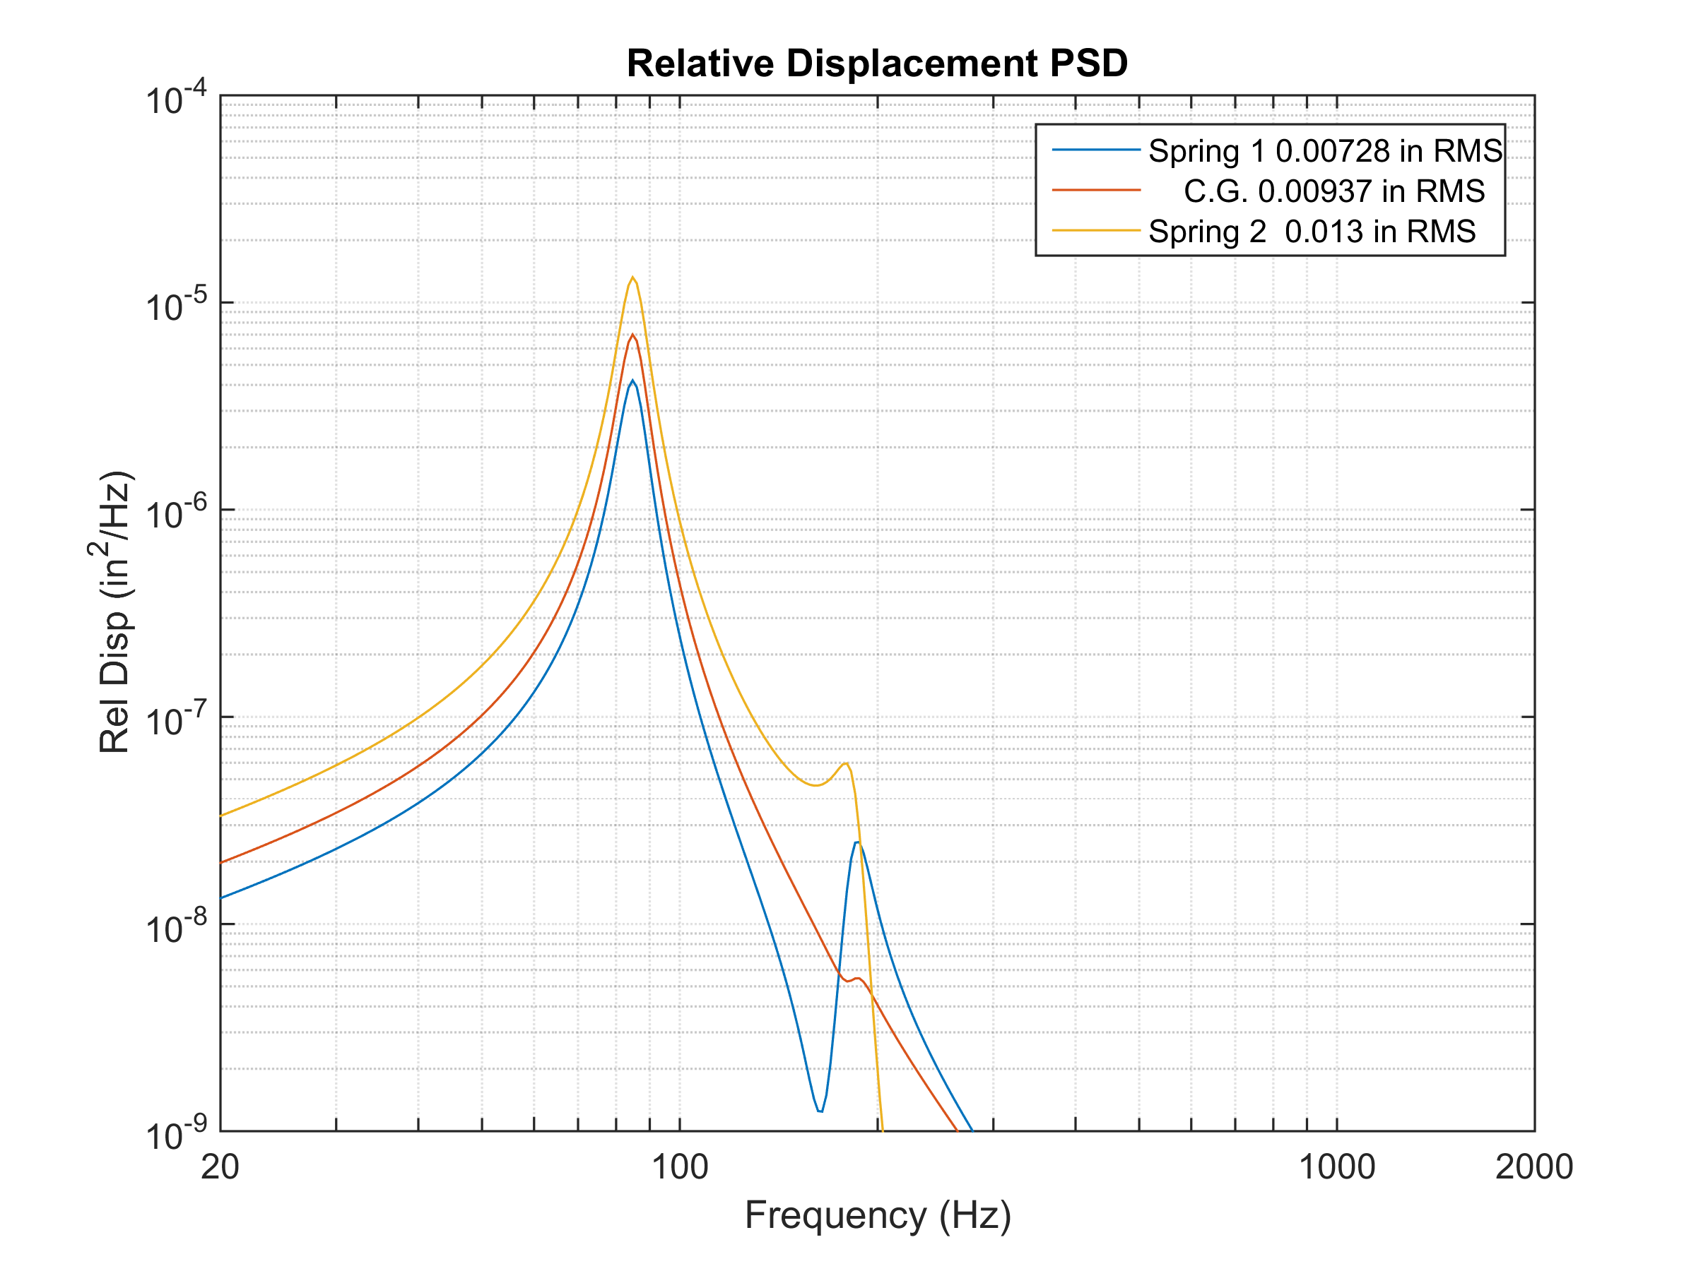
Vibrationdata

Slide 43
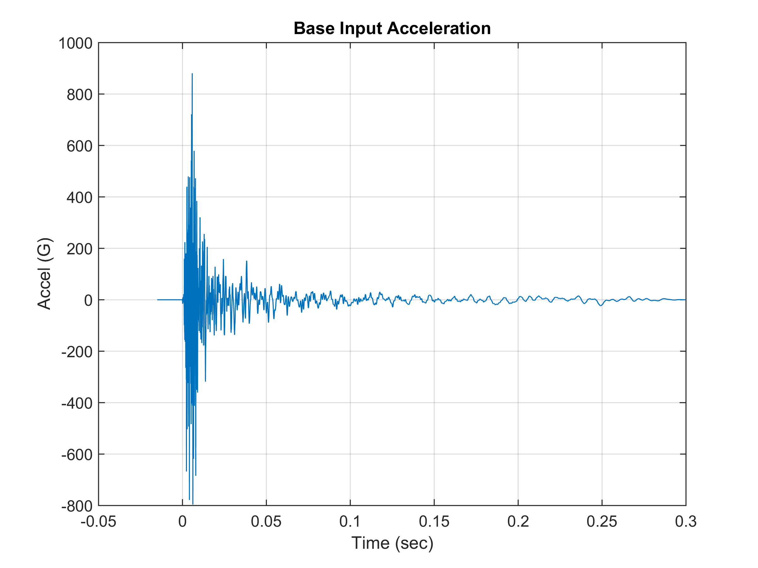
Angular Displacement Transmissibility
Vibrationdata

Slide 44
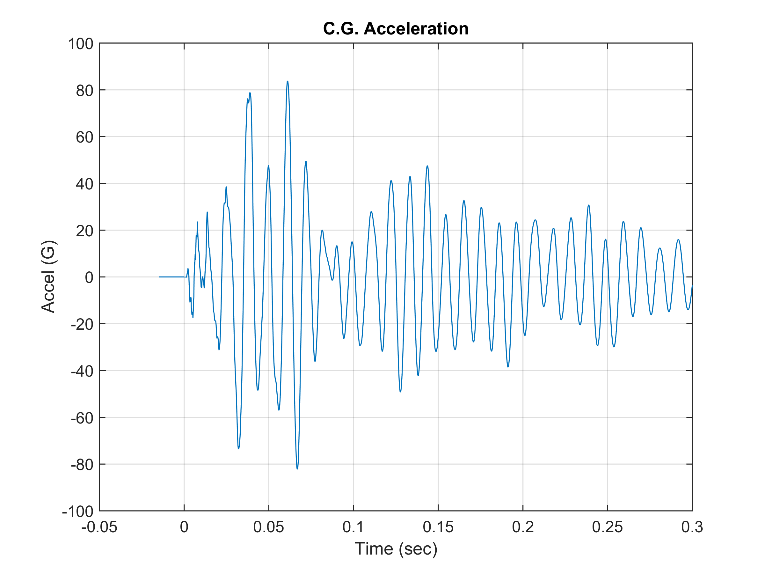
Angular Displacement Transmissibility
Vibrationdata

Slide 45
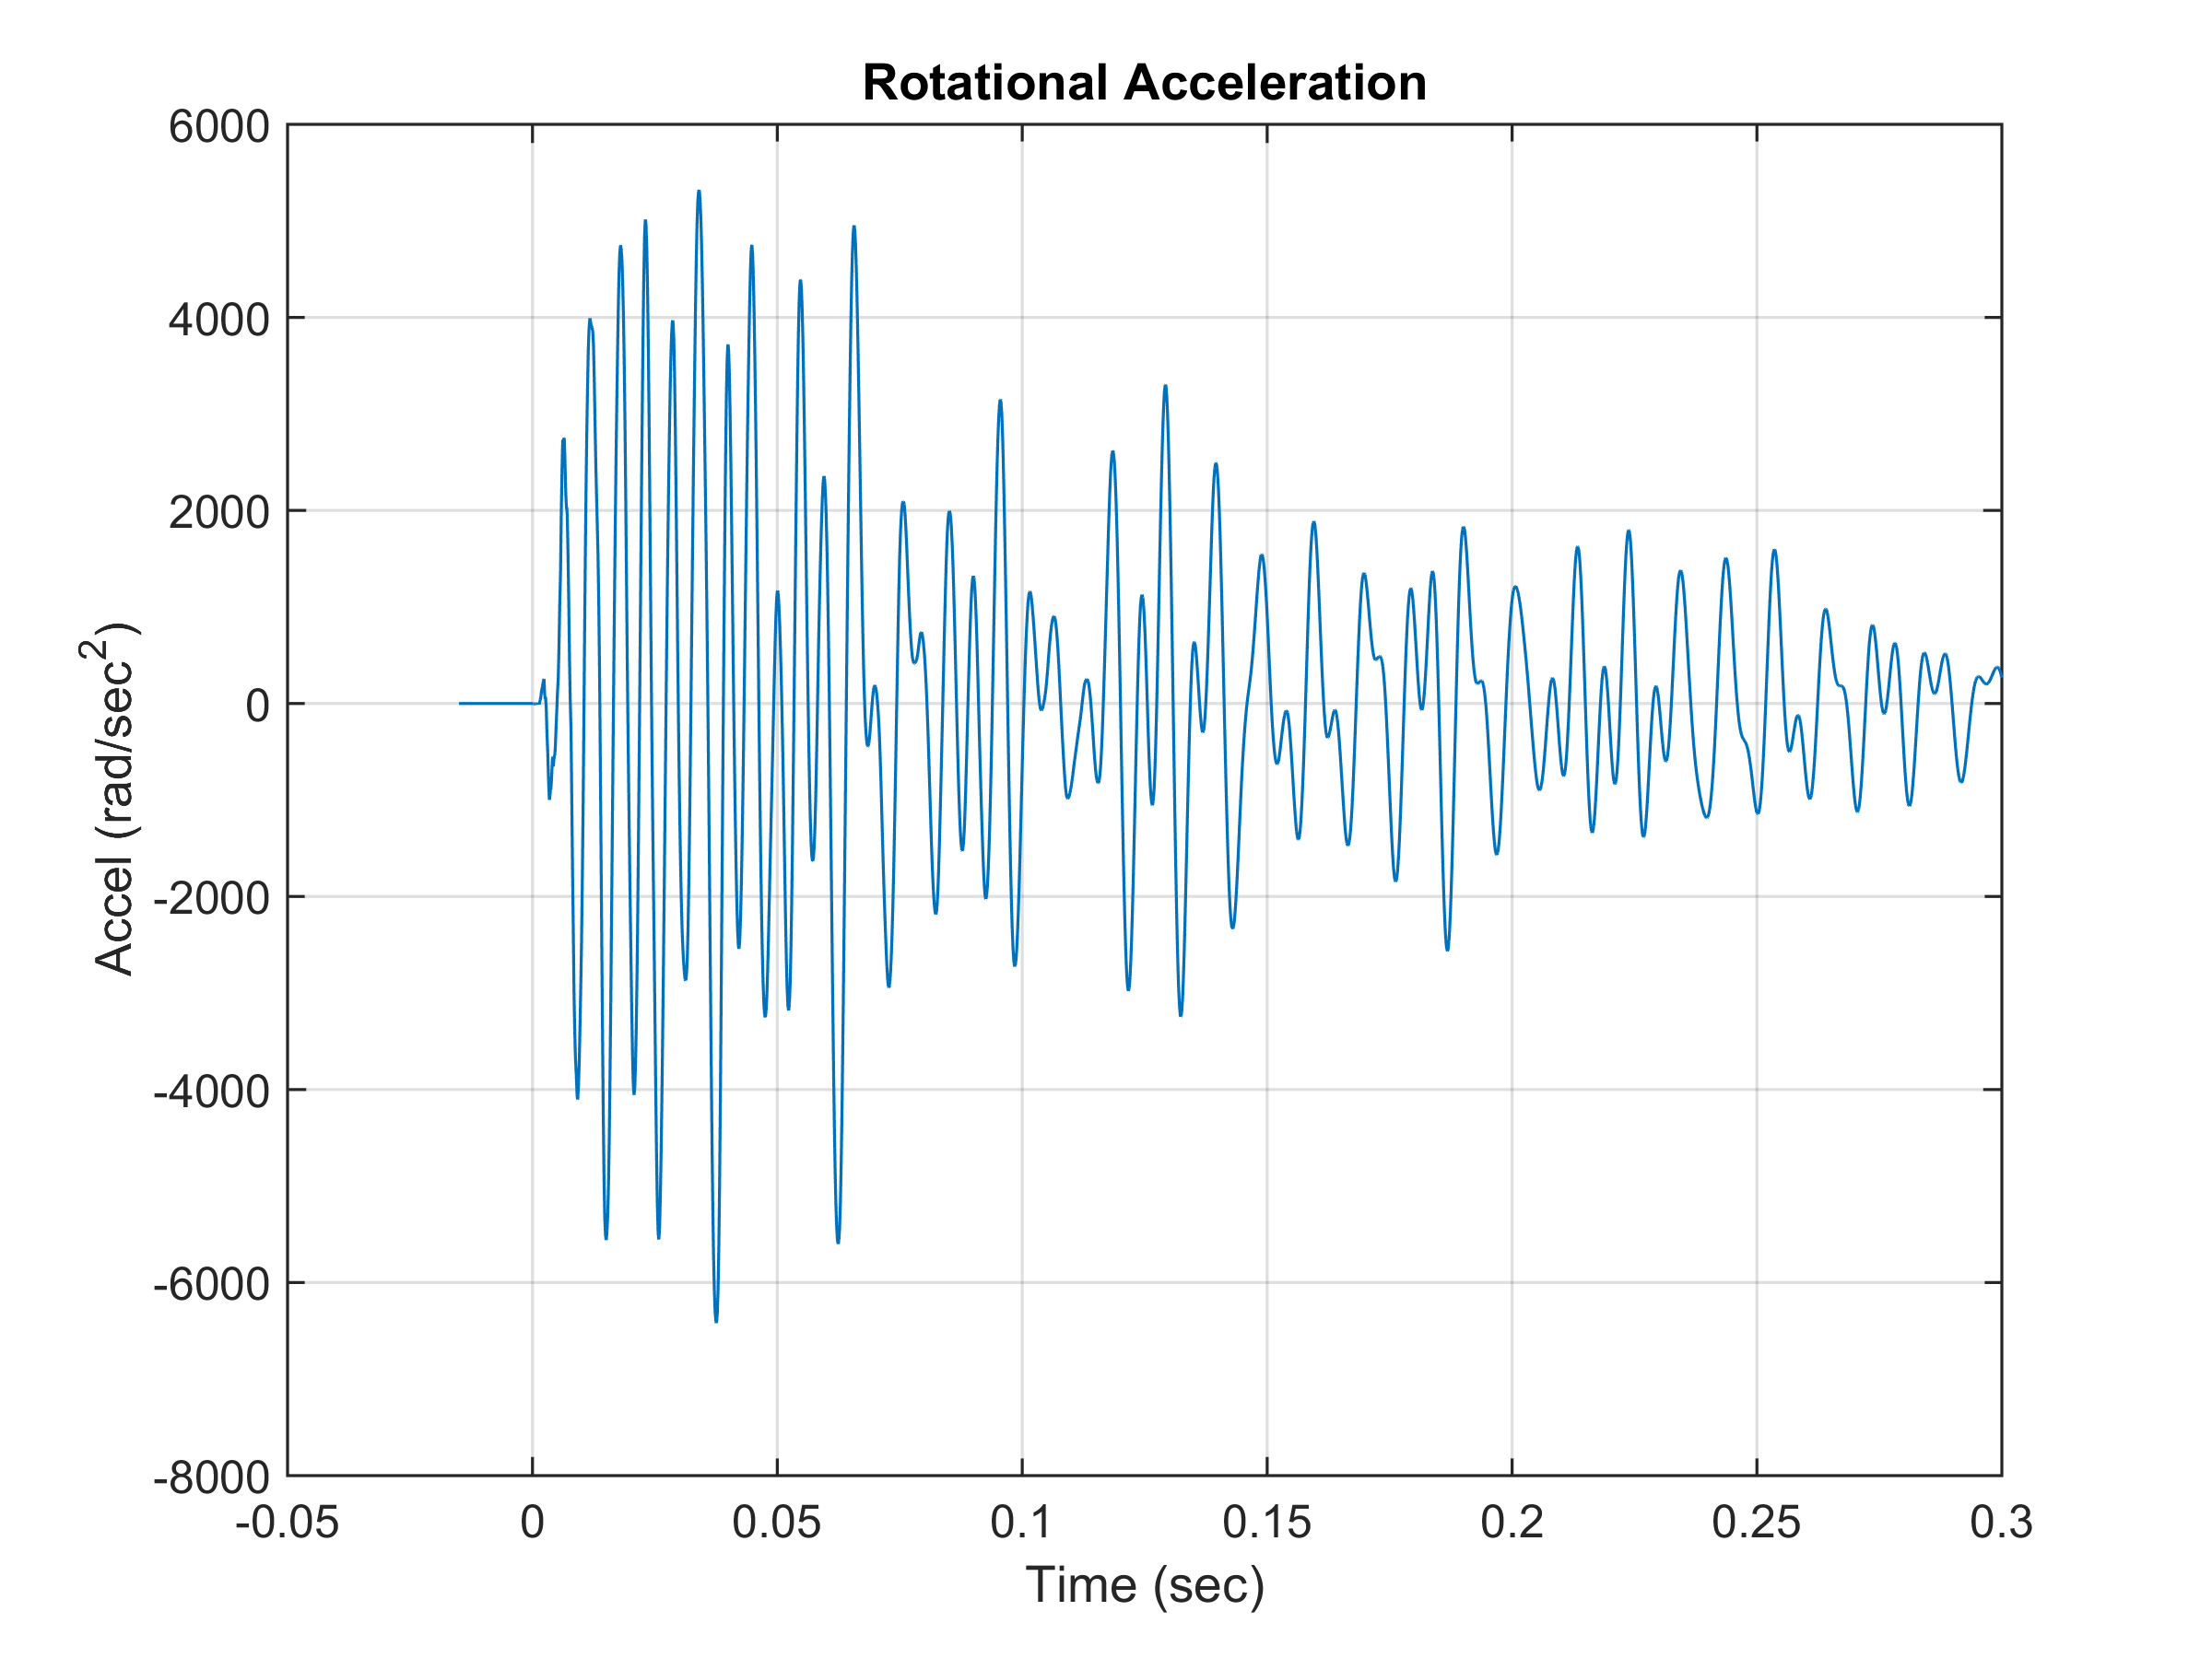
Angular Displacement Transmissibility
Vibrationdata

Slide 46
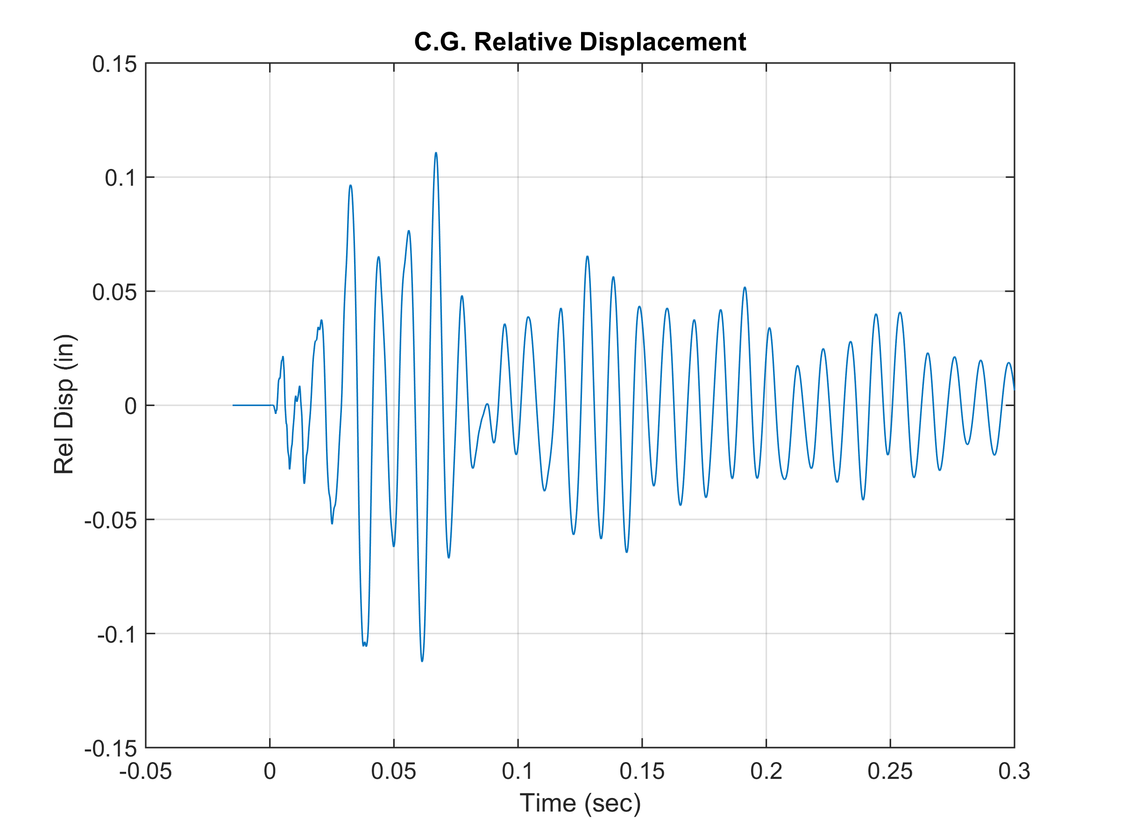
Angular Displacement Transmissibility
Vibrationdata

