Slide 1
Unit 46
Vibrationdata
Two-degree-of-freedom System with Translation & Rotation Subjected to Multipoint Enforced Motion

Slide 2
Introduction
Vibrationdata
L₁
L₂
θ
x
m, J
k ₁
k ₂
k ₁

Slide 3
Introduction
Vibrationdata
L₁
L₂
Rotational degree-of-freedom dynamic problem requires mass moment of inertia
θ
x₃
m₃, J
k ₁
k ₂
x₁
x₂
m₁
m₂

Slide 4
Free Body Diagram
Vibrationdata
L₂
x₃
L₁
θ
m₃, J
k₂ (x₃+L₂θ - x₂)
k₁ (x₃-L₁θ - x₁)
k₂ (x₃+L₂θ - x₂)
k₁ (x₃-L₁θ - x₁)
x₁
x₂
m₁
m₂

Slide 5
Four Equations of Motion
Vibrationdata

Slide 6
Matrix Format
Vibrationdata
Enforced Displacement at x₁ and x₂
Solution given in:
T. Irvine, Spring-Mass System Subjected to Multipoint Enforced Motion

Slide 7
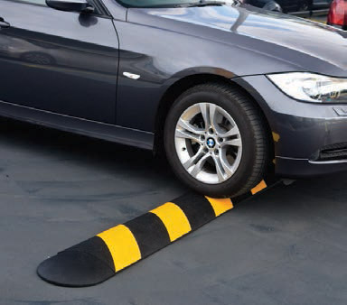
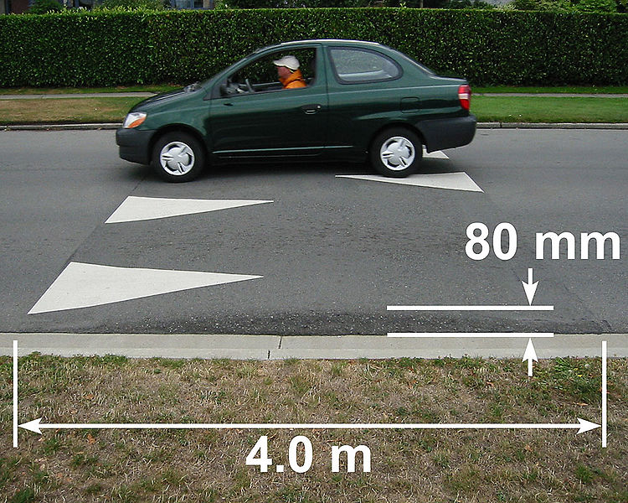
Traffic Calming Devices
Vibrationdata
Speed Bump
Speed Hump

Slide 8
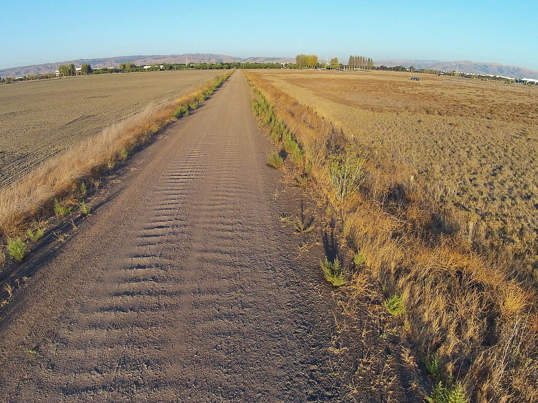
Washboard Road
Vibrationdata

Slide 9
Washboard Road Characteristics
Vibrationdata
Occurrence of periodic, transverse ripples in the surface of gravel and dirt roads
Typically occurs in dry, granular road material with repeated traffic, traveling at speeds above 5 mph
Creates an uncomfortable ride for the occupants of traversing vehicles and hazardous driving conditions for vehicles that travel too fast to maintain traction and control
An automobile that does not experience full contact with the ground might not be able to brake properly

Slide 10
Jerk, Mechanical Effects
Vibrationdata
Jerk is the derivative of acceleration with respect to time
Jerk can cause high-frequency, high-amplitude mechanical stress waves
A steeper slope of the acceleration, i.e. a bigger jerk, excites bigger wave components in the shockwave with higher frequencies, belonging to higher Fourier coefficients, and so an increased probability of exciting a resonant mode
Engineers designing cams work very hard to minimize the jerk of the cam follower
Some precision machining processes are sensitive to jerk

Slide 11
Jerk, Physiological Effects
Vibrationdata
Muscle - neural path – brain system has a control loop system
Muscles can either be relaxed or tightened
The system needs to time to adjust muscle tension according to stress changes
Jerk can upset equilibrium
Muscle tension overshoot can result
Neck and back problems can occur
Recommended jerk limit for elevators < 2.5 m/sec^3 = 0.25 G/sec
Jerk levels in vehicles much higher for speed bumps and washboard roads

Slide 12
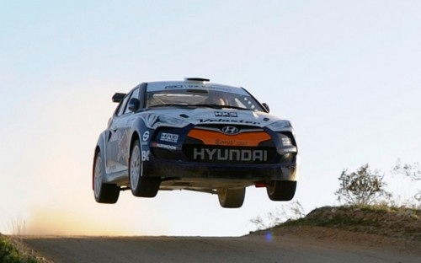
Acceleration Limit
Vibrationdata
Vertical acceleration must be < 1 G
Otherwise car will go airborne

Slide 13
Sample Automobile
Vibrationdata
Variable | Value | Value
m | 3200 lbm | -
L₁ | 4.5 ft | 54 in
L₂ | 5.5 ft | 66 in
k₁ | 2400 lbf / ft | 200 lbf/in
k₂ | 2600 lbf / ft | 217 lbf/in
R | 4.0 ft | 48 in
Subject to speed bump, 5 inch high, 24 in wide
Various speeds at 5 mph steps
Q=1.5 for each mode (33% viscous damping )
From Thomson, Theory of Vibration with Applications

Slide 14
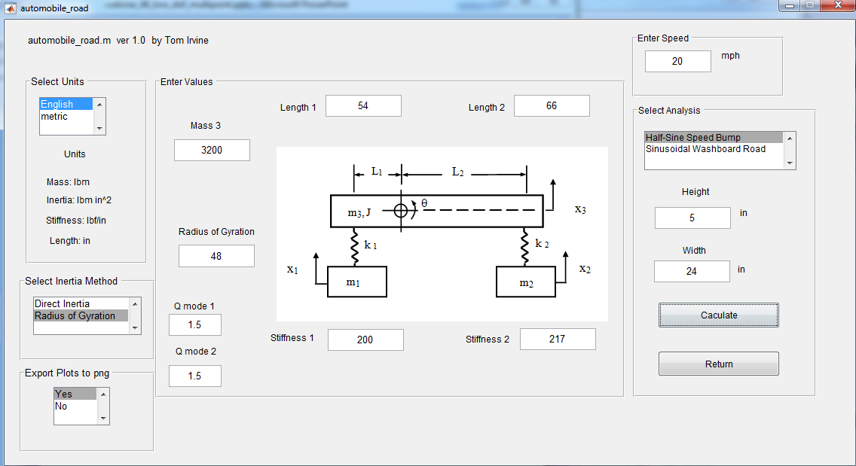
Results, Peak Results
Vibrationdata
vibrationdata > Structural Dynamics > Spring-Mass Systems > Two-DOF Automobile

Slide 15
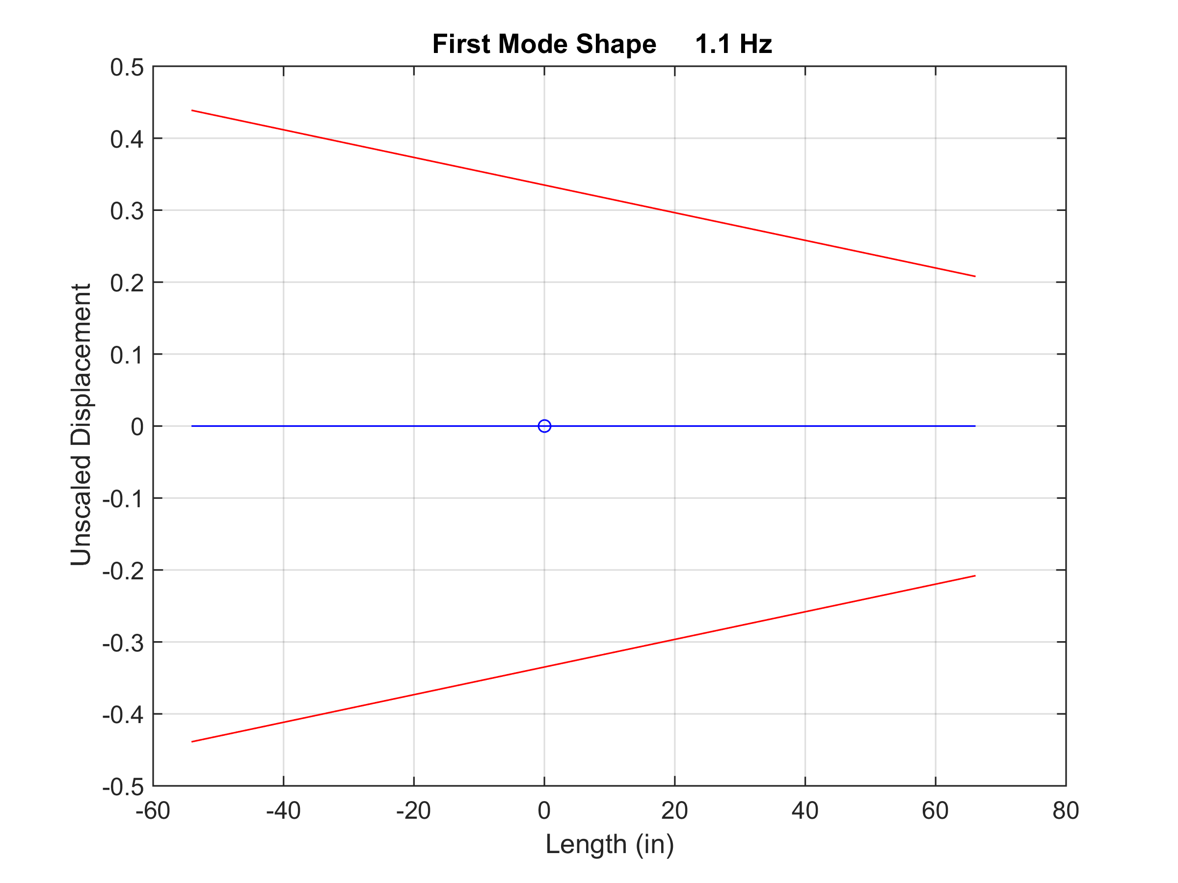
Vibrationdata
Combined rotation and translation

Slide 16
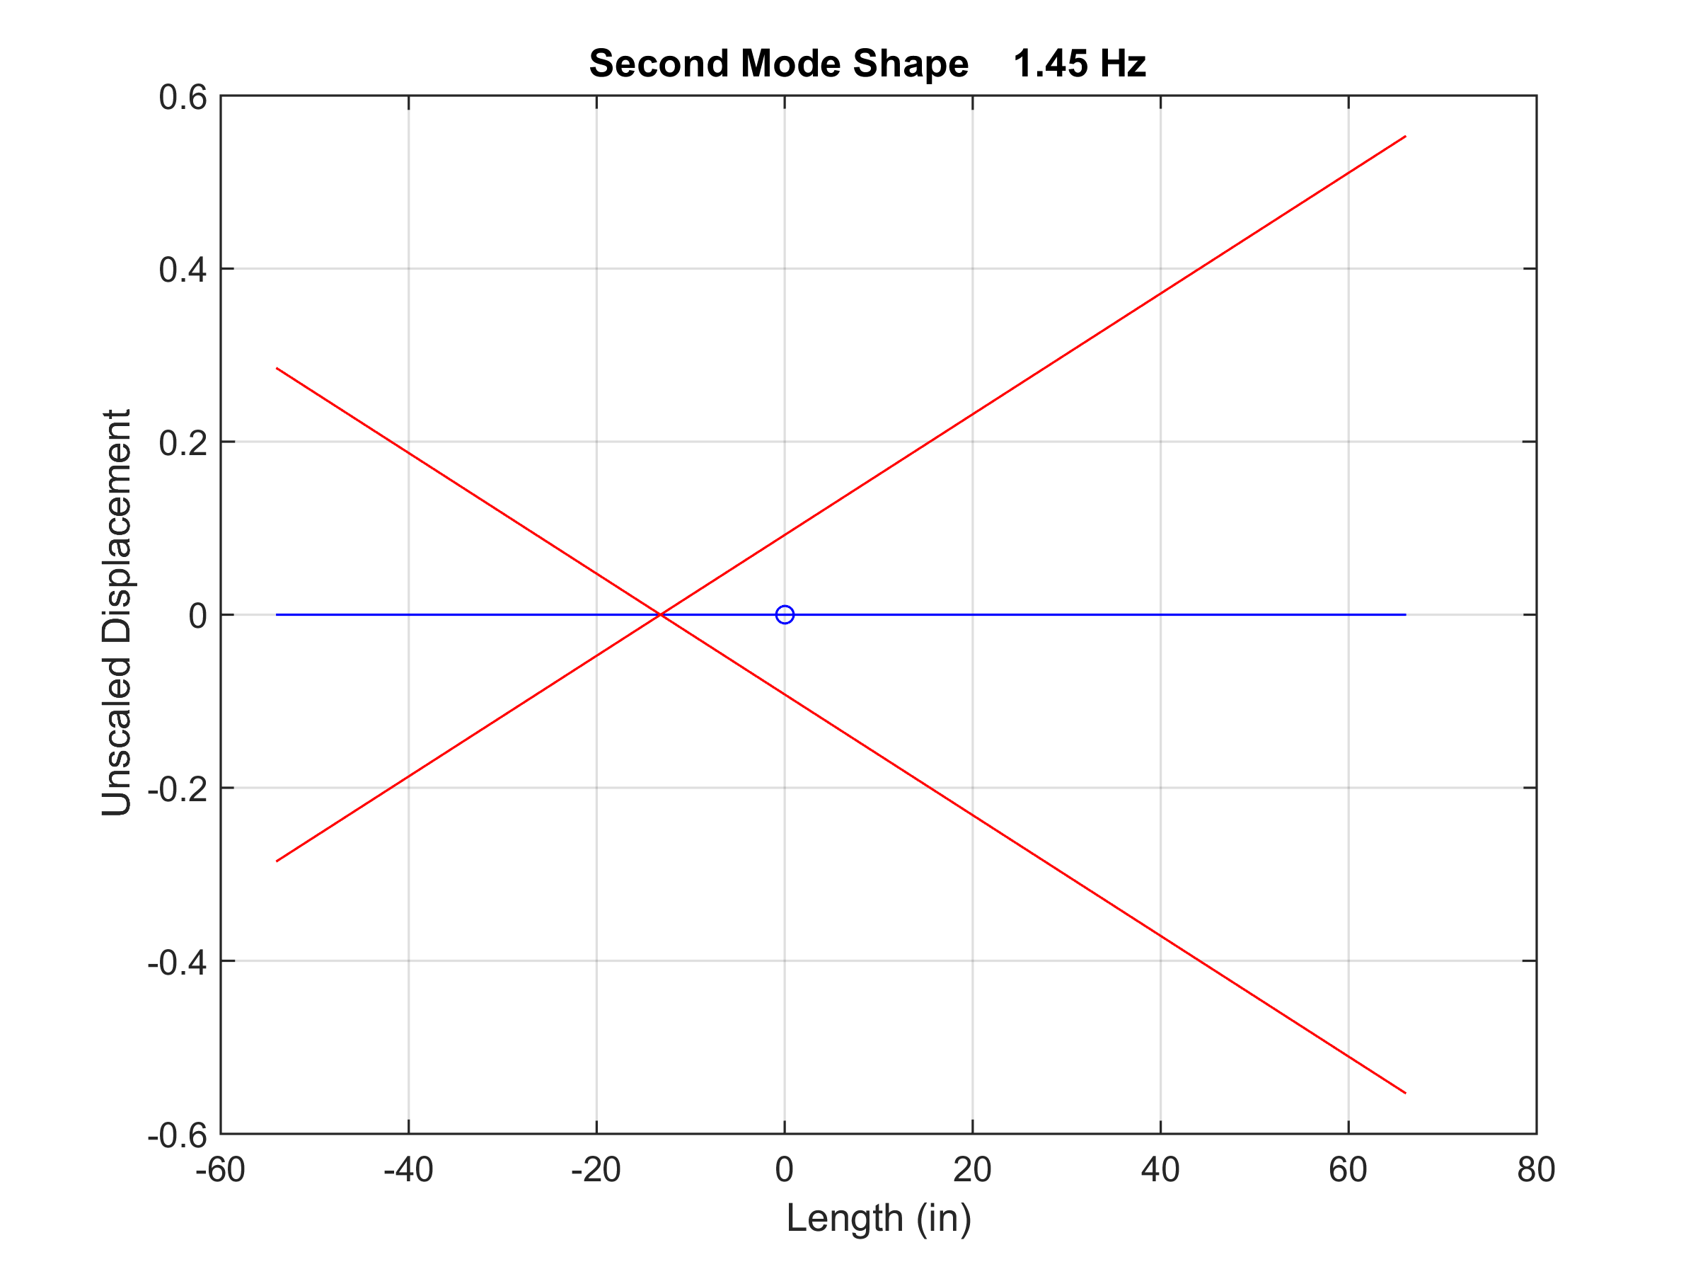
Vibrationdata
Combined rotation and translation

Slide 17
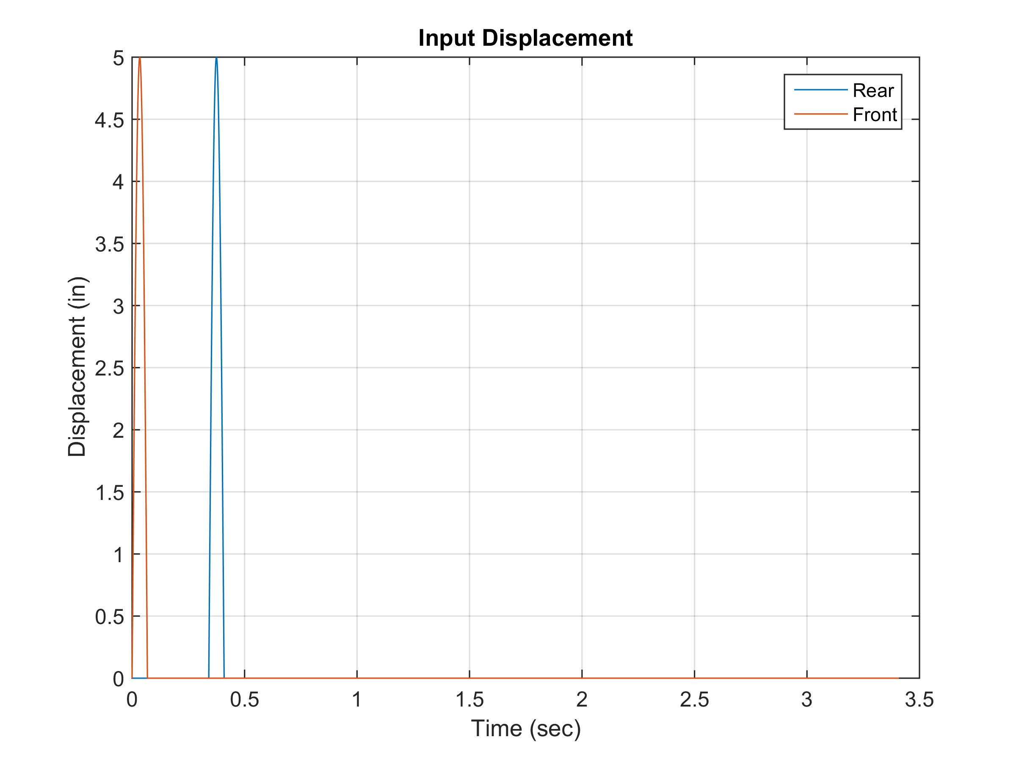
Speed Bump, 20 mph

Slide 18
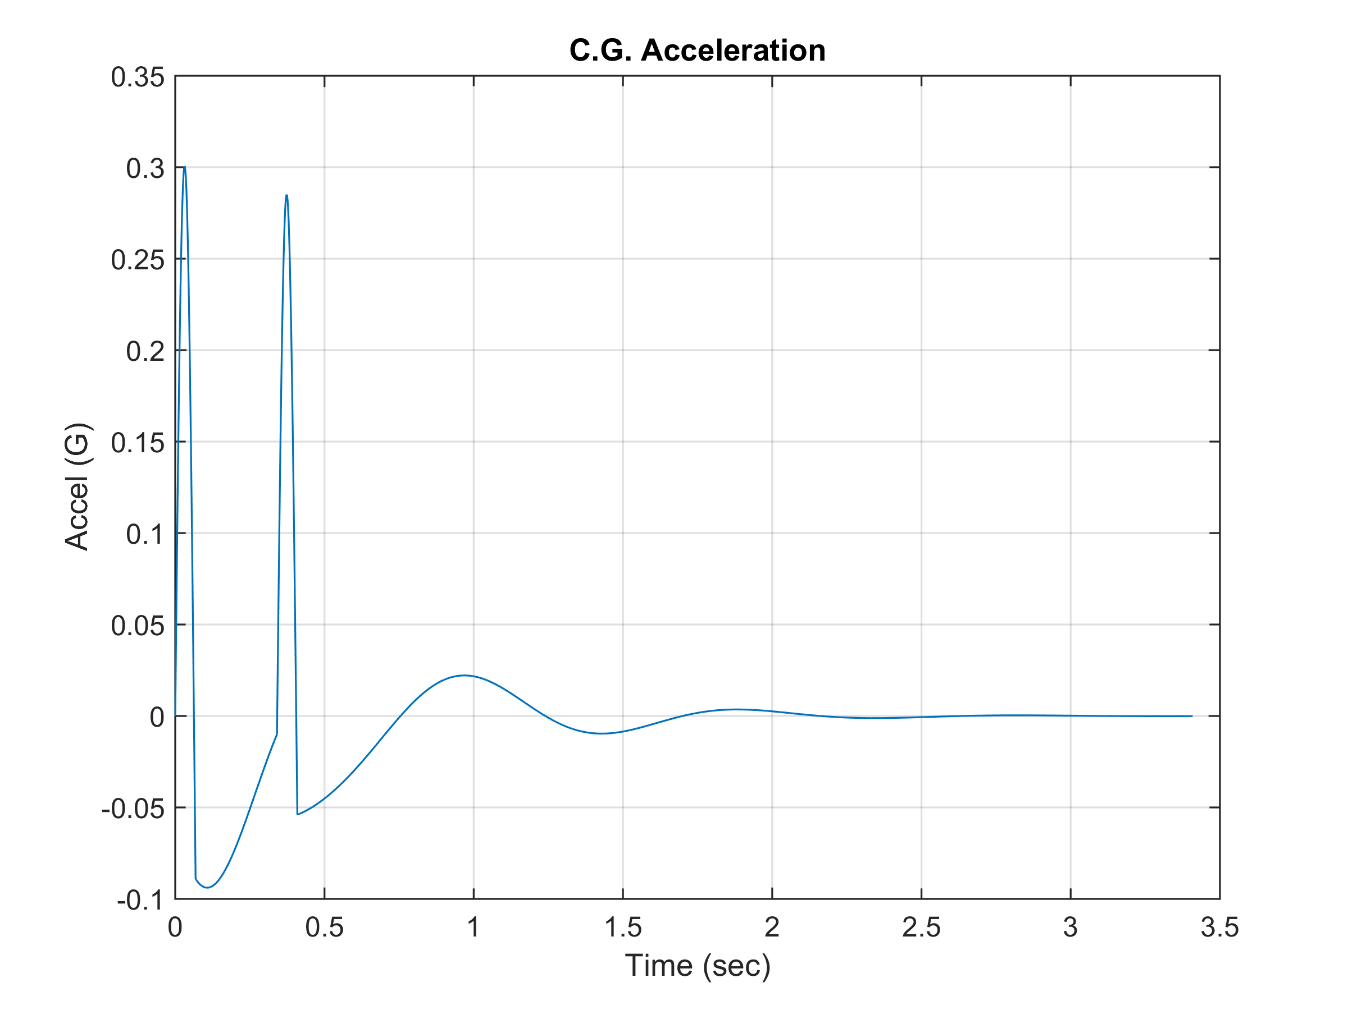
Speed Bump, 20 mph

Slide 19
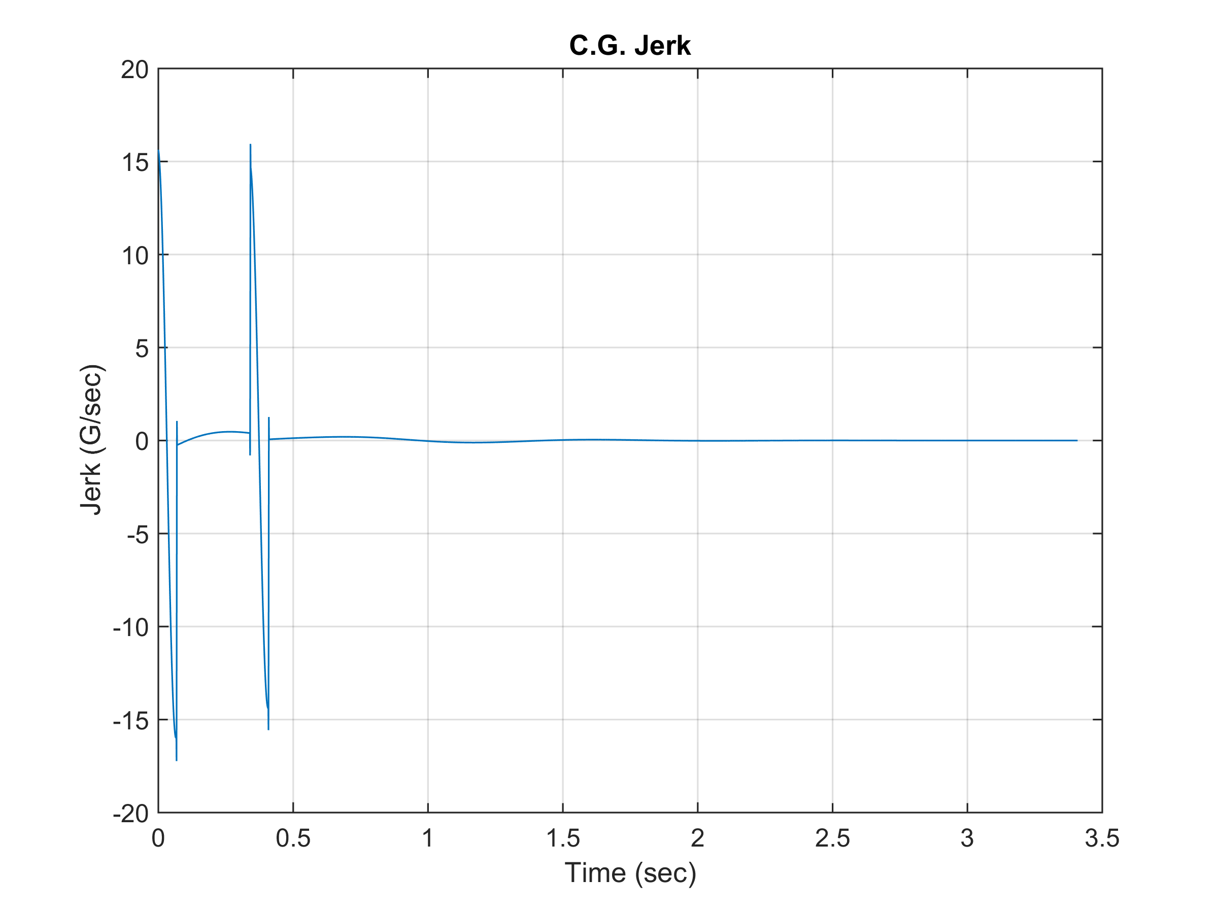
Speed Bump, 20 mph

Slide 20
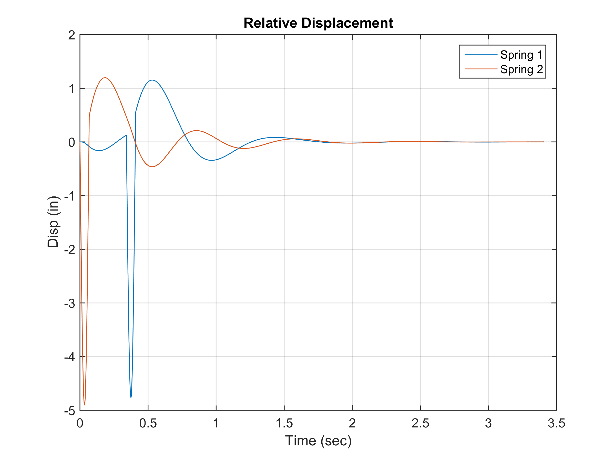
Speed Bump, 20 mph

Slide 21
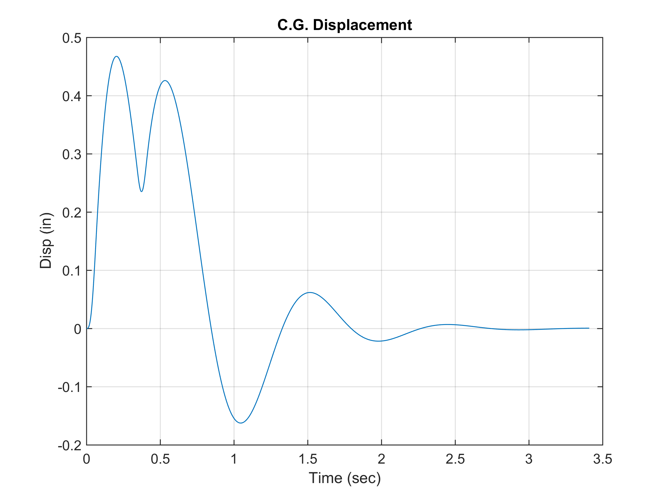
Speed Bump, 20 mph

Slide 22
Speed Bump Results, Peak Results
Vibrationdata
Speed (mph) | Jerk (G/sec) | C.G. Accel (G) | Spring 1 Rel Disp (in) | Spring 2 Rel Disp (in) | C.G. Disp (in)
5 | 4.0 | 0.31 | 4.1 | 4.2 | 1.9
10 | 8.6 | 0.28 | 4.9 | 4.7 | 1.0
15 | 13.0 | 0.31 | 4.6 | 4.8 | 0.6
20 | 17.2 | 0.30 | 4.8 | 4.9 | 0.5
25 | 21.5 | 0.31 | 4.9 | 4.9 | 0.4
30 | 25.7 | 0.31 | 5.0 | 5.0 | 0.4
35 | 29.9 | 0.32 | 5.0 | 5.0 | 0.4

Slide 23
Speed Bump, Peak Response Results
Vibrationdata
Jerk is directly proportional to speed
C.G. Acceleration is nearly constant at about 0.30 G
C.G. Displacement is greater at lower speeds, but reaches lower limit of 0.4 inch at higher speeds
Spring relative displacement varied from 4 to 5 inches

Slide 24
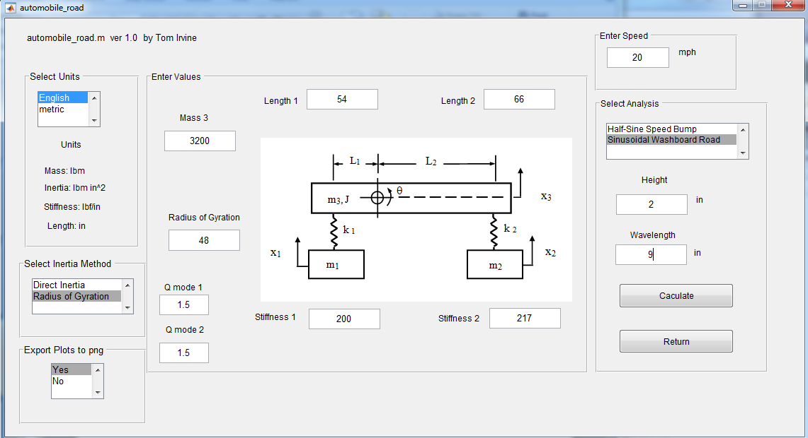
Washboard Road, height=2 in, wavelength = 9 in

Slide 25
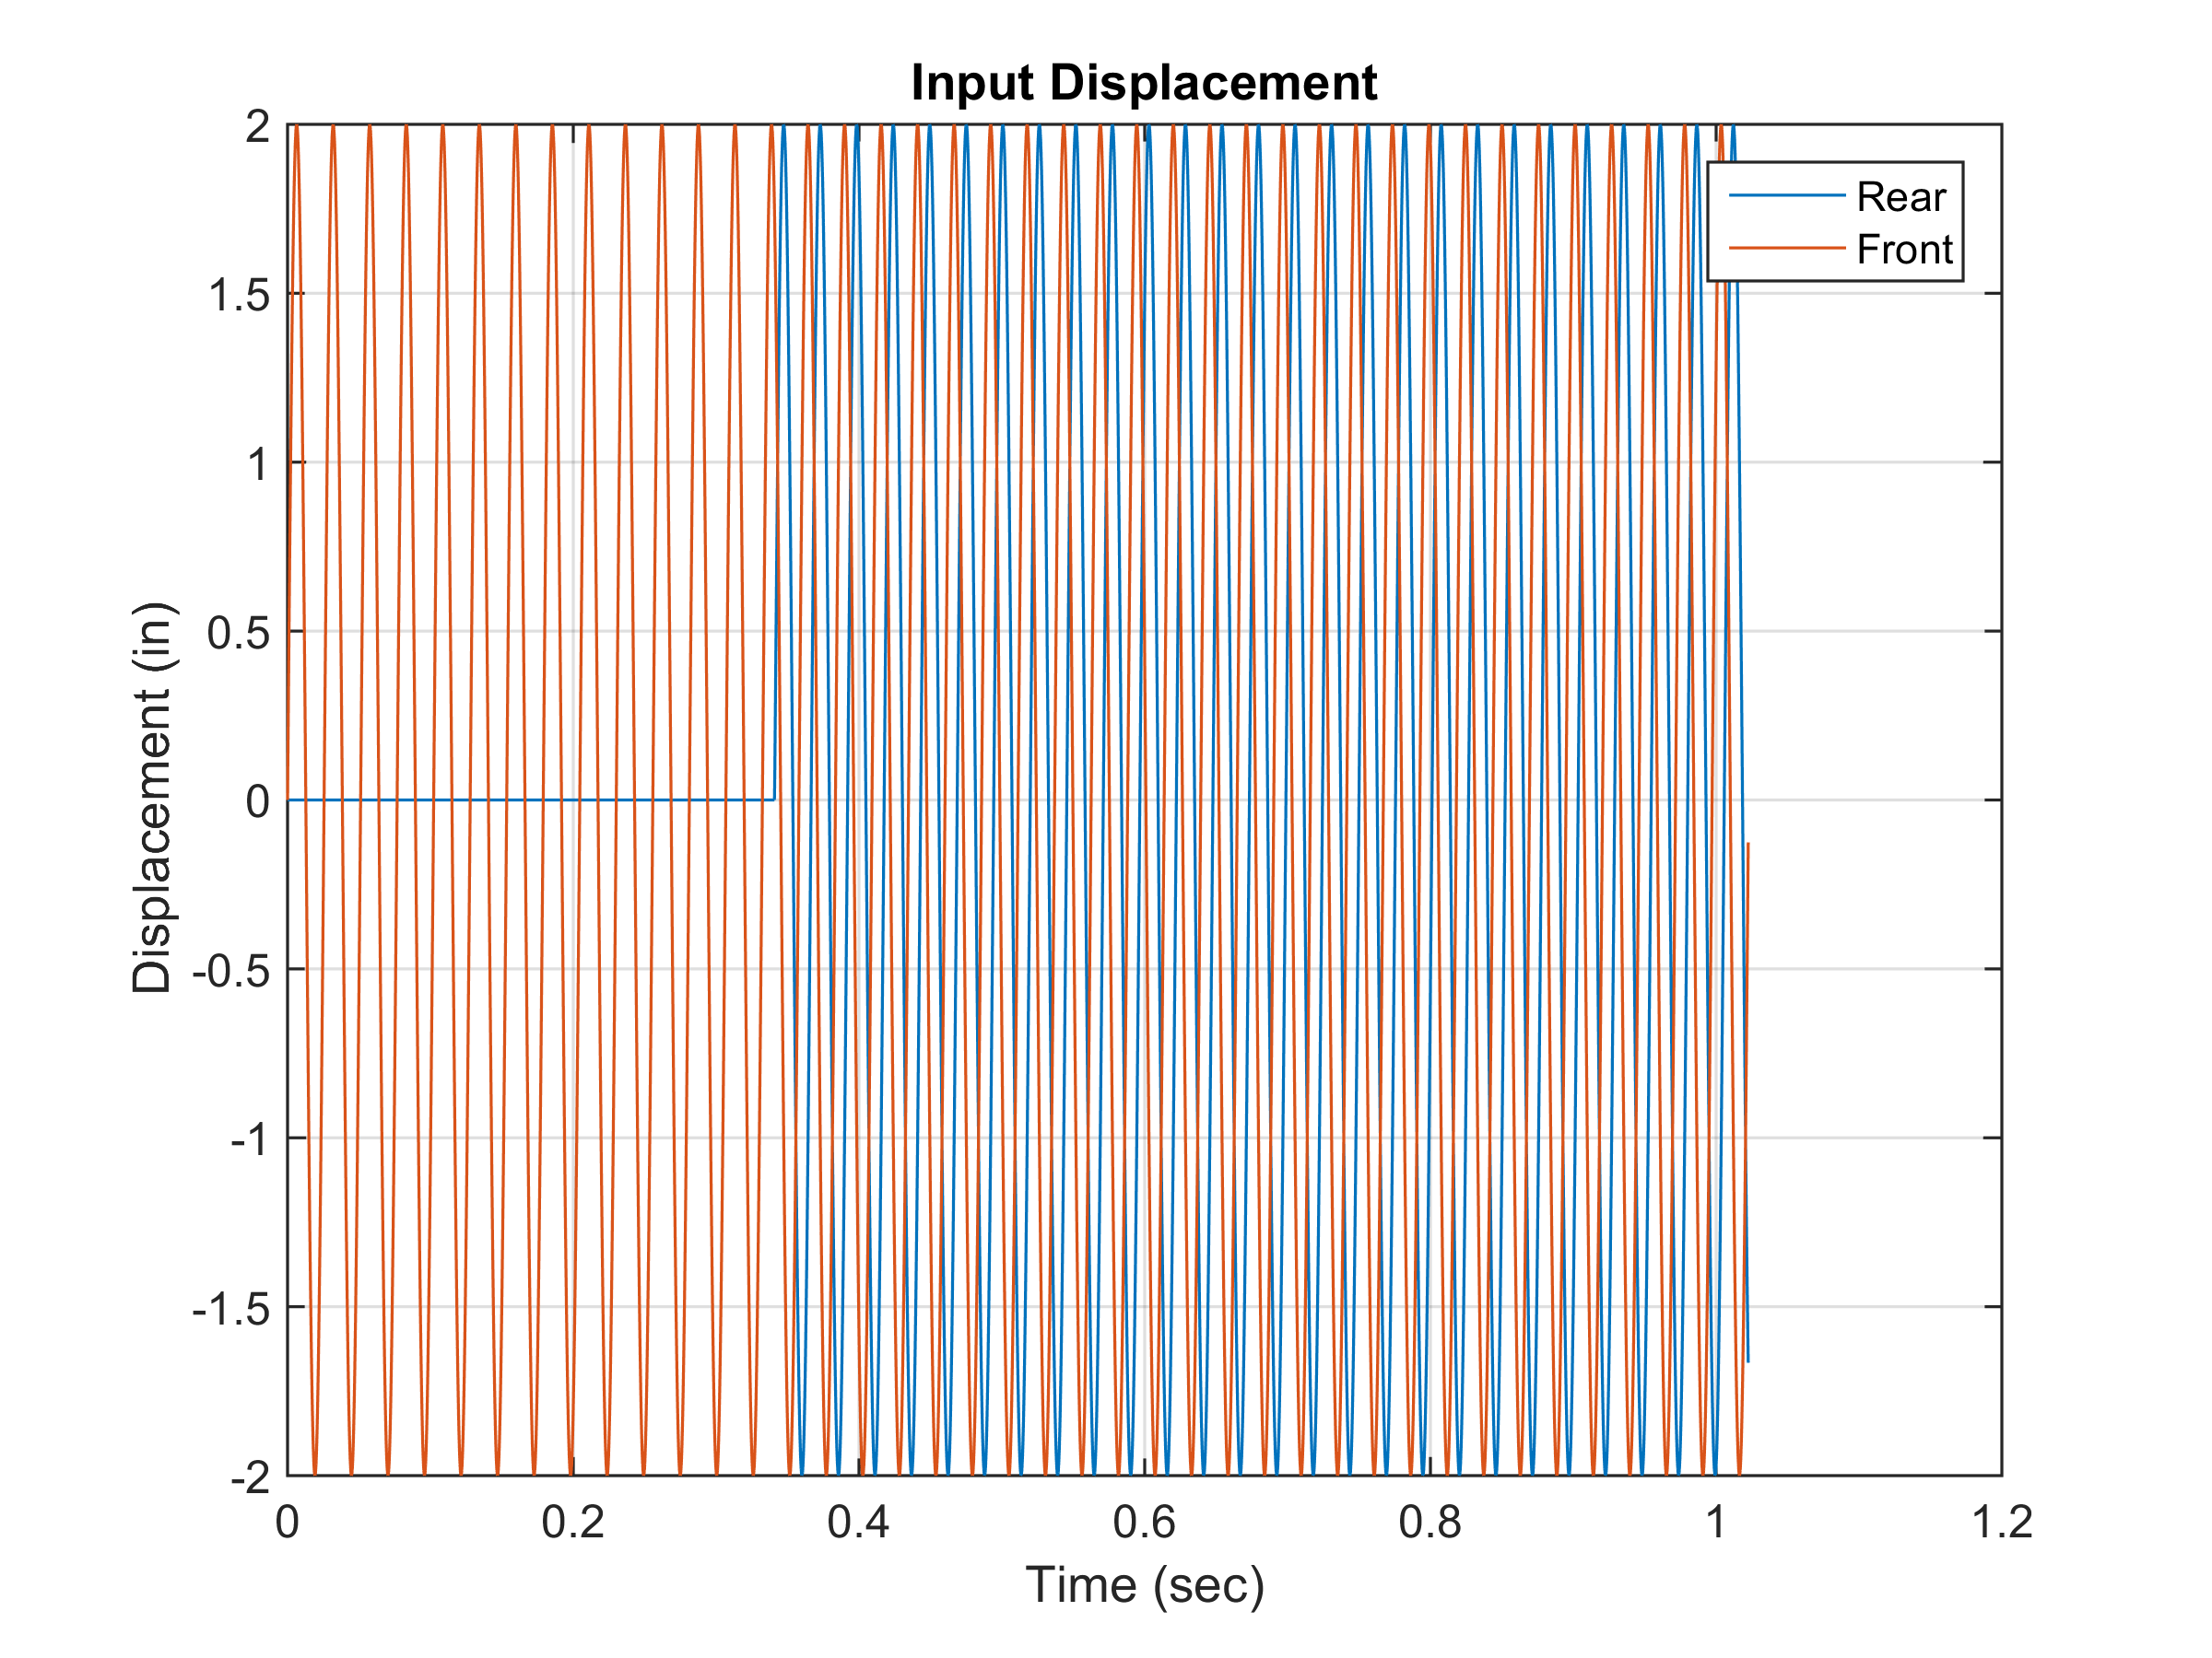
Washboard Road, 20 mph
Correlation coefficient = -0.496. Rear lags front by 127 degrees.

Slide 26
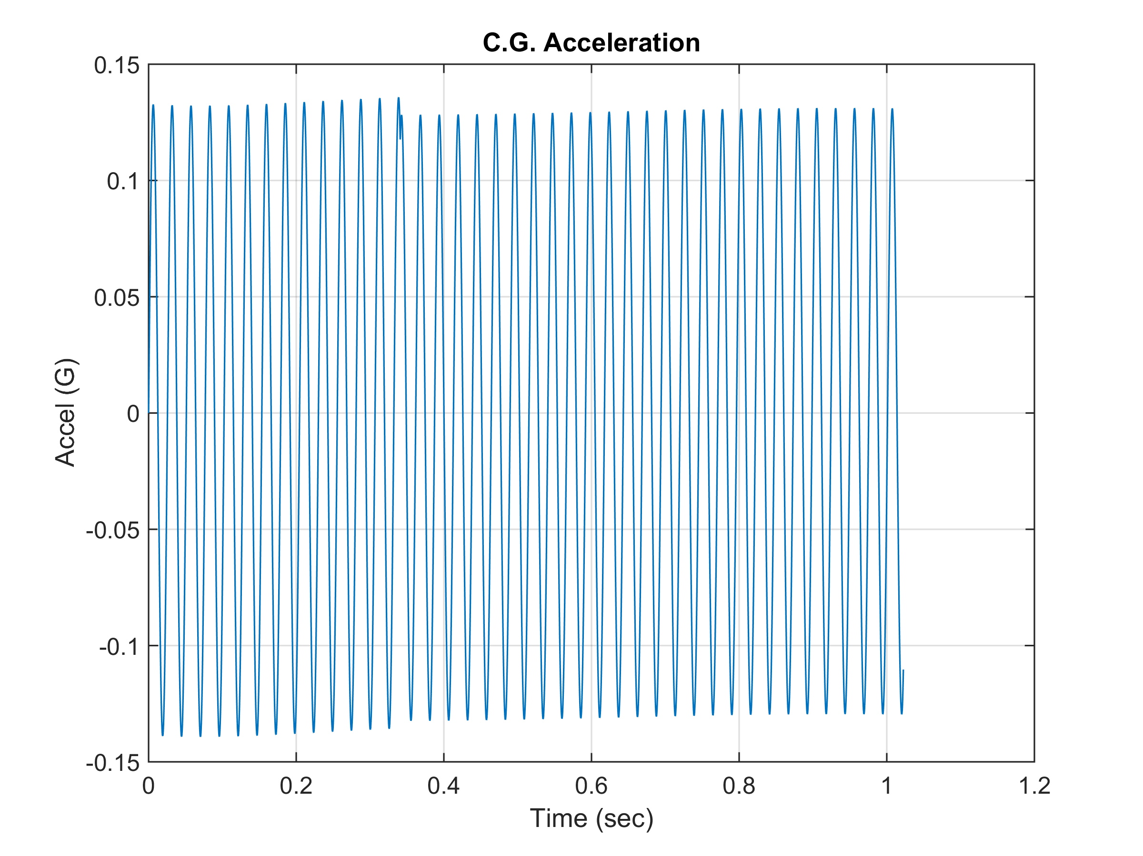
Washboard Road, 20 mph

Slide 27
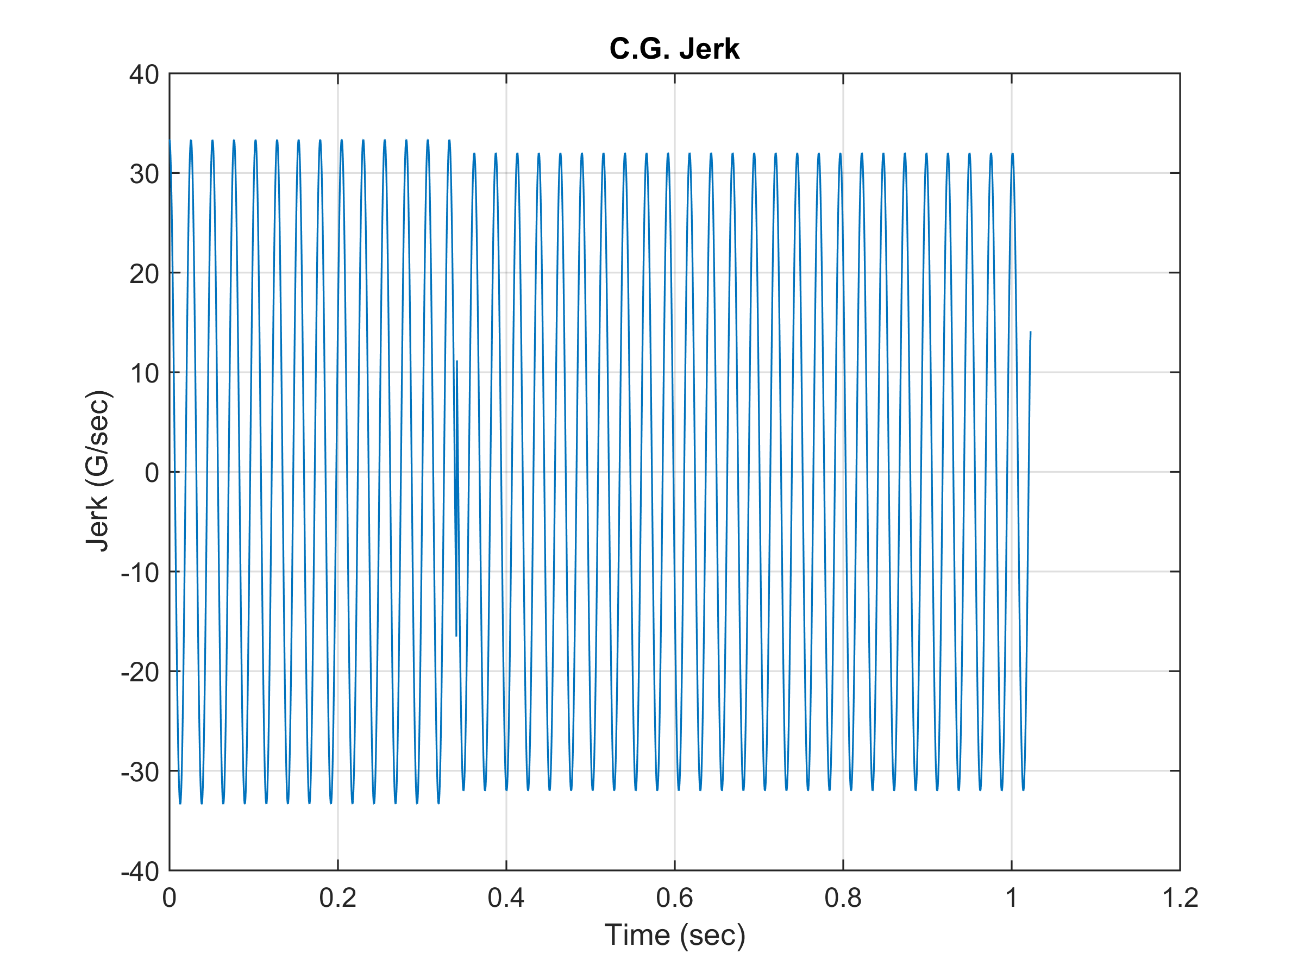
Washboard Road, 20 mph

Slide 28
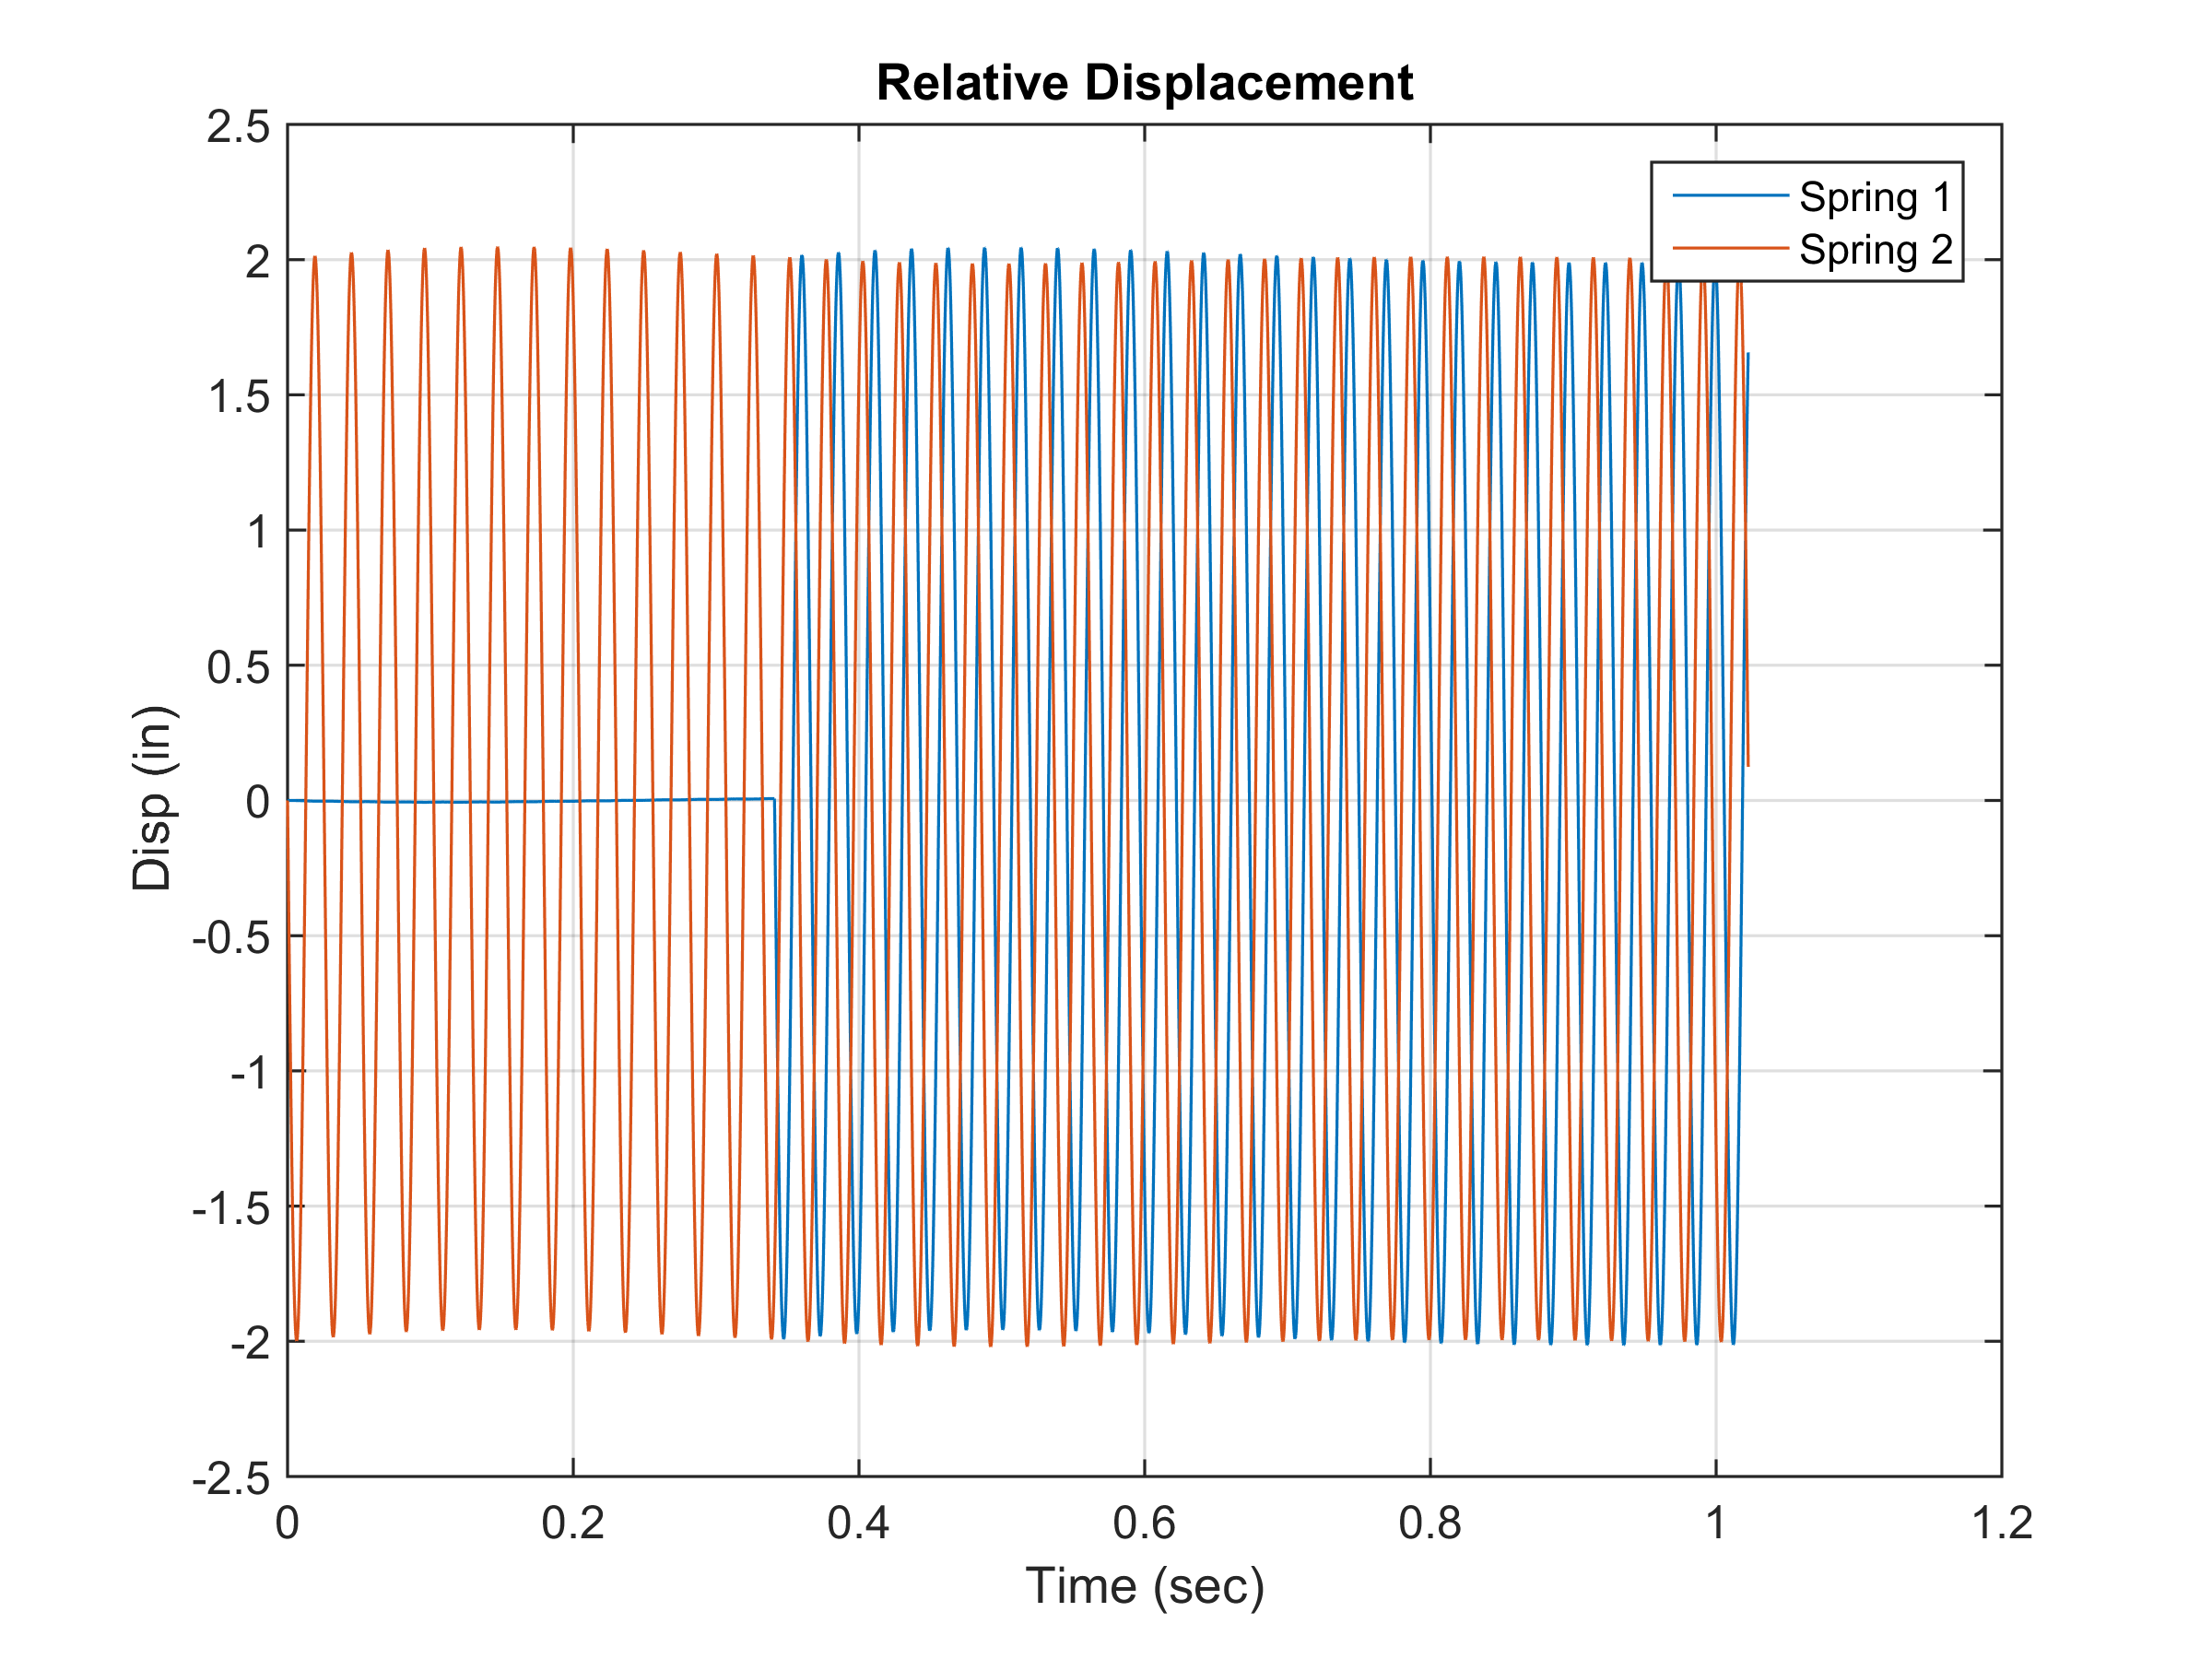
Washboard Road, 20 mph

Slide 29
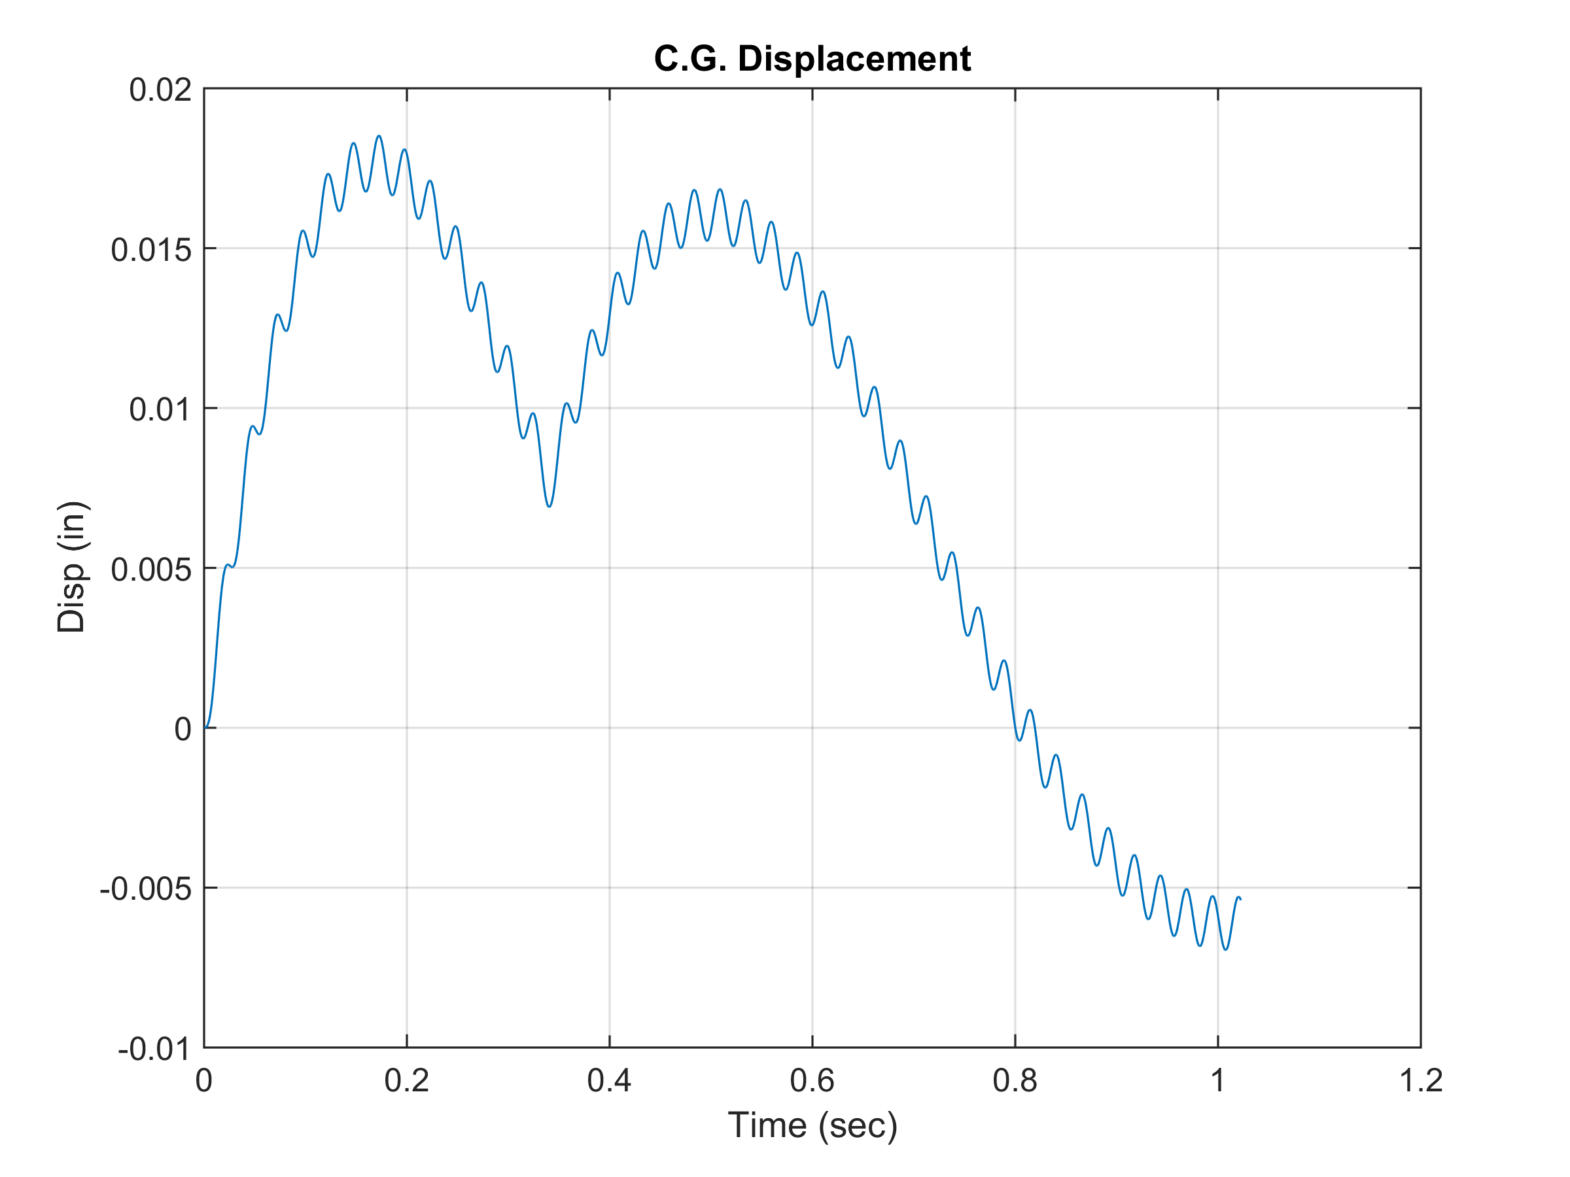
Washboard Road, 20 mph
Very low

Slide 30
Washboard Road, Peak Results
Vibrationdata
Correlation coefficient = -0.50
Speed (mph) | Jerk (G/sec) | C.G. Accel (G) | Spring 1 Rel Disp (in) | Spring 1 Rel Disp (in) | C.G. Disp (in) | Frequency (Hz)
5 | 8.5 | 0.15 | 2.2 | 2.2 | 0.09 | 10
10 | 16.8 | 0.14 | 2.1 | 2.1 | 0.04 | 20
15 | 25.1 | 0.14 | 2.1 | 2.1 | 0.03 | 29
20 | 33.4 | 0.14 | 2.0 | 2.0 | 0.02 | 39
25 | 41.7 | 0.14 | 2.0 | 2.0 | 0.02 | 49
30 | 50.1 | 0.14 | 2.0 | 2.0 | 0.02 | 59
35 | 58.4 | 0.14 | 2.0 | 2.0 | 0.02 | 68
40 | 66.8 | 0.14 | 2.0 | 2.0 | 0.01 | 78
45 | 75.1 | 0.14 | 2.0 | 2.0 | 0.01 | 88

Slide 31
Washboard Road Results
Vibrationdata
Jerk is directly proportional to speed
C.G. Acceleration is nearly constant at 0.14 G
Spring relative displacement nearly constant at 2 inches
Input frequency was well above modal frequencies, isolation region

Slide 32
Pearson’s Correlation Coefficient
Vibrationdata
The correlation r between two signals X and Y is
where
n = number of points
= signal X mean
S_{x} = signal X std dev
etc.

Slide 33
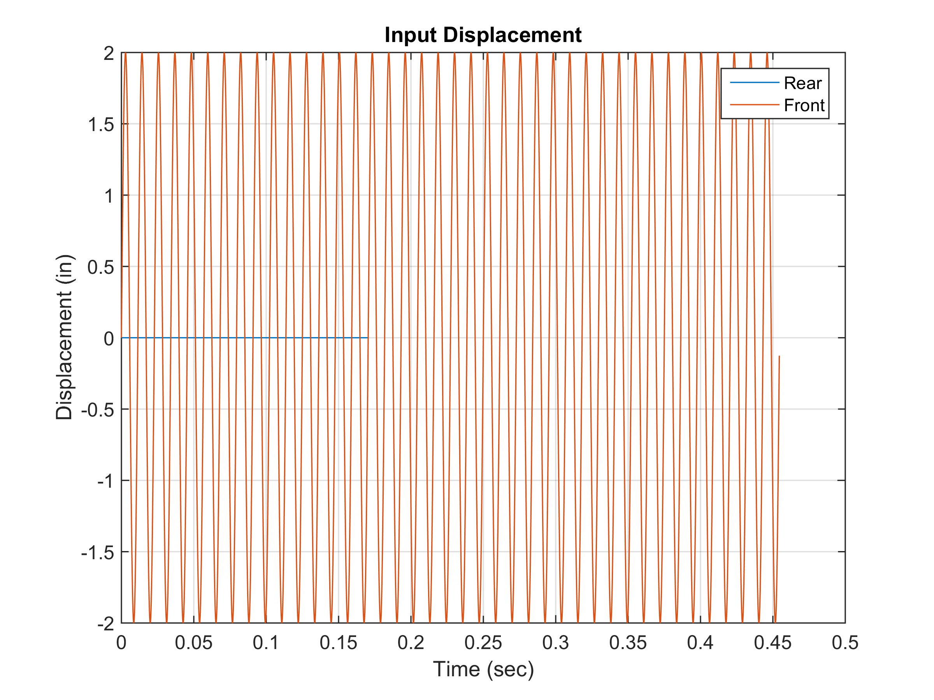
Wavelength = 8 inch, Correlation r=1
Vibrationdata
120 in / 8 in = 15
Signals in phase
The speed is 40 mph but is irrelevant for correlation

Slide 34
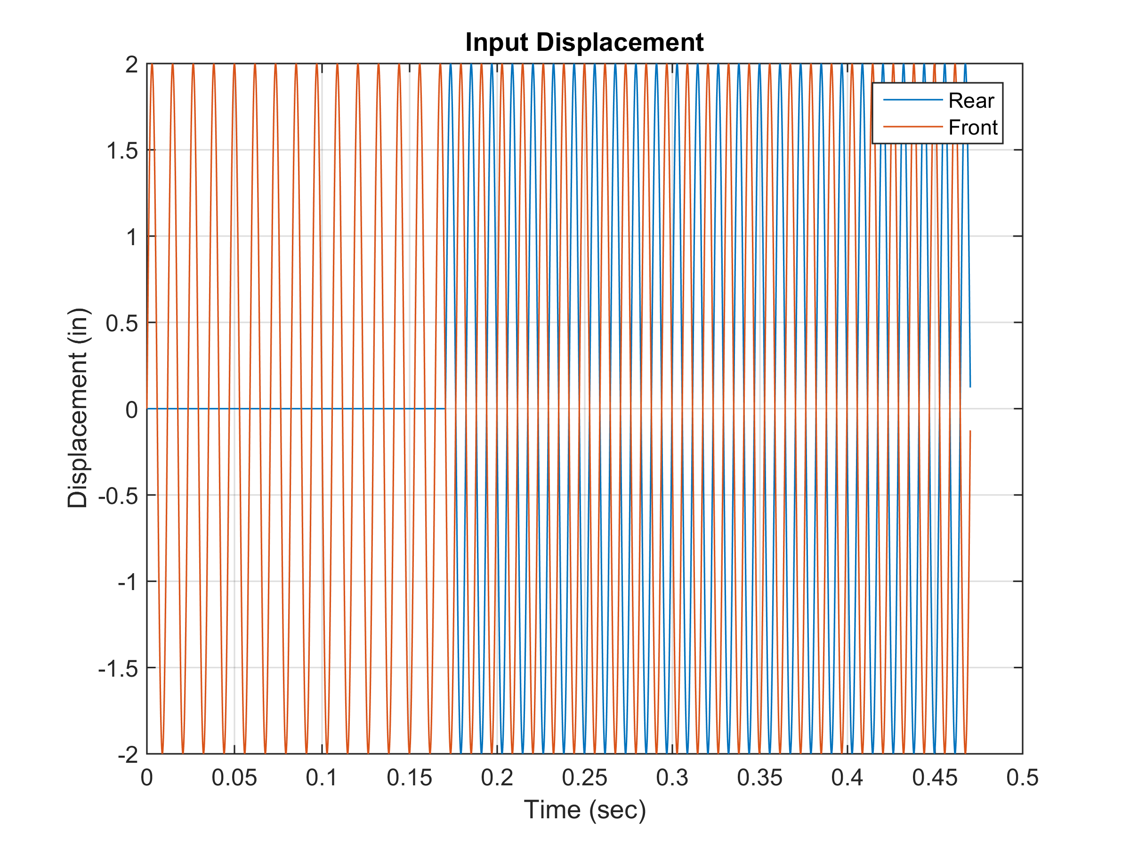
Wavelength = 8.276 inch, Correlation r= -1
Vibrationdata
120 in / 8.276 in = 14.5
Signals 180 degrees out-of-phase
The speed is 40 mph but is irrelevant for correlation

Slide 35
Acceleration vs. Correlation
Vibrationdata

