Slide 1
Webinar 47
SRS Synthesis Special Topics
By Tom Irvine

Slide 2
Topics
Seismic analysis and testing of launch vehicles and equipment using historical strong motion data scaled to satisfy shock response spectra specifications
Temporal Moments

Slide 3
Introduction
Consider the following type of equipment:
  Telecommunication
  Medical life-support
  Network servers
  Nuclear power plant control consoles
  Now consider that this equipment is to be installed in buildings in an active seismic zone
The equipment must be designed and tested accordingly to withstand the dynamic loads
A typical specification format for the loading is the shock response spectrum (SRS)
The testing is performed on a shaker table

Slide 4

San Onofre Nuclear Power Plant
Nuclear plant equipment must be tested to seismic shock specifications.

Slide 5
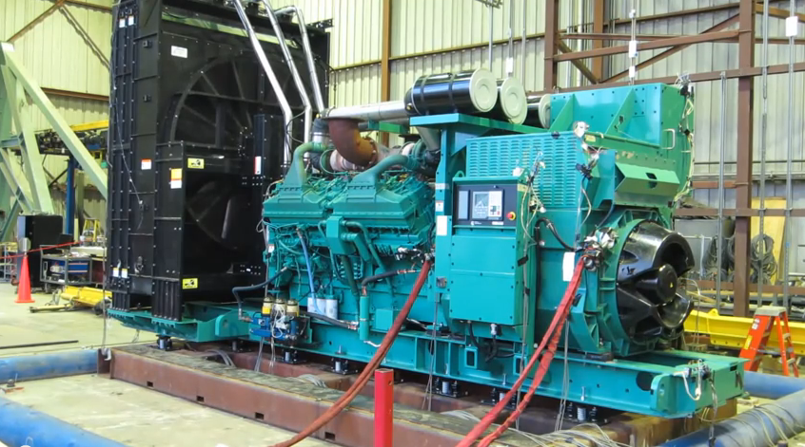
Generator Subjected to Seismic Test

Slide 6

Generator Test Video
Click to play

Slide 7
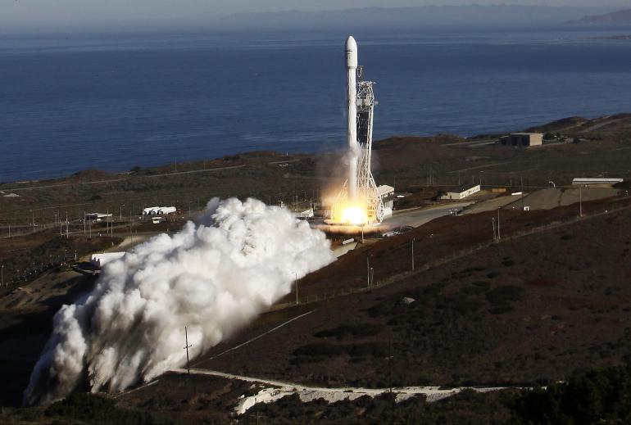
Falcon 9, Launched from Vandenberg
The vehicle as mounted on the pad is a tall cantilever beam. Its ability to withstand seismic events must be verified via analysis.

Slide 8
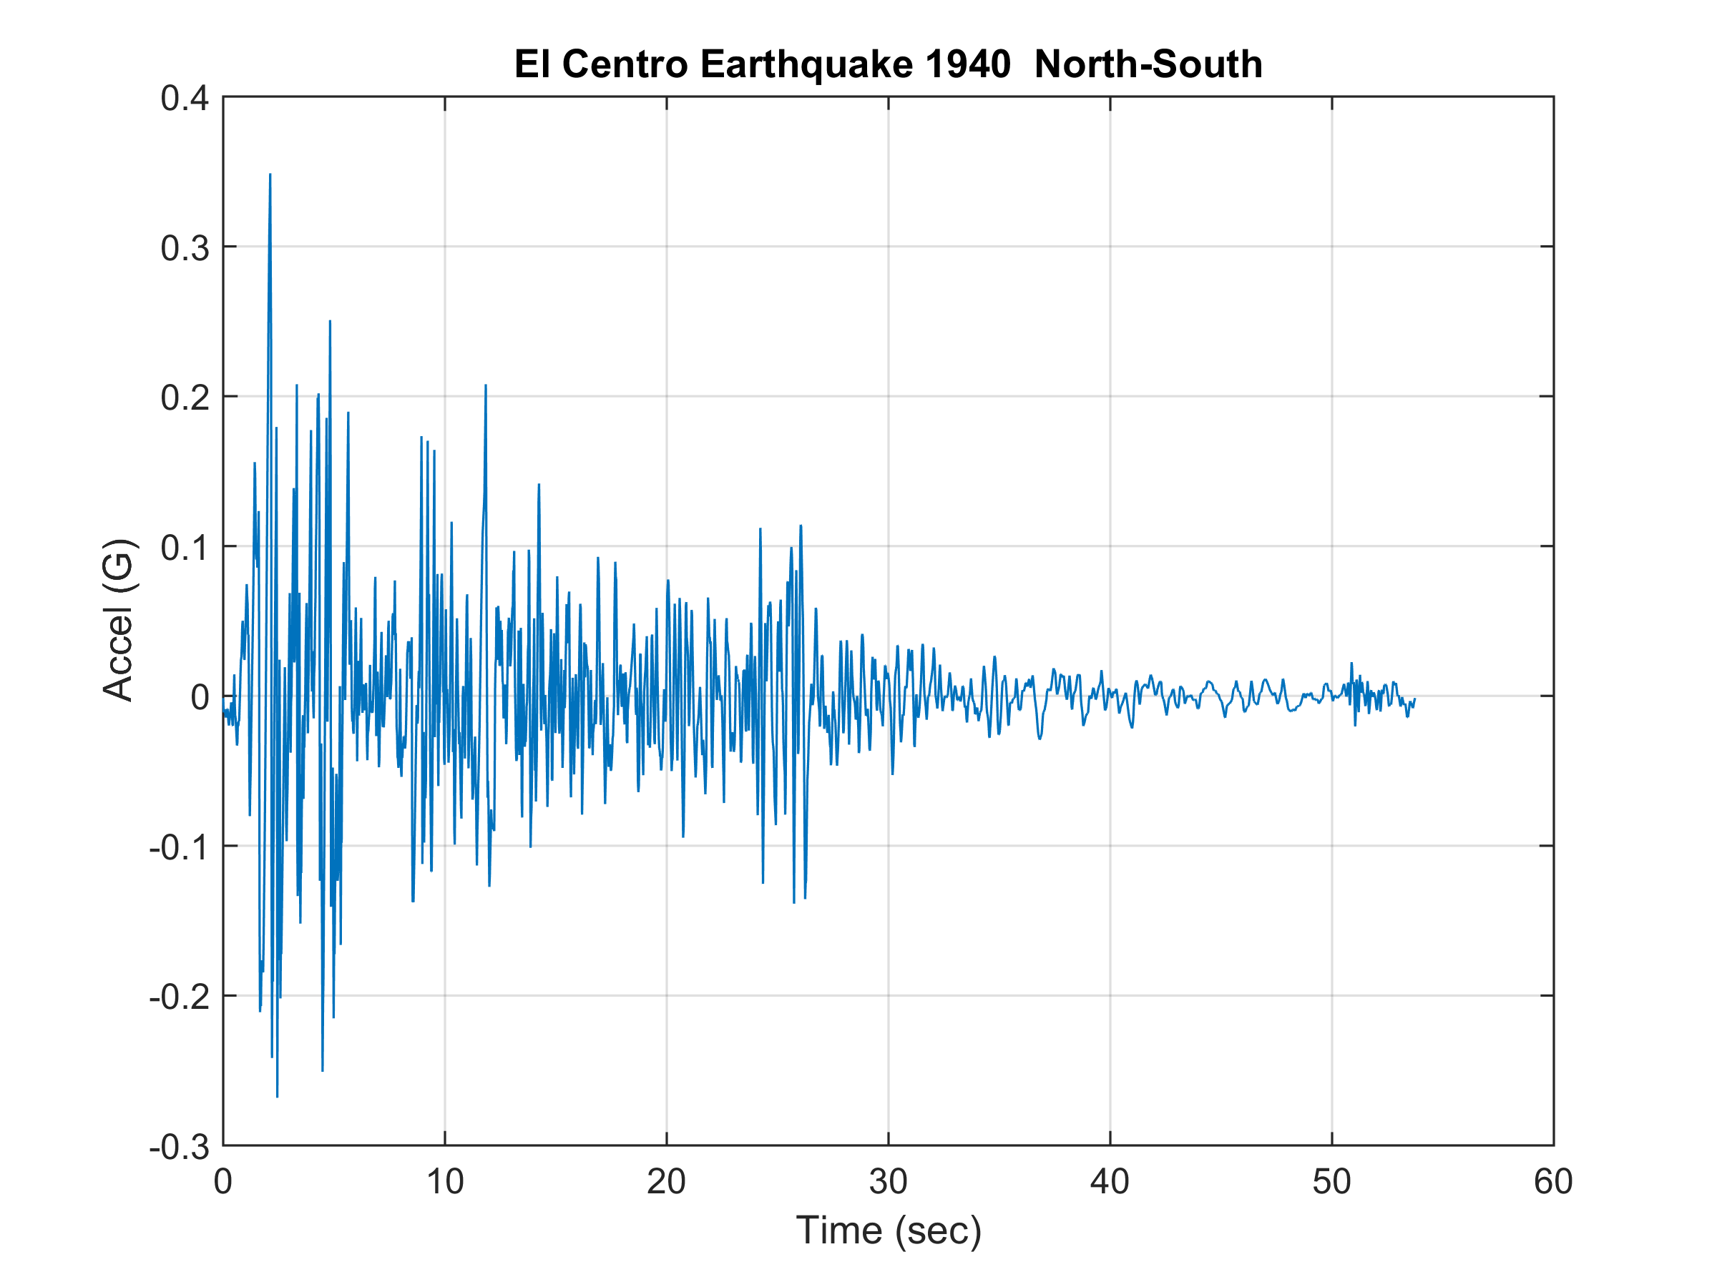
El Centro Strong Motion Data

Slide 9
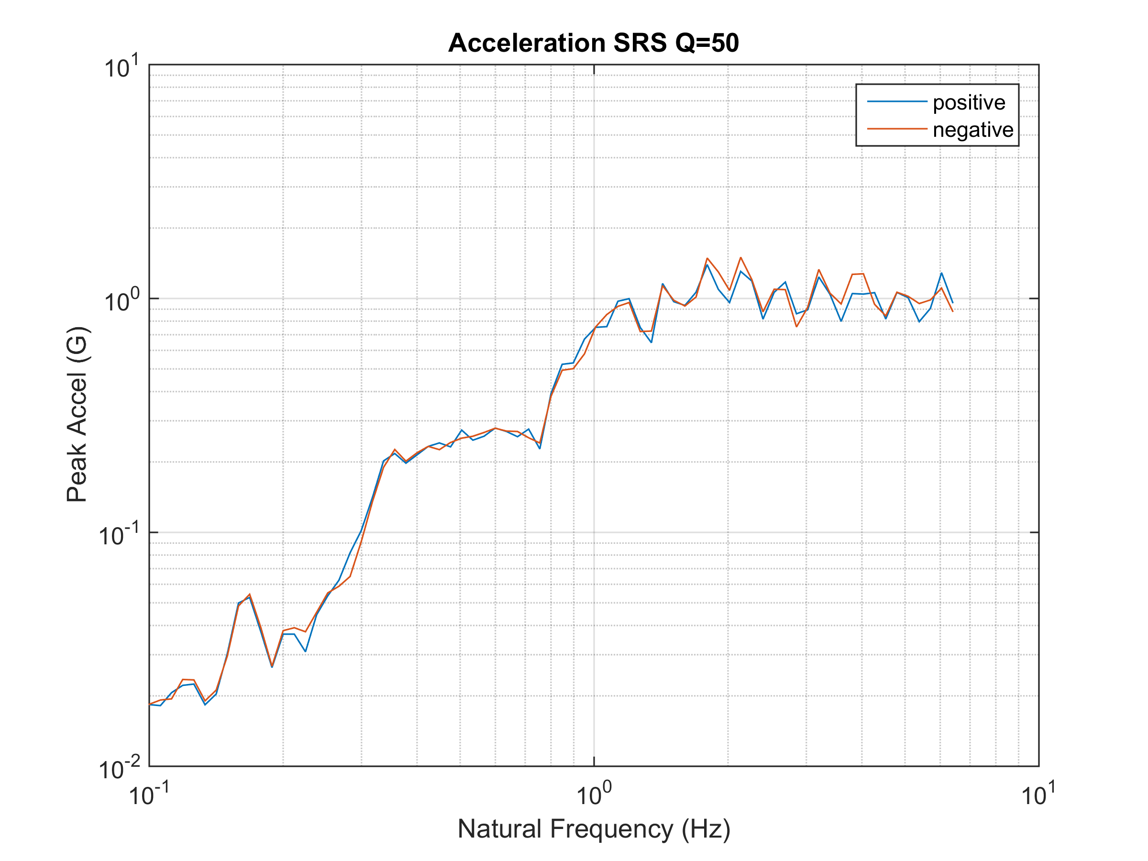
El Centro NS SRS

Slide 10
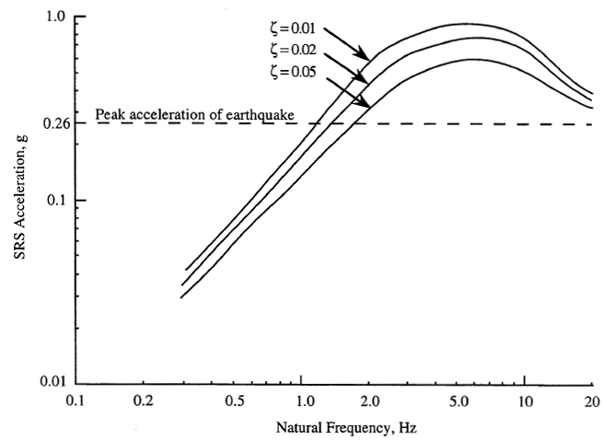
NASA HDBK-7005, Vandenberg AFB

Slide 11
SRS Synthesis
A given time history has a unique SRS
On the other hand, a given SRS may be satisfied by a variety of base inputs within prescribed tolerance bands
The SRS format thus offers flexibility
A common testing approach is to use a burst of wavelets such that the synthesized time history resembles a transient sine sweep with descending frequency

Slide 12
Synthesis Concerns
The drawback is that the time history used to satisfy the SRS may be very dissimilar from the measured source data.
This brings us a number of concerns including linearity and multi-modal response
Some of these concerns can be quantified in terms of the scalar temporal moments which quantify the energy, RMS, skewness and kurtosis.
These concerns have led to a desire to synthesize a time history which “resembles” the real-world event while still satisfying the SRS
The purpose of this paper is present a method which uses a measured reference time history as a basis for synthesizing a time history to meet the SRS specification

Slide 13
Method Description, Step 1
The following steps use trial-and-error-random number generation with some built-in convergence
The method is implemented as a function in the Vibrationdata Matlab GUI package
The first step is to decompose the reference time history into a series of wavelets
An acceleration wavelet has zero net velocity and zero net displacement
A series of wavelets likewise has these properties
Wavelets are very amenable to shaker table shock testing and are also convenient for analysis
The examples in the paper use a series of 200 wavelets to model a reference time history

Slide 14
Method Description, Step 2
The second step is to randomly vary the wavelet amplitudes so that the modified wavelet series will have an SRS that matches the specification as closely as possible
The number of iterations may be 16000 or so
The modified time history will thus have some distortion relative to the reference, but this is needed to shape the time history so that its SRS meets the specification
The second step yields an SRS that has some peaks and dips relative to the specification
This is a consequence of trying to adapt a measured time history to a smoothed SRS

Slide 15
Method Description, Step 3
The third step is to add wavelets so that the resulting SRS meets the specification within, say, + 3 dB tolerance limits
The third step also adds some distortion
The amount of distortion depends largely on how much the SRS specification differs from that of the reference data

Slide 16
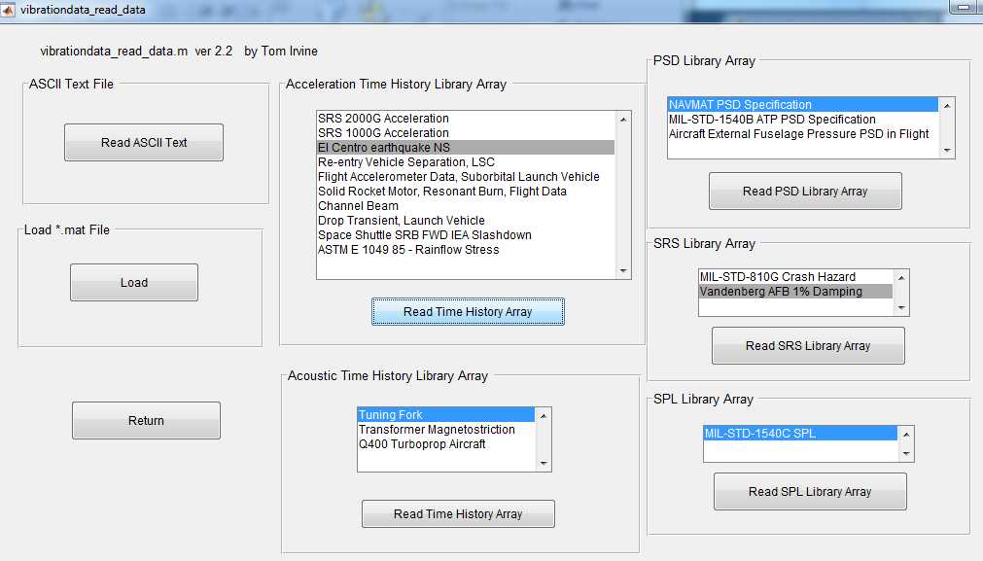
Read in El Centro earthquake NS & Vandenberg SRS Specification

Slide 17
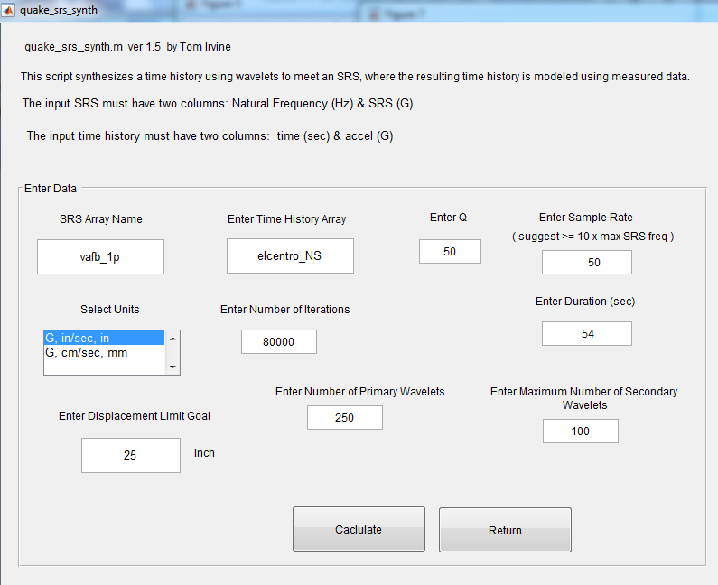
Shock Response Spectrum > Earthquake Synthesis

Slide 18
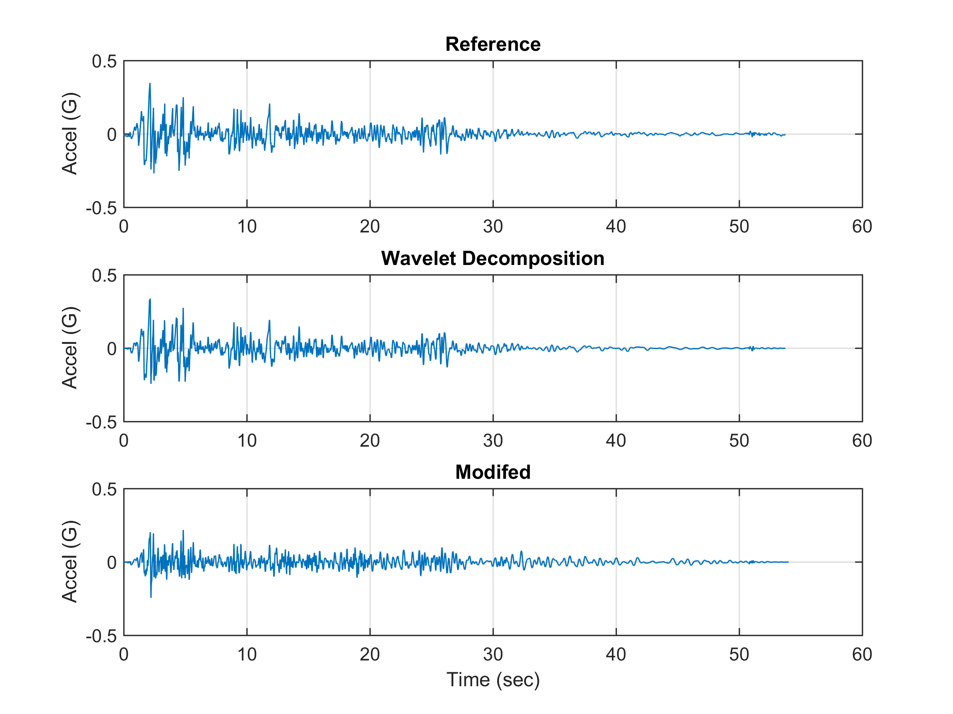
The top time history is the measured El Centro NS data
The middle time history is the wavelet series model.
The bottom time history has additional wavelets to improve the SRS match, and it is scaled downward since the El Centro SRS plateau is greater than the specification

Slide 19
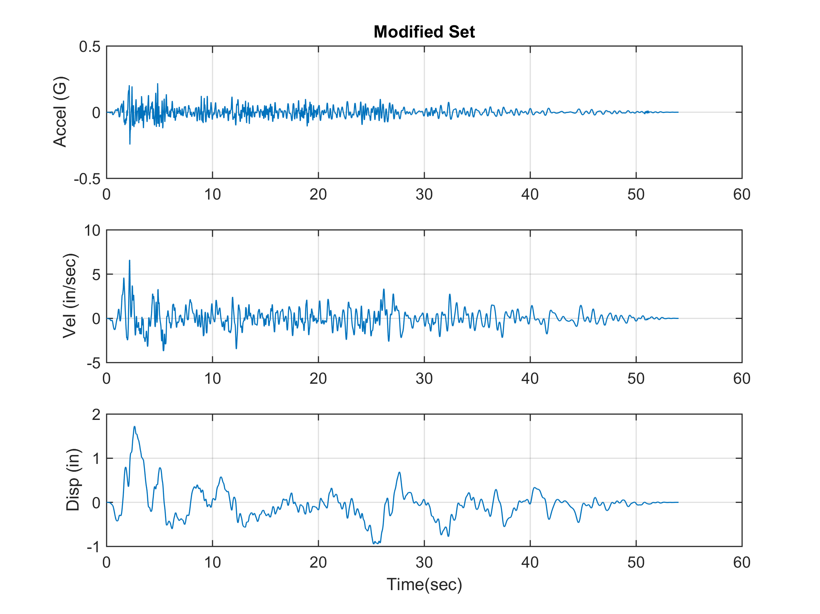
The velocity and displacement time histories are well-behaved which is important for both testing and analysis.

Slide 20
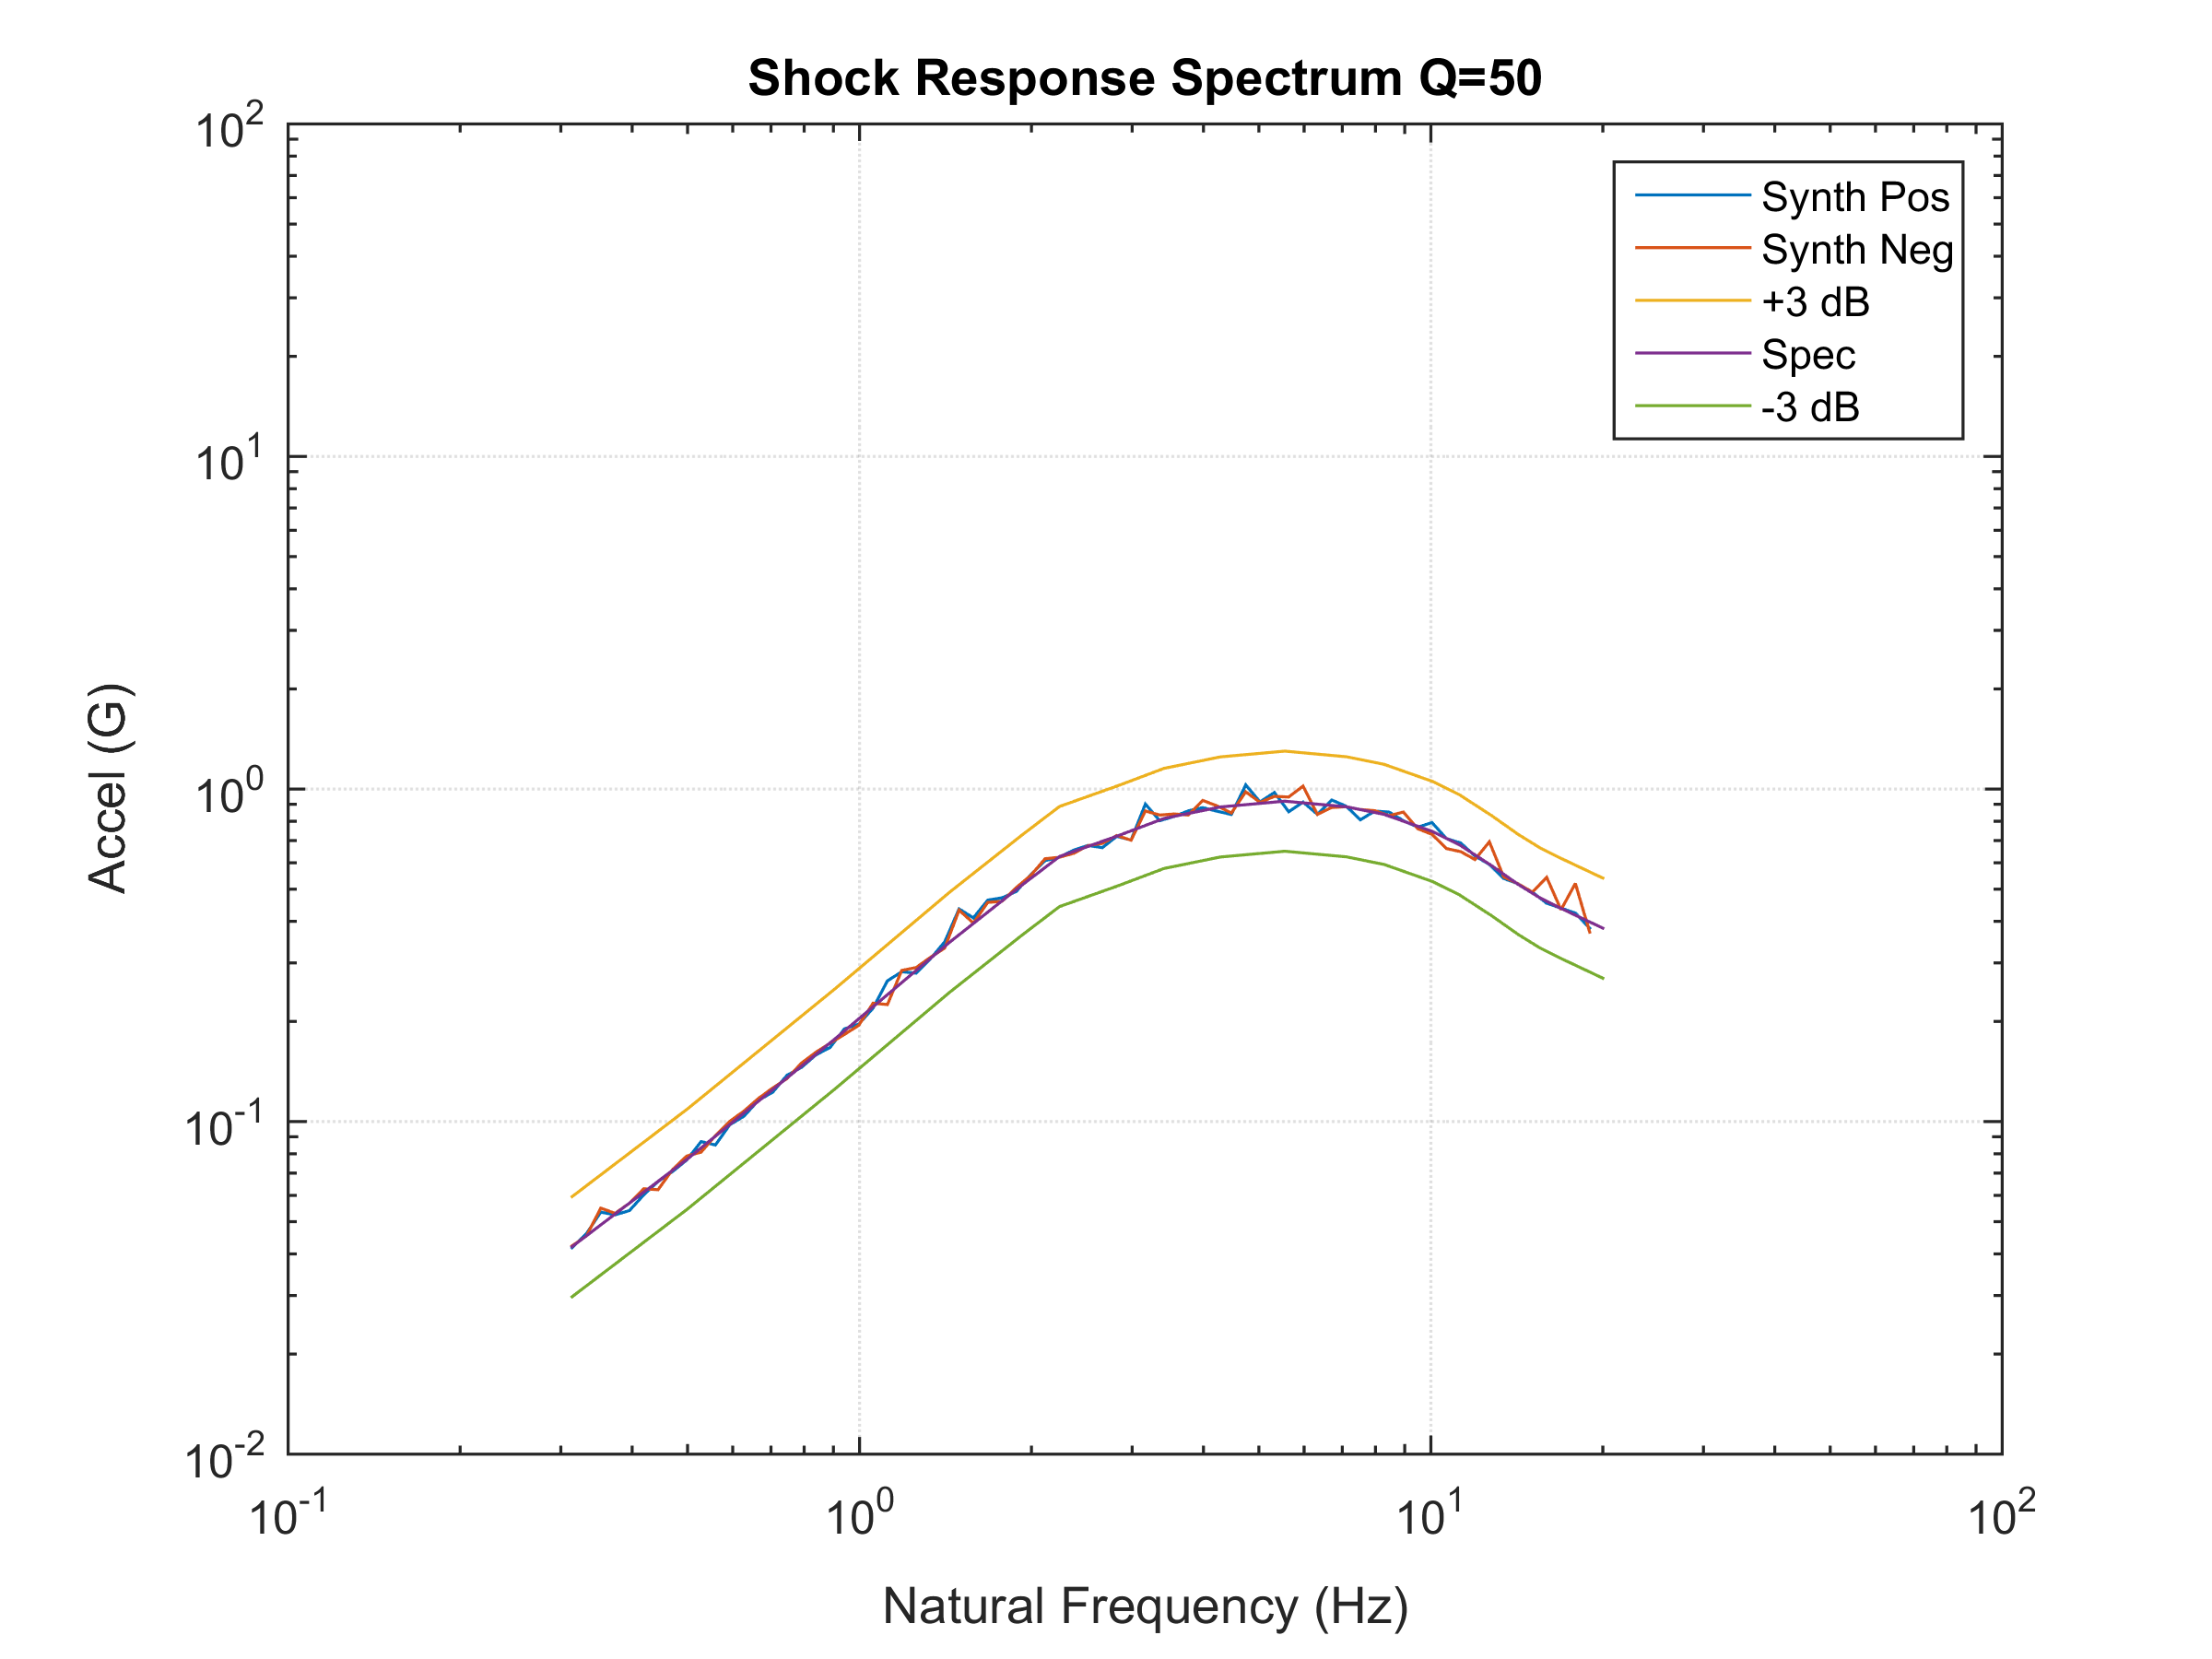
The SRS of the modified, or synthesized, time history is within + 3 dB of the nominal specification. The method is thus successful in generating an El Centro-like time history to meet the specification.

Slide 21
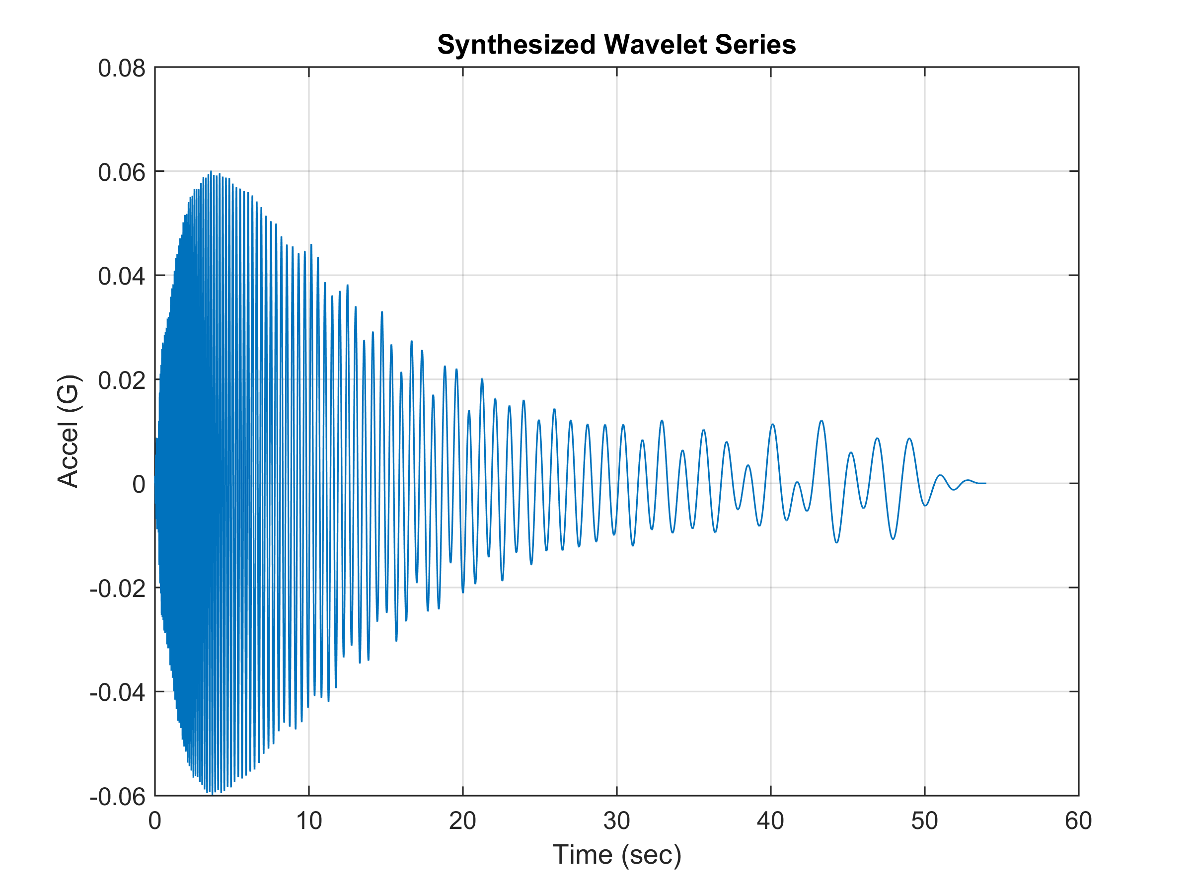
Satisfy Same Specification with Alternate Time History

Slide 22
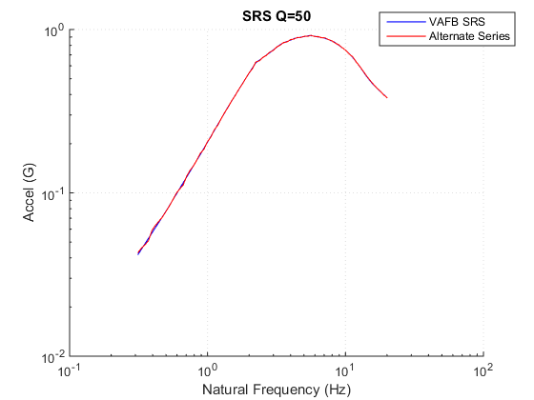
Webinar 47

Slide 23
Temporal Moments
Parameter | El Centro Synthesis | Alternate Synthesis
Energy E | 0.0589 | 0.01935
Root energy amplitude Ae | 0.0731 | 0.04754
Central time T (sec) | 13.56 | 9.687
RMS duration D (sec) | 11.02 | 8.562
Central skewness St(sec) | 10.21 | 11.06
Normalized skewness S | 0.9267 | 1.291
Central kurtosis Kt(sec) | 60.13 | 73.67
Normalized kurtosis K | 5.455 | 8.604
The alternate synthesis has less energy and thus may cause an “under test” even though its SRS matches the specification.

Slide 24
Example 2
Steep slope is a challenge for time history
26.5 dB/octave
C. Harris, Shock and Vibration Handbook, Fourth Edition; W.J. Hall, Chapter 24, Vibrationdata of Structures Induced by Ground Motion, McGraw-Hill, New York, 1996.

Slide 25
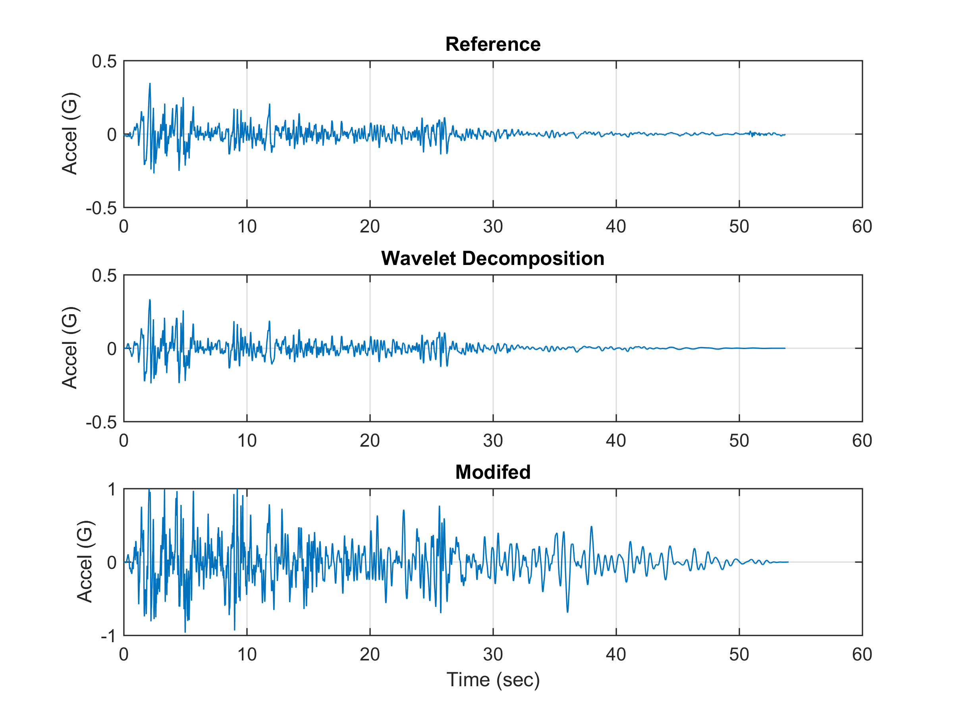
The El Centro NS data is again used as a basis
The modified time history departs somewhat from the Reference in order to meet the SRS specification with its steep initial slope

Slide 26
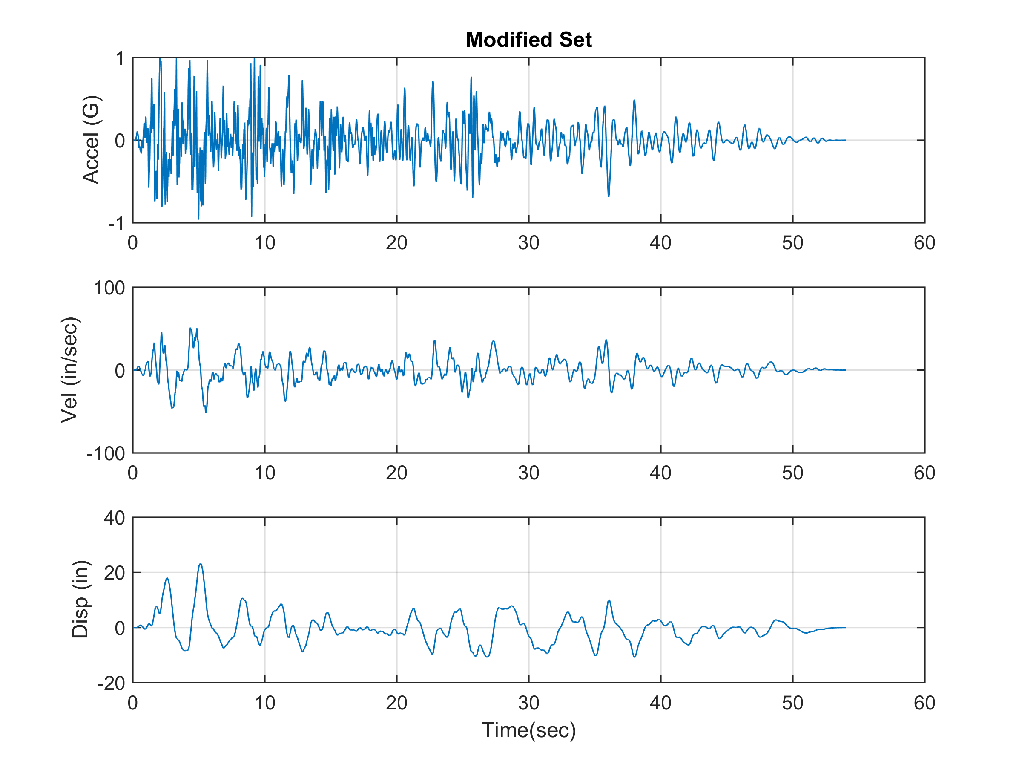

Slide 27
