Slide 1
Unit 9
White Noise FFT

Slide 2
Fourier Transform, Sine Function
Review . . .
A Fourier transform will give the exact magnitude and frequency for a steady-state sine function provided that no leakage error occurs
The sine function must have an integer number of cycles to prevent leakage
The same is true for an FFT if the time history has 2^{N} points where N is an integer

Slide 3
White Noise
But how useful is the FFT for broadband random vibration such as white noise?

Slide 4
White Noise
Generate white noise with the following parameters:
SR = 6553.6 samples/sec
10 second duration
Std dev = 5
65536 samples
No band limit filter
Then extract the 0 to 1.25 second segment from the 10-second time history

Slide 5
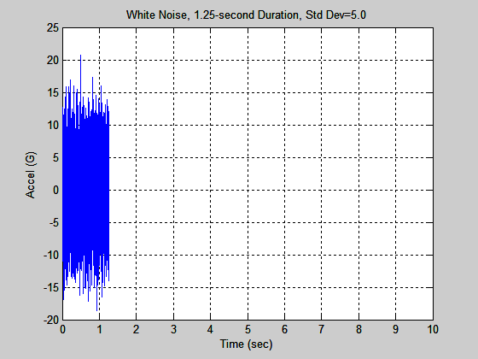
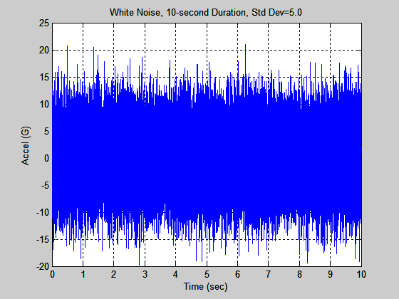
White Noise
Each time history has std dev = 5.0

Slide 6
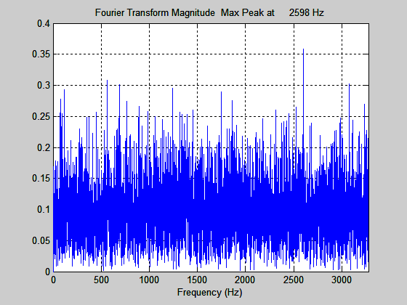
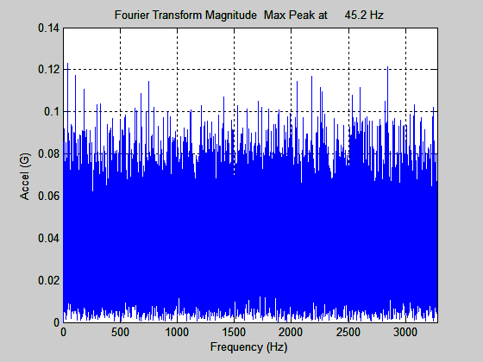
White Noise
Top FFT:
1.25 second duration
Δf=0.8 Hz
Mean = 0.0971
Bottom FFT:
10 second duration
Δf=0.1 Hz
Mean = 0.0347
Difference in mean = √8

Slide 7
White Noise Comparison
Ideally, the "white noise" would have a constant Fourier transform magnitude with respect to frequency
The fact that there is some variation within each transform is unimportant for this example
The pertinent point is that the mean magnitude changes by √8 , comparing the two transforms
The reason for the decrease is that the transform in the 1.25 second figure has 4096 spectral lines compared to the 32768 spectral lines in the 10 second figure (up to Nyquist Frequency)
Thus, the "energy" is divided into a greater number of spectral lines in the 10 second transform

Slide 8
Fourier Magnitude, 1.25 second Record
Freq(Hz) | G peak | GRMS | GRMS^2 | sum of squares (GRMS^2) | sqrt(sum of squares) GRMS
0 | 0.00000 | 0.00000 | 0.00000 | 24.64 | 4.96
0.8 | 0.02399 | 0.01696 | 0.00029
1.6 | 0.05106 | 0.03610 | 0.00130
2.4 | 0.06377 | 0.04509 | 0.00203
3.2 | 0.11684 | 0.08262 | 0.00683
4 | 0.08453 | 0.05977 | 0.00357
4.8 | 0.16942 | 0.11980 | 0.01435
5.6 | 0.03408 | 0.02410 | 0.00058
6.4 | 0.00531 | 0.00375 | 0.00001
7.2 | 0.11172 | 0.07900 | 0.00624
8 | 0.02902 | 0.02052 | 0.00042
Recall time history synthesis ,
std dev = 5
(GRMS = std dev, for zero mean)
First twelve row of Excel spreadsheet are shown.
GRMS = G peak / sqrt(2)
Use fill down to cover all 4096 rows.

Slide 9
Parseval’s Theorem
x(t) is the time history
X(f) is the Fourier transform
The RMS value can either be calculated from the time history or the Fourier transform. The results is the same regardless.

Slide 10
Conclusion
The FFT magnitude is a poor tool for characterizing white noise magnitude!
Need a better tool for random vibration
That tool will be the Power Spectral Density (PSD)
PSD can be calculate from an FFT, but it expresses the energy as a density
PSD magnitude is mostly insensitive to duration except that a greater number of statistical-degrees-of-freedom are accumulated by taking a longer duration

Slide 11
Exercise
Perform the example in the main text yourself
Use the Vibrationdata GUI package & Excel
Note that the package has a function :
Signal Edit Utilities > Extract Segment

